Slide 1



CFA
Simone Campanoni simonec@eecs.northwestern.edu

Slide 2
Outline
Why do we need control-flow analysis?
Basic blocks
Control flow graph

Slide 3
Optimization example:constant propagation
int sumcalc (int a, int b, int N){
int x,y;
x = 0;
y = 0;
for (int i=0; i <= N; i++){
x = x + (a * b);
x = x + b*y;
}
return x;
}

Slide 4
Constant propagation
Find a constant expression
Instruction i: varX = CONSTANT_EXPRESSION
Replace the use of the variable defined in a constant expression with that constant if
All paths to the use of varX passes its assignment I
There are no intervening definition of that variable
We need to know the “control-flow” of the program

Slide 5
Representing the control flow of the program
Most instructions
Jump instructions
Branch instructions

Slide 6
Representing the control flow of the program
A graph where nodes are instructions
Very large
Lot of straight-line connections
Can we simplify it?
Basic block

Slide 7
Basic blocks
A basic block is a maximal sequence of instructions such that
Only the first one can be reached from outside this basic block
All instructions within are executed consecutively if the first one get executed
Only the last instruction can be a branch/jump
Only the first instruction can be a label

Slide 8
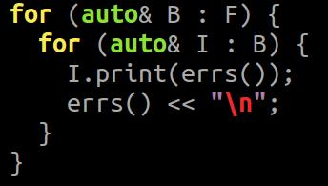
Basic blocks in LLVM
Every basic block in LLVM must
Have a label associated to it
Have a “terminator” at the end of it
The first basic block of LLVM (entry point) cannot have predecessors
LLVM organizes “compiler concepts” in containers
A basic block is a container of ordered LLVM instructions
A function is a container of basic blocks
A module is a container of functions

Slide 9
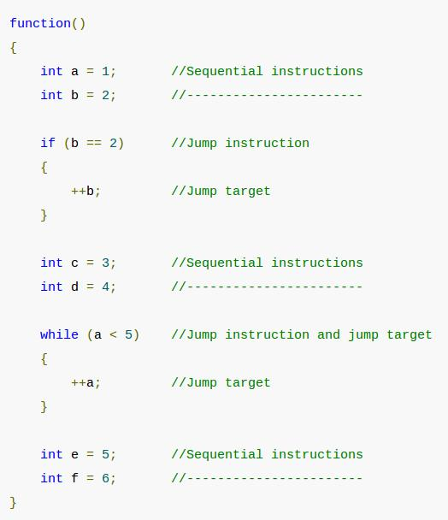
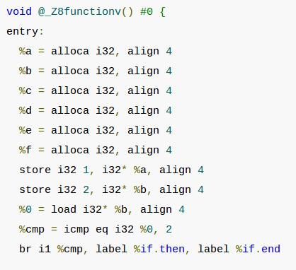
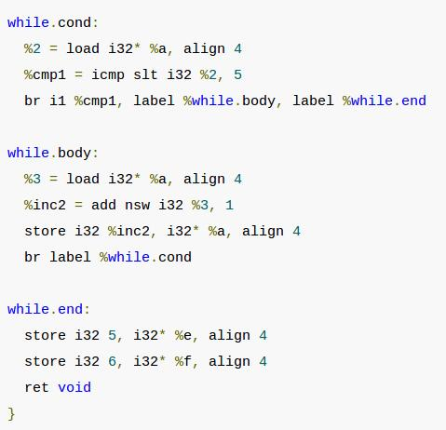
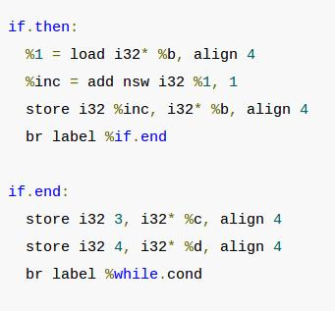
Basic blocks in LLVM in action
Bitcode generation
Bitcode generation
Bitcode generation
Bitcode generation
Bitcode generation
Bitcode generation

Slide 10
Control Flow Graph (CFG)
A CFG is a graph G = <Nodes, Edges>
Nodes: Basic blocks
Edges: (x,y) ϵ Edges iff
last instruction in basic block x might be executed just before the first instruction of the basic block y
Examples?

Slide 11
Control Flow Graph (CFG)
Entry node: block with the first instruction of the function
Exit nodes: blocks with the return instruction
Some compilers make a single exit node by adding a special node
ret
ret

Slide 12
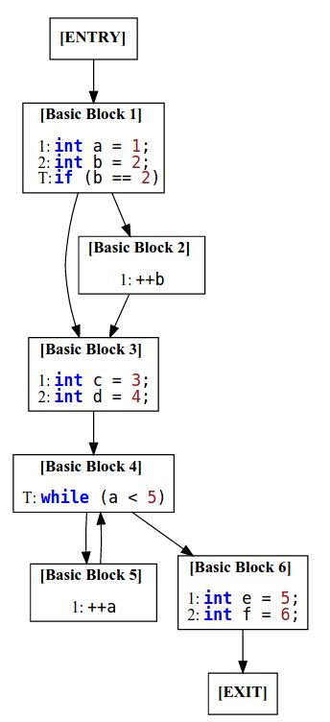
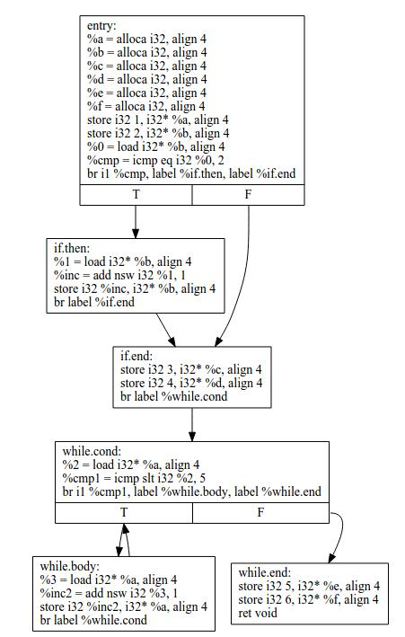
CFG in LLVM
Differences?
Bitcode generation
opt -view-cfg

