Slide 1
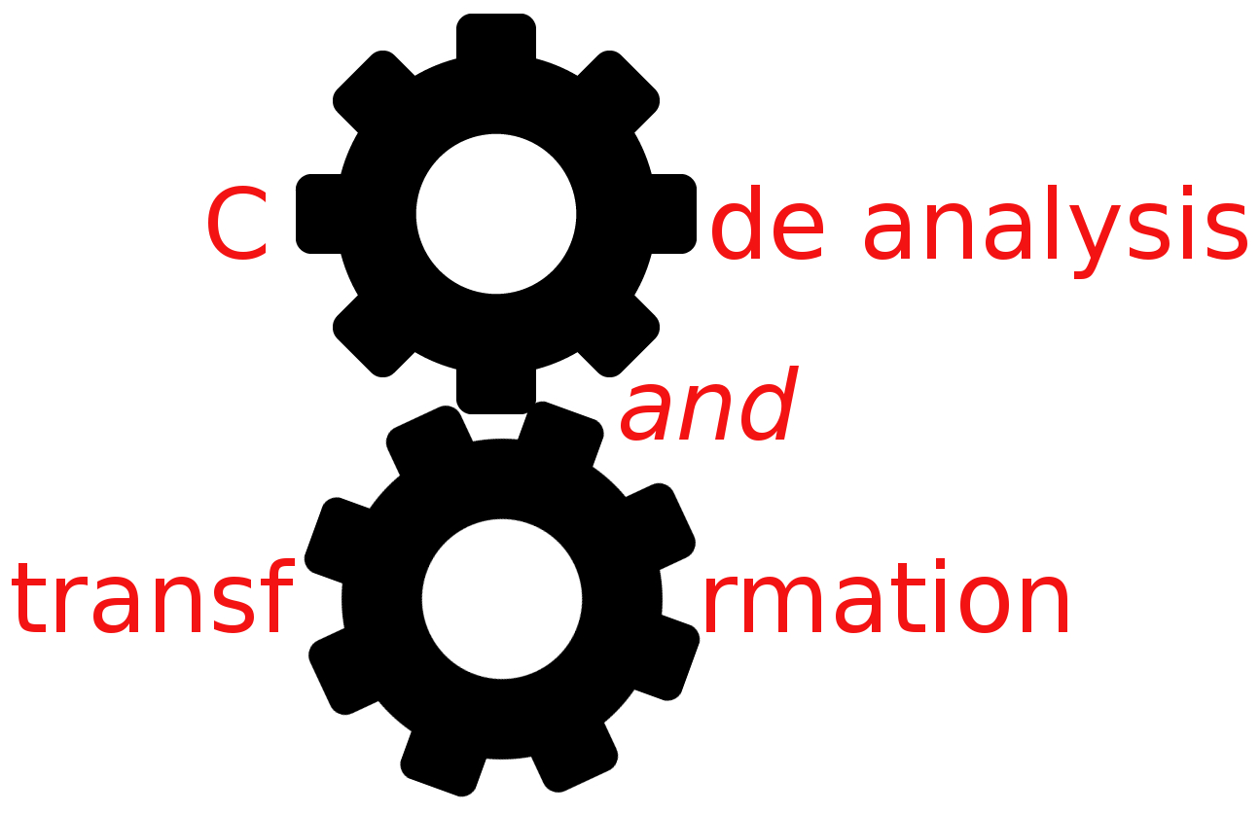


DFA
Simone Campanoni simonec@eecs.northwestern.edu

Slide 2
Outline
Why do we need data-flow analysis?
Data-flow sets and transfer functions
An example of data-flow analysis: reaching definitions
Implementation of data-flow analysis

Slide 3
Constant propagation
Find a constant expression
Instruction i: varX = CONSTANT_EXPRESSION
Replace the use of the variable defined in a constant expression with that constant if
All paths to the use of varX passes its assignment I
There are no intervening definition of that variable

Slide 4
Optimization example:constant propagation
int sumcalc (int a, int b, int N){
int x,y;
x = 0;
y = 0;
if (a > b){
x = x + N;
}
if (b > N){ return y;}
return x;
}
Data-flow analysis is a collection of techniques for compile-time reasoning about the run-time flow of values
if (b > N){ return 0;}
We need to know the “data-flow” of the program
Understanding the data-flow requires understanding the control-flow

Slide 5
Static program vs. dynamic execution
b = b + 1
Statically: Finite program
Dynamically: Can have infinitely many possible execution paths
Data flow analysis abstraction: For each point in the program: combines information of all the instances of the same program point.
Example of a data flow question:
Which definition defines the value used in statement “b = a”?
If (b > N)

Slide 6
Data-flow expressed in CFG
{ }
int x,y
x = 0
y = 0
If (a > b)
Data-flow value:
set of all possible program states that can be observed at a given program point
e.g., all definitions in the program that might have been executed before that point
IN=
{ x=0 }
=OUT
x = x +N
If (b > N)
return y
Data-flow analysis computes IN and OUT sets
return x

Slide 7
Transfer functions
Let i be an instruction: IN[i] and OUT[i] are the set of data-flow values before and after the instruction i of a program
A transfer function fs relates the data-flow values before and after an instruction i
In a forward data-flow problem
OUT[ s ] = fs( IN[ s ] )
In a backward data-flow problem
IN[ s ] = fs( OUT[ s ] )

Slide 8
Data-flow example: reaching definitions
A definition d reaches a program point X if there is a path from the point immediately following d to X such that d is not killed along that path
The data-flow problem for a flow graph is to compute IN[i] and OUT[i] for all i in that graph
0: int x,y
1: x = 0
2: y = 0
3: If (a > b)
4: x = x +N
5: If (b > N)

Slide 9
Computing INs and OUTs
GEN[0] = { }
GEN[1] = {1}
GEN[2] = {2}
GEN[3] = { }
Forward or backward?
OUT[i] = fs (IN[i] )
fs ?
GEN[i] = what i generates
KILL[i] = what i removes
fs within a basic block?
Let i be an instruction and p be its only predecessor
IN[i] = OUT[p]
OUT[i] = GEN[i] U (IN[i] – KILL[i])
IN=
{ }
0: int x,y
1: x = 0
2: y = 0
3: If (a > b)
{ x=0 }
=OUT
Local reaching definitions

Slide 10
Data-flow example: reaching definitions
A definition d reaches a program point X if there is a path from the point immediately following d to X such that d is not killed along that path
The data-flow problem for a flow graph is to compute IN[i] and OUT[i] for all i in that graph
IN[i] = OUT[p]
OUT[i] = GEN[i] U (IN[i] – KILL[i])
IN[entry] = { }
Global reaching definitions
0: int x,y
1: x = 0
2: y = 0
3: If (a > b)
Up a predecessor of i
4: x = x +N
5: If (b > N)

Slide 11
We defined data-flow equations (i.e., IN and OUT equations)
How can we actually compute them?

Slide 12
Iterative algorithm for reaching definitions
Given a flow graph for which the GEN and KILL sets have been computed for instruction, we compute the set of definitions reaching the entry and exit of each instruction i as following
OUT[ENTRY] = { };
for (each instruction i other than ENTRY) OUT[i] = { };
while (changes to any OUT occur) for (each instruction i other than ENTRY) { IN[i] = ∪p a predecessor of i OUT[i];
OUT[i] = GEN[i] ∪ (IN[i] ─ KILL[i]); }
}
ß
ß

Slide 13
Can we optimize the analysis?
OUT[ENTRY] = { };
for (each instruction i other than ENTRY) OUT[i] = { };
while (changes to any OUT occur) for (each instruction i other than ENTRY) { IN[i] = ∪p a predecessor of i OUT[i];
OUT[i] = GEN[i] ∪ (IN[i] ─ KILL[i]); }
}

Slide 14
Optimization 1: basic blocks
OUT[ENTRY] = { };
for (each basic block B other than ENTRY) OUT[B] = { };
while (changes to any OUT occur) for (each basic block B other than ENTRY) { IN[B] = ∪p a predecessor of B OUT[B];
OUT[B]= GEN[B]∪ (IN[B] ─ KILL[B]); }
}
Contains all definitions killed
by instructions in block B
Contains all definitions in block B that are visible immediately after B

Slide 15
Optimization 2: bit-sets
OUT[ENTRY] = { };
for (each basic block B other than ENTRY) OUT[B] = { };
while (changes to any OUT occur) for (each basic block B other than ENTRY) { IN[B] = ∪p a predecessor of B OUT[B];
OUT[B]= GEN[B]∪ (IN[B] ─ KILL[B]); }
}

Slide 16
Optimization 2: bit-sets
Assign a bit to each element of the set
Union: bit OR
Intersection: bit AND
Subtraction: bit NEGATE and AND
Fast implementation
64 elements packed to each word on today’s commodity processors
AND and OR are single machine code instructions

Slide 17
Optimization 3: work list
OUT[ENTRY] = { };
for (each basic block B other than ENTRY) OUT[B] = { };
while (changes to any OUT occur) for (each basic block B other than ENTRY) { IN[B] = ∪p a predecessor of B OUT[B];
OUT[B]= GEN[B]∪ (IN[B] ─ KILL[B]); }
}

Slide 18
Optimization 3: work list
OUT[ENTRY] = { };
for (each basic block B other than ENTRY) OUT[B] = { };
workList = all basic blocks
while (workList isn’t empty)
B = pick and remove a block from workList
oldOUT = OUT[B] IN[B] = ∪p a predecessor of B OUT[B];
OUT[B]= GEN[B]∪ (IN[B] ─ KILL[B]);
if (oldOut != OUT[B]) workList = workList U {all successors of B}
}

Slide 19
Optimization 4: block order
OUT[ENTRY] = { };
for (each basic block B other than ENTRY) OUT[B] = { };
workList = all basic blocks
while (workList isn’t empty)
B = pick and remove a block from workList
oldOUT = OUT[B] IN[B] = ∪p a predecessor of B OUT[B];
OUT[B]= GEN[B]∪ (IN[B] ─ KILL[B]);
if (oldOut != OUT[B]) workList = workList U {all successors of B}
}

Slide 20
What we learned was for forward data-flow analysis
OUT[ s ] = fs( IN[ s ] )
What about backward data-flow analysis?
IN[ s ] = fs( OUT[ s ] )
OUT[ENTRY] = { };
for (each instruction i other than ENTRY) OUT[i] = { };
while (changes to any OUT occur) for (each instruction i other than ENTRY) { IN[i] = ∪p a predecessor of i OUT[i];
OUT[i] = GEN[i] ∪ (IN[i] ─ KILL[i]); }
}

Slide 21
Food for thought
Correctness: is the answer ALWAYS correct?
Meaning: what is exactly the meaning of the answer?
Precision: how good is the answer?
Convergence:
Will the analysis ALWAYS terminate?
Under what conditions does the iterative algorithm converge?
Speed: how long does it take to converge?

