Slide 1
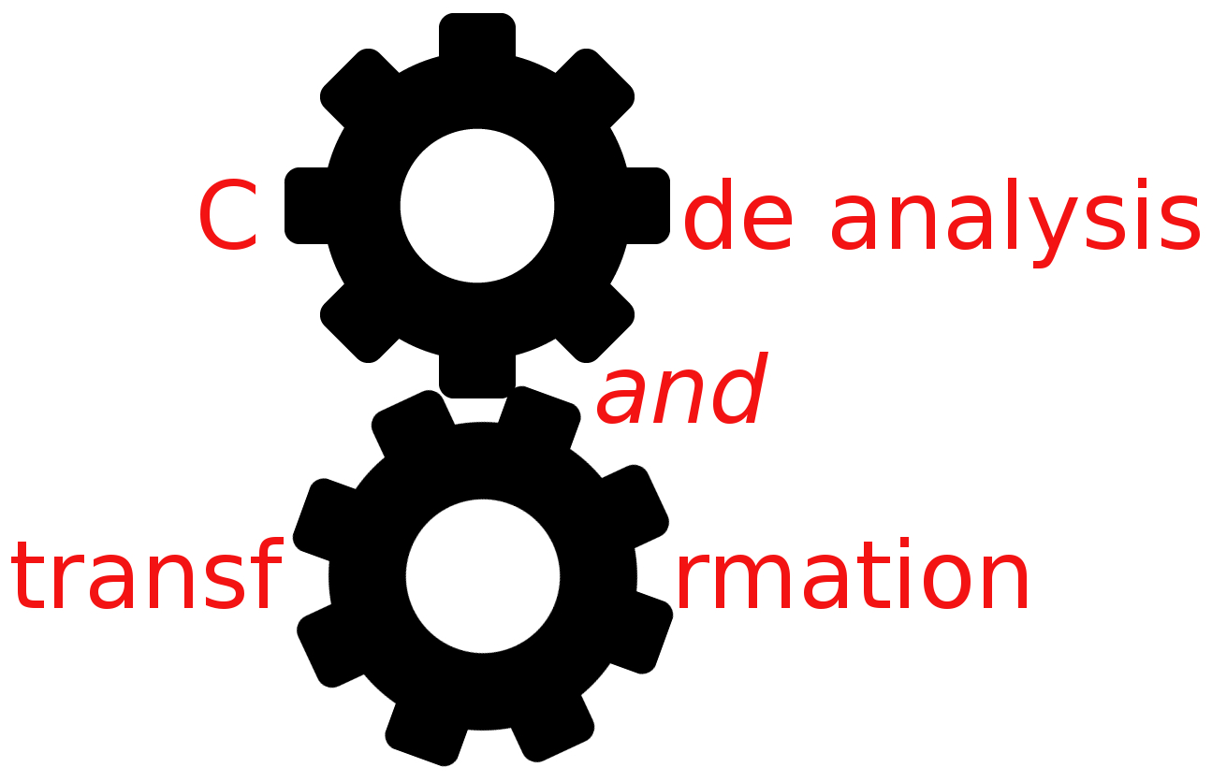


DFA foundations
Simone Campanoni simonec@eecs.northwestern.edu

Slide 2
Data-flow analysis
Correctness: is the answer ALWAYS correct?
Meaning: what is exactly the meaning of the answer?
Precision: how good is the answer?
Convergence:
Will the analysis ALWAYS terminate?
Under what conditions does the iterative algorithm converge?
Speed: how long does it take to converge?

Slide 3
Outline
Lattice and data-flow analysis
DFA correctness
DFA convergence
DFA precision
DFA complexity

Slide 4
Understanding DFAs
We need to understand all of them
Liveness analysis: is it correct? Precision? Convergence?
Reaching definitions: is it correct? Precision? Convergence?
…
Idea: create a framework to help reasoning about them
Goal:
Provide a single formal model that describes all data-flow analyses
Formalize the notions of “safe,” “conservative,” and “optimistic”
Correctness proof for IDFA
Place bounds on time complexity of data-flow analysis

Slide 5
Lattices
Lattice L = (V, ≤):
V is a (possible infinite) set of elements
≤ is a binary relation over elements of V
Properties of ≤:
≤ is a partial order (reflexive, transitive, anti-symmetric)
Every pair of elements in V has
A unique greatest lower bound (a.k.a. meet) and
A unique least upper bound (a.k.a. join)
Height of L: longest path through partial order from greatest to least
Infinite large lattice can still have finite height
Top (T) = unique greatest element of V (if it exists)
Bottom (⊥) = unique least element of V (if it exists)

Slide 6
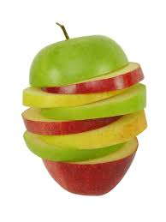


Lattice example
How many apples I must have?
V = sets of apples
≤ = set inclusion
T = (best case) = all apples
⊥ = (worst case) no apples (empty set)
Apples, definitions, variables, expressions …
T={ , , }
{ , }
{ , }
{ , }
{ } ≤
{ , }
{ }
{ }
{ }
⊥={ }

Slide 7
How can we use this mathematical framework
, lattice,
to study DFA?

Slide 8
Use of lattice in DFA
Define domain of program properties (flow values --- apple sets) computed by data-flow analysis, and organize the domain of elements as a lattice
Define flow functions and a merge function over this domain using lattice operations
Exploit lattice theory in achieving goals

Slide 9
Data-flow analysis and lattice
Elements of the lattice (V) represent flow values (IN[] and OUT[] sets)
e.g., Sets of apples
T “best-case” information (initial flow value)
e.g., Empty set
⊥ “worst-case” information
e.g., Universal set
If x ≤ y, then x is a conservative approximation of y
e.g., Superset
T={ , , }
{ , }
{ , }
{ , }
{ }
{ }
{ }
⊥={ }

Slide 10
Data-flow analysis and lattice
Elements of the lattice (V) represent flow values (IN[] and OUT[] sets)
e.g., Sets of live variables for liveness
⊥ “worst-case” information
e.g., Universal set
T “best-case” information (initial flow value)
e.g., Empty set
If x ≤ y, then x is a conservative approximation of y
e.g., Superset
T={ }
{ v1 }
{ v2 }
{ v3 }
{v1,v2}
{v1,v3}
{v2,v3}
⊥={v1,v2,v3}

Slide 11
Data-flow analysis and lattice (reaching defs)
Elements of the lattice (V) represent flow values (IN[], OUT[])
e.g., Sets of definitions
T represents “best-case” information (initial flow value)
e.g., Empty set
⊥ represents “worst-case” information
e.g., Universal set
∧ (meet) merges flow values
e.g., Set union
If x ≤ y, then x is a conservative approximation of y
e.g., Superset

Slide 12
How do we choose which element in our lattice is the data-flow value of a given point of the input program?

Slide 13
Computing a data-flow value (ideal)
For a forward problem, consider all possible paths from the entry to a given program point, compute the flow values at the end of each path, and then meet these values together
Meet-over-all-paths (MOP) solution at each program point
It’s a correct solution
V_{entry}
Entry

Slide 14
Computing MOP solution for reaching definitions
V_{entry}
{d1,d2,d3}
Entry
{d1,d2}
d3
d1
{d1}
d2
⊥={ }

Slide 15
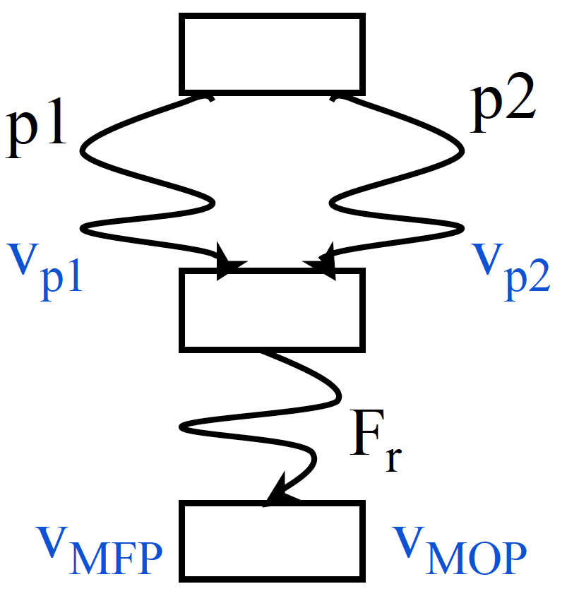
From ideal to practical solution
Problem: statements following merge must be analyzed for all preceding paths
Exponential blow-up
Solution: compute meets early (at merge points) rather than at the end
Maximum fixed-point (MFP)
Questions:
Is MFP correct?
What’s the precision of MFP?

Slide 16
Outline
Lattice and data-flow analysis
DFA correctness
DFA convergence
DFA precision
DFA complexity

Slide 17
Correctness
V_{correct} ≤
V_{MOP}
V_{entry}
T={ }
Entry
{ d1 }
{ d2 }
{ d3 }
d1
d2
{d1,d2}
{d1,d3}
{d2,d3}
⊥={d1,d2,d3}

Slide 18
Correctness
Key idea:
“Is MFP correct?” iff V_{MFP} ≤ V_{MOP}
Focus on merges:
V_{MOP} = fs(V_{p1}) ∧ fs(V_{p2})
V_{MFP} = fs(V_{p1} ∧ V_{p2} )
V_{MFP} ≤ V_{MOP} iff fs(V_{p1} ∧ V_{p2} ) ≤ fs(V_{p1}) ∧ fs(V_{p2})
X ≤ Y then fs(X) ≤ fs(Y) (monotonic fs)
So fs(V_{p1} ∧ V_{p2} ) ≤ fs(V_{p1}) ∧ fs(V_{p2})
And therefore V_{MFP} ≤ V_{MOP}
MFP is correct!

Slide 19
Monotonicity
X ≤ Y then fs(X) ≤ fs(Y)
If the flow function f is applied to two members of V, the result of applying f to the “lesser” of the two members will be under the result of applying f to the “greater” of the two
More conservative inputs leads to more conservative outputs (never more optimistic outputs)

Slide 20
Outline
Lattice and data-flow analysis
DFA correctness
DFA convergence
DFA precision
DFA complexity

Slide 21
Convergence
From lattice theory Because fs is monotonic, then the maximum number of times fs can be applied to self w/o reaching a fixed point is Height(V) – 1
Iterative DFA is guaranteed to terminate if the fs is monotonic and the lattice has finite height

Slide 22
Precision
V_{MOP}: the best solution
V_{MFP} ≤ V_{MOP}
fs(V_{p1} ∧ V_{p2} ) ≤ fs(V_{p1}) ∧ fs(V_{p2})
Distributive fs: fs(V₁ ∧ V₂ ) = fs(V₁) ∧ fs(V₂)
fs(V_{p1} ∧ V_{p2} ) = fs(V_{p1}) ∧ fs(V_{p2})
V_{MFP} = V_{MOP}
Is reaching definition fs distributive?

Slide 23
Complexity
OUT[ENTRY] = { };
for (each instruction i other than ENTRY) OUT[i] = { };
while (changes to any OUT occur){ for (each instruction i other than ENTRY) { IN[i] = ∪p a predecessor of i OUT[p];
OUT[i] = GEN[i] ∪ (IN[i] ─ KILL[i]); }
}

Slide 24
Complexity
N=500
Worst case: 62,500,000,000
Optimized average case: 500 – 250,000
N instructions (N definitions at most)
Each IN/OUT set has at most N elements
Each set-union operation takes O(N) time
The for loop body
constant # of set operations per node
O(N) nodes ⇒ O(N²) time for the loop
Each iteration of the repeat loop can only make the set larger
Each iteration modifies at least one set
N iterations to reach the fixed point at most (why?)
Worst case: O(N⁴)
Typical case: 2 to 3 iterations with good ordering & sparse sets
O(N) to O(N²)

Slide 25
Example: reaching constants
Goal
Compute value of each variable at each program point (if possible) (must)
Flow values (V)
Set of (variable,constant) pairs
Merge function
Intersection
Data-flow equations
Effect of node n x = c
KILL[n] = {(x,k)| ∀k}
GEN[n] = {(x,c)}
Effect of node n x = y + z
KILL[n] = {(x,k)| ∀k}
GEN[n] = {(x,c) | c=valy+valz, (y, valy) ∈ in[n], (z, valz) ∈ in[n]}

Slide 26
Reaching constants: characteristics
T = ?
⊥ = ?
IN = ?
OUT = ?
Let’s study this analysis
Correctness?
Convergence?
is fs monotonic? Has the lattice a finite height?
Precision?
is fs distributive?

Slide 27
What we have learned so far
CATs vs. compilers
IR and SSA form
LLVM
Control-flow analysis
Data-flow analysis
Scalar optimizations
Next week: loops!

