Slide 1



Loops
Simone Campanoni simonec@eecs.northwestern.edu

Slide 2
… points …
H0, H1, H2 …
… up to 30 points … … (excluding extra points) …
… out of 100
Grade | Points
A | 95 – 100
A - | 90 – 94
B + | 80 – 89
B | 61 – 79
C | 50 - 60
D | 25 – 49
F | 0 - 24

Slide 3
H1 solution: data structure

Slide 4
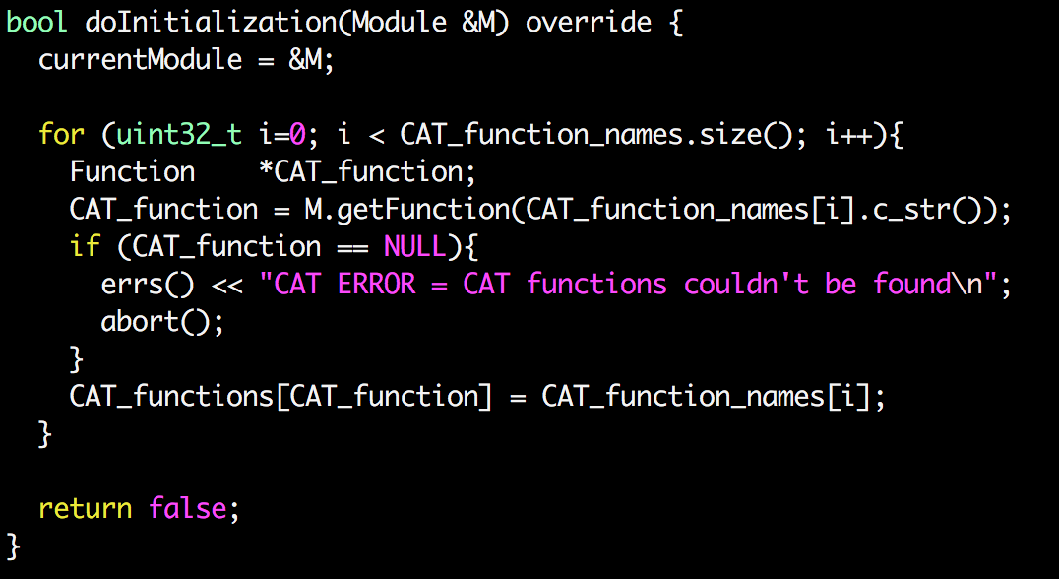
H1: finding CAT functions

Slide 5
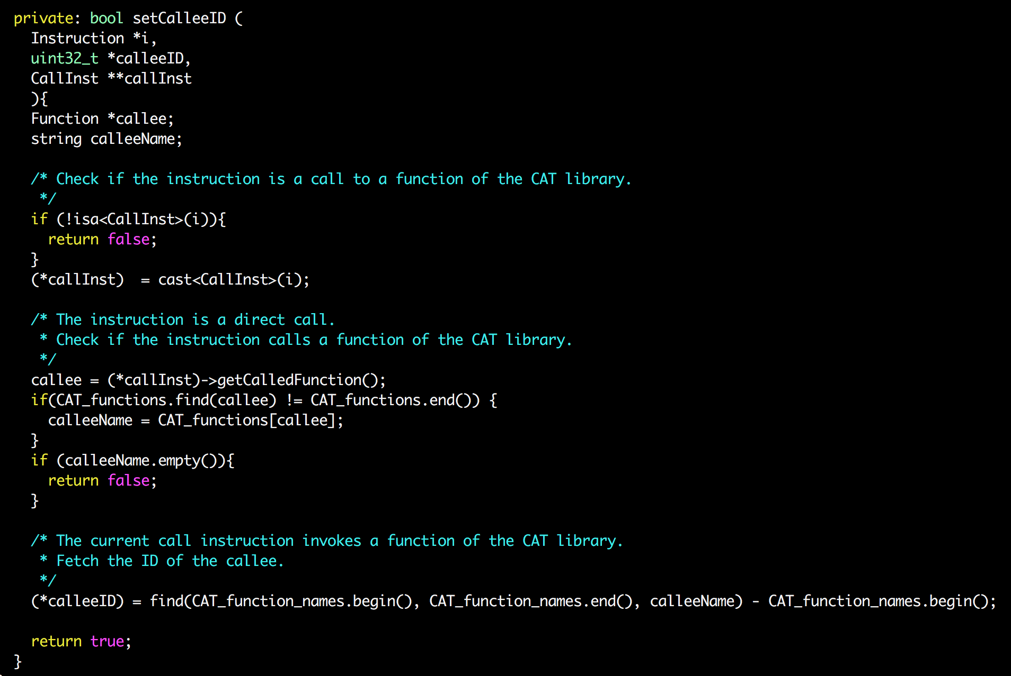
H1

Slide 6
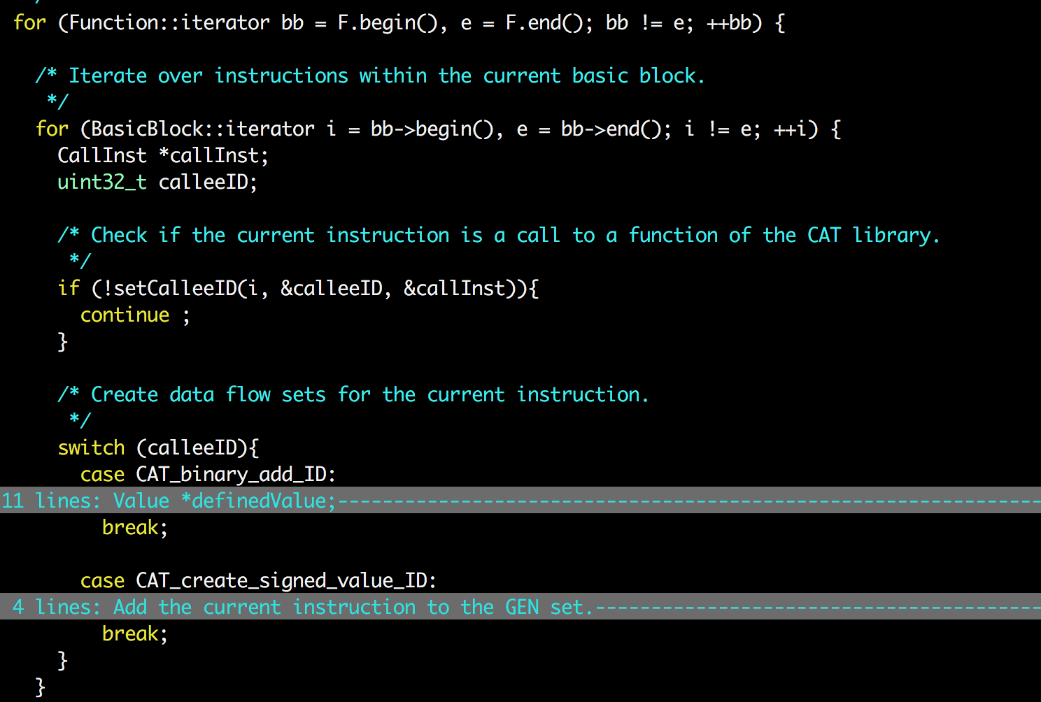
H1

Slide 7
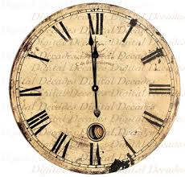
Homework H3 is due tomorrow!

Slide 8
Outline
Loops
Identify loops
Loop normalization

Slide 9
Impact of optimized code to program
Code transformation
1 second
10 seconds
How much did we optimize the overall program?
Coverage of optimized code
10% coverage: Speedup=~1.10x (100->91 seconds)
20% coverage: Speedup=~1.22x (100->82 seconds)
90% coverage: Speedup=~5.26x (100->19 seconds)

Slide 10

90% of time is spent in 10% of code
Cold code
Loop
Hot code
Identify hot code to succeed!!!

Slide 11
Loops …
... but where are they?
... How can we find them?

Slide 12
Loops in source code
for (i=0; i < 10; i++){
…
}
i=0;
do {
…
i++;
} while (i < 10);
S={0,1,…,10}
foreach (i in S){
…
}
i=0;
while (i < 10){
…
i++;
}
Is there a LLVM IR instruction “for”?
There is no IR instruction for “loop”

Slide 13
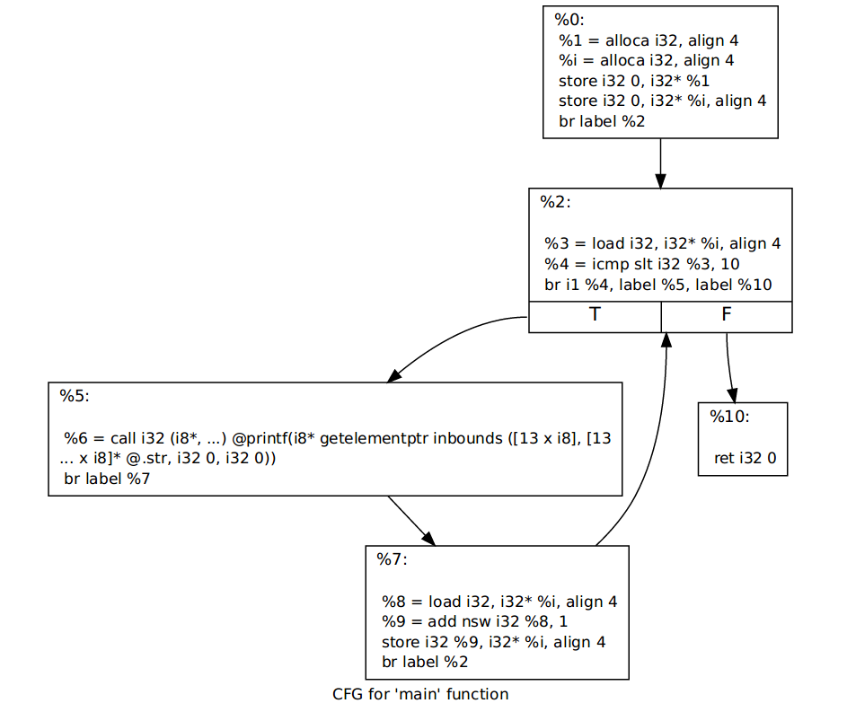
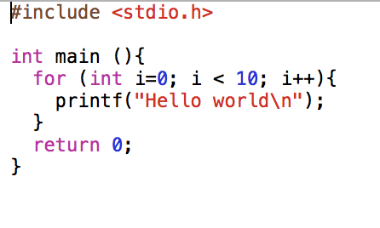
Target optimization: we need to identify loops
There is no IR instruction for “loop”
How to identify an IR loop?

Slide 14
Loops in IR
Loop identification:
Input: Control-Flow-Graph
Output: loops in CFG
Not sensitive to input syntax: a uniform treatment for all loops
Define a loop in graphic-theoretic terms
Intuitive properties of a loop
Single entry point
Edges must form at least a cycle in CFG
How to check these properties automatically?

Slide 15
Dominators
Definition: Node d dominates node n in a graph (d dom n) if every path from the start node to n goes through d
What is the relation between instructions within a basic block?
What is the relation between basic blocks 1, 2, and 3?
What is the relation between basic blocks 1 and 2?
1
2
3

Slide 16
Immediate dominators
Definition: the immediate dominator of a node n is the unique node that strictly dominates n but does not strictly dominate another node that strictly dominates n
1
1
1
Dominator tree
2
2
2
3
3
3
CFG
Immediate dominators

Slide 17
Natural loops in CFG
Header: node that dominates all other nodes in a loop
Single entry point of a loop
Back edge: arc (tail -> head) whose head dominates its tail
Natural loop of a back edge: smallest set of nodes that includes the head and tail of the back edge, and has no predecessors outside the set, except for the predecessors of the header.

Slide 18
Identify natural loops
Find the dominator relations in a flow graph
Identify the back edges
Find the natural loop associated with the back edge

Slide 19
Finding dominators
Definition: Node d dominates node n in a graph (d dom n) if every path from the start node to n goes through d.
Data-flow analysis:
Direction?
Values?
GEN? KILL? IN? OUT?
Meet operator?
Top? Bottom?

Slide 20
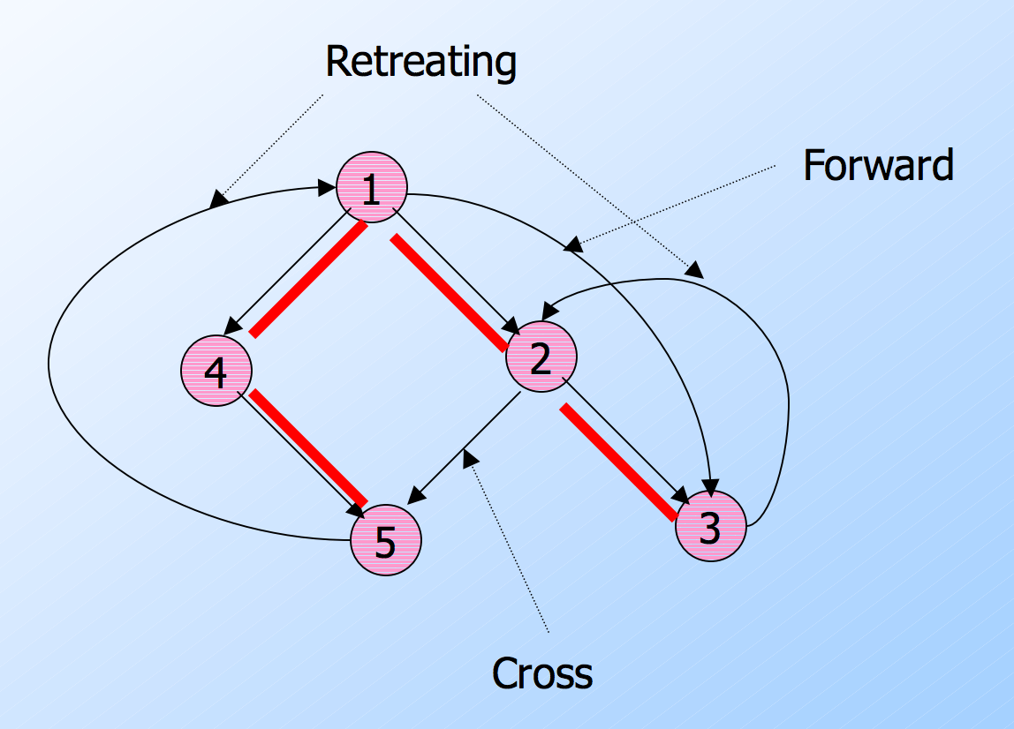
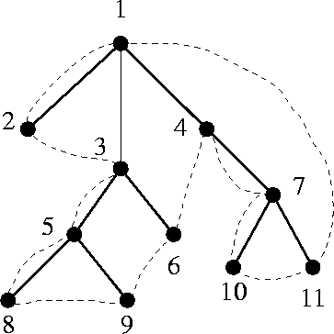
Finding back-edges
Definition: a back-edge is an arc (tail -> head) whose head dominates its tail
(A) Depth-first spanning tree
Edges traversed in a depth-first search of the flow graph form a depth-first spanning tree
Compute retreating edges in CFG:
Advancing edges: from ancestor to proper descendant
Retreating edges: from descendant to ancestor
(B) For each retreating edge t->h, check if h is in t’s dominator list

Slide 21
Finding natural loops
Definition: the natural loop of a back edge is smallest set of nodes that includes the head and tail of the back edge, and has no predecessors outside the set, except for the predecessors of the header
Let t->h be the back-edge
Delete h from the flow graph
Find those nodes that can reach t (those nodes plus h form the natural loop of t->h)

Slide 22
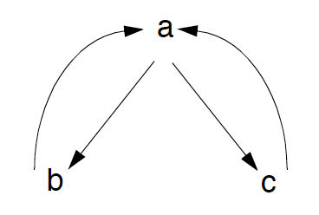
Identify inner loops
If two loops do not have the same header
they are either disjoint, or
one is entirely contained (nested within) the other
inner loop, one that contains no other loop
Loop nesting tree
What about if two loops share the same header?
while (i < 10){
if (i == 5) continue; }

Slide 23
Loop-nest tree
Loop-nest tree: each node represents the blocks of a loop, and parent nodes are enclosing loops.
The leaves of the tree are the inner-most loops.
1
1,2,3,4
2
2,3
3
How to compute the loop-nest tree?
4

Slide 24
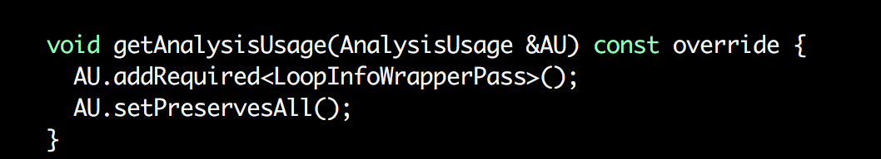
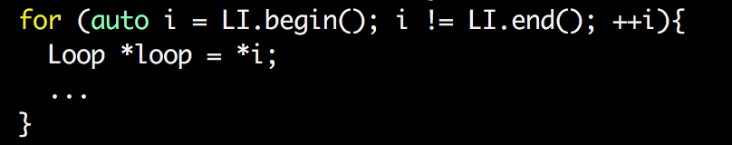
Loops in LLVM
Rely on other passes to identify loops
Fetch the result of the LoopInfoWrapperPass analysis
Iterate over loops

Slide 25
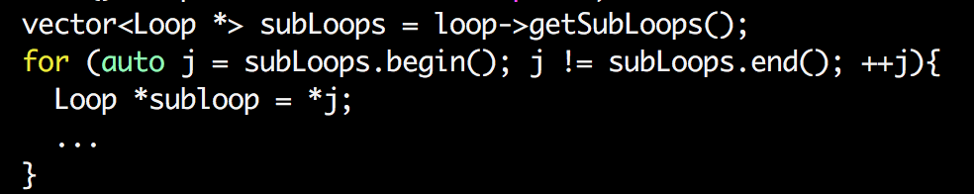
Loops in LLVM: sub-loops
Iterate over sub-loops of a loop

Slide 26
Defining loops in graphic-theoretic terms
Is it good? Bad? Implications?
L1: …
if (X < 10) goto L2;
goto L1;
L2: ...
if (…) goto L1;
…
do {
…
L1: …
} while (X < 10);
The good
The bad
The ugly?

Slide 27
Outline
Loops
Identify loops
Loop normalization

Slide 29
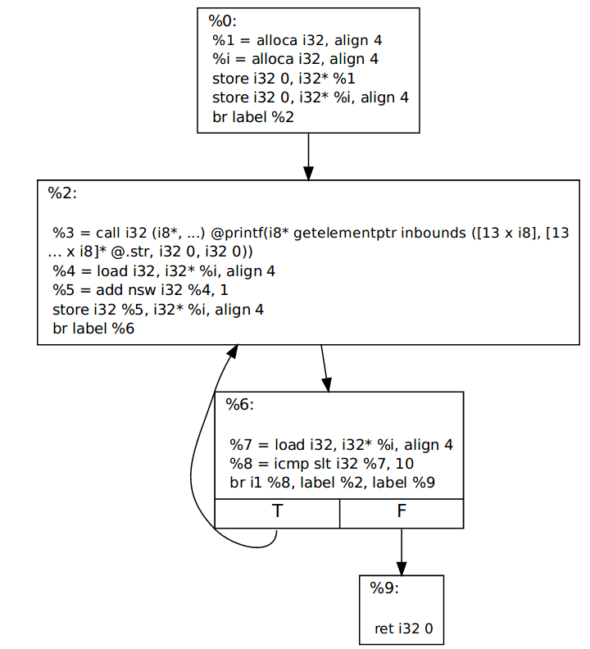
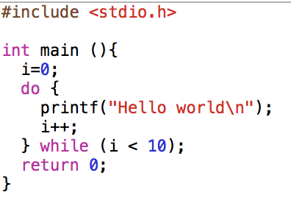

Slide 30
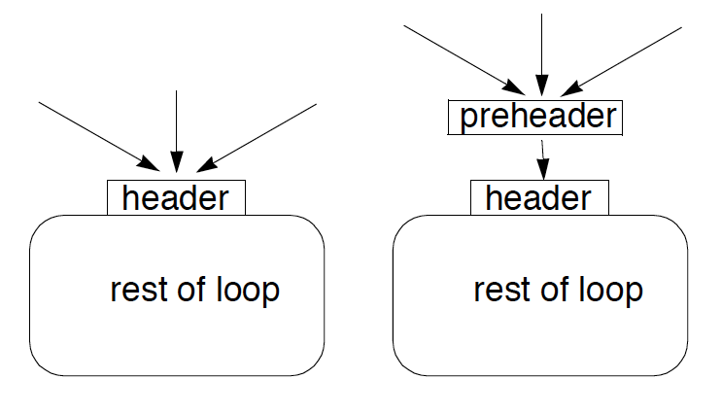
First normalization: adding a pre-header
Optimizations often require code to be executed once before the loop
Create a pre-header basic block for every loop

Slide 31
Common loop normalization
Pre-header
Header
Body

Slide 32
Loop normalization in LLVM
The loop-simplify pass normalize natural loops
Output of loop-simplify:
Pre-header: the only predecessor of the header
Latch: node executed just before starting a new loop iteration
Exit node: ensures it is dominated by the header
n1
n2
n3
nX
Header
exit
Body

Slide 33
Loop normalization in LLVM
The loop-simplify pass normalize natural loops
Output of loop-simplify:
Pre-header: the only predecessor of the header
Latch: node executed just before starting a new loop iteration
Exit node: ensures it is dominated by the header
n1
n2
n3
Pre-header
nX
Header
exit
Body

Slide 34
Loop normalization in LLVM
The loop-simplify pass normalize natural loops
Output of loop-simplify:
Pre-header: the only predecessor of the header
Latch: node executed just before starting a new loop iteration
Exit node: ensures it is dominated by the header
n1
n2
n3
Pre-header
nX
Header
Latch
exit
Body

Slide 35
Loop normalization in LLVM
The loop-simplify pass normalize natural loops
Output of loop-simplify:
Pre-header: the only predecessor of the header
Latch: node executed just before starting a new loop iteration
Exit node: ensures it is dominated by the header
n1
n2
n3
nX
Pre-header
Header
Exit node
Latch
exit
Body

Slide 36
Loop normalization in LLVM
Pre-header llvm::Loop:getLoopPreheader()
Header llvm::Loop::getHeader()
Latch llvm::Loop::getLoopLatch()
Exit llvm::Loop::getExitBlocks()
opt -loop-simplify bitcode.bc -o normalized.bc
Pre-header
Header
Exit node
Latch
Body

Slide 37
Further normalizations in LLVM
Loop representation can be further normalized:
loop-simplify normalize the shape of the loop
What about definitions in a loop?
Problem: updating code in loop might require to update code outside loops for keeping SSA
Loop-closed SSA form: no var is used outside of the loop in that it is defined
Keeping SSA form is expensive with loops
lcssa insert phi instruction at loop boundaries for variables defined in a loop body and used outside
Isolation between optimization performed in and out the loop
Faster keeping the SSA form
Propagation of code changes outside the loop blocked by phi instructions

Slide 38
Loop pass example in LLVM
while (){
d = …
}
… ... = d op ...
while (){
d = …
...
if (...){
d = ...
}
}
… ... = d op ...
while (){
d = …
...
if (...){
d2 = ...
}
}
… ... = d op ...
while (){
d = …
...
if (...){
d2 = ...
}
d3=phi(d,d2)
}
…
... = d op ...
while (){
d = …
...
if (...){
d2 = ...
}
d3=phi(d,d2)
}
…
... = d3 op ...
Changes to code outside our loop

Slide 39
Further normalizations in LLVM
Loop representation can be further normalized:
loop-simplify normalize the shape of the loop
What about definitions in a loop?
Problem: updating code in loop might require to update code outside loops for keeping SSA
Loop-closed SSA form: no var is used outside of the loop in that it is defined
Keeping SSA form is expensive with loops
lcssa insert phi instruction at loop boundaries for variables defined in a loop body and used outside
Isolation between optimization performed in and out the loop
Faster keeping the SSA form
Propagation of code changes outside the loop blocked by phi instructions

Slide 40
Loop-closed SSA form in LLVM
opt -lcssa bitcode.bc -o transformed.bc
llvm::Loop::isLCSSAForm(DT)
formLCSSA(…)

Slide 41
Further normalizations in LLVM
Last loop-related normalization: Induction variable normalization

Slide 42

Coding time

