Slide 1
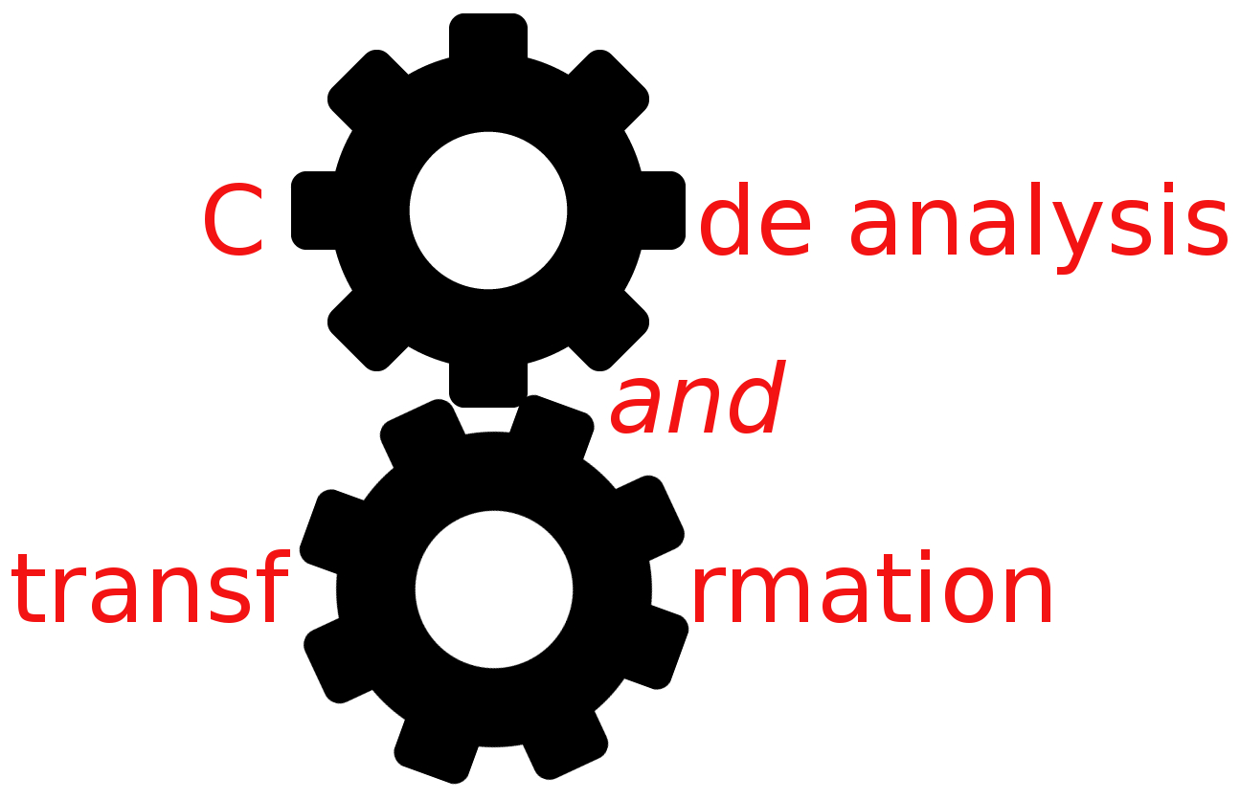


Optimization
Simone Campanoni simonec@eecs.northwestern.edu

Slide 2
Outline
Constant propagation
Copy propagation
Dead code elimination
Common sub-expression elimination

Slide 3
Constant propagation: problem definition
Given a program, we would like to know for every point in that program, which variables have constant values, and which do not.
We say that a variable has a constant value at a certain point if every execution that reaches that point, gives that variable the same constant value.
i: x = 0
j: N = N + 1
k: Z = x + N

Slide 4
Reaching definition summary
Reaching definition data-flow analysis computes IN[i] and OUT[i] for every instruction i
IN[i] (OUT[i]) includes definitions that reach just before (just after) instruction i
Each IN/OUT set contains a mapping for every variable in the program to a “value”

Slide 5
Constant propagation
1: int x,y
2: x = 0
3: y = 0
4: If (a > b)
IN[2]={ }
IN[3]={2}
IN[4]={2,3}
For a use of variable v in statement n,
n: x = ... v ...
If the definitions of v that reach n are all of the form
d: v = c [c a constant]
then replace the use of v in n with c
Any problem?
5: x = x +N
IN[5]={2,3}
IN[7]={2,3,5}
IN[6]={2,3,5}
IN[8]={2,3,5}
6: If (b > N)
7: return y
8: return x

Slide 6
Constant propagation problem?
1: int x,y
3: y = 0
4: If (a > b)
Better solutions for
the C language?
New analysis
Customize reaching definitions
What about in
The CAT language?
CATData CAT_create_signed_value (int64_t value);
IN[3]={}
IN[4]={3}
5: x=5
IN[5]={3}
IN[7]={3,5}
IN[6]={3,5}
IN[8]={3,5}
6: If (b > N)
7: return y
8: return x

Slide 7
Copy propagation: problem definition
Given a program, we would like to know for every point in the program, if a variable contains always the same value of another one.
Copy propagation
1: x = y
2: a = 5
3: b = x + 3
1: x = y
2: a = 5
3: b = y + 3

Slide 8
Reaching definition summary
Reaching definition data-flow analysis computes IN[i] and OUT[i] for every instruction i
IN[i] (OUT[i]) includes definitions that reach just before (just after) instruction i
Each IN/OUT set contains a mapping for every variable in the program to a “value”;

Slide 9
Copy propagation
1: int x,y
2: x = a
3: y = x
4: If (a > b)
IN[2]={ }
IN[3]={2}
IN[4]={2,3}
For a use of variable v in statement n,
n: x = ... v ...
If the definitions of v that reach n are all of the form
d: v = z [z is another variable]
then replace the use of v in n with z
Any problem?
5: x = x +N
IN[5]={2,3}
IN[7]={2,3,5}
IN[6]={2,3,5}
IN[8]={2,3,5}
6: If (b > N)
7: return y
8: return x

Slide 10
Thinking about what we have done
What’s the value of these propagations?
Constant propagation: less register uses
Redundant use of registers
Copy propagation: less register uses
Redundant use of registers
Redundancy operations are the principal source of optimization in compilers
Front-end
…
Back-end

Slide 11
Dead code elimination: problem definition
Given a program, we would like to know statements/instructions
that do not influence the program at all (i.e., dead code)
1: y = …
2: x = y
3: return x
Copy propagation
1: y = …
2: x = y
3: return y
Any idea?

Slide 12
Liveness analysis
A variable is live at a particular point in the program if its value at that point will be used in the future (dead, otherwise)
To compute liveness at a given point, we need to look into the future
How to use variable liveness information for eliminating dead-code?
Another use: register allocation
A program contains an unbounded number of variables
Must execute on a machine with a bounded number of registers
Two variables can use the same register if they are never in use at the same time

Slide 13
Example of variable liveness and dead-code elimination
What are in IN/OUT sets?
IN[0] = {}
OUT[0] = {a}
IN[1] = {a}
OUT[1] = {a, b}
IN[2] = {a, b}
OUT[2] = {b}
IN[3] = {b}
OUT[3] = {b}
IN[4] = {b}
OUT[4] = {}
0: a = 0
0: a = 0
1: b = a + 1
1: b = a + 1
1: b = 0 + 1
2: a = a + b
4: return 1
4: return b
3: d = b * 2
4: return b
Any dead-code?

Slide 14
Liveness analysis
A variable v is live at a given point of a program p if
Exist a directed path from p to a use of v and
that path does not contain any definition of v
Is liveness data-flow analysis forward or backward?
Liveness flows backwards through the CFG, because the behavior at future nodes determines liveness at a given node
GEN[i]=? KILL[i]=?
IN[i] = GEN[i] ∪(OUT[i] – KILL[i])
OUT[i] = ∪_{s a successor of i} IN[s]
IN[ s ] = fs( OUT[ s ] )

Slide 15
Common sub-expression elimination: problem definition
Given a program, we would like to know for every point in the program, which expressions are available
1: y = x + 3
2: b = x + 3
1: y = x + 3
2: b = y

Slide 16
Available expressions
Elements in data-flow sets?
GEN and KILL?
Forward or backward?
IN and OUT?
IN[i] = ∩ _{p a predecessor of i} OUT[p]
OUT[i] = GEN[i] U (IN[i] – KILL[i])
How to use available expressions for eliminating redundant code?
1: y = x + 3
2: b = x + 3

Slide 17
So far …
Reaching definitions
Constant propagation
Copy propagation
Variable liveness
Dead-code elimination
Available expressions
Common sub-expression elimination

Slide 18
What about function parameters?
int myFunction (int a, int b){
if (a > b){
a = 5;
} else {
a = b;
}
return a;
}

Slide 19

Data-flow analysis: food for thought
Correctness: is the answer ALWAYS correct?
Meaning: what is exactly the meaning of the answer?
Precision: how good is the answer?
Convergence:
Will the analysis ALWAYS terminate?
Under what conditions does the iterative algorithm converge?
Speed: how long does it take to converge?

