Slide 1



SSA
Simone Campanoni simonec@eecs.northwestern.edu

Slide 2
LLVM IR (4)
It’s a Static Single Assignment (SSA) representation
A variable is set only by one instruction in the function body
%myVar = …
A static assignment can be executed more than once

Slide 3
SSA and not SSA example
float myF (float par1, float par2, float par3){ return (par1 * par2) + par3; }
define float @myF(float %par1, float %par2, float %par3) {
%1 = fmul float %par1, %par2
%1 = fadd float %1, %par3
ret float %1 }
NOT SSA
define float @myF(float %par1, float %par2, float %par3) {
%1 = fmul float %par1, %par2
%2 = fadd float %1, %par3
ret float %2 }
SSA

Slide 4
Motivation for SSA
Code analysis needs to represent facts at every program point
What if
There are a lot of facts and
there are a lot of program points?
potentially takes a lot of space/time
define float @myF(float %par1, float %par2, float %par3) {
%1 = fmul float %par1, %par2
%2 = fadd float %1, %par3
ret float %2 }

Slide 5
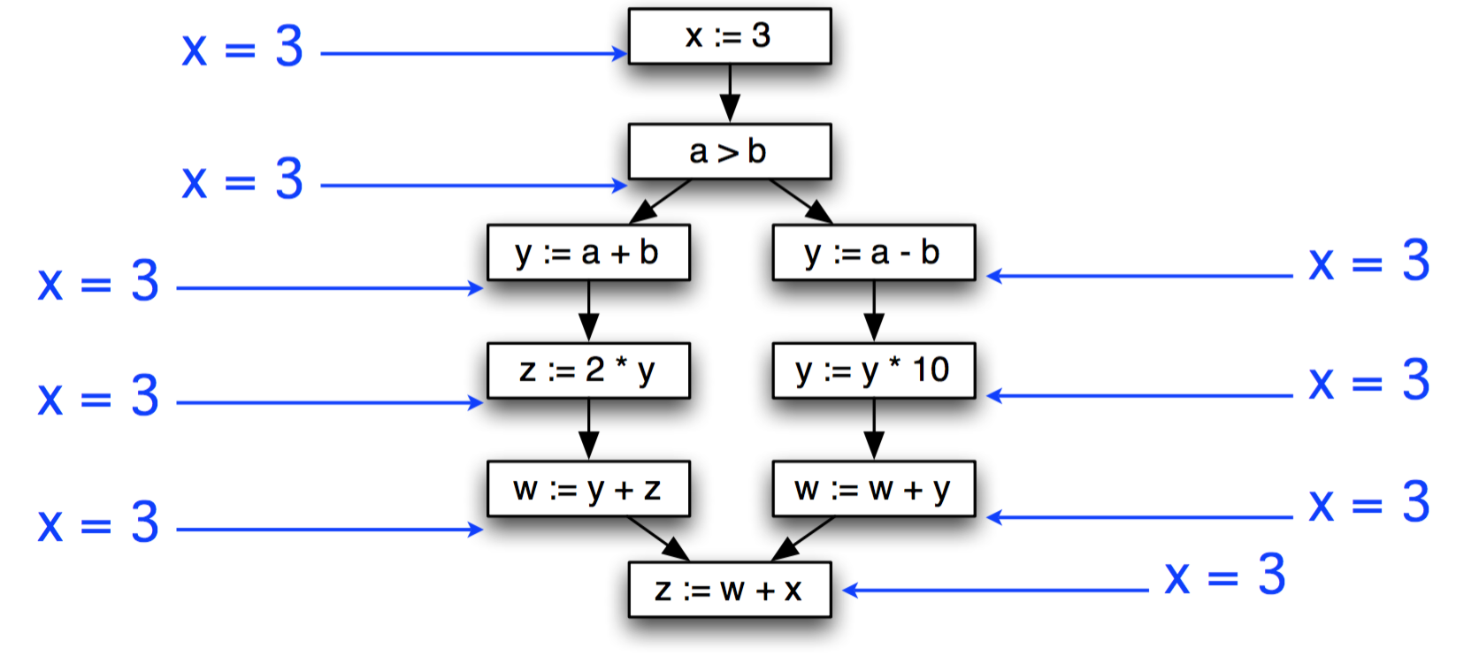
Example

Slide 6
Sparse representation
Instead, we’d like to use a sparse representation
Only propagate facts about x where they’re needed
Enter static single assignment form
Each variable is defined (assigned to) exactly once
But may be used multiple times

Slide 7
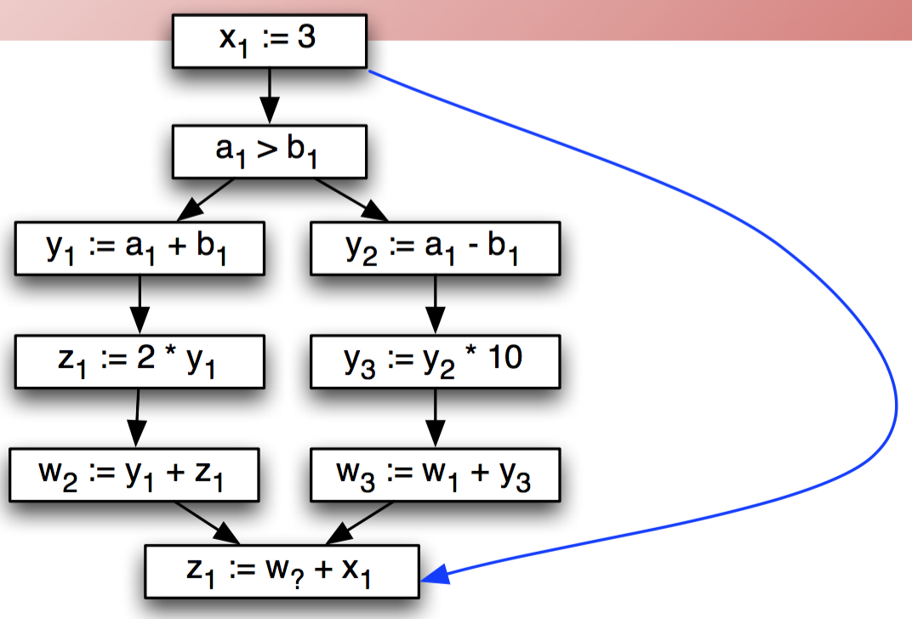
Static Single Assignment (SSA)
Add SSA edges from definitions to uses
No intervening statements define variable
Safe to propagate facts about x only along SSA edges
In our pass llvm/4
call->uses()

Slide 8
What about joins?
Add Φ functions/nodes to model joins
One argument for each incoming branch
Operationally
selects one of the arguments based on how control flow reach this node
At code generation time, need to eliminate Φ nodes
b = c + 1
b = d + 1
b1 = c + 1
b2 = d + 1
b1 = c + 1
b2 = d + 1
If (b > N)
If (? > N)
b3=Φ(b1, b2)
If (b3 > N)
Not SSA
Still not SSA
SSA

Slide 9
Eliminating Φ
Basic idea: Φ represents facts that value of join may come from different paths
So just set along each possible path
b1 = c + 1
b2 = d + 1
b1 = c + 1
b3 = b1
b2 = d + 1
b3 = b2
b3=Φ(b1, b2)
If (b3 > N)
If (b3 > N)
Not SSA

Slide 10
Eliminating Φ in practice
Copies performed at Φ may not be useful
Joined value may not be used later in the program
(So why leave it in?)
Use dead code elimination to kill useless Φs
Subsequent register allocation will map the variables onto the actual set of machine register

Slide 11
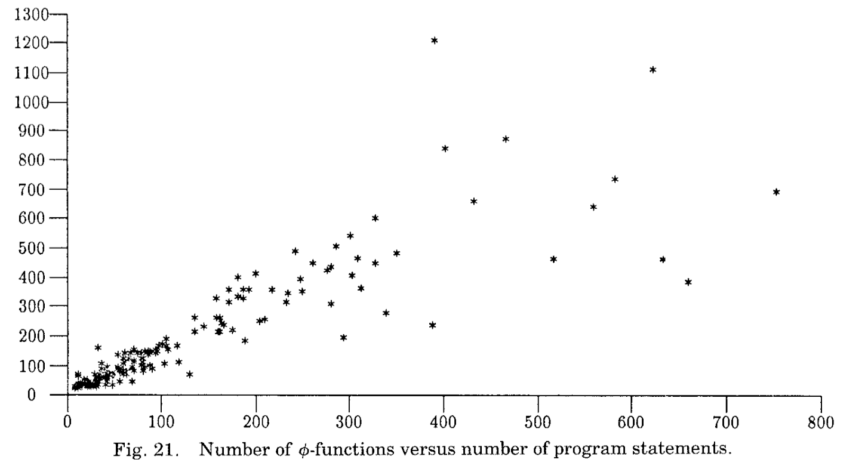
SSA efficiency in practice

Slide 12
SSA in LLVM
The IR must be in SSA all the time
Checked at boundaries of passes
No time wasted converting automatically IR to its SSA form
CAT designed with this constraint in mind
Φ instructions only at the top of a basic block
Must have exactly 1 entry for every predecessor
Must have at least one entry
May include undef values

Slide 13
SSA in LLVM: how to survive
Let’s say we have a variable defined multiple times
How should we generate LLVM IR in SSA?
Idea:
Memory isn’t in SSA, just registers (e.g., stack locations---alloca)
Exploit already existing passes to reduce inefficiencies (mem2reg)

Slide 14
The mem2reg LLVM pass
The LLVM IR is natively SSA
An Instruction is the same thing as the Value it produces
%foo = inst in the LLVM IR just gives a name to inst in the syntax; %foo does not exist inside the compiler
It may be nontrivial for frontends to emit SSA directly
mem2reg understands certain use patterns that frontends use to emit “variables”
mem2reg maps memory locations to registers when possible

Slide 15
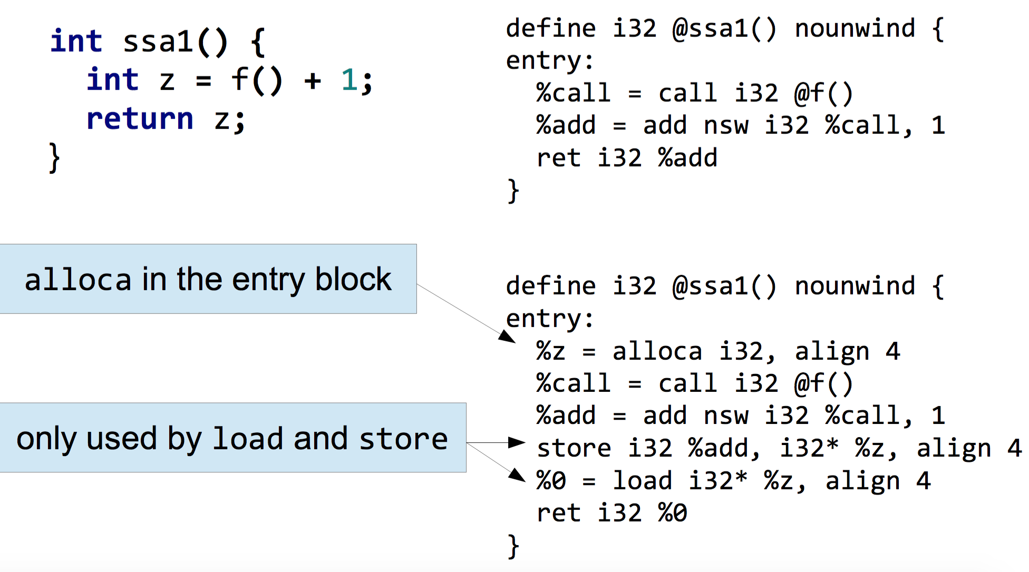
The mem2reg LLVM pass

Slide 16
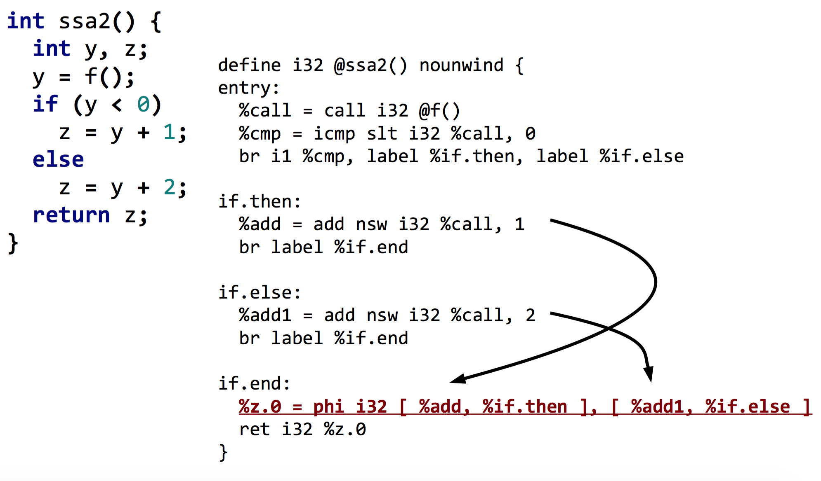
mem2reg might add new instructions

Slide 17
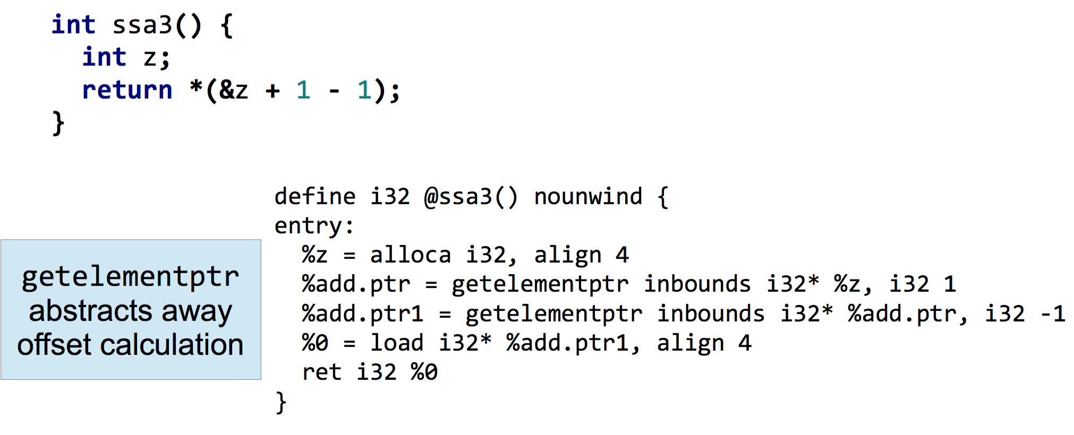
mem2reg get confused easily

