Slide 1


Slide 2

Future Genius LMS

Slide 3
Future Genius LMS
Group ID : S25PROJECT44E74
VU ID : BC190410098, BC210403598
STUDENTNAME : (Ayesha)

Slide 4
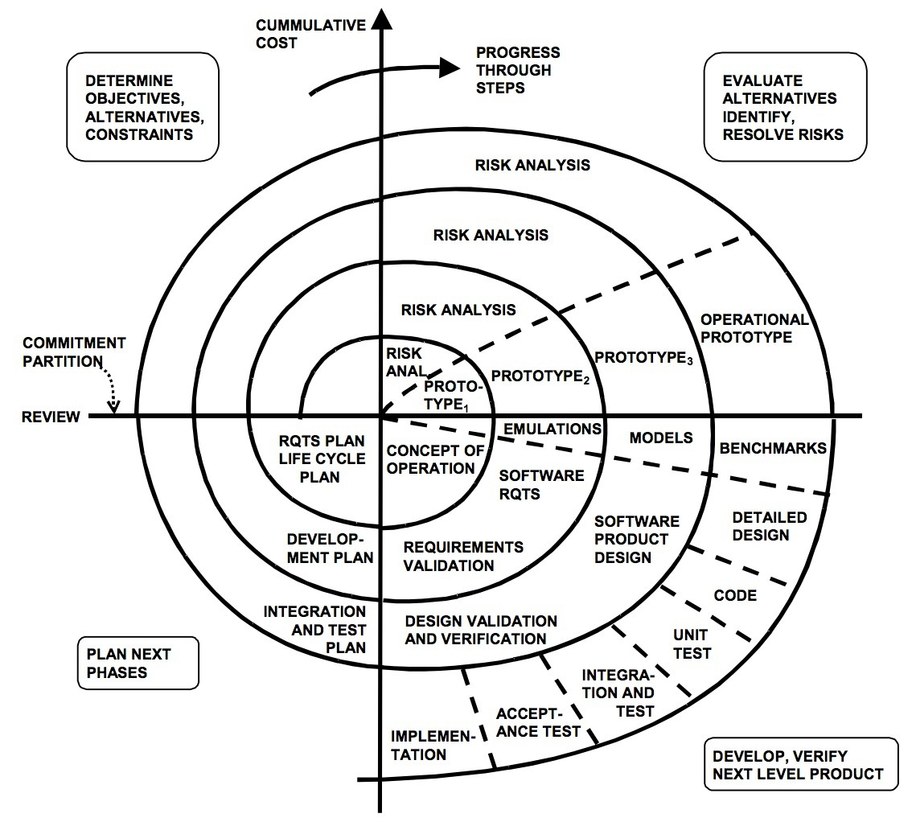
Spiral Model

Slide 5
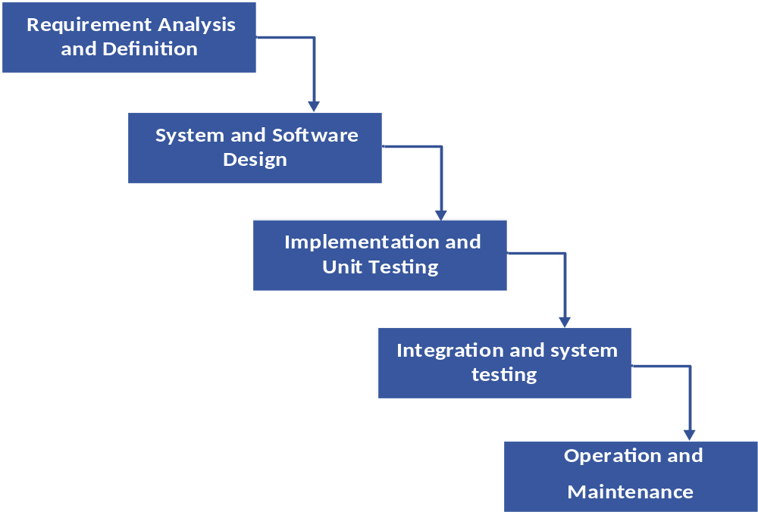
WATER FALL MODEL

Slide 6
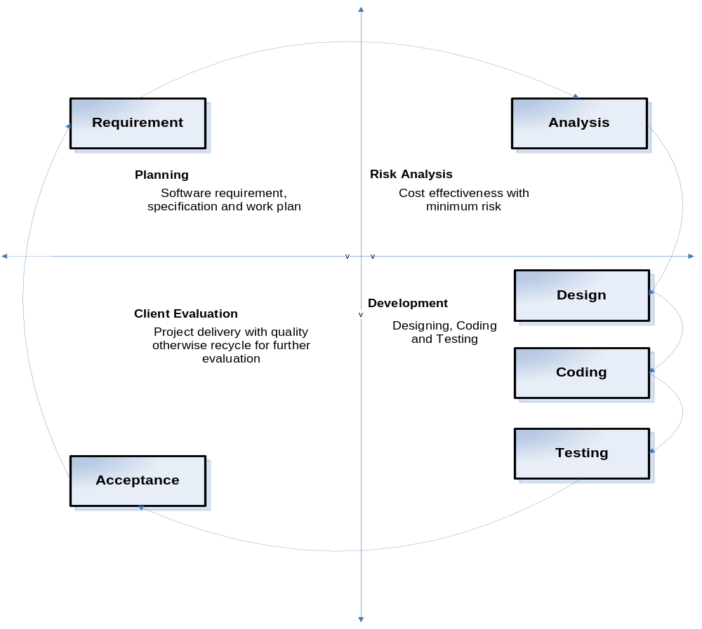
VU PROCESS MODEL

Slide 7
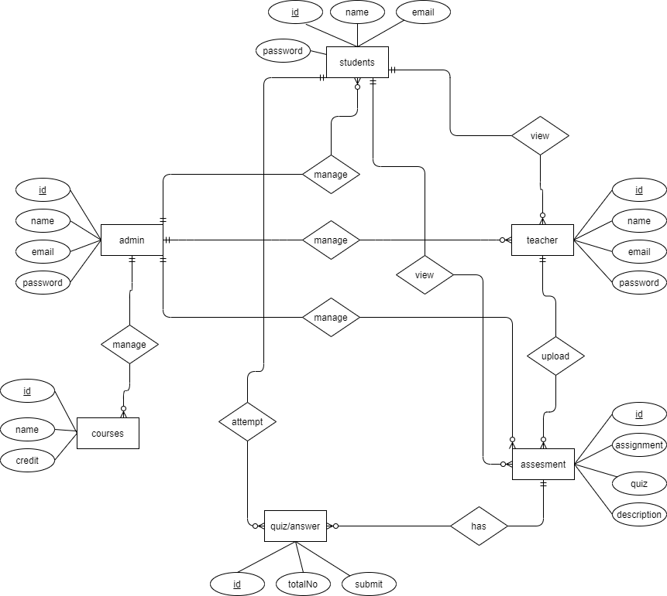
ERD DIAGRAM

Slide 8
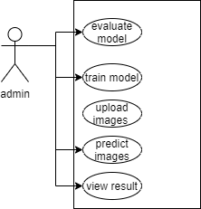
Use Case Diagram:

Slide 9
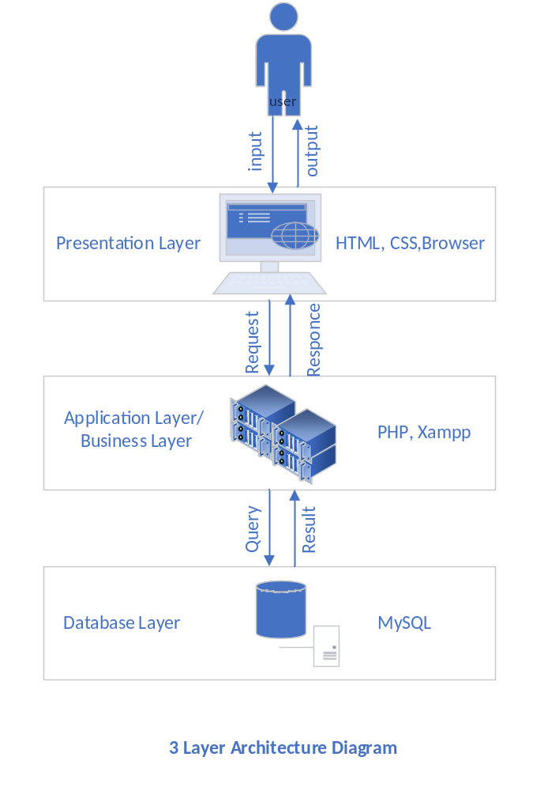
Architectural Design:

Slide 10
Project Schedule:

Slide 11
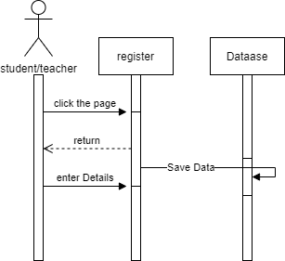
Sequence Diagrams:

Slide 12
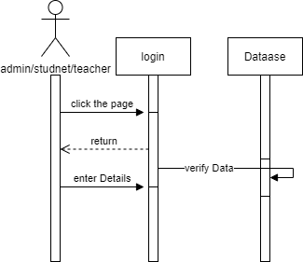
Login

Slide 13
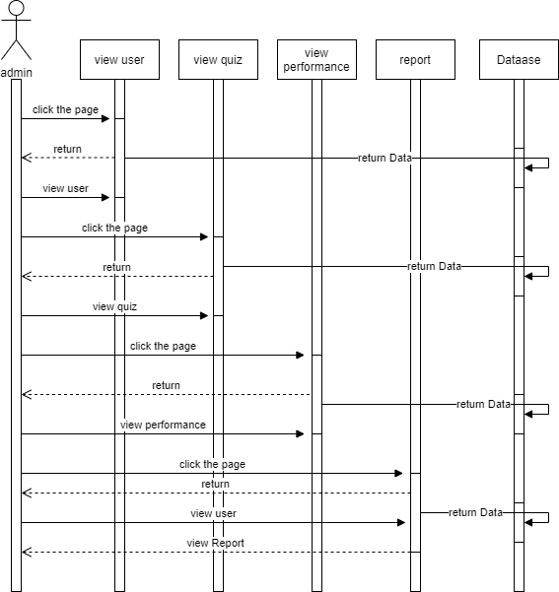
Admin Pannel

Slide 14
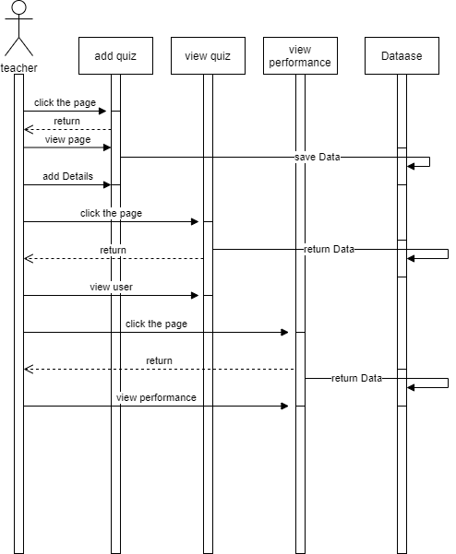

Slide 15
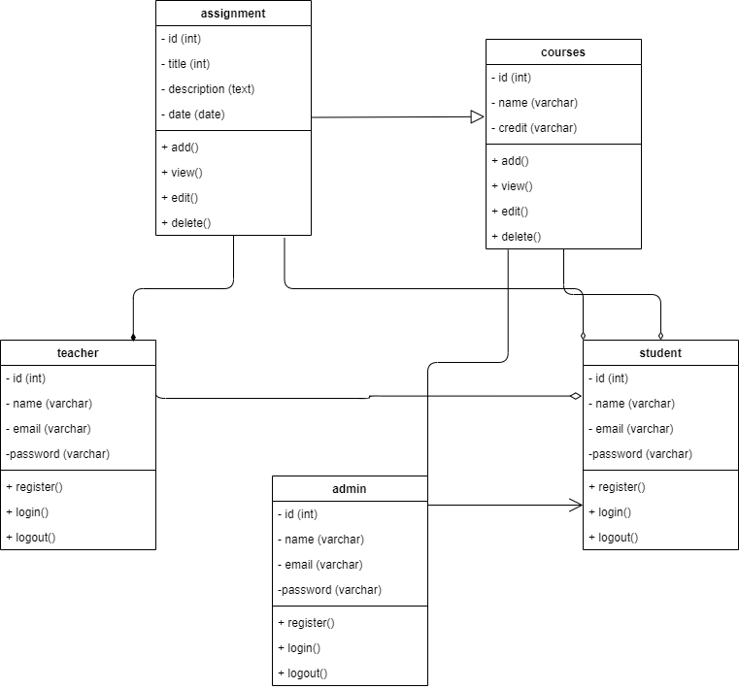
Class Diagram

Slide 16
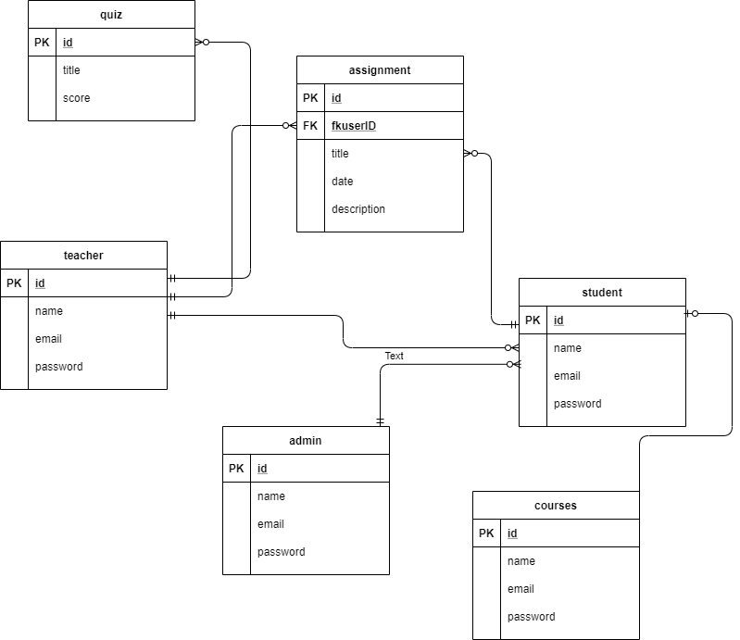
Database Diagram:

Slide 17
PROJECT TOOLS
HTML
CSS
BOOTSTRAP
PHP
MYSQL

Slide 18
THANK YOU SIR!

