Slide 1


Slide 2

Kidicode

Slide 3
Group Members Introduction
Name: AYESHA BIBI, AYESHA
Student ID: BC190410098,BC210403598
Group ID: S25PROJECT44E74

Slide 4

INTRODUCTION OF PROJECT
Kidicode is a web-based Learning Management System (LMS) designed to provide engaging STEM and AI coding courses for kids in Pakistan. The platform offers interactive online and in-person learning experiences, enabling students to learn, track progress, and earn achievements. It also includes dedicated portals for admins, instructors, students, and parents, along with features like course management, gamification, and secure payment integration.

Slide 5
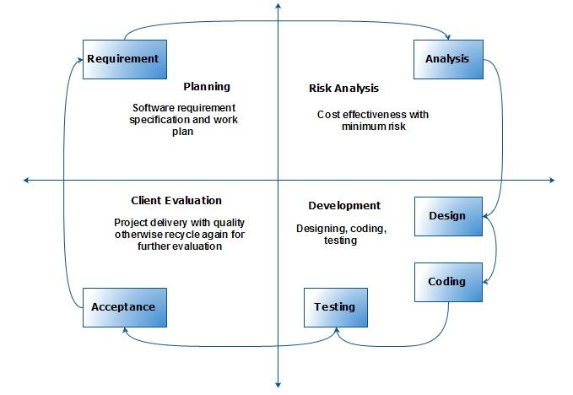
VU Process diagram

Slide 6
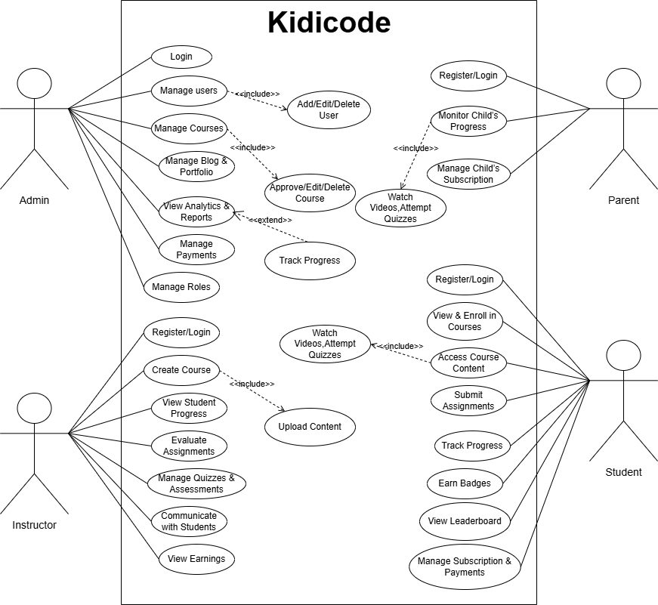
Use Case Diagram

Slide 7
Business Rules Catalog
User Roles & Authentication
1. Admin Panel: Manage content, users, and analytics.
2. Instructor Dashboard: Upload courses, monitor student progress.
3. Student Dashboard: Access courses, track progress, complete assignments.
4. Parent Portal: Monitor child’s learning progress.
5. User Authentication: Sign-up/login via email, phone, or social media.
Course Management & Interactive Learning Features
1. Course Creation & Management: Create, edit, delete courses; assign difficulty levels (Beginner, Intermediate, Advanced).
2. Quizzes & Assessments: MCQs, coding challenges, and subjective questions.
3. Gamification: Points, badges, and leaderboards for engagement.
4. SCORM/xAPI Integration: Ensure compatibility for tracking learning experiences.

Slide 8
Business Rules Catalog
Payment & Subscription
1. Free & Paid Courses
2. Subscription Plans: Monthly/Yearly access.
3. Payment Gateway Integration
Company Portfolio & Blog
1. Showcase training programs, achievements, and student success stories.
2. Provide an overview of the LMS and its functionalities.

Slide 9
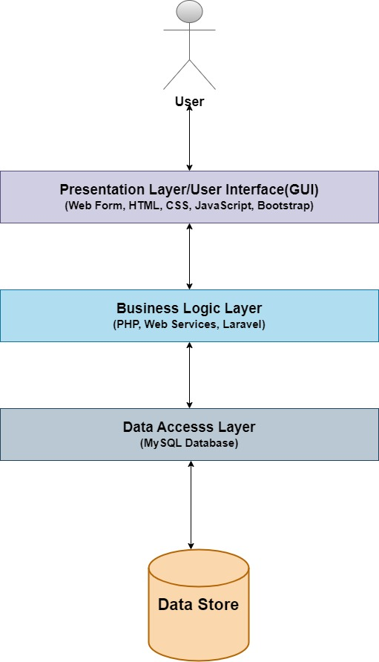
Architectural Design

Slide 10
Team Structure
My teammate and I worked together on this project.

Slide 11
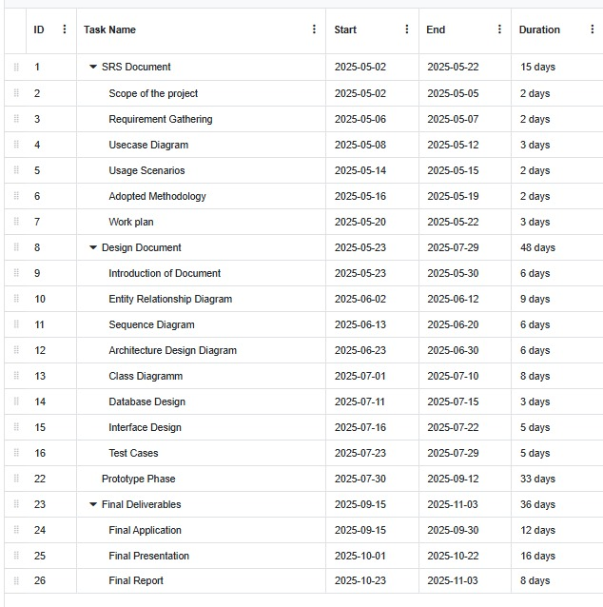
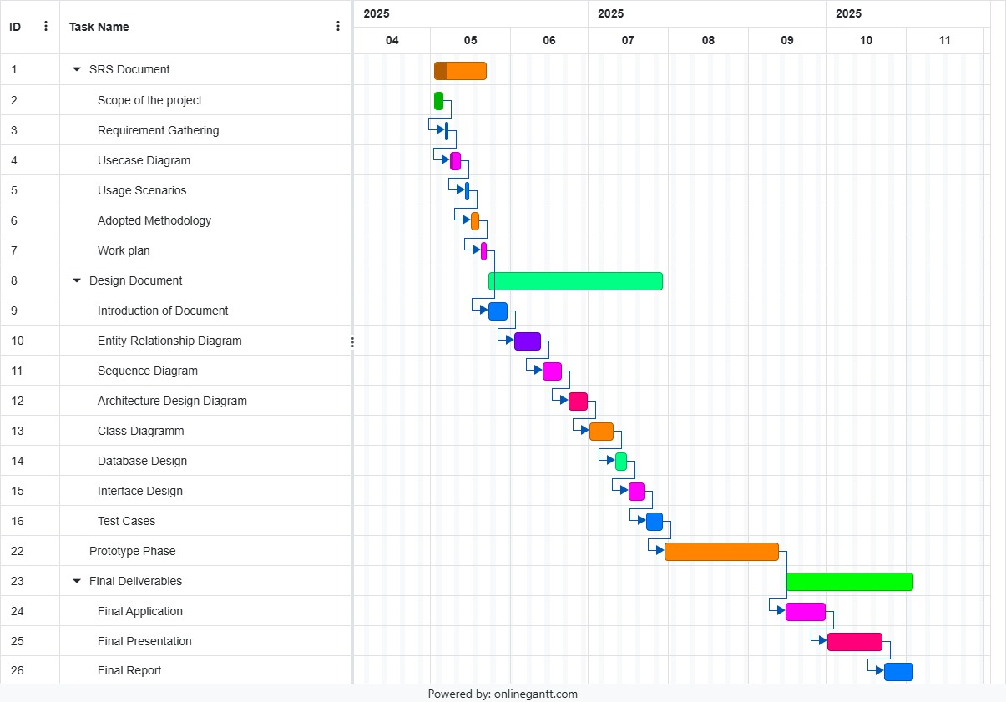
Project Schedule

Slide 12
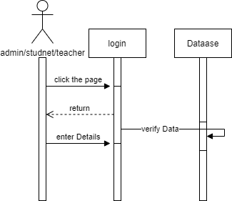
Sequence Diagrams

Slide 13
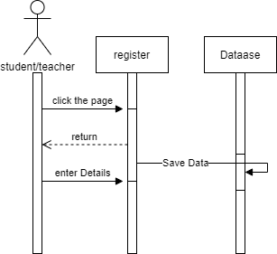
Sequence Diagrams

Slide 14
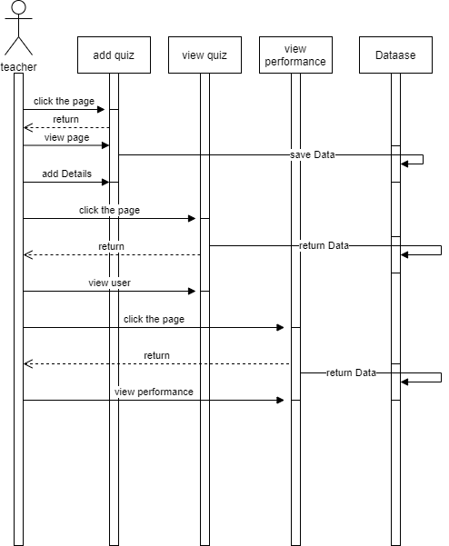
Sequence Diagrams

Slide 15
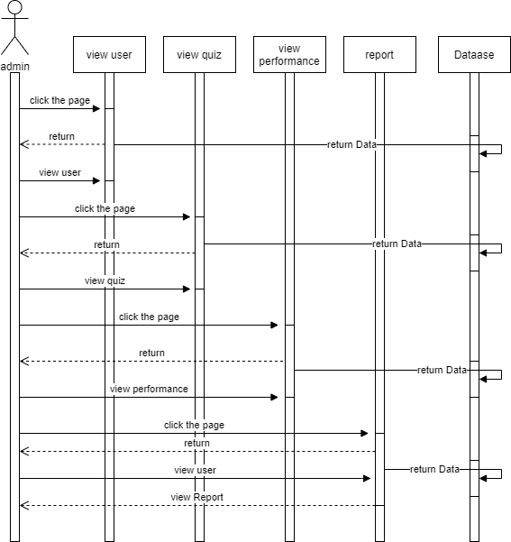
Sequence Diagrams

Slide 16
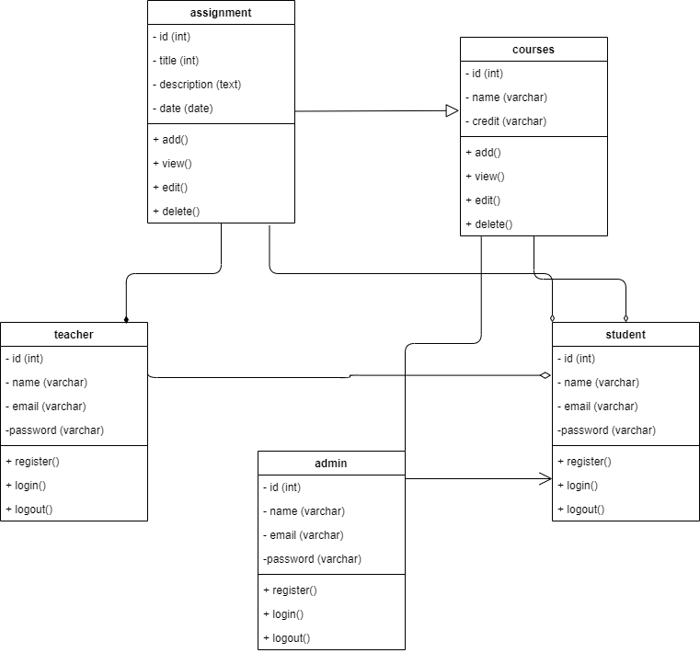
Logical Model/Class Diagram

Slide 17
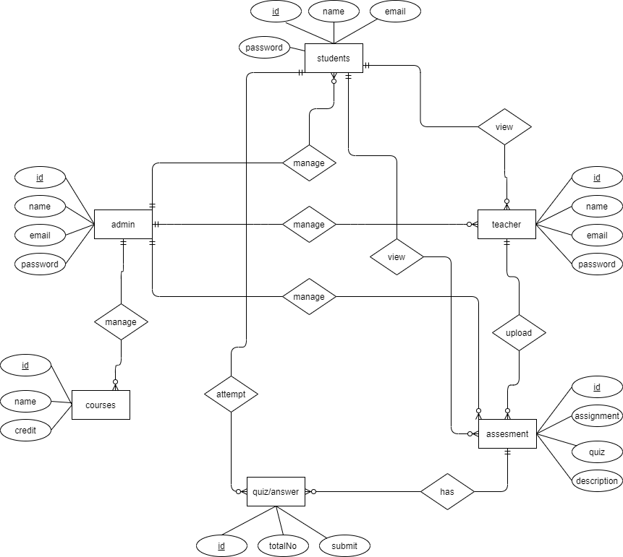
Entity-Relationship Diagram

Slide 18
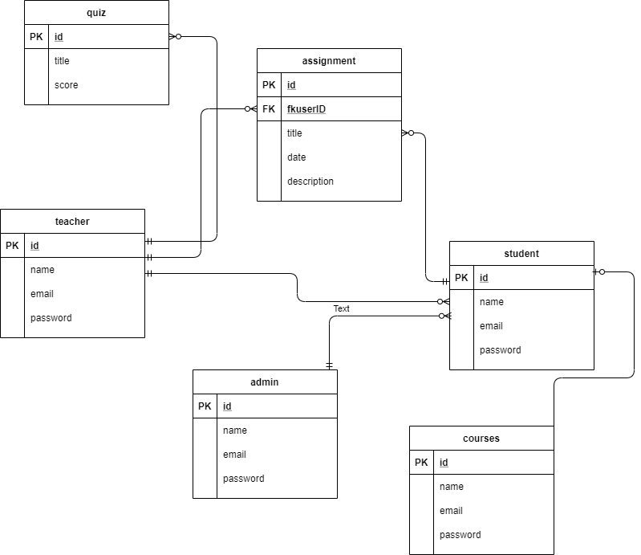
Database Diagram

Slide 19
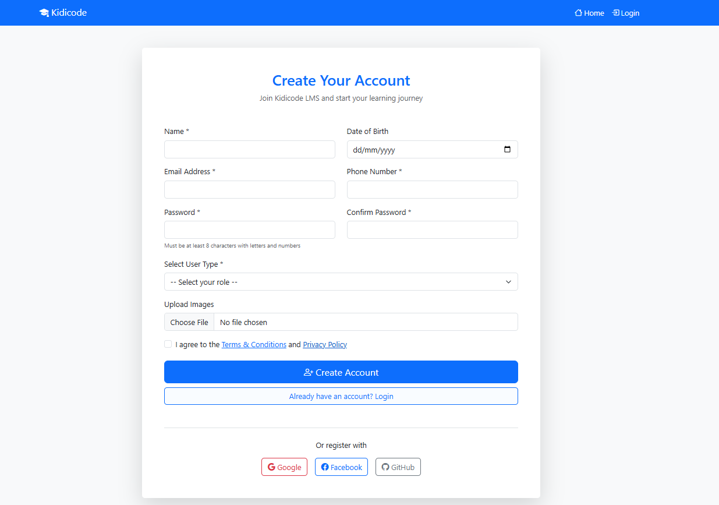
User Interfaces

Slide 20
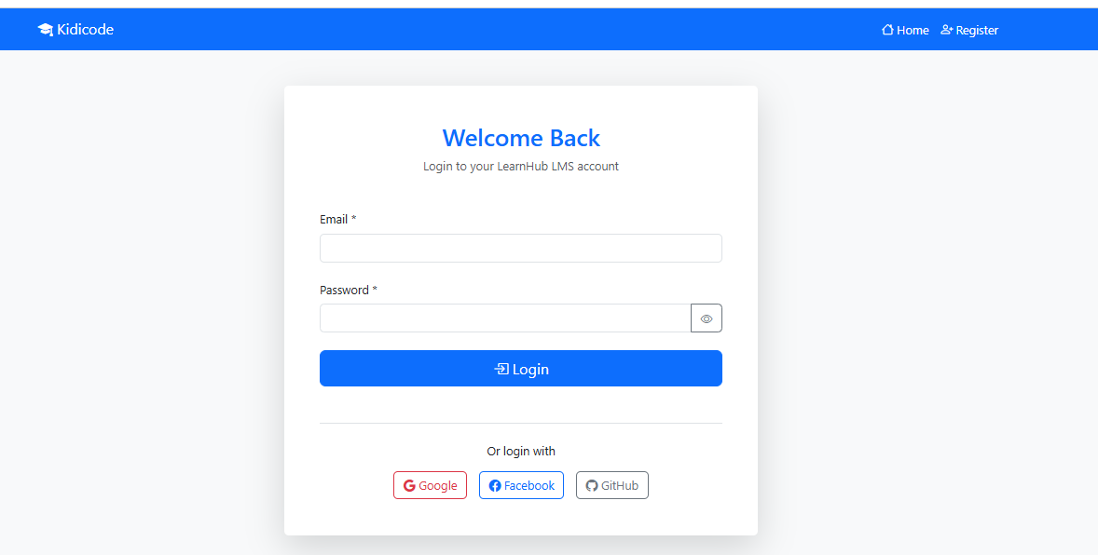
User Interfaces

Slide 21
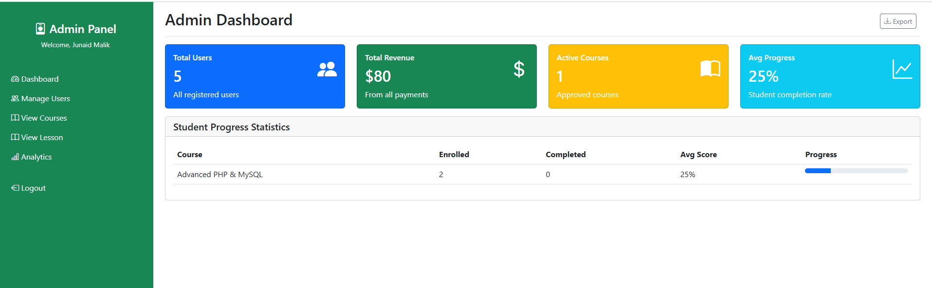
User Interfaces

Slide 22
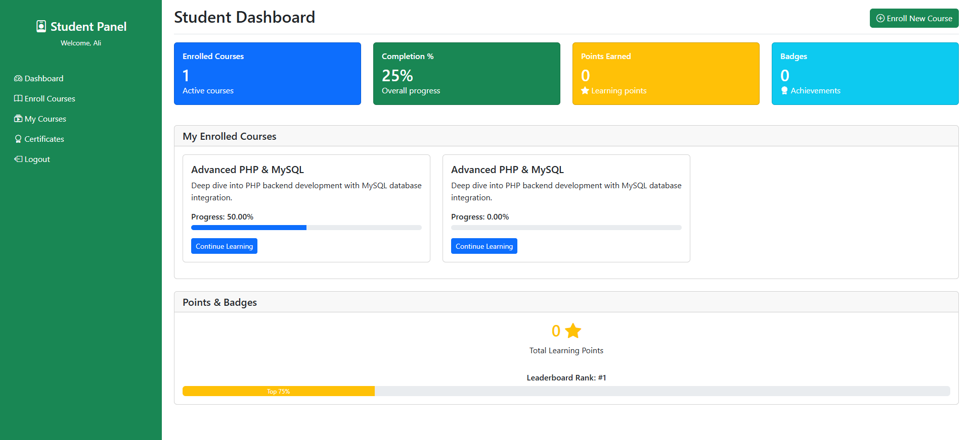
User Interfaces

Slide 23
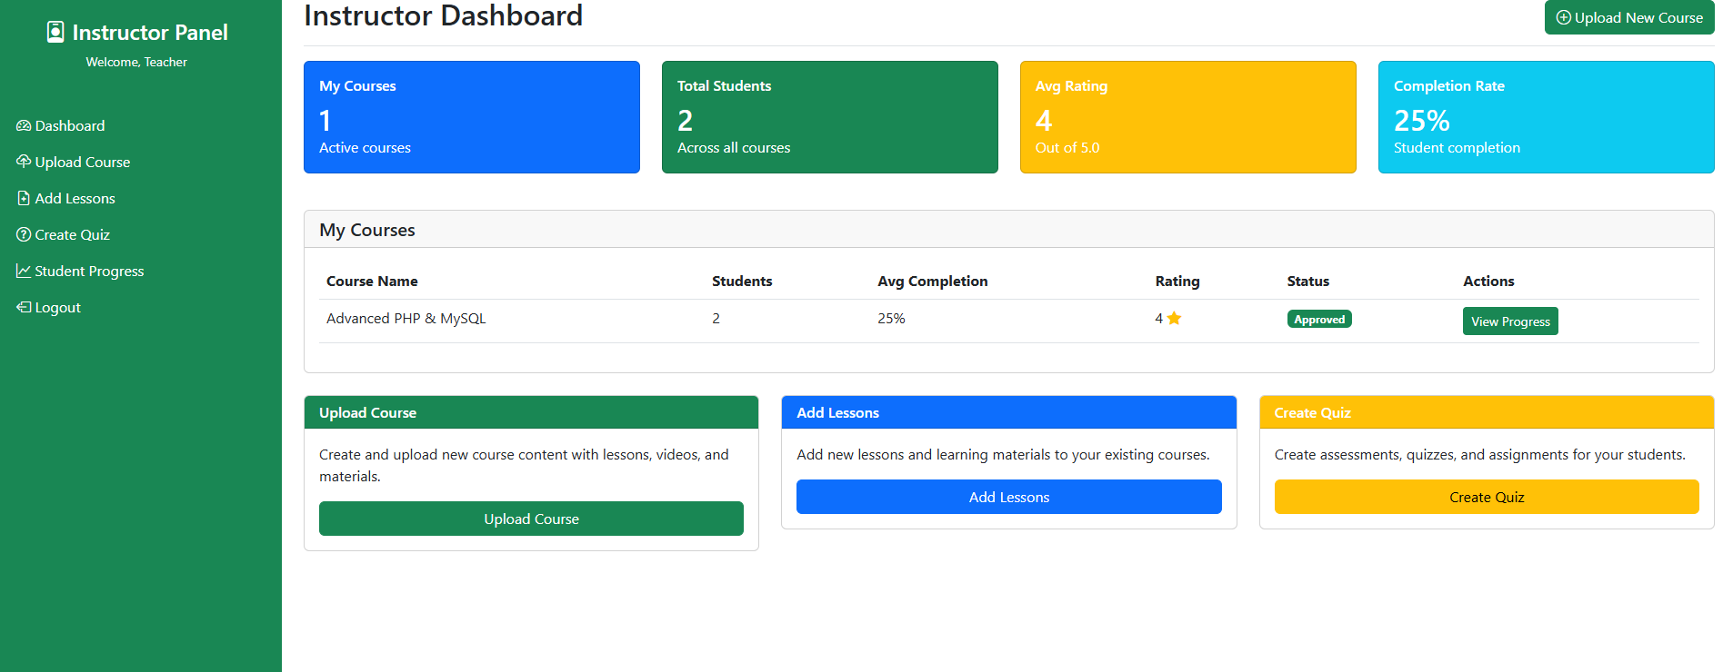
User Interfaces

Slide 24
Tools
Xampp
Sublime
MySQL
HTML, CSS, Bootstrap, JavaScript
PHP

