Slide 1


Slide 2

Food Waste Reduction System
Computer Science
CS519
Associate Degree Program (ADP)

Slide 3
Introduction
NAME: Hassan Zahid
STUDENT ID: BC220403459
GROUP ID: S240265DF4

Slide 4

INTRODUCTION OF PROJECT
Food waste is a significant global challenge, contributing to environmental degradation and economic inefficiency. To address this, a Food Waste Reduction System (FWRS) is proposed.
Following are the functionalities of the system:
User Profile: A user can create his profile on this system which he will use in future to login to system. He can manage his profile in future
Inventory Management: User can add items to inventory by providing basic information of item like name, expiry date, quantity and storage location. User can also manage the inventory afterwards, i.e, he can edit or delete the item from inventory.
Expiry Reminders: When any item is going to expire in coming three (3) days, expiry reminder button will start to shake. On clicking that button, a modal showing details of item will popup. This will help user to utilize item before expiry date.

Slide 5
Storage Tips: For effective and prolonged storage of food item, system has option for storage tips. User can consult these to learn more. Moreover, there is also an option for Storage Tip of the Day to engage user.
Food Suggestions: While creating user profile, a user can tell system about his dietary preference & allergy details which are then used to suggest user recipes. Available inventory is also considered for this purpose.
Search Recipe: If user wants to add anything other than his daily food preferences, he can. For this purpose, system has an option to search through all the available recipes irrespective of user’s dietary preference and allergy history.
User Feedback: Feedback is very valuable motivation to keep improving. So the system also provide user with the facility of giving his worthy feedback on either recipe suggestion or storage tip or overall experience. He can rate anything he wants on a scale from 1 to 10 along with his feedback in form of text.

Slide 6
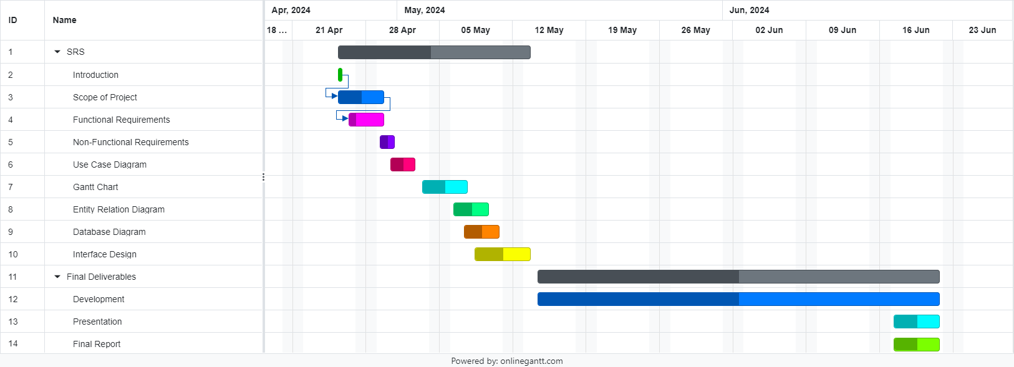
Project Schedule

Slide 7
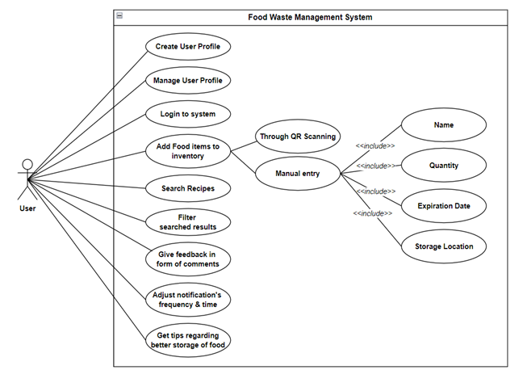
Use Case Diagram

Slide 8
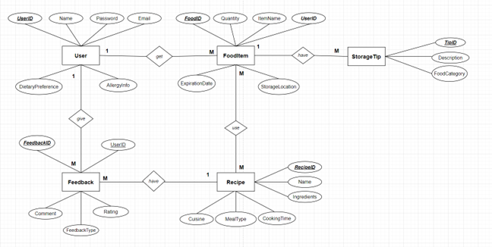
Entity-Relationship Diagram

Slide 9
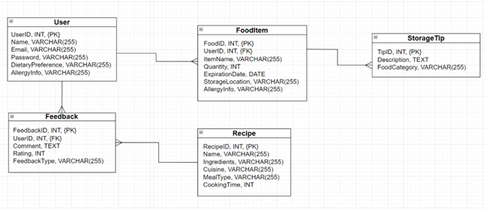
Relational Schema

Slide 10
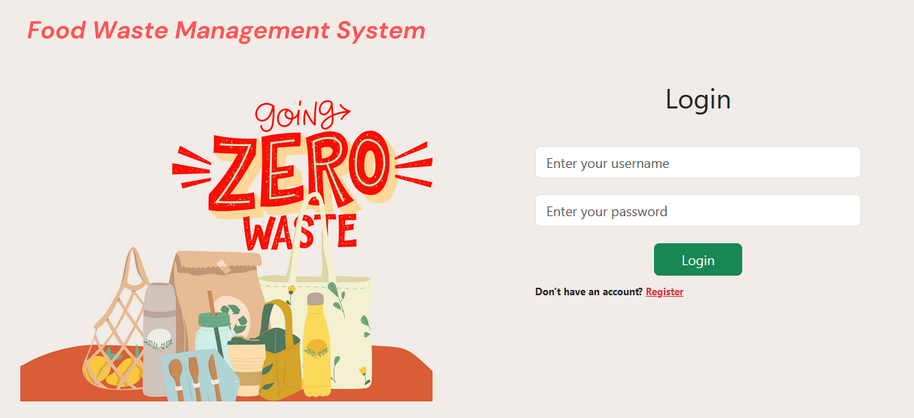
User Interfaces
1. Login Page

Slide 11
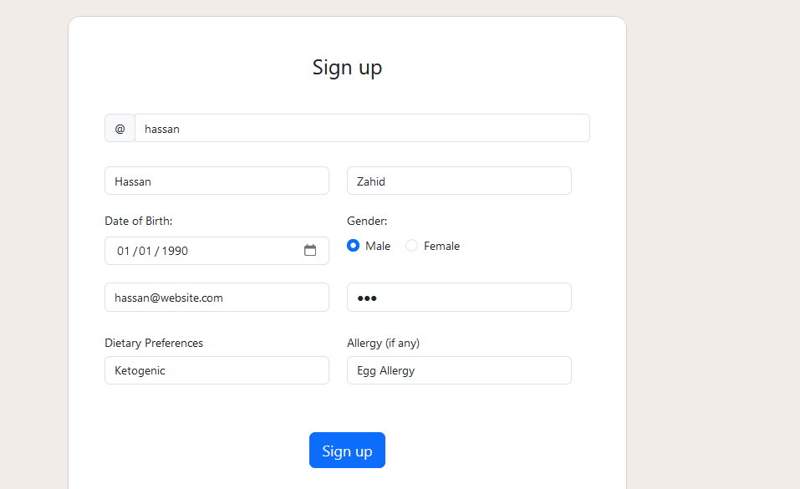
User Interfaces
2. Signup Page

Slide 12
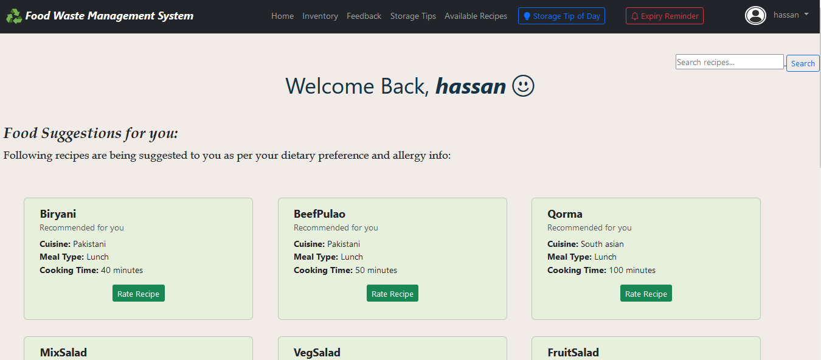
User Interfaces
3. Main Dashboard

Slide 13
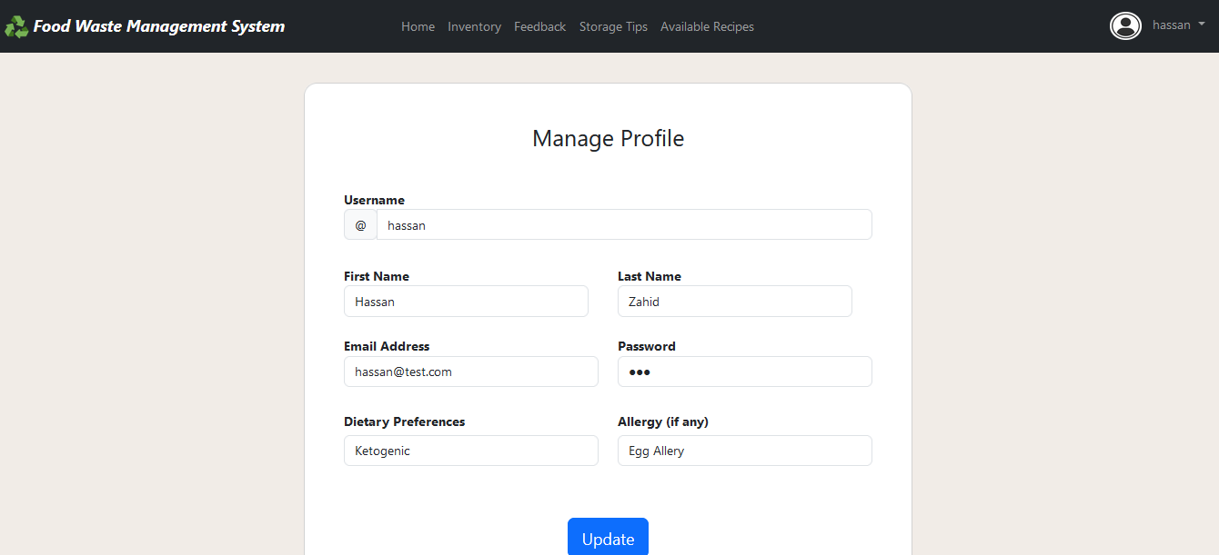
User Interfaces
4. Manage Profile Interface

Slide 14
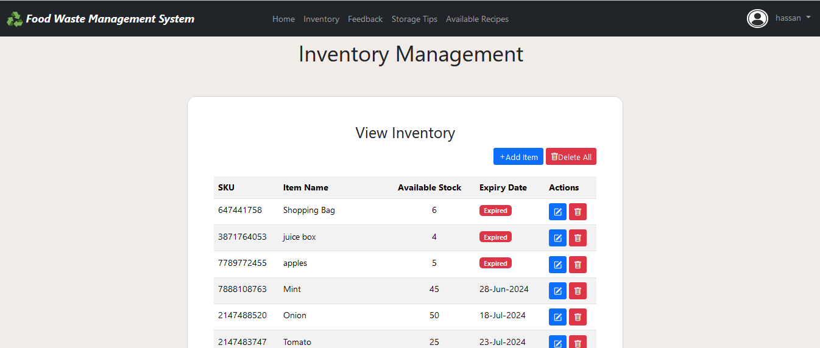
User Interfaces
5. Inventory Management Page

Slide 15
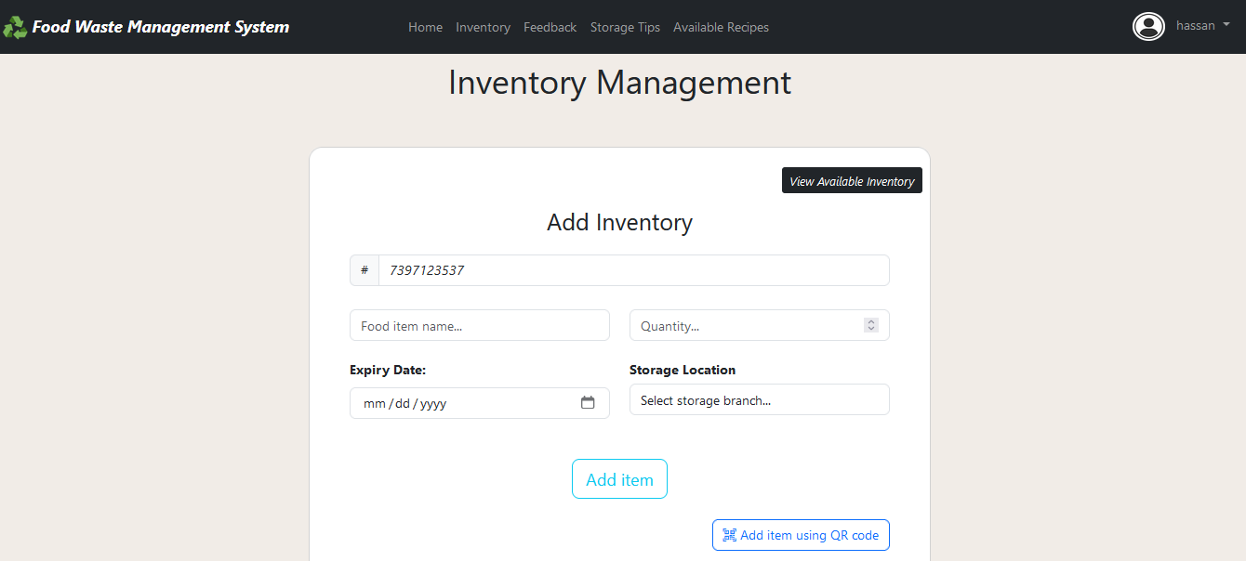
User Interfaces
6. Add Inventory Page

Slide 16
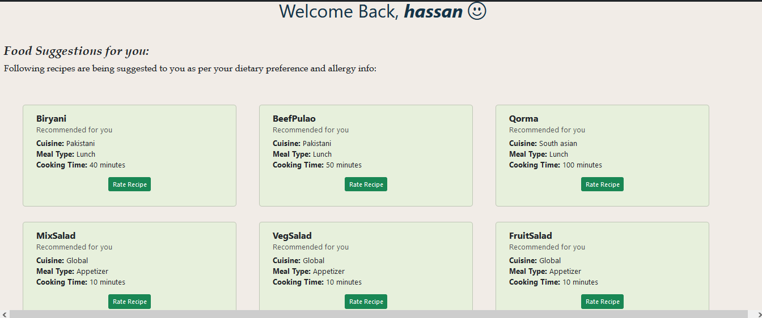
User Interfaces
7. Recipe Suggestions

Slide 17
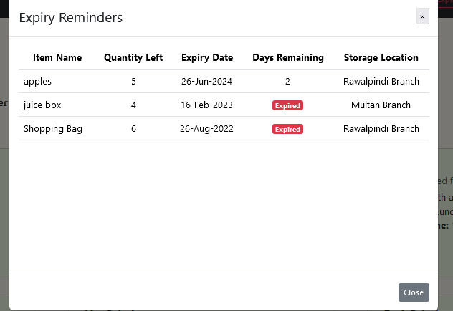
User Interfaces
8. Expiry Reminder Interface

Slide 18
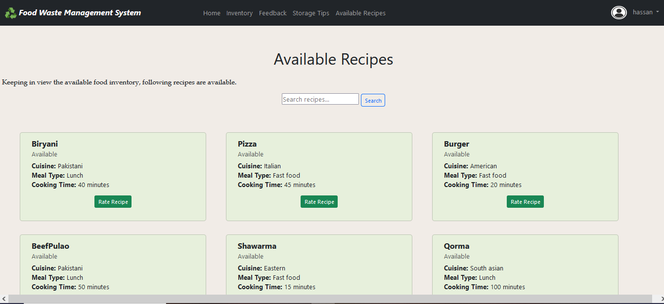
User Interfaces
9. Available Recipes Page

Slide 19
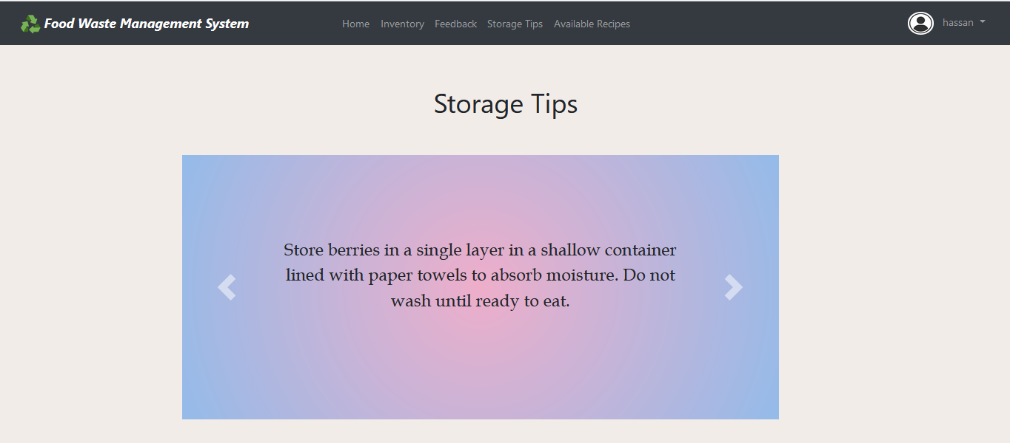
User Interfaces
10. Storage Tips Page

Slide 20
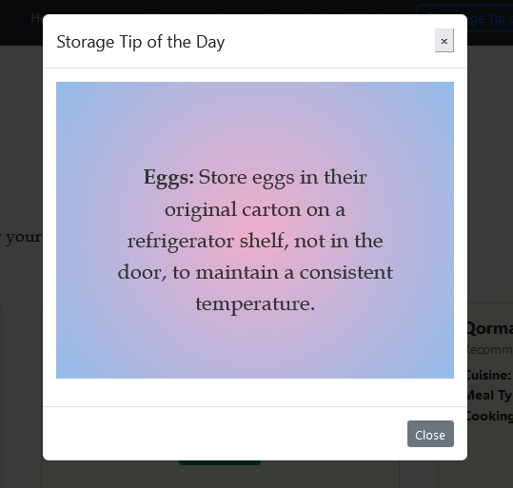
User Interfaces
11. Storage Tip of the day

Slide 21
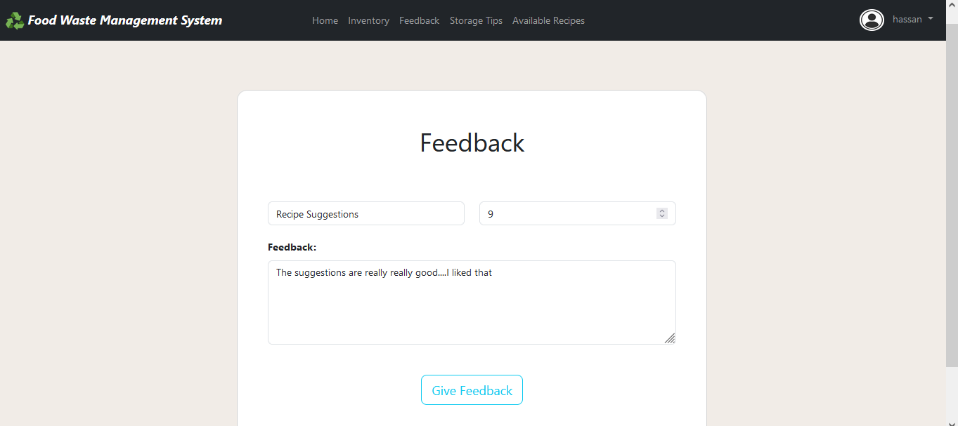
User Interfaces
12. Feedback Page

Slide 22
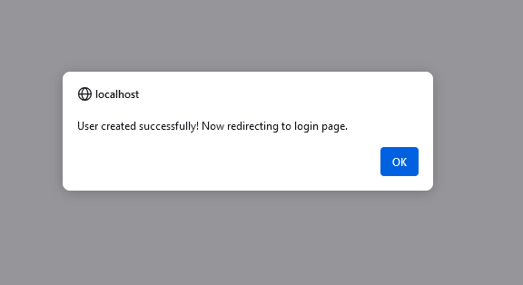
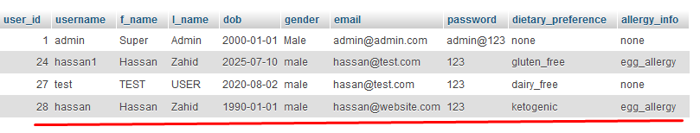
Results
User Sign up:
When I entered following details on Sign-up page and clicked Sign up, It added the record in database and confirmation alert showed.

Slide 23
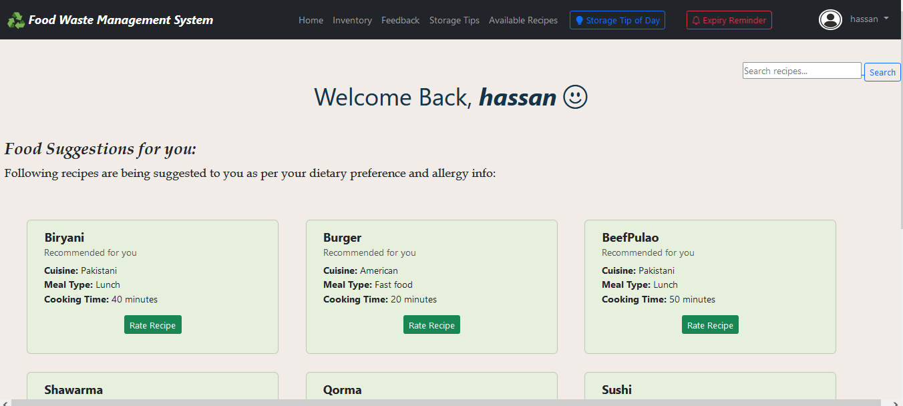
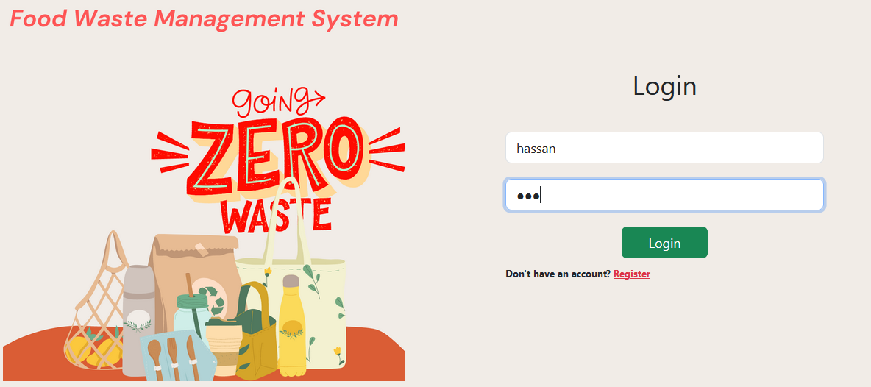
Results
User Sign in:
Now I used the username and password I registered last time login purpose. On hitting login button after entering data, it matched given data with records in database and logged in on finding matched record and redirected me to Main Dashboard Page

Slide 24
Results
My Dashboard:
My dashboard contains multiple links to other pages like Inventory, Tips, Available Recipes, Tip of the day, Expiry Date Reminder, Feedback, etc. All of these are connected with database and fetching data from there

Slide 25
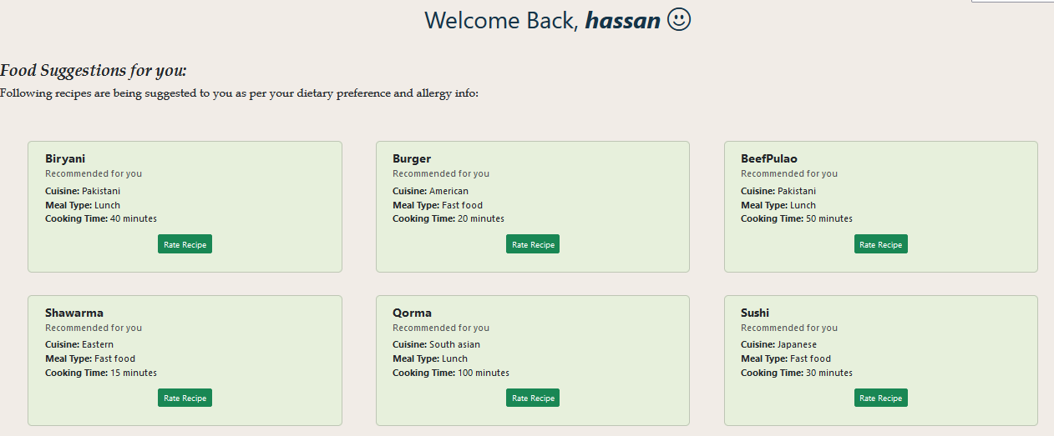
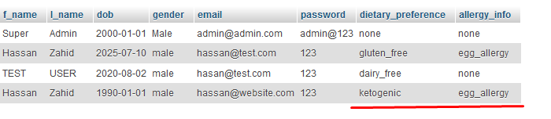
Results
Recipes Suggestions:
During Sign-up, I also entered my dietary preference and allergy information which was later saved in database. Now system will use that information and available inventory to suggest me recipes.
As I preferred ketogenic diet and I am allergic to eggs, it is excluding all recipes having eggs or non-keto ingredients

Slide 26
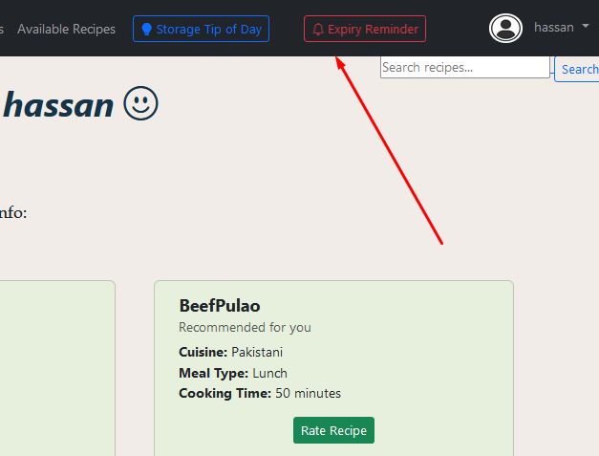
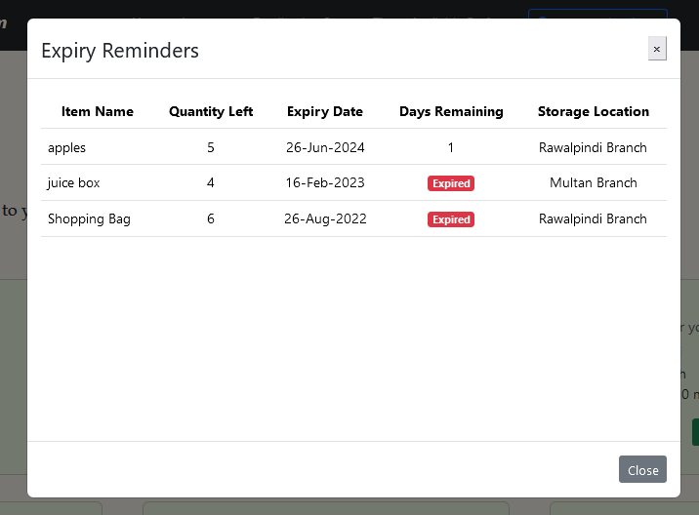
Results
Expiry Reminder Button:
On the main dashboard one can see two buttons in navigation bar, one of them is in red color and is for reminders for those items whose expiry dates are approaching in coming three (3) days. On clicking it fetches the data of items from database and also number of days in their expiry. It shows the status of item Expired if expiry date has passed.

Slide 27
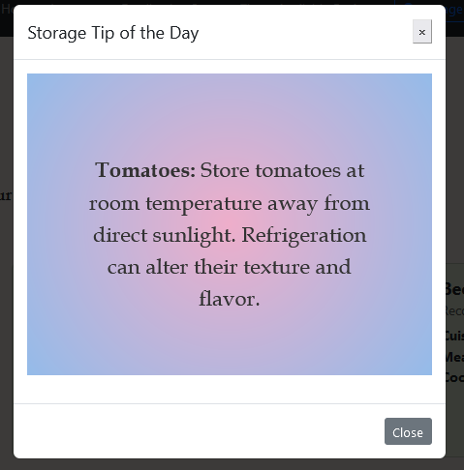
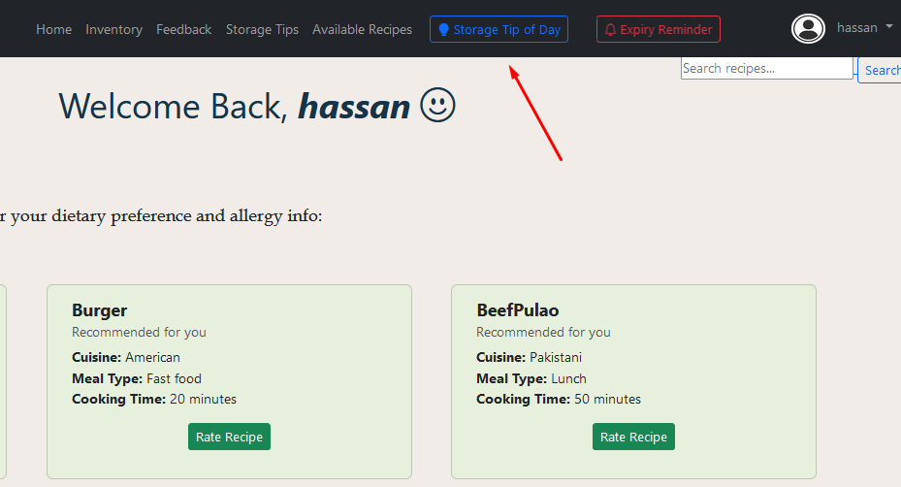
Results
Storage Tip of the Day Button:
The other button on navbar is for Storage Tip of the day. Which shows one (1) random tip on click regarding better storage method of food item to prolong freshness.

Slide 28
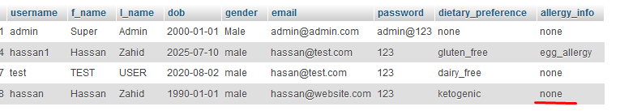
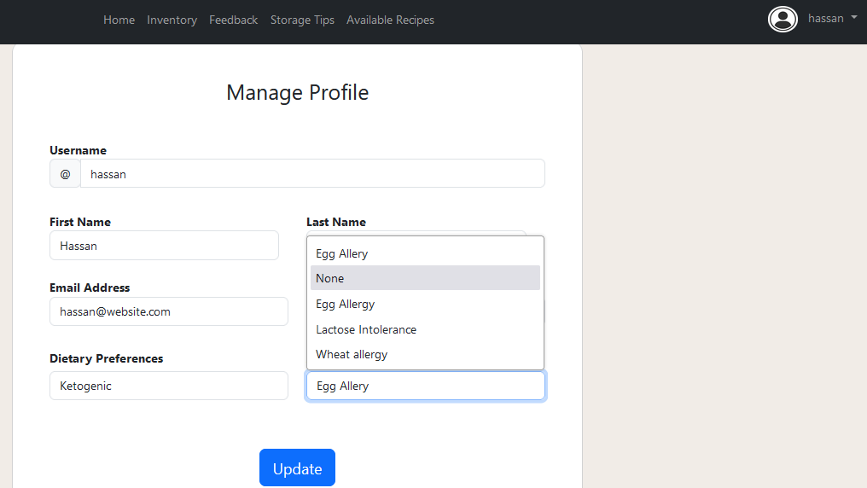
Results
Manage User Profile:
After creating profile, a user can change his personal information through Update Profile UI which he can find under dropdown below his name and user avatar image. Like, here I changed the allergy information to none and it updated record on database.

Slide 29
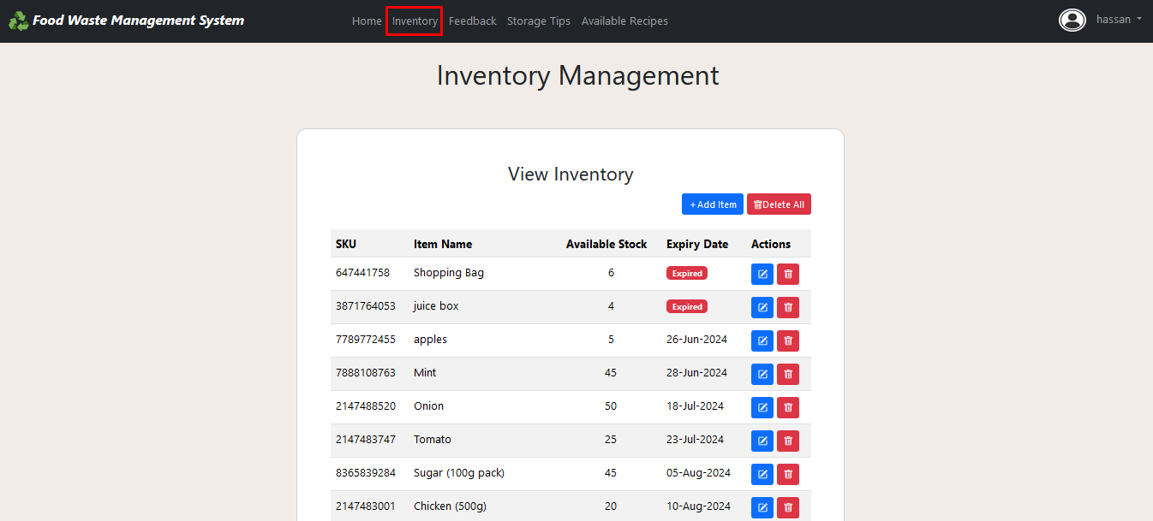
Results
Inventory Management:
Link to Inventory page can be found in navbar. It has all the data of food inventory items and their basic details like expiry dates, SKU (Stock Keeping Unit), name & quantity. User can Update or Delete any inventory. He also has the facility to Delete All at once.

Slide 30
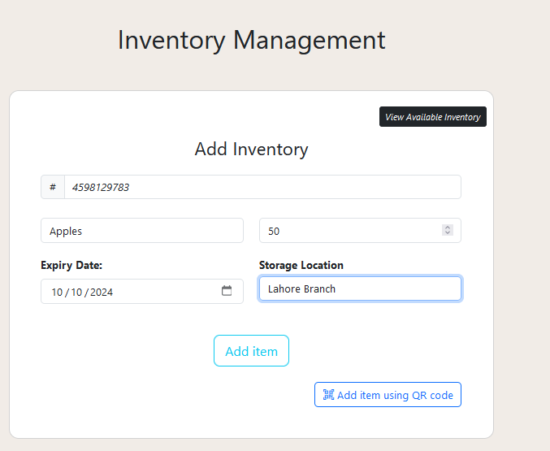

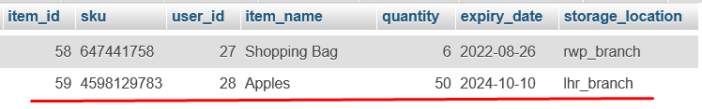
Results
Add Inventory:
A user can easily enter any item to inventory. He has to click on +Add Item. Below interface will show up. Just enter basic details like name, expiry date, storage location & quantity and hit add button. Item will be added to DB. (SKU is auto-generated through function)

Slide 31
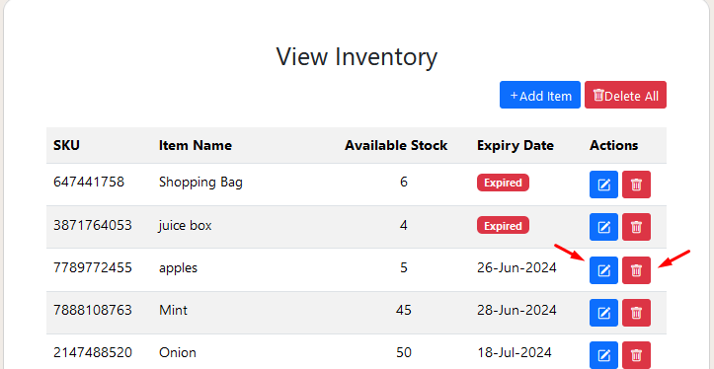
Results
Update/Delete Inventory:
A user can delete or update inventory item once added to database by using action buttons. Even a user can delete every food item in inventory just by clicking Delete All button. Once clicked, It will ask for confirmation of user and deletes all records once user confirms.

Slide 32
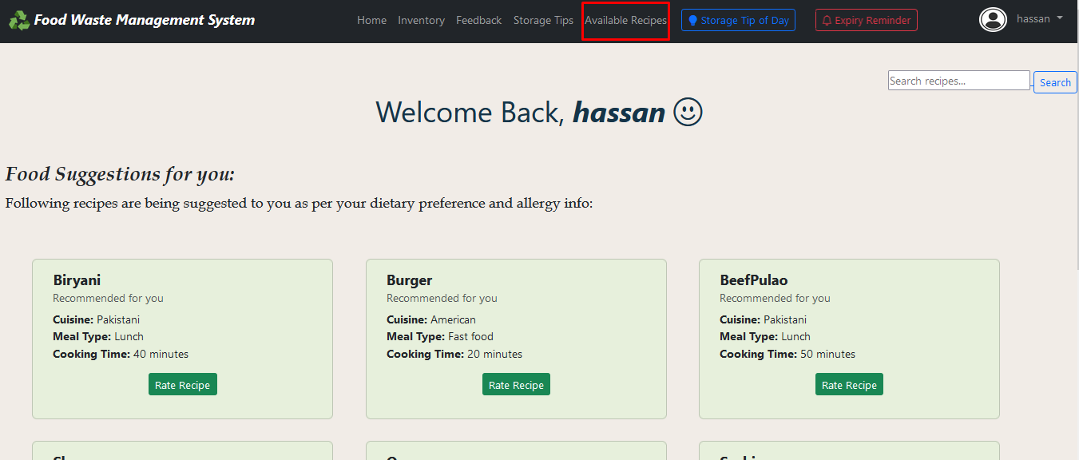
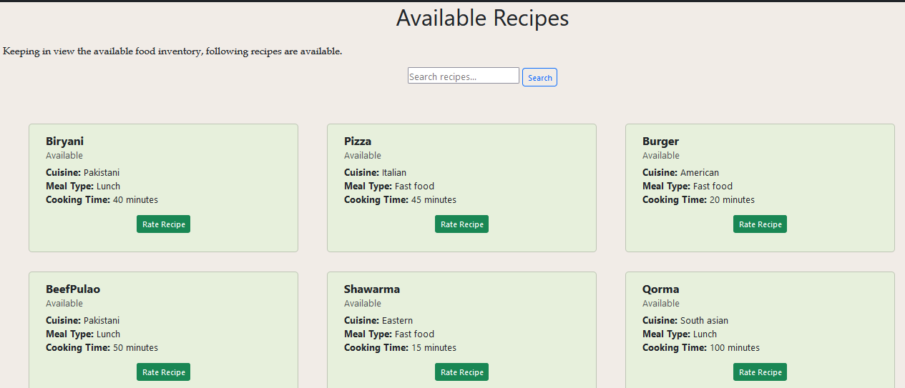
Results
View all recipes:
Although system suggests user recipes based on his dietary preferences, allergy details and available fresh ingredients but if anyhow user wants to explore other recipes then his daily diet, he can do this by explore Available Recipes Page. This page will show him all the available recipes irrespective of any dietary preference or allergy details. He can also Rate the Recipes

Slide 33
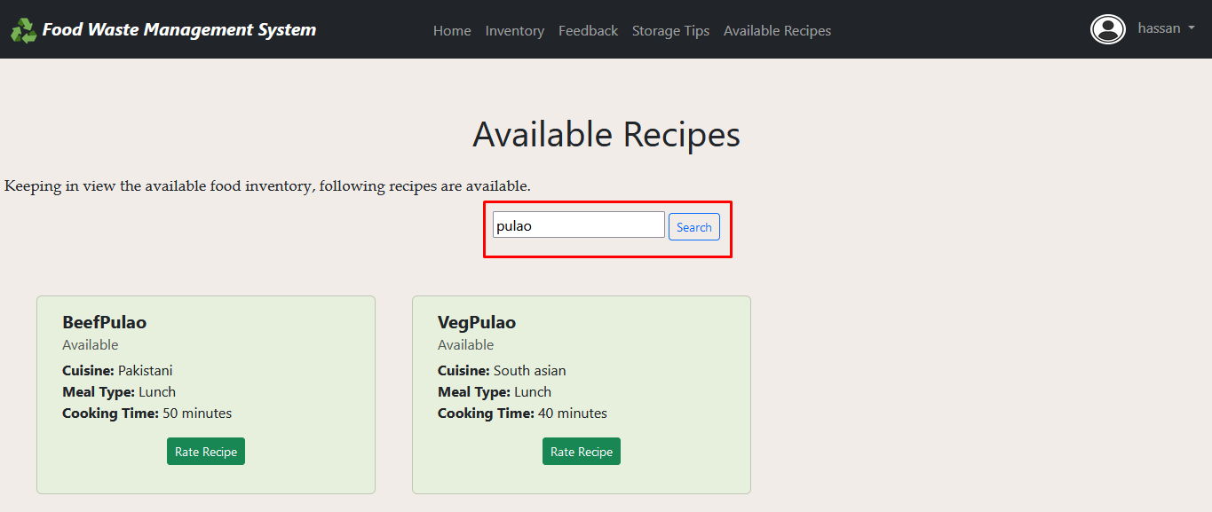
Results
Search through available recipes:
If the user is in hurry or hungry and wants to find the recipes he wants to try quickly, he can search through all the available recipes to see if that exists. He can do this by simply entering desired recipe in Search box and hitting search button.

Slide 34
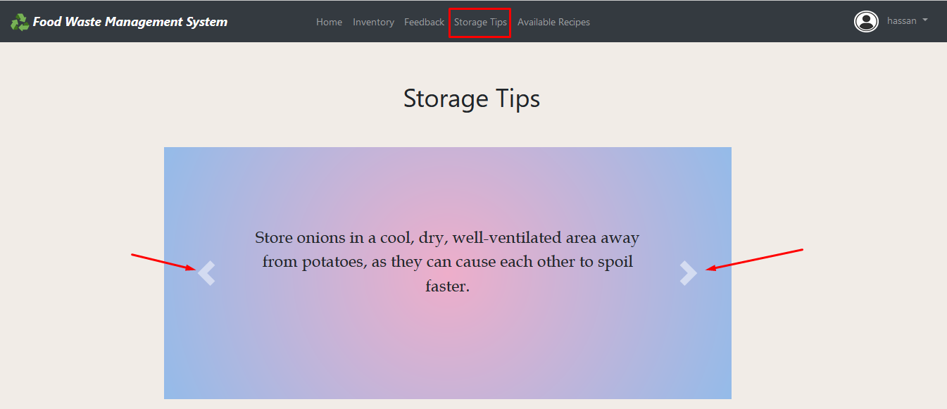
Results
View all the storage tips:
As we have discussed before the Storage Tip of the day button. Now if a user is curious to learn about more storage tips, he can go on Storage Tips page from navigation bar and go through all the available storage tips which are getting fetched from database. When the help of previous and next button, he can go through all the tips easily.

Slide 35
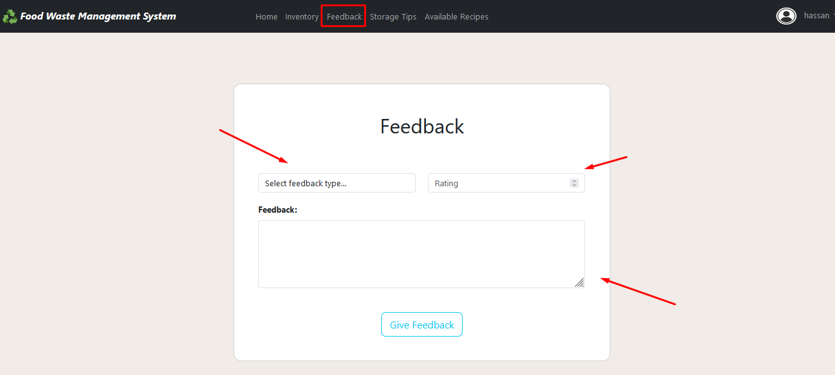
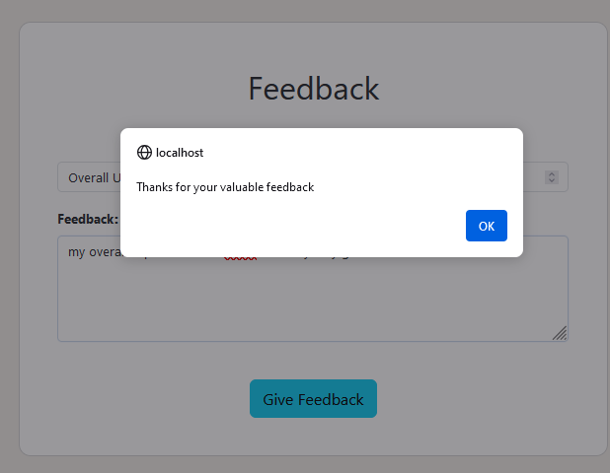
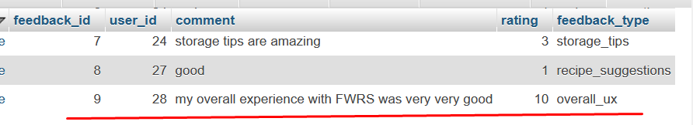
Results
User Feedback:
Now, In the end If user wants to give feedback about his experience with system, he can do so by going on Feedback Page and write his feedback in form of text, give rating on range of 0 to 10 with category he wants to give suggestion for. This feedback will be stored in database along with that user’s ID.

Slide 36
Tools
Front-end: HTML, CSS, Javascript, Bootstrap
Back-end: PHP
Database: MySQL
IDE: Visual Studio Code
Browser: Firefox
Local Server: XAMPP

Slide 37
Thank you

