Slide 1
Introduction to R: A Computational Workbench for Biological Data Analysis
Brian Capaldo
Office of Research Core Administration University of Virginia
bc2zb@virginia.edu
CYTO 2017

Slide 2
R, not just before S but also after (History of R)
The R programming language has its roots in S, a language created forty years ago at ATT Bell Labs by Chambers, Becker and Wilks.
The motivation for S was to simplify the task of calling statistical routines written in FORTRAN (this involved writing code to read in, format and write out the data).
The goal of S was to free users of the drudgery of writing that interface code and speed up the data analyst’s workflow. The key linguistic design principle was to design a language that could be extended and that was devoid of arbitrary limitations.
The S language was such a success that users started writing statistical routines in S.
The R programming language was designed by Ross Ihaka and Robert Gentleman at the University of Auckland around 1992.
R departed from S in number of ways, it was an open source language released under a GPL license to ensure that everything related to R remains in the public domain, R cleaned up some corners of S and improve the performance of programs written in the language.

Slide 3
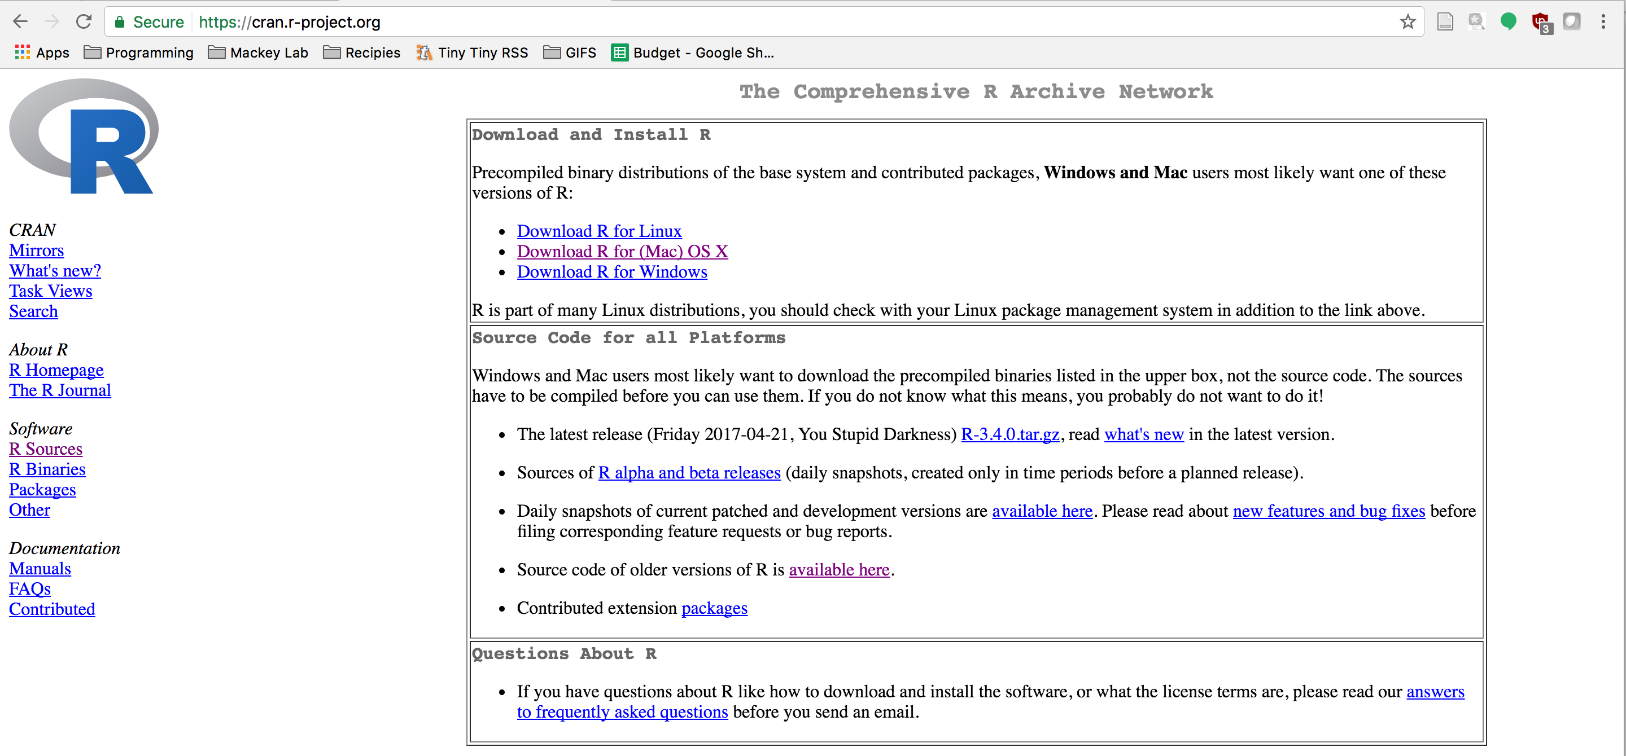
Installing R

Slide 4
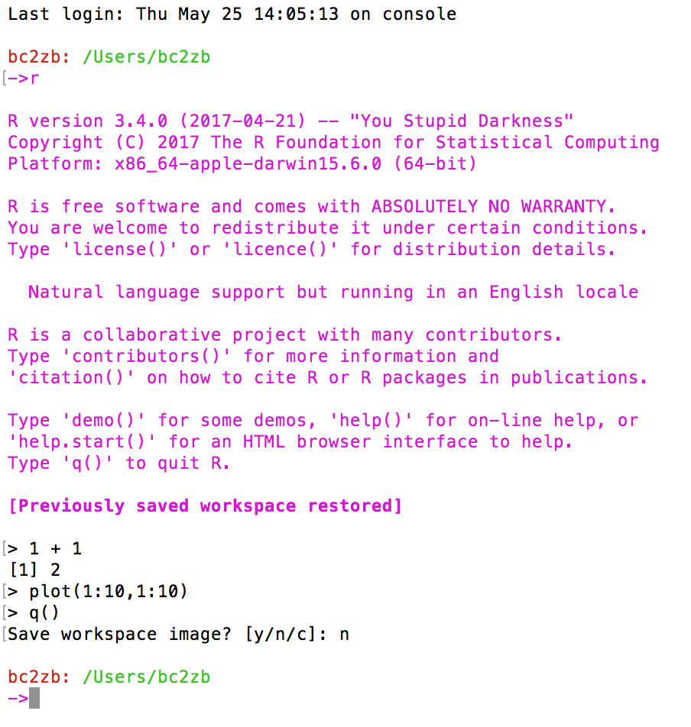
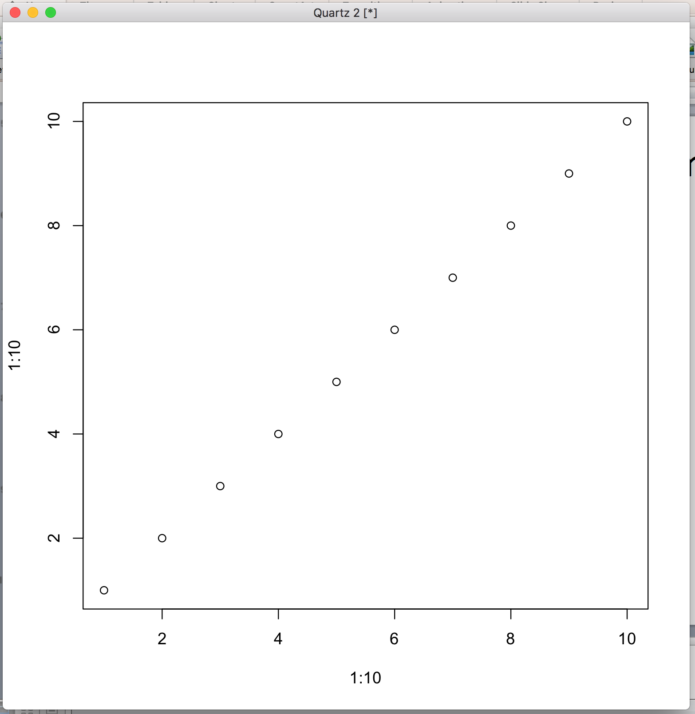
R on the terminal

Slide 5
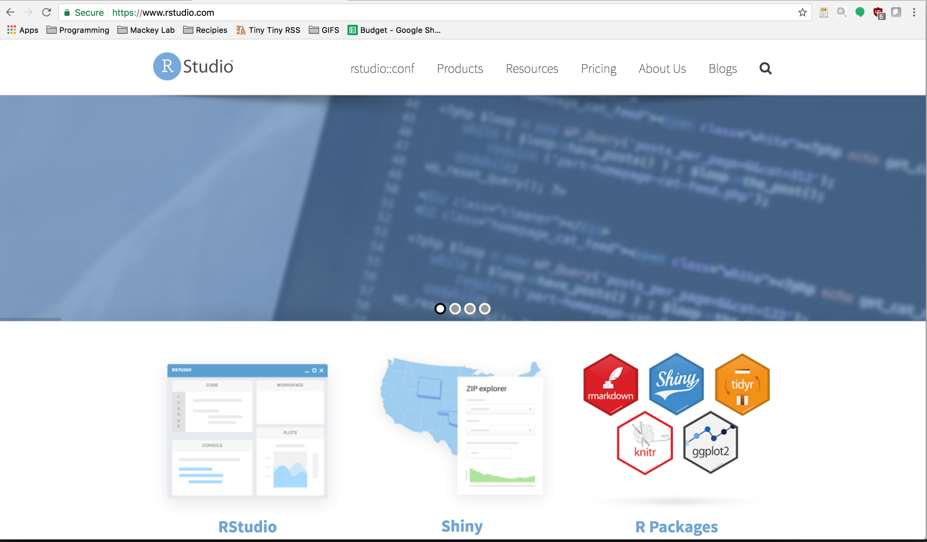
RStudio

Slide 6
R as a computational bench top
Data as experiments
Data structures as glassware
Functions as instruments
Vignettes as protocols

Slide 7
Bioconductor
http://bioconductor.org/help/course-materials/
If libraries are instruments, repositories (bioconductor/CRAN) are the vendors

Slide 8
Goals
Overview of R and Bioconductor
Installing R
Installing libraries in R
Installing Bioconductor libraries in R
Introduction to cytometry packages available in Bioconductor
Introduction to cytometry packages not available in Bioconductor
Basics of fcs file manipulation in R
The power of Bioconductor vignettes
Using a vignette to analyze your own data
Stringing vignettes together to create your own analysis pipelines
Further resources to explore
CyTOF Forum
Bioconductor mailing list
Github, sourceforge, reddit discussion boards
Conclusions/Discussion

