Slide 1
Machine Learning for Image Denoising
Brandon Cann

Slide 2
Overview
Project Goal:
Research into existing Invertible Neural Networks for image denoising
Compatibility with different noise types
What parts of an image are most important for features to be learnt

Slide 3
Background
Importance:
Imaging is used in many fields including medical imaging, military, forensics etc.
Noise can corrupt key parts of an image.
The two architectures in this project, WINNET (Wavelet Inspired Invertible Neural Network) and RWNN (Recursive Wavelet Neural Network) have only been trained and tested with Additive Gaussian Noise – in the real world, noise is made up of many other types/combinations.

Slide 4
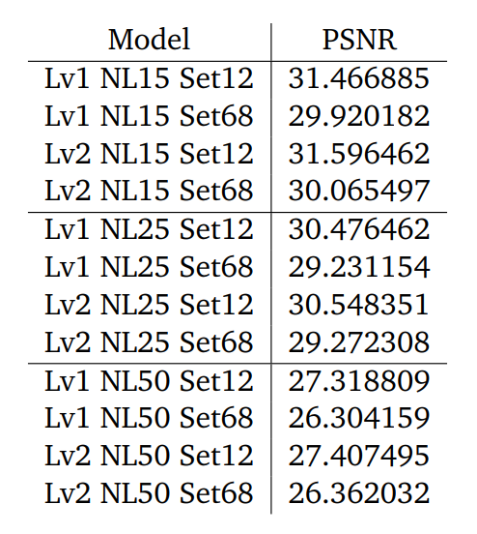
Initial Testing
WINNET:
Testing of all pretrained models.
Serves as a baseline for comparison with new models to be trained.
Lower noise levels have better performance.
Level 2 models generally perform better.

Slide 5
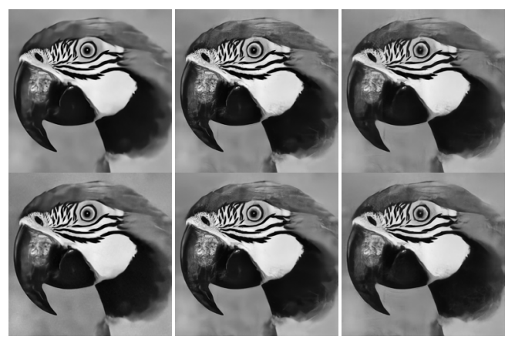
Initial Testing
Level 1
Level 2
Noise level 15
Noise level 25
Noise level 50

Slide 6

Initial Testing
RWNN:
Testing of all pretrained models.
Serves as a baseline for comparison with new models to be trained.
Similar performance to WINNET noise level 25.

Slide 7

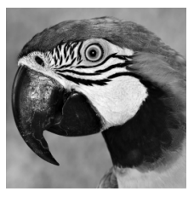
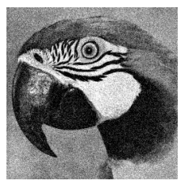
Noise Types
Additive Gaussian Noise:
Normal distribution with mean 0 and variance equal to the noise level/255.
Original
Additive Gaussian Noise

Slide 8
Noise Types
Conflated Gaussian Noise:
Combination of Additive Gaussian Noise and Conflation Noise.
Normal distribution with mean 0 and variance equal to the noise level/255.
Concatenated two normal distributions with noise level 15 and 50 and shuffling together to produce the Conflation Noise.
Type 1 Conflated Gaussian Noise: Additive Gaussian Noise + Conflation Noise.
Type 2 Conflated Gaussian Noise: Additive Gaussian Noise + Salt and Pepper Noise.
Type 3 Conflated Gaussian Noise : Additive Gaussian Noise + Conflation Noise + Salt and Pepper Noise.

Slide 9
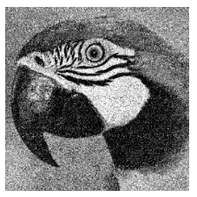
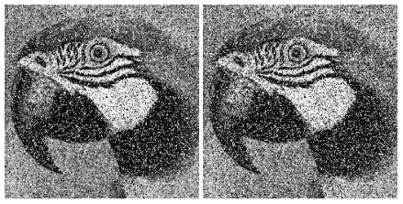
Noise Types
Conflated Gaussian Noise:
Original
Type 1
Type 2
Type 3

Slide 10

Noise Types
Salt and Pepper Noise:
Setting random pixels to black and white.
Thresholding set at 220.
Original
Salt and Pepper Noise

Slide 11


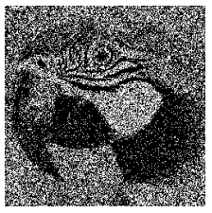
Noise Types
Poisson Noise:
Poisson distribution where
Default lambda of torch.poisson() used.
Only applied noise of all noise types.
Original
Poisson Noise

Slide 12
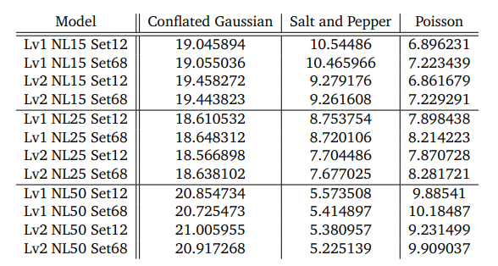
Results
WINNET:
Pretrained networks against new noise types.

Slide 13
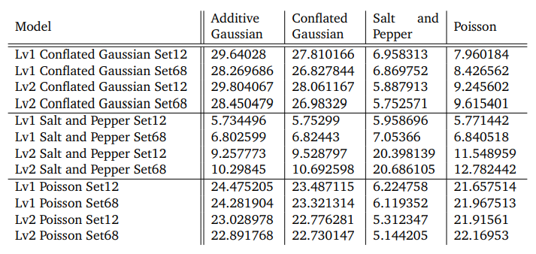
Results
WINNET:
Newly trained networks against noise types.

Slide 14
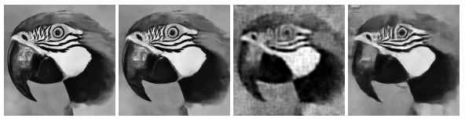
Results
WINNET:
Best performances for each noise type.
Original
Additive Gaussian
Conflated Gaussian
Salt and Pepper
Poisson

Slide 15
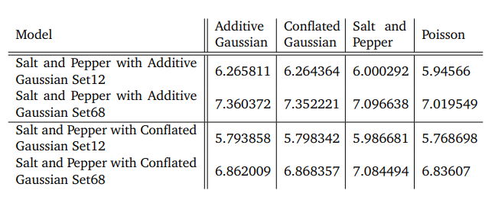
Results
WINNET:
Alternative Conflated Gaussian Noise trained networks against noise types.

Slide 16
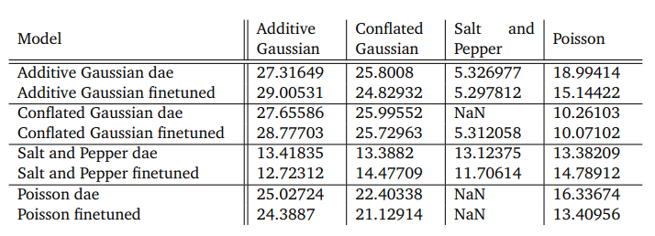
Results
RWNN:
Newly trained networks against noise types.

Slide 17

Results
RWNN:
Edge detection-based Gaussian Noise
mean of 0.
Variance proportional to the value of the image that has undergone edge detection with an offset of 1e-6.
Range of noise levels is set to 1e-6 and 100 for the initial Prewitt and Sobel filter edge detection algorithms.
An additional Prewitt model generated with double scaling on the variance.

Slide 18
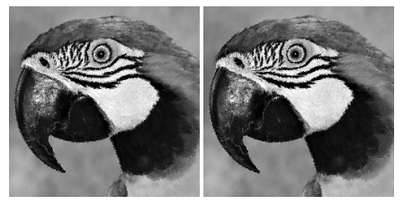

Results
RWNN:
Edge detection-based Gaussian Noise
Original
Prewitt
Prewitt with double scaling
Sobel

Slide 19
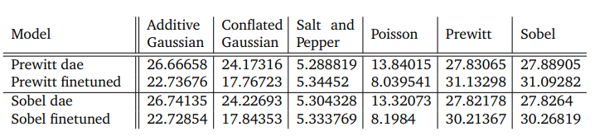
Results
RWNN:
Newly trained edge detection-based networks against noise types.

Slide 20
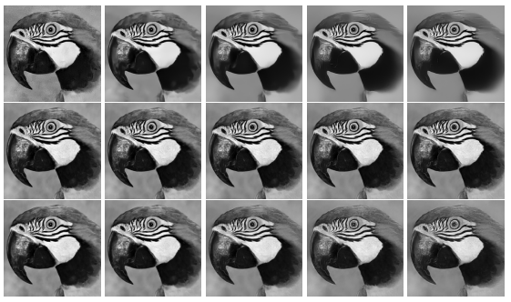
Results
RWNN:
Output of edge detection-based models with varying recursion levels.
Additive Gaussian
Prewitt
Prewitt with double scaling
K = 1
K = 2
K = 3
K = 4
K = 5

Slide 21
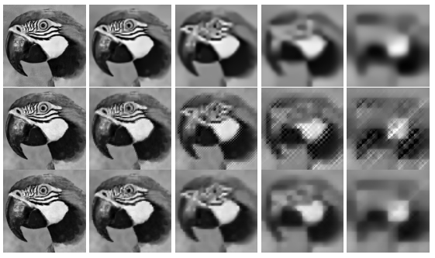
Results
RWNN:
Output of edge detection-based models with varying recursion levels.
Additive Gaussian
Prewitt
Prewitt with double scaling
K = 1
K = 2
K = 3
K = 4
K = 5

Slide 22
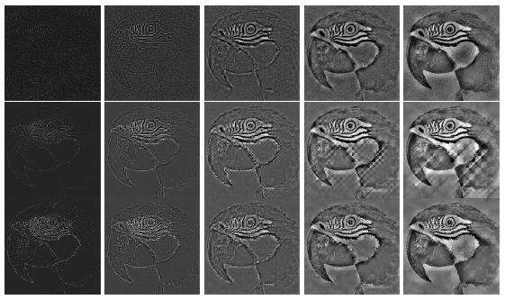
Results
RWNN:
Output of edge detection-based models with varying recursion levels.
Additive Gaussian
Prewitt
Prewitt with double scaling
K = 1
K = 2
K = 3
K = 4
K = 5

Slide 23
Conclusion
Conclusion of Results:
Compatibility with Gaussian-based noise types confirmed.
Salt and Pepper Noise was the main problem for both architectures.
Edges seem not to be as important for image reconstruction.
More research required to come to firm conclusions.

Slide 24
Conclusion
Limitations and Difficulties:
Training time.
Hardware availability.
Debugging of training models.

Slide 25
Conclusion
Future Work:
Training and testing of models
Higher level models, more noise types, varying noise levels, tuning of parameters, different datasets, other architectures.
Features:
Extending research on importance of edges with more noise scaling or different edge detection algorithms.
Feature invariances – features that remain unchanged after rotations/scaling of the image.

Slide 26
Questions

Slide 27
Initial Research
Research other similar architectures to help with understanding:
Convolutional Neural Networks:
Made up of multiple layers.
Each layer aims to learn new features – filters, padding, normalisation etc.
All brought together at the end using a fully connected layer.
Recurrent Neural Networks:
Stores states of previous inputs.
Used for sequential data/time series data.
Convolutional Invertible Neural Networks:
Made up of forward and backward pass.
Output must be same dimension as input so no fully connected layer.

Slide 28
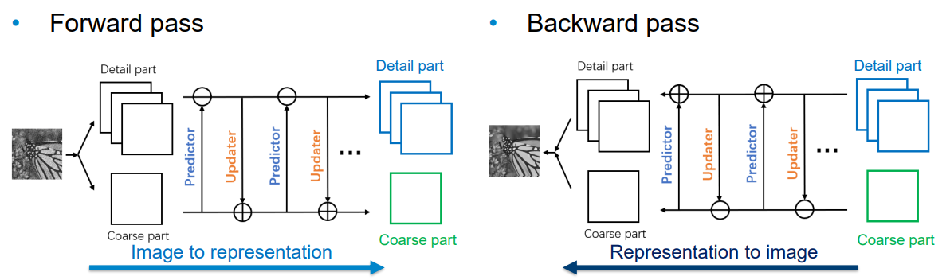
Initial Research
Lifting Inspired Invertible Neural Networks:
Consists of a split and merge operator.
Estimates and updates predictions of odd and even parts.

Slide 29
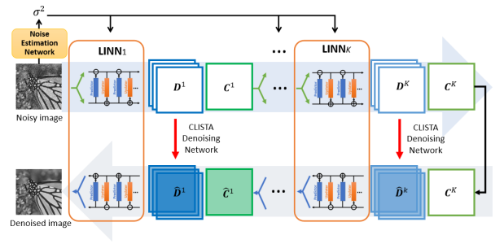
Initial Research
Wavelet Inspired Invertible Neural Network:
Uses K-level LINNs.
Predictions and updates only on coarse part of image – predictor replaced with a soft thresholding CNN.
A non-invertible denoising operation on the detail coefficients is used to achieve sparsity.

Slide 30
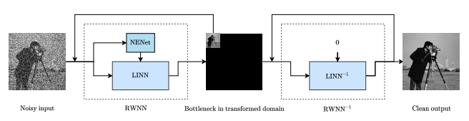
Initial Research
Recursive Wavelet Neural Network:
Similar to WINNET.
Incorporates aspects of a RNN.
Recursions to produce an image with smaller coarse parts in transformed domain.

Slide 31
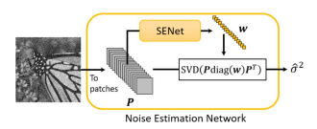
Initial Research
Noise Estimation Network:
Converts the image into patches.
Performs SVD on the weights acquired from the Selection Network.
Used to estimate variance of the noise.
PSNR is a method of comparison which compares pixels.

Slide 32
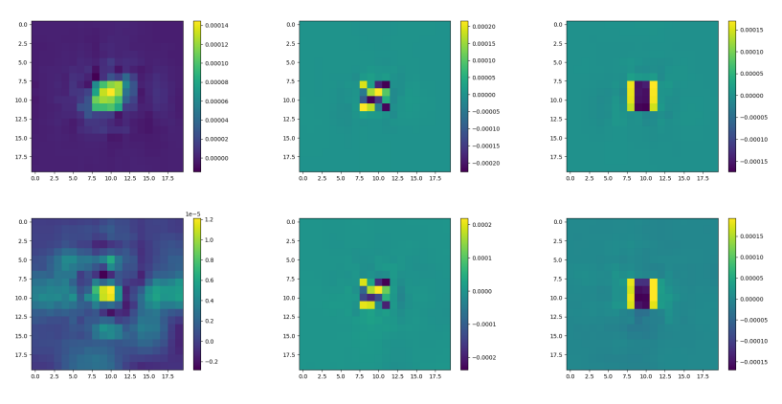
Initial Testing
WINNET:
Updated code to be compatible with Python 3.9.13.
Alteration of feature map to check understanding.
Level 1
Level 2
Coarse layer
Detail layer 4
Detail layer 5

Slide 33
Questions

