Slide 1




WORKSHOP PRESENTATION
Università degli Studi dell’Aquila
NFT + DAO Architecture for Real-World Information Systems
DISIM Department of Information Engineering, Computer Science and Mathematics
A decentralized architecture integrating NFT-based digital assets and DAO governance into usable information systems.
Asif Saeed · Marco Cipriani · Massimiliano Nibid
DISIM, Università degli Studi dell’Aquila · BCC Studio S.r.l. Supervisor: Prof. Giovanni De Gasperis

Slide 2
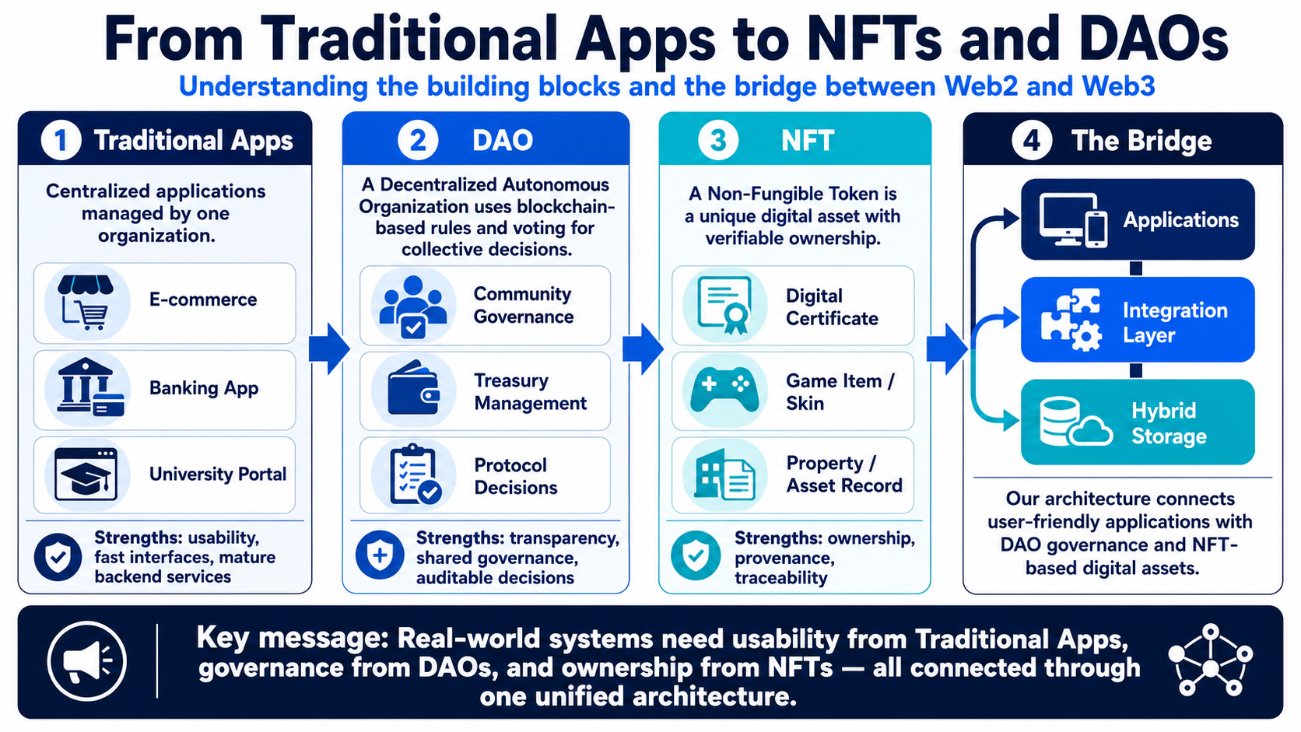
Introduction
A Decentralized Architecture Integrating NFT-Based Digital Assets and DAO Governance
2

Slide 3
Why This Research Matters
Web3 tools are powerful — but real products need more than smart contracts.
Digital ownership
Transparent governance
Usable deployment
Assets must be unique, verifiable, and portable.
Examples: certificates, game items, records.
Organizations need rules for approval, update, and revocation.
Decisions must be auditable, not hidden.
Real systems still need apps, APIs, storage, and identity.
Otherwise blockchain stays a prototype.
Core issue
Most existing solutions focus on one piece of the puzzle — NFTs, DAO voting, or smart contracts — but not the full information system needed for real deployment.
A Decentralized Architecture Integrating NFT-Based Digital Assets and DAO Governance
2

Slide 4
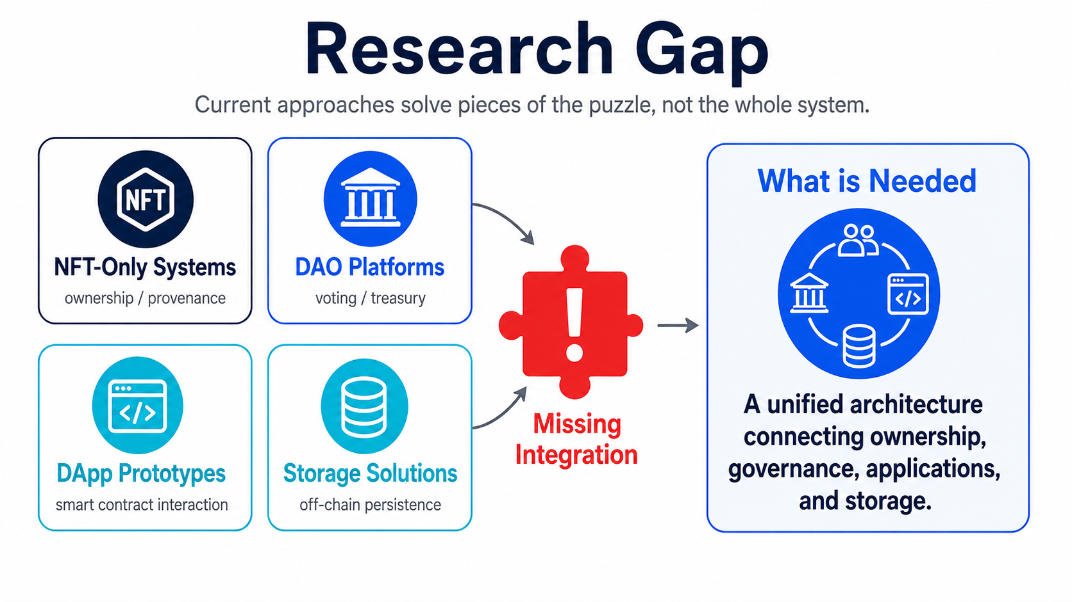
Research Gap
Why current approaches fall short
Takeaway: The contribution is not a new token or DAO protocol; it is a system architecture that makes these technologies deployable in practice.
A Decentralized Architecture Integrating NFT-Based Digital Assets and DAO Governance
3

Slide 5
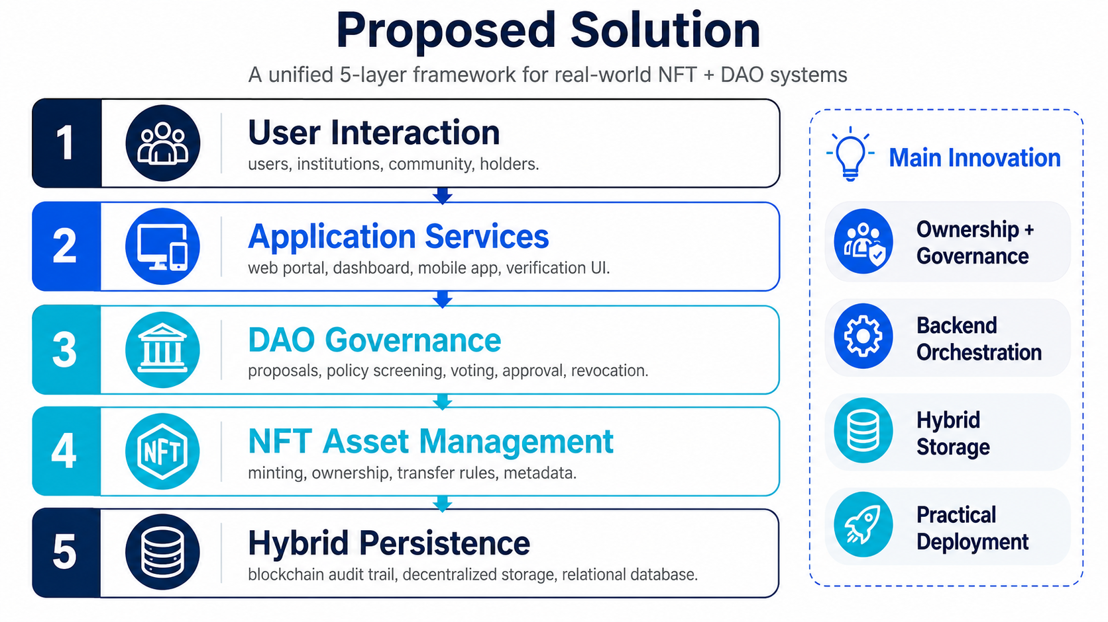
Proposed Solution
Five-layer architecture
One architecture connects Web2 usability with Web3 trust.
A Decentralized Architecture Integrating NFT-Based Digital Assets and DAO Governance
4

Slide 6
Core Novelty
The work does not propose another token or DAO platform.
It proposes a deployable architecture that connects digital assets, governance, backend workflows, and hybrid storage.
1
NFT Ownership
2
DAO Governance
3
Backend Bridge
digital asset proof
policy and approval
apps, APIs, storage
Main message: isolated Web3 tools become practical only when designed as a complete information system.

Slide 7
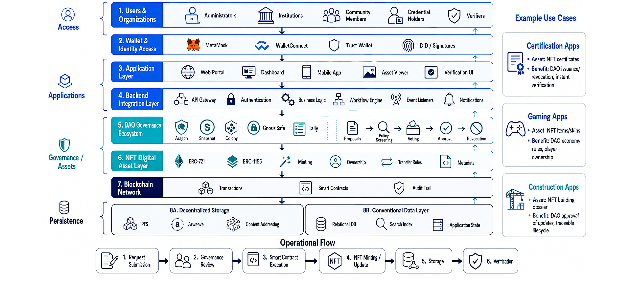
System Architecture
Detailed view
A Decentralized Architecture Integrating NFT-Based Digital Assets and DAO Governance
6

Slide 8
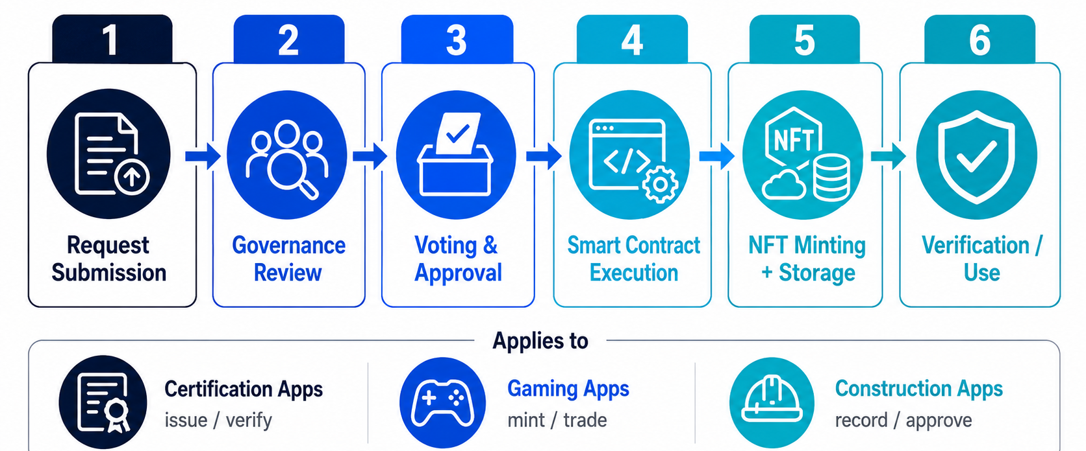
How the System Works
End-to-end workflow
A Decentralized Architecture Integrating NFT-Based Digital Assets and DAO Governance
5

Slide 9
Real-World Use Cases
Where this architecture helps
One architecture can support many application domains by changing the asset type and governance rules.
Certification apps
Gaming apps
Construction apps
NFT = diploma or certificate
DAO = issuer approval and revocation
Benefit = instant, tamper-evident verification
NFT = rare item, skin, character, ticket
DAO = economy rules and community decisions
Benefit = player ownership and tradable assets
NFT = building dossier or record
DAO = consortium approval of updates
Benefit = traceable lifecycle and shared accountability
Ticketing
Property records
Supply chain
Membership
Digital identity
A Decentralized Architecture Integrating NFT-Based Digital Assets and DAO Governance
7

Slide 10
Validation and Findings
What the workshop paper demonstrates
Validation setup
Key findings
Transparency
Workshop paper: conceptual architecture, not a full production prototype
Main scenario: digital credential issuance, verification, update, and revocation
Blockchain layer: smart contracts and ERC-721 / ERC-1155
Governance examples: Aragon, Snapshot, Colony, Gnosis Safe, Tally
Storage model: blockchain proof + IPFS/Arweave + application database
DAO decisions are auditable.
Interoperability
APIs bridge Web2 and Web3 components.
Deployability
Hybrid storage supports practical deployment.
Usability
Apps and wallets make the system accessible.
Scalability
Not all data has to live on-chain.
A Decentralized Architecture Integrating NFT-Based Digital Assets and DAO Governance
11

Slide 11
Main Contributions
What the paper adds
1
Unified framework
2
Five-layer model
Brings NFT assets and DAO governance into one deployable system architecture.
Separates users, apps, orchestration, governance/assets, and persistence.
3
Workflow clarity
4
Real-world relevance
Shows how requests become governed digital assets with verifiable history.
Demonstrates applicability to certificates, gaming, construction, and more.
A Decentralized Architecture Integrating NFT-Based Digital Assets and DAO Governance
12

Slide 12
Limitations and Roadmap
Honest next steps
Roadmap
Current limitations
Conceptual architecture; no full production prototype yet
No quantitative measurements for latency, gas cost, throughput, or usability
Security, privacy, and governance risks still need formal evaluation
1
2
3
4
5
Prototype
Metrics
Security + privacy
Cross-chain
AI services
Next research goal
Build and test a prototype that measures performance, user experience, and policy/security behavior in real deployments.
A Decentralized Architecture Integrating NFT-Based Digital Assets and DAO Governance
13

Slide 13
KEY TAKEAWAYS
One architecture makes Web3 usable in practice.
Università degli Studi dell’Aquila
• NFTs represent the digital asset.
• DAOs govern approval, update, and revocation.
• Apps and APIs make the system usable.
• Hybrid storage keeps it scalable and practical.
• The same pattern can support certificates, gaming, and construction apps.
DISIM Department of Information Engineering, Computer Science and Mathematics
Thank you · Q&A
Asif Saeed · Università degli Studi dell’Aquila

