Slide 1
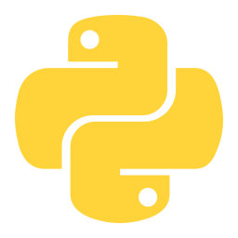
PYTHON PROGRAMMING
An Introduction for Beginners
What it is • Why it matters • How it runs • Your first program
Undergraduate Course | Module 1

Slide 2


What is Python?
A high-level, general-purpose programming language.
Python emphasizes readable, English-like syntax and lets you express ideas in fewer lines of code than most languages.
1991
Interpreted — Runs line-by-line via an interpreter — no separate compile step needed
Dynamically typed — No need to declare variable types up front
First released by Guido van Rossum
Multi-paradigm — Supports procedural, object-oriented, and functional styles
Fun fact: Python is named after the British comedy show "Monty Python's Flying Circus" — not the snake!
Open source — Free to use, modify, and distribute
Try this in a Python shell: import this
Introduction to Python
2

Slide 3






Why Python is Popular
Readable Syntax
Batteries Included
Strong Community
Close to plain English — reads almost like pseudocode
A huge standard library ships with the language itself
Millions of developers, forums, tutorials, and support
Cross-Platform
Massive Ecosystem
Beginner Friendly
The same code runs on Windows, macOS, and Linux
Over 500,000 third-party packages available on PyPI
Gentle learning curve — a top choice for first languages
Introduction to Python
3

Slide 4






Applications, by Domain
Web Development
Data Science
Machine Learning / AI
Django · Flask · FastAPI
pandas · NumPy · Jupyter
scikit-learn · PyTorch · TensorFlow
Automation & Scripting
Scientific Computing
Game Development
File handling · web scraping · task bots
SciPy · research & academia
Pygame · prototyping
Introduction to Python
4

Slide 5



Compiled vs. Interpreted Languages
COMPILED
INTERPRETED
C, C++, Rust, Go
Python, JavaScript, Ruby, PHP
Source Code
Compiler
Machine Code
Run by CPU
Source Code
Interpreter
Executes Live
Translated entirely to machine code before running
Translated and executed one line at a time, at runtime (repeats each run)
Produces a standalone, platform-specific executable
No standalone executable — interpreter must be present
Errors caught at compile time — checked upfront
Errors surface at runtime, when that line executes
Fast execution; slower edit-compile-run cycle
Slower execution; fast, immediate edit-run cycle
Introduction to Python
5

Slide 6

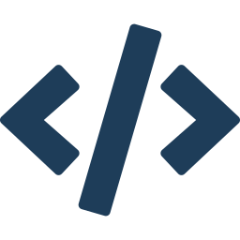



Python Environment & Execution Model
Python is both compiled and interpreted — source is compiled to bytecode, then the Python Virtual Machine interprets it.
source.py
Compiler
.pyc Bytecode
PVM
Output
Your Python code
Translates to bytecode
Platform-independent
Python Virtual Machine
interprets bytecode
Program runs
Implementations
Ways to Run Code
Environment Setup
CPython (standard) · PyPy (JIT, faster) · Jython (JVM) · IronPython (.NET)
Interactive REPL · python file.py · VS Code / PyCharm / Jupyter · Google Colab
Install from python.org or Anaconda · python --version · Virtual envs via venv · pip installs packages from PyPI
Python Environment
6

Slide 7
Basic Python Program Structure
1
Comments
add_numbers.py
Start with # — ignored by Python, explain the code to humans
# 1. Comment — documents the code
# Program to add two numbers
2
Input
# 2. Input — read text from the user
input() pauses and reads what the user types, as text
num1 = input('Enter first number: ')
num2 = input('Enter second number: ')
3
Variables
# 3. Variables — convert text to numbers
Store data; int() converts text input into a whole number
num1 = int(num1)
num2 = int(num2)
4
Expressions
# 4. Expression — add the two numbers
The + operator combines the two variables into a result
total = num1 + num2
# 5. Output — display the result
5
Output
print('The sum is:', total)
print() displays the final result on the screen
Program Structure
7

Slide 8
Sample Example Code
A simple program that adds two numbers using basic input and output.
add_numbers.py
# Program to add two numbers
num1 = int(input('Enter first number: '))
num2 = int(input('Enter second number: '))
total = num1 + num2
print('The sum is:', total)
Sample Output
Concepts Used
>>> Enter first number: 12
>>> Enter second number: 8
The sum is: 20
input() reads what the user types, as text
int() converts that text into a whole number
+ operator adds the two numeric values
print() displays the result on screen
Sample Example Code
8

Slide 9
Questions?
Next up: Data Types, Variables & Operators

