Slide 1

Digital Portfolio
STUDENT NAME: LEELAVATHY.A
REGISTER NO AND NMID: 2401111033020,asunm1112401111033020
DEPARTMENT: COMPUTER APPLICATION
COLLEGE: L.N.GOVT COLLEGE / MADRAS UNIVERSITY

Slide 2
PROJECT TITLE
Al-Powered Resume Analyzer or Smart Agriculture Monitoring System
AI-Based Resume Screening System
AI-Based Resume Screening System

Slide 3
AGENDA
1.Problem Statement 2.Project Overview 3.End Users 4.Tools and Technologies 5.Portfolio design and Layout 6.Features and Functionality 7.Results and Screenshots 8.Conclusion 9.GithubLink
.Problem Statement
2.Project Overview
3.End Users
4.Tools and Technologies
5.Portfolio design and Layout
6.Features and Functionality
7.Results and Screenshots
8.Conclusion
9.GithubLink

Slide 4
PROBLEM STATEMENT
Clearly explain the challenge or gop you aimed to solve. Example: "Fresh graduates face difficulty in showcasing skills effectively to employers."

Slide 5
PROJECT OVERVIEW
A short summary of your project. Method/approach used. Main outcome or benefit. Example: “We developed a web-based application that uses NLP to classify resumes based on job requirements, reducing screening time by 60%.”

Slide 6
WHO ARE THE END USERS?
Who benefits from your project? Students Recruiters / Employers Academic Institutions

Slide 7
TOOLS AND TECHNIQUES
List the software, frameworks, and platforms used. Example: Frontend: HTML, CSS, React Backend: Node.js, Django, or Flask Database: MySQL / MongoDB Version Control: Git & GitHub

Slide 8
PORTFOLIO DESIGN AND LAYOUT
Show screenshots or mockups of your portfolio. Highlight your UI/UX design choices (navigation, color theme, responsive design).
8

Slide 9
FEATURES AND FUNCTIONALITY
Key features of your portfolio: Personal & academic details Project showcase with descriptions & images Resume download option GitHub / LinkedIn integration Contact form

Slide 10
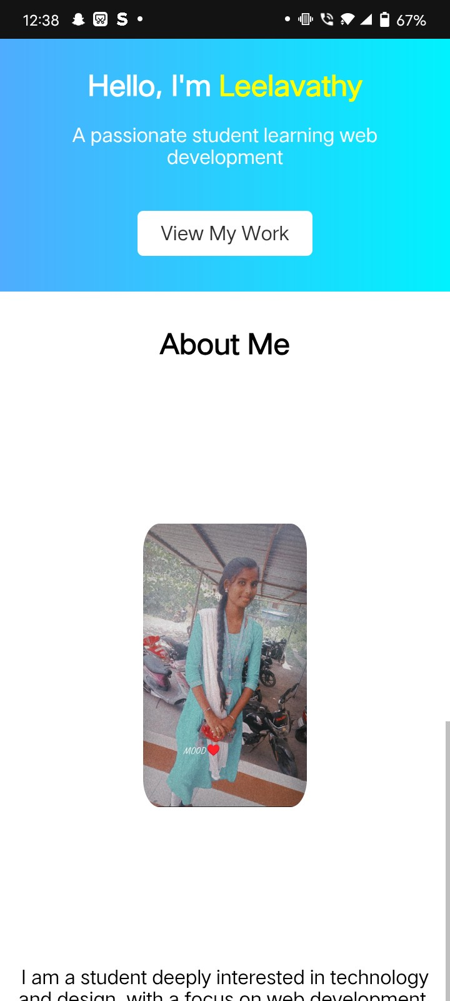
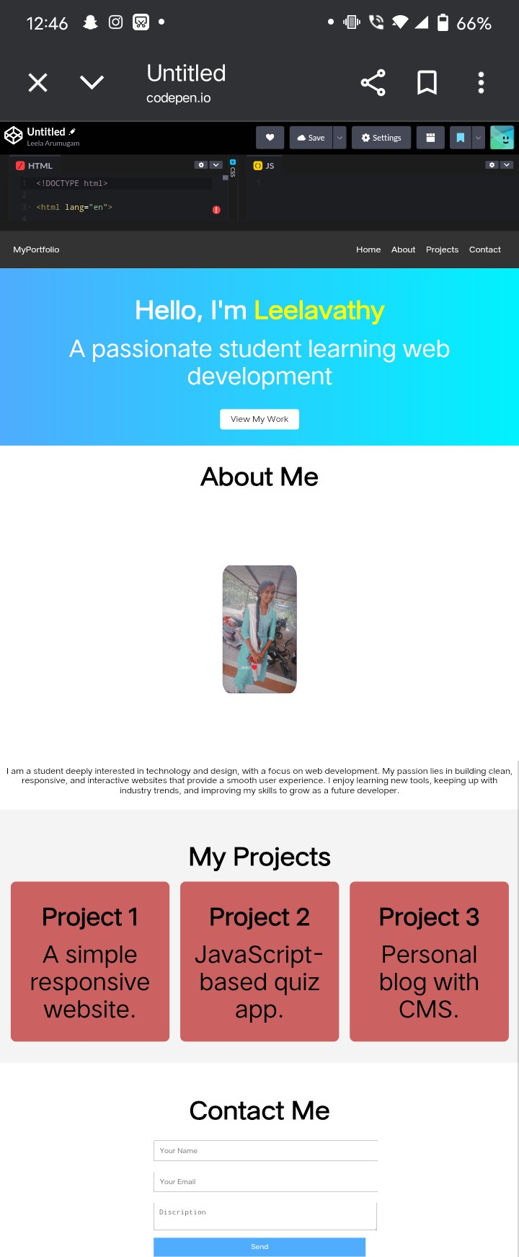
RESULTS AND SCREENSHOTS
3/21/2024 Annual Review
10

Slide 11
https://bca2401111033020-leela.github.io/Profile/
Github link

Slide 12
CONCLUSION
Summarize your learnings. Future improvements (e.g., AI-based resume analysis, more automation).
12

