Slide 1
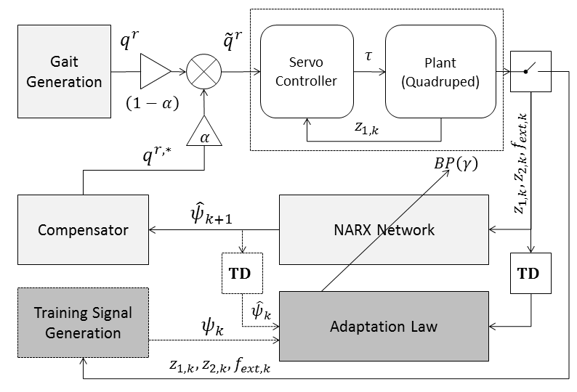
Trunk Stabilization of Multi-legged Robots
Using On-line Learning via a NARX-NN Comp.
Brian Cairl¹, Farshad Khorrami¹,
¹NYU Polytechnic School of Engineering, USA
Used to stabilize/level trunk during open-loop gait execution
NARX-NN trained to predict periodic dynamical disturbances
Outputs used to cancel disturbances through adjustments to joint reference commands

