Slide 1
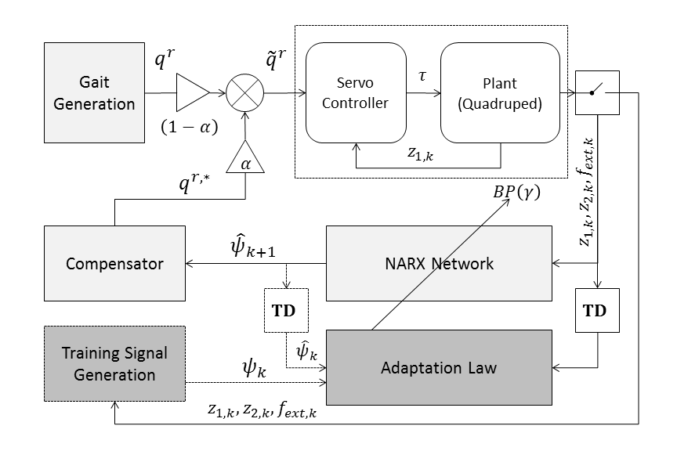
Trunk Stabilization of Multi-legged Robots
Using On-line Learning via a NARX Neural Network Compensator
Notes:
Backprop
Bold driver

