Slide 1
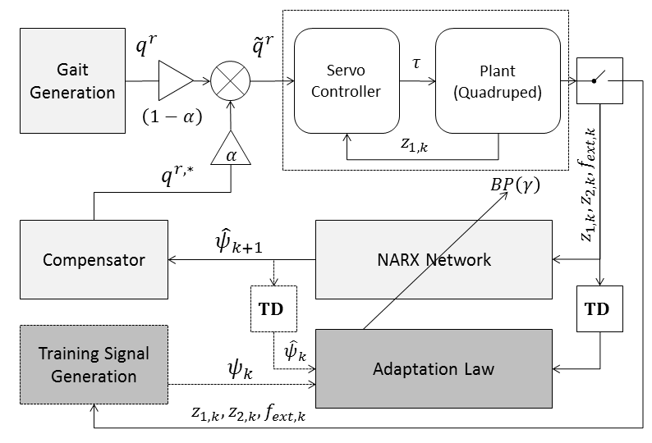
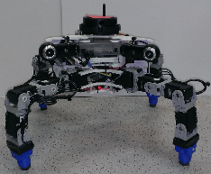
Trunk Stabilization of Multi-legged Robots Using On-line Learning via a NARX-NN Compensator
Brian Cairl¹, Farshad Khorrami¹
¹NYU Polytechnic School of Engineering, USA
Stabilization/leveling trunk of a quadruped during open-loop gaiting
Prediction of periodic disturbances via a NARX-NN
Disturbance attenuation via modification of joint reference commands using NARX-NN

