Slide 1
Design and Control of the BlueFoot Platform:
A Multi-terrain Quadruped Robot
Brian Cairl
Dr. Farshad Khorrami
May 13, 2015

Slide 2
Overview
Introduction
Hardware and Design
Software Architecture
System Modeling
Gait and Stability Control
Navigation Control
Concluding Remarks

Slide 3
Introduction: Quadruped Robotics
Well known advantages over wheeled robots, mainly in adaptability to terrain
At the follows expenses:
Higher power consumption (more actuators)
Lower payload capacity (higher actuator loading)

Slide 4
Introduction: Quadruped Robotics
Inspired by notable quadruped robotic systems from the past decade:
LittleDog (Boston Dynamics)
BigDog (Boston Dynamics)
Tekken (Kyoto Institute of Technology)
Kolt (Stanford University)
HyQ (Istituto Italiano di Tecnologia)

Slide 5
Introduction: Quadruped Robotics
Practical Applications of such a system
Gaiting design/research
Rough-terrain navigation/planning
Toward:
Disaster recovery
Search and rescue
Environmental mapping

Slide 6
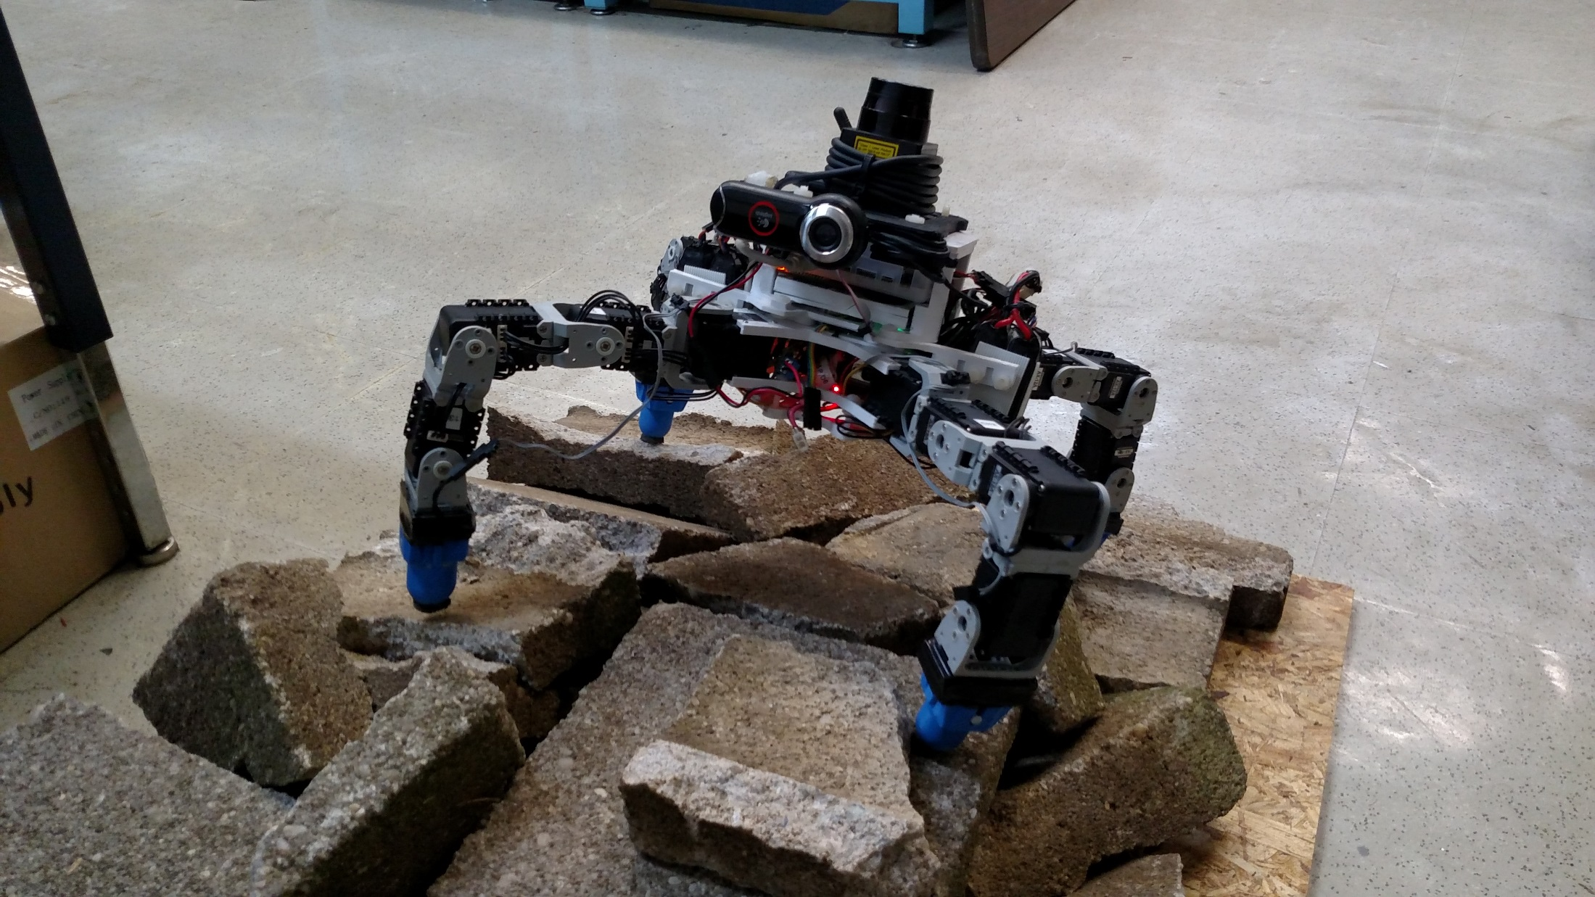
Introduction: The BlueFoot Platform

Slide 7
Introduction: The BlueFoot Platform
Small-scale quadruped robot
16 actuated degrees of freedom
High Dexterity:
Stabilize and reposition on rough terrain
Trunk articulation
Overcome raised/uneven terrain

Slide 8
Introduction: The BlueFoot Platform
Small-scale quadruped robot
16 actuated degrees of freedom
High Dexterity:
Stabilize and reposition on rough terrain
Trunk articulation
Overcome raised/uneven terrain

Slide 9
Introduction: Control Overview
Central Pattern Generator (CPG)-based gait control
Zero-Moment Point (ZMP) body posture control
Virtual-Force foothold controller
NARX-Neural Network based trunk-leveling controller

Slide 10
Introduction: Navigation/Control Overview
Potential-Fields/Visual-Servoing control
Surface Reconstruction for rough terrain navigation
3D Point cloud composition from 2D LIDAR scans
Height-map Generation
Surface Estimation
Planning using Height-maps

Slide 11
Design: Physical Structure

Slide 12
Design: Core Devices

Slide 13
Design: Device Association

Slide 14
Design: Power Requirements/Run-time

Slide 15
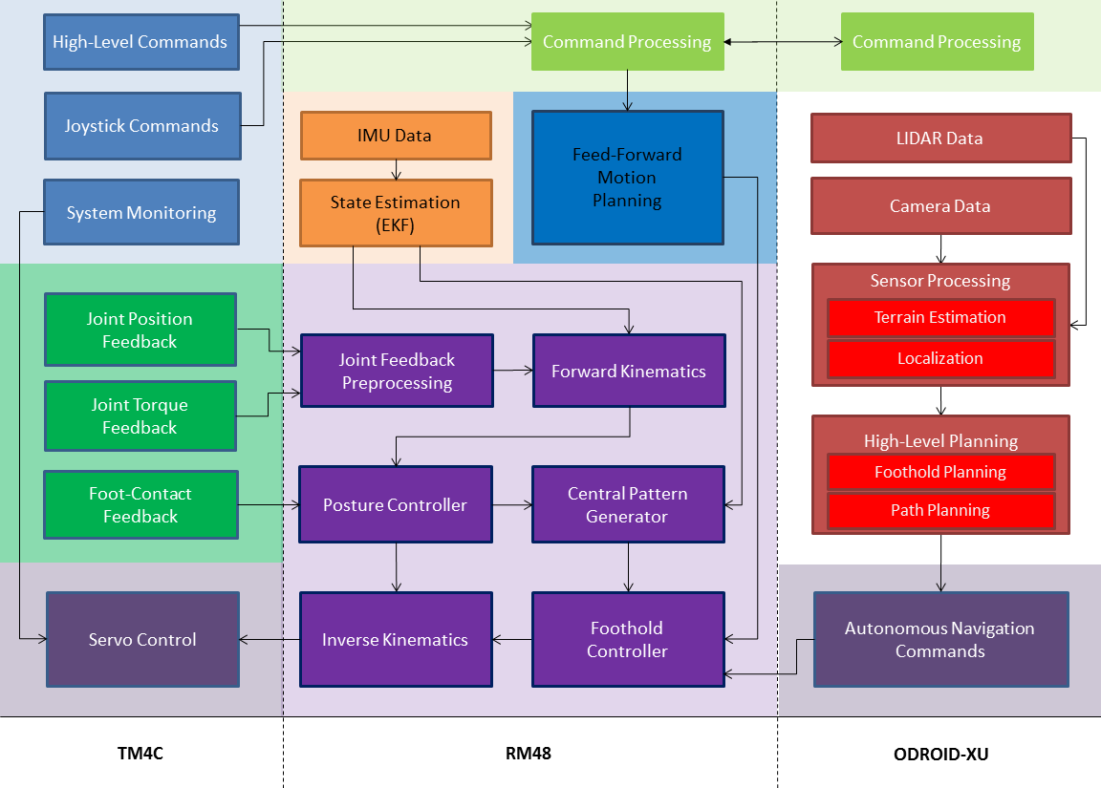

Slide 16
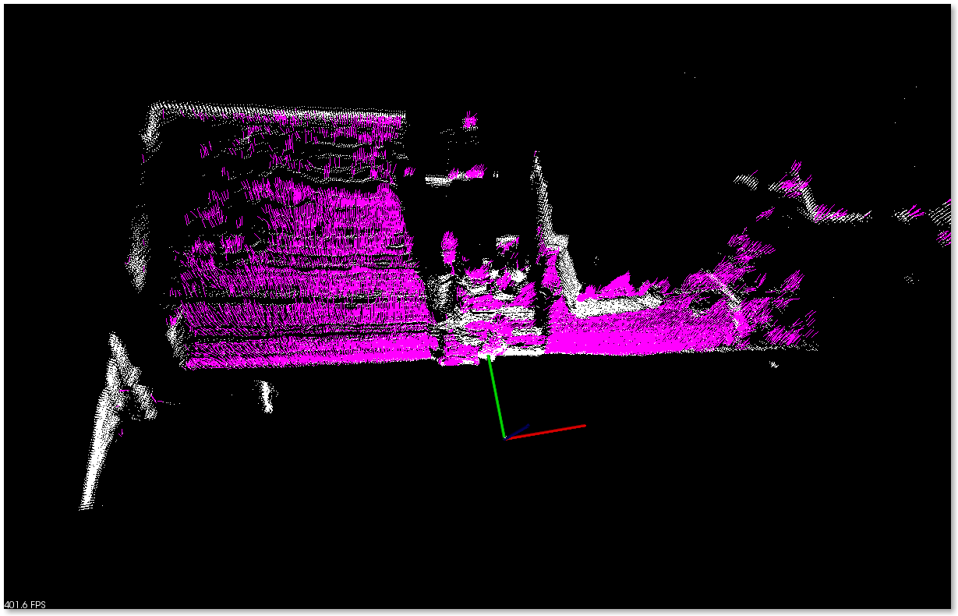
Source Point Cloud (1)

Slide 17
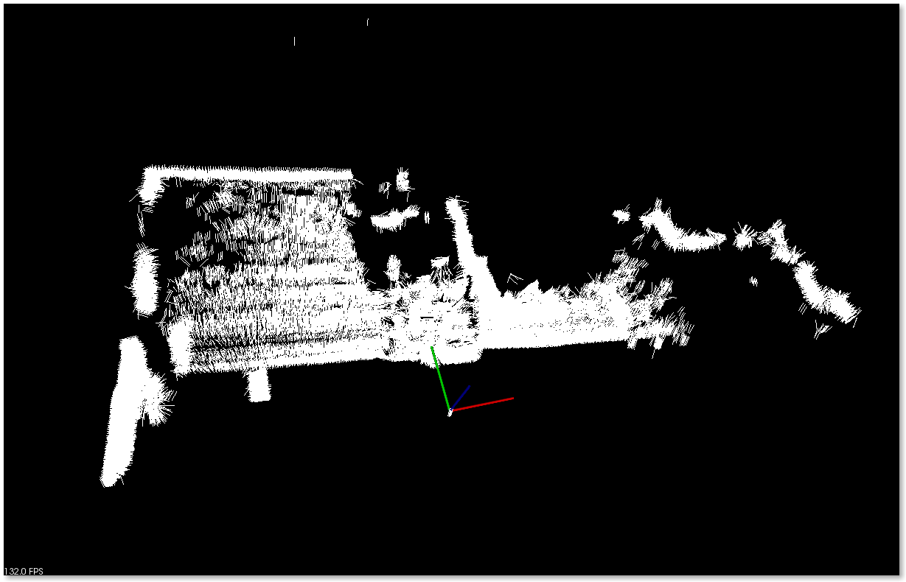
Surface Normal Estimation (2)

Slide 18
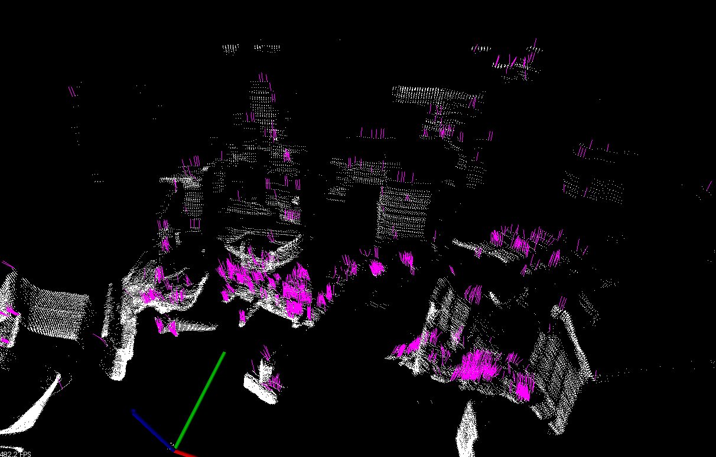
Source Point Cloud (2)

Slide 19
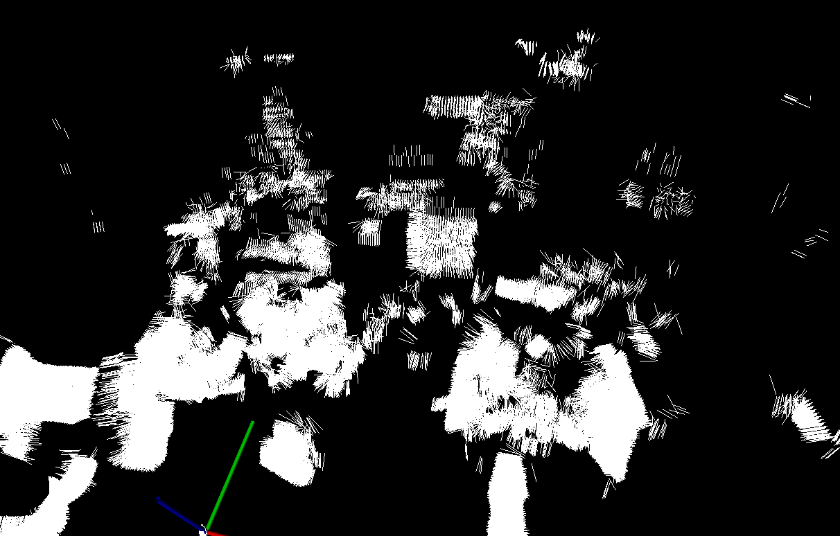
Surface Normal Estimation (2)

