Slide 1

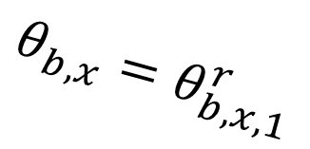

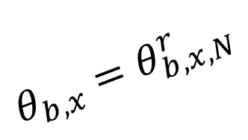


$$S_{1}$$
$$LIDAR$$
$$S_{i}$$
$$θ_{b,x}=θ_{b,x,N}^{r}$$
$$θ_{b,x}=θ_{b,x,1}^{r}$$
$$S_{N}$$

