Slide 1
Design and Control of the BlueFoot Platform:
A Multi-terrain Quadruped Robot
Brian Cairl Dr. Farshad Khorrami
May 13, 2015

Slide 2
Overview
Introduction
Hardware and Design
Software Architecture
System Modeling
Gait and Stability Control
Navigation Control
Concluding Remarks

Slide 3
Introduction: Quadruped Robotics
Well known advantages over wheeled robots, mainly in adaptability to terrain
At the follows expenses:
Higher power consumption (more actuators)
Lower payload capacity (higher actuator loading)

Slide 4
Introduction: Quadruped Robotics
Inspired by notable quadruped robotic systems from the past decade:
LittleDog (Boston Dynamics)
BigDog (Boston Dynamics)
Tekken (Kyoto Institute of Technology)
Kolt (Stanford University)
HyQ (Istituto Italiano di Tecnologia)

Slide 5
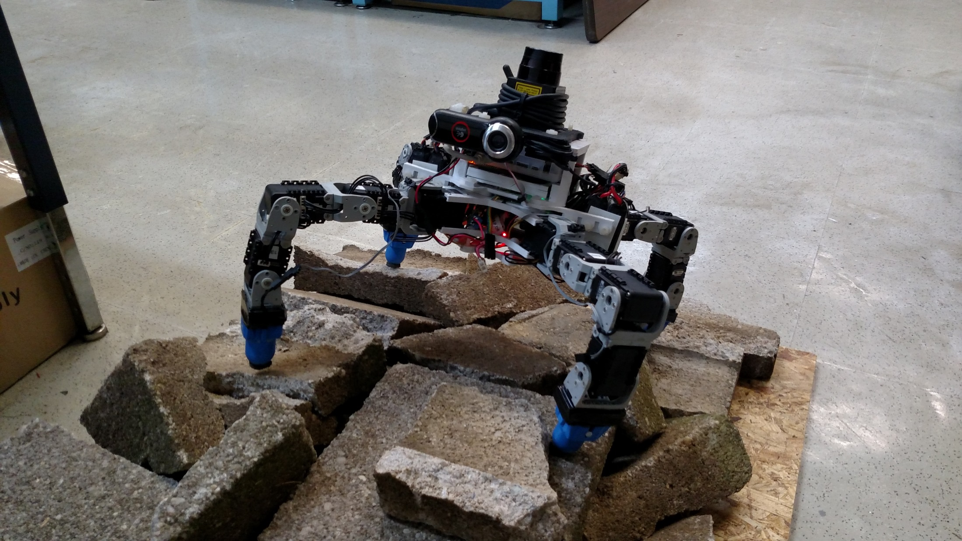
Introduction: The BlueFoot Platform

Slide 6
Introduction: The BlueFoot Platform
Small-scale quadruped robot
16 actuated degrees of freedom
High Dexterity:
Stabilize and reposition on rough terrain
Trunk articulation
Overcome raised/uneven terrain

Slide 7
Introduction: The BlueFoot Platform
Small-scale quadruped robot
16 actuated degrees of freedom
High Dexterity:
Stabilize and reposition on rough terrain
Trunk articulation
Overcome raised/uneven terrain

Slide 8
Introduction: Control Overview
Central Pattern Generator (CPG)-based gait control
Zero-Moment Point (ZMP) body posture control
Virtual-Force foothold controller
NARX-Neural Network based trunk-leveling controller

Slide 9
Introduction: Navigation/Control Overview
Potential-Fields/Visual-Servoing control
Zero-Moment Point (ZMP) body posture control
Virtual-Force foothold controller
NARX-Neural Network based trunk-leveling controller

Slide 10
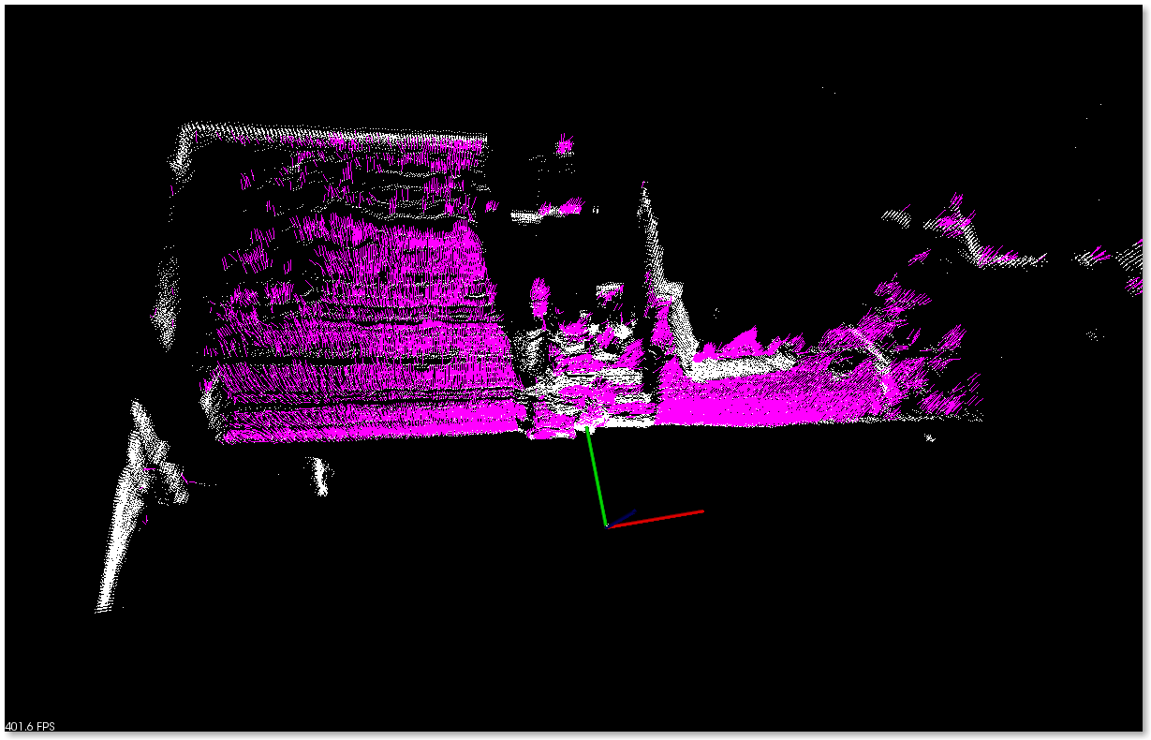
Source Point Cloud (1)

Slide 11
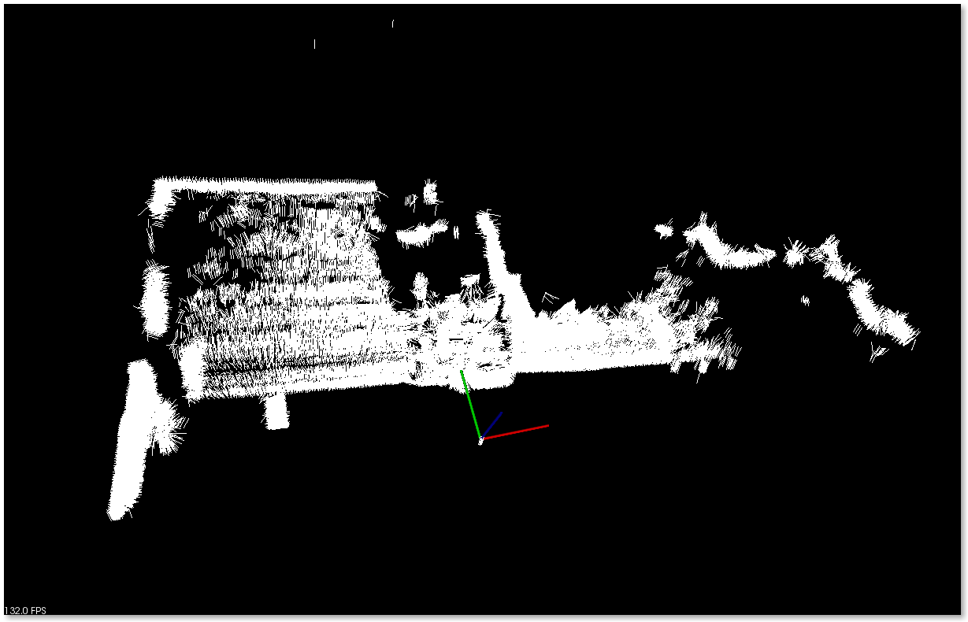
Surface Normal Estimation (2)

Slide 12
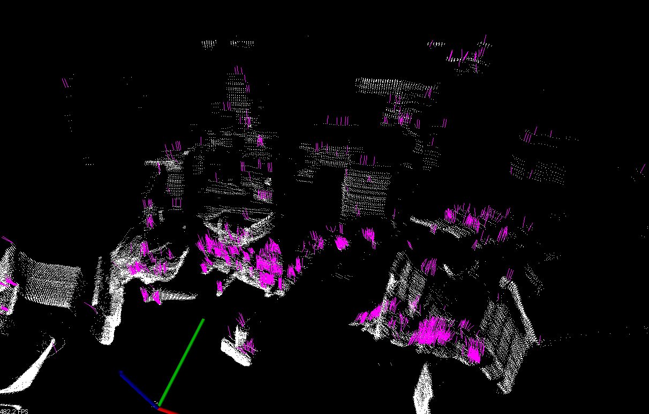
Source Point Cloud (2)

Slide 13
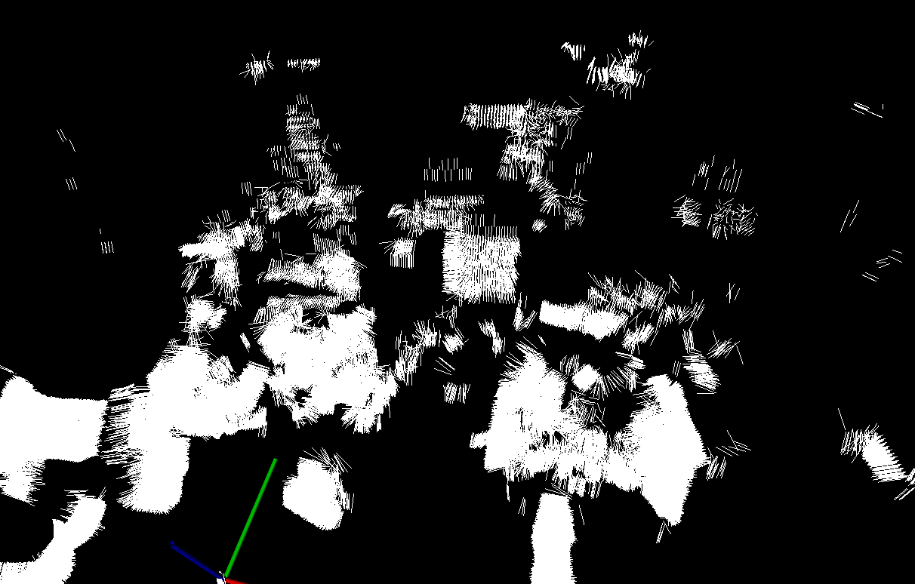
Surface Normal Estimation (2)

