Slide 1
Design and Control of the BlueFoot Platform:
A Multi-terrain Quadruped Robot
Brian Cairl
Dr. Farshad Khorrami
May 13, 2015

Slide 2
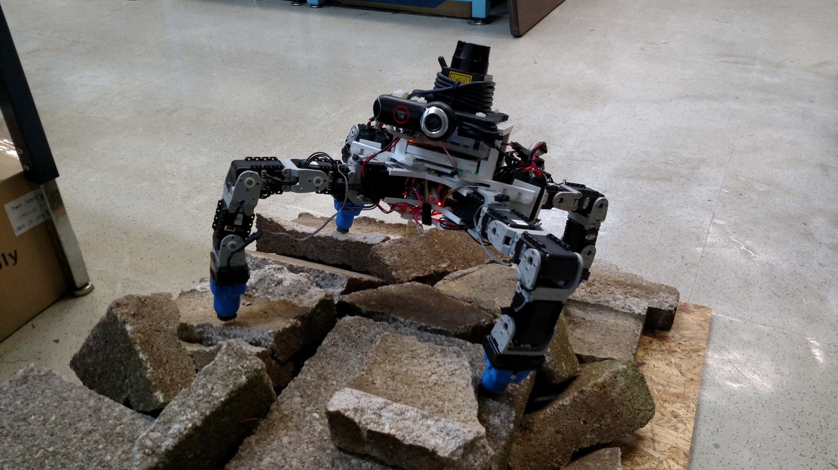
The BlueFoot Platform

Slide 3
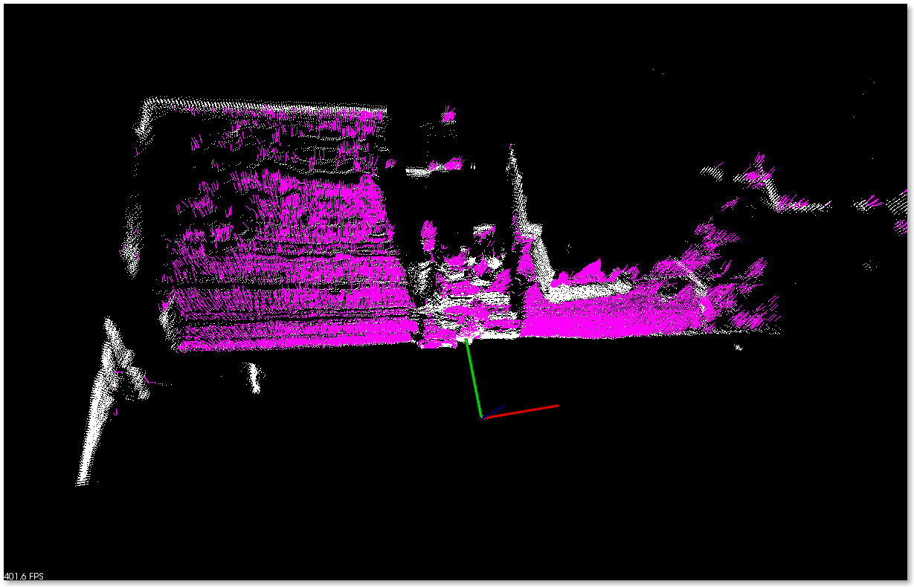
Surface Reconstruction

Slide 4
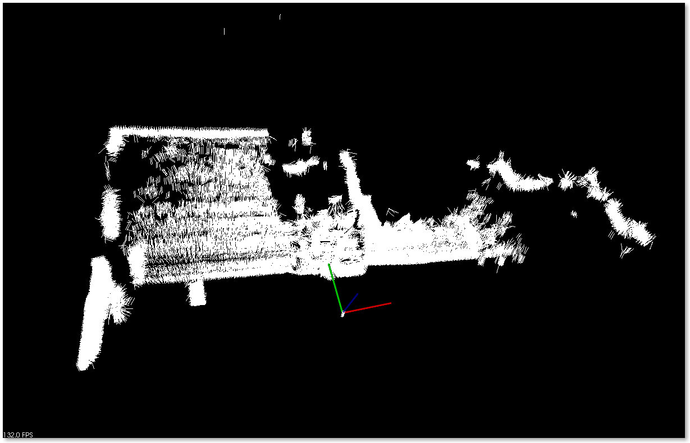
Surface Reconstruction

