Slide 1
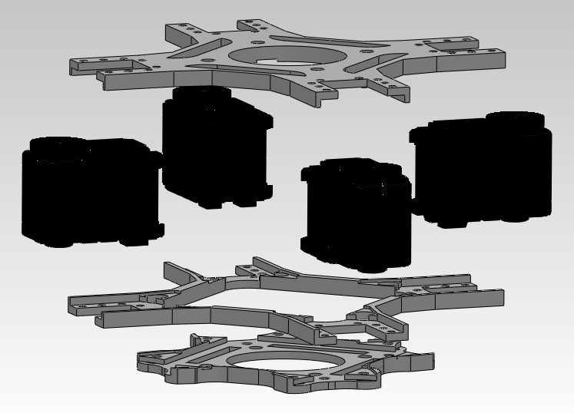
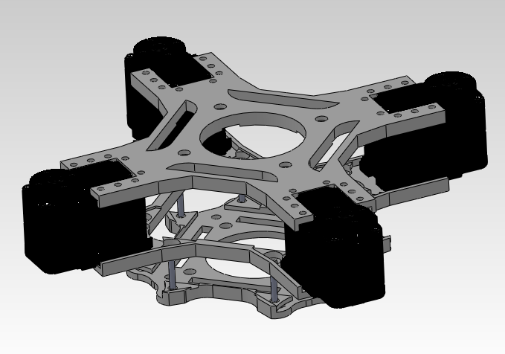
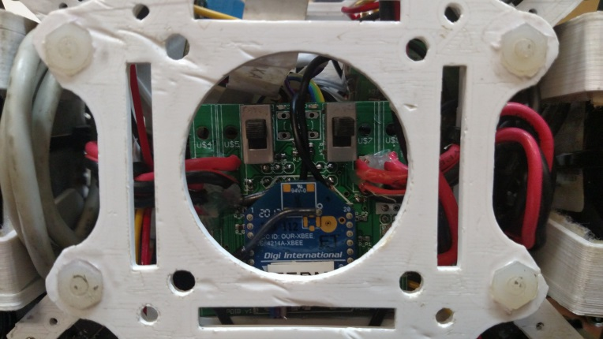
AX12a

Slide 2
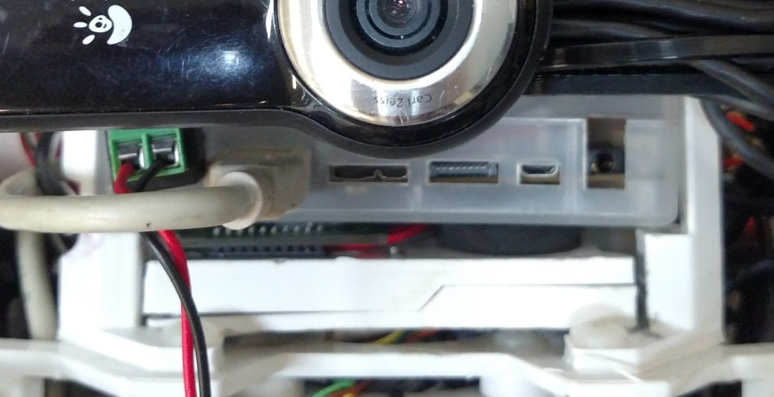
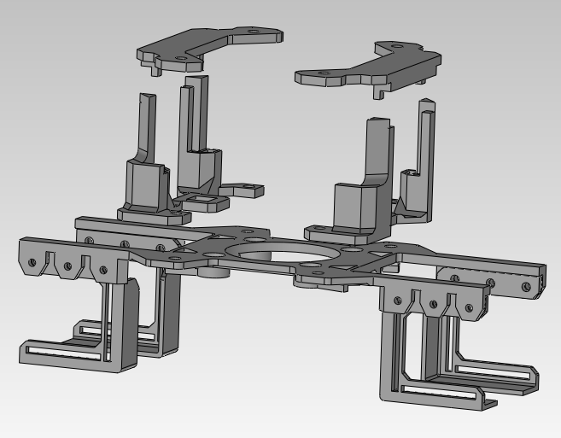
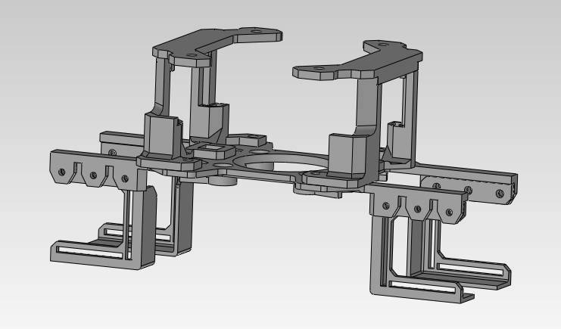
Battery Holsters
Computer Payload Area

Slide 3
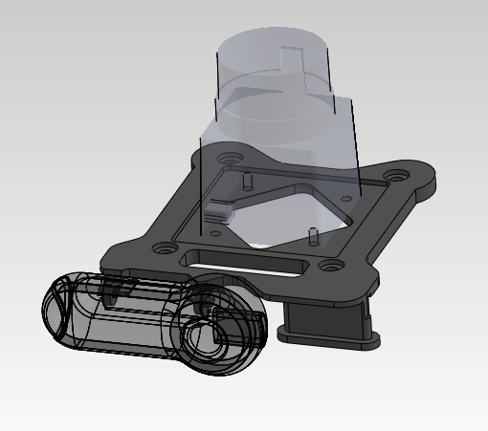
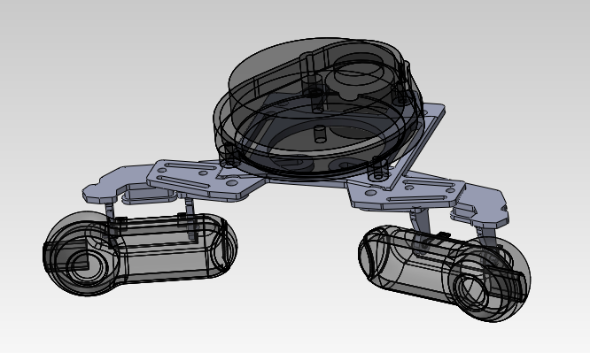
Hokuyo-URG
Piccolo LDS
Logitech 9000

Slide 4
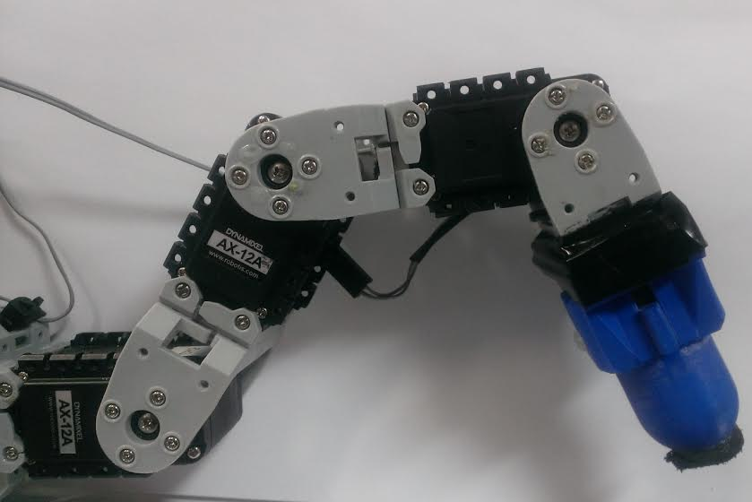
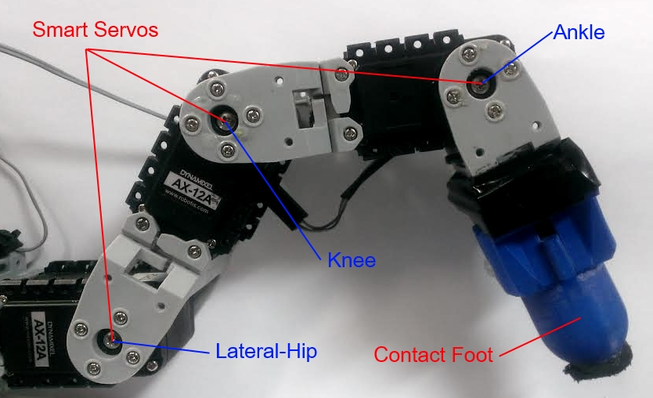









$$p_{i,3}$$
$$p_{i,3}$$
$$a_{3}$$
$$a_{2}$$
$$a_{4}$$
$$a_{1}$$
$$p_{i,1}$$
$$p_{i,2}$$
$$p_{i,e}$$

