Slide 1
Design and Control of the BlueFoot Platform:
A Multi-terrain Quadruped Robot
Brian Cairl Dr. Farshad Khorrami
May 13, 2015

Slide 2
Overview
Introduction
Hardware and Design
Software Architecture
System Modeling
Gait and Stability Control
Navigation Control
Concluding Remarks

Slide 3
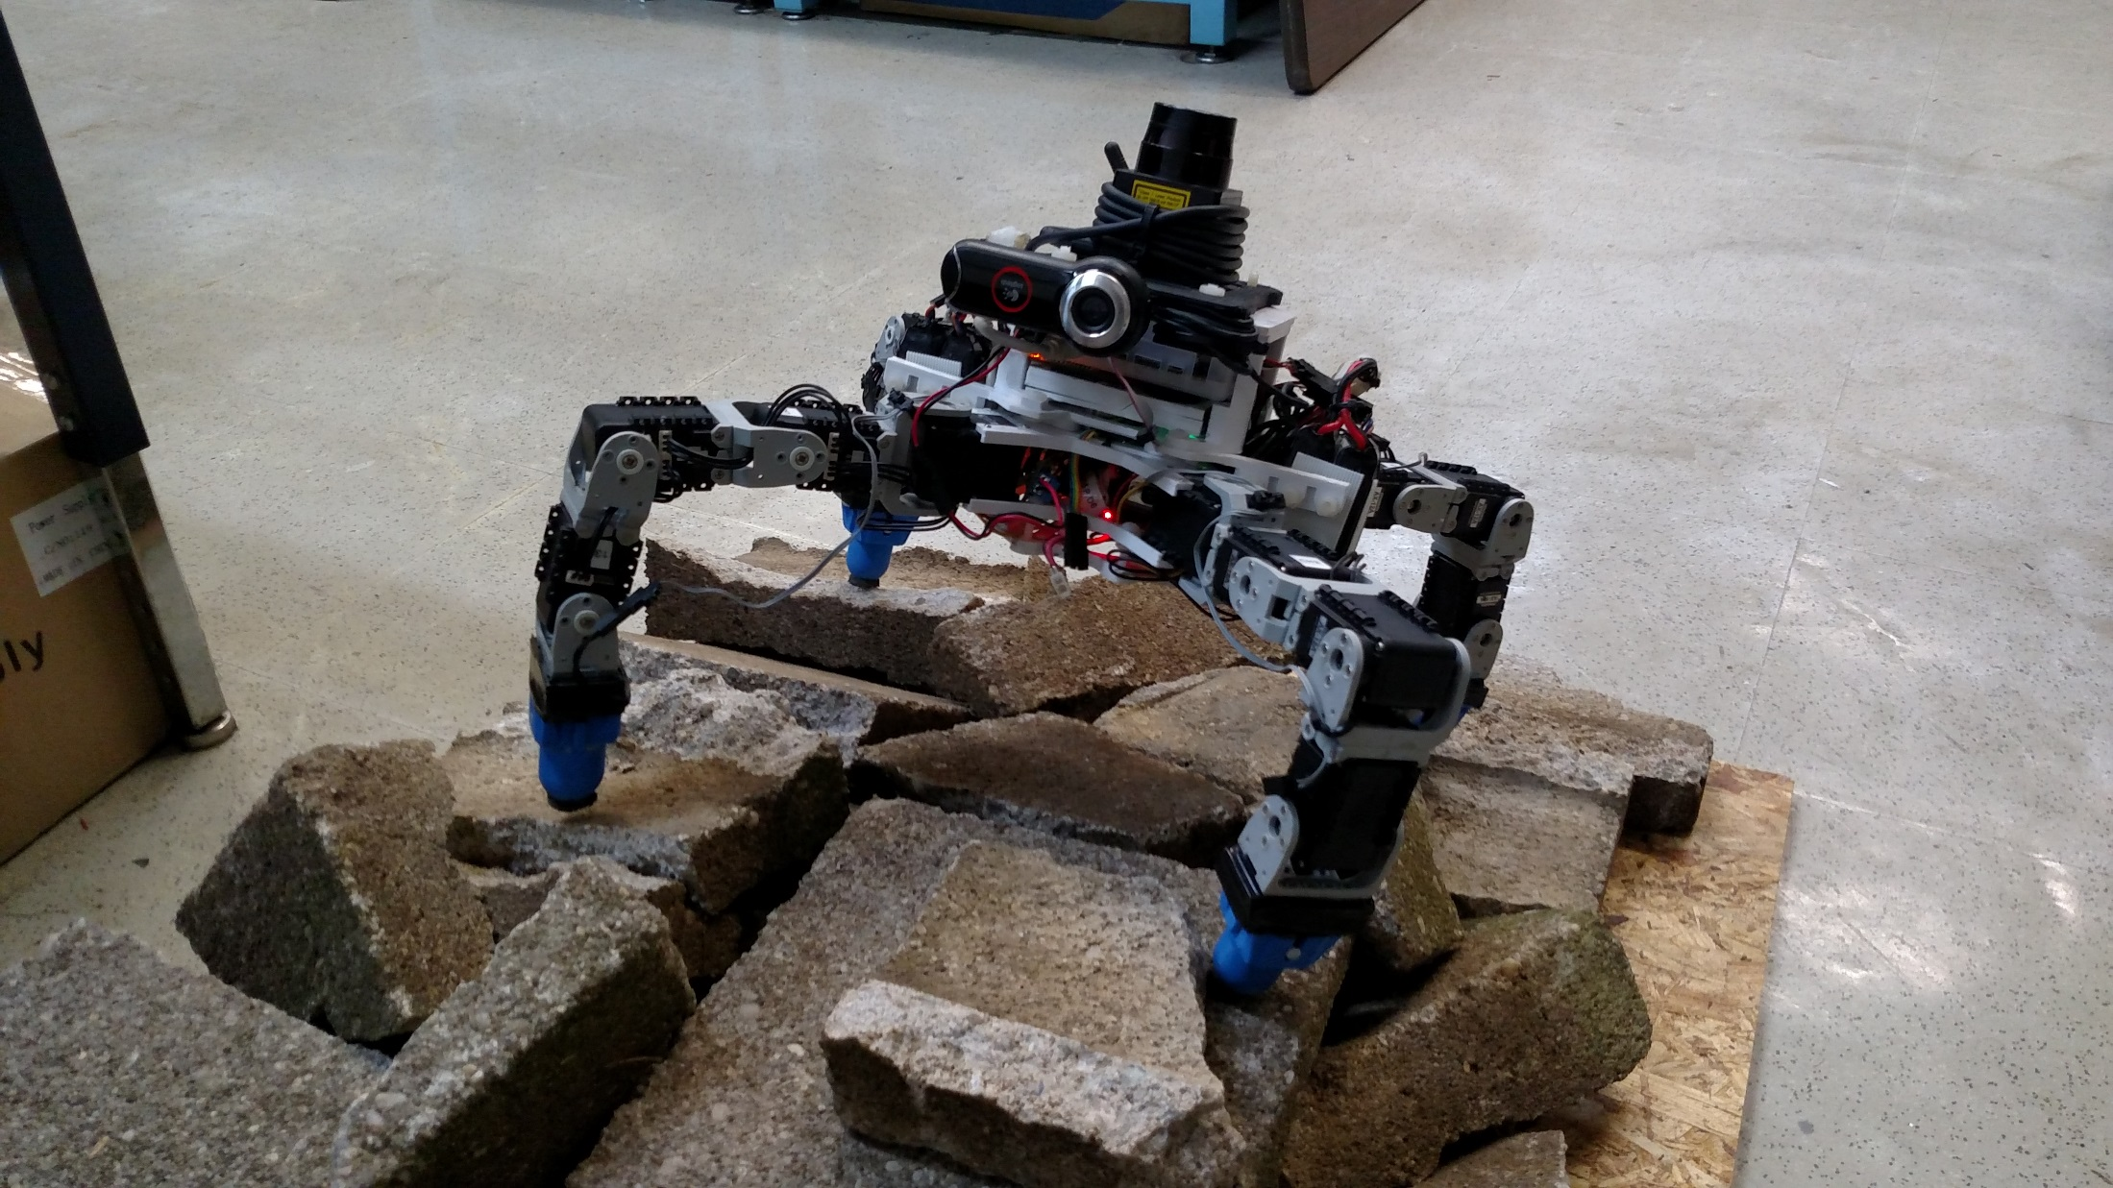
Introduction: The BlueFoot Platform

Slide 4
Introduction: The BlueFoot Platform
Project inspired by well known quadruped robotic systems from the past decade:
BigDog (Boston Dynamics)
LittleDog (Boston Dynamics)
Tekken (Kyoto Institute of Technology)
Kolt (Stanford University)
HyQ (Istituto Italiano di Tecnologia)

Slide 5
Introduction: The BlueFoot Platform
Small-scale quadruped robot
16 actuated degrees of freedom
High Dexterity:
Stabilize and reposition on rough terrain
Trunk articulation
Overcome raised/uneven terrain

Slide 6
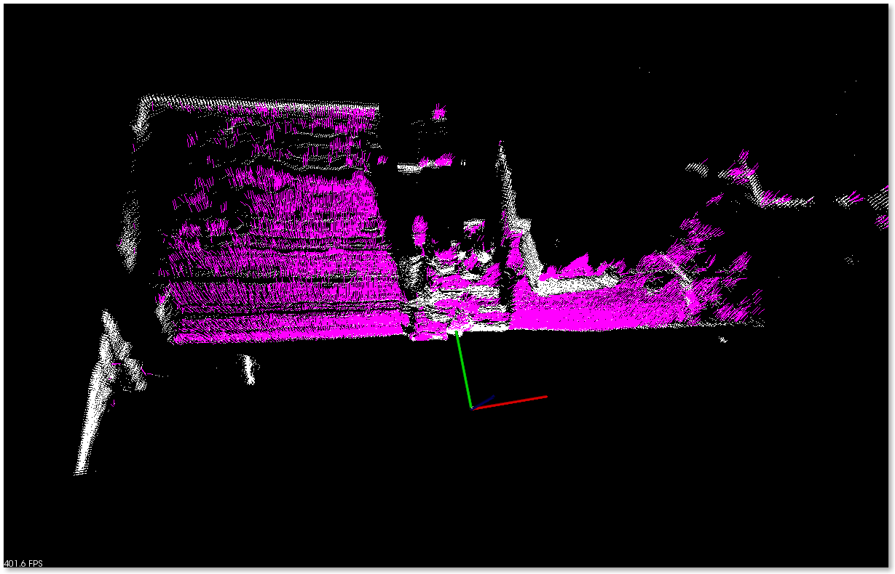
Source Point Cloud (1)

Slide 7
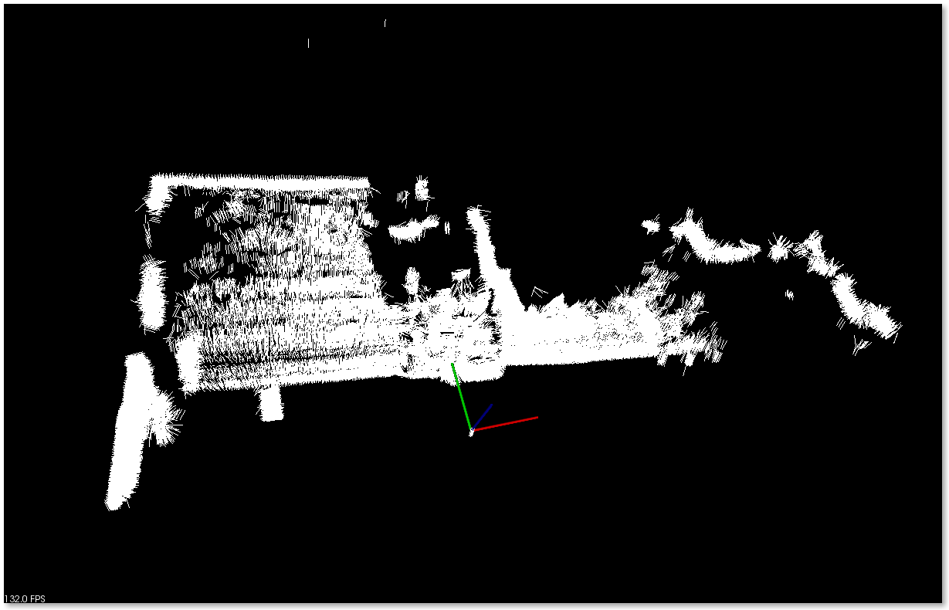
Surface Normal Estimation (2)

Slide 8
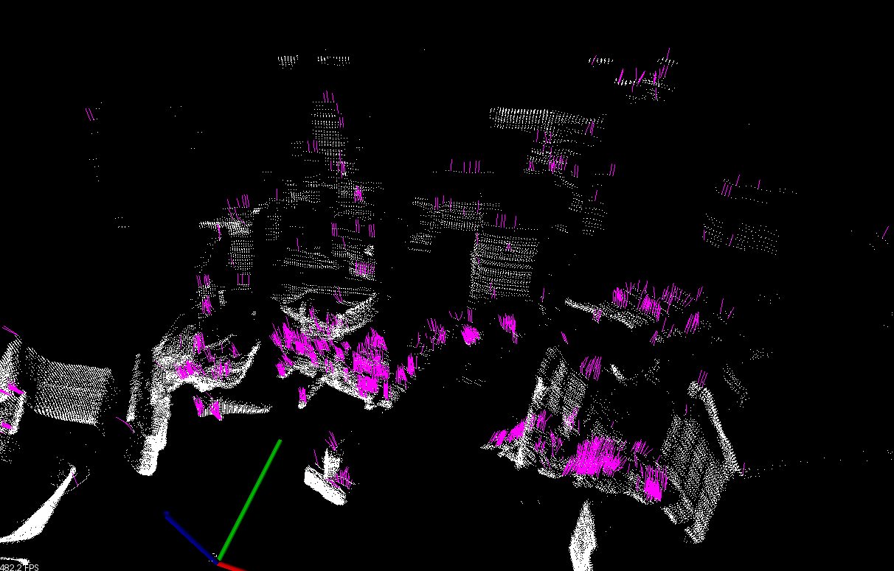
Source Point Cloud (2)

Slide 9
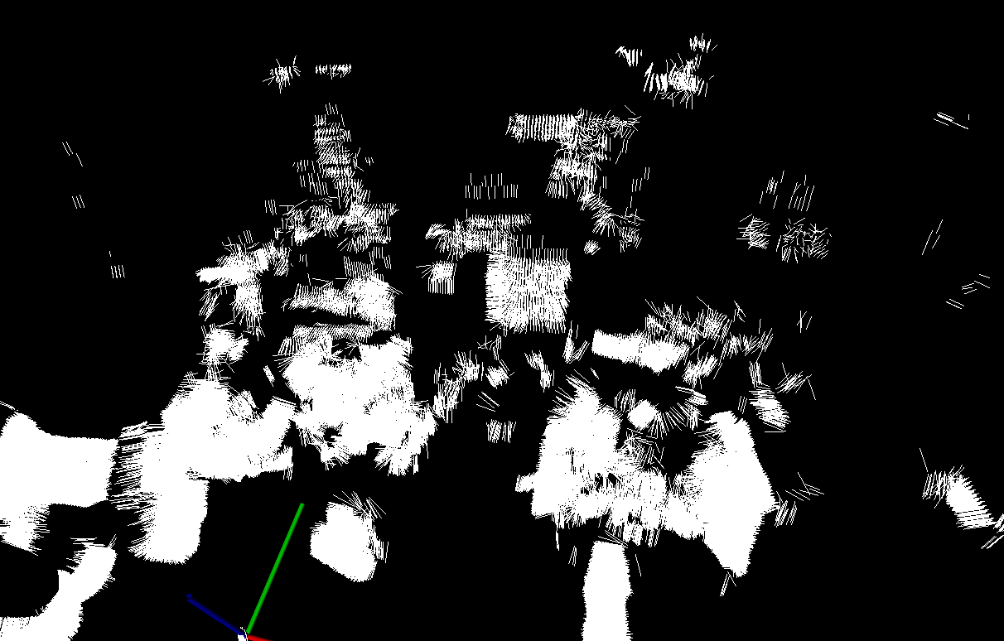
Surface Normal Estimation (2)

