Slide 1
Introduction of 3D Shape Analysis
Prof. Yi Fang
yfang@nyu.edu
Fall, 2015

Slide 2
Announcement
Grade for Project 1 released
Individual final project open now

Slide 3
Review of Previous Lecture
Euclidean Distance
Geodesic Distance

Slide 4
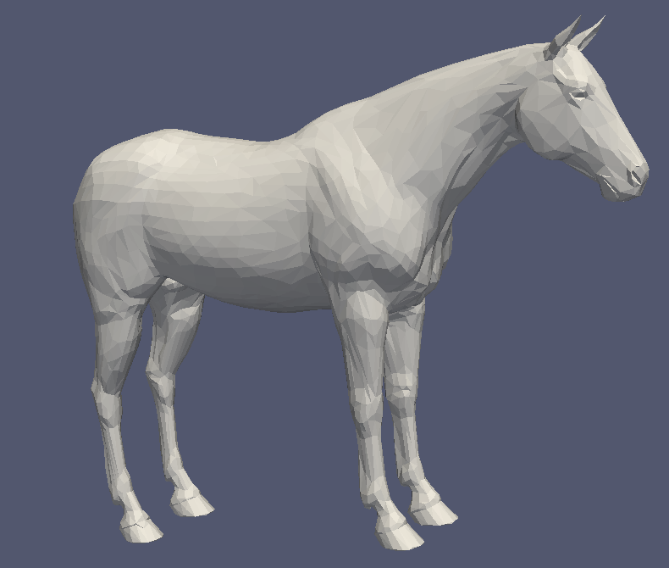
Euclidean Distance
3D Euclidean space we live in, where the distance between two points is the length of the straight line that connects them.

Slide 5
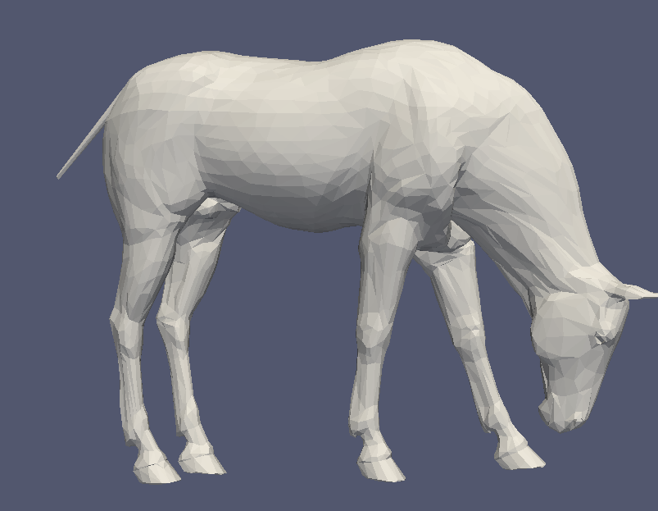
Euclidean Distance
Does Euclidean distance reflect the real geometry of 3D horse model?
Notes:
The comparison between thos

Slide 6
Geodesic Distance
Geodesic Distance: the geodesic distance between two points is defined as the length of a shortest path between the two points on the surface.

Slide 7
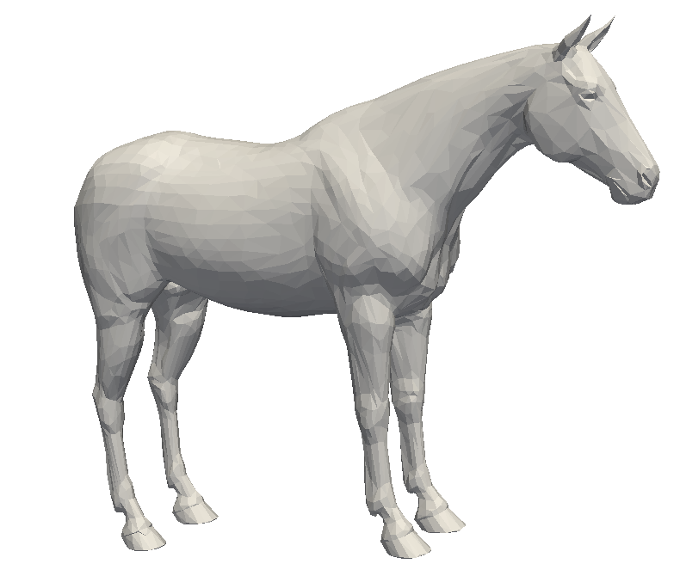
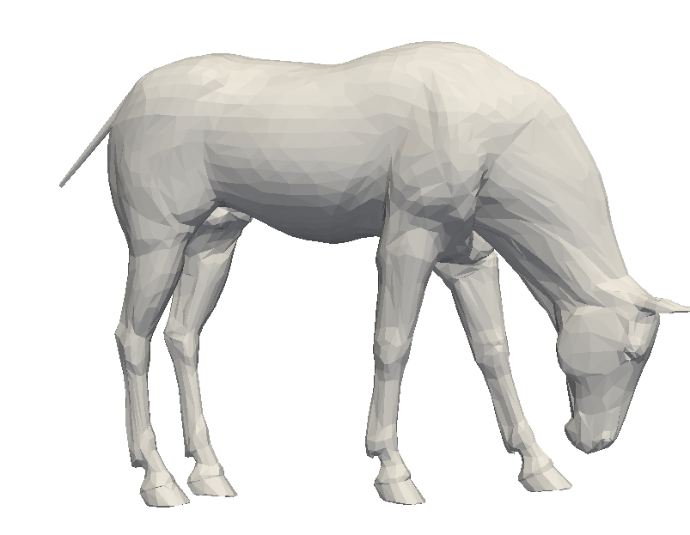

Slide 8
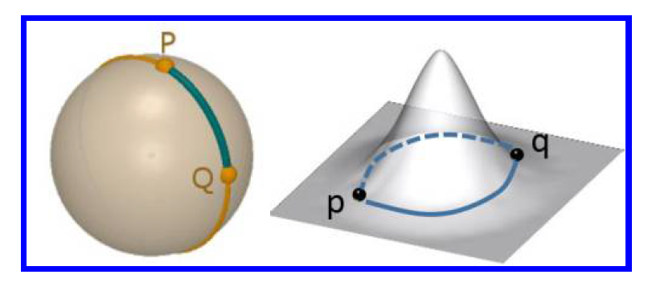
Non-uniqueness

Slide 9
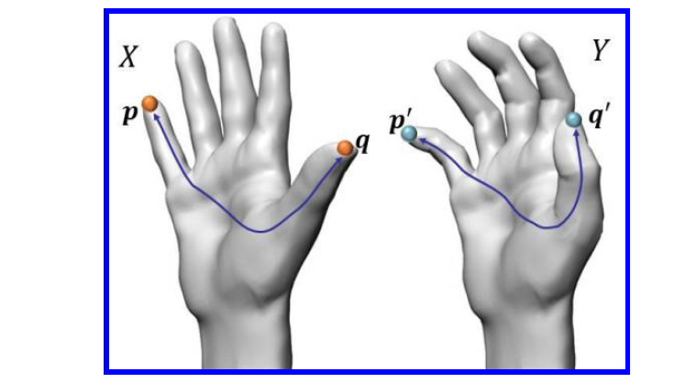
Intrinsic metric

Slide 10
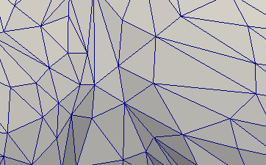
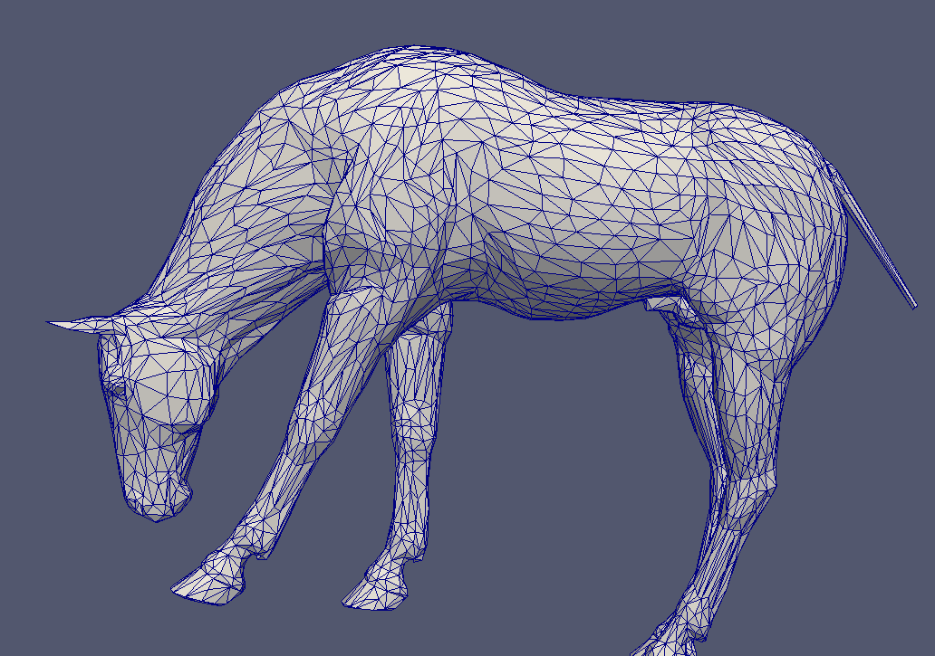
Computing Geodesics on meshes

Slide 11
Exact Path

Slide 12
Approximate Shortest Path
Notes:
Approximate Shortest Path:

Slide 13
Dijkstra's algorithm for Geodesic Distance Approximation on a Graph
Input: a mesh containing n vertices and m edges, source s, destination d.
Output: a set of vertices and edges connecting s and d with minimal length
For i from 0 to n
  L(vi) = Infinite
  L(s) = 0
S = empty
While d is not in S
u = a vertex not in S with L(u) minimal
Add u to S
for all u’s neighbors v not in S
if L(u) + distance(u, v) < L(v) then L(v) = L(u) + distance(u, v)
end
Note: L(d) is the length of shortest path from s to d

Slide 14
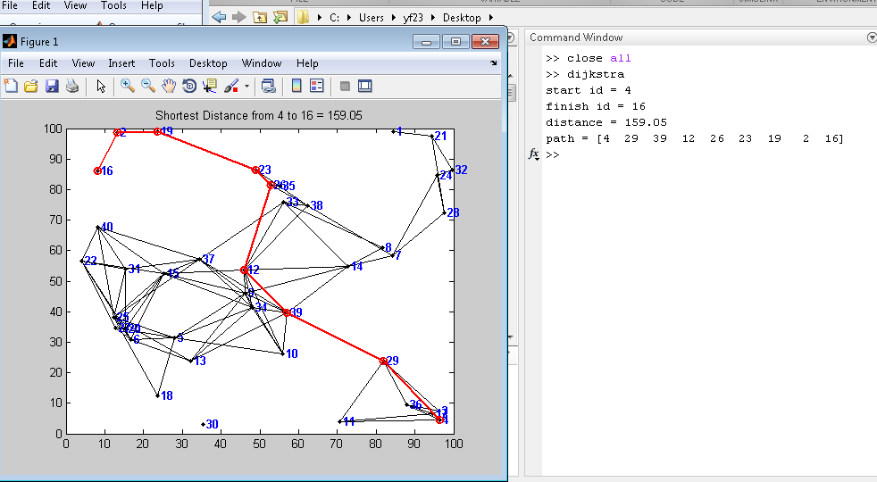

Slide 15
Today’s Lecture
Graph representation of a 3D model
Euclidean Distance Graph
Geodesic Distance Graph
Diffusion Distance Graph
Distance 3D point signature
Distance 3D global shape descriptor
Brief introduction of other shape descriptors

Slide 16
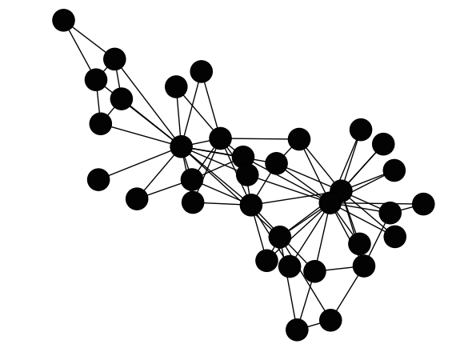
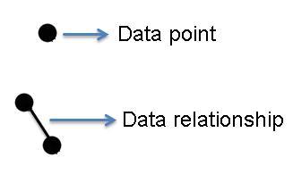
Graph data structure of a 3D model
Graph Representation of data

Slide 17
Adjacency Graph
b
 | a | b | c | d
a | 0 | 1 | 1 | 1
b | 1 | 0 | 1 | 0
c | 1 | 1 | 0 | 1
d | 1 | 0 | 1 | 0
a
c
d

Slide 18
Weighted Graph
w1
b
 | a | b | c | d
a | 0 | w1 | w2 | W4
b | w1 | 0 | w3 | 0
c | w2 | w3 | 0 | w5
d | w4 | 0 | w5 | 0
a
w2
w3
w4
c
w5
d

Slide 19
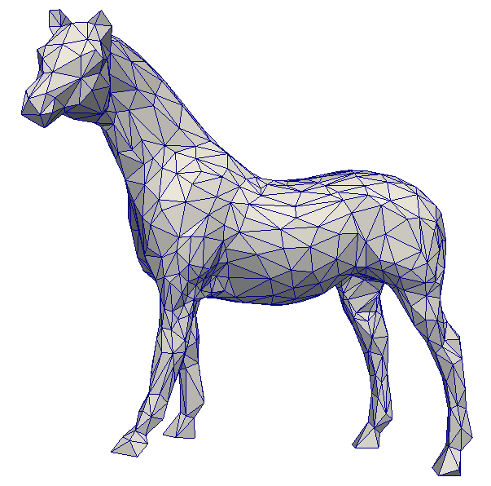
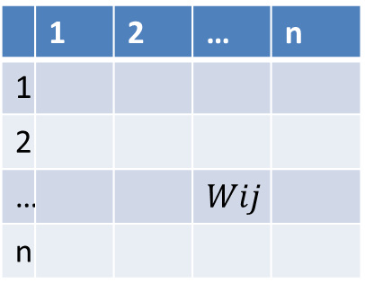






Representation of a 3D Model by Graph
Each vertex is a node in the graph, the edge weight is defined based on different applications.

Slide 20
Weighted Graph
w1
b
 | a | b | c | d
a | 0 | w1 | w2 | w4
b | 1 | 0 | 1 | 0
c | 1 | 1 | 0 | 1
d | 1 | 0 | 1 | 0
a
w2
w3
w4
c
w5
d

Slide 21
Steps of building a graph for 3D model
Given a 3D mesh, what are the steps to build a weighted graph?
List of Vertices
List of Triangles
G = (V,E)
1. Pseudo code?
2. The definition of E varies in different applications.

Slide 22
Mesh Adjacent Graph
G = (V,E)
The weight for E is assigned with “1” or “0”.
“1” indicates that there is a link between two vertices, and “0” indicates that there is no link between two vertices.

Slide 23
Euclidean Distance (ED) Graph
G = (V,E)
The weight for E is assigned with Euclidean distance between a pair of nodes.

Slide 24
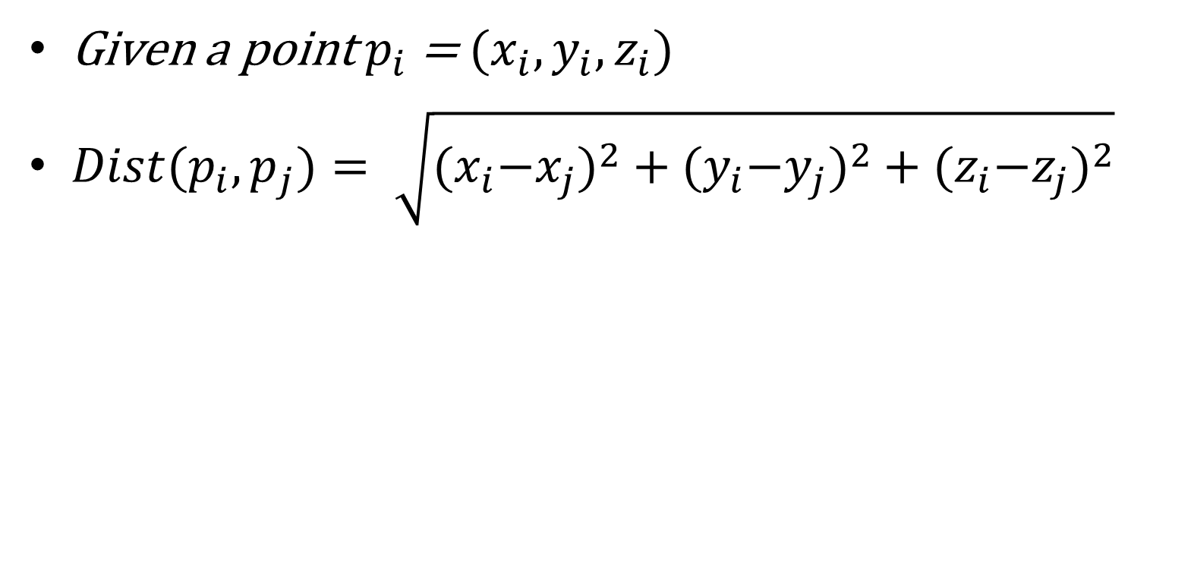
Computation

Slide 25
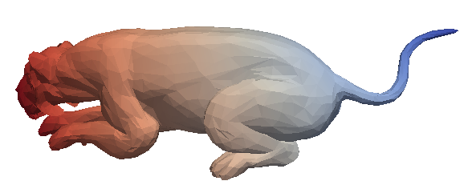
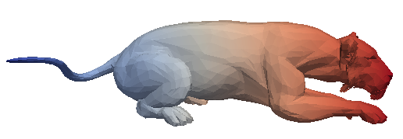
Euclidean Distance Mapped on Surface

Slide 26
Geodesic Distance (GD) Graph
G = (V,E)
The weight for E is assigned with geodesic distance between a pair of nodes.

Slide 27
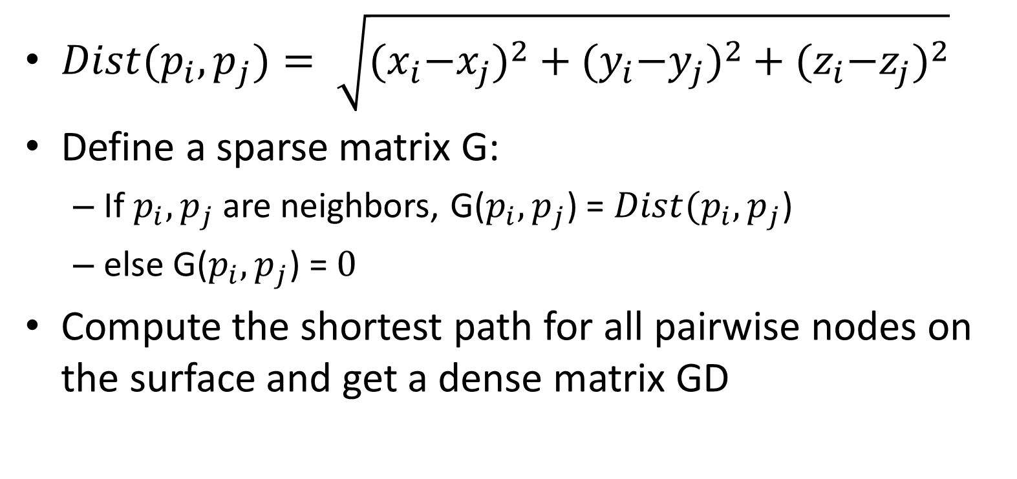
Computation

Slide 28
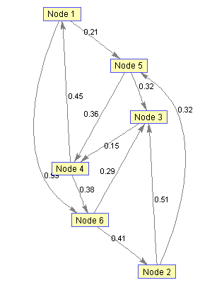
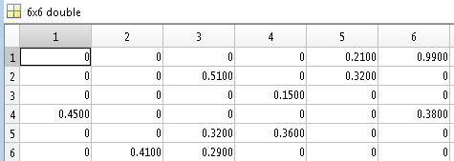

Slide 29
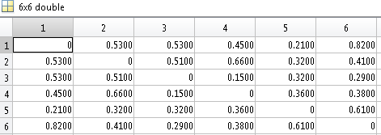
Shortest path propagation

Slide 30
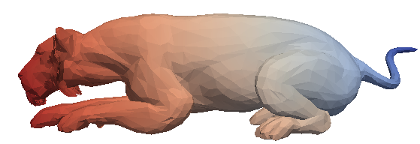
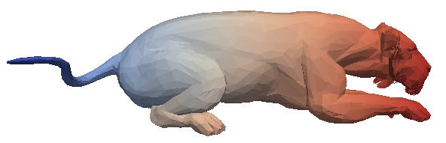
Geodesic Distance Mapped on Surface

Slide 31
Comparison between ED and GD
Euclidean distance is easy to calculate but sensitive to deformation
Geodesic distance is intrinsic, and robust to deformation

Slide 32
TA Demo
The computation

Slide 33
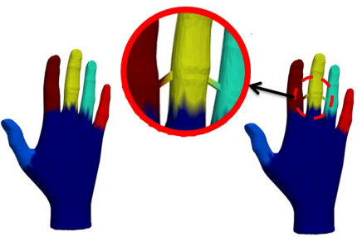
What is problem of GD?
Sensitive to noise as the propagation is along a single path

Slide 34
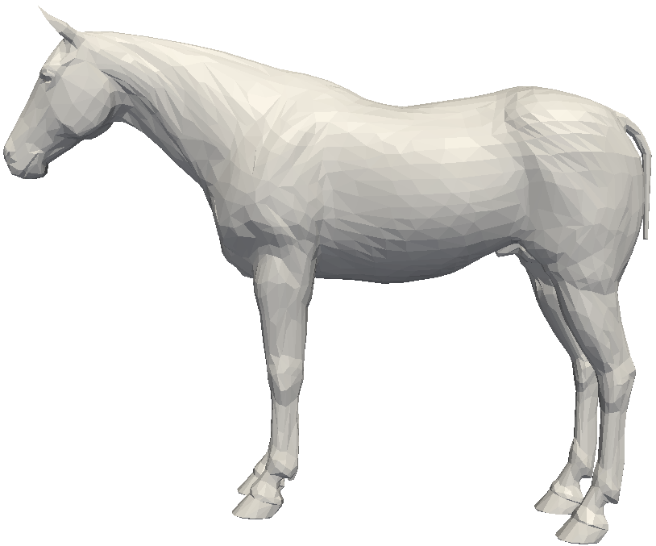
Diffusion Distance (DD) Graph
P2
G = (V,E)
P1
The weight for E is assigned with diffusion distance between a pair of nodes.

Slide 35
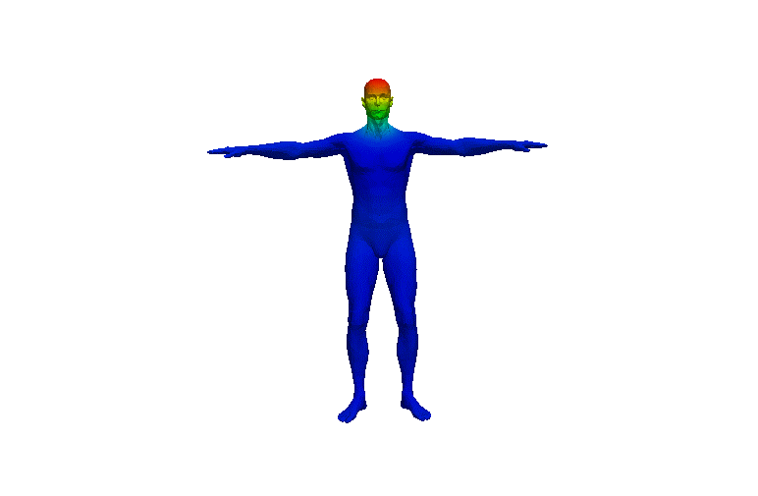
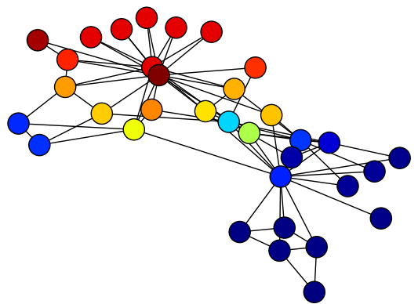
Heat Diffusion Process
Heat diffusion is controlled by how well data points are connected to each other.
Heat Source
Heat Source

Slide 36
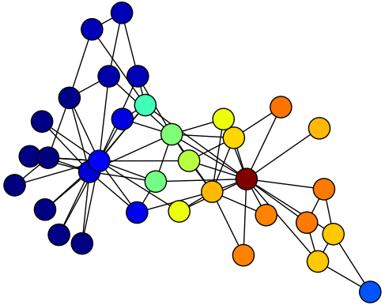
Flow of heat across the graph
Heat Source
Low
High
How the heat transfers from one node to another node?

Slide 37
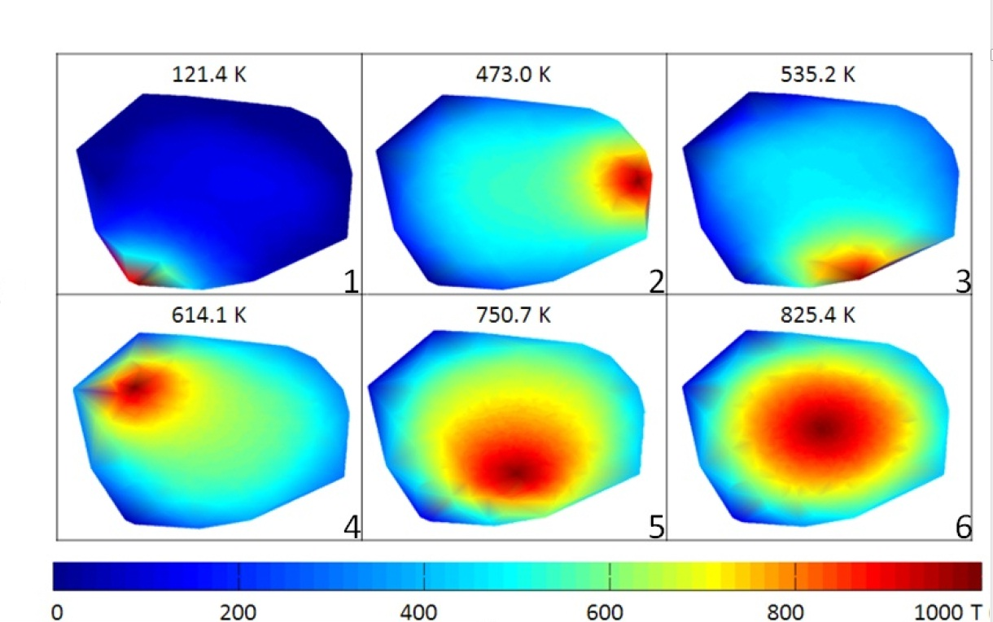
Position of heat source
How position of the heat source affects the heat flow across the graph?

Slide 38
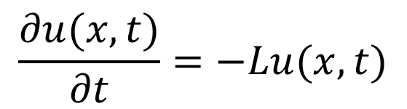
Heat Equation
Heat equation
The heat flow across the graph is governed by the heat equation:

Slide 39
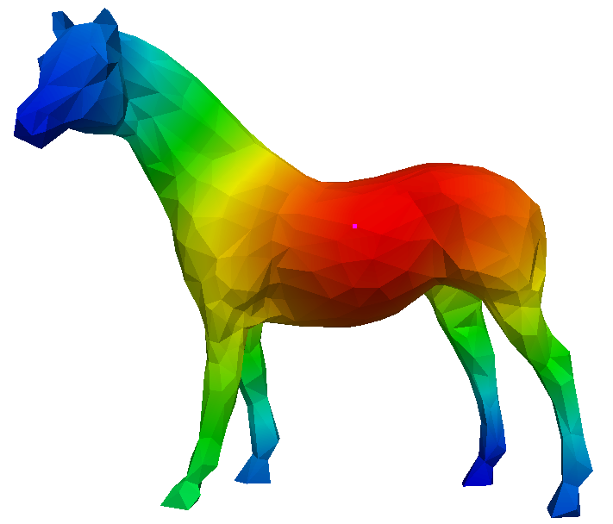


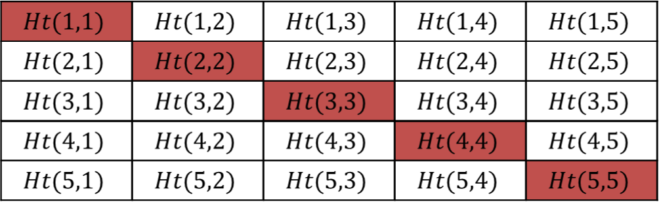


P3
P2
P1
The heat kernel provides the fundamental solution
of the heat equation.
P5
P4
P1 P2 P3 P4 P5
P1 P2 P3 P4 P5
Simple 5*5 Heat Kernel Matrix

Slide 40

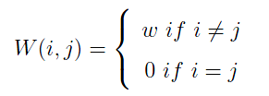










where
and
V_{i}
V_{j}

Slide 41
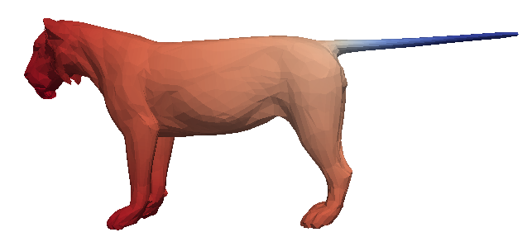
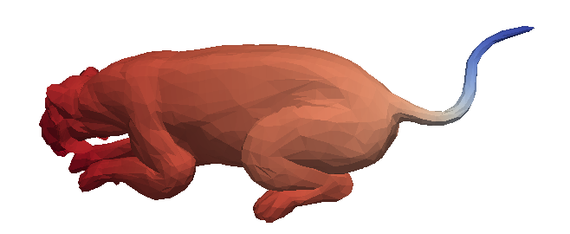
Diffusion Distance Mapped on Surface

Slide 42
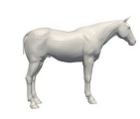
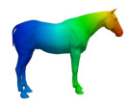
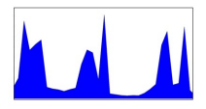
Distance based global shape descriptor
Shape distance distribution: Representing the description of an object as a shape distribution sampled from a shape distance function measuring global geometric properties of an object.
Model
Distance Function
Shape Descriptor

Slide 43
Number of Points
Distance Value

Slide 44
What is the number of vertices is different?
Normalize the histogram by the total number of vertices.
Percentage
Distance Value

Slide 45
ED Shape Descriptor
Robust to rotation and translation
Sensitive to noise
Sensitive to deformation

Slide 46
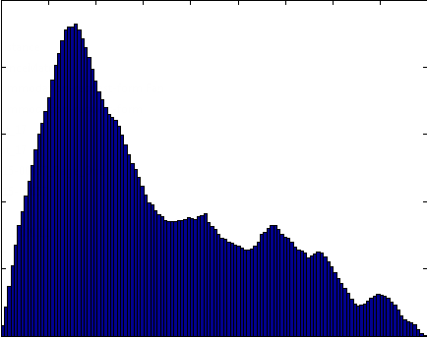

Slide 47
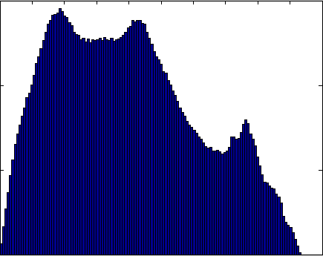

Slide 48
GD Shape Descriptor
Robust to rotation and translation
Robust to deformation
Sensitive to noise

Slide 49

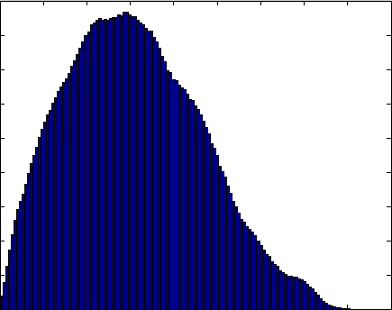


Slide 50
DD Shape Descriptor
Robust to rotation and translation
Robust to noise
Robust to deformation

Slide 51
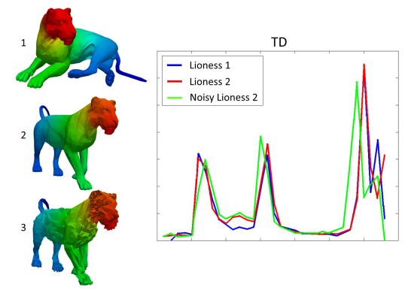
Yi Fang, Temperature distribution descriptor for robust 3D shape retrieval, 2015, CVPR

Slide 52
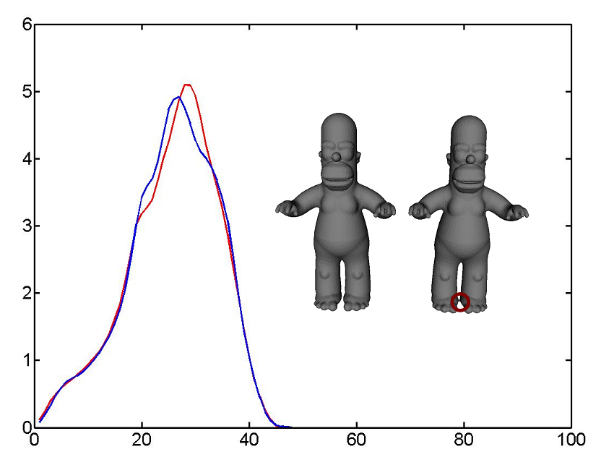
Raif, Laplace-Beltrami Eigenfunctions for Deformation Invariant Shape Representation, 2007, SGP

Slide 53
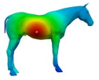
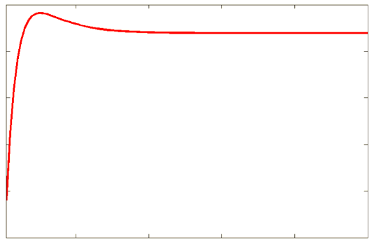
Distance based point shape signature
Point shape signature: Representing the description of a point on the surface as a shape distribution sampled from a shape distance function measuring local geometric properties of an object.
Model
Distance Function
Point Shape Signature

Slide 54
Number of Points
Distance Value

Slide 55
DD Based Point Shape Signature
Robust to rotation and translation
Robust to noise
Robust to deformation

Slide 56
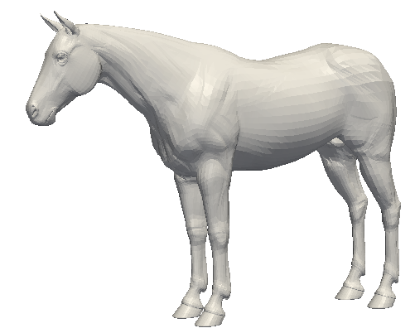
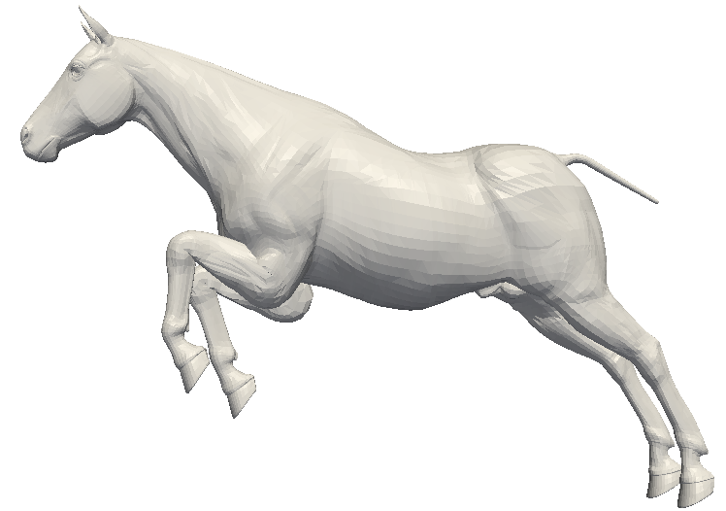






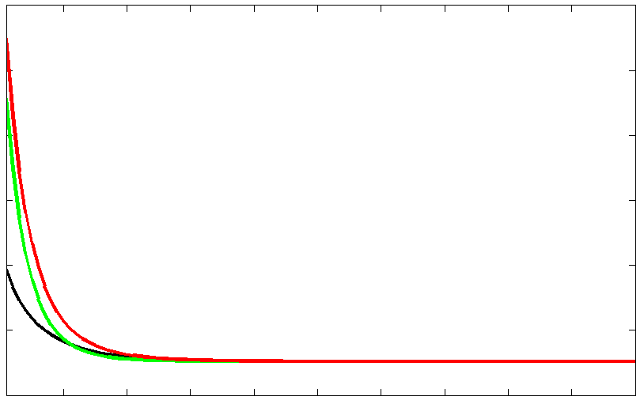
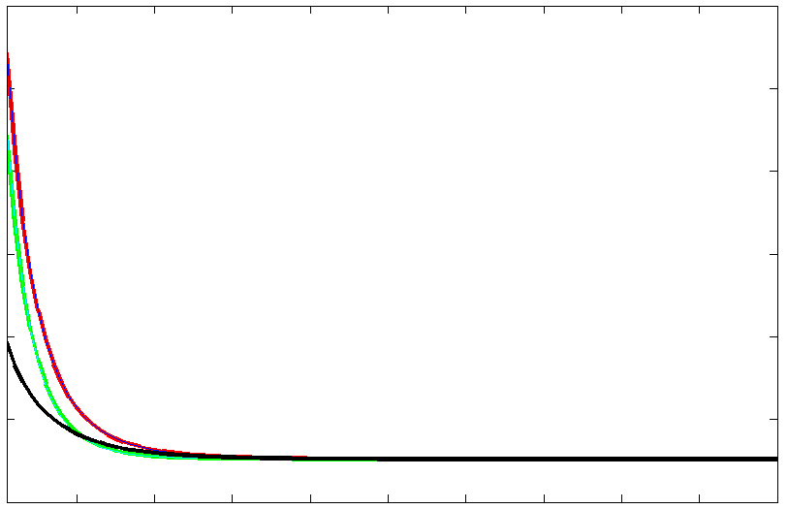

Slide 57
Paraview Tutorial
Mapped a function value on the surface
Example: Mapped Geodesic Distance Function with a reference to source node

Slide 58
How to map function value on 3D surface using Paraview?

Slide 59
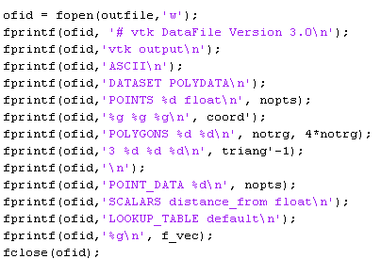
Output a new VTK file with function value mapped on the surface
Function values

Slide 60
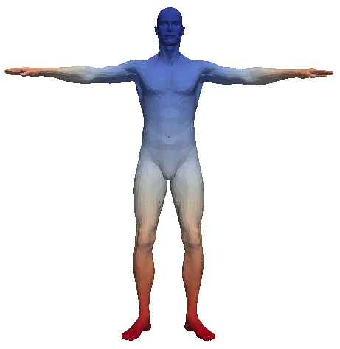


Mapping with different function values

Slide 61
Optional Assignment
Write program for ED and GD graph for a mesh file.
Mapped the ED and GD on a mesh and using paraview display it.

Slide 62
Reading Assignment
Raif, Laplace-Beltrami Eigenfunctions for Deformation Invariant Shape Representation, 2007, SGP
ROBERT OSADA, Shape Distributions, 2002, TOG

