Slide 1
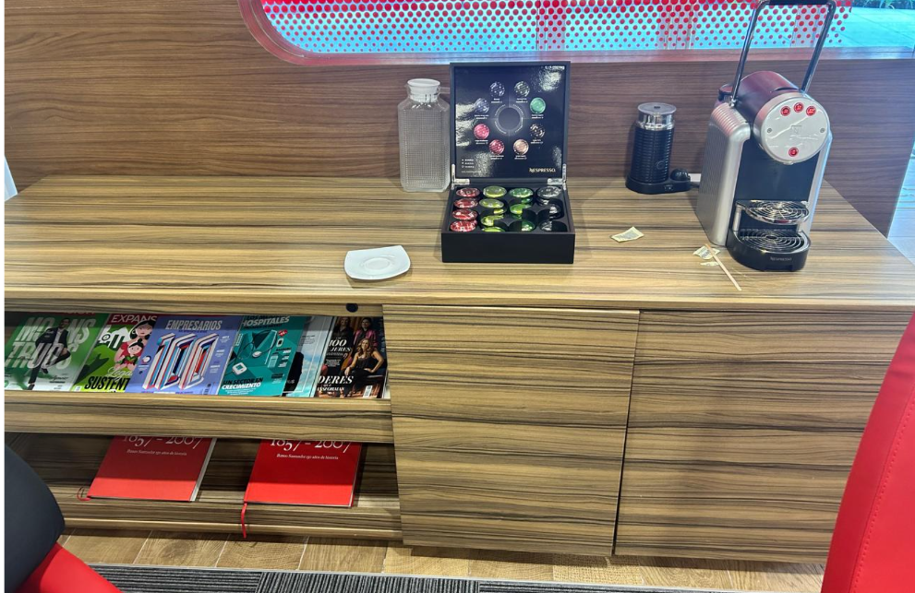

40 cm
180 cm
75 cm

Slide 2
