Slide 1
PYTHON NANOCOURSE- DAY 2
Sruthi Chappidi

Slide 2
Agenda
Strings Review
Loops
Data Structures
Modules and Packages
I/O and Files

Slide 3
Resources
Coursera: Python for Genomic Science
Cold Spring Harbour
DataCamp -python course
https://www.python-course.eu/
https://www.learnpython.org

Slide 4
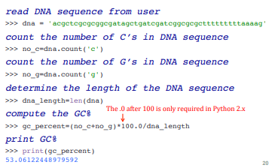
Strings- Review
Notes:
(1) Review of strings

Slide 5
Loops
Collection-controlled loops
For loops
Condition-controlled loops
While loop
Notes:
Big picture idea: Computers can do a ton of boring things quickly (and quite happily). You can leverage that power if you can program.
Will be able to: automate repetitive arithmetic tasks without making errors is something Which are iterations and very common
reason I am introducing loops here is If-statements are simplistic and useless without loops.
One form of iteration are for and while loops: Repeated execution of a set of statements using either a recursive function call or a loop.
Collection-controlled loop This is a special construct which allow looping through the elements of a "collection", which can list, tuples or other ordered sequence.
Condition-controlled loop A loop will be repeated until a given condition changes, i.e. changes from True to False or from False to True, depending on the kind of loop. There are while loops and do while loops with this behaviour.

Slide 6
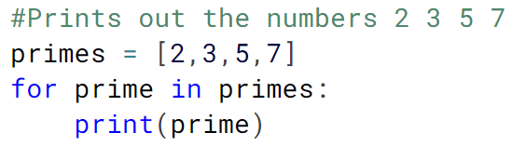
For Loop
Collection-controlled loop
For loops iterate over list or characters in a given sequence .
For loops can iterate over a sequence of numbers using the "range" function.
range() function returns a new list with numbers of that specified range
>>> range(5)
range(0, 5)
>>> list(range(5))
[0,1, 2,3,4]
>>>list(range(4,10,2)
4 6 8
Notes:
https://www.learnpython.org/en/Loops
This is next example is using a for loop to iterating over a string. Remember a string is a sequence like a list. Each character has a position. Look back at "Extracting a Substring, or Slicing" in the Strings section to see other ways that strings can be treated like lists.
Range will return [0,5)
# start at 4 end <10 with increment of 2
(start, end, increment)

Slide 7
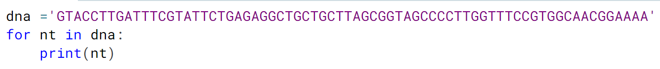
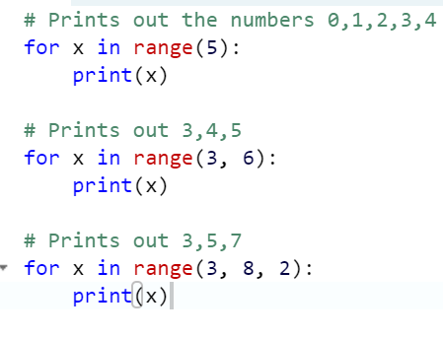
Example
Using a for loop to iterating over a string of DNA sequence. Remember a string is a sequence like a list.
range(stop)
range(start, stop):
range(start,stop,step)
Notes:
range(stop)
range(start, stop):
(0,3) →[0,3)
[0,1,2]
range(start,stop,step)

Slide 8
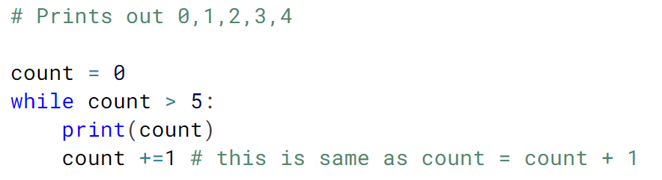
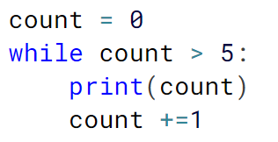
While Loop
Repeats loop as long as a certain Boolean condition is met
+= is an assignment operation that adds to the variable and later assigns the same
Infinite Loop
Notes:
flow of execution for a while statement:Evaluate the condition, yielding True or False.
Count +=1
+= is an assignment operatior and when followed by an expression with a numerical value,
If the condition is false, exit the while statement and continue execution at the next statement.
If the condition is true, execute the body and then go back to step 1.
Infinite Loop
While (True):
print 1

Slide 9
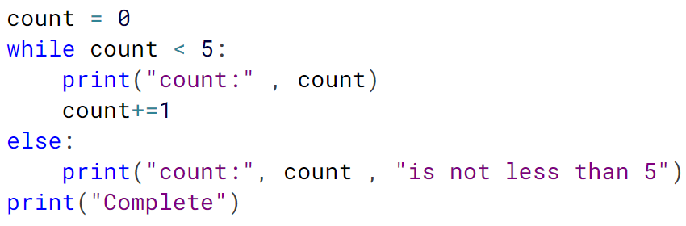
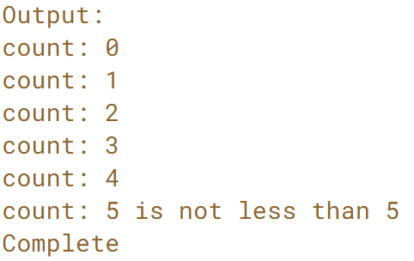
While Loop ( Cont’d)
Similar to the if statement, while loop can also have else part
Notes:
flow of execution for a while statement:Evaluate the condition, yielding True or False.
Count +=1
+= is an assignment operatior and when followd by an expression with a numerical value,
If the condition is false, exit the while statement and continue execution at the next statement.
If the condition is true, execute the body and then go back to step 1.
Infinite Loop
While (True):
print 1

Slide 10
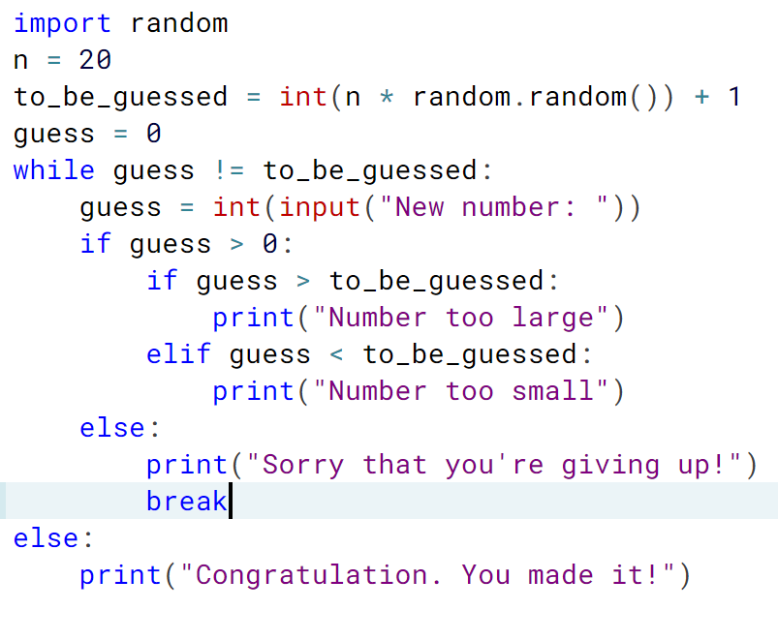
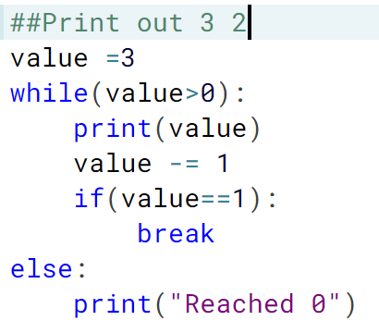
Loop Control: "break"
break is used to exit a for loop or a while loop
Notes:
USE Notebook
a while loop only ends, if the condition in the loop head is fulfilled.
With the help of a break statement a while loop can be left prematurely, i.e. as soon as the control flow of the program comes to a break inside of a while loop (or other loops) the loop will be immediately left.
"break" shouldn't be confused with the continue statement. "continue" stops the current iteration of the loop and starts the next iteration by checking the condition.
A loop is terminated when a break statement is executed. All the lines of code after the break, but within the loop block are not executed. No more iteration of the loop are preformed
Code:
##Print out 3 2
value =3
while(value>0):
print(value)
value -= 1 # equivalent to value = value -1
if(value==1):
break
else:
print("Reached 0")

Slide 11
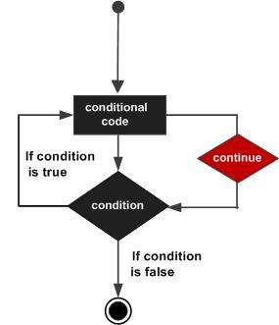
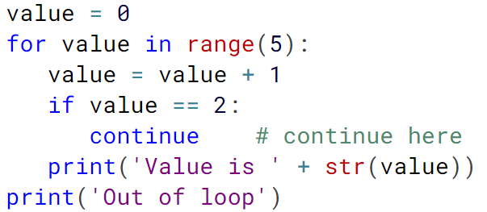
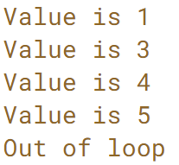
Loop Control: “continue"
Continue is used to skip the current iteration and return to the "for" or "while" statement.
Notes:
a while loop only ends, if the condition in the loop head is fulfilled.
"break" shouldn't be confused with the continue statement. "continue" stops the current iteration of the loop and starts the next iteration by checking the condition.
When a continue statement is encountered inside a loop, control jumps to the beginning of the loop for next iteration, skipping the execution of statements inside the body of loop for the current iteration.

Slide 12
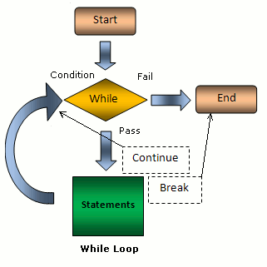
Notes:
This figure will clearly show

Slide 13
Exercises
Day2_Lesson3_Exercise1.ipynb
1.1, 1.2
Extra Practice: https://codingbat.com/python
String-2
Notes:
3.1 : loop and range
3.2 : loop and if
3.3 : break
3.4 : continue
Lists and Loops

Slide 14
DATA STRUCTURES

Slide 15
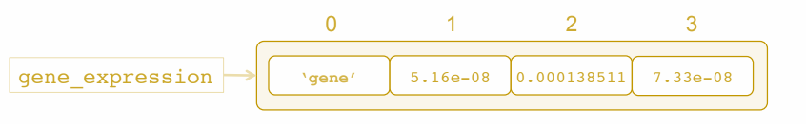
Lists
An ordered, indexed collection of values/data.
Enclosed with square brackets and elements are separated by commas
['gene', 5.16e-08, 0.000138511, 7.33e-08]
Variable to hold list:
gene_expression=['gene', 5.16e-08, 0.000138511, 7.33e-08]
Notes:
List data structure is a way to make a list without typing out each element. There are many many ways to use list comprehension to generate lists. Some are quite complex, yet useful.
# lists are declared by surrounding its elements with a pair of brackets
Lists are used to store an ordered, indexed collection of data.
the order of their elements do not rearrange unintentionally
Gene expression variable is location to pointer in memory
Similar to string the list index will start from 0
Example is with gene strings and three value representing p-value to show significance of this gene expression under three different conditions.
We can not only access individual elements in a list, but we can also change their values. Change gene name in our list instead of just a string gene. let's say this is the name Lif,
Gene_expression[0] = ‘Lif’
Mutable: the number of elements in the list and what's stored in each element can change\

Slide 16
Examples of Lists
numbers = [1, 2, 3, 4]
mixed_numbers = [5, 6.5, 1.23, 6.5]
fruits = ['apples', 'oranges', 'blueberries']
empty_list = []
lists = [numbers, mixed_numbers, fruits, empty_list]
lots_of_stuff = [7, [1, 'hello'], 3.21, '12', 7, lists]
Notes:
dna_list =['TAGC','ACGTATGC','ATG','ACGGCTAG’]
lengths = []# empty list
for dna in dna_list: l
lengths.append(len(dna))print(lengths)

Slide 17
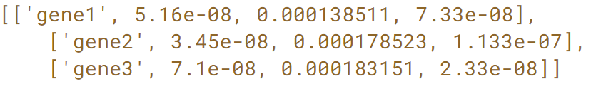
Nested Lists
A list may also be nested within another list
gene_expression1=['gene1', 5.16e-08, 0.000138511, 7.33e-08]
gene_expression2=['gene2’, 3.45e-08, 0.000178523, 11.33e-08]
gene_expression3=['gene3’, 7.1e-08, 0.000183151, 2.33e-08]
gene_expression = [gene_expression1, gene_expression2, gene_expression3]
print(gene_expression)
Notes:
Access individual list elements
# what is the length of films list?
len(films)

Slide 18
Accessing and Slicing Lists
Mutable. Element can be replaced by element
>>>gene_expression1[0] = ‘TNF’
>>>print(gene_expression1)
['TNF', 5.16e-08, 0.000138511, 7.33e-08]
Accessing List
>>> print(gene_expression1[0])
TNF
Slicing Lists - it will create a new list and doesn’t modify existing list
>>> print(gene_expression1[-3:] )
[5.16e-08, 0.000138511, 7.33e-08]
Change Content:
>>>gene_expression1[1:3]=[6.09e-07]
[‘TNF’, 6.09e-07, 7.33e-08]
Clear list:
>>>gene_expression1[:] =[]
>>>gene_expression1.clear()
Notes:
Unlike strings which are immutable, lists are a mutable type! → you can modify the content of indexed element
Just as we did with string, we can slice lists too. And the slice operation on a list or return on your list containing the requested elements in the slice.
This means that the following slice, gene expression of -3, colon, nothing, square bracket, returns a new copy of the list
#slicing:
From index 1 or -3 till the end
[start,end] = [1:3)
Start at second element and end at 4th element in the list but not include it

Slide 19
List Methods
Concatenate lists:
>>> gene_expression1 + [5.16e-08, 0.000138511]
[‘TNF', 6.09e-07, 9.33e-08, 5.16e-08, 0.000138511]
Length:
>>>len(gene_expression1)
3
Append - adds as a single element to list; length of the list increasing by one
>>> dna_seq = [‘ATCGCGATAG’, 10]
>>>gene_expression1.append(dna_seq)
[‘TNF', 6.09e-07, 9.33e-08, 5.16e-08, 0.000138511, [‘ATCGCGATAG’, 10]]
Extend - adds each element to list and length of list will increase based on number of elements added.
>>>gene_expression1.extend([‘test_string1’,’test_string2’])
[‘TNF', 6.09e-07, 9.33e-08, 5.16e-08, 0.000138511, [‘ATCGCGATAG’,10], ‘ATCGCGATAG’, 10]
Insert - add item in a particular index in the list
>>>gene_expression1.insert(4, “TNF”)
[‘TNF', 6.09e-07, 9.33e-08, 5.16e-08,’TNF’, 0.000138511, [‘ATCGCGATAG’,10],‘ATCGCGATAG’, 10]
Notes:
a method to extend a list by appending all the items in a given list: multiple items at ones
append : add one item at a time. Add list of elements as one element
Extend will takes list of items and adds then a invidually to list
len(gene_expression1) = 3 because concatenate doesn’t modify the list like
gene_expression1.insert(4, “TNF”) --> will add at 4th index or move before 4th index

Slide 20
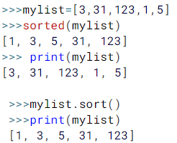
List Methods
count() - occurrence of elements
>>>gene_expression1.count(‘TNF’)
2
reverse()
>>>gene = [1, ‘brca1’, ‘cancer’]
>>>gene.reverse()
[‘cancer’, ‘brca1’, 1]
Sorting
sorted(mylist) : doesn’t modify original list
mylist.sort() : modifies the list
Notes:
>>> mylist=[3,31,123,1,5]
>>> sorted(mylist) [1, 3, 5, 31, 123]
>>> mylist [3, 31, 123, 1, 5
>>> mylist.sort()

Slide 21
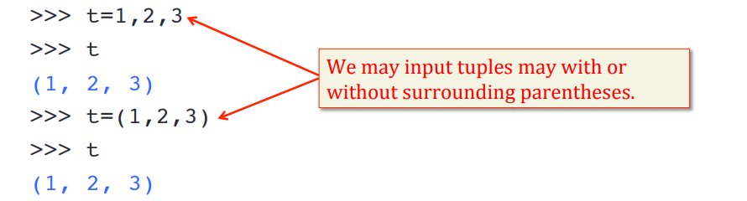
Tuples
A tuple consists of sequence of values separated by commas, and is another standard sequence data type, like strings and lists.
A tuple can have items with different types (integer, float, list, string etc.).
A list can have tuples as elements
>>>myList =[(1,2,3),(4,5,6),(7,8,9)]
Notes:
Tuples have many common properties with lists, such as indexing and slicing operations, but while lists are mutable, tuples are immutable, and usually contain an heterogeneous sequence of elements.
A tuple is created by placing all the items (elements) inside a parentheses (), separated by comma. The parentheses are optional but is a good practice to write it.

Slide 22
Tuples
Tuples share similar properties with lists
indexing
slicing
concatenation
>>> print((1, 2, 3) + (4, 5, 6))
1, 2, 3, 4, 5, 6
Tuple are used for heterogeneous (different) data types
>>> mixed_tuple = (1,’a’,2,’b’)
Tuple are immutable,
Once created it cant be changed: cannot remove tuple item
gene_expression1[0] = ‘TNF’
iterating through tuple is faster than with list. So there is a slight performance boost.
Notes:
Tuples have many common properties with lists, such as indexing and slicing operations, but while lists are mutable, tuples are immutable, and usually contain an heterogeneous sequence of elements.

Slide 23
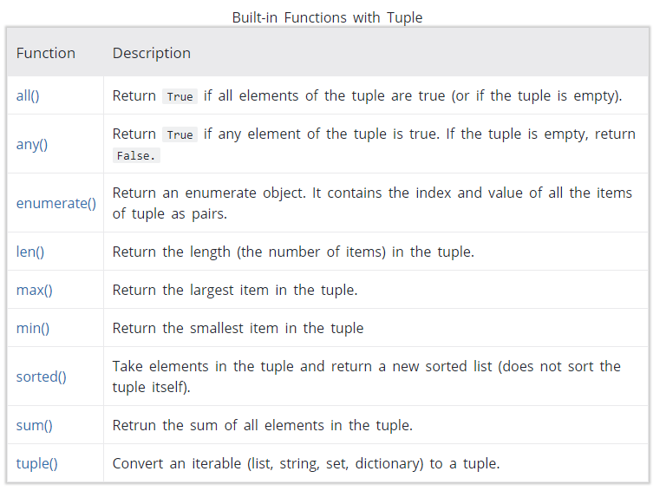
Tuples Method
Notes:
len()
sorted()
sum()
tuple()
We can test if an item exists in a tuple or not, using the keyword in.
count(‘x’)
index(‘x’)

Slide 24
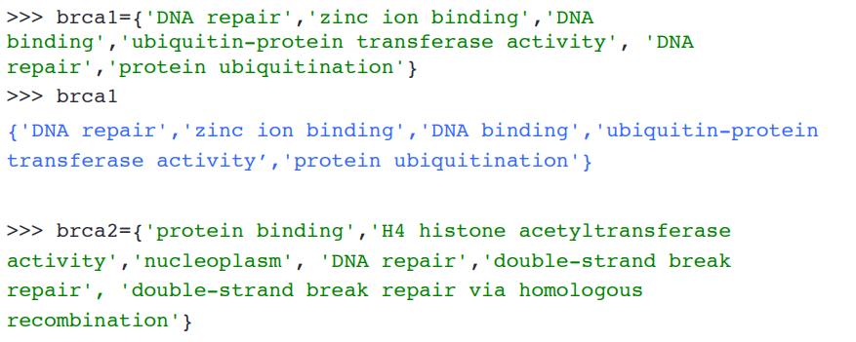
Sets
An unordered collection of elements and values
Sets do not support indexing, slicing, or other sequence-like behavior.
No duplicate elements
Supports mathematical operations like union, intersection, and difference
Notes:
Make sure to explain further what union, intersection and difference are for new users.
curly braces
Being an unordered collection, sets do not record element position or order of insertion.
BReast CAncer susceptibility gene

Slide 25
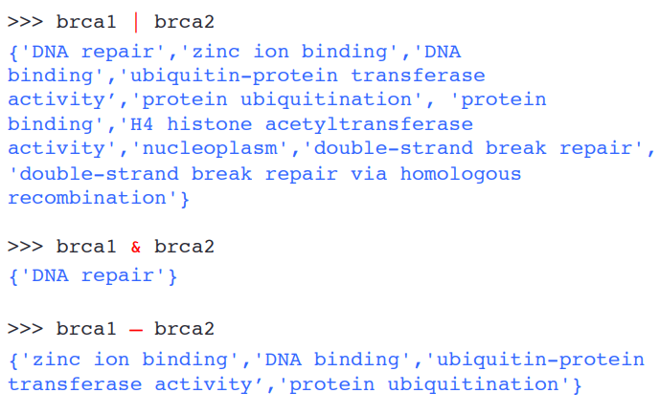
Operations With Sets
Union
Intersection
difference
Notes:
Union |
intersection &
difference -

Slide 26
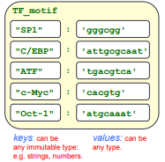
Dictionaries
Unordered set of key and value pairs and not sequence like string and list.
Dictionaries are a collection of key/value pairs enclosed by {}.
keys must be unique within one dictionary and immutable
No duplicate keys, but there can be duplicate values
colon (:) to separate key from its value(s) and commas to separate elements/values.
Use dictionaries with two pieces of information that naturally go together, like gene name and sequence.
TF_motif = {
‘SP1' : 'gggcgg’,
'C/EBP':'attgcgcaat’,
'ATF':'tgacgtca’,
'c-Myc':'cacgtg'}
Notes:
TF_motif (Transcription Factor) : recognition sequence for ATF transcription
Dictionaries are another iterable, like a string and list. Unlike strings and lists, dictionaries are not a sequence, or in other words, they are unordered and the position is not important.
Empty dictionary without any items is written with just two curly braces, like this: {}
Each key in a dictionary is unique, while values may not be. The values of a dictionary can be of any type, but the keys must be of an immutable data type such as strings, numbers, or tuples.
TF_motif={'SP1' : 'gggcgg', 'C/EBP':'attgcgcaat', 'ATF':'tgacgtca','c-Myc':'cacgtg'}

Slide 27
Dictionaries (Cont’d)
Accessing Values
>>>print(“The recognition sequence for the ATF transcription is.”, TF_motif['ATF'])
The recognition sequence for the ATF transcription is tgacgtca.
Adding new key: value pair to dictionary
>>> TF_motif['BARHL1’]='tgagtca'
{'ATF': 'tgacgtca', 'c-Myc': 'cacgtg', 'SP1': 'gggcgg', 'C/EBP': 'attgcgcaat', 'BARHL1’: 'tgagtca'}
Modify Existing entry
>>> TF_motif['BARHL1’]='tg(a/t)agtca'
{'ATF': 'tgacgtca', 'c-Myc': 'cacgtg', 'SP1': 'gggcgg', 'C/EBP': 'attgcgcaat', 'BARHL1’: 'tg(a/t)agtca’}
Delete a key from dictionary
>>>del TF_motif[‘sp1’]
{'ATF': 'tgacgtca', 'c-Myc': 'cacgtg', 'C/EBP': 'attgcgcaat, 'BARHL1’: 'tg(a/t)agtca’}
Notes:
The sequence of the gene TP53 is stored as a value of the key 'TP53'. We can assess the
sequence by using the key in this format dict[key]
To Access: we need to check if key is there, which can be done with ‘key’ in TF_motif

Slide 28
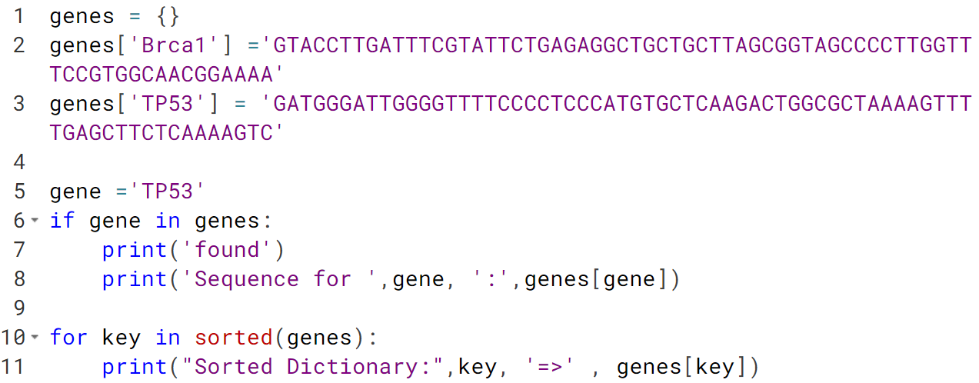
Dictionaries (Cont’d)
Listing all values and keys: keys() and values() methods
>>>list(TF_motif.keys())
['ATF', 'c-Myc', 'SP1', 'C/EBP', 'Oct-1', 'BARHL1']
>>>list(TF_motif.values())
['tgacgtca', 'cacgtg', 'gggcgg', 'attgcgcaat', 'atgcaaa', 'tg(a/t)agtca']
Sorted() method
Values can be lists
>>>mydict = {'fruits': ['banana', 'apple', 'orange'], 'vegetables': ['pepper’, 'carrot']}
Notes:
The sequence of the gene TP53 is stored as a value of the key 'TP53'. We can assess the
sequence by using the key in this format dict[key]
To Access: we need to check if key is there, which can be done with ‘key’ in TF_motif
----code:
genes = {}
genes['Brca1'] ='GTACCTTGATTTCGTATTCTGAGAGGCTGCTGCTTAGCGGTAGCCCCTTGGTTTCCGTGGCAACGGAAAA'
genes['TP53'] = 'GATGGGATTGGGGTTTTCCCCTCCCATGTGCTCAAGACTGGCGCTAAAAGTTTTGAGCTTCTCAAAAGTC'
gene ='TP53'
if gene in genes:
print('found')
print('Sequence for ',gene, ':',genes[gene])
for key in sorted(genes):
print(“Sored Dictionary: ” key, ‘=>’, genes[key])

Slide 29
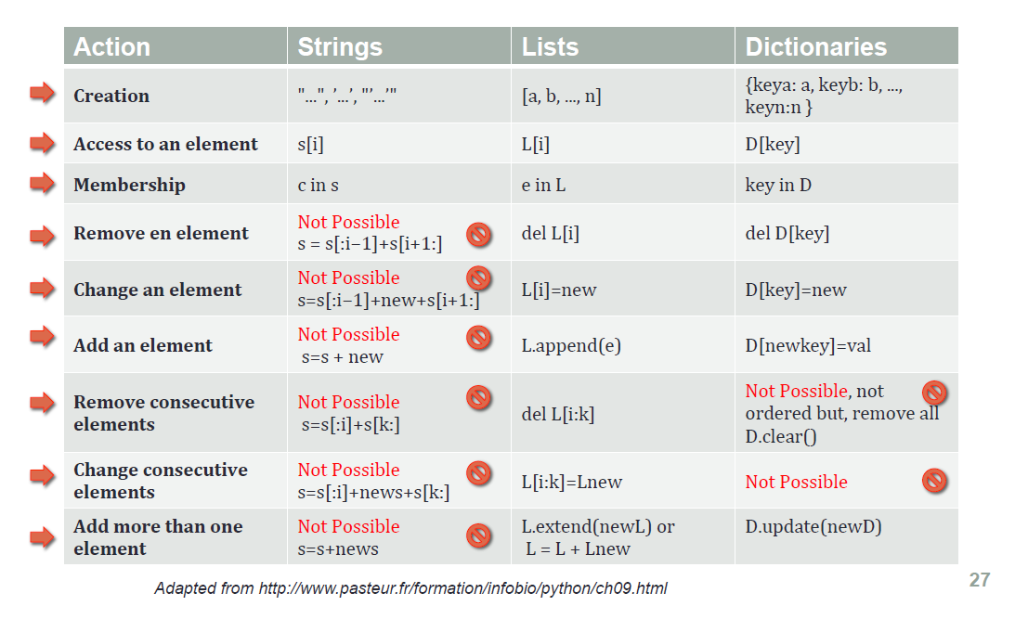

Slide 30
Exercises
Day2-Lesson-3-Exercise1.ipynb

Slide 31
MODULES AND PACKAGES
Notes:
We could put all the functions we wrote to process a DNA sequence in a File called, for instance, dnautil.py

Slide 32
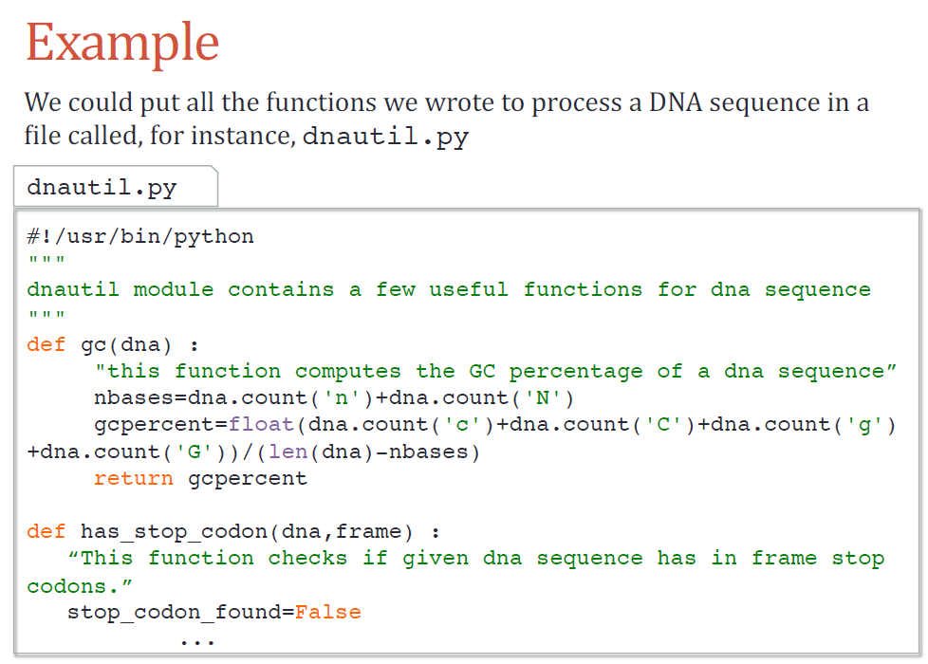
Modules
Python file with libraries of code, which contain definitions of functions , or variables.
Grouping related code into a module makes the code easier to understand and use
To create a module just save the code you want in a file with the file extension .py
Notes:
Python modules are libraries of code and you
You have been using Modules already such as Math

Slide 33
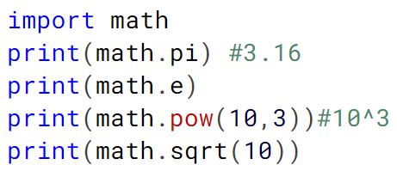
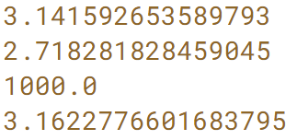
Built-in Modules : Math
math is a module, which is standard library with several function.
Explore all the functions in a module using the built-in function dir().
>>>dir(math)
[ 'ceil', 'cos', 'cosh', 'degrees', 'exp', 'fabs', 'factorial', 'floor', 'gcd', 'log' 'log10', 'pi', 'pow', 'radians', 'sin',....]
Notes:
We're going to import the math module by saying "import math". The module comes with several functions. We're just going to demonstrate a couple of them. For example, if I wanted to use the value of pi, I would type math.pi and Python would tell me the value of pi, 3.14, and so on. The math module also comes with several functions, or methods. Let's try out the square root function. To use that, I type math.sqrt and the input argument is the number that I want the square root to be taken of. So in this case, I've asked Python to return the value of square root of 10. Let's do something a little more sophisticated. What if I wanted to find out the value of sin pi over 2? Let's first extract the value of pi, which we know is math.pi. We can then take this number and divide that by 2. So this is pi over 2. To take the sin of this number, we say math.sin and use math.pi over 2 as an input to the sin function. And as expected, Python tells us the sin of pi over 2 is exactly 1. Sometimes, we don't want to use the entire module. Perhaps we just want to choose one function from that module. Let's think about a situation where I just need to be able to have the value of pi available to me in my program. So I didn't need anything else from the math library, just the value of pi. To do that, I can do the following-- I can tell Python from math, import pi. In this case, Python has imported just the value of pi from that module and nothing else. Let's talk a little bit about namespaces. What is a namespace? Well namespace is a container of names shared by objects that typically go together. And its intention is to prevent naming conflicts. Perhaps the best way to understand namespace is through an example. So let's do the following. Let's import the math module first. We're then going to import the numpy module as np. Now, the math module has a square root method, sqrt, but numpy also has a square root method, sqrt. What is the difference between these two functions? Well, let's try an example. If I type math.sqrt, I can ask Python to calculate the value of the square root of 2. I can do the same exact thing using the square root function from the numpy module.

Slide 34
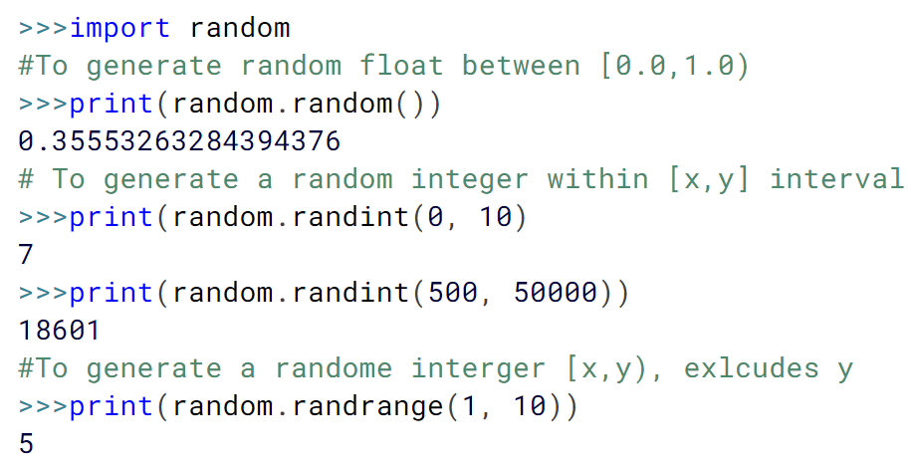
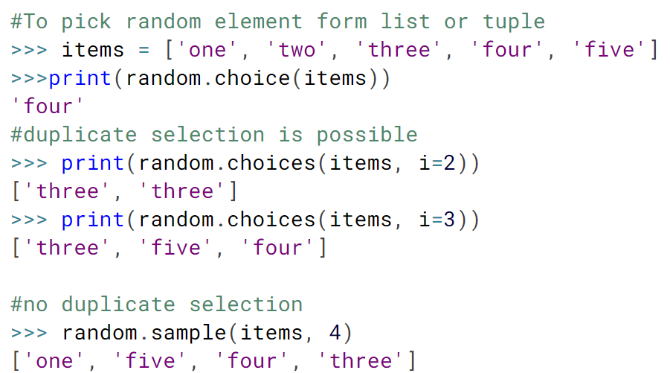
Built-in Modules: Random
random module is the most widely known tool for generating random data
random(), randint(x,y), randrange(x,y),
Random selection of items from List and Tuple:
choices(list/tuple, number picks) : will select duplicate values
sample(list/tuple, number picks) : will select unique values
Notes:
#Use jupyter notebook
To pick a random element from a non-empty sequence (like a list or a tuple), you can use random. Choice().
There is also random. Choices() for choosing multiple elements from a sequence with replacement (duplicates are possible):
>>>import random
#To generate random float between [0.0,1.0)
>>>print(random.random())
0.35553263284394376
# To generate a random integer within [x,y] interval
>>>print(random.randint(0, 10)
7
>>>print(random.randint(500, 50000))
18601
#To generate a randome interger [x,y), exlcudes y
>>>print(random.randrange(1, 10))
5
#To pick random element form list or tuple
>>> items = ['one', 'two', 'three', 'four', 'five']
>>> random.choice(items)
'four'
>>> random.choices(items, k=2)
['three', 'three']
>>> random.choices(items, k=3)
['three', 'five', 'four']

Slide 35
Example: dnautil Module
Notes:
Notebook

Slide 36
Using Modules
Using import statements , we can use modules
>>>import dnautil
>>>dna = “atgagggctaggt”
>>>dnautil.gc(dna)
0.5384615384615384
import all functions using:
>>> from dnautil import *
>>>gc(dna)
Or import few selected functions
>>> from dnautil import gc,has_stop_codon
Notes:
When importing using the from keyword, do not use the module name when referring to elements in the module. Example: person1["age"], notmymodule.person1["age"]
Note: Module being imported should be in your directory to avoid errors

Slide 37
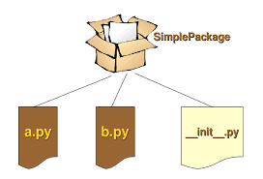
Packages
Consists of multiple modules.
Each package in Python is a directory which MUST contain a special file called __init__.py.
Notes:
__init_py: This file can be empty, and it indicates that the directory it contains is a Python package, so it can be imported the same way a module can be imported.
Each package in Python is a directory which MUST contain a special file called __init__.py. This file can be empty, and it indicates that the directory it contains is a Python package, so it can be imported the same way a module can be imported.
If we create a directory called foo, which marks the package name, we can then create a module inside that package called bar. We also must not forget to add the __init__.py file inside the foo directory.
To use the module bar, we can import it in two ways:

Slide 38
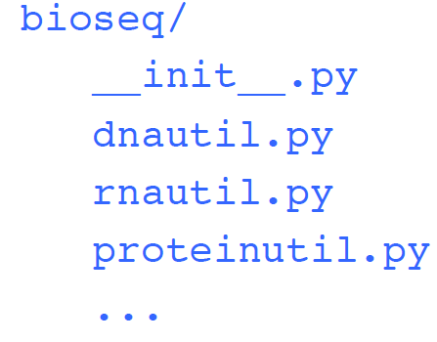
Packages Example
bioseq - Package to process all types of biological sequences
dnautil.py - file/module containing useful functions to process DNA sequences
rnautil.py -file/module containing useful function to process RNA sequences
proteinutil.py -file/module containing useful function to process protein sequences
To use proteinutil module from bioseq package
>>>import bioseq.dnautil
>> from bioseq import dnautil
Numpy, Pandas, Keras
Notes:
__init_py: This file can be empty, and it indicates that the directory it contains is a Python package, so it can be imported the same way a module can be imported.
Possible structure for bioseq module

Slide 39
I/O and Files

Slide 40
I/O: Input/Output
I/O stands for input/output. The in and out refer to getting data into and out of your script.
Why I/O?
Real programs interact with the world
They read and write ﬁles
They send and receive messages
Examples of I/O:
Writing to the screen
Reading from the keyboard
Reading from a file
Writing to a file
Notes:
I/O stands for input/output. The in and out refer to getting data into and out of your script. It might be a little surprising at first, but writing to the screen, reading from the keyboard, reading from a file, and writing to a file are all examples of I/O.
Exercises: http://www.dabeaz.com/python3io/index.html
Exercises:
https://www.techbeamers.com/python-file-handling-quiz-part-1/

Slide 41
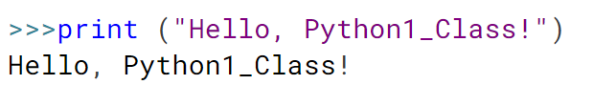
Writing to the Screen
The simplest way to produce output is using the print() statement
You can pass zero or more expressions separated by commas.
This function converts the expressions you pass into a string and writes the result to standard output as follows
Notes:
I/O stands for input/output. The in and out refer to getting data into and out of your script. It might
be a little surprising at first, but writing to the screen, reading from the keyboard, reading from a
file, and writing to a file are all examples of I/O.
It might be a little surprising at first, but ..
Exercises: http://www.dabeaz.com/python3io/index.html
Exercises:
https://www.techbeamers.com/python-file-handling-quiz-part-1/

Slide 42
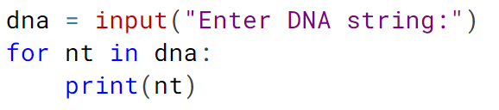
2. Reading from keyboard
There is a function which prints a message to the screen and waits for input from the keyboard. This input can be stored in a variable.
Built-in function : input()
reads one line from standard input and returns it as a string (removing the trailing newline).
-prints a message to the screen and waits for input
-from the keyboard. This input can be stored in a variable.
Notes:
I/O stands for input/output. The in and out refer to getting data into and out of your script. It might
be a little surprising at first, but writing to the screen, reading from the keyboard, reading from a
file, and writing to a file are all examples of I/O.
It might be a little surprising at first, but ..
Exercises: http://www.dabeaz.com/python3io/index.html
Exercises:
https://www.techbeamers.com/python-file-handling-quiz-part-1/
dna = input("Enter DNA string:")
for nt in dna:
print(nt)

Slide 43
2. Reading from keyboard(Cont’d)
Python sys module provides file handlers for the standard input, output and error
>>>sys.stdin.read()
first line from file
another line to file (Ctrl-D)
‘first line from file\nanother line to file\n’
>>>sys.stdout.write(“writing output to file.\n”)
writing output to file
22
>>dir(sys)
['argv', 'callstats', 'copyright', 'displayhook', 'dont_write_bytecode', 'exc_info', 'excepthook', 'exec_prefix', 'executable', 'exit', 'flags', 'float_info', 'float_repr_style', 'get_coroutine_wrapper', 'is_finalizing', 'modules', 'path', ‘ 'setswitchinterval', 'settrace', 'stderr', 'stdin', 'stdout', 'thread_info', 'version', 'version_info', 'warnoptions']
Notes:
Reading until CTRL-D or you can have character to indicate end with while loop condition
Then prints the file content
Write: prints number of character written to file

Slide 44
3. File I/O: Reading From a File
Python provides basic functions and methods necessary to manipulate files by default.
open() function returns with a file object, which is similar as string and list object
Reading from a File
Open file using file_object = open(filename, mode)
>>>file_object = open(“seq.nt.fa”,”r”)
The most common access modes:
r: reading is the default value for mode parameter
r+: for both reading and writing
w: writing
w+: for both reading and writing
Close file using file.close()
Notes:
If the file already exists using mode ‘w’ truncates its content.
To append to the end of the @ile, if it exists, use mode ‘a’:
Until now, you have been reading and writing to the standard input and output. Now, we will see how to use actual data files.
Python provides basic functions and methods necessary to manipulate files by default.
Most of the data we will be dealing with will be contained in files. (fasta files, csv files or Genbank, BAM/SAM)
The first thing to do with a file is open it. We can do this with the open() function. The open() function takes the file name, access mode as arguments and returns a file object.
The most common access modes are reading (r) and writing (w).
Why close:
Many changes to files in python do not get saved until after the file is closed, so if your script edits, leaves open, and reads a file, it won't see the edits.
It can slow down your program. Too many things open, and thus more used space in the RAM, will impact performance.

Slide 45
3. File I/O: Reading From a File (cont’d)
There are number of ways to read from File
read(): all content till end of the file as string
>>>file = open(“myFile.txt”, “r”) >>>print file.read()
read(n): reads first n number of characters
>>print file.read(5)
Hello
readline(): reads single line of information from file at a time
>>print file.readline()
Hello World
>>print file.readline(5)
and this is another line
readlines(): reads all lines in properly separated format
>>print file.readlines()
[‘Hello World’, ‘This is our new text file’, ‘and this is another line.’]
seek(n): to change the file object position
>>print file.seek(0) # go to beginning of the file
0
myFile.txt
Hello World This is our new text file and this is another line.

Slide 46
4. File I/O: Writing to a File
Writing to a File
Open file using file_object.open(filename, mode)
>>>file_object = open(“seq.nt.fa”,”w”)
The most common access modes:
w: writing
w+: for both reading and writing
a: for appending. The file pointer is at the end of the file if the file exists. If the file does not exist, it creates a new file for writing
Close file using file.close()

Slide 47
4. File I/O: Writing to a File (Cont’d)
Creating and Writing to File
write(string): write the contents of string to the file and return number of characters written
>>>file = open(‘myFile.txt’, ‘w’) >>>print file.write(‘Add new line’)
12
>>>file.close()
Writing to a Existing file: mode = a
>>>file = open('/Users/mpertea/Work/courses/python/myfile',a’) >>>print file.write(‘Last line of file’)’
18
>>>file.close()
myFile.txt
Hello World This is our new text file and this is another line.
Add new line
Last line of file
Notes:
Why close:
Many changes to files in python do not get saved until after the file is closed, so if your script edits, leaves open, and reads a file, it won't see the edits.

Slide 48
File handling
Looping: another efficient and fast way to read the content from a file
>>>file = open(‘myFile.txt’, ‘r’) for line in file:
print(line)
With Statement
write(string): write the contents of string to the file
>>>with open(“myFile.txt”) as file: for line in file: print line
>>>with open(“myFile.txt”,w) as file: file.write(“new line”)
File will be automatically closed
myFile.txt
Hello World This is our new text file
Notes:
You can also work with file objects using the with statement. It is designed to provide much cleaner syntax and exceptions handling when you are working with code. That explains why it’s good practice to use the with statement where applicable. One bonus of using this method is that any files opened will be closed automatically after you are done. This leaves less to worry about during cleanup.
https://www.pythonforbeginners.com/files/reading-and-writing-files-in-python

Slide 49
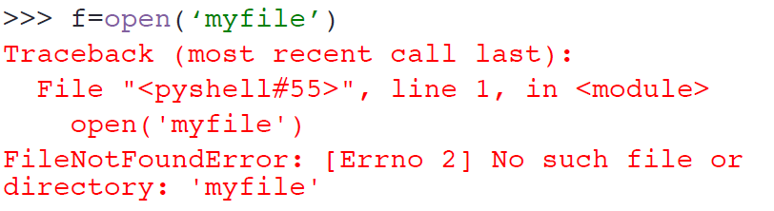
Errors while reading file
File should exist
Path: File should be in current working directory or provide complete path
file1 = open(‘/Users/Owner/Desktop/myfile.txt)

Slide 50
Exercises
Day2-Lesson-3-Exercise2.ipynb

Slide 51
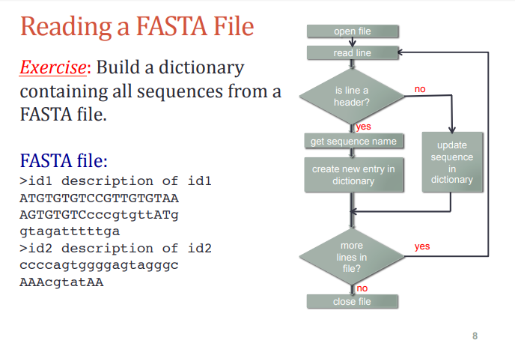
Reading Fasta file- Homework

Slide 52
Resources and References
http://www.python.org : the official Python site
https://www.python-course.eu/
Introduction to Programming using Python -http:// www.pasteur.fr/formation/infobio/python/ : a programming course for biologists at the Pasteur Institute
Beginning Python for Bioinformatics -http://www.onlamp.com/ pub/a/python/2002/10/17/biopython.html : a tutorial by Patrick O'Brien
Think Python: How to Think Like a Computer Scientist - http:// www.greenteapress.com/thinkpython/ : a free online Python book by Allen B. Downey
Notes:
Coursera Python for Genomics

