Slide 1
UCSC Table Browser
Download Sequence and Annotation of a Gene

Slide 2
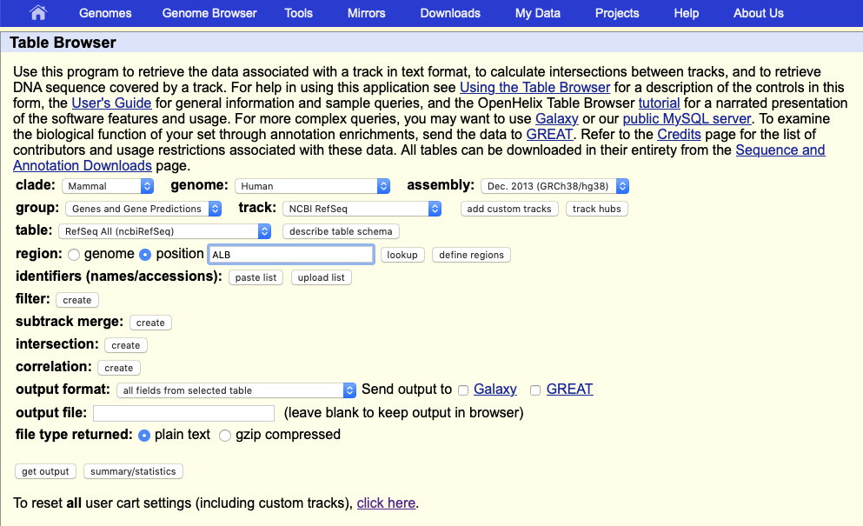
Download the fasta sequence of ALB

Slide 3
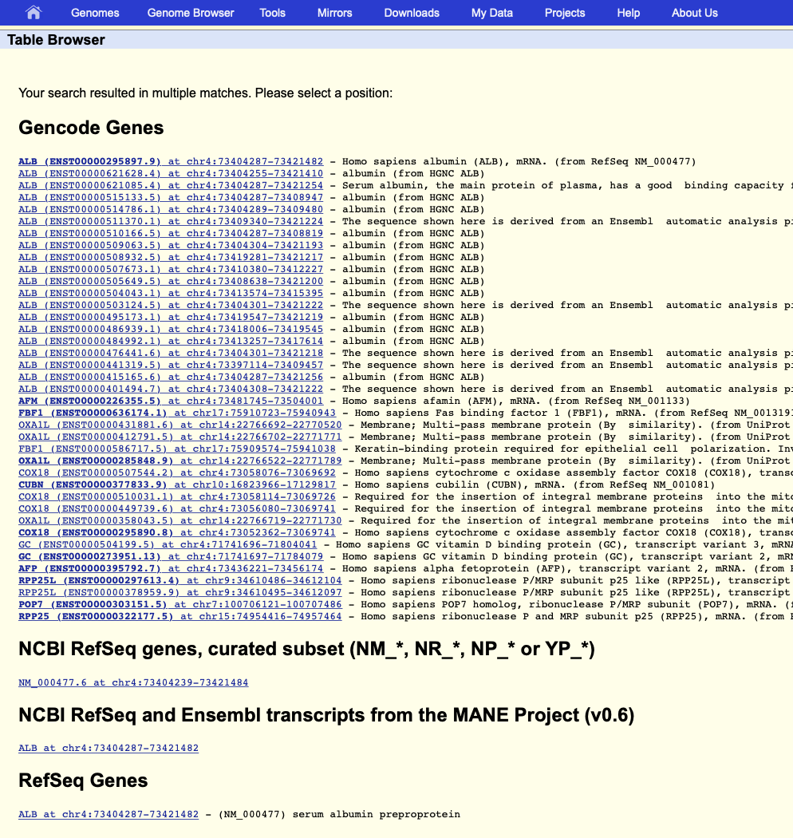
Download the fasta sequence of ALB

Slide 4
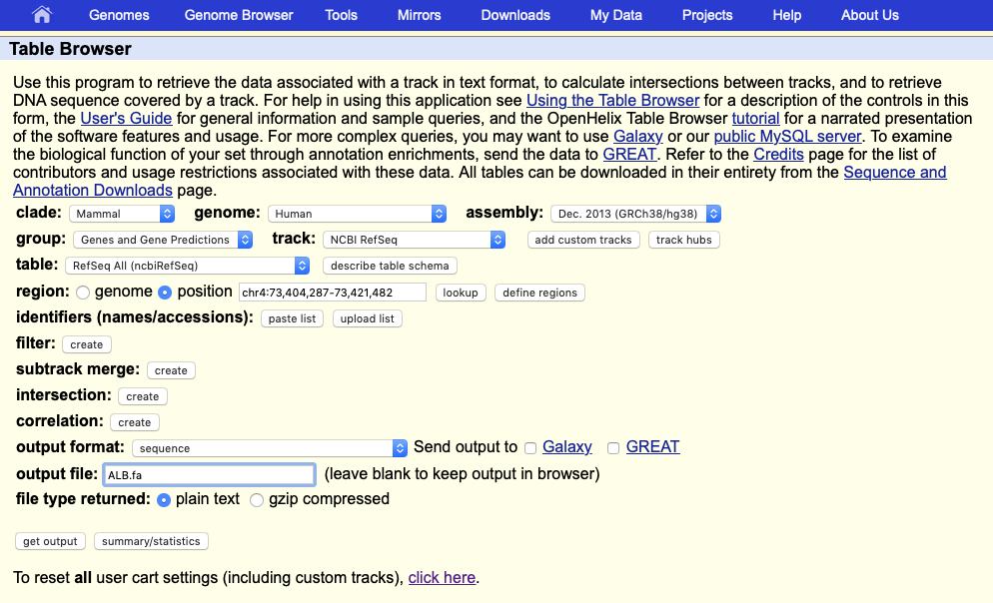
Download the fasta sequence of ALB

Slide 5
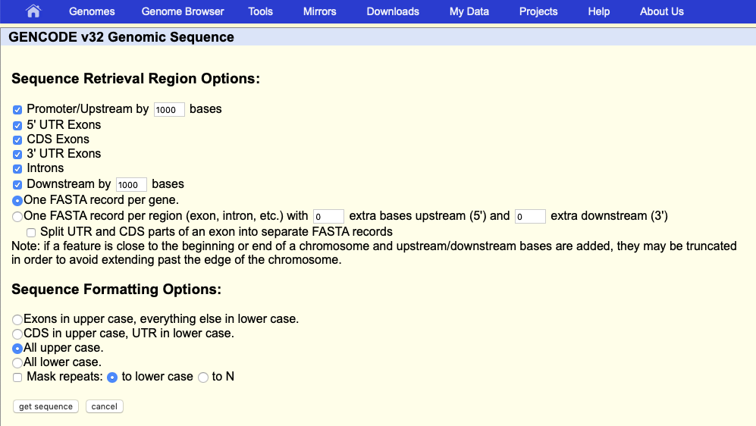
Download the fasta sequence of ALB

Slide 6
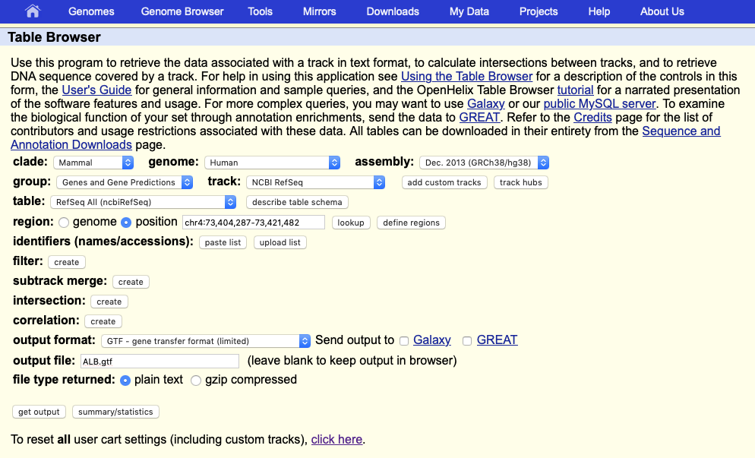
Download the GTF of ALB

