Slide 1
UCSC Genome Browser
Sharing a session of “Big Data”
Within UTSW campus using BioHPC

Slide 2
Create an account (if you do not have one)
http://genome.biohpc.swmed.edu
-> My Data
-> My Sessions

Slide 3
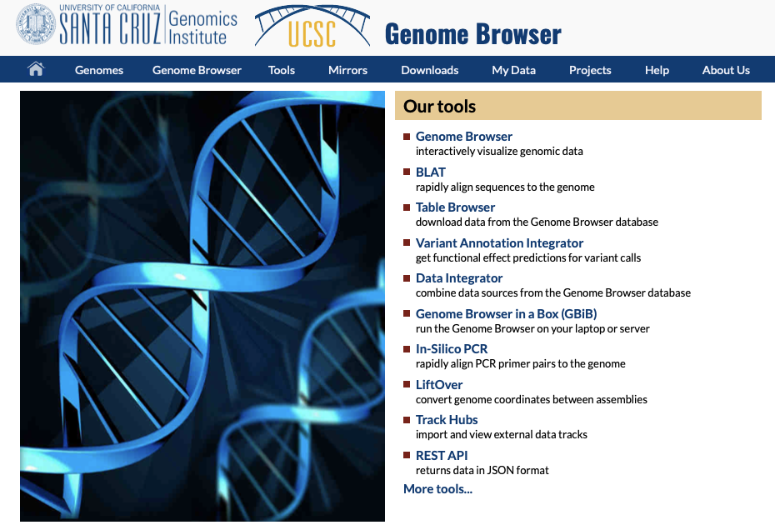
Navigate to the internal UCSC website
http://genome.biohpc.swmed.edu

Slide 4
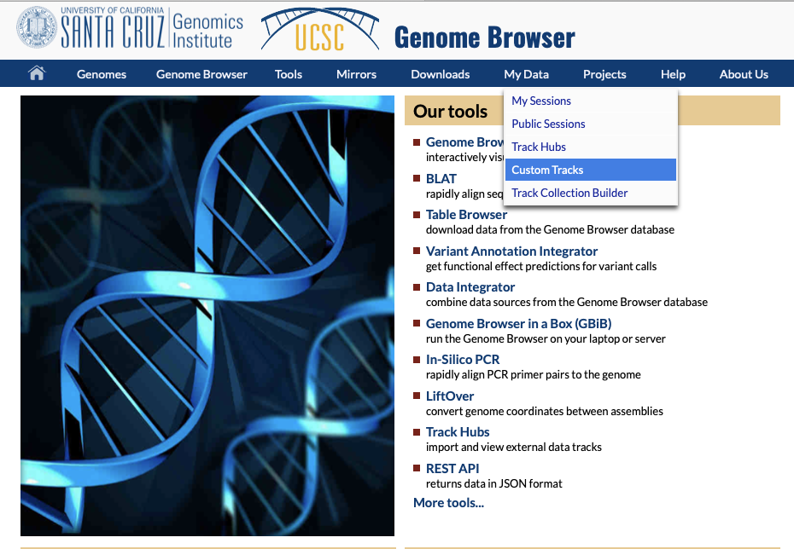
Create a Custom Track

Slide 5
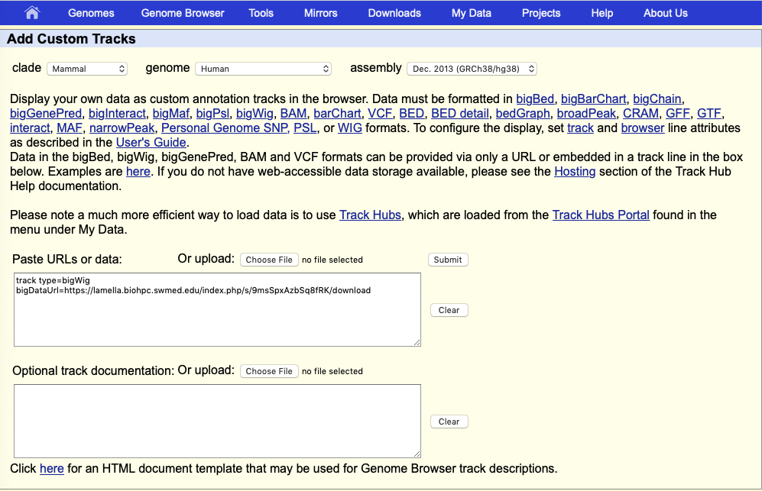
Paste URL and Labels for Track
track type=bigWig bigDataUrl=https://lamella.biohpc.swmed.edu/index.php/s/9msSpxAzbSq8fRK/download

Slide 6
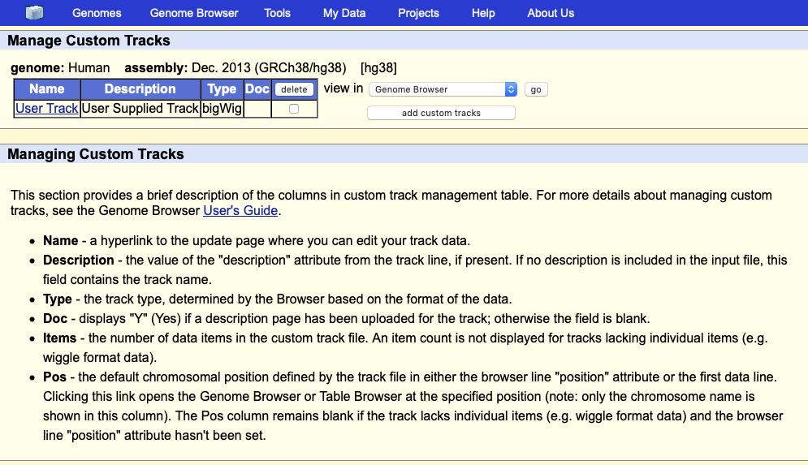
View Data in Genome Browser

Slide 7
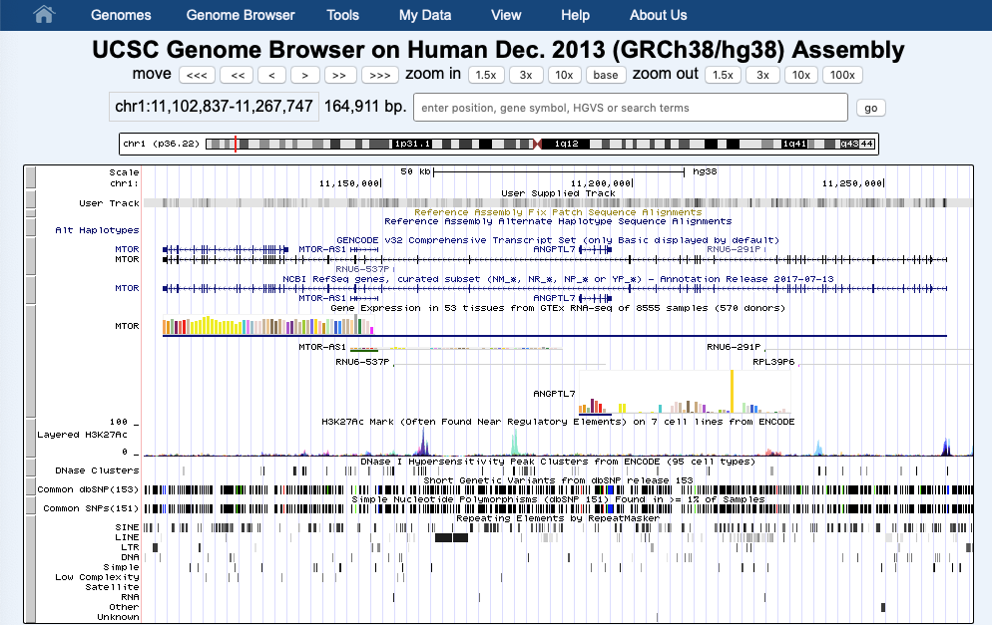
View Data in Genome Browser

Slide 8
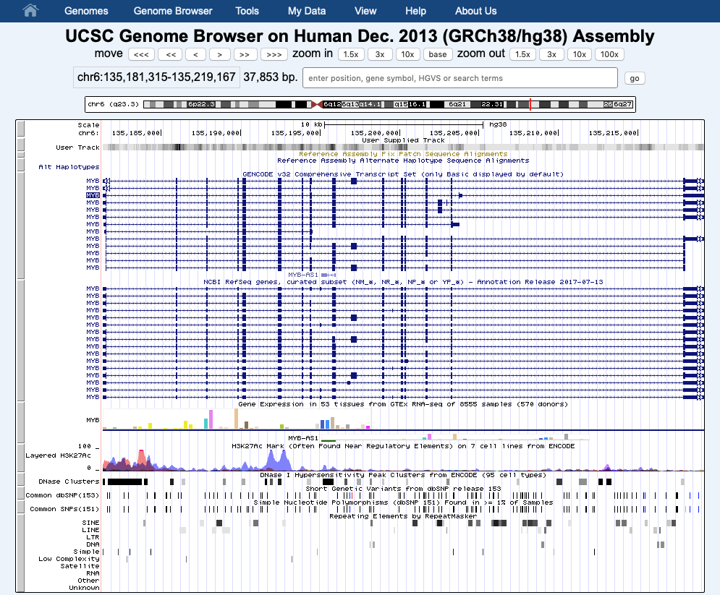
Navigate to Your Favorite Gene - MYB

Slide 9
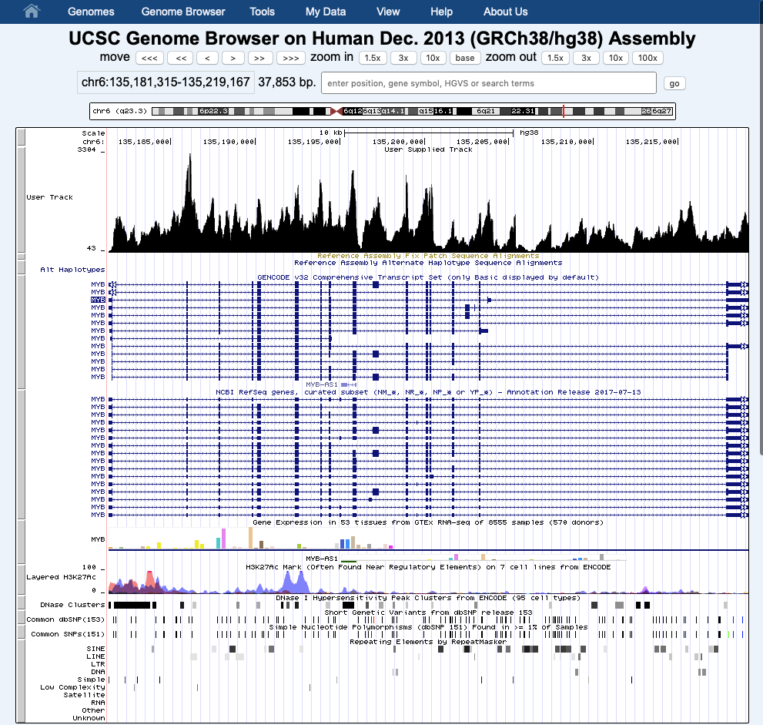
Fix your bigwig view

Slide 10
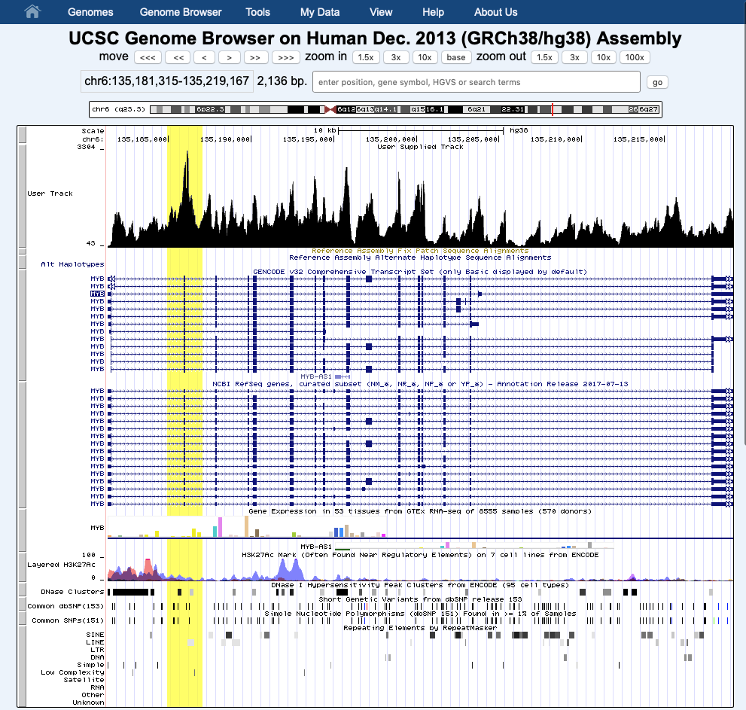
Highlight an area of interest

Slide 11
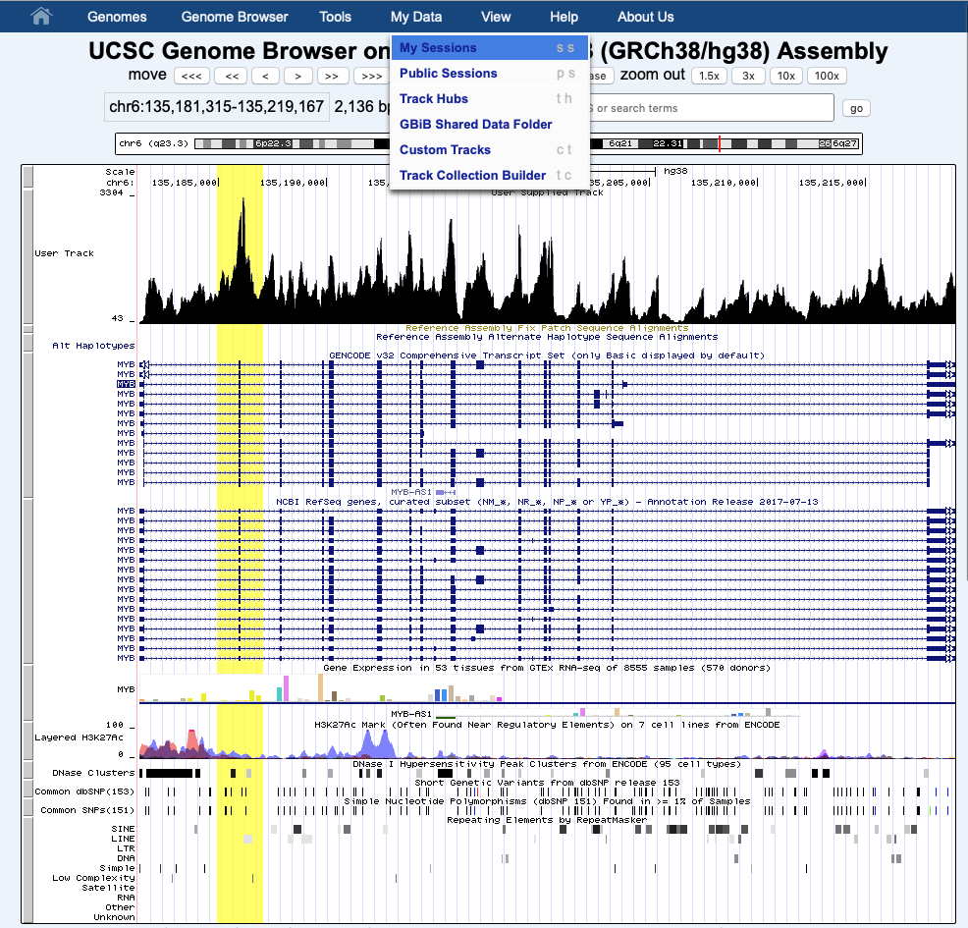
Save and Share Session

Slide 12
Make sure you are logged in

Slide 13
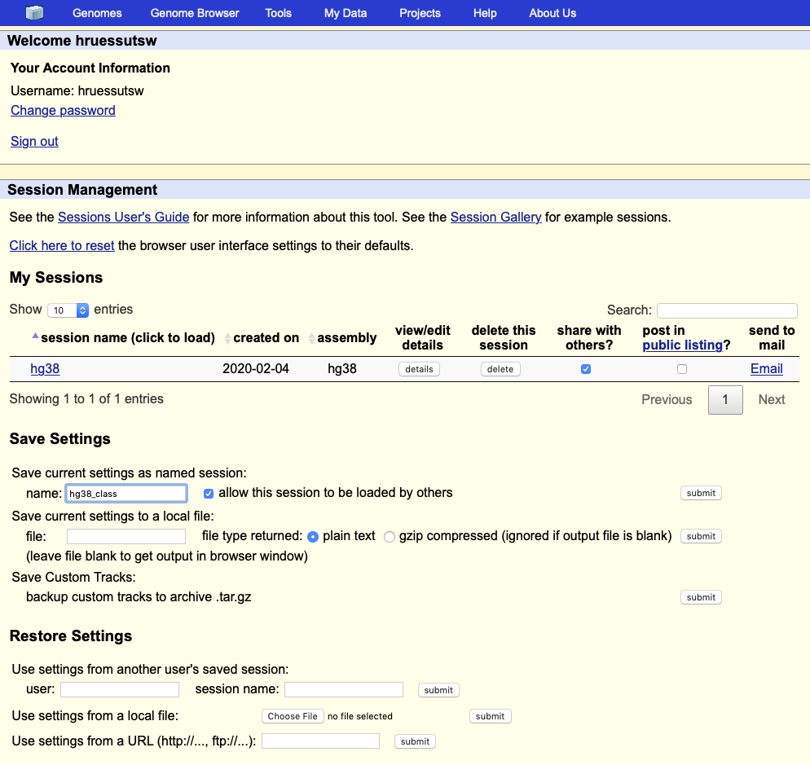
Save and Share Session

Slide 14
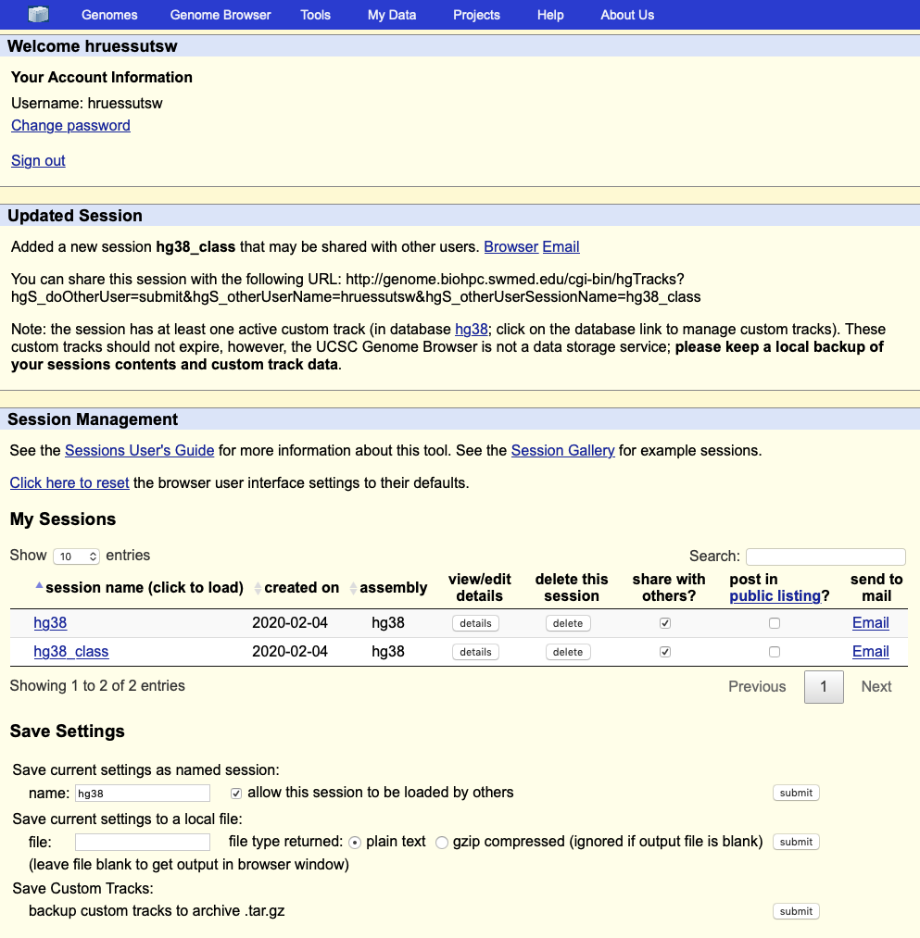
Save and Share Session – email URL

Slide 15
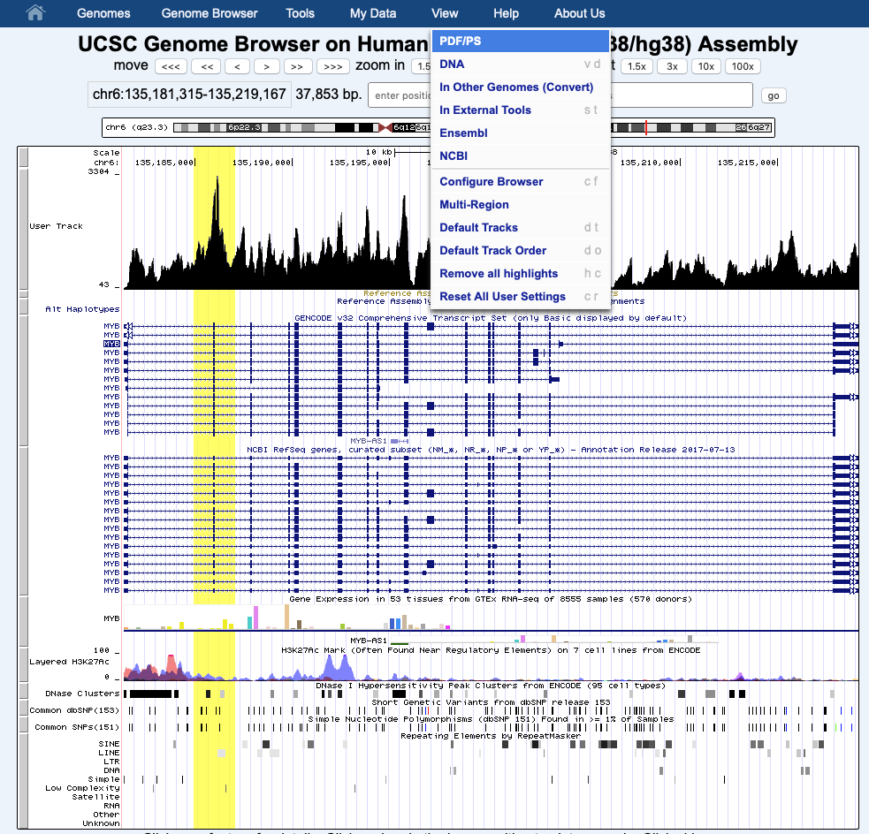
Export Publication Quality Images

Slide 16
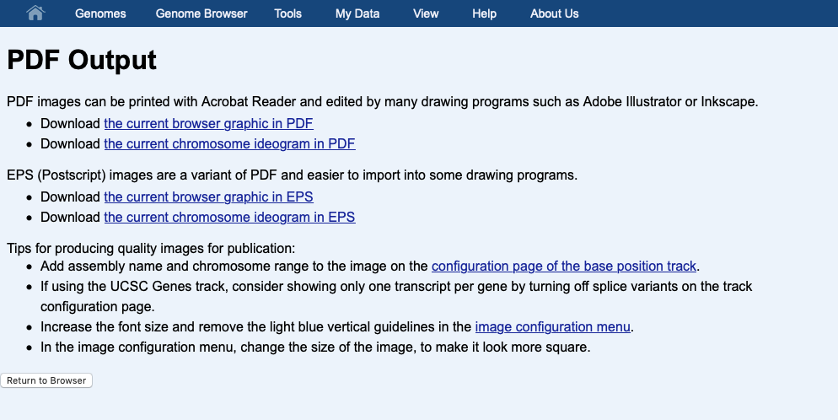
Export Publication Quality Images

