Slide 1
Clustering
Satwik Rajaram

Slide 2
What is Clustering?
Assigning objects to groups such that objects within the same group are more similar than those in different groups

Slide 3
Usage Scenarios
Simplifies the space of object states to just a few
Simple understanding of data in terms of groups
Much more manageable experimental follow up
Applications
Identification of cell types from single cell transcriptomics
Patient sub-grouping

Slide 4

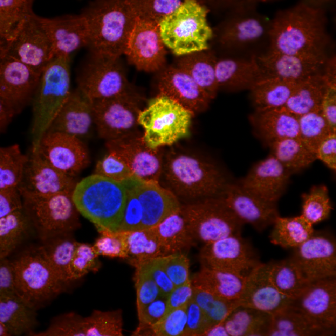
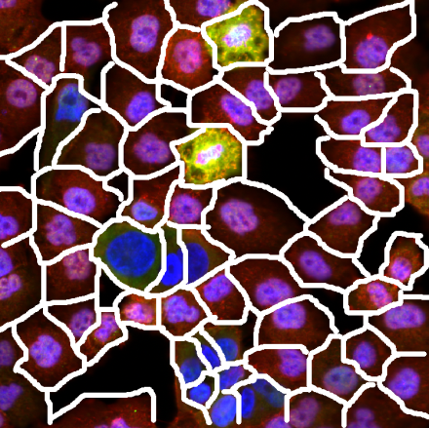



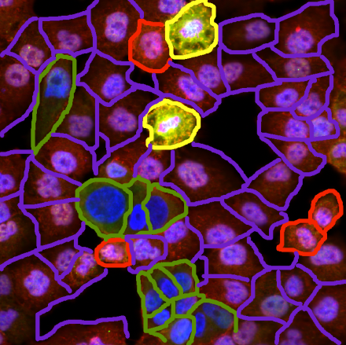
Example: Cell State Identification
Images
Cellular Regions
Cell Features
Cell Types
F 2
F 2
F 3
F 1
F 3
F 1
F 4
F n
F 4
F n
C₃
Class I
100%
C₁
C₂
C₃
C_{N}
C₁
Class II
C₂
Cell Type Fractions
C_{N}
0%
Experimental Conditions
Functional Correlation
Subpopulation Profiles
Subpopulation Assignment

Slide 5
Groups are not intrinsic!
Crucial application specific decisions must be made in determining groups
Features to use
Interpoint similarity
Point to groups similarity

Slide 6
Broad Classes of Clustering
Agglomerative
Partitional

Slide 7
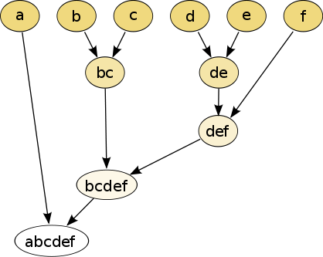
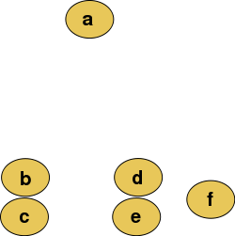
Hierarchical Clustering Overview
Algorithm:
Calculate all pairs of distances
Join the closest points to form a cluster
Go to 1 unless, no more points left

Slide 8
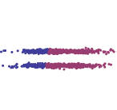


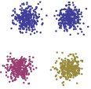
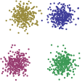
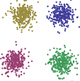
Linkage Choices
Single Linkage
Complete Linkage
Average Linkage
Prefers Connected Clusters
Sensitive to Noise
Prefers Compact Clusters
Robust to Noise
Prefers Compact Clusters
Robust to Noise

Slide 9
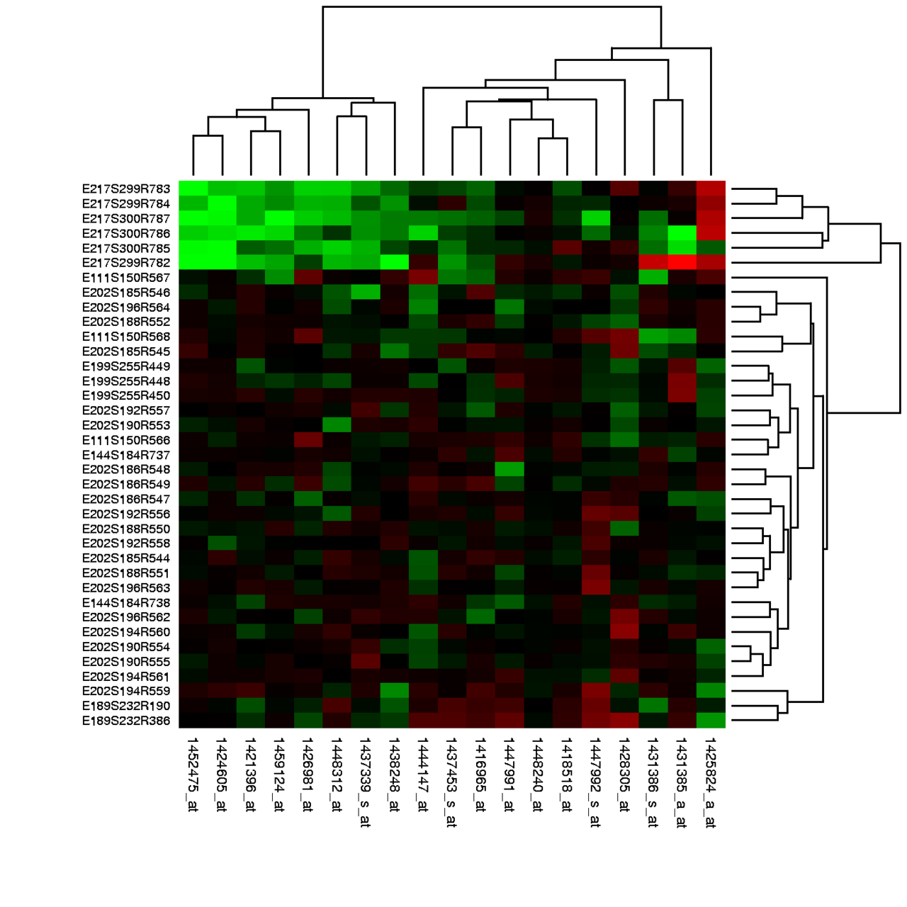
Clustergram
Most common use of hierarchical clustering
However hierarchical clustering does not specify row/column order!
Arbitrary pivoting of leaves consistent with hierarchical clustering tree
Ordering comes from optimal leaf ordering obeying tree constraints
Be careful interpreting adjacent rows from different clusters

Slide 10
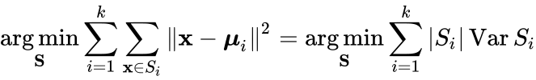
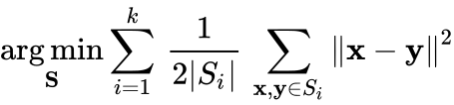
K-means
Given number of clusters k
Attempt to find k clusters
Identify k-cluster centers
Assignment of points to closest center
Minimize distance of points to cluster centers
Equivalent to minimizing pairwise distances within clusters

Slide 11
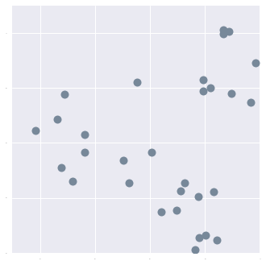
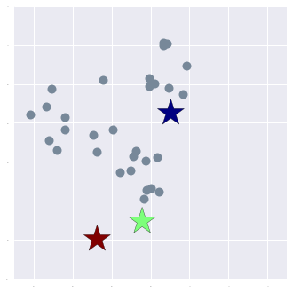
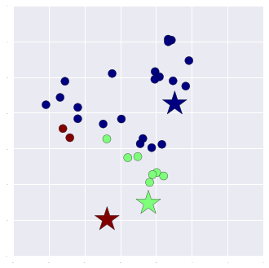
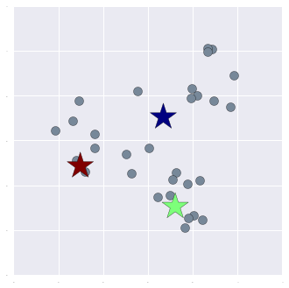
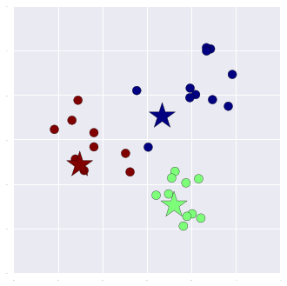
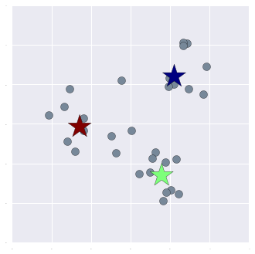
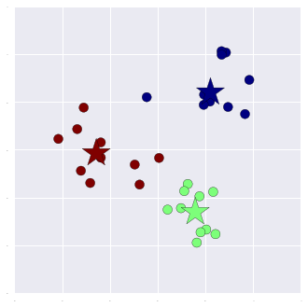
Implementation Example k=3
Random Guess
K Centers
Input Data
Assign Points To
Closest Center
Update Centers To
Centroids of Points
Assign Points To
Closest Center
Update Centers To
Centroids of Points
Assign Points To
Closest Center
Repeat Till
Convergence

Slide 12
K-means optimization
Centroid minimizes mean square distance to points
Convergence: “error” does not increase
Can get stuck in local minimum
Randomness: Depends on random initial seeding

Slide 13
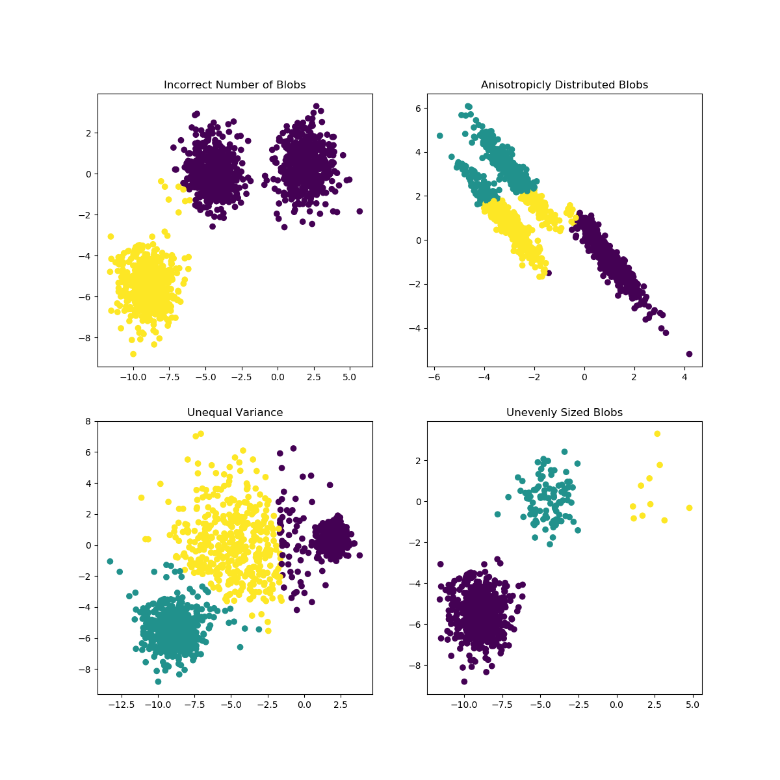
Limitations of k-means
Assumes clusters are spherical
Assumes clusters are the same size
Hard assignments

Slide 14
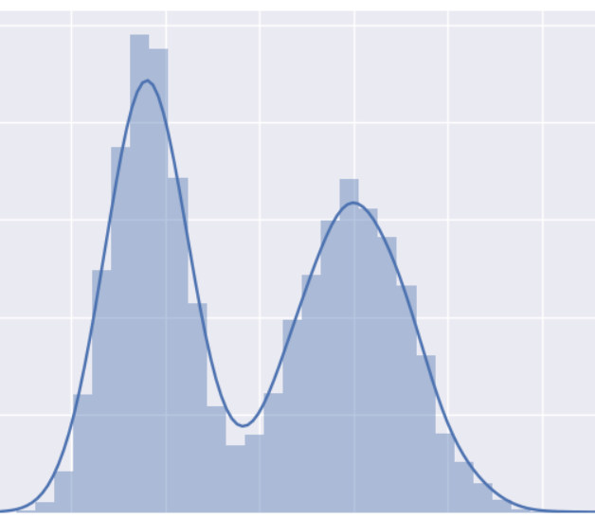
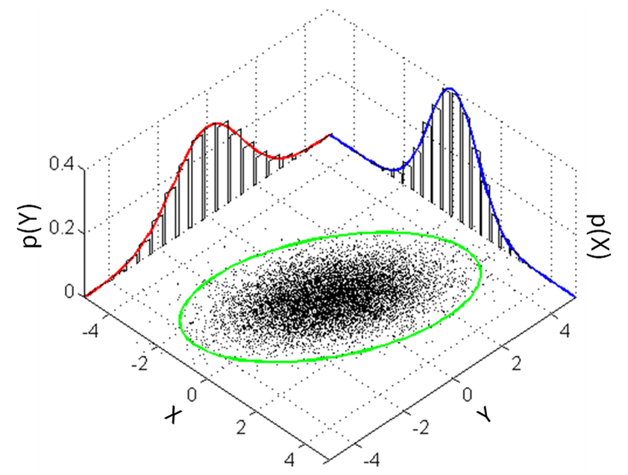
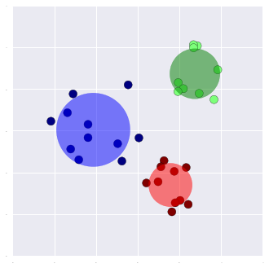
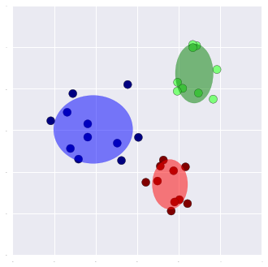
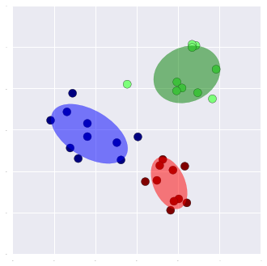




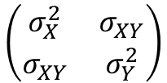



Gaussian Mixture Models
1D- Gaussians
Multivariate Gaussian
Mixture
$$p_{1}$$
Number Of
Gaussians
×
$$p_{2}$$
$$σ_{1}$$
$$σ_{2}$$
$$\left(\begin{matrix}σ_{X}^{2} & σ_{XY} \\ σ_{XY} & σ_{Y}^{2}\end{matrix}\right)$$
Data
Dimensionality
$$μ_{1}$$
$$μ_{2}$$
$$\vec{μ}$$

Slide 15
Identifying Clusters
Update process similar to k-means
Initialize random Gaussians
Loop expectation-maximization till convergence
Assign points to Gaussian with highest likelihood of generating it
For each cluster of points construct best fit gaussian

Slide 16
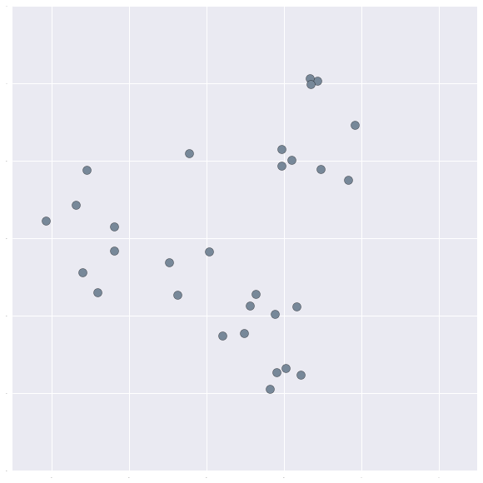
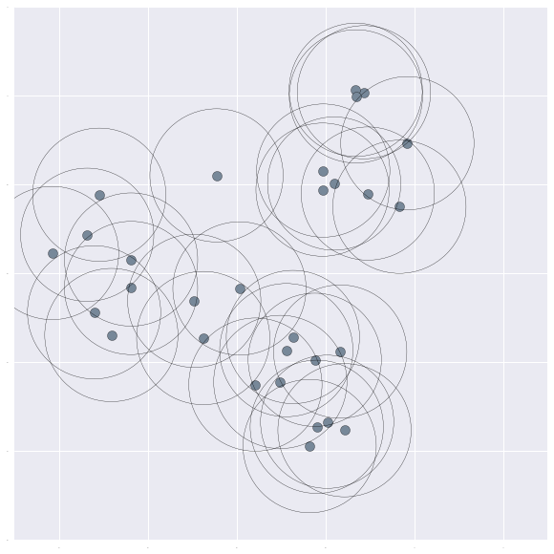
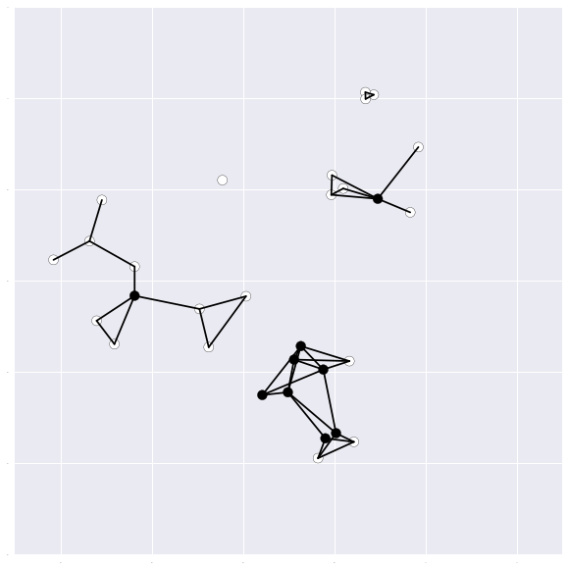
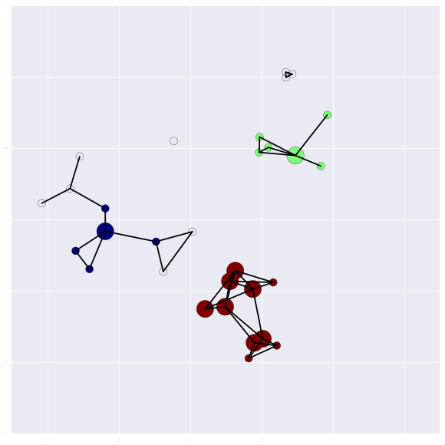
DBSCAN
Density based method
Number of clusters not pre-specified
Based on domain knowledge of density
Clusters are one-neighbor out from connected core points
Raw Data
Draw ε neighborhoods
Core points have N≥4 neighbors

Slide 17
GMM vs k-means vs Agglomerative vs DBSCAN
GMM can be made to behave as a probabilistic version of k-means
GMM is generative
Number of parameters
K-means: linearly with dimensionality
GMM: square o dimensionality
Complexity (as a function of N:number of points. k: number of clusters)
Agglomerative: O(N²log(N))
K-means: O(k*N)
GMM: O(k*N)

Slide 18
Methods of Selecting Number of Clusters Challenge: More clusters will always give better fit
Penalize model complexity (regularization)
Bayesian Information Criterion:
AIC: Similar with smaller model penalty
Variational Methods:
Effectively the number of clusters is also a variable to fit
$$BIC=−2∗log\left(likelihood\right)+log\left(N\right)∗k$$
Number of Parameters (k)

