Slide 1
Unsupervised Machine Learning
Satwik Rajaram

Slide 2
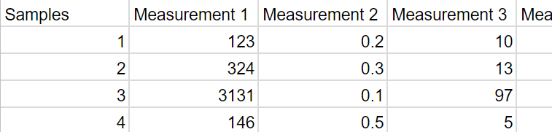
Usage Scenario: What’s going on with my data?
High dimensional data
No pre-defined groups to classify points
Often first pass analysis
Want to know about structure of data
What are the groupings in the data?
What are the dominant effects?
Supervised:
Does the data contain this info?
Unsupervised:
What information does the data tell us?
Utility is more subjective
Experimental Classes
Measurement 2
Not Used In Analysis
Measurement 1

Slide 3
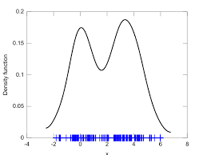
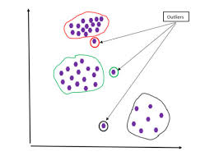
Different Types of Unsupervised Learning
Density Estimation
Outlier Detection
Dimensional Reduction
Clustering

Slide 4
Dimension Reduction
Experimental Classes
Experimental Classes
Dimension
Reduction
Measurement N
Reduced Space 2
3
2
Measurement 1
Reduced Space 1
Applications:
Visualization for humans
Pre-processing to reduce redundancy/noise
Measurement 2
Measurement n
Measurement 1
Measurement m

Slide 5
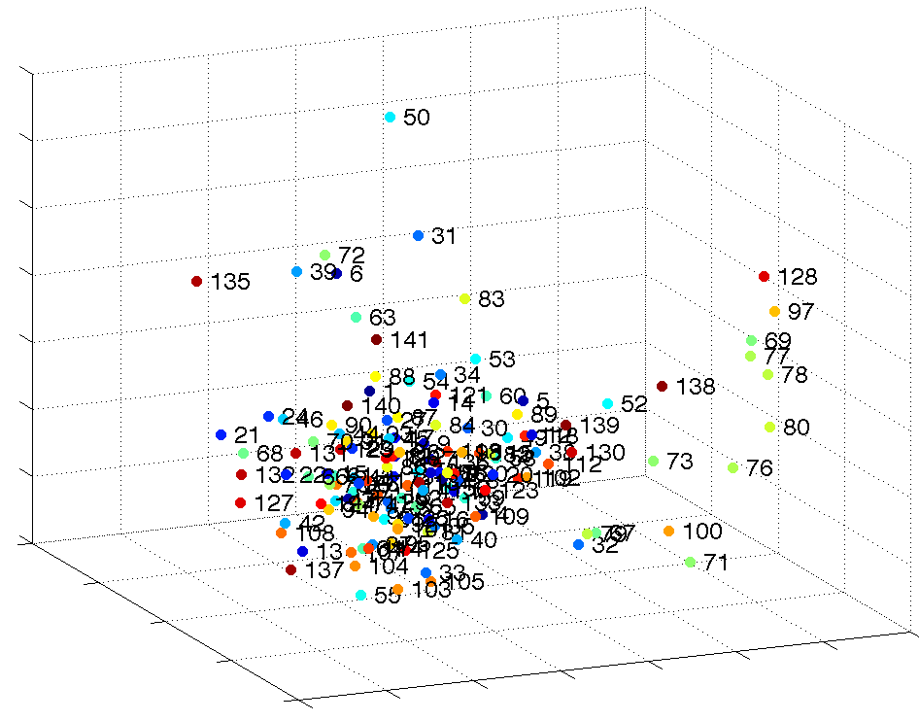
Example from my Work
Natural Compounds Library (N=133) Screen: System: Mouse striatal neuronal cell line (STHdh) Readout: phosphorylation in N17 region of huntingtin
Kinetin (N6 furfuryladenine)
IKK Kinase
Inhibitors
Anti-oxidants
6 hr treatment
5 images/well
αN17S13pS16p
40x magnification
Laura Bowie
@ Truant Lab
PCA Space plot from PhenoRipper

Slide 6
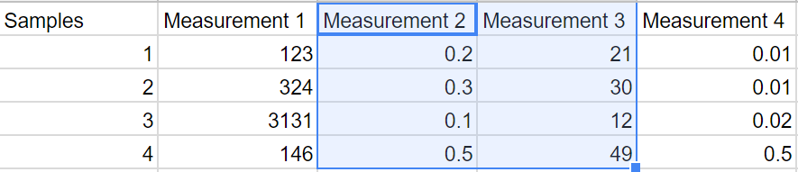
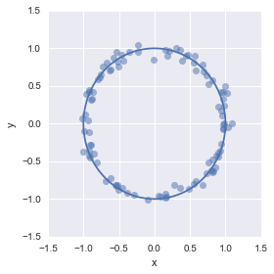
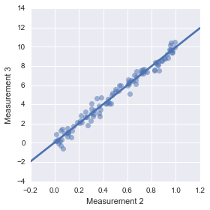
Why is dimensional reduction possible? Ans: The whole input space is not used
Correlated variables don’t offer independent information
Constraints can cause data to inhabit sub-space
Dimension Reduction is not always successful!

Slide 7
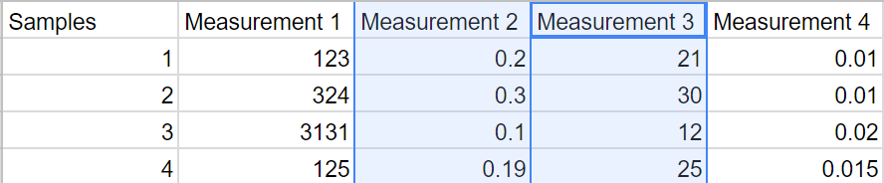
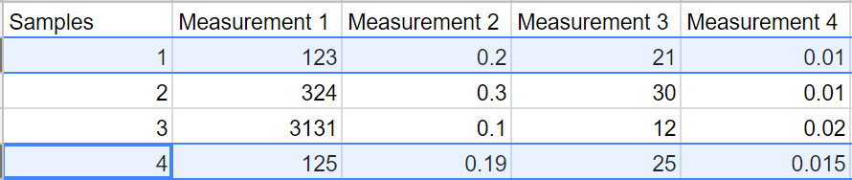
Approaches to dimensional reduction
Variable Based
Distance Based
Similar Original Data
⇩
Similar After Reduction
Correlated Variables
Form Single Dimension
Examples:
Principal Components Analysis
Non-negative Matrix Factorization
Examples:
Multidimensional Scaling
t-Distributed Stochastic Neighbor Embedding

Slide 8
Principal Component Analysis (PCA)
Intuition: Rotate data so most variation is brought to the front
Original Data
PCA Transform
Variation 1
Variation PCA1
Measurement 2
Variation 2
Variation
PCA2
PCA 2
PCA 2
PCA1
Measurement 1
PCA1

Slide 9
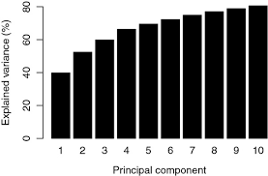
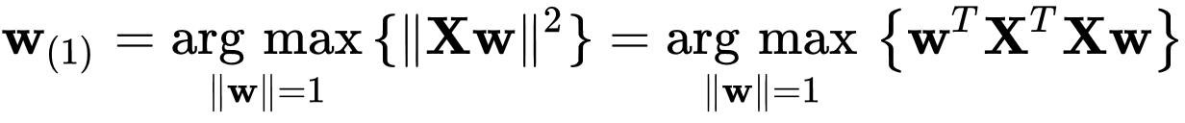
Dimensional Reduction With PCA
Generalize to More Dimensions
Measurement 2
Reconstruction Error
PCA 2
PCA1
Measurement 1
Since Total Variance is Constant
Maximizing Variance Captured
Minimizes Reconstruction Error

Slide 10
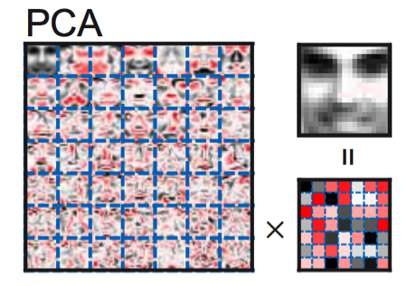
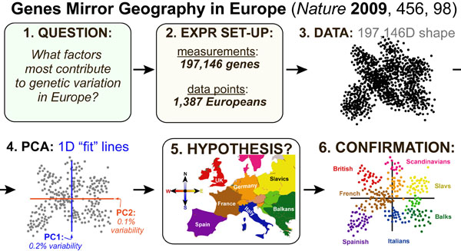
PCA Examples

Slide 11


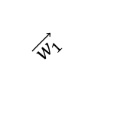

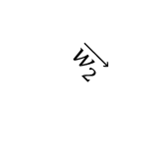




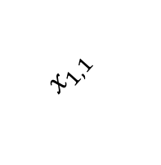
Generalizing the Idea
Basis Vectors
1st Data Point
$\vec{X_{1}}=x_{1,1}\vec{w_{1}}$+ $x_{1,2}\vec{w_{2}}$+ $x_{1,3}\vec{w_{3}}+⋯$
$$\vec{w_{2}}$$
$$\vec{w_{1}}$$
Coordinates
Of 1st Data Point
$\vec{X_{2}}=x_{2,1}\vec{w_{1}}$+ $x_{2,2}\vec{w_{2}}$+ $x_{2,3}\vec{w_{3}}+⋯$
$$x_{1,2}$$
$\vec{X_{3}}=x_{3,1}\vec{w_{1}}$+ $x_{3,2}\vec{w_{2}}$+ $x_{3,3}\vec{w_{3}}+⋯$
$$x_{1,1}$$
$$\vec{X_{1}}$$
$\vec{X_{N}}=x_{N,1}\vec{w_{1}}$+ $x_{N,2}\vec{w_{2}}$+ $x_{N,3}\vec{w_{3}}+⋯$
$$\min_{w}\left\|X−xw\right\|$$

Slide 12
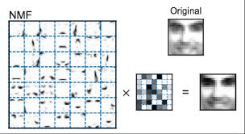


Non-Negative Matrix Factorization
$$\min_{w}\left\|X−xw\right\|$$
With constraint: $X,x \& w$ are all non-negative
What nNMF giveth, it can’t taketh away!
Parts based representation

Slide 13
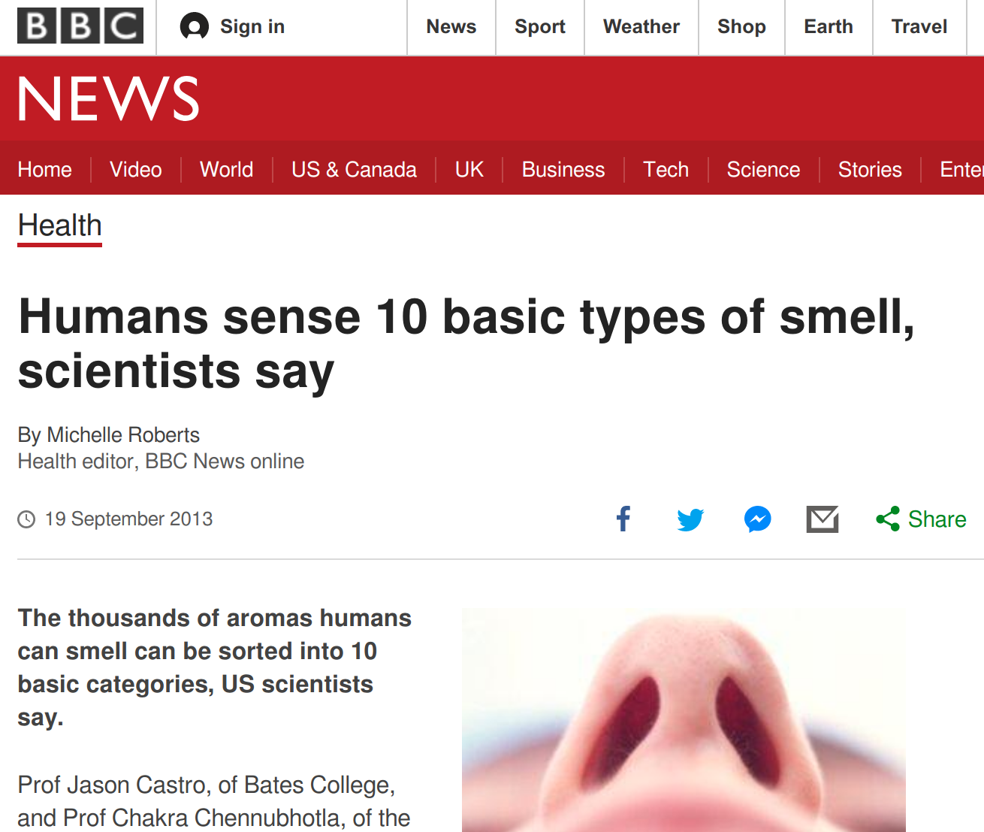

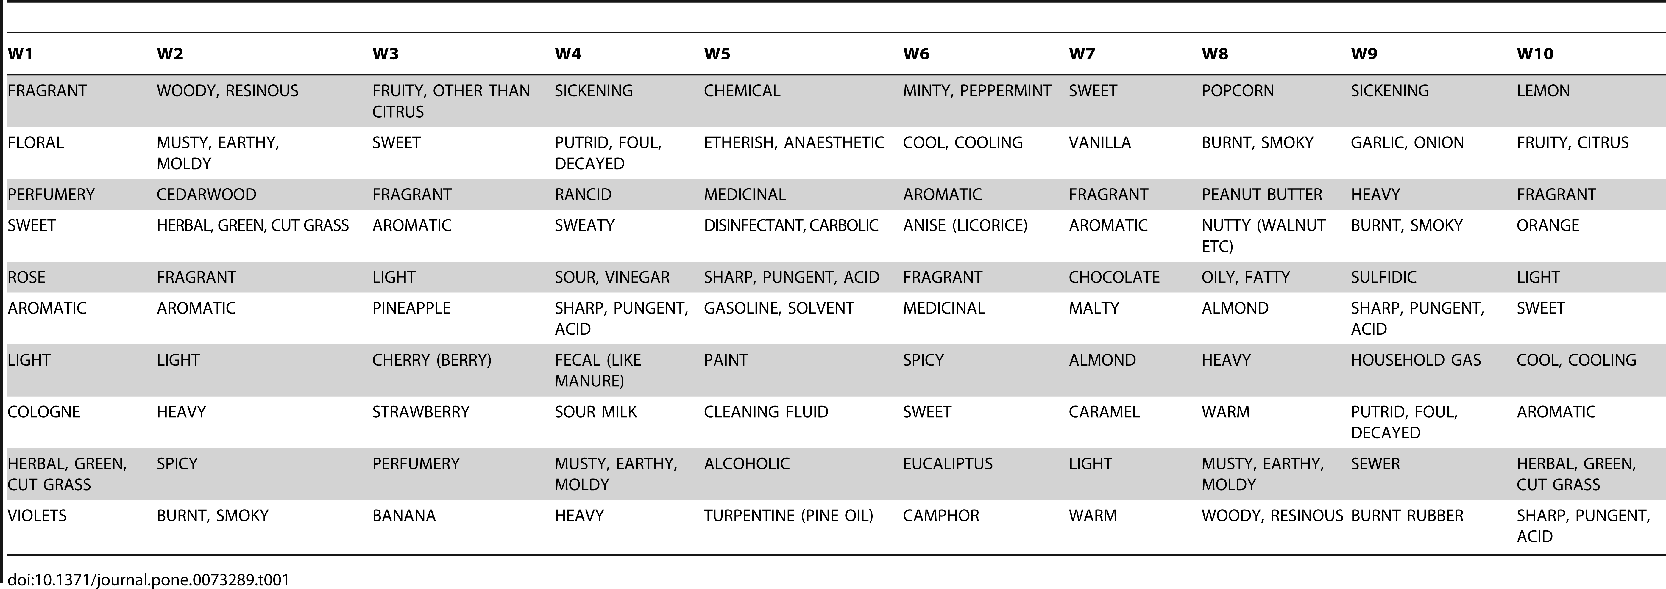
nNMF Example

Slide 14

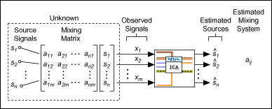
Independent Component Analysis: Where the basis vectors are the primary interest
Cocktail party problem:
Similar to previous problem:
We want signals to be independent
Orthogonal vectors (PCA) are related through negative information
Find vectors that have zero mutual information or
Maximize non-gaussianity

Slide 15
Distance Based Methods
Variable Based
Distance Based
Similar Original Data
⇩
Similar After Reduction
Correlated Variables
Form Single Dimension
Examples:
Principal Components Analysis
Non-negative Matrix Factorization
Examples:
Multidimensional Scaling
t-Distributed Stochastic Neighbor Embedding

Slide 16













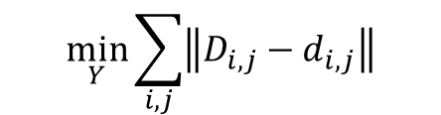
Intuitive Idea: Get distances to “agree” low and high dimensions
Given:
High Dimensional Space (X)
Inferred
Low Dimensional Space (Y)
Naïve Implementation: Get D = d numerically
1
$$D_{1,4}$$
4
4
$$D_{1,2}$$
1
$$d_{1,4}$$
$$d_{3,4}$$
$$\min_{Y}{\sum_{i,j}{\left\|D_{i,j}−d_{i,j}\right\|}}$$
$$D_{2,4}$$
$$D_{1,3}$$
$$D_{3,4}$$
$$d_{1,3}$$
3
2
$$d_{1,2}$$
$$d_{2,4}$$
$$d_{2,3}$$
$$D_{2,3}$$
3
2
Challenge: Points are distributed fundamentally different in higher dimensions!
More Neighbor Options
Most Volume in Shell in High-Dimensions
Low-D
$$ε$$
<
High-D
1D
2D
>

Slide 17
Non-metric Multidimensional Scaling
Don’t require Distance to have same values, but satisfy ordering inequalities
If D_{a,b} <D_{m,n} then d_{a,b} <d_{m,n}
Effectively try to get rankings D_{i,j} and d_{i,j} to agree
Computationally intensive for large number of points
Considers both small and large scale structure

Slide 18
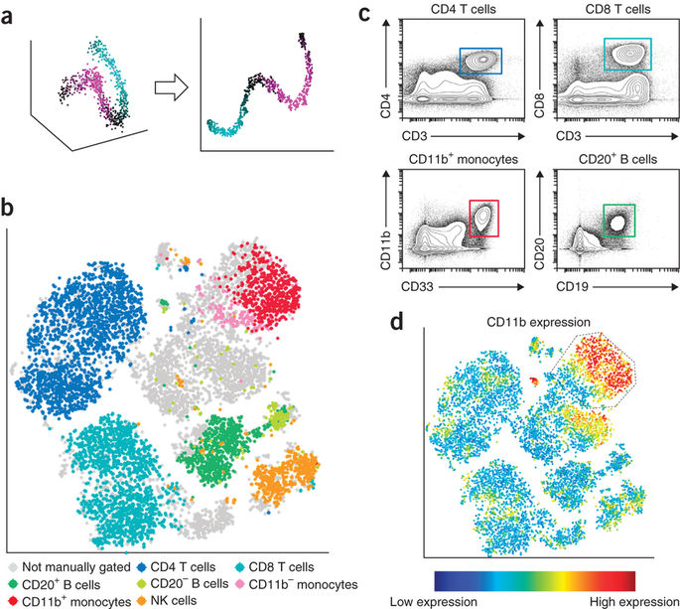
t-Distributed Stochastic Neighbor Embedding (tSNE)
It’s the new hotness! Especially in single cell profiling
Seems to work well for identifying clusters of similar cells
Intuitive idea
Neighbors in Original Space ⬄ Neighbors In Embedded Space
Maximize agreement in probability of being neighbors
Define probabilities differently in original & embedded
Longer tail in embedded (low) dimension to account for smearing
Better at preserving short range than long range information
Has free parameter related to neighborhood size
Faster for large data sets than MDS
Is stochastic (different runs produce differing results)
Fine for visualization, don’t treat results as true, or for pre-processing

Slide 19
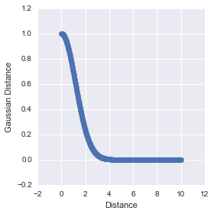
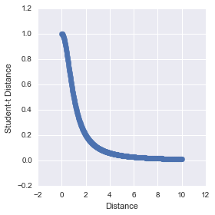
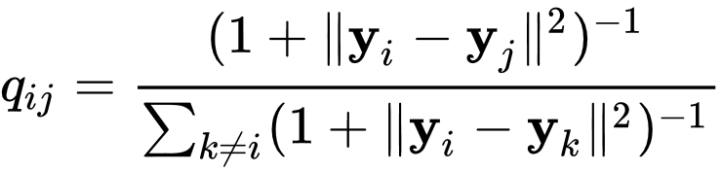
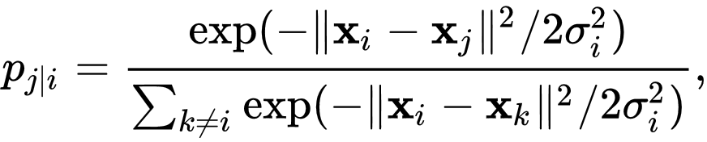
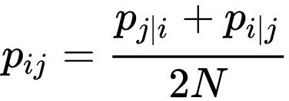
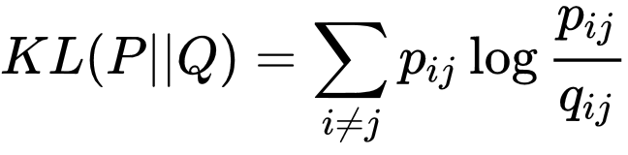
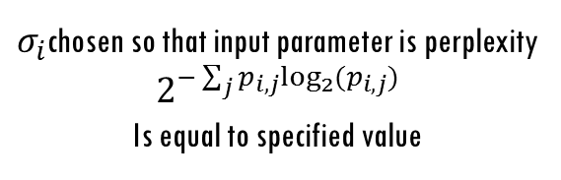
tSNE: Math
High Dimensional Space (X)
Low Dimensional Space (Y)
Probability of being neighbors
Probability of being neighbors
Point specific sigma:
Chosen so points have similar neighbor distributions
Agreement in Prob
Of Being
Neighbors
$σ_{i}$chosen so that input parameter is perplexity $$2^{−\sum_{j}{p_{i,j}\log_{2}}(p_{i,j})}$$
Is equal to specified value
Minimize

Slide 20
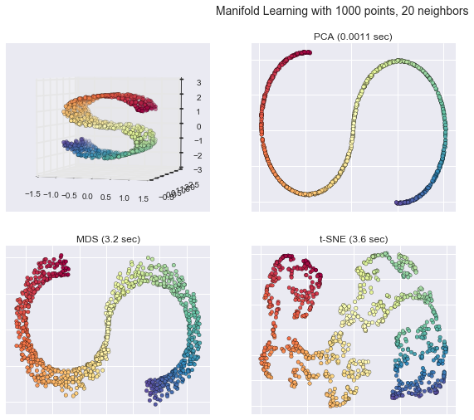
Comparison
Linear Variable Models Like PCA:
Faster for large number of points
Co-ordinates are interpretable
Less dimensional reduction ability
Non-linear distance based:
Slower
More powerful dimensional reduction
Co-ordinates not interpretable

