Slide 1
“rcellminer”: Bioconductor Package Overview
R For New Users Nanocourse
Jonathan M. Cooper
July 28, 2017

Slide 2
rcellminer Package
Tool to explore data from NCI-60 Cancer Cell Line Panel
NCI-60 contains anticancer drug response data along with with extensive characterization of gene and protein expression, copy number, mutation, etc. in these cell lines.
Developed as an enhancement of the CellMiner project (http://discover.nci.nih.gov/cellminer)
For specialized scientific questions rcellminer provides
Functionality of CellMiner
Programmatic data access
Data visualization
Data analysis
Building block for advanced tools through interactive Shiny applications
Best of all, the functions of rcellminer are useable for beginner R users
https://www.bioconductor.org/packages/release/bioc/vignettes/rcellminer/inst/doc/rcellminerUsage.html

Slide 3
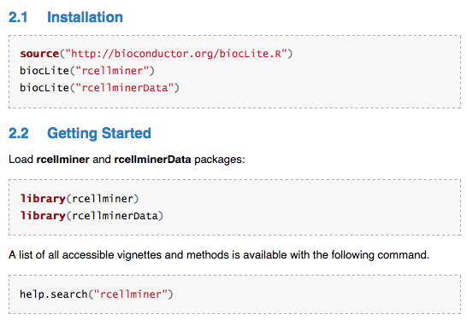
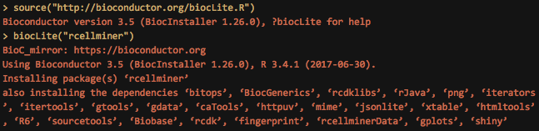
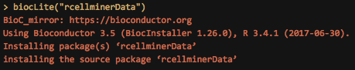
rcellminer Package Installation
Make sure Java and rJava are installed
install.packages(“rJava”)
https://www.bioconductor.org/packages/release/bioc/vignettes/rcellminer/inst/doc/rcellminerUsage.html

Slide 4
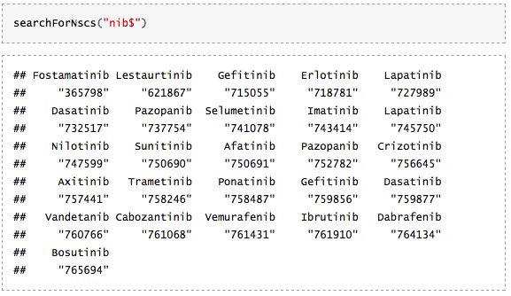
Compound Search
Example: MEK1/2 Inhibitor, Trametinib
searchForNscs(pattern)
Arguments: pattern (a search pattern. This string will be treated as a regular expression with the case ignored.
NSC (numerical identifier of compound as submitted to NCI)
https://www.bioconductor.org/packages/release/bioc/vignettes/rcellminer/inst/doc/rcellminerUsage.html

Slide 5
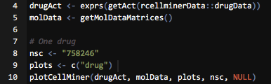
Single Compound Z-score plot
Example: MEK1/2 Inhibitor, Trametinib
getAct <- Returns an eSet object with drug activity data.
DrugData <- Returns a DrugData object.
getMolDataMatrices <- Returns a list of molecular data type matrices, with rownames in each matrix prefixed with a data type abbreviation.
plotCellMiner <- Produces CellMiner-like plots in R
plotCellMiner(drugAct, molData, plots, nsc = NULL, gene = NULL)
drugAct a matrix of drug activity values (cell lines as columns, drug entries as rows)
molData = a list of matricies a molecular
plots = a vector of characters denoting the plots to include and the order (e.g. c("mut”, "drug", "cop"). Currently, supported entries mutations (mut), drug activities (drug), copy number variations (cop)
nsc = a string NSC ID that will be plotted when a "drug" entry appears in the plots vector
gene = a string HUGO gene symbol for which the "mut", "cop", or "exp" plots will be produced if in plots vector

Slide 6

Compound/Gene Combined Information Plot
Example: EGFR/EGFR Inhibitor, Erlotinib

Slide 7
Compound/Gene Combined Information Plot
Example: EGFR/EGFR Inhibitor, Erlotinib

Slide 8
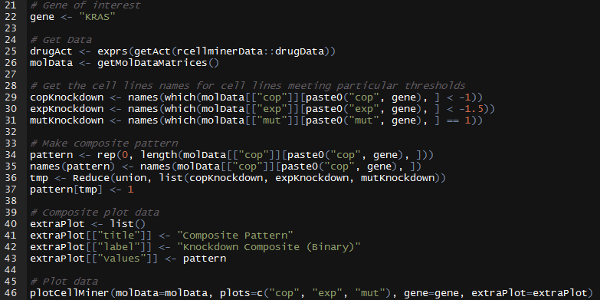
Pattern Construction and Visualization
Example: KRAS
Construct and visualize a composite gene pattern for the KRAS oncogene, integrating gene expression, copy, and mutation data. The composite pattern is then used to identify compounds with correlated activity patterns.
--> By saving the script, you can iterate this for your gene(s) of interest

Slide 9
rcellminer Package Link
https://www.bioconductor.org/packages/release/bioc/html/rcellminer.html
Thank you!

