Slide 1
What Cocktail of Transcription Factors Regulates Which Genes — and Is It Conserved?
One genome builds many cell types. We ask which TF combinations define each tissue/cell-type program, and whether that regulatory logic is shared across mammals.
Two complementary views: bulk RNA-seq across 26 vertebrates (breadth) + single-cell across human/mouse/lemur (cell-type resolution).
1 / 7

Slide 2
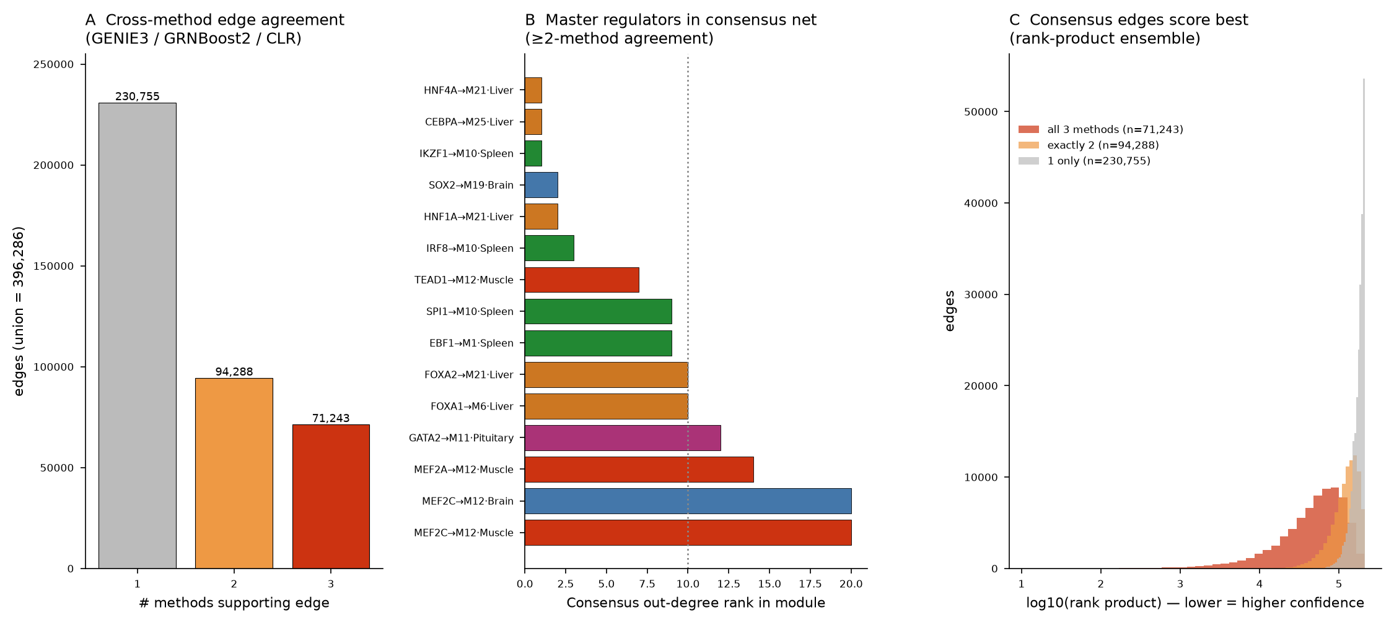
Methods — Two Arms, One Question
▸ Bulk RNA-seq arm (breadth across the tree of life)
Human GTEx reference (recount3, 30 tissues) → WGCNA co-expression modules
Preservation tested across 26 vertebrates (WGCNA Zsummary) + phylogenetic signal (Blomberg’s K)
TF layer: 793 TFs, 3-method GRN ensemble (GENIE3 + GRNBoost2 + CLR), XGBoost+SHAP cocktails
▸ Single-cell RNA-seq arm (resolution within tissues)
Tabula atlases: human / mouse / lemur; 4 core tissues, 357k cells, 14,073 1:1 orthologs
Cell types harmonized to a 34-type panel (Cell Ontology); per-cell-type regulon inference
Full pySCENIC: GRNBoost2 → cisTarget motif pruning → AUCell, 10-bootstrap stability
▸ The key comparison
Bulk mixes all cell types in a tissue; single-cell separates them — so we can ask which bulk“ master regulators” are real cell-intrinsic drivers vs. artifacts of tissue composition
Bulk 3-method GRN ensemble

Slide 3
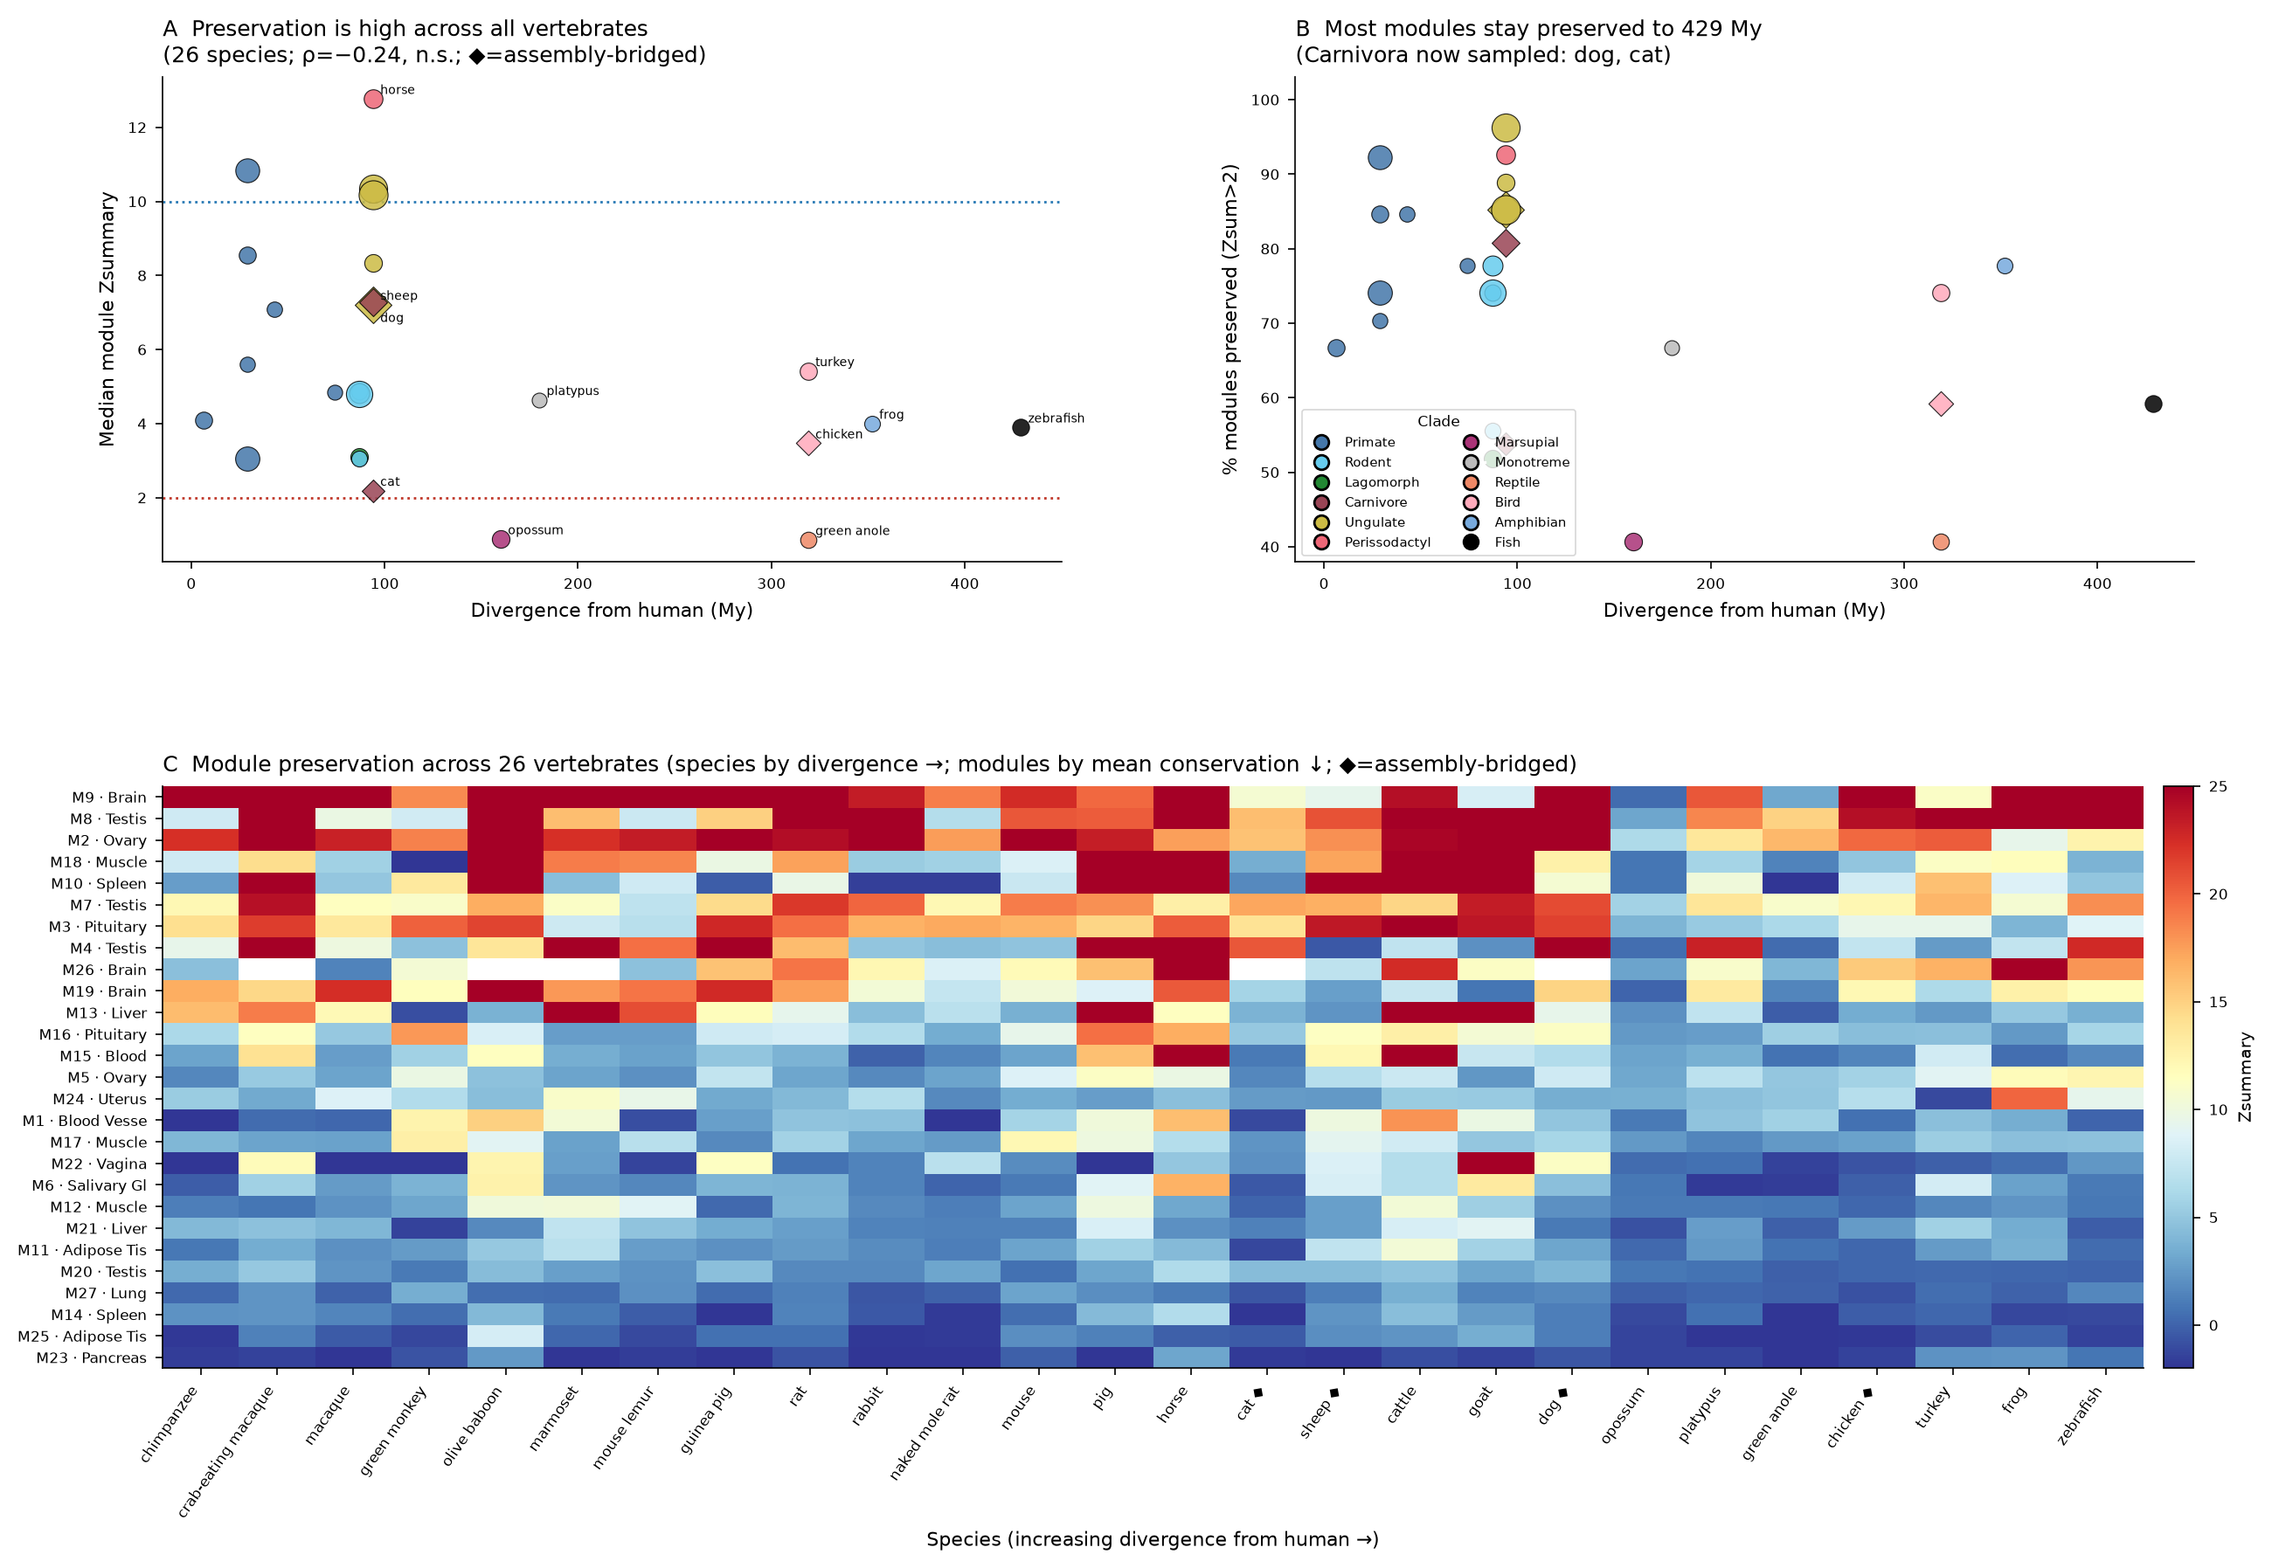
Bulk RNA-seq (1) — Tissue Modules Are Deeply Conserved
▸ 27 tissue-defining co-expression modules (7,034 genes)
Each module maps cleanly to a tissue (liver M13, muscle M18, spleen M14, testis, ovary…)
▸ Conservation is module-driven, not divergence-driven
Module membership preserved across all 26 vertebrates (6–429 My); Zsummary high throughout
But wiring diverges: connectivity preservation ≈ 0 while density preservation stays high
▸ Phylogenetic signal is weak and uniform
Every module Blomberg’s K ≪ 1 (mean 0.18) — conservation does NOT track the phylogeny
A few modules carry signal (pituitary K=0.47, testis, spleen) — candidate adaptive programs
▸ Takeaway: what is conserved is membership; how genes are wired shifts between species
Cross-species module preservation (26 vertebrates)

Slide 4
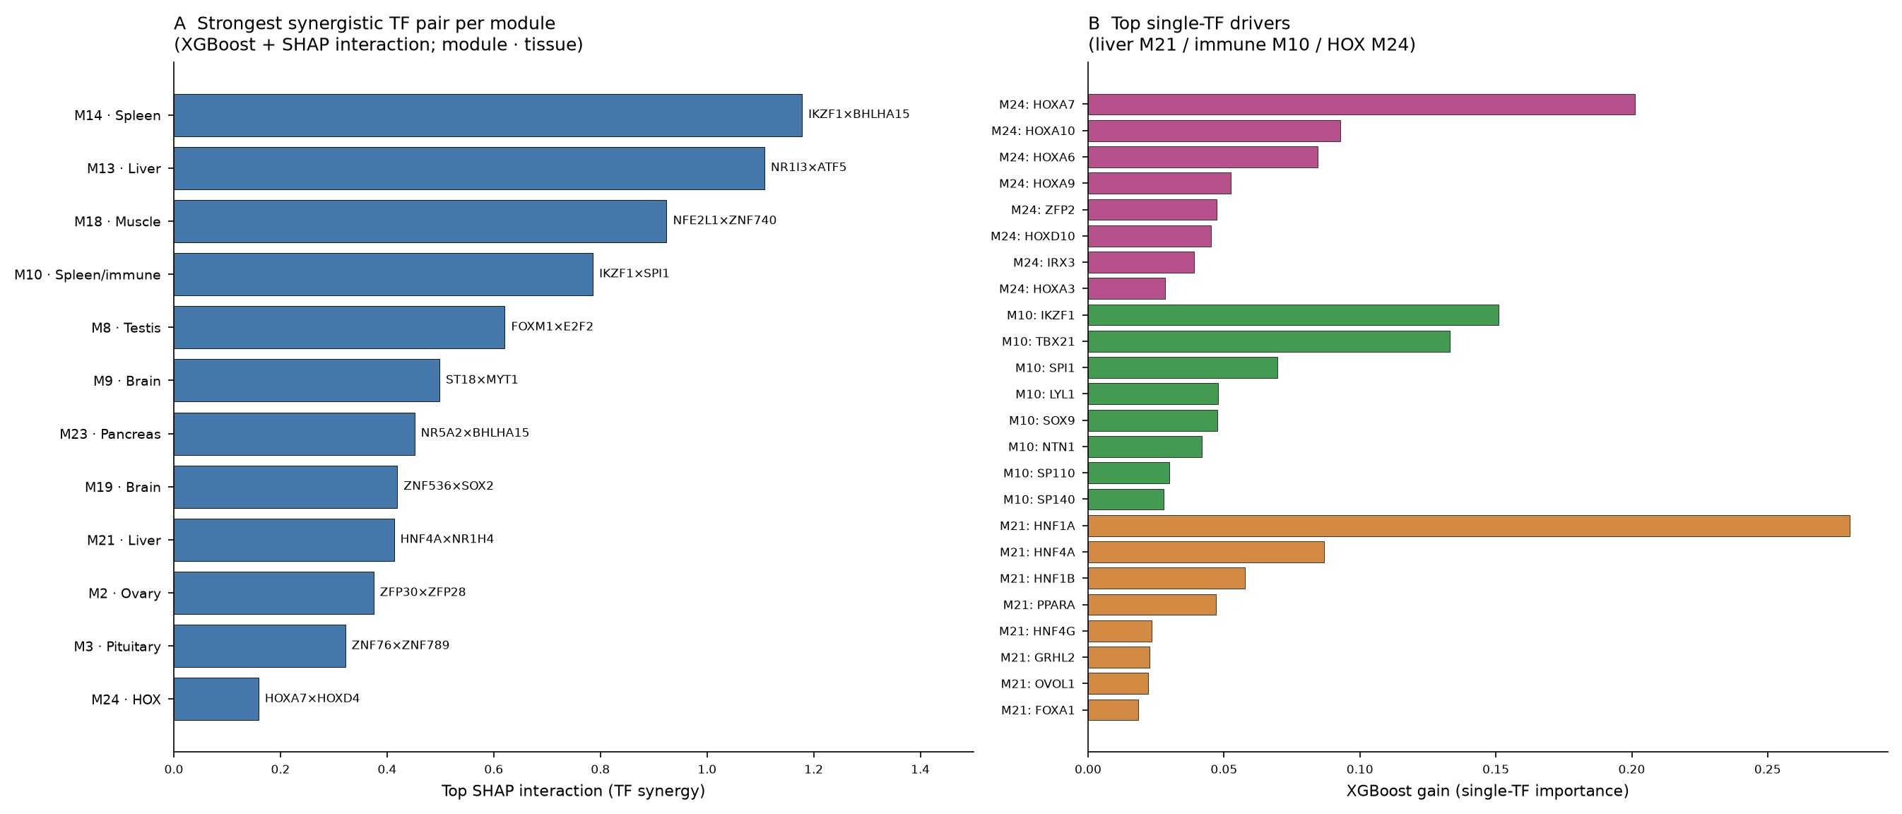
Bulk RNA-seq (2) — Context-Dependent TF Cocktails
▸ Caveat that motivates single-cell: bulk cannot tell a cell-intrinsic driver from a TF that merely tracks how much of a cell type is in the tissue
▸ One TF, different partners in different tissues
The regulatory backbone (TF sub-networks) preserves BETTER than the full modules
FOXA1 acts with distinct co-factors per tissue; HNF1A+HNF4A+HNF1B define liver
▸ Strongest cocktails (XGBoost SHAP interaction)
Spleen/immune M14: IKZF1×BHLHA15 (1.18), IKZF1×IRF4 (1.15)
Liver M13: NR1I3(CAR)×ATF5 (1.11)
Immune M10: IKZF1×SPI1 (0.79)

Slide 5
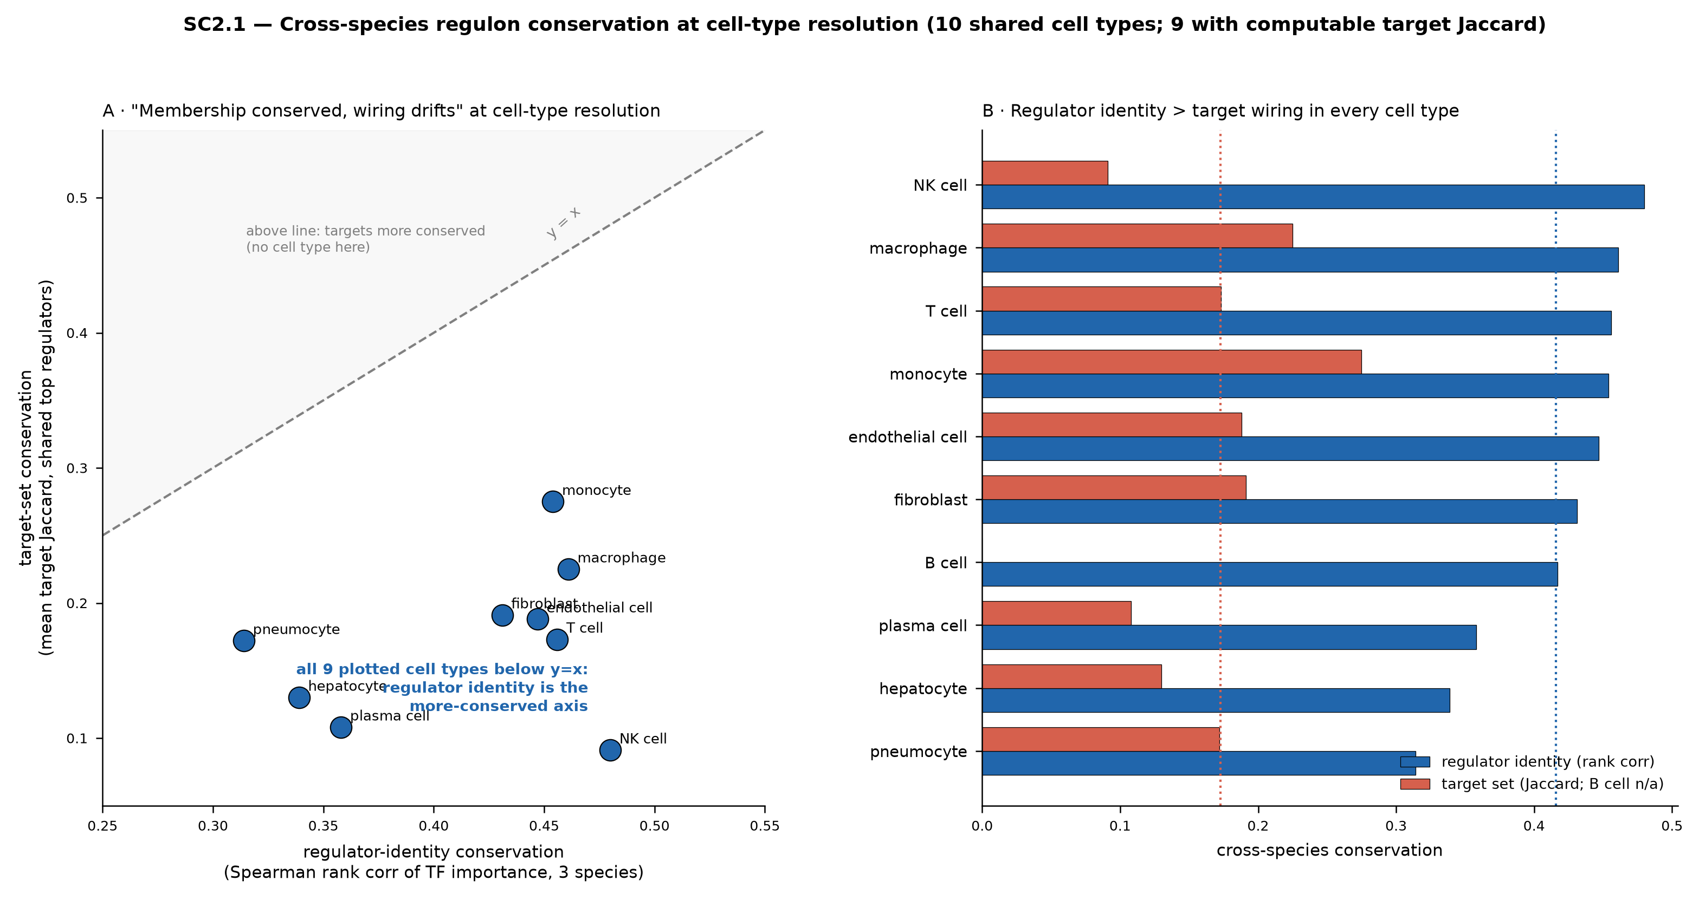
Single-Cell (1) — The Thesis Holds at Cell-Type Resolution
▸ Single-cell separates the cell types bulk mixed together
4 tissues × 3 species; per-cell-type regulons for plasma cell, hepatocyte, monocyte, T cell…
▸ “Membership conserved, wiring drifts” — confirmed within cell types
Regulator sets conserved 3.5× more than target wiring (motif-pruned Tier-4; 2.4× in co-expression, 3.2–5.0× above chance)
Held-out test: lemur regulons predicted from human+mouse track conservation at ρ = 0.79
▸ Canonical masters survive strict cisTarget motif pruning
XBP1 (plasma cell), HNF4A (hepatocyte), CEBPB + FOS (monocyte, all 3 species)
▸ Reaches teleost: master regulators recur in zebrafish (~450 My; p ≤ 0.016)
Brackets marsupials & Afrotheria — the conserved core “goes the distance”
Regulator-identity vs target-set conservation

Slide 6
Single-Cell (2) — Bulk vs Single-Cell Master Regulators Differ
Single-cell resolves the true cell-intrinsic master; bulk names composition-linked TFs instead.
Cell type / module | Bulk RNA-seq masters | Single-cell masters | What single-cell reveals
Plasma cell (M14) | IKZF1 / NKX2-3 / EBF4 | XBP1 / JUND / TCF12 | XBP1 = the true UPR/secretory master; IKZF1 was a B/plasma composition signal
Hepatocyte (M13) | NR1I3 / ATF5 / PROX1 | NFIA / KLF12 / ETV6 | Bulk xenobiotic-TFs give way to cell-intrinsic drivers; MLXIPL×NR1H4 genuine all 3 sp
Monocyte (M15) | STAT6 / TBX21 / SP110 | SPI1 / FOSB / MAF | SPI1/PU.1 — the canonical myeloid master — emerges only at single-cell resolution
T cell (M10) | IKZF1 / TBX21 / SPI1 | MZF1 / BACH2 / IRF4 | Bulk repeats IKZF1 (same as plasma) — a shared-lymphocyte artifact; sc separates them
Bulk = XGBoost gain rank (whole-tissue); Single-cell = pySCENIC motif-pruned regulon, module-gene targets (human). Red = bulk, teal = single-cell.
6 / 7

Slide 7
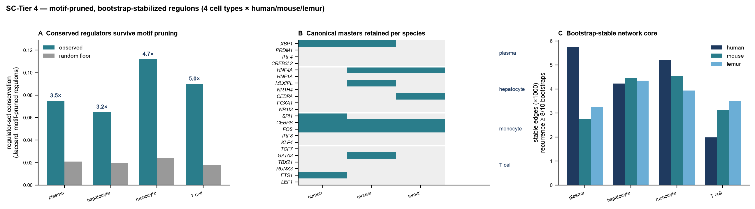
Bottom Line — Why Both Views Matter
▸ The regulatory logic of tissues is ancient, but written in the regulators — not the wiring
Conserved across 26 vertebrates (bulk) and confirmed within cell types to teleost (single-cell)
▸ Single-cell corrects bulk’s composition confound
Bulk “masters” IKZF1 (plasma & T cell) reflect lymphocyte content, not cell-intrinsic control
Single-cell recovers the textbook masters: XBP1 (plasma), SPI1/PU.1 (monocyte), HNF4A (liver)
▸ Bulk SHAP magnitude does NOT predict single-cell validation
MLXIPL×NR1H4 (hepatocyte) genuine in all 3 species yet under-ranked in bulk
KZF1×IRF4 (top bulk spleen cocktail) genuine in lemur only
▸ Use bulk to find conserved programs across species; use single-cell to name the TF that actually drives the program in the cell you care about
7 / 7
Tier-4 motif-pruned regulon conservation & stability

