Slide 1
Conserved Gene Co-expression & Transcription-Factor Regulatory Logic Across Vertebrates
Bulk RNA-seq analysis — human GTEx reference, tested across 26 vertebrate species
recount3 · Bgee v15.2 · FarmGTEx | WGCNA modules → cross-species preservation → phylogenetic signal → TF regulatory network
Companion bulk-RNA-seq track to the single-cell confirmation analysis

Slide 2
The Question
▸ How does one genome give rise to many cell types and tissues — and how much of that regulatory architecture is conserved across evolution?
– Co-expression modules capture tissue- and cell-type programs driven by differential expression and transcription factors
– Which modules are preserved across the vertebrate tree, and which are evolutionarily labile?
– Does the conserved co-expression architecture carry a conserved TF regulatory logic?
▸ Scope decision (with the researcher): tissue-resolved reference, not organism-averaged networks
– Organism-averaged expression collapses exactly the cell-type signal of interest
– Strategy: discover modules in a well-powered reference (human GTEx), then test preservation in a broad species panel, then build the TF layer on the conserved modules
2 / 11

Slide 3
Approach — Two Stages, Two Phases
STAGE 1
Human GTEx WGCNA modules
30 tissues · 3,267 samples → 27 modules
STAGE 2
Cross-species preservation
26 species · 12 clades Zsummary test
PHASE A
Phylogenetic signal
Blomberg K · Pagel λ on timetree
PHASE B
TF regulatory layer
793 TFs · ensemble GRN cocktails · validation
All results below are from bulk RNA-seq only. Modules are discovered once in human and then tested — not re-derived — in every other species, so preservation is a genuine out-of-sample test.
3 / 11

Slide 4
Methods & Data
▸ Data sources (bulk RNA-seq)
– Human reference: recount3 GTEx — 30 tissues, 3,267 samples (balanced subsample)
– Cross-species: Bgee v15.2 (24 species) + FarmGTEx cattle; 26 species, 12 clades, 6.4–429 My
– Independent cross-check: ENCODE mouse (419 samples, 20 tissues)
▸ Module discovery — WGCNA
– CPM→log2, variance-filtered to 14,000 genes; signed-hybrid network, soft power β=8
– Signed TOM → hierarchical clustering → dynamicTreeCut → eigengene merge (r>0.75)
– Pure-Python reimplementation (no osx-arm64 R build), validated against mouse network
▸ Cross-species & regulatory analysis
– Preservation: WGCNA Zsummary (Langfelder 2011) on 1:1 orthologs
– Phylo signal: Blomberg's K + Pagel's λ on TimeTree ultrametric tree (ape/phytools)
– TF layer: GO/JASPAR annotation · 3-method GRN ensemble (GENIE3+GRNBoost2+CLR) · XGBoost/SHAP cocktails · DoRothEA validation
4 / 11

Slide 5
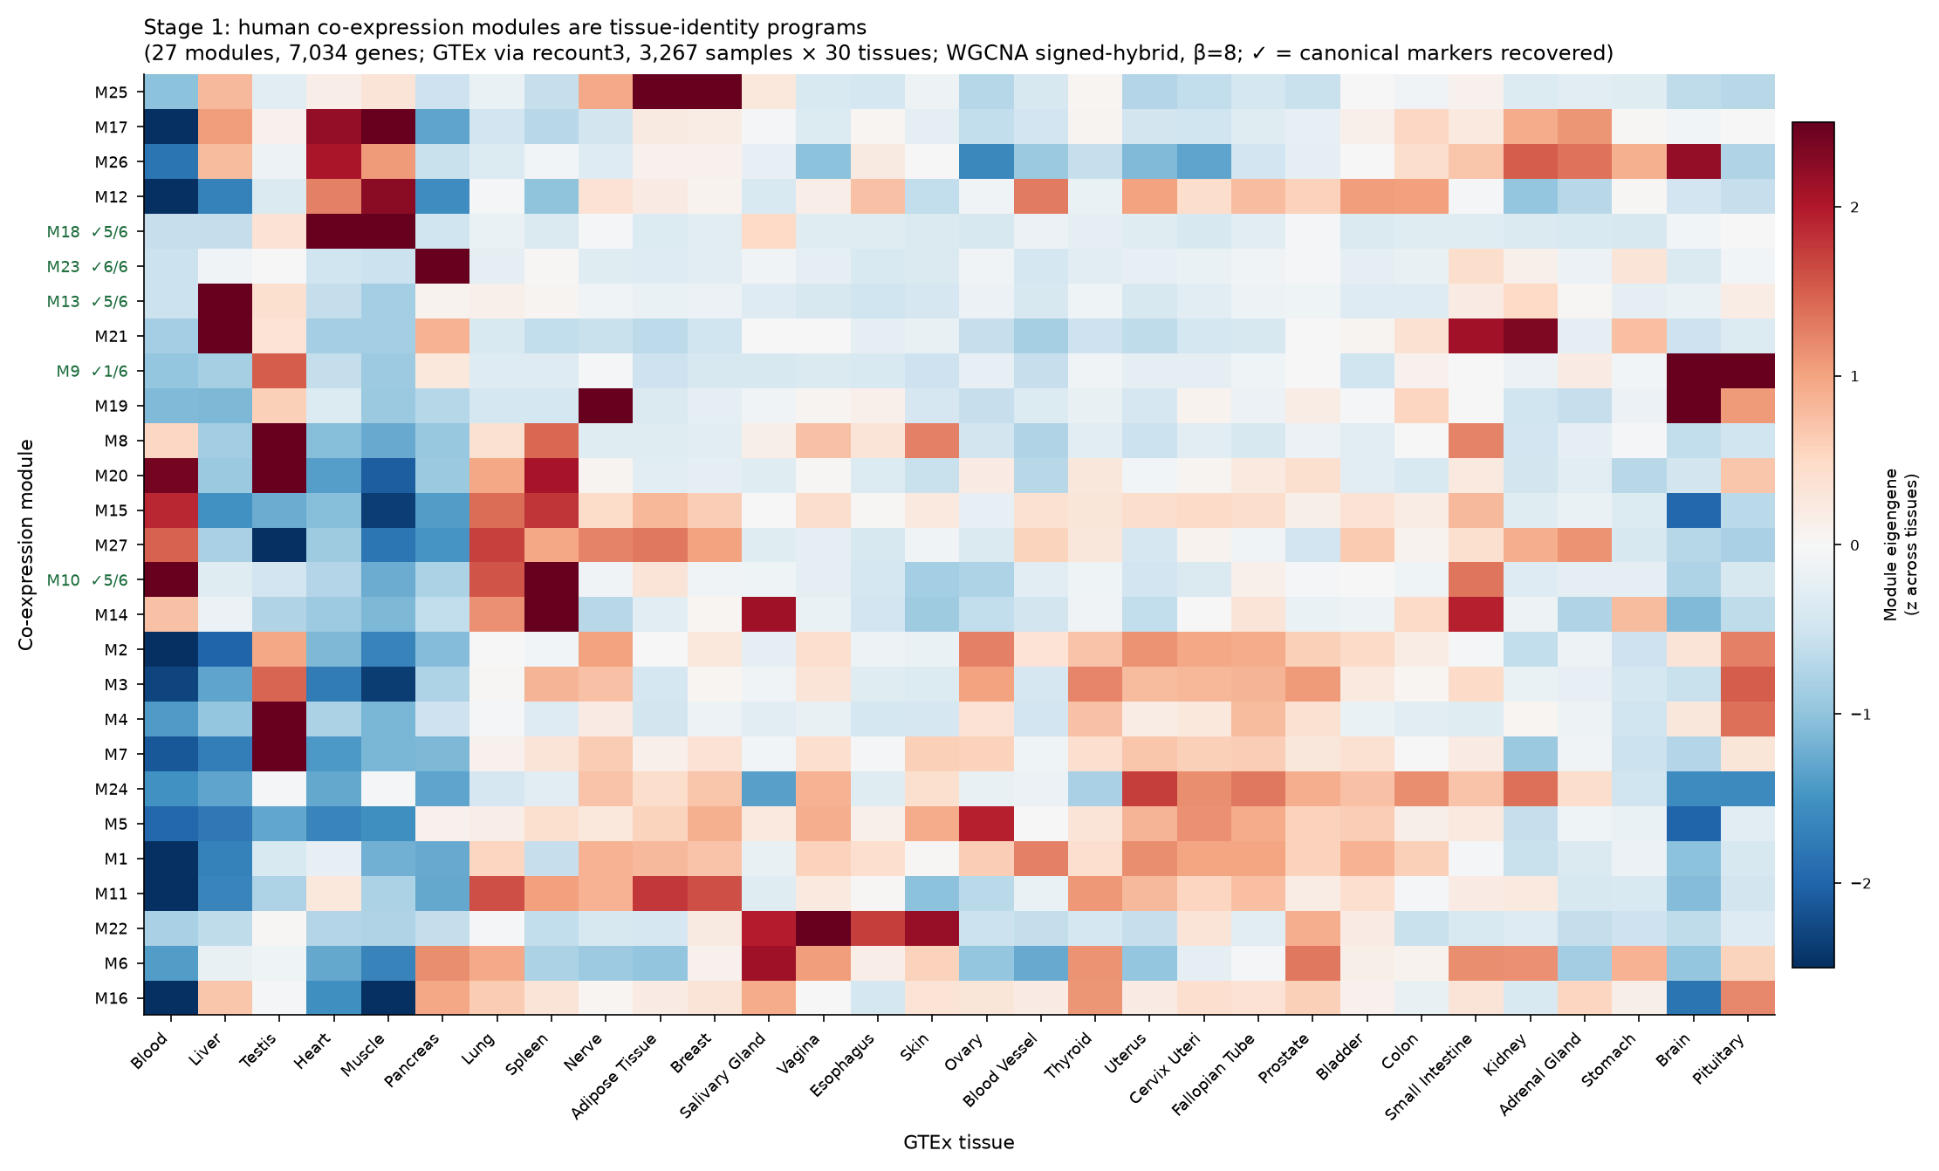
Stage 1 — 27 Tissue-Defining Modules in Human
▸ 27 modules, 7,034 genes assigned
– Cleanly tissue-organised
– Marker-validated: pancreas 6/6, liver 5/6, muscle 5/6, spleen 5/6
▸ Resolves sub-tissue programs
– Brain → synaptic / mitochondrial / glial
– Liver → xenobiotic vs core metabolism
– Testis → meiosis / DNA-repair / spermatogenesis
– The cell-type structure recovered from bulk co-expression
5 / 11

Slide 6
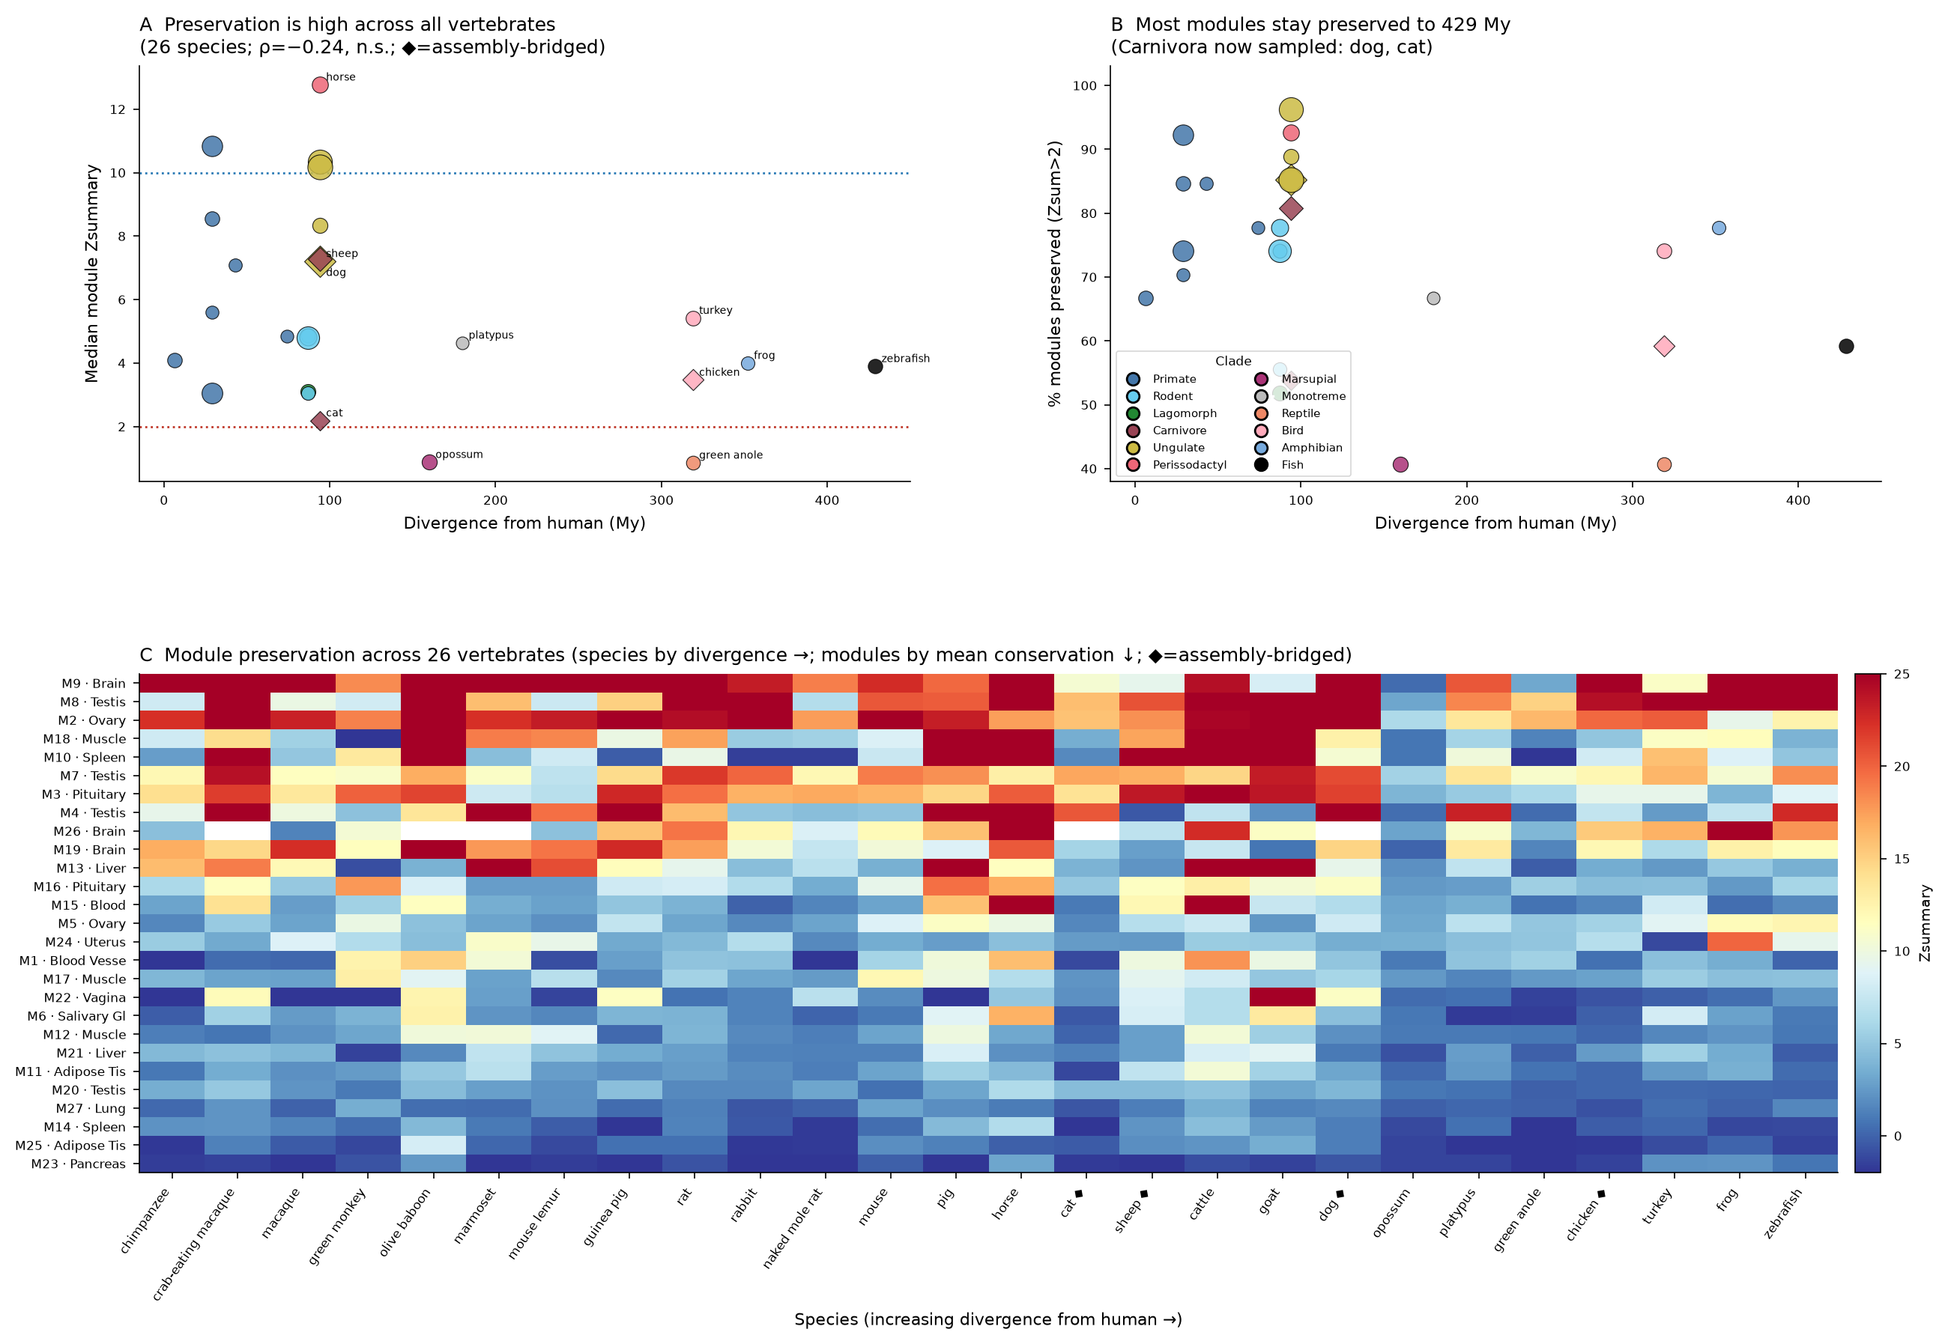
Stage 2 — Conservation Is Module-Driven, Not Divergence-Driven
▸ 26 species · 12 clades · 6.4–429 My
▸ Preservation vs divergence time:
– Spearman ρ = −0.24, p = 0.23 (n.s.)
– conservation does NOT decay with distance
▸ Universally conserved
– brain M9 (Zsum 24.9), testis M8 (22.6), ovary M2 (21.5), muscle M18, spleen M10
▸ Labile
– pancreas M23, adipose M25, lung M27
▸ Mouse cross-check: 23/26 modules recovered independently
6 / 11

Slide 7
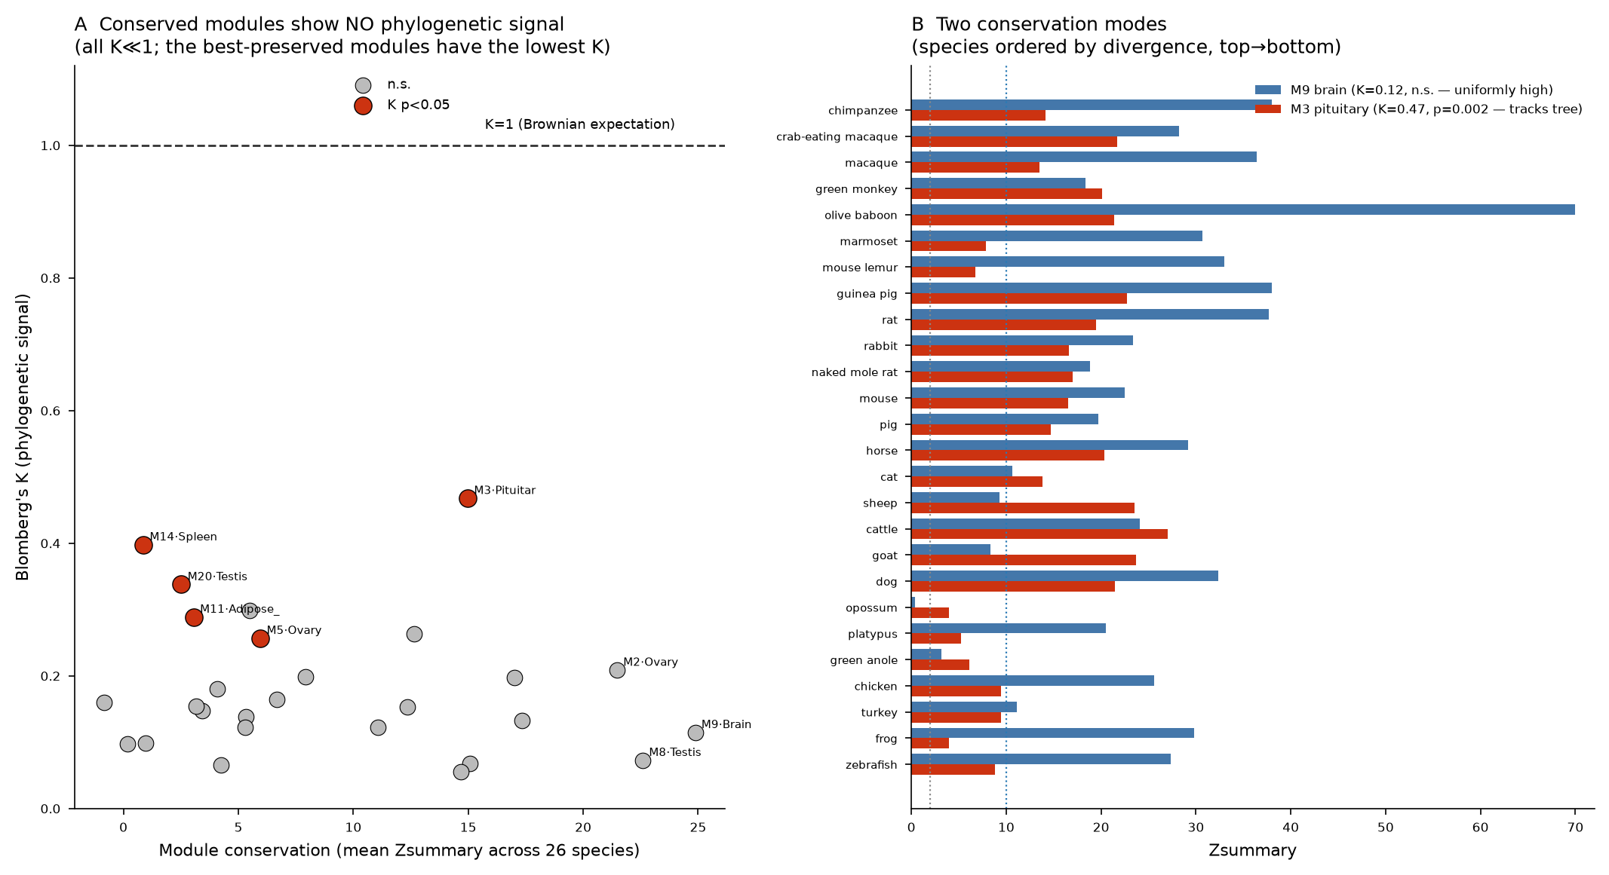
Phase A — Conservation Does Not Track the Phylogeny
▸ Every module K ≪ 1
– range 0.055–0.468, mean 0.18 (K=1 = Brownian)
▸ Only 5/27 significant K
– M3 pituitary K=0.47 (p=0.002), M14 spleen, M20 testis, M11 adipose, M5 ovary
▸ Counterintuitive core result
– the most-conserved modules have the LOWEST K
– core programs conserved everywhere at once — deep stabilizing selection, not graded by relatedness
– phylo signal lives in the labile modules — where regulation genuinely varies by clade
7 / 11

Slide 8
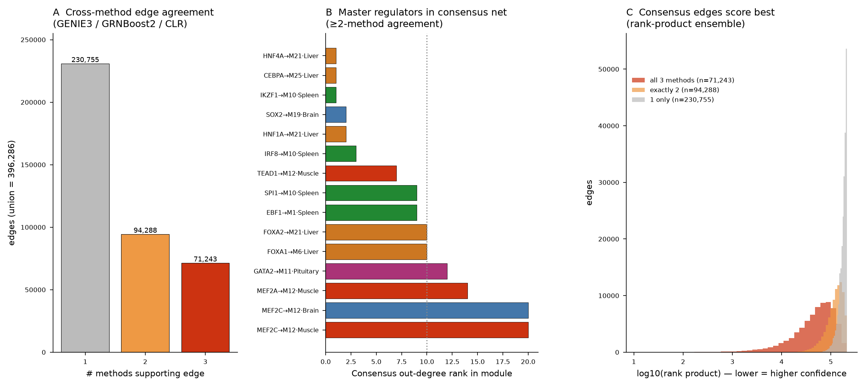
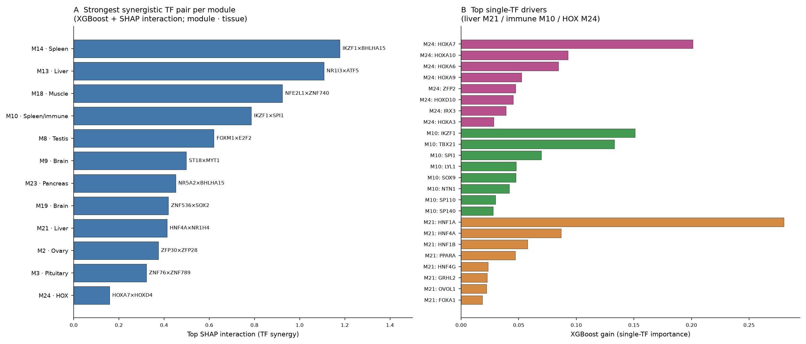
Phase B — TF Regulatory Network on Conserved Modules
793 TFs annotated · 3-method ensemble GRN (396,286 edges, 165,531 with ≥2-method support) · master regulators rank at the top of their modules (HNF4A #1 liver, IKZF1 #1 immune, SOX2 a top-3 brain regulator) · combinatorial codes recovered from expression alone (HNF1A+HNF4A, IKZF1×SPI1, FOXM1×E2F2)
8 / 11

Slide 9
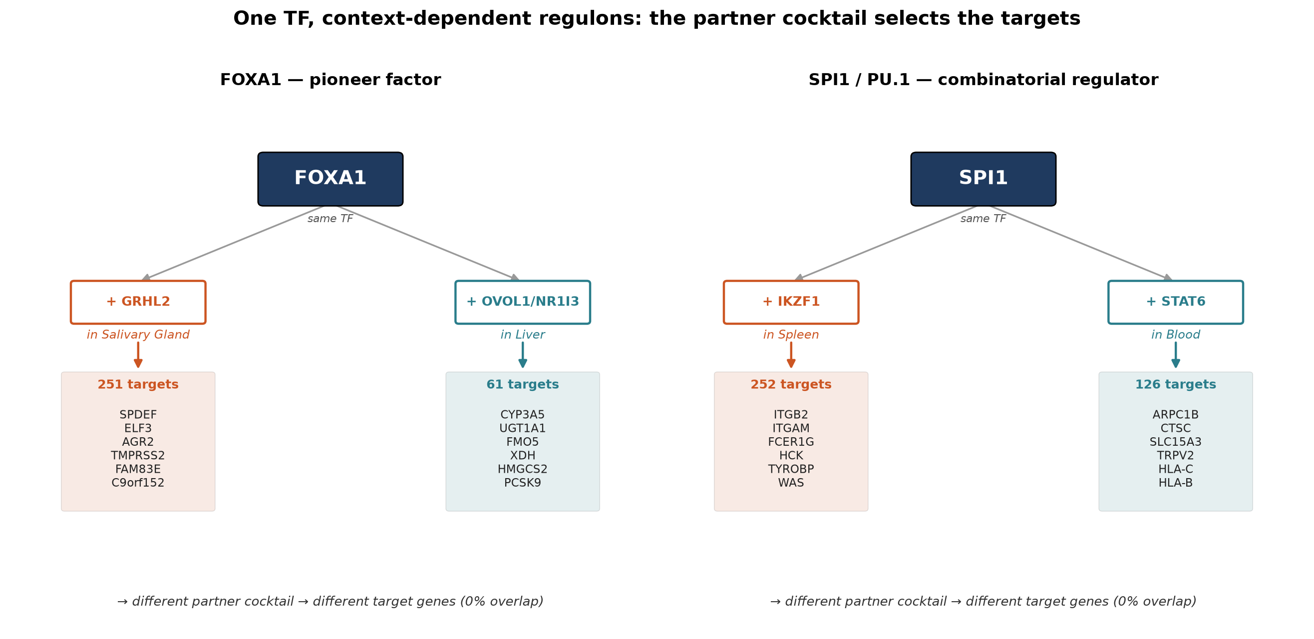
Context-Dependent Regulation — One TF, Different Cocktails, Different Targets
Directly answers the motivating question. FOXA1 (a pioneer factor) and SPI1/PU.1 (a combinatorial regulator) each control completely non-overlapping gene sets (0% target overlap) in different tissues — and the SHAP-inferred partner cocktail differs with them: FOXA1+GRHL2 drives epithelial genes (SPDEF, TMPRSS2) in salivary gland, FOXA1+NR1I3/CAR drives xenobiotic metabolism (CYP3A5, UGT1A1) in liver.
9 / 11

Slide 10
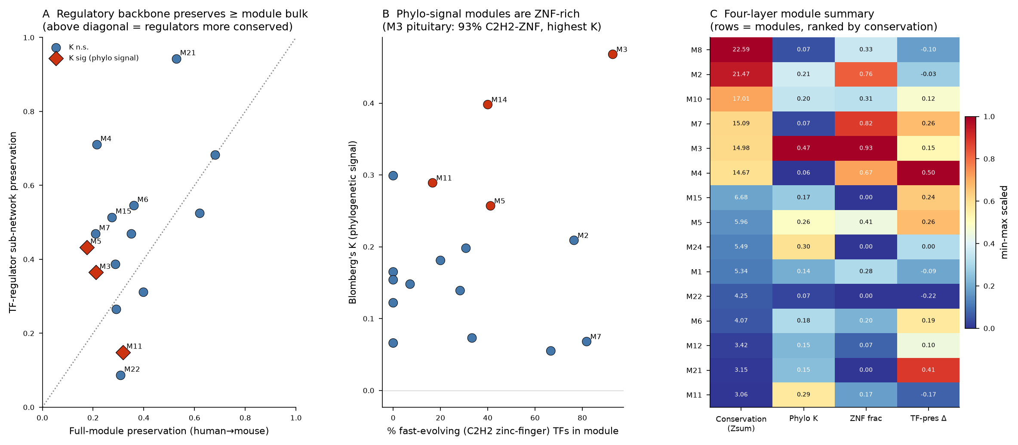
Key Finding — Regulatory Backbone Is the Conserved Core
▸ TF regulator sub-networks preserve BETTER than full modules
– 0.46 vs 0.35 (Wilcoxon p=0.06); 10/15 modules
– liver HNF core 0.94 vs 0.53 full module
– Membership drifts; core regulatory logic is locked
▸ Clade-variable regulation is localised
– M11 adipose: regulators rewire AND carry phylo signal
▸ TF-family axis
– M3 pituitary (highest K) is 93% C2H2 zinc-finger — the fastest-evolving TF family
– conserved logic borne by classical TFs; labile signal in KRAB-ZNF modules
10 / 11

Slide 11
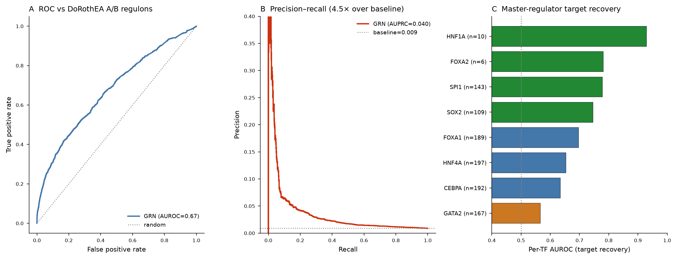
Validation & Summary
▸ Takeaways (bulk RNA-seq)
– 27 human modules; 23/26 recovered in mouse
– Conservation is module-identity-driven, not divergence-driven (ρ=−0.24 n.s.)
– Core programs conserved everywhere at once; phylo signal in labile modules
– Conserved co-expression DOES carry conserved TF logic — the regulatory backbone is the deepest-conserved layer
– Next: single-cell confirmation (in progress) + genome-scale orthogroups/motif layer
GRN vs DoRothEA gold standard: AUROC 0.67–0.69 (best on highest-confidence tier), AUPRC 4.5–7× baseline. Master regulators recover individually: HNF1A 0.93, FOXA2/SPI1 0.78, SOX2 0.75.
11 / 11

