Slide 1
Conserved Gene Co-expression & Transcription-Factor Regulatory Logic Across Vertebrates
Bulk RNA-seq analysis — human GTEx reference, tested across 26 vertebrate species
recount3 · Bgee v15.2 · FarmGTEx | WGCNA modules → cross-species preservation → phylogenetic signal → TF regulatory network
Now extended with a single-cell arm (Tabula human/mouse/lemur + zebrafish) — slides 12–18.

Slide 2
The Question
▸ How does one genome give rise to many cell types and tissues — and how much of that regulatory architecture is conserved across evolution?
– Co-expression modules capture tissue- and cell-type programs driven by differential expression and transcription factors
– Which modules are preserved across the vertebrate tree, and which are evolutionarily labile?
– Does the conserved co-expression architecture carry a conserved TF regulatory logic?
▸ Scope decision (with the researcher): tissue-resolved reference, not organism-averaged networks
– Organism-averaged expression collapses exactly the cell-type signal of interest
– Strategy: discover modules in a well-powered reference (human GTEx), then test preservation in a broad species panel, then build the TF layer on the conserved modules
2 / 18

Slide 3
Approach — Two Stages, Two Phases
STAGE 1
Human GTEx WGCNA modules
30 tissues · 3,267 samples → 27 modules
STAGE 2
Cross-species preservation
26 species · 12 clades Zsummary test
PHASE A
Phylogenetic signal
Blomberg K · Pagel λ on timetree
PHASE B
TF regulatory layer
793 TFs · ensemble GRN cocktails · validation
All results below are from bulk RNA-seq only. Modules are discovered once in human and then tested — not re-derived — in every other species, so preservation is a genuine out-of-sample test.
3 / 18

Slide 4
Methods & Data
▸ Data sources (bulk RNA-seq)
– Human reference: recount3 GTEx — 30 tissues, 3,267 samples (balanced subsample)
– Cross-species: Bgee v15.2 (24 species) + FarmGTEx cattle; 26 species, 12 clades, 6.4–429 My
– Independent cross-check: ENCODE mouse (419 samples, 20 tissues)
▸ Module discovery — WGCNA
– CPM→log2, variance-filtered to 14,000 genes; signed-hybrid network, soft power β=8
– Signed TOM → hierarchical clustering → dynamicTreeCut → eigengene merge (r>0.75)
– Pure-Python reimplementation (no osx-arm64 R build), validated against mouse network
▸ Cross-species & regulatory analysis
– Preservation: WGCNA Zsummary (Langfelder 2011) on 1:1 orthologs
– Phylo signal: Blomberg's K + Pagel's λ on TimeTree ultrametric tree (ape/phytools)
– TF layer: GO/JASPAR annotation · 3-method GRN ensemble (GENIE3+GRNBoost2+CLR) · XGBoost/SHAP cocktails · DoRothEA validation
4 / 18

Slide 5
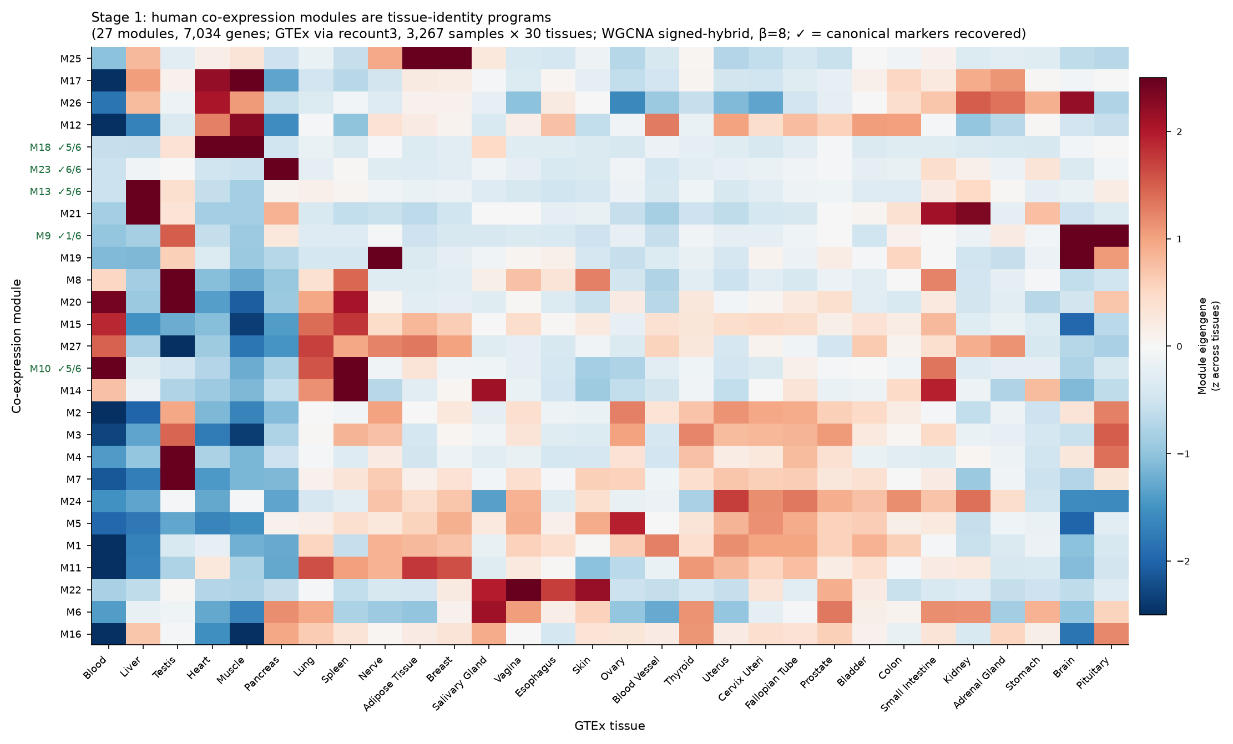
Stage 1 — 27 Tissue-Defining Modules in Human
▸ 27 modules, 7,034 genes assigned
– Cleanly tissue-organised
– Marker-validated: pancreas 6/6, liver 5/6, muscle 5/6, spleen 5/6
▸ Resolves sub-tissue programs
– Brain → synaptic / mitochondrial / glial
– Liver → xenobiotic vs core metabolism
– Testis → meiosis / DNA-repair / spermatogenesis
– The cell-type structure recovered from bulk co-expression
5 / 18

Slide 6
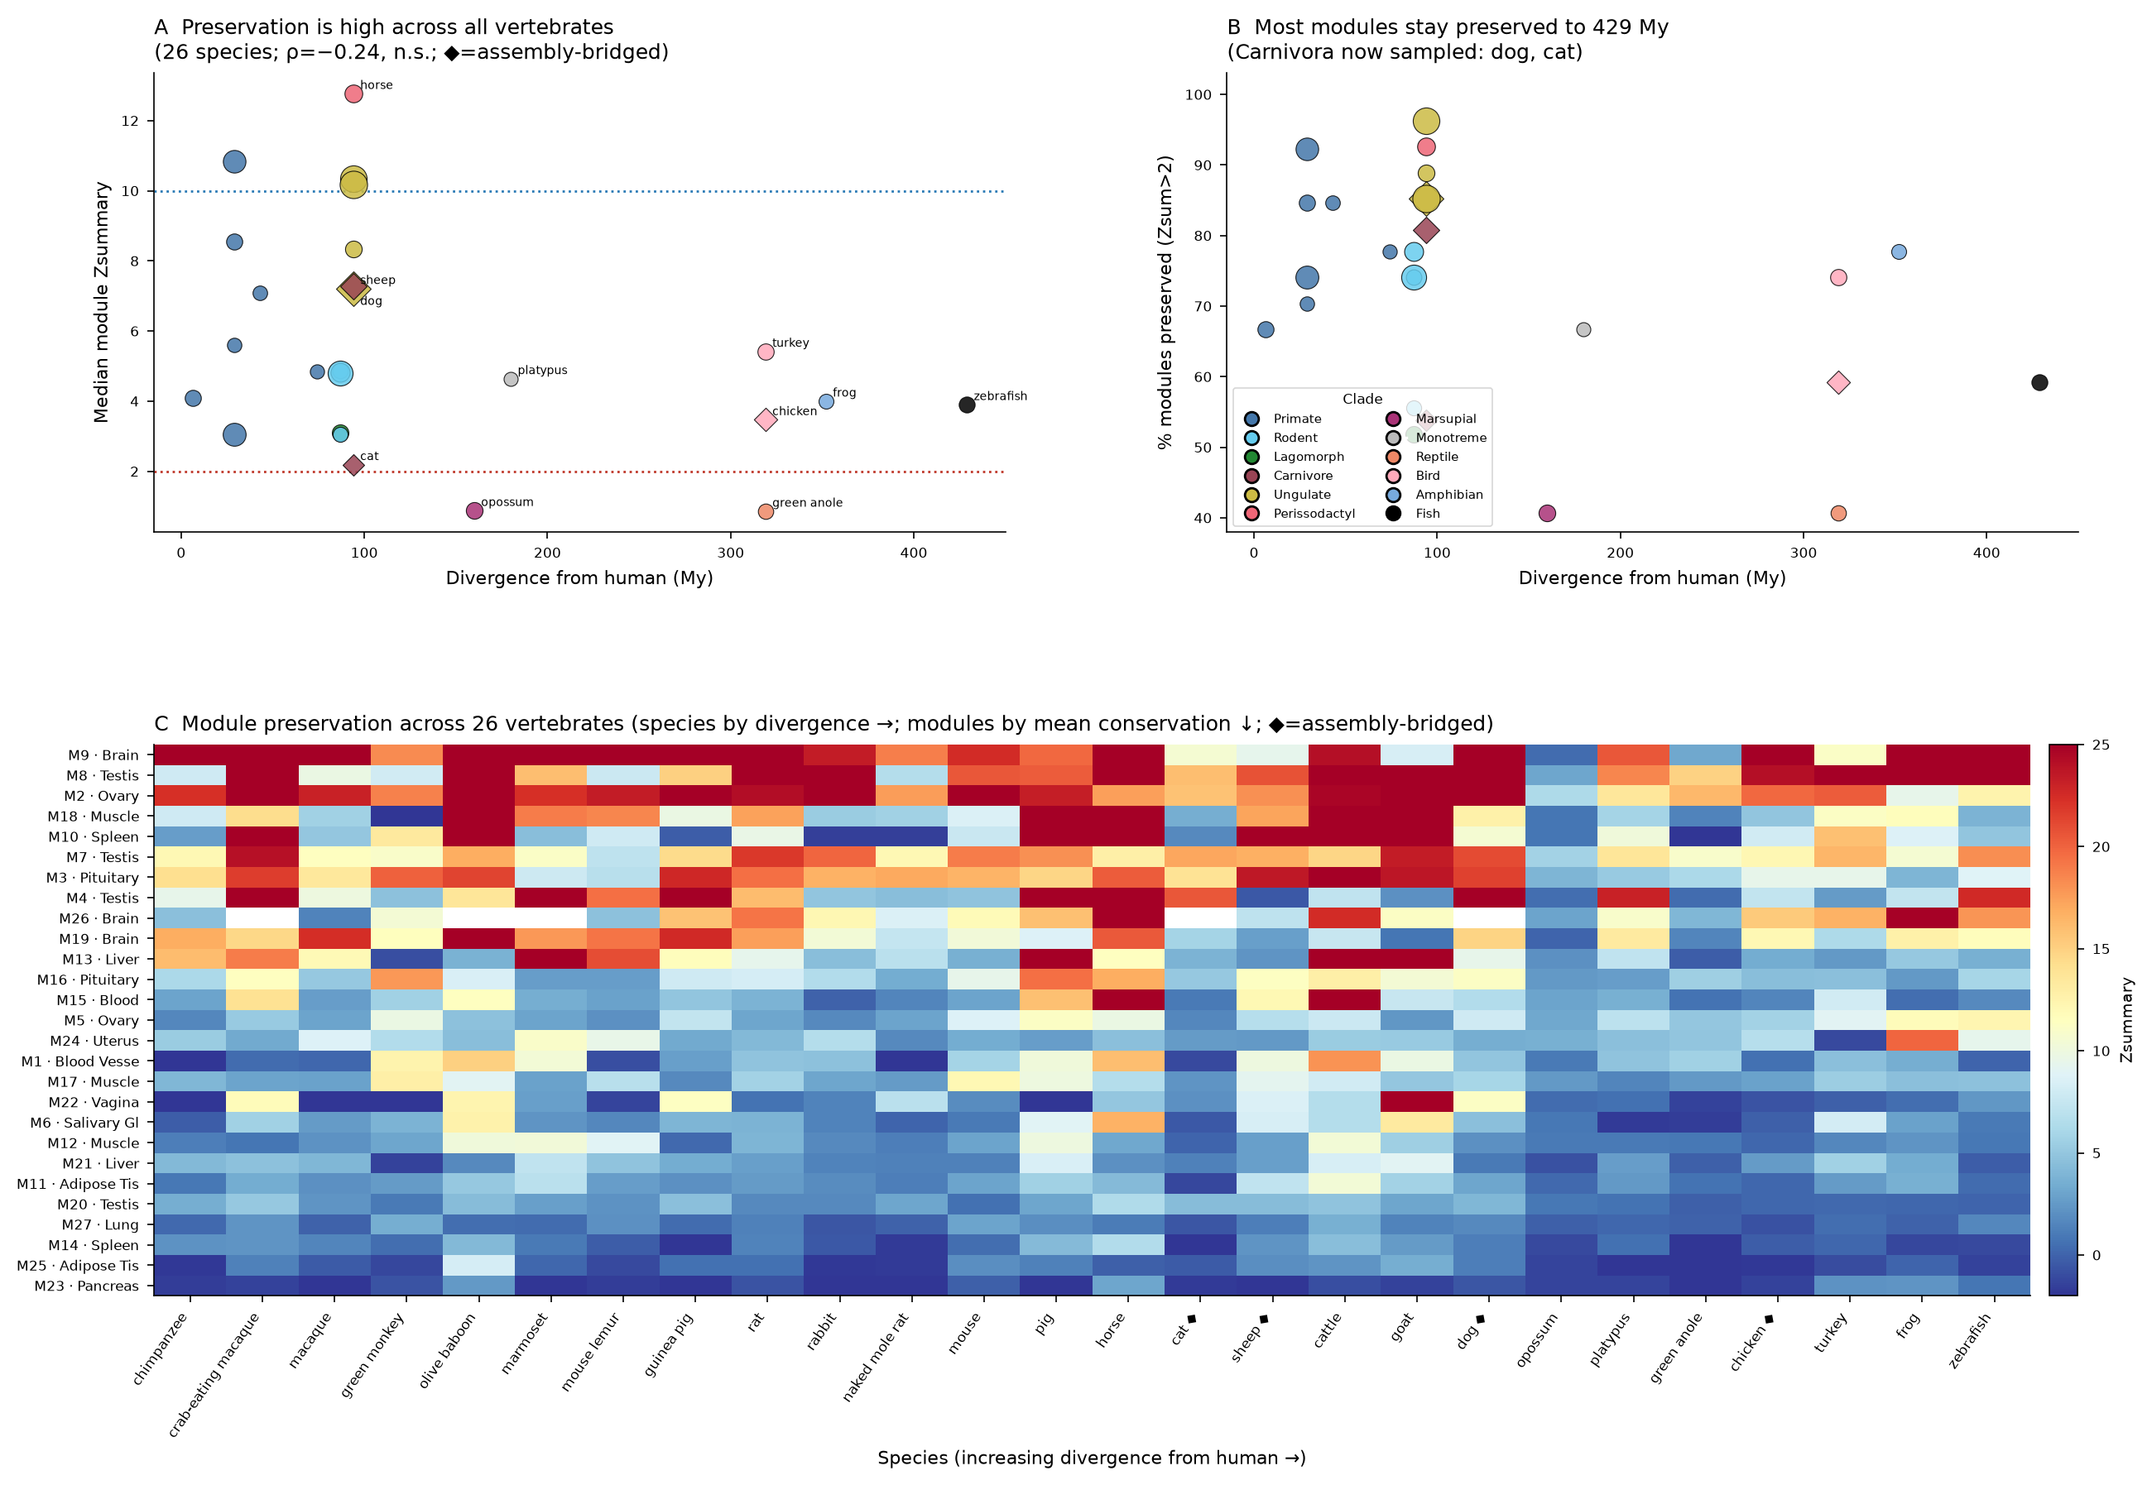
Stage 2 — Conservation Is Module-Driven, Not Divergence-Driven
▸ 26 species · 12 clades · 6.4–429 My
▸ Preservation vs divergence time:
– Spearman ρ = −0.24, p = 0.23 (n.s.)
– conservation does NOT decay with distance
▸ Universally conserved
– brain M9 (Zsum 24.9), testis M8 (22.6), ovary M2 (21.5), muscle M18, spleen M10
▸ Labile
– pancreas M23, adipose M25, lung M27
▸ Mouse cross-check: 23/26 modules recovered independently
6 / 18

Slide 7
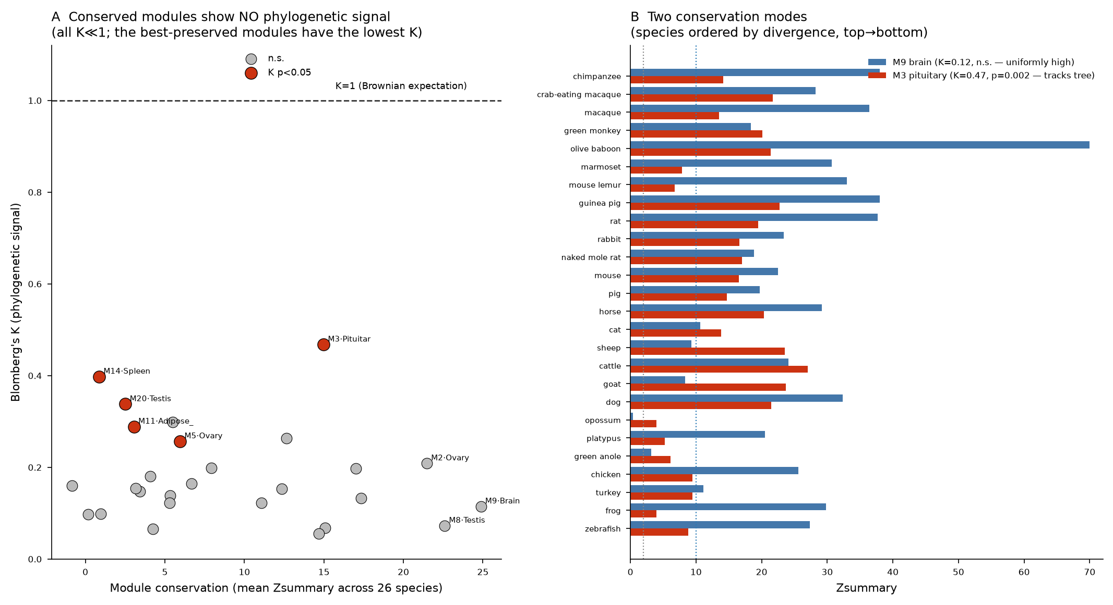
Phase A — Conservation Does Not Track the Phylogeny
▸ Every module K ≪ 1
– range 0.055–0.468, mean 0.18 (K=1 = Brownian)
▸ Only 5/27 significant K
– M3 pituitary K=0.47 (p=0.002), M14 spleen, M20 testis, M11 adipose, M5 ovary
▸ Counterintuitive core result
– the most-conserved modules have the LOWEST K
– core programs conserved everywhere at once — deep stabilizing selection, not graded by relatedness
– phylo signal lives in the labile modules — where regulation genuinely varies by clade
7 / 18

Slide 8
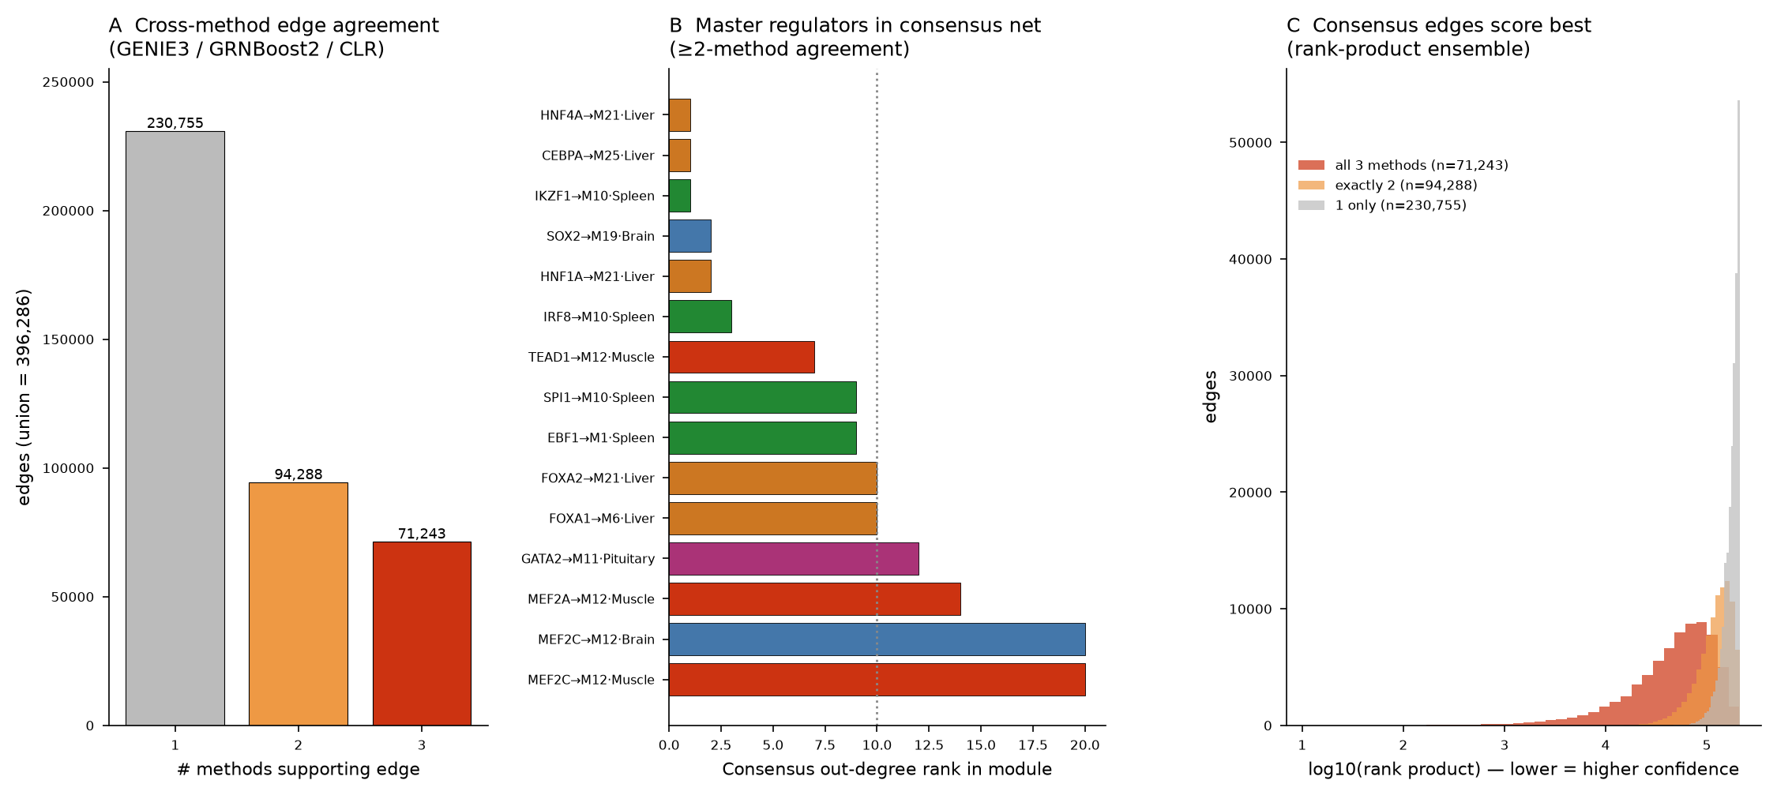
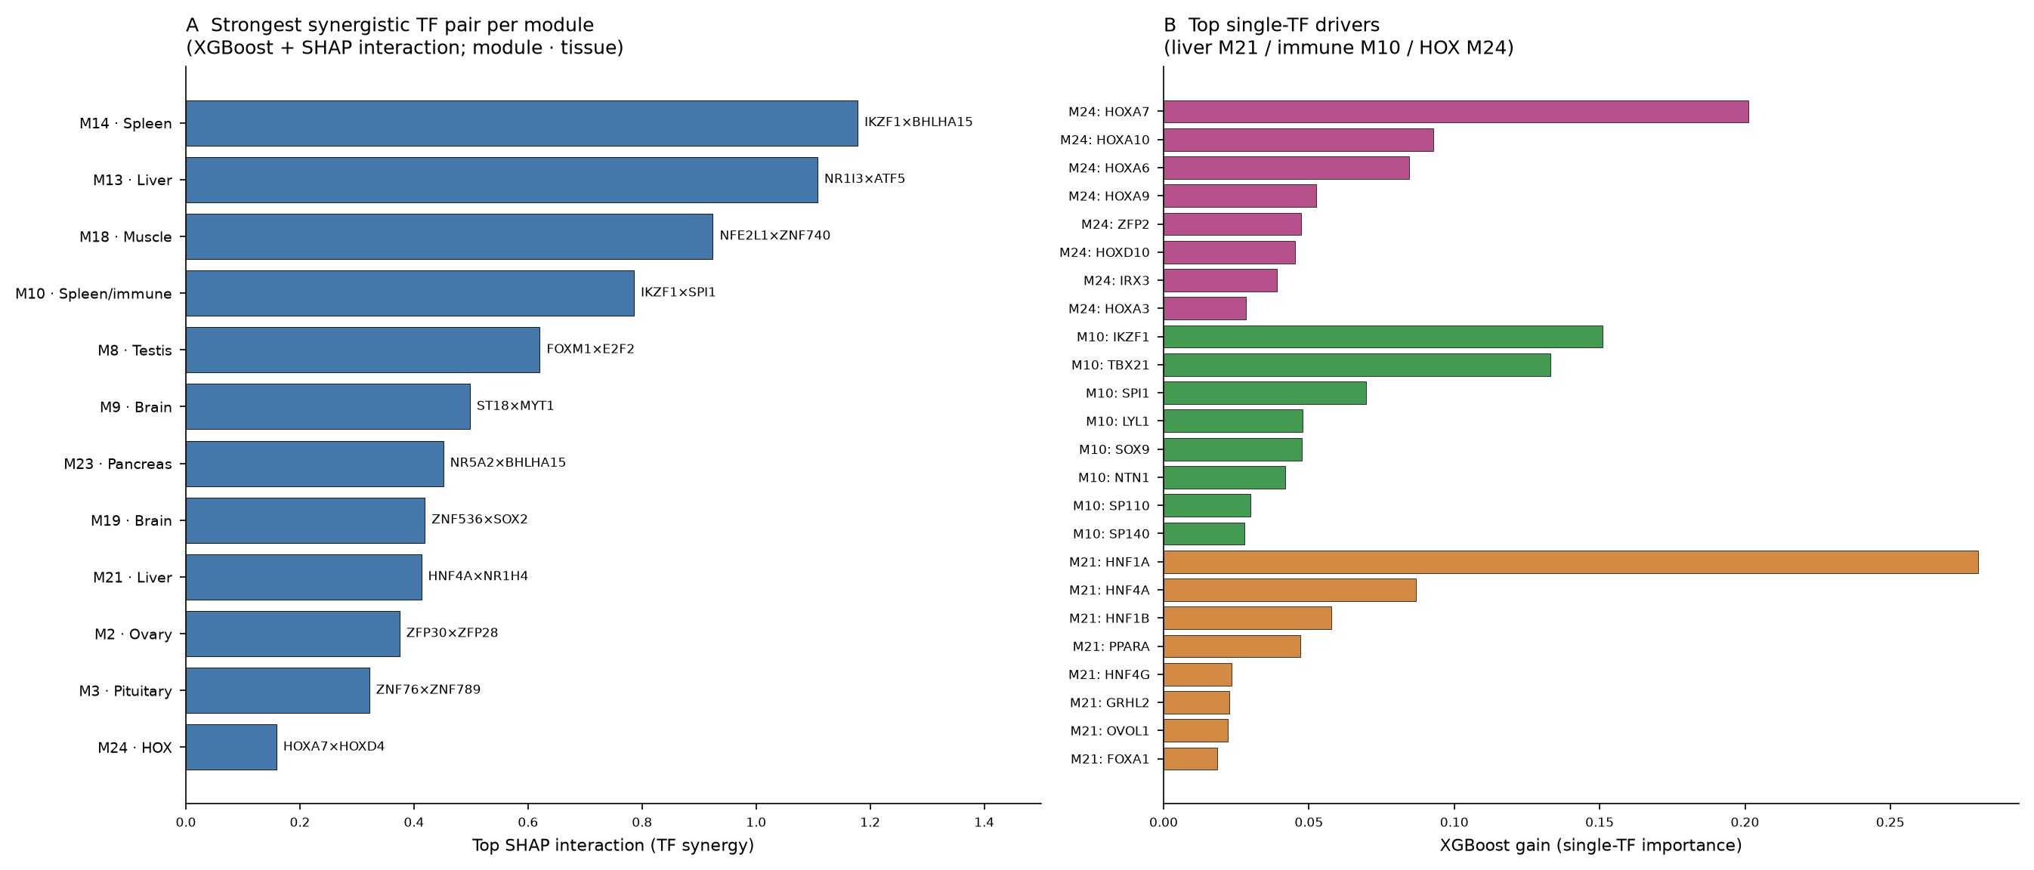
Phase B — TF Regulatory Network on Conserved Modules
793 TFs annotated · 3-method ensemble GRN (396,286 edges, 165,531 with ≥2-method support) · master regulators rank at the top of their modules (HNF4A #1 liver, IKZF1 #1 immune, SOX2 a top-3 brain regulator) · combinatorial codes recovered from expression alone (HNF1A+HNF4A, IKZF1×SPI1, FOXM1×E2F2)
8 / 18

Slide 9
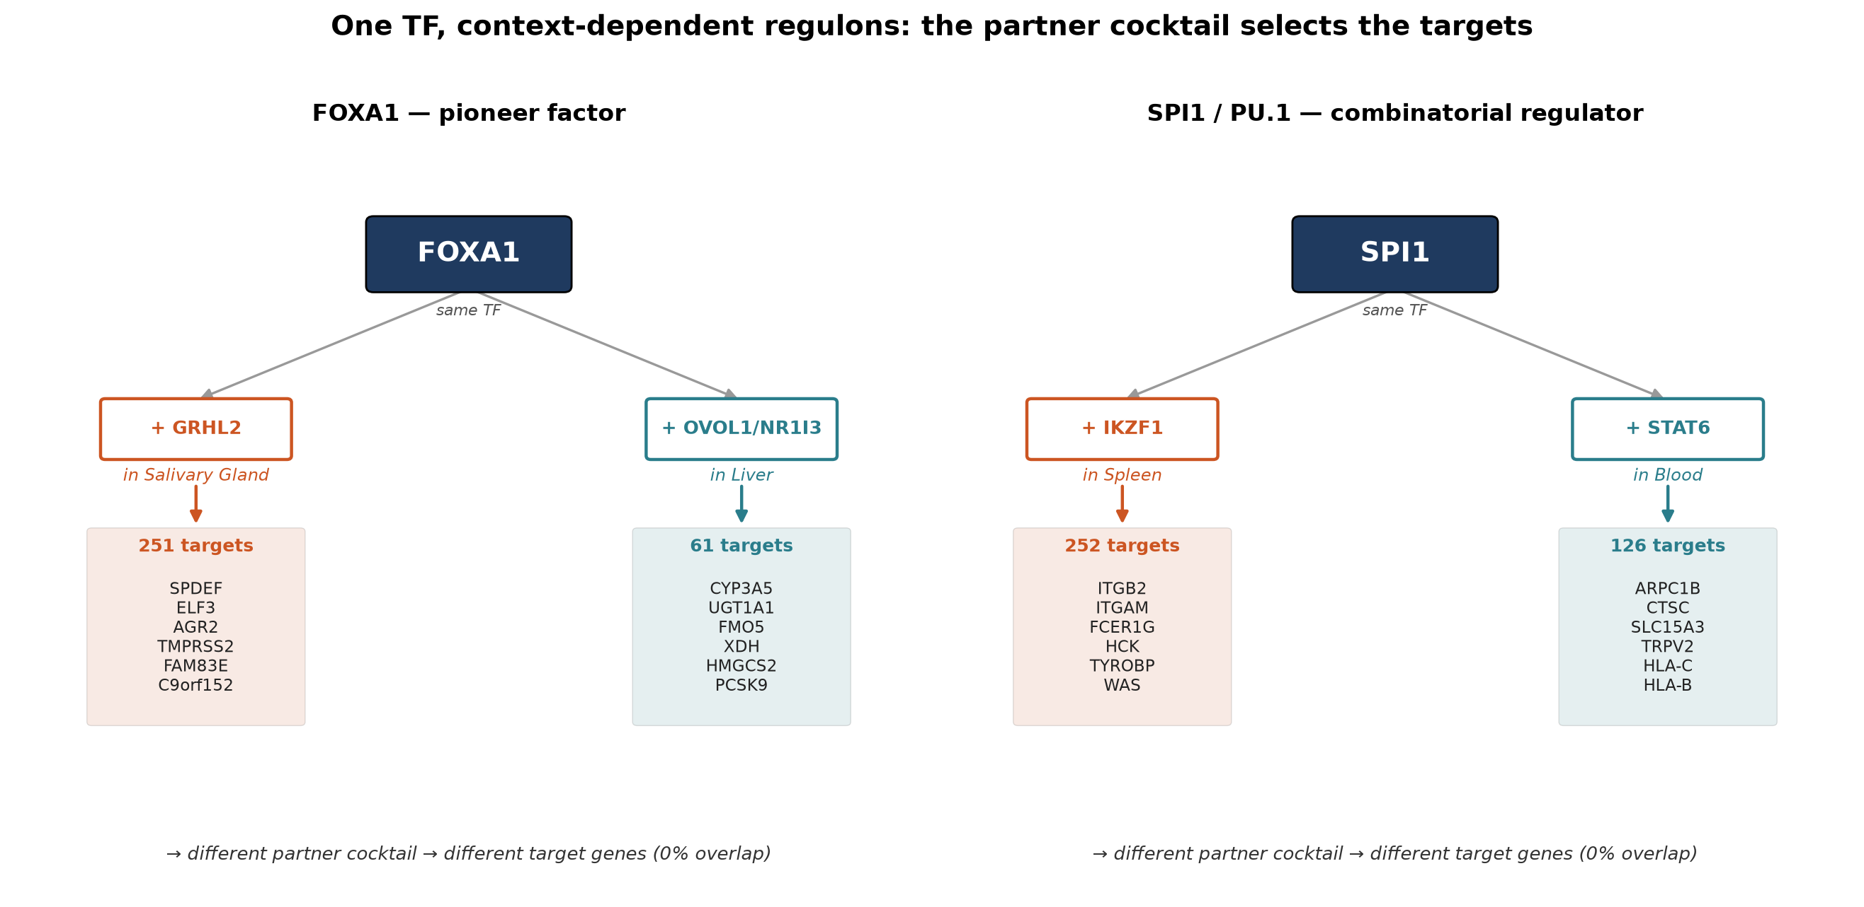
Context-Dependent Regulation — One TF, Different Cocktails, Different Targets
Directly answers the motivating question. FOXA1 (a pioneer factor) and SPI1/PU.1 (a combinatorial regulator) each control completely non-overlapping gene sets (0% target overlap) in different tissues — and the SHAP-inferred partner cocktail differs with them: FOXA1+GRHL2 drives epithelial genes (SPDEF, TMPRSS2) in salivary gland, FOXA1+NR1I3/CAR drives xenobiotic metabolism (CYP3A5, UGT1A1) in liver.
9 / 18

Slide 10
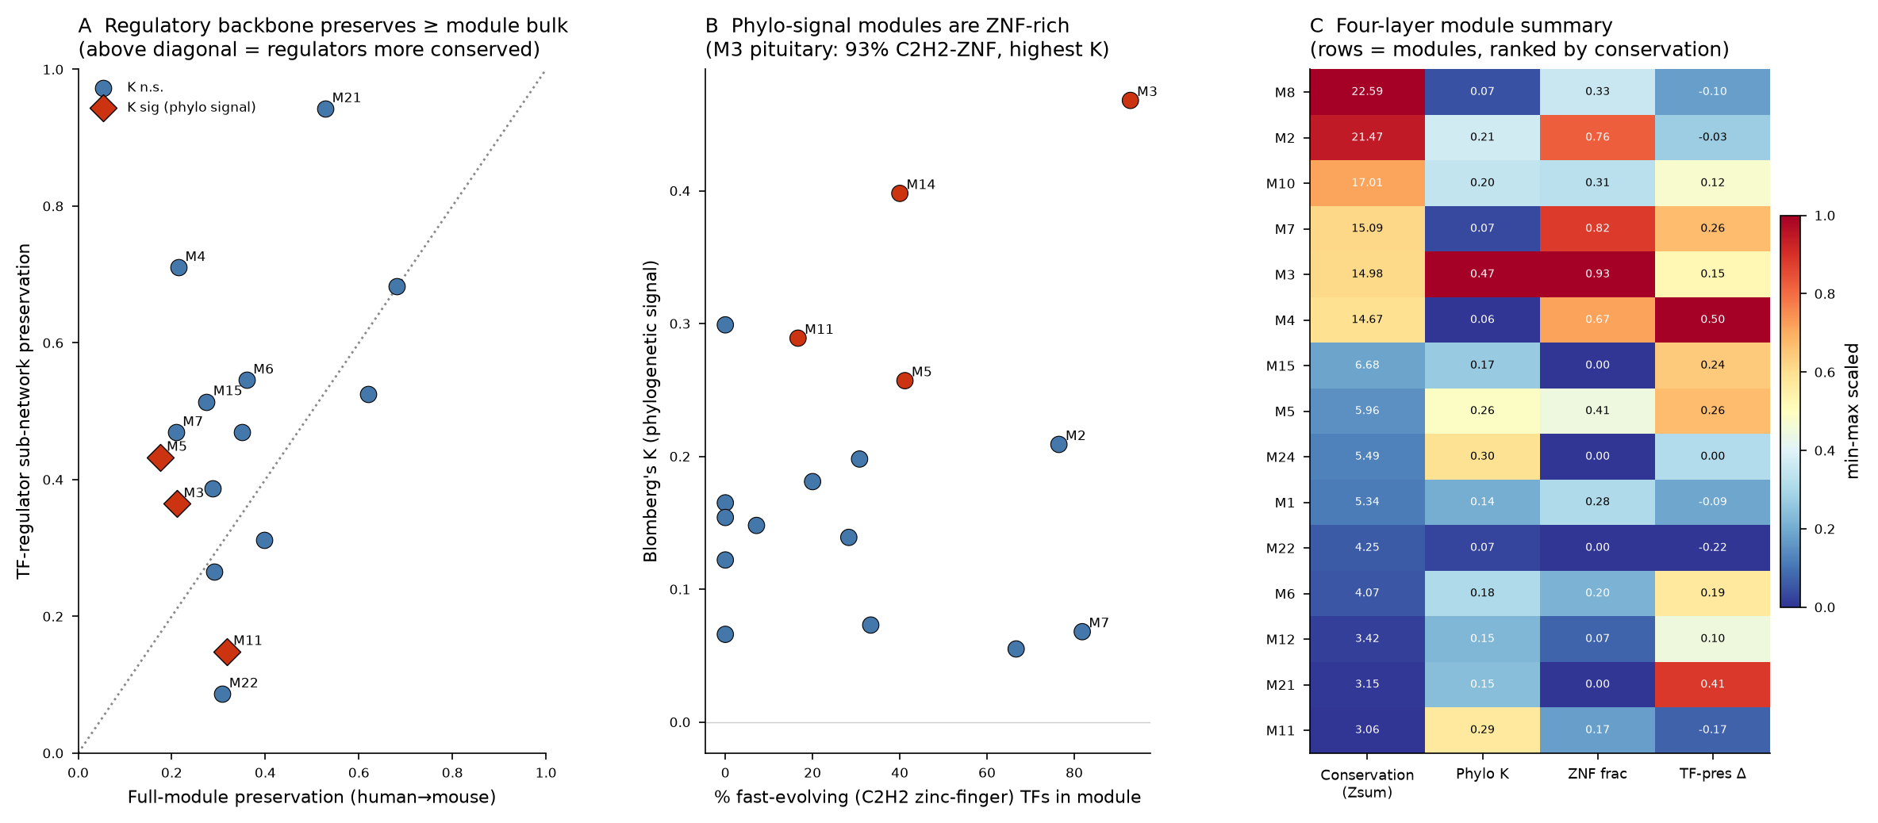
Key Finding — Regulatory Backbone Is the Conserved Core
▸ TF regulator sub-networks preserve BETTER than full modules
– 0.46 vs 0.35 (Wilcoxon p=0.06); 10/15 modules
– liver HNF core 0.94 vs 0.53 full module
– Membership drifts; core regulatory logic is locked
▸ Clade-variable regulation is localised
– M11 adipose: regulators rewire AND carry phylo signal
▸ TF-family axis
– M3 pituitary (highest K) is 93% C2H2 zinc-finger — the fastest-evolving TF family
– conserved logic borne by classical TFs; labile signal in KRAB-ZNF modules
10 / 18

Slide 11
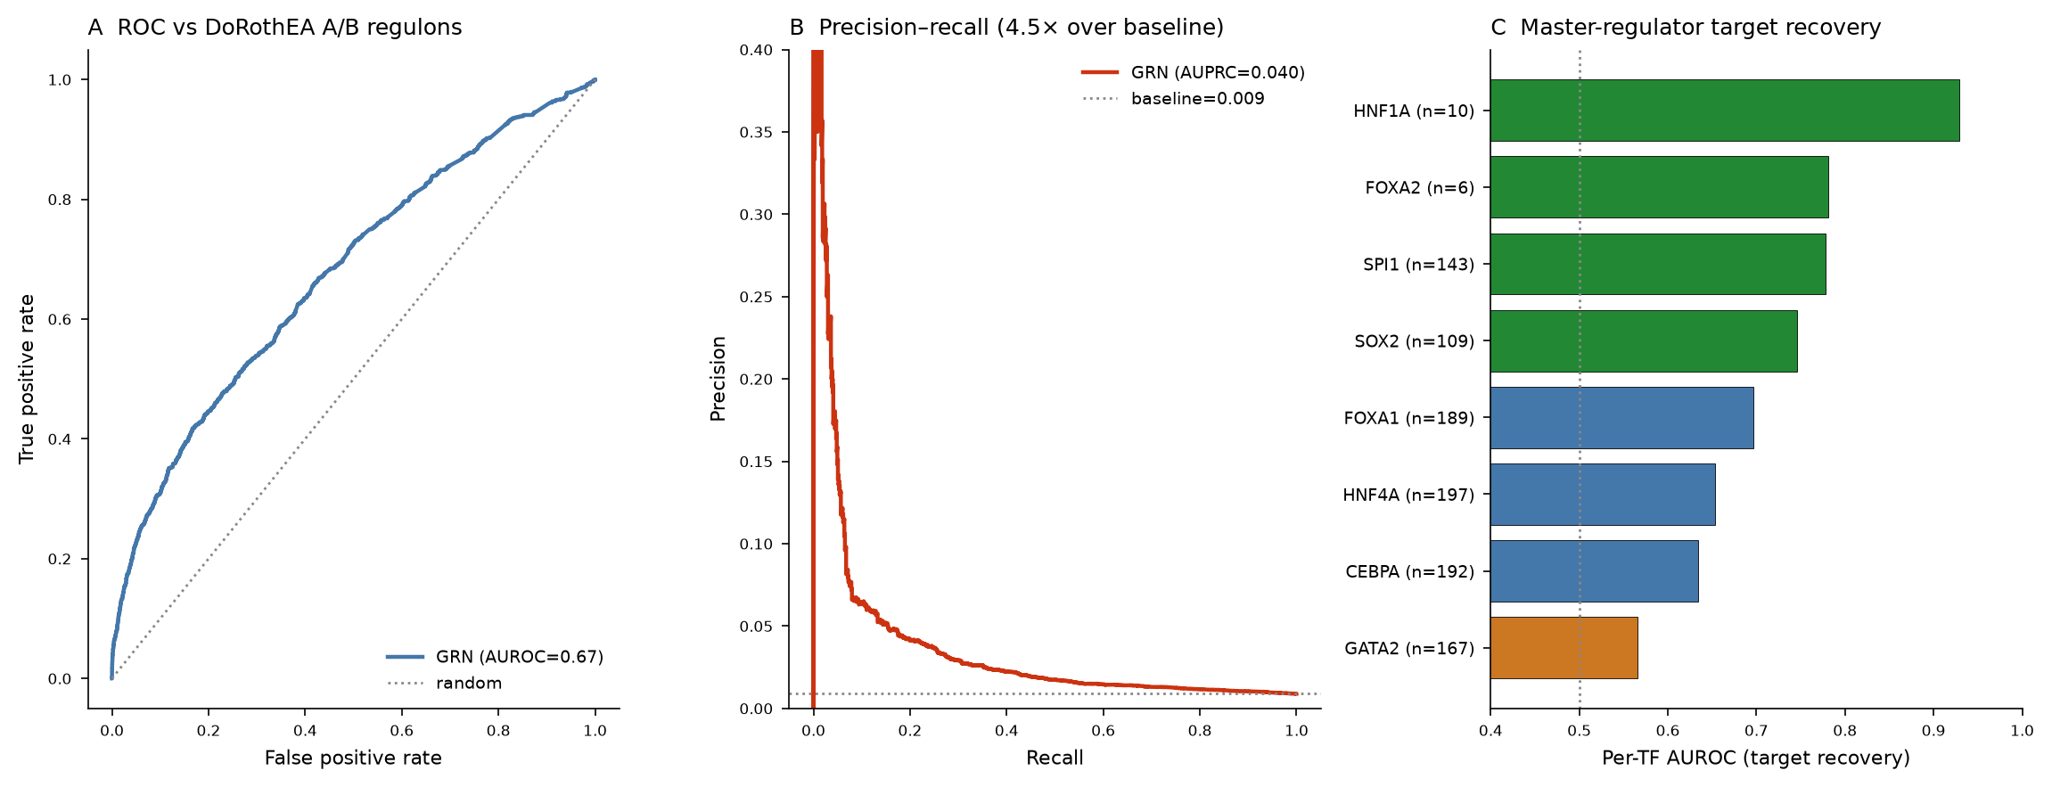
Validation & Summary
▸ Takeaways (bulk RNA-seq)
– 27 human modules; 23/26 recovered in mouse
– Conservation is module-identity-driven, not divergence-driven (ρ=−0.24 n.s.)
– Core programs conserved everywhere at once; phylo signal in labile modules
– Conserved co-expression DOES carry conserved TF logic — the regulatory backbone is the deepest-conserved layer
– Next: single-cell confirmation (in progress) + genome-scale orthogroups/motif layer
GRN vs DoRothEA gold standard: AUROC 0.67–0.69 (best on highest-confidence tier), AUPRC 4.5–7× baseline. Master regulators recover individually: HNF1A 0.93, FOXA2/SPI1 0.78, SOX2 0.75.
11 / 18

Slide 12
Single-Cell Extension — Refining the TF Networks at Cell-Type Resolution
Does the bulk “membership conserved, wiring drifts” thesis hold within cell types? And how far does the conserved core reach?
Tabula Sapiens / Muris Senis / Microcebus (human · mouse · lemur) + zebrafish deep-outgroup
12 / 18

Slide 13
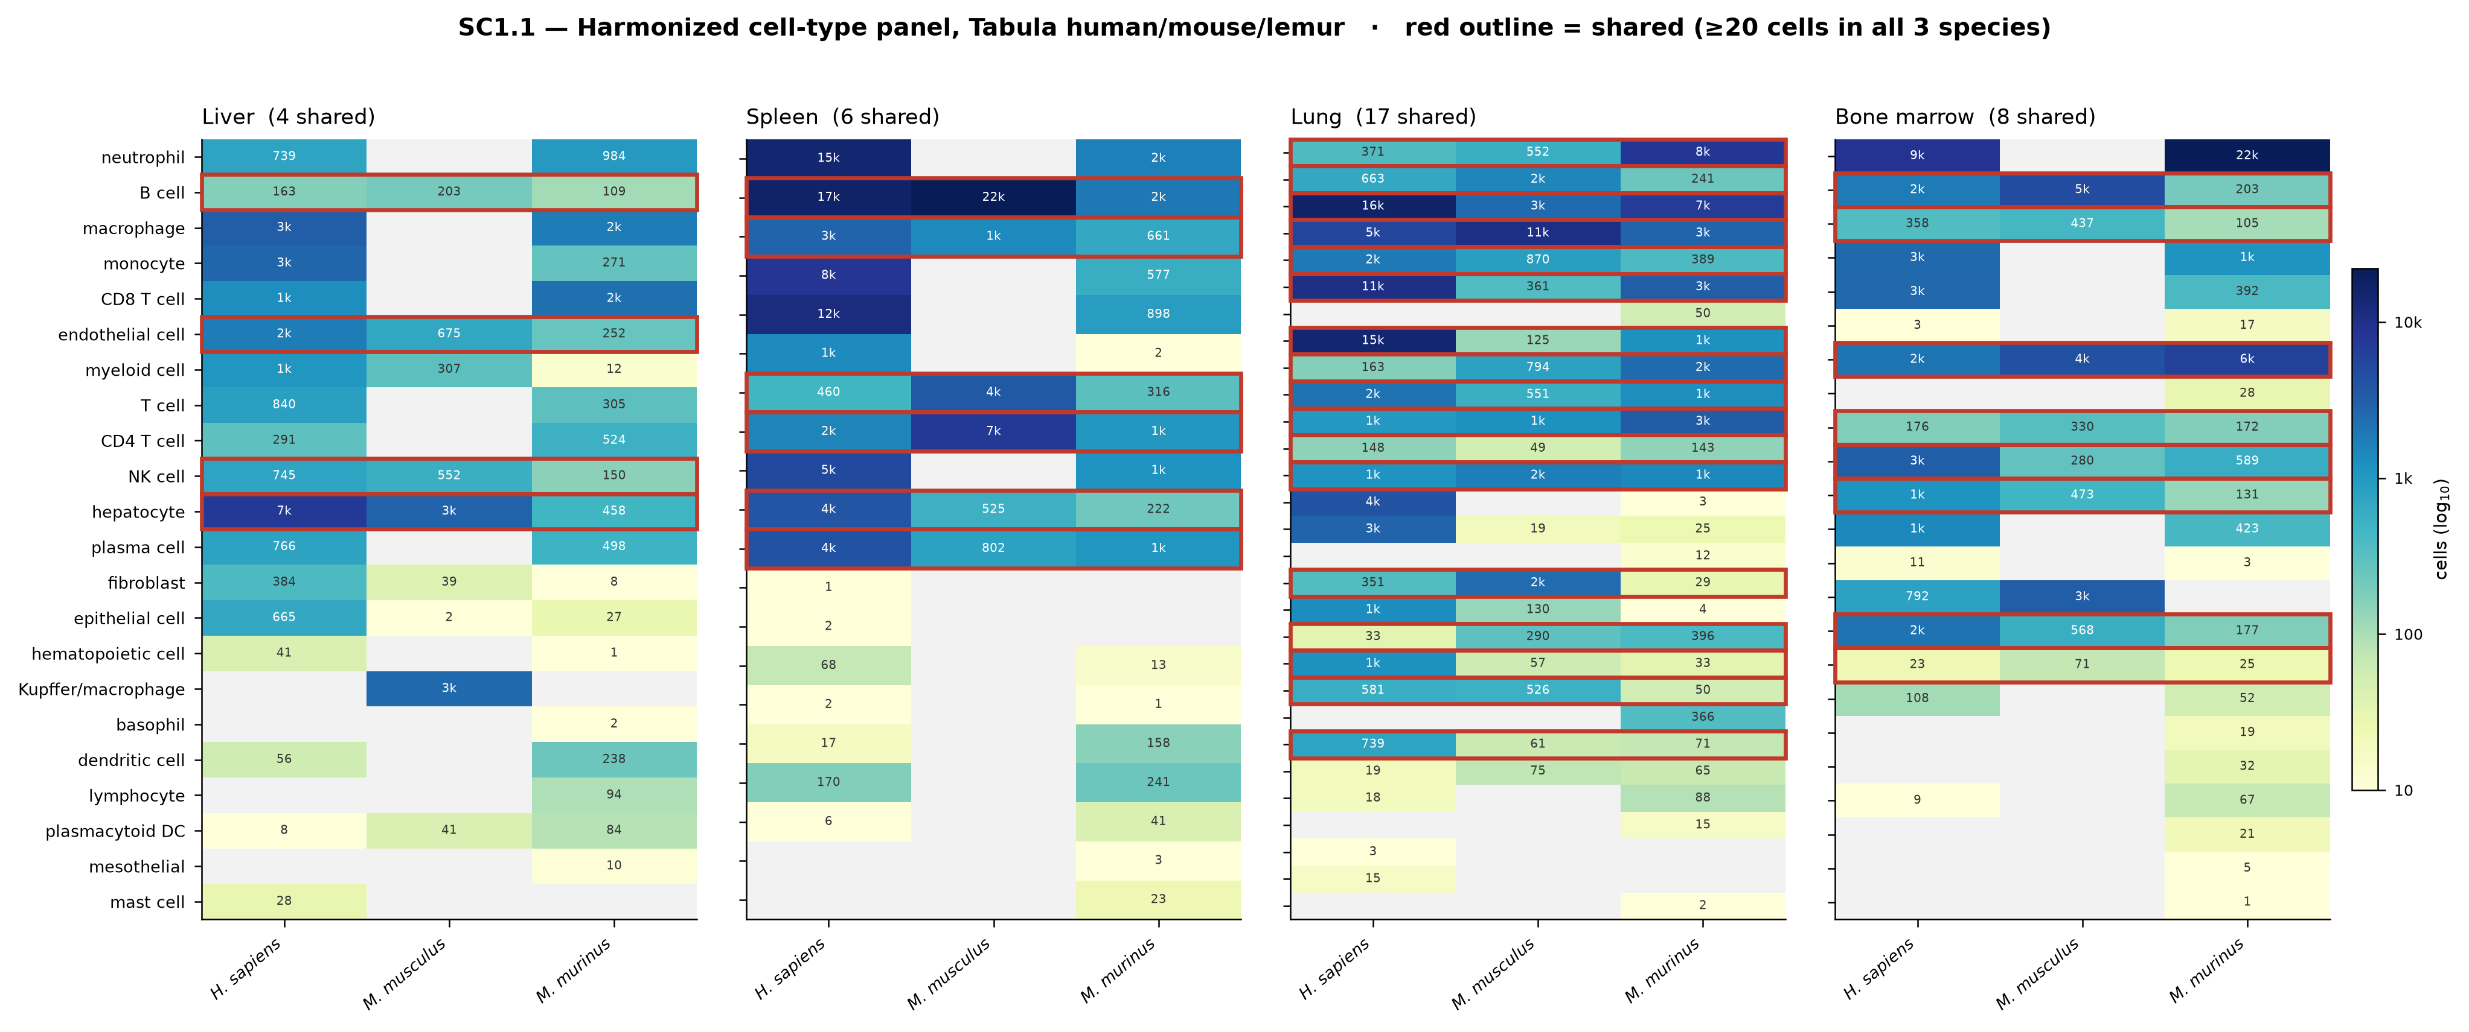
Datasets — CZ Biohub Tabula Atlases
▸ Substrate: the Tabula single-cell atlases (CZ Biohub)
– Tabula Sapiens (human, 3.4M cells) · Muris Senis (mouse, 1.07M) · Microcebus (lemur, 0.49M)
– One consortium, harmonized protocols → no cross-atlas batch confound (vs. bulk’s multi-source panel)
– Count matrices open on CELLxGENE; raw human reads appear controlled-access (0 public SRA/ENA runs; inferred, needs dbGaP/SRA confirmation)
▸ Matched-by-tissue acquisition (avoids the 136 GB full download)
– Core 4 clean tissues × 3 species = 9.5 GB, 357k cells: liver, spleen, lung, bone marrow
– Widened (“option 3”) with muscle / adipose / pancreas (3-way) + testis / ovary / uterus / pituitary
– 1,116 pseudobulk profiles across 11 tissues
▸ Harmonized analysis space
– 96 Cell-Ontology terms → 34-type broad panel (OLS4 hierarchical ancestors, 94/96 mapped)
– 14,073 three-way 1:1 orthologs — essentially the same gene space as the bulk 14k network
– 10 well-powered shared cell types (≥100 cells/species) used throughout
Cell-type × species coverage (4 core tissues)
13 / 18

Slide 14
Methods — From Bulk Modules to Cell-Type Regulons
▸ SC1.2 — Composition-vs-co-regulation diagnostic
– Per-module cell-type enrichment on pseudobulk; coherence_retention = within-cell-type ÷ all-profile coherence
– Separates genuine within-cell co-regulation from cross-sample composition covariance
▸ SC1.3 — Per-cell-type regulon inference
– GRNBoost2 core (gradient-boosted regression per target gene); targets restricted to module genes
– Full pySCENIC + cisTarget motif pruning + 100-run stability = Tier 4 (Dockerized, running now)
▸ SC1.4 — Bulk↔single-cell cocktail reconciliation
– Per species: genuine if both TFs rank ≤30 AND co-regulate ≥2 shared module targets
▸ SC2.1 / SC2.2 — Cross-species conservation + synthesis
– Regulator-identity (Spearman rank corr of TF importance) vs target-set conservation (Jaccard)
– Fused with Phase A phylogenetic signal (Blomberg K) + bulk preservation (Zsummary)
▸ SC2.3 — Zebrafish deep-outgroup floor (Track C)
– 8,486 strict 1:1 human↔zebrafish orthologs; canonical master ranks vs 10k-permutation null
▸ SC-Tier 3 — Validation: DoRothEA gold standard · JASPAR motif support · cross-species held-out
14 / 18

Slide 15
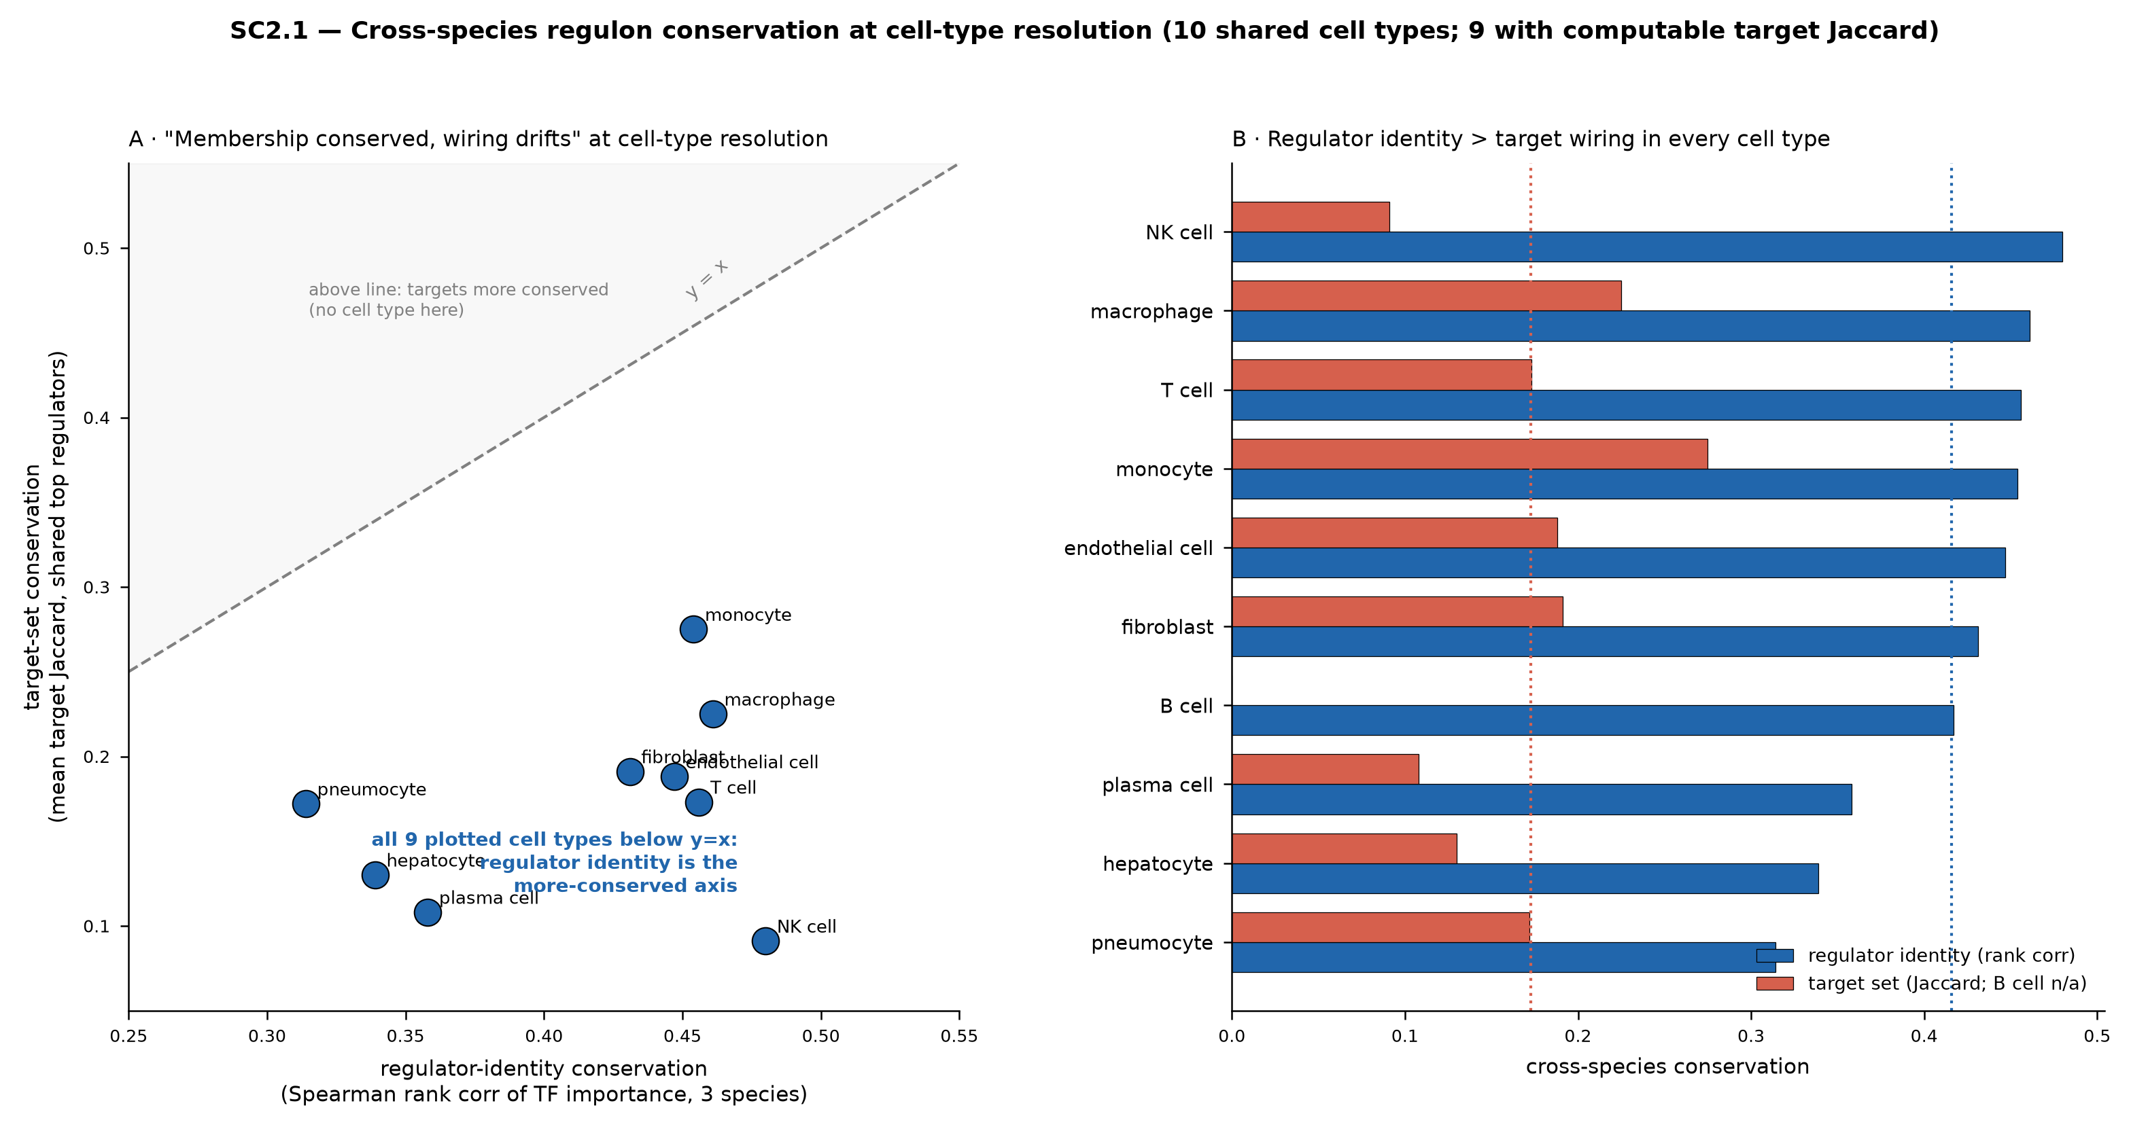
Key Finding 1 — “Membership Conserved, Wiring Drifts” Holds Within Cell Types
▸ SC2.1: the bulk thesis confirmed at the resolution bulk couldn’t reach
– Mean regulator-identity conservation = 0.42 > mean target-set conservation = 0.17
– ALL cell types below the y=x line: regulator identity is the conserved axis, wiring is labile
– Most conserved: NK / macrophage / T cell (0.46–0.48); least: pneumocyte / hepatocyte
▸ Reconciliation (SC1.4): bulk SHAP magnitude does NOT predict single-cell validation
– MLXIPL×NR1H4 (hepatocyte) genuine in all 3 species — yet bulk under-ranked it (SHAP 0.20)
– IKZF1×IRF4 (top spleen bulk cocktail, SHAP 1.15) genuine in lemur only; demotes in human+mouse
– XBP1 is the true plasma-cell master, conserved rank-1 across all 3 species
SC2.1: regulator-identity vs target-set conservation, 10 cell types
15 / 18

Slide 16
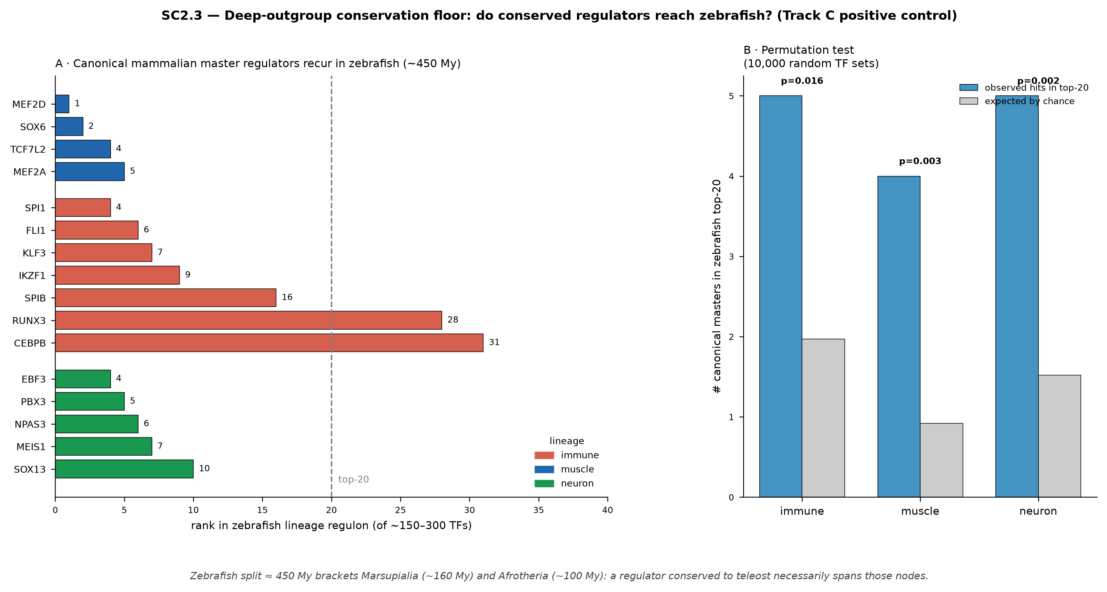
Key Finding 2 — The Conserved Core Reaches Teleost (~450 My)
▸ SC2.3: canonical mammalian master regulators recur in zebrafish top-20
– Muscle: MEF2D rank 1, SOX6 rank 2 | Immune: SPI1/PU.1 rank 4, FLI1 rank 6, IKZF1 rank 9
– Neuron: EBF3 rank 4, PBX3 rank 5, MEIS1 rank 7
– Permutation null (10k random TF sets): muscle p=0.003, neuron p=0.002, immune p=0.016
▸ Why it matters — “going the distance”
– The 450-My zebrafish split BRACKETS Marsupialia (~160 My) and Afrotheria (~100 My)
– A regulator conserved to teleost necessarily spans those intermediate nodes
– Prediction: MEF2, SPI1/PU.1, IKZF1, EBF3, PBX/MEIS hold across marsupials + afrotherians
(no single-cell atlas exists for either clade yet — zebrafish is the strongest available proxy)
SC2.3: master-regulator ranks in zebrafish + permutation test
16 / 18

Slide 17
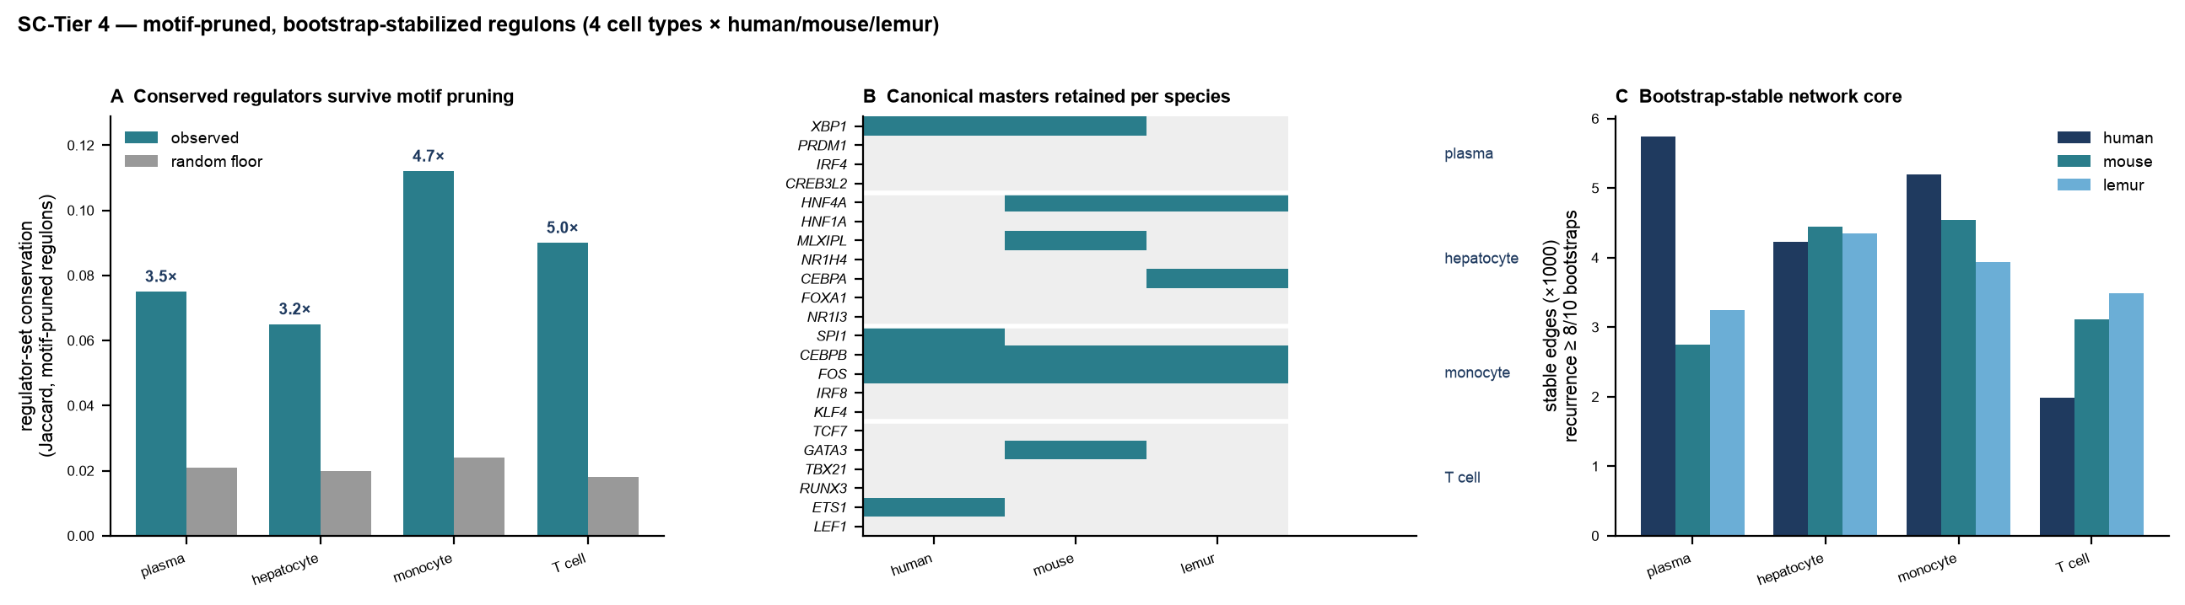
Tier 4 — Motif-Pruned, Bootstrap-Stabilized Regulons
▸ Full pySCENIC on the 4 headline cell types × 3 species (12 units, ~26 h)
– GRNBoost2 → cisTarget motif pruning → AUCell, 10 bootstrap runs each; run natively (Docker)
▸ The conservation thesis survives the stricter method
– Regulator-set conservation 3.2–5.0× above random floor (monocyte 4.7×, T cell 5.0×)
– Regulators conserved 3.5× more than target wiring — same ordering as co-expression (2.4×)
▸ Canonical masters survive motif pruning where it matters
– XBP1 (plasma, human+mouse) · HNF4A (hepatocyte, mouse+lemur) · CEBPB+FOS (monocyte, all 3)
– Pruning is strict (~28% of top-20 retained); the lineage masters are among the survivors
▸ Bootstrap stability = a reproducible network core
– ~3,900 edges recur in ≥8/10 bootstraps per unit (~7,200 at ≥7/10)
Tier-4 conservation, master survival, and stability (4 cell types)
17 / 18

Slide 18
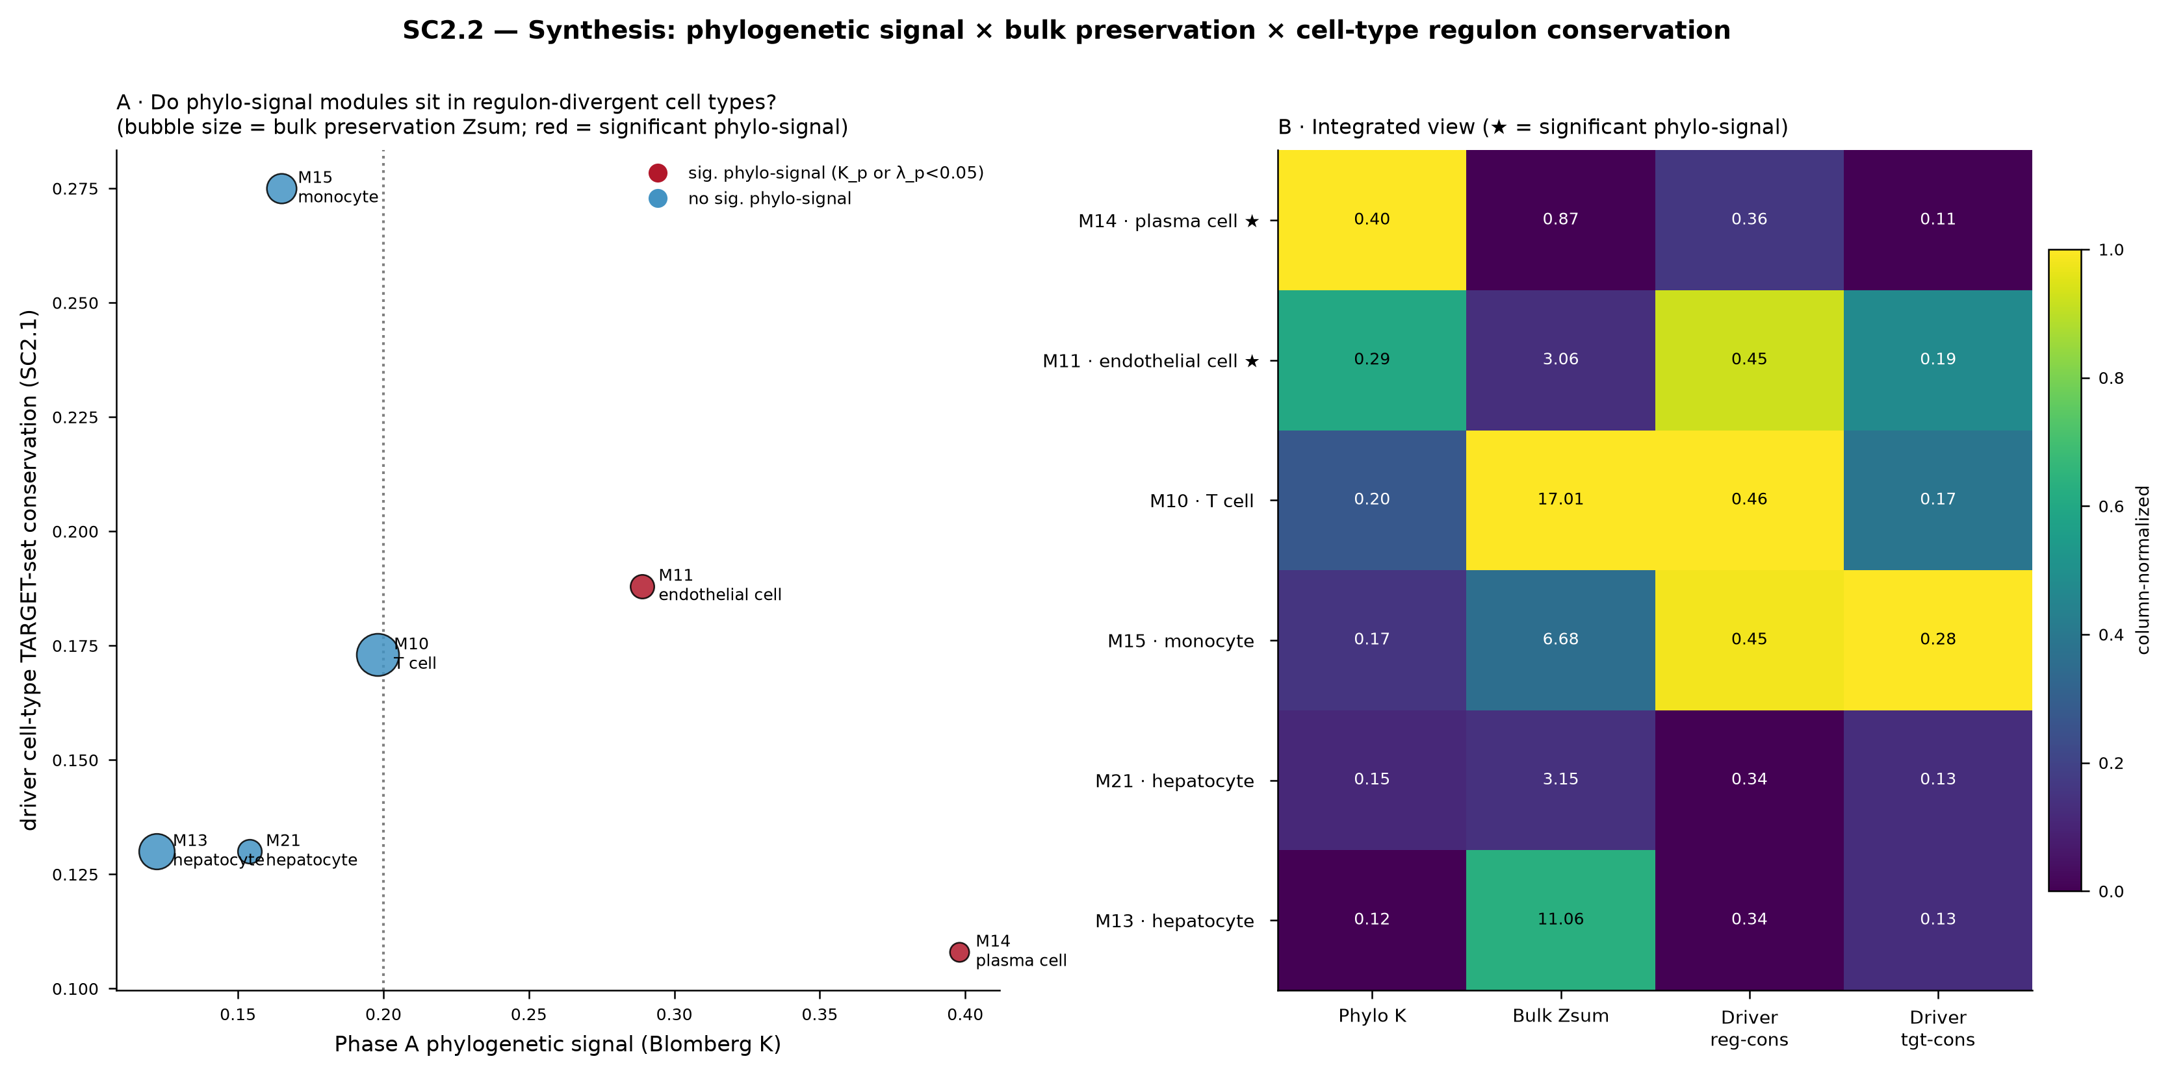
Single-Cell Summary — Synthesis & Validation
▸ SC2.2 synthesis (fuses with Phase A)
– Phylo-signal at tissue level can reflect EITHER conserved cell-intrinsic regulation OR conserved composition
– M14/plasma cell: high phylo-signal (K=0.40) + conserved regulator (XBP1), divergent targets
– M11/adipose: significant phylo-signal but composition-driven — single-cell distinguishes the two
(n=6 reliably-mapped modules — exploratory; strongest phylo-signal modules are data-limited)
▸ SC-Tier 3 validation
– Motif support: mean 83% of top regulators carry a JASPAR motif
– Cross-species held-out (h+m→lemur) accuracy tracks SC2.1 conservation at ρ=0.79
– DoRothEA: cell-type AUROC ~0.57 < bulk 0.67 — single-cell buys resolution, not gold-standard breadth
▸ Status: SC-Tiers 1–3 complete; Tier 4 (full pySCENIC, motif-pruned + bootstrap) complete for 4 headline cell types (see slide 17)
SC2.2: phylo-signal × preservation × cell-type regulon conservation
18 / 18

