Slide 2
Learning Linux @ FB Inter-process communication
Alexandre Fiori
Francesco Chemolli
Bruno Penteado
Production Engineers

Slide 3
Outline
Fork
Signals
Pipes
FIFOs
File Locking
Memory Mapped Files
Inter-process communication
Semaphores
Message Queues
Shared Memory Segments
Unix Sockets

Slide 4
Fork
Processes are duplicated
Duplication includes variables and file descriptors
Duplication is relatively cheap due to copy-on-write
Parents should watch for children
(more on Signals later on)
Notes:
When a child process dies and has not been wait()ed on, becomes <defunct>
If parents die before wait(), child is reparented to init; however, if child is already defunct, becomes <zombie>
The init destroys all defuncts that it owns
Make sure parents either ignore or handle SIGCHLD or wait()
Calls to wait() block until any first child dies
fork(2) can be a ticket to destruction: shell fork bomb :(){ :|: & };:
vfork(2) is cheaper still as it doesn’t COW, but automatically suspends parent until child exits or calls exec(2)

Slide 5
Signals
Method for one process to bug another
The kill(1) command or shell builtin
The kill(2) system call
Custom signal handlers must be async-safe
sigaction(2) for handling signal
sig(empty,fill,add,del)set(3), sigismember(3)
The SA_RESTART flag
signal_safety(7) for what is safe to call from signal handlers
Threads are special: POSIX vs Linux, pthreads(7)
Other cool stuff: sigqueue(3), sigwait(3), signalfd(2)
Notes:
Mention signal(7)
Default signal for the kill command is SIGTERM
Standard signals
List of async-safe library functions and system calls
You may restart system calls manually handling errno EINTR
You may use SA_RESTART to restart system calls automatically
Only alter global variables of type volatile sig_atomic_t
Use of signal(2) is discouraged
Run dd if=/dev/zero of=/dev/null and hit ^t to trigger SIGINFO
LinuxThreads implements threads as “processes sharing more”; this causes significant deviations from the POSIX standard. Only relevant for historic reasons now

Slide 6
Signals: example
fgets(3) and SIGINT with and without SA_RESTART
void sigint_handler(int sig) { write(2, "Received SIGINT\n", 17); }
int main() {
struct sigaction sa = {
.sa_handler = sigint_handler,
.sa_flags = SA_RESTART,
};
sigaction(SIGINT, &sa, NULL);
char buf[128];
if (fgets(buf, sizeof buf, stdin) == NULL)
perror("fgets"), exit(1);
printf("buf is %s\n", buf);
return 0;
}
Notes:
If sa_flags is 0, fgets return EINTR
With SA_RESTART, fgets restarts the underlying read syscall
During restarts, buf content is reset (potential data loss)

Slide 7
Signals: SIGCHLD common patterns
/* wait on single child (sync) */ pid_t cpid = fork(); if (cpid) pid_t child = waitpid(cpid); /* parent blocks */
/* handle children death (async) */ int child_death(int signal){ pid_t pid = wait(NULL); } struct sigaction sa; sa.sa_handler = child_death;
sigaction(SIGCHLD, &sa, NULL);
/* don’t care about children */ struct sigaction sa; sa.sa_flags = SA_NOCLDSTOP | SA_NOCLDWAIT; sigaction(SIGCHLD, &sa, 0);
Notes:
obtain child exit value:
int i; wait(&i); int rc = WEXITSTATUS
2. is useful if you have multiple live children at the same time, and you have an internal map that describes each of them by pid
wait4 can be used to wait and also retrieve detailed resource usage by the parent

Slide 8
Pipes
Introduced in Version 3 UNIX by Douglas McIlroy
Implemented “in one feverish night” by Ken Thompson
Allows one-liner pipelines: ls | wc -l
The pipe(2) system call
Unidirectional communication
Limited buffer capacity (16 memory pages (64kb by default))
Max capacity per pipe in /proc/sys/fs/pipe-max-size
Must either handle or ignore SIGPIPE
More info in pipe(7)
Notes:
First appeared in 1973 in Version 3 UNIX
Present in all BSD and UNIX-like OSes
Unix pipes are related to, and were preceded by, the 'communication files' developed by Ken Lochner in the 1960s for the Dartmouth Time Sharing System
In Tony Hoare's communicating sequential processes (CSP) from 1977, McIlroy's pipes are further developed
Digression: Go(lang)
Based on CSP, co-authored by Ken Thompson
Multi-threaded runtime
Concurrency primitives: goroutines and channels
Blocking API with support for cancellation
Code reads top-to-bottom, compiles natively to static binaries to multiple platforms (Linux, macOS, BSD, Windows, etc)
Compiler toolset originally from Plan9 (with Ken Thompson’s assembler); now bootstrapped
Motto: Share memory by communicating

Slide 9
Pipes: example
Connect output of ls to input of wc –l using pipe and fork system calls
int main() {
int pipefd[2];
pipe(pipefd);
if (!fork()) {
close(1);
dup(pipefd[1]); // dup pipe writer onto fd 1 (stdout)
close(pipefd[0]); // don’t need this
execlp("ls", "ls", NULL);
} else {
close(0);
dup(pipefd[0]); // dup pipe reader onto fd 0 (stdin)
close(pipefd[1]); // don’t need this
execlp("wc", "wc", "-l", NULL);
}
return 0;
}
Notes:
dup() uses the first fd available; mention dup2()
We close the other end of the pipe to save fd count for the process
Not ignoring SIGCHLD or wait()ing, relying on pipes for synchronization (bugs!)

Slide 10
FIFOs
Named pipes
File on disk
Created by mkfifo(1), mknod(2) mode S_IFIFO, or mkfifo(3)
Distinct processes can communicate
Producers and consumers block on open(2)
Must either handle or ignore SIGPIPE
Should cleanup after use (remove the file)
Notes:
FIFOs are known as named pipes
It has a name (on the file system) so distinct process can communicate
The reason for having a name is to get around the shortcomings of normal pipes: can’t grab one end of the pipe that was created by an unrelated process

Slide 11
FIFOs: example
Create FIFO file and use echo to produce, cat to consume:
$ mkfifo queue
$ ls -l queue
prw-rw-r-- 1 ubuntu ubuntu 0 Mar 12 10:45 queue
# Terminal 1 Terminal 2
$ echo hello world > queue $ cat queue
hello world
$ rm queue
Notes:
FIFO files are of type ‘p’, because they are pipes

Slide 12
File Locking
Byte-range file locking mechanisms
Mandatory locks: via fcntl(2)/lockf(3)
Requires filesystem configuration; unreliable on Linux
Must open(2) files in the same mode as the lock
Advisory locks: high level flock(2) system call, not emulated by fcntl(2)
Special cases, e.g. see local_lock option for NFS on nfs(5)
Inherited across fork(2) and only released on the last close(2)
Read and Write locks
aka. Shared and Exclusive locks, respectively
The flock(1) command line manages file locks from shell scripts
Must clear locks after use, and avoid dead-locks
Notes:
Advisory locks are not enforced and are useful only between cooperating processes
Linux implementation is based on non-POSIX Open file description locks

Slide 13
File Locking: example (1/2)
Try to put an exclusive lock /tmp twice:
Terminal 1:
$ flock /tmp -c cat
# Blocks until ^C
Terminal 2:
$ flock -w .5 /tmp -c echo; echo $?
# 1/2 second delay
1

Slide 14
File Locking: example (2/2)
Linux advisory byte-range lock using struct flock:
int main(int argc, char **argv) {
struct flock fl = {
.l_type = F_RDLCK,
.l_whence = SEEK_SET,
.l_start = 0,
.l_len = 128,
};
int fd = open(argv[0], O_RDONLY);
fcntl(fd, F_SETLK, &fl);
// lock acquired, use it…
fl.l_type = F_UNLCK;
fcntl(fd, F_SETLK, &fl);
close(fd);
}

Slide 15
Memory Mapped Files
mmap(2) to map files into memory
So many APIs…
msync(2) to synch memory to file (on non-RAM filesystem)
mlock(2) to lock pages in physical RAM preventing swap
mremap(2) to resize or move memory (better move with memcpy)
mprotect(2) to set the protection mode on a region of memory
Locks
…
Notes:
mremap(2) is slow to move memory; better do memcpy

Slide 16
Shared Memory Virtual Filesystem
Available in two variations: shm and tmpfs(5)
shm is mounted by the kernel on boot (internal)
RAM-backed storage for System V IPC
tmpfs may be mounted on /dev/shm (also /tmp, /var/tmp)
An efficient RAM-backed filesystem
Based on ramfs: uses the page cache + supports swapping pages out
Resizable: mount –o remount,size={new size} tmpfs /path
glibc expects tmpfs to be mounted on /dev/shm for both POSIX shared memory and semaphores
Otherwise shm_open(3), etc. will fail
Notes:
tmpfs defaults to half the physical RAM and half the RAM pages to avoid out-of-memory problems

Slide 17
Shared Memory
Segment of memory shared between processes
Allow processes to communicate information by sharing a region of memory
Uses tmpfs, e.g. /dev/shm
shm_open(3), shm_unlink(3), …
API supports regular file operations
Allocate on ftruncate(2), mmap(2)
Notes:
Kernel’s shm filesystem not exposed to user space, but there is ipcs(1), ipcmk(1) and ipcrm(1)
Truncate can also be used to create sparse files: truncate –s 1M clownz
Regular file operations: fchmod, fcntl, flock, fstat, ftruncate

Slide 18
Shared Memory: examples
Creates named shared segment in /dev/shm:
int main() {
int fd = shm_open("/clowncopterize", O_CREAT | O_RDWR, 0644);
ftruncate(fd, 12);
char *m = mmap(NULL, 12, PROT_READ|PROT_WRITE, MAP_SHARED, fd, 0);
memcpy(m, "hello world\n", 12);
munmap(m, 12);
//shm_unlink("/clowncopterize");
return 0;
}

Slide 19
Inter-process Communication
From AT&T commercial UNIX System V (“System Five”) released in 1983
Used by Graphical User Interfaces (e.g. Common Desktop Environment)
Provides:
Semaphores
Message Queues
Shared Memory Segments
Supported on namespaces(7)
Backed by the Shared Memory Virtual Filesystem
Notes:
POSIX 2008 (??)
Surprisingly it’s just files

Slide 20
System V IPC vs POSIX IPC
Both available on Linux and BSD*
Both APIs are thread-safe on Linux
System V IPC
Uses ftok(3) for resource id (int)
Documentation:
svipc(7)
Utilities:
ipcs(1), ipcmk(1), ipcrm(1)
POSIX IPC
Uses string (path) for resource id
Extended: Message Queue
Documentation:
mq_overview(3)
sem_overview(3)
shm_overview(3)
Notes:
ftok()’s key_t is a __kernel_key_t, which is an int: http://lxr.free-electrons.com/source/include/uapi/linux/posix_types.h#L32
POSIX IPC does not have ipcmk(1) nor ipcs(1) but provides similar information from e.g. /proc/sys/fs/mqueue

Slide 21
Semaphores
Generic advisory locking mechanism
Allow processes and threads to synchronize their actions
Anonymous, or identified by system-wide unique ID
Can be used as mutex to synchronize threads
Simpler API without loss of functional power
Notes:
System V IPC
Works with sets of semaphores instead of single locks
Semaphores and File Locking used to share resources between processes
Capacity configured in /proc/sys/kernel/sem
Columns in /proc/sys/kernel/sem:
SEMMSL: Max number of semaphores per semaphore set
SEMMNI: Max number of semaphore sets for the entire Linux system
SEMMNS: Max number of semaphores (not sets) for the entire Linux system
SEMOPM: Max number of semaphore operations performed by the semop(2) system call
Semaphore or mutex?
Semaphore is often used as a definitive mechanism for answering how many elements of a resource are in use

Slide 22
Semaphores: example (mutex 1/2)
Declare a global semaphore:
sem_t mutex;
Initialize the semaphore before using it:
sem_init(&mutex, 0, 1);
Thread 1 | Thread 2 | Data
sem_wait(&mutex); |  | 0
 | sem_wait(&mutex); | 0
a = data; | // blocked | 0
a = a + 1; | // blocked | 0
data = a; | // blocked | 1
sem_post(&mutex); | // blocked | 1
// blocked | b = data; | 1
// blocked | b = b + 1; | 1
// blocked | data = b; | 2
// blocked | sem_post(&mutex); | 2

Slide 23
Semaphores: example (mutex 2/2)
sem_t mutex;
int data = 0;
void *incr(void *arg) {
sem_wait(&mutex);
++data;
sem_post(&mutex);
return NULL;
}
int main() {
sem_init(&mutex, 0, 1);
pthread_t task1, task2;
pthread_create(&task1, NULL, incr, NULL);
pthread_create(&task2, NULL, incr, NULL);
pthread_join(task1, NULL);
pthread_join(task2, NULL);
printf("data=%d\n", data);
return 0;
}
Notes:
futex(7) NOTES: POSIX semaphores are implemented via futexes
Better to use thread scoped data instead of global variables (especially for unit testing)
Mention sem_open(3) vs sem_init(3), the latter for anonymous semaphores

Slide 24
Message Queues
Similar to FIFOs
Allow processes to exchange data in the form of messages
Identified by system-wide unique ID
Configuration and information available in /proc/sys/fs/mqueue
POSIX IPC message queues:
Support mq_notify(3)
File descriptors support select(2), poll(2), and epoll(7)
Timed send and receive, message priority
Can be used as a file system: mount -t mqueue none /dev/mqueue
Must cleanup after use
Notes:
The mq_notify(3) man page has an example of how to use POSIX message queue notifications
System V message queues API is older, but generally more available across systems
mq_overview(7) has an overview of message queues

Slide 25
Message Queues: example
Create queue, send message, receive, close, destroy
int main() {
struct mq_attr attr = {
.mq_flags = 0,
.mq_maxmsg = 10,
.mq_msgsize = 11,
.mq_curmsgs = 0,
};
mqd_t mq = mq_open("/clowncopterize", O_CREAT| O_RDWR, 0644, &attr);
mq_send(mq, "hello world", 11, 0);
char msg[12] = {};
mq_receive(mq, msg, sizeof msg - 1, 0);
printf("msg: %s\n", msg);
mq_close(mq);
mq_unlink("/clowncopterize");
return 0;
}
Notes:
$ cat /dev/mqueue/clowncopterize
QSIZE:11 NOTIFY:0 SIGNO:0 NOTIFY_PID:0

Slide 26
Unix Sockets
Bidirectional communication pipe
Remember FIFOs? But two-way
Domain for the socket(7) API: AF_UNIX
Socket type is (usually) SOCK_STREAM or SOCK_DGRAM
Quick full-duplex anonymous pipes: socketpair(2)
Client-server semantic with named pipes
Server listens, client connects
Allows passing file descriptors between processes
Via sendmsg(2) and recvmsg(2)
Notes:
Mention that the socket(7) API supports various domains, where the most common is AF_INET (@fb we should say AF_INET6)

Slide 27
Unix Sockets: quick pipe
int main() {
int pipefd[2];
char buf[13] = {};
socketpair(AF_UNIX, SOCK_STREAM, 0, pipefd);
if (!fork()) {
int n = read(pipefd[1], buf, sizeof buf - 1);
write(pipefd[1], buf, n);
}
write(pipefd[0], "hello world\n", 12);
read(pipefd[0], buf, sizeof buf - 1);
printf("buf=%s\n", buf);
return 0;
}

Slide 28
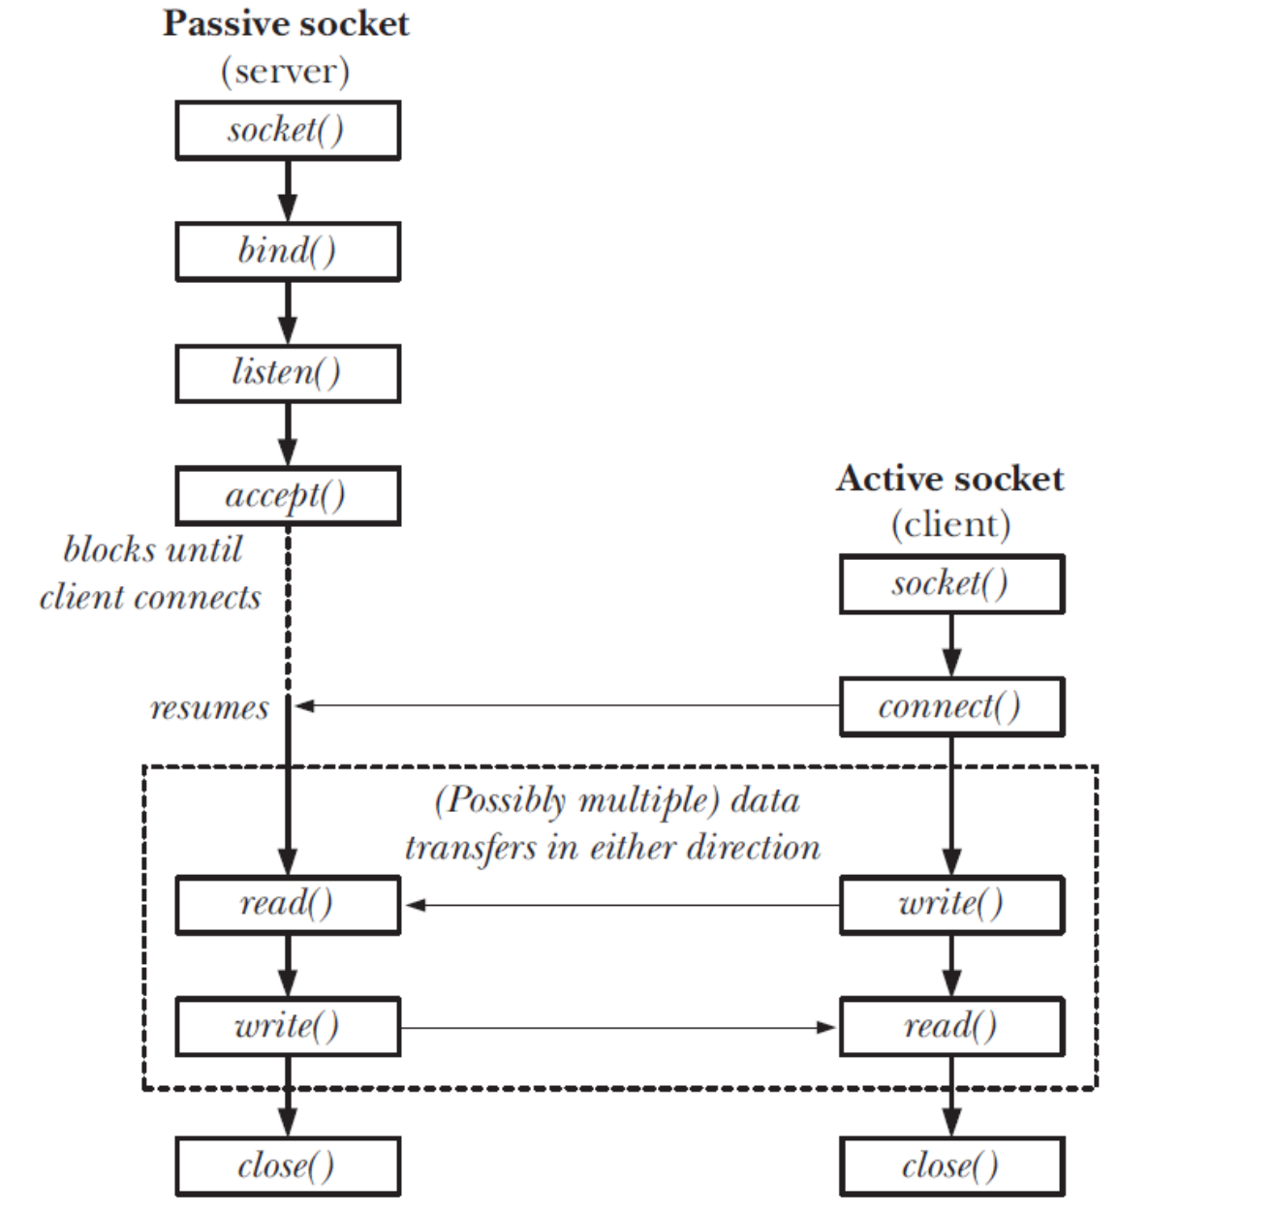
SOCK_STREAM

Slide 29
Unix Sockets: server
int main() {
struct sockaddr_un srv = {
.sun_family = AF_UNIX,
.sun_path = "./clowntown",
};
int srvfd = socket(PF_UNIX, SOCK_STREAM, 0);
bind(srvfd, (struct sockaddr *) &srv, sizeof srv);
listen(srvfd, 5);
for(;;) {
int clifd = accept(srvfd, NULL, 0);
char buf[12];
int n = read(clifd, buf, sizeof buf);
write(clifd, buf, n);
close(clifd);
}
return 0;
}
Notes:
File type ’s’ in ls -l

Slide 30
Unix Sockets: client
int main() {
struct sockaddr_un addr = {
.sun_family = AF_UNIX,
.sun_path = "./clowntown",
};
int fd = socket(PF_UNIX, SOCK_STREAM, 0);
connect(fd, (struct sockaddr *) &addr, sizeof addr);
write(fd, "hello world\n", 12);
char buf[13] = {};
read(fd, buf, sizeof buf - 1);
close(fd);
printf("buf=%s\n", buf);
return 0;
}
Notes:
File type ’s’ in ls -l

Slide 31
References
Beej’s Guide to IPC: http://beej.us/guide/bgipc/
Pipeline: https://en.wikipedia.org/wiki/Pipeline_(Unix)
Linux mandatory locks: https://www.kernel.org/doc/Documentation/filesystems/mandatory-locking.txt
Shared Memory Virtual Filesystem: https://www.kernel.org/doc/gorman/html/understand/understand015.html
tmpfs: https://www.kernel.org/doc/Documentation/filesystems/tmpfs.txt
System V IPC vs POSIX IPC: http://ranler.github.io/2013/07/01/System-V-and-POSIX-IPC/
Synchronizing threads with POSIX semaphores: http://www.csc.villanova.edu/~mdamian/threads/posixsem.html
Linux filesystem header (see e.g. struct file_operations): https://github.com/torvalds/linux/blob/master/include/linux/fs.h

