Slide 1
Bootstrap – Background and Intuition
SDS 291
March 4, 2020

Slide 2
What’s the problem?
We want to make inferences to a larger population
But!
We only have one sample
Some tests/statistics don’t have standard deviations/errors to use
Or the assumptions of regression are violated
So we don’t have a way to conduct formal tests, construct CIs, etc.

Slide 3
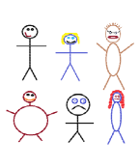
Suppose we have a random sample of 6 people:

Slide 4
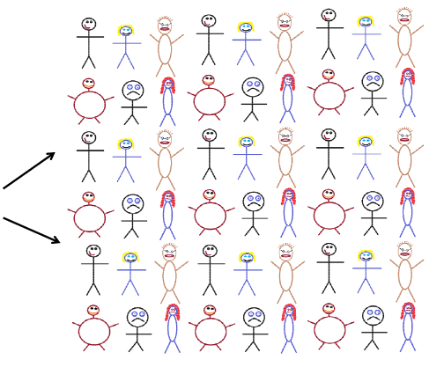
Original Sample
A simulated “population” to sample from

Slide 5




Bootstrap Sample: Sample with replacement from the original sample, using the same sample size.
Original Sample
Bootstrap Sample

Slide 6
Let’s make our own Bootstrap Sampling Distribution!
Our original sample has 2 people who have the flu and four people who don’t.
With a partner: Divide your paper into 6 even pieces. Write “Flu” on two of them, and “no flu” on 4 of them.
Take a sample of size 6 with replacement from your cards, and record what proportion have the flu in this new bootstrap sample
Take a total of 5 bootstrap samples and calculate 5 proportions of flu prevalence in the sample.
Make a dot for each of your 5 proportions on the board

Slide 7
Bootstrap
A bootstrap sample is a random sample taken with replacement from the original sample, of the same size as the original sample
A bootstrap statistic is the statistic computed on a bootstrap sample
A bootstrap distribution is the distribution of many bootstrap statistics

Slide 8
BootstrapSample
Bootstrap Statistic
BootstrapSample
Bootstrap Statistic
Original Sample
Bootstrap Distribution
.
.
.
.
.
.
Sample Statistic
BootstrapSample
Bootstrap Statistic

