Slide 1
Likelihoods and Logistic Regression Diagnostics
SDS 291
April 22, 2020
Notes:
8

Slide 2
No
Yes
Yes
No
No
Yes
A B C

Slide 3
Estimating Parameters in Logistic Regression
Parameters are chosen to maximize the likelihood of the observed sample (maximum likelihood estimation).
^
If the i^{th} point is YES (y_{i} = 1), calculate π_{i}.
If the i^{th} point is NO (y_{i} = 0), calculate 1 − π_{i}.
^
Likelihood:
^
Here the estimated probabilities, π, come from a model. What model is best?
(See Exercise 9.9 and likelihood-play.xls)

Slide 4
A Simple(?!) Max Likelihood Problem
^
If the i^{th} point is YES (y_{i} = 1), calculate π.
If the i^{th} point is NO (y_{i} = 0), calculate 1 − π.
^
Likelihood:
Suppose n = 20 and there are 14 total successes.
Calculus shows that the best estimate is

Slide 5
Evaluating Overall Effectiveness
Likelihood of the sample
Output below gives Log-likelihood
* Always negative
* Smaller −2Log-likelihood is better
Automated
logLik(logitmod)
Manual
pi<- fitted.values(logitmod)
likelihood <- ifelse(Pulse$Gender == 1, pi, 1 - pi)
log(prod(likelihood))

Slide 6
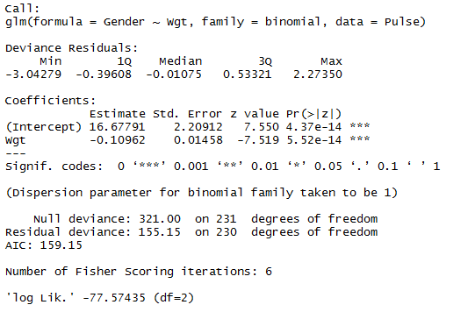
Example: Predict Gender via Weight
Hgt

Slide 7
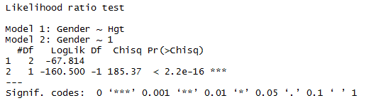
Evaluating Overall Fit
2. Test for overall fit
(Similar to regression ANOVA)
t.s. = G = improvement in –2ln(L) over a model with just a constant term
Compare to χ² with k d.f.
# predictors
require(lmtest)
lrtest(logitmod)

Slide 8
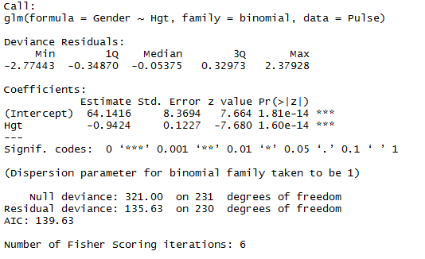
Deviance in R Output
-2LL
Constant Model
This Model
How much better do we do with height than with nothing?
G = 321.00 - 135.63 = 185.37

Slide 9
Test for Overall Model—Logistic
Is there something effective in the model?
H₀: β₁ = 0
H₁: β₁ ≠ 0
vs.
Same odds for all X
Odds are linear function of X
Compare to χ²₁.
Improvement in −2ln(L) when using linear function of X.

Slide 10
The Logistic Reg Max Likelihood Problem
Likelihood:
where
For the putting data this is:
Maximize this with respect to and .

Slide 11
Example: Golf Putts
Length | 3 | 4 | 5 | 6 | 7
Made | 84 | 88 | 61 | 61 | 44
Missed | 17 | 31 | 47 | 64 | 90
 | 0.826 | 0.730 | 0.605 | 0.465 | 0.330
When Length = 3, the model predicts
The Likelihood component for Length = 3 is
Notes:
11

Slide 12
Length | 3 | 4 | 5 | 6 | 7
Made | 84 | 88 | 61 | 61 | 44
Missed | 17 | 31 | 47 | 64 | 90
 | 0.826 | 0.730 | 0.605 | 0.465 | 0.330
Combining for all the data, the Likelihood is:
Coefficients are chosen to make ln(L) as large as possible.
Notes:
12

Slide 13
Topic 11.2
Binary logistic regression
Goodness-of-fit tests
Saturated model
Logistic diagnostics
Overdispersion
Concordance
Pseudo-R²

Slide 14
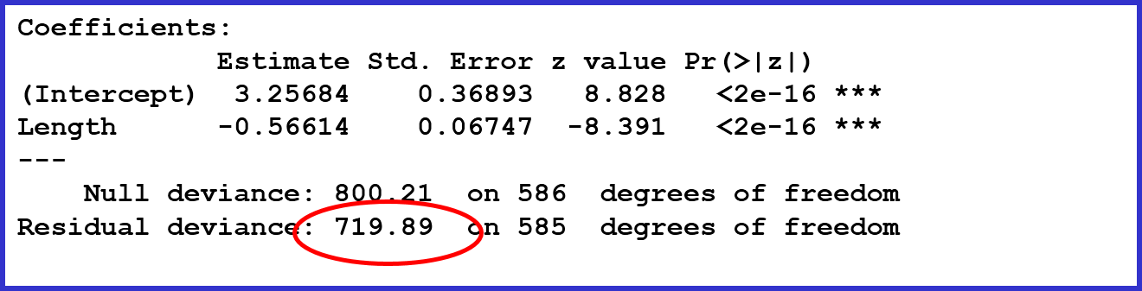
Recall: Evaluating Overall Fit (1 of 2)
Likelihood of the sample
Output gives residual deviance = −2log(L)
* Smaller −2log(L) is better
* Coefficients are chosen to minimize −2log(L)
For Putts1 model: −2log(L) = 719.89

Slide 15
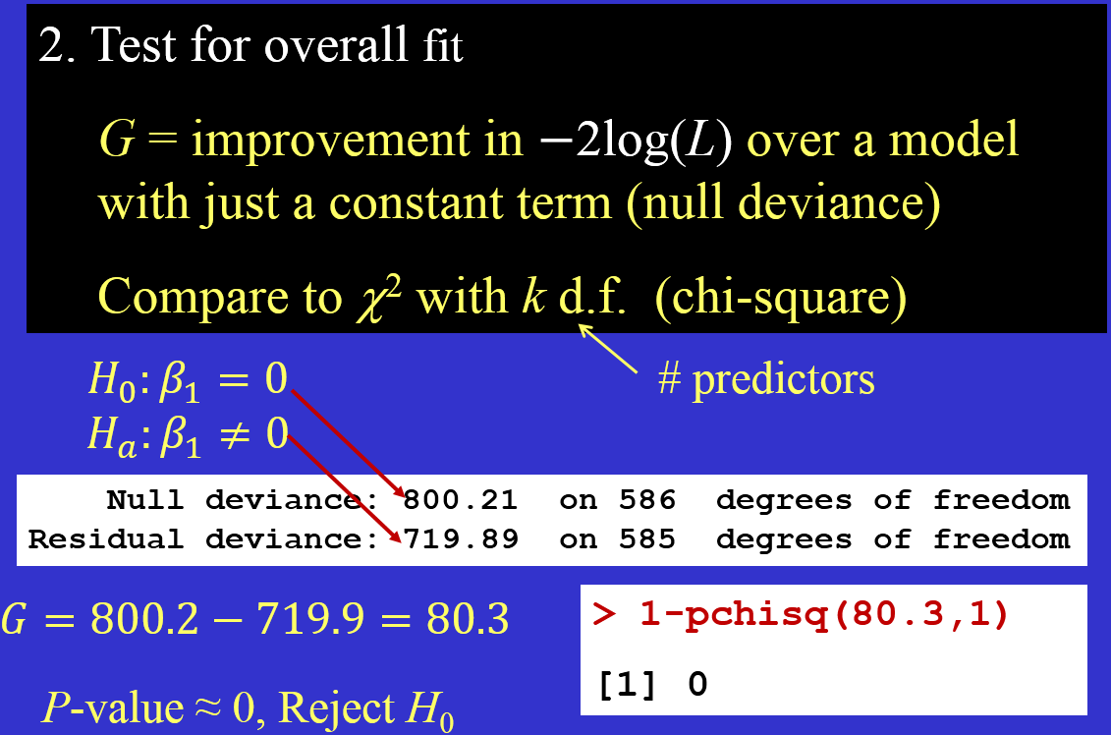
Recall: Evaluating Overall Fit (2 of 2)

Slide 16
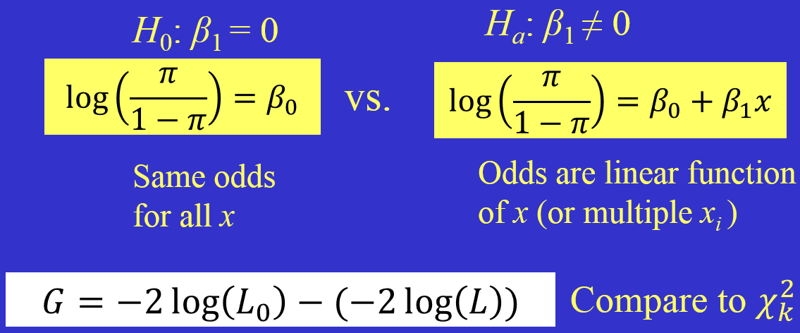
Test Overall Model—Logistic
Is the predictor (or predictors) effective?
Improvement in −2log(L) when using linear function of x (or multiple x_{i}’s).

Slide 17
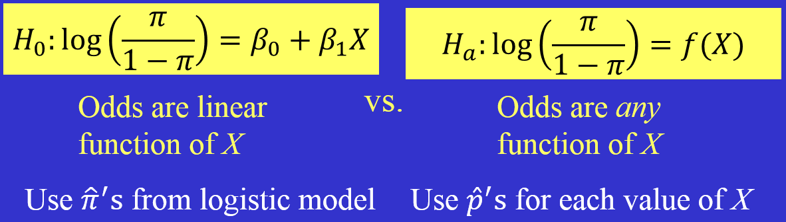
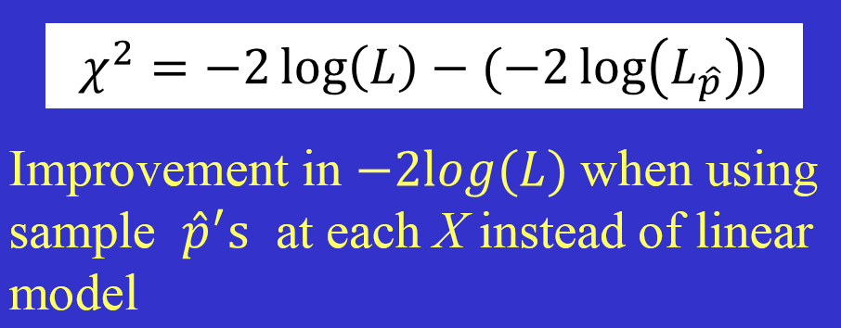
Goodness of Fit (Logistic)
Could we do much better with some other function of X?
Compare to χ²
d.f. = #X values − 2
(requires multiple cases at each X)

Slide 18
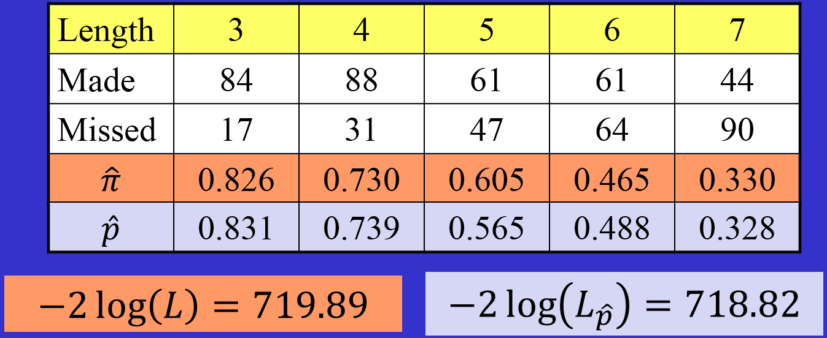

Example: Golf Putts
Change in −2log(L) is X² = 719.89 − 718.82 = 1.07
Do not reject H₀ ➔ The logistic model is probably adequate.

Slide 19
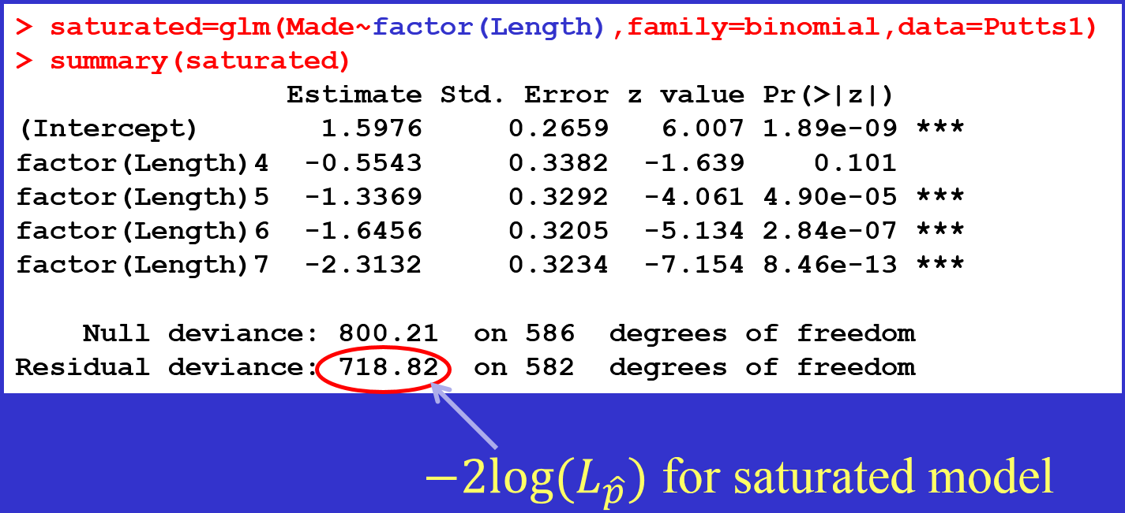
Finding −2log(Lphat) with R (1 of 2)
Trick: Treat X as a categorical variable

Slide 20
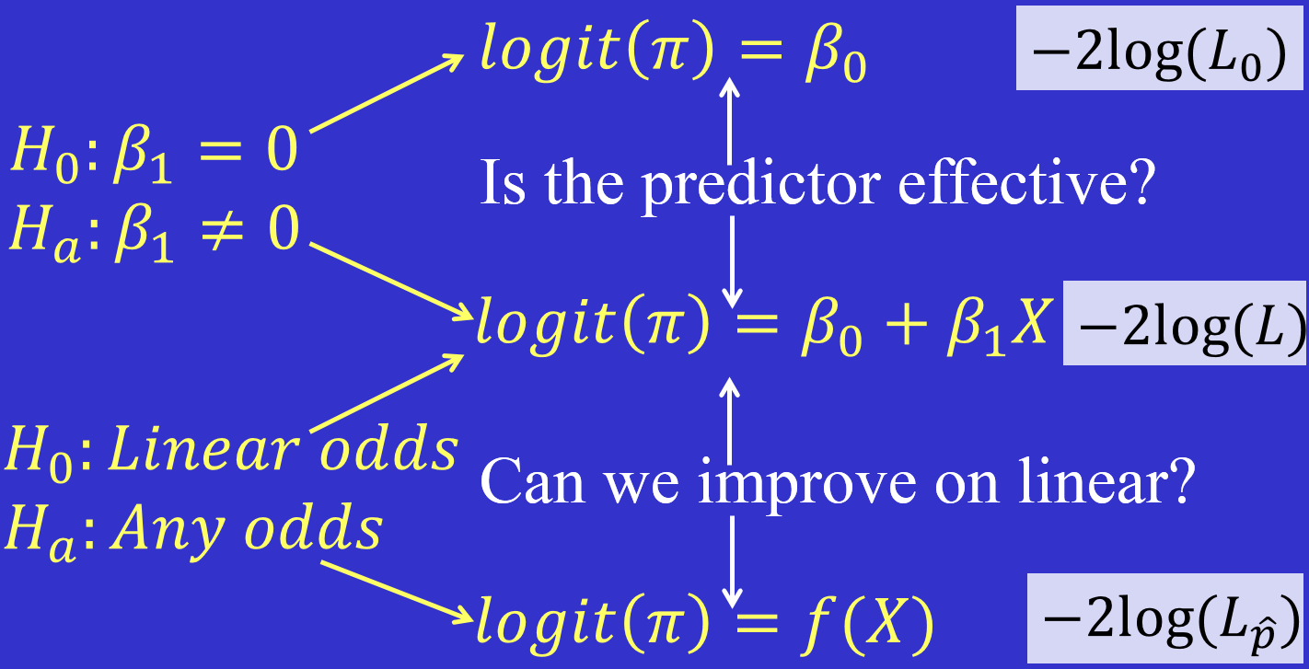
Finding −2log(Lphat) with R (2 of 2)
Can extend these to models with multiple predictors.

Slide 21
Unusual Points
Recall: In ordinary regression, we use residual plots, leverage, and Cook’s D as tools to identify unusual points.
Similar tools for logistic regression:
Pearson residuals
Deviance residuals
Standardized residuals
Leverage (same as in ordinary regression)
Cook’s D

Slide 22
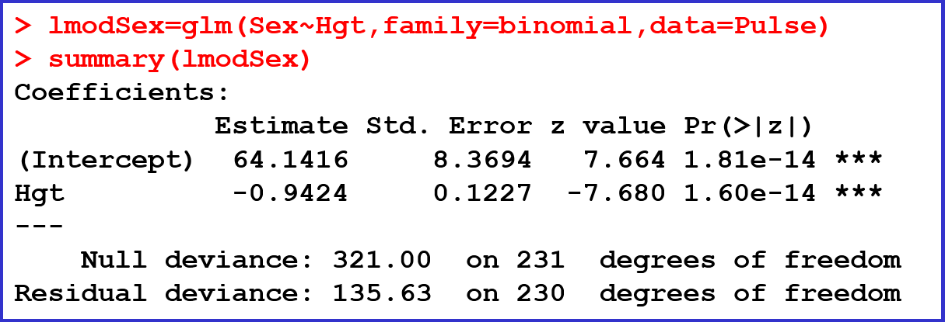
Example: Pulse Data
Y = Sex (0 = Male, 1 = Female)
X = Height (inches)

Slide 23
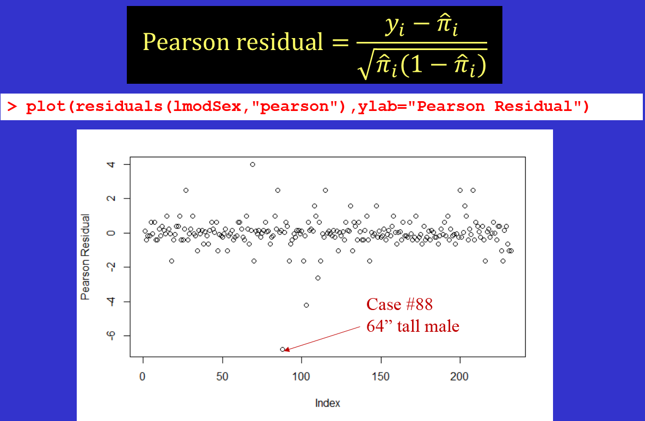
Pearson Residuals

Slide 24
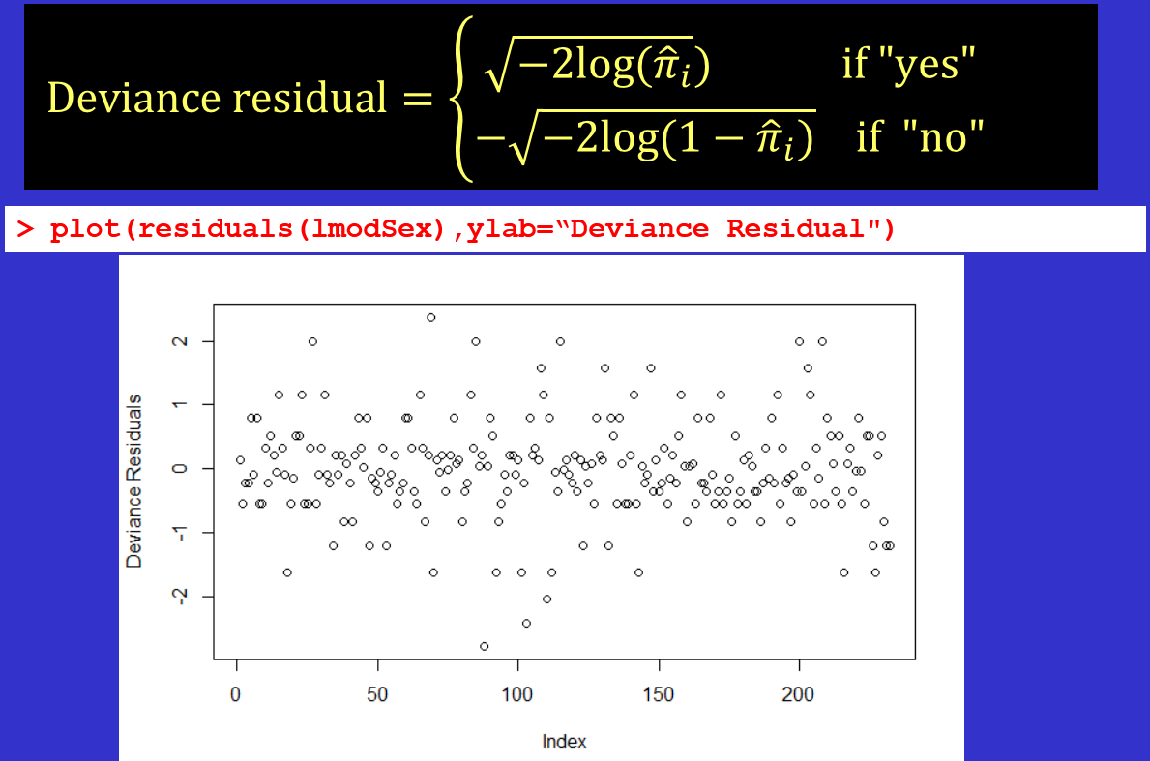
Deviance Residuals

Slide 25
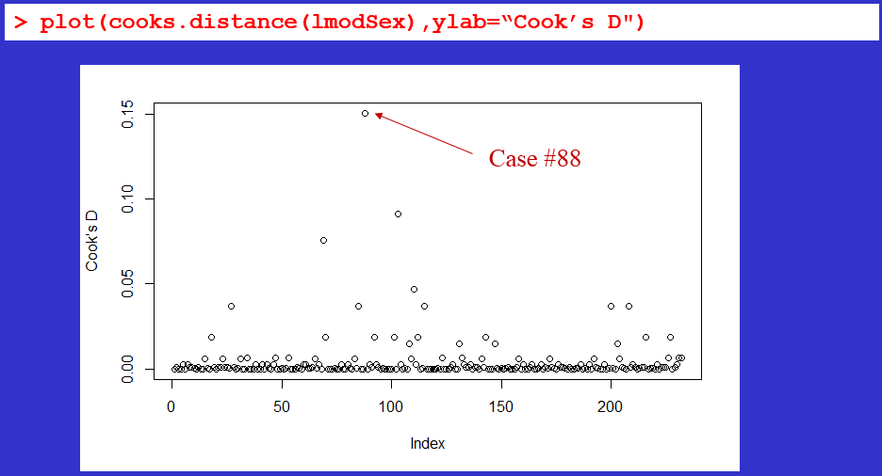
Cook’s Distance
As in ordinary regression, uses both residuals and leverage.

Slide 26
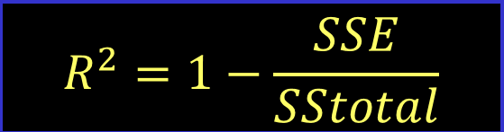

Measuring Overall Fit: Pseudo-R²
Recall for ordinary regression:
One way to mimic this for logistic regression is to use −2log(L) in place of sums-of-squares variability.
i.e., We compare the residual and null deviances.

Slide 27
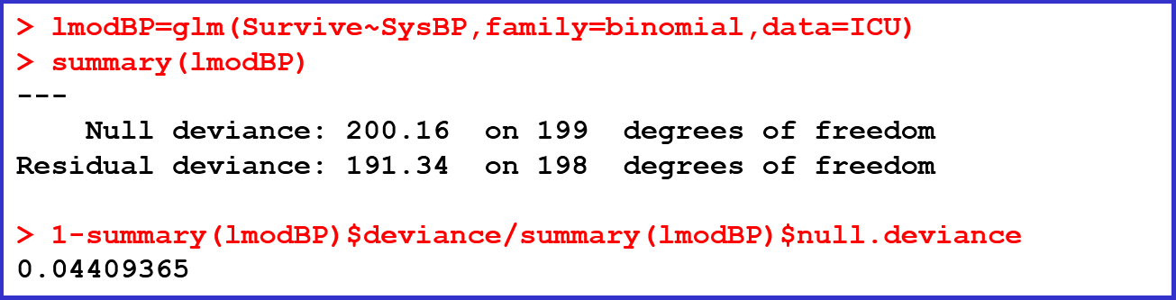
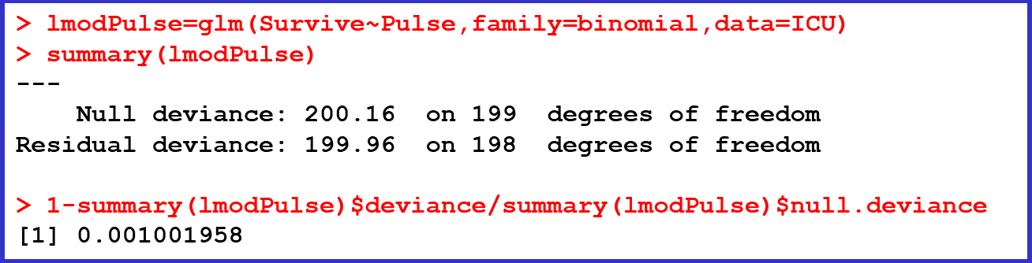
Example: ICU Data (3 of 3)
For SysBP as a predictor of Survive:
For Pulse as a predictor of Survive:

Slide 28
Additional Concepts
These are totally optional…

Slide 29
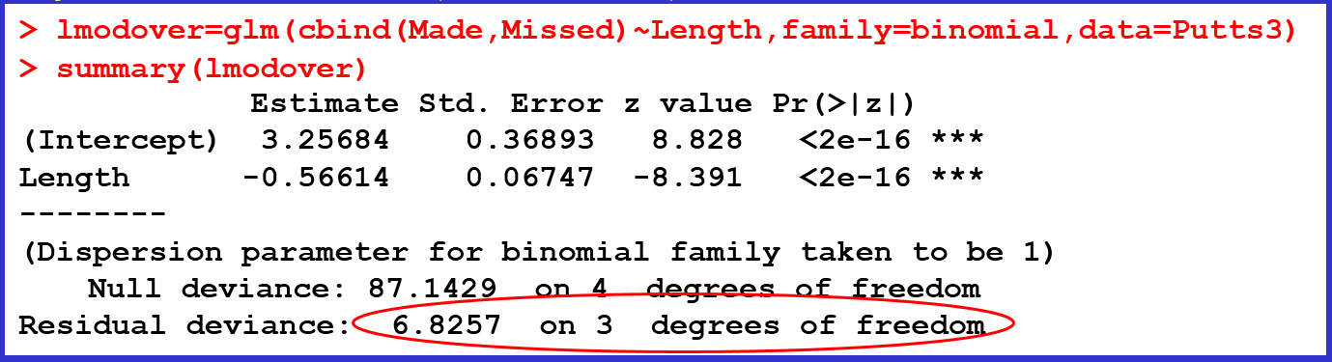
Overdispersion (1 of 2)
Sometimes seemingly binomial data, for which the variance should be predictable, actually deviate from being binomial.
Try the Putts3 data (short form):
If Residual deviance is well above the d.f., then we may have “extra-binomial” variation.
Notes:
Additional Readings on the idea of Overdispersion:
1. https://onlinelibrary.wiley.com/doi/pdf/10.1002/9781118445112.stat06788.pub2 (this is a very mathematical, technical treatment – good if you’re interested in understanding the math of the different estimators)

Slide 30
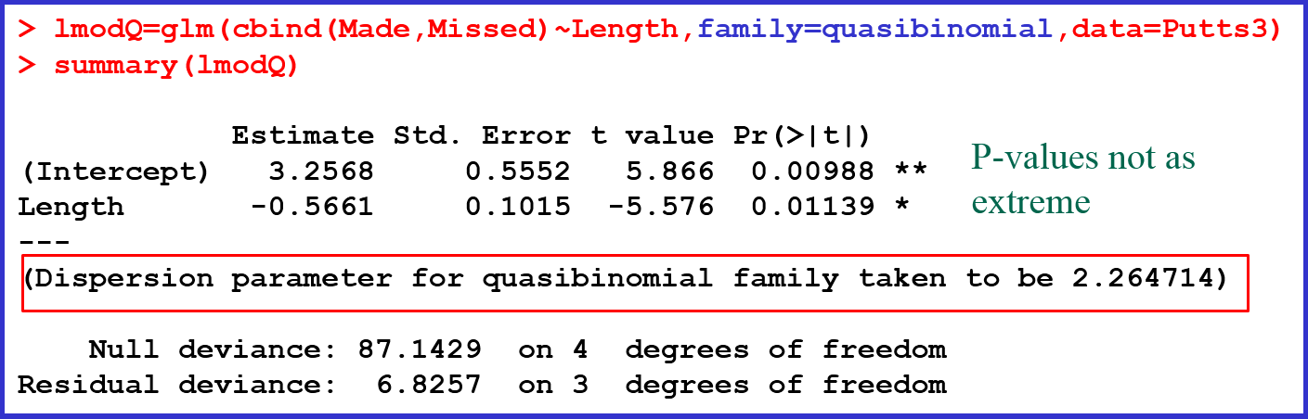
Overdispersion (2 of 2)
What to do if we suspect overdispersion?
Change the family from binomial to quasibinomial

Slide 31
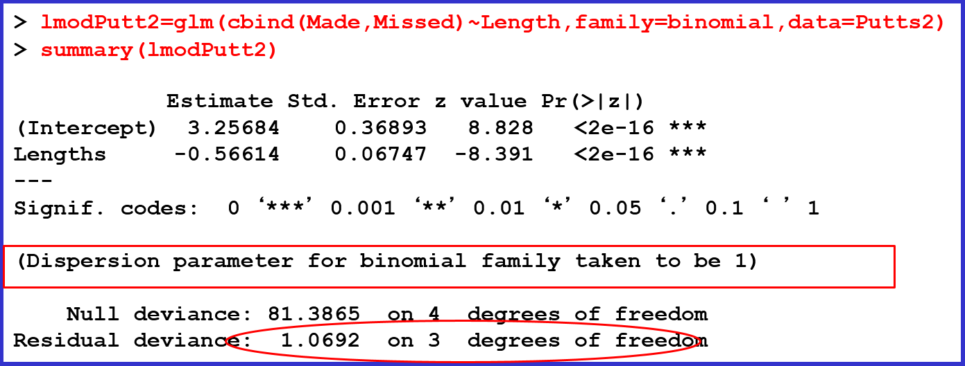
Original Putts2 Data
Not much concern with overdispersion.

Slide 32
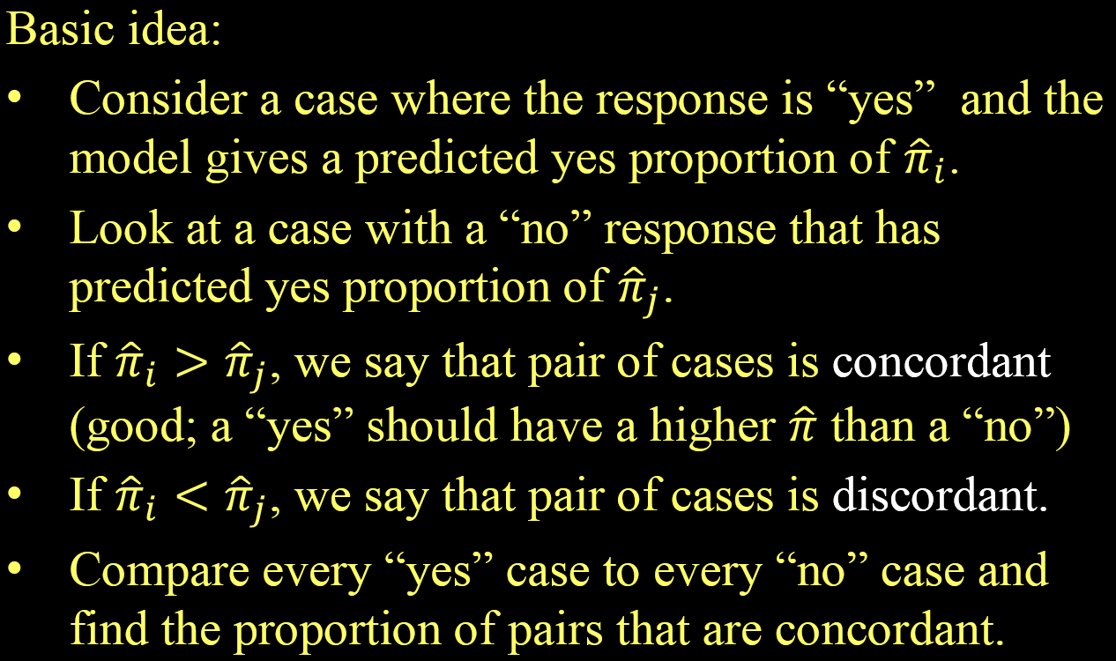
Measuring Overall Fit: Concordance

Slide 33
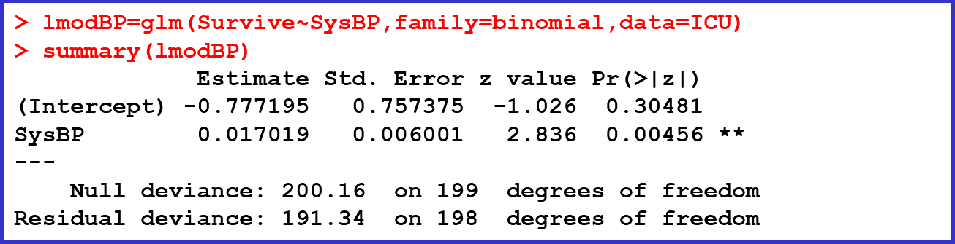

Example: ICU Data (1 of 3)
Consider a model to predict Survive for ICU patients using blood pressure (SysBP). The data have 160 cases that survive and 40 cases that did not survive
There are 160 × 40 = 6400 possible pairs
Notes:
See the Sec11.2.Rmd file for some R code to compute concordance

Slide 34
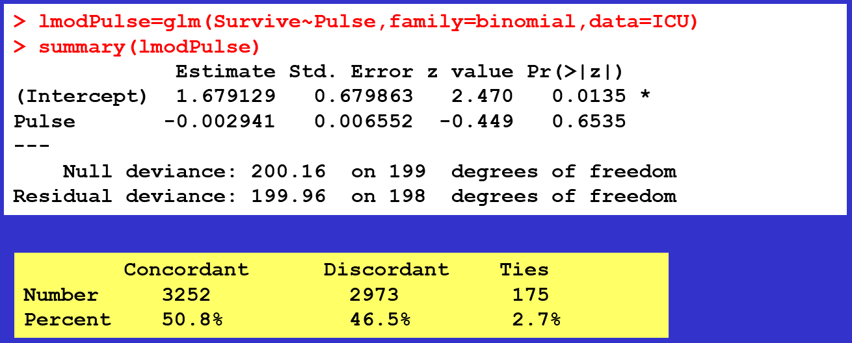
Example: ICU Data (2 of 3)
Compare the 61.9% concordance for using SYSBP as the predictor to a model using Pulse rate.
Pulse is a weaker predictor than SysBP.

