Slide 1
Simple Logistic Regression – Part 2
SDS 291
April 8, 2020
Notes:
8

Slide 2
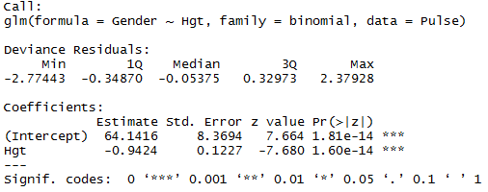
Example: Female Gender as a Function of Height
logitmod=glm(Gender ~ Hgt, family = binomial, data=Pulse)
summary(logitmod)

Slide 3
Odds
Definition:
is the odds of Yes.
Try some odds for the Height/Gender data.

Slide 4

Taller ← Shorter
69” 68” 67”
Log(Odds)
Odds
$$π$$

Slide 5



Taller ← Shorter
69 | 68 | 67
-0.880 | 0.063 | 1.005
0.415 | 1.065 | 2.732
0.293 | 0.516 | 0.732
Log(Odds) = $64.14−0.9424Hgt$
$${\text{Odds}\text{ =}e}^{64.14−0.9424Hgt}$$
$$\hat{π}=\frac{e^{64.14−0.9424Hgt}}{{\text{1+}e}^{64.14−0.9424Hgt}}$$

Slide 6
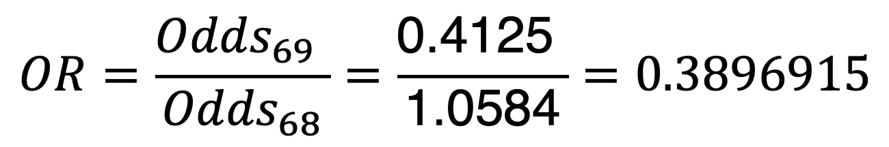
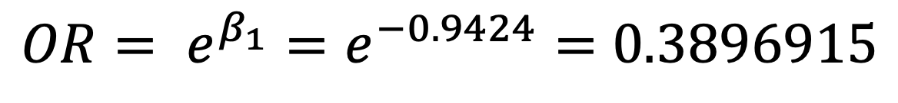
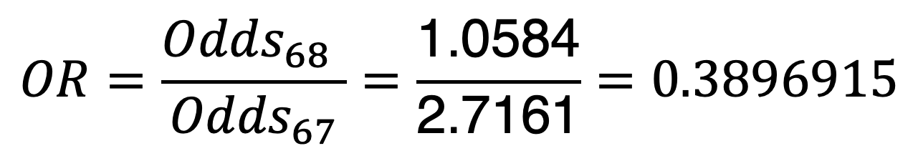
Odds Ratio
A common way to compare two groups is to look at the ratio of their odds.
$$OR=\frac{{Odds}_{69} }{{Odds}_{68}}=\frac{\text{0.4125} }{\text{1.0584}}=0.3896915$$
$$OR=\frac{{Odds}_{68} }{{Odds}_{67}}=\frac{\text{1.0584}}{\text{2.7161}}=0.3896915$$
$OR= e^{β_{1}}=e^{−0.9424}=$ $0.3896915$
Every additional inch in height is associated with 0.39 times the odds of being female than a person 1 inch shorter, on average.

Slide 7
Conditions for Inference for Logistic Regression
Linearity: The logits (log odds) should have a linear relationship with the predictor. [For binomial (“short form”) data, we can check this with a plot.]
Independence: No pairing or clustering of data.
Random: Either a random sample from a population OR random assignment within an experiment.
Normality: This does not apply. The responses are 0/1.
Constant variance: Also does not apply. In fact, variability in Y is highest when π is near ½ and lowest when π is near 0 or 1.

Slide 8
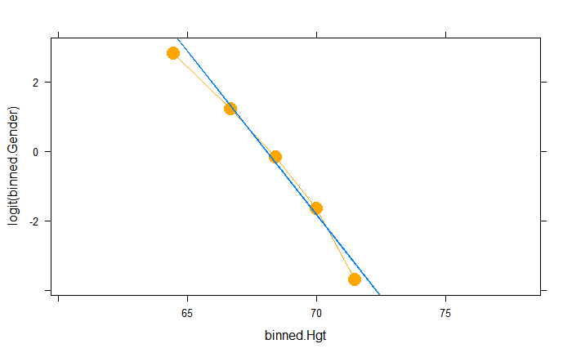
Notes:
>PropMade=c(84/101,88/119,61/108,61/125,44/134)
>PuttLength=c(3,4,5,6,7)
>logitPropMade=log(PropMade/(1-PropMade))
>model=glm(Made~Length,family=binomial)
>plot(logitPropMade~PuttLength)
>abline(reg=model)

Slide 9
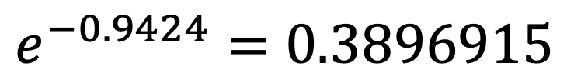
Output for Gender Logistic
$e^{−0.9424}=$ $0.3896915$
Some sort of tests?

Slide 10
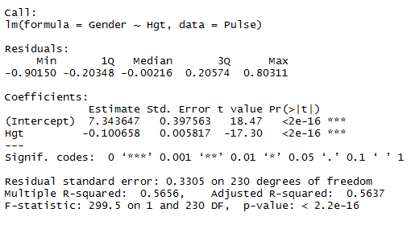
Recall: “Ordinary” Regression
Similar tests for logistic regression?
Tests for individual coefficients
Compare models
Test for overall fit

Slide 11
Test for Individual Coefficients
H₀: β_{i} = 0
H₁: β_{i} ≠ 0
Supplied by R
Interpret as with individual t-tests in ordinary regression.
p-value = 2P(Z > |t.s.|)

Slide 12
CI for Slope and Odds Ratio
From logistic model for Gender:
CI for slope:
−0.9424 ± 1.96(0.1227) = (-1.183, −0.702)
Exponentiate CI for slope
CI for odds ratio:
(e^{−1.183} , e^{−0.702} ) = (0.30, 0.49)
We are 95% confident that the odds of being female go down by a factor somewhere between 0.30 and 0.49 for every extra inch in height.

Slide 13

From logistic model for - height example:
logitmod<-glm(Gender ~ Hgt, family = binomial, data=Pulse)
exp(cbind(OR = coef(logitmod), confint(logitmod)))
We are 95% confident that the odds of being female go down by a factor somewhere between 0.29 and 0.48 for every extra inch in height.

Slide 14
Estimating Parameters in Logistic Regression
Parameters are chosen to maximize the likelihood of the observed sample (maximum likelihood estimation).
^
If the i^{th} point is YES (y_{i} = 1), calculate π_{i}.
If the i^{th} point is NO (y_{i} = 0), calculate 1 − π_{i}.
^
Likelihood:
^
Here the estimated probabilities, π, come from a model. What model is best?
(See Exercise 9.9 and likelihood-play.xls)

Slide 15
A Simple(?!) Max Likelihood Problem
^
If the i^{th} point is YES (y_{i} = 1), calculate π.
If the i^{th} point is NO (y_{i} = 0), calculate 1 − π.
^
Likelihood:
Suppose n = 20 and there are 14 total successes.
Calculus shows that the best estimate is

Slide 16
Evaluating Overall Effectiveness
Likelihood of the sample
Output below gives Log-likelihood
* Always negative
* Smaller −2Log-likelihood is better
Automated
logLik(logitmod)
Manual
pi<- fitted.values(logitmod)
likelihood <- ifelse(Pulse$Gender == 1, pi, 1 - pi)
log(prod(likelihood))

Slide 17
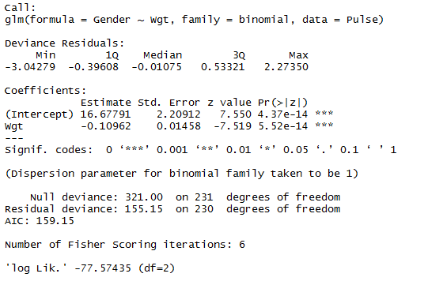
Example: Predict Gender via Weight
Hgt

Slide 18
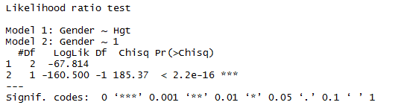
Evaluating Overall Fit
2. Test for overall fit
(Similar to regression ANOVA)
t.s. = G = improvement in –2ln(L) over a model with just a constant term
Compare to χ² with k d.f.
# predictors
require(lmtest)
lrtest(logitmod)

Slide 19
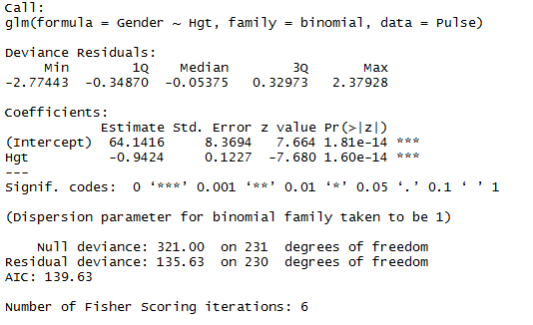
Deviance in R Output
-2LL
Constant Model
This Model
How much better do we do with height than with nothing?
G = 321.00 - 135.63 = 185.37

Slide 20
Test for Overall Model—Logistic
Is there something effective in the model?
H₀: β₁ = 0
H₁: β₁ ≠ 0
vs.
Same odds for all X
Odds are linear function of X
Compare to χ²₁.
Improvement in −2ln(L) when using linear function of X.

Slide 21

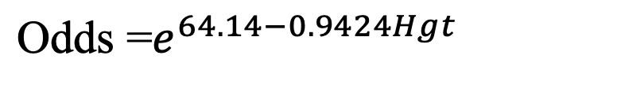
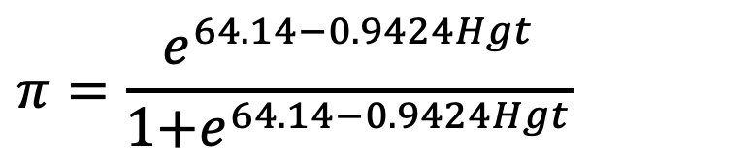
Taller ← Shorter
69” 68” 67”
-0.8856 0.0568 0.9992
0.4125 1.0584 2.7161
0.2920 0.5142 0.7309
Log(Odds) = $−0.9424Hgt$
$${\text{Odds}\text{ =}e}^{64.14−0.9424Hgt}$$
$$π=\frac{e^{64.14−0.9424Hgt}}{{\text{1+}e}^{64.14−0.9424Hgt}}$$

Slide 22
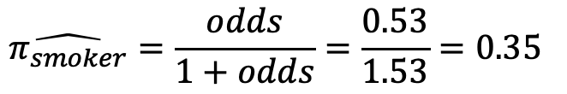
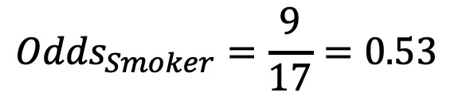
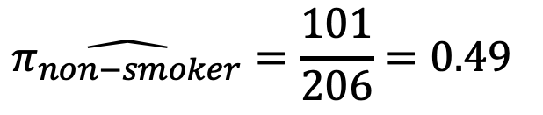
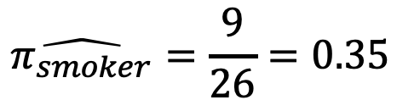
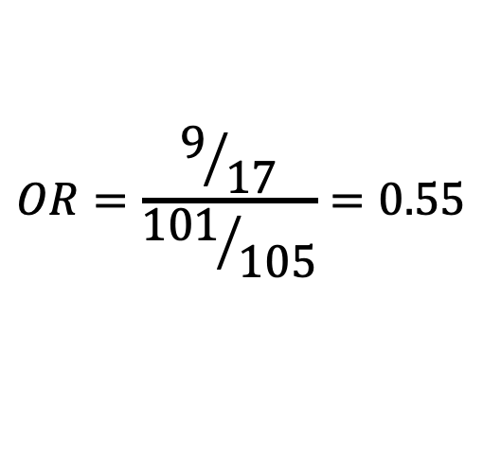
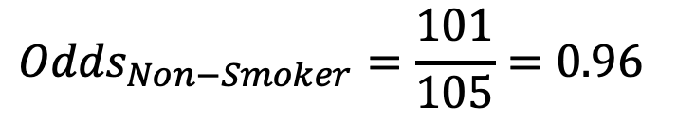
Example: Gender as a function of Smoking?
Gender | Smoker | Non-Smoker
Female | 9 | 101
Male | 17 | 105
Total | 26 | 206
$$\hat{π_{smoker}}=\frac{9}{26}=0.35$$
$${Odds}_{Smoker}=\frac{9}{17}=0.53$$
$$\hat{π_{smoker}}=\frac{odds}{1+odds}=\frac{0.53}{1.53}=0.35$$
$$\hat{π_{non−smoker}}=\frac{101}{206}=0.49$$
$${Odds}_{Non−Smoker}=\frac{101}{105}=0.96$$
$$OR=\frac{9/{17}}{{101}/{105}}=0.55$$
Odds are 0.55 times lower of a smoker being Female than a non-smoker.

Slide 23
No
Yes
Yes
No
No
Yes

Slide 24
The Logistic Reg Max Likelihood Problem
Likelihood:
where
For the putting data this is:
Maximize this with respect to and .

Slide 25
Example: Golf Putts
Length | 3 | 4 | 5 | 6 | 7
Made | 84 | 88 | 61 | 61 | 44
Missed | 17 | 31 | 47 | 64 | 90
 | 0.826 | 0.730 | 0.605 | 0.465 | 0.330
When Length = 3, the model predicts
The Likelihood component for Length = 3 is
Notes:
25

Slide 26
Length | 3 | 4 | 5 | 6 | 7
Made | 84 | 88 | 61 | 61 | 44
Missed | 17 | 31 | 47 | 64 | 90
 | 0.826 | 0.730 | 0.605 | 0.465 | 0.330
Combining for all the data, the Likelihood is:
Coefficients are chosen to make ln(L) as large as possible.
Notes:
26

