Slide 1

Odds, Probabilities, Odds Ratios
SDS 291 – Multiple Regression
April 1, 2020

Slide 2
Recapping Transformations

Slide 3
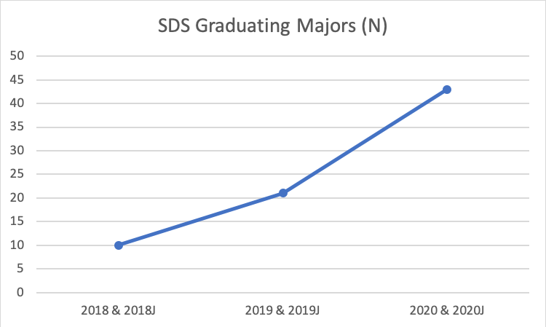
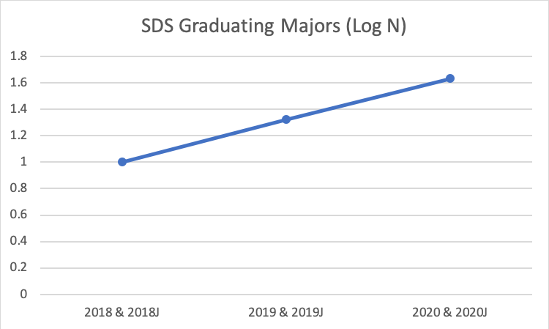
Growth in SDS Majors

Slide 4
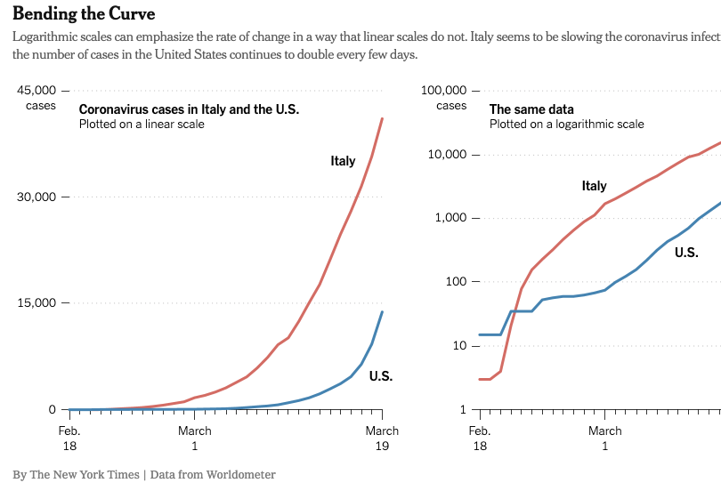
COVID-19
Chang, K. (2020, March 20). A Different Way to Chart the Spread of Coronavirus. The New York Times.

Slide 5
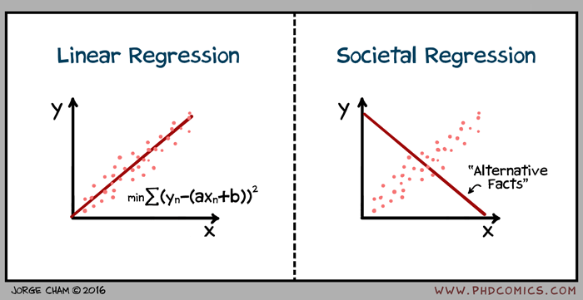
Transformations Linearize Patterns
It’s easier to interpret linear relationships
This Photo by Unknown Author is licensed under CC BY-SA

Slide 6
Odds, Probabilities, and Odds Ratios

Slide 7
What are Odds and Probabilities?
What are they?
Where have you seen them? Give 1-2 examples.

Slide 8
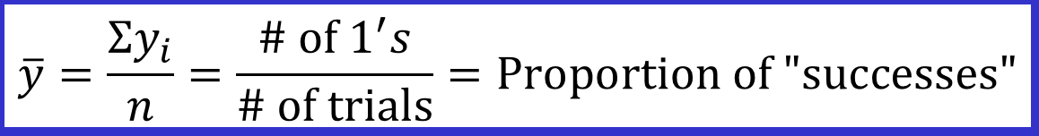
Probabilities: π = Proportion of “Successes”

Slide 9

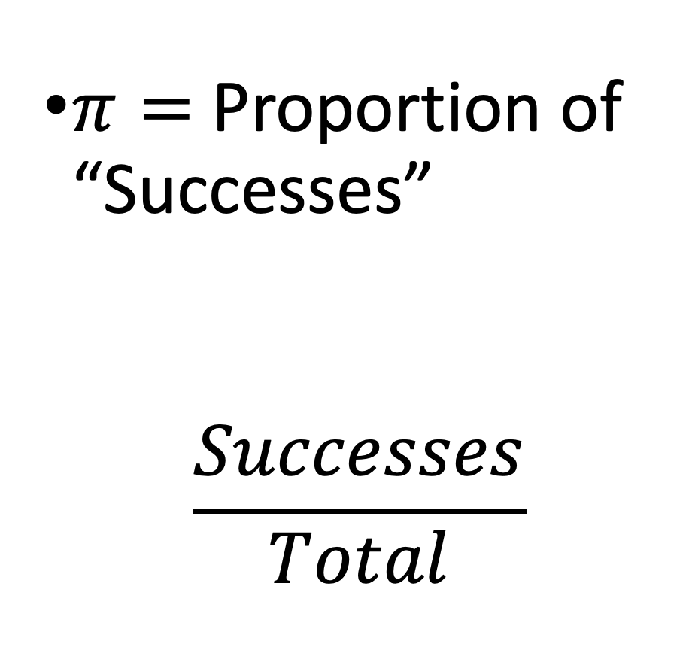
Probability
$π=$Proportion of “Successes”
$$\frac{Successes}{Total}$$

Slide 10


Odds
“Successful” Events : “Unsuccessful” Events
$$\frac{”Successes”}{”Failures”}$$

Slide 11
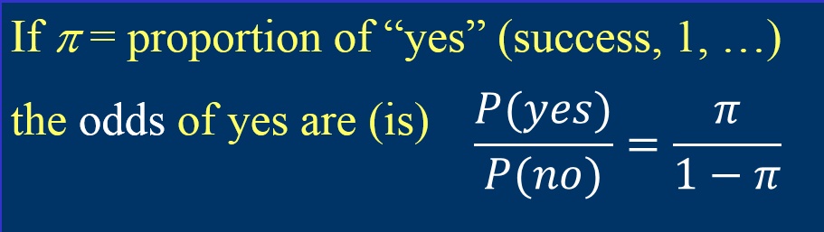
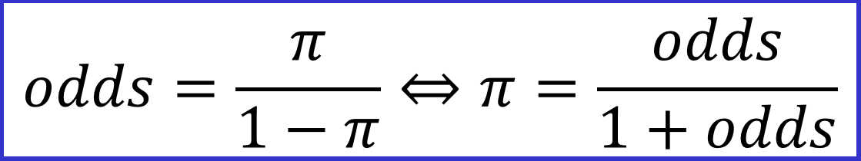
Odds Probability
A little bit of algebra shows

Slide 12
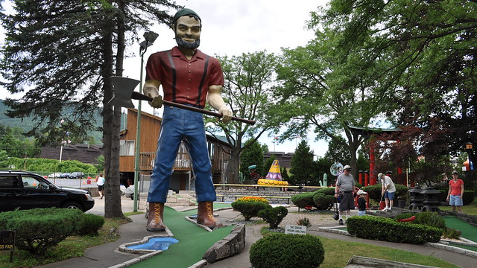
Let’s imagine you’re mini-golfing
Ft. away | 3 | 4 | 5 | 6 | 7
Made | 84 | 88 | 61 | 61 | 44
Missed | 17 | 31 | 47 | 64 | 90
Total | 101 | 119 | 108 | 125 | 134
Prob. | 84/101 = 0.832 | 88/119= 0.739 | 61/108= 0.565 | 61/125= 0.488 | 44/134 = 0.328
Odds | 84/17 = 4.94 | 88/31= 2.84 | 61/47 = 1.30 | 61/64 = 0.95 | 44/90 = 0.49
This Photo by Unknown Author is licensed under CC BY-NC

Slide 13
Odds Ratios
Ft. away | 6 | 7
Made | 61 | 44
Missed | 64 | 90
Total | 125 | 134
Prob. | .488 | .328
Odds | 0.95 | 0.49
Odds Ratio | 0.49 / 0.95 = 0.512
What are the odds you’ll make a putt from 7 feet away compared to 6 feet?

Slide 14

95% CI for an Odds Ratio
 | Made | Missed
Farther (7ft) | (a) 44 | (b) 90
Closer (6 ft) | (c) 61 | (d) 64
Odds | 7ft : 44/90 | 6ft: 61/64
Odds Ratio | 7ft / 6ft = 0.512
ln(OR) | -0.667
SE_ln(OR) | 0.25
$$\ln\left(OR\right)±Z^{∗}\sqrt{\frac{1}{a}+\frac{1}{b}+\frac{1}{c}+\frac{1}{d}}$$
-0.66 $±$ (1.96*0.256) = -1.17, -0.16
exp(-1.17, -0.16)
95% CI for OR: 0.31, 0.85

