Slide 1
MSDA 607 Final Project : Analysis of Honduras Foreign Aid Projects
Benjamin Arancibia

Slide 2
The Problem
Work for a company that builds foreign aid management systems.
Honduras Foreign Aid Projects don’t have compiled list of locations.
Donors have locations, but do not share with Government of Honduras (GoH)
Two datasets
Honduras Foreign Aid Projects
Honduras Locations
Combine two datasets
Based on project ids

Slide 3
The Data
Honduras Projects Commitments
1097 Projects with 186 columns per project
ID
Monetary Amounts
Honduras Project Locations
5065 Locations with 6 variables
AMPID
PROJECT TITLE
LATITUDE
LONGITUDE
TYPE
DESCRIPTION

Slide 4
Results
Mean of Foreign Aid Projects = 19,400,000 USD
Standard Deviation = 20,776,332 USD
Statistically means that projects can’t be significant if use t-tests; however, this does not determine foreign aid project significance.
Top Sectors
Multisector
Transport
Agriculture
Energy Generation

Slide 5
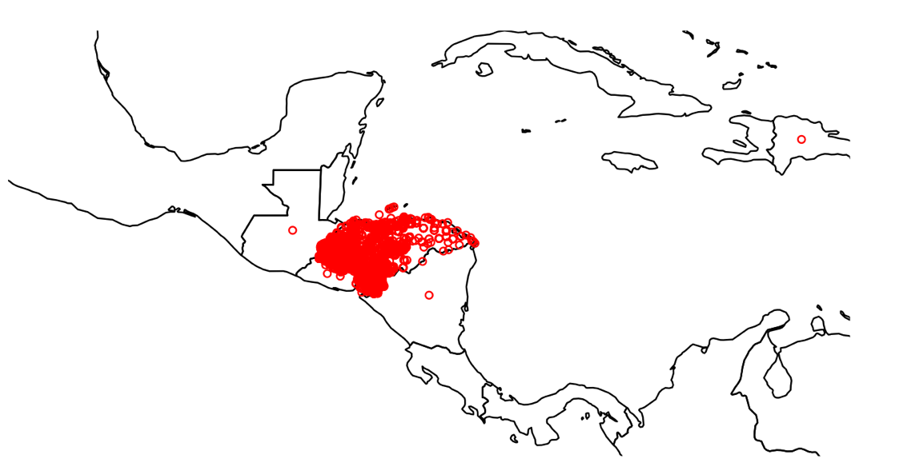
Maps
Used rworldmap to map project locations

Slide 6
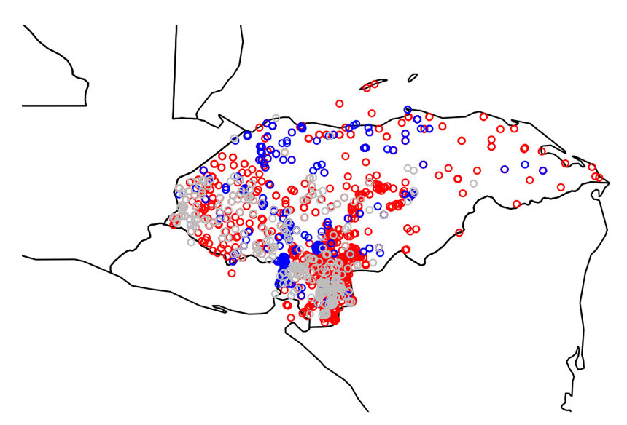
Maps - Continued
Red – Multisector Projects
Blue – Transport
Grey - Agriculture

Slide 7
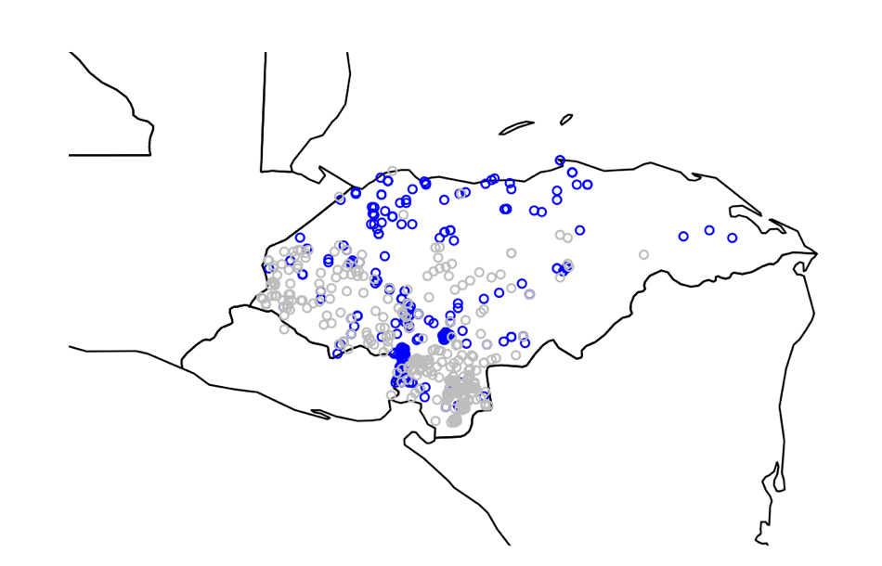
Maps - Continued
Blue –Transport
Grey – Agriculture

Slide 8
Issues
Data UTF – 8 Encoding
Mapping is hard in R
Does not make sense to use R to do spatial analysis and visualization
Data is not complete
Missing data from some donors

