Slide 1
OBJECTIVE
WINE REVIEWS
Brian Caterfino
CAPSTONE Data Science Project
Using Data Analysis to Gain Insight into the Wine Review Process

Slide 2
ABSTRACT
Tasting, buying, and reviewing wine can be an unnecessarily complex and haughty process. This project is meant to provide insight for the consumer when choosing which bottle of wine they want to buy. I start with some exploration of value of bottles of wine by region, category, and price. The end goal is to use machine learning to build a model to classify bottles of wine, to know which bottles will lead to a positive critic score.

Slide 3




PROCESS
The Data Science Process Overview
Obtain &Scrub Data
Explore Data
The process begins by gathering the data, and modifying it to be uniform and well-suited for analysis.
Looking into the data with graphs and statistics. From here, which models to build.
Model Data
Interpret Data
Building mathematical/statistical models to draw inferences from the data.
Draw conclusions from the model and offer insight into the topic explored.

Slide 4
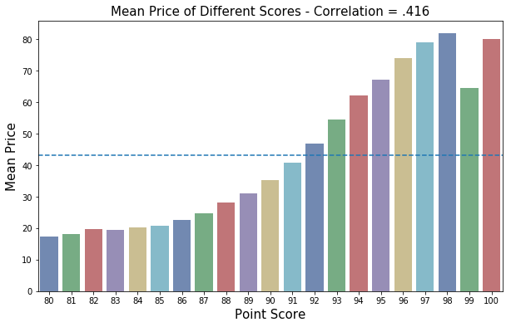
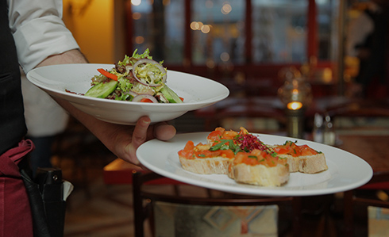
UNDERSTANDING THE DATA
Features:
First Data Exploration:
Points: Review Score (80-100)
Price: Cost of Bottle
Value: Points/Price
Country: Origin Country of Bottle
Variety: Type of Wine
Description: Text Review of Bottle
Positive: Above/Below mean Score
This graph shows the mean price of all bottles of a certain score, on a scale from scores 80 -100.

Slide 5
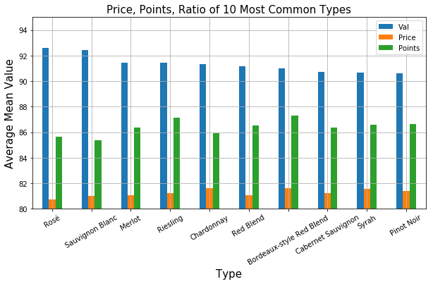
Assessing Value of Different Varieties
Value of Varieties
This visualization shows the mean value ratio, price, and review score of the 10 most common varieties of wine, scaled from 80-100
Rosé = Best Value
Pinot Noir = Worst Value

Slide 6
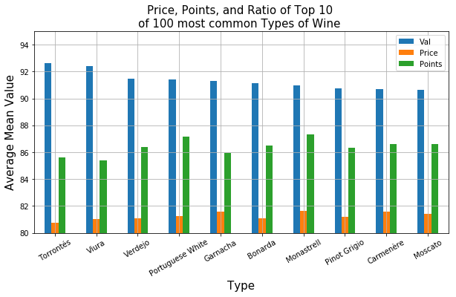
Assessing Value of Different Varieties
Value of Varieties
This visualization shows the mean value ratio, price, and review score of the 10 highest value bottles from the 100 most common varieties, scaled from 80-100
Torrontés = Best Value

Slide 7
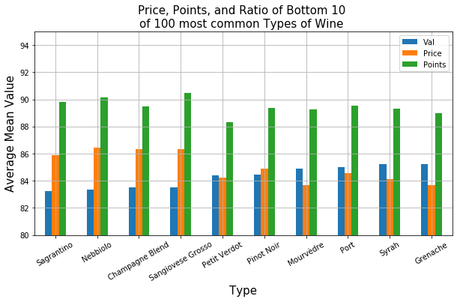
Assessing Value of Different Varieties
Value of Varieties
This visualization shows the mean value ratio, price, and review score of the 10 lowest value bottles from the 100 most common varieties, scaled from 80-100
Sagrantino = Worst Value

Slide 8
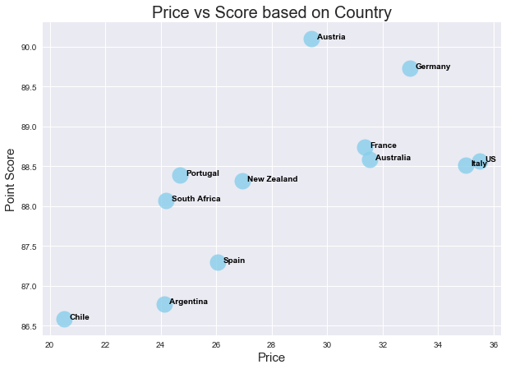
Assessing Value of Different Countries of Origin
Value of Country
This visualization is a scatterplot of the price vs score of the 12 most common countries of origin of the bottles in this dataset.
Best Value: Germany, Austria, US, Italy
Worst Value: Chile, Argentina

Slide 9
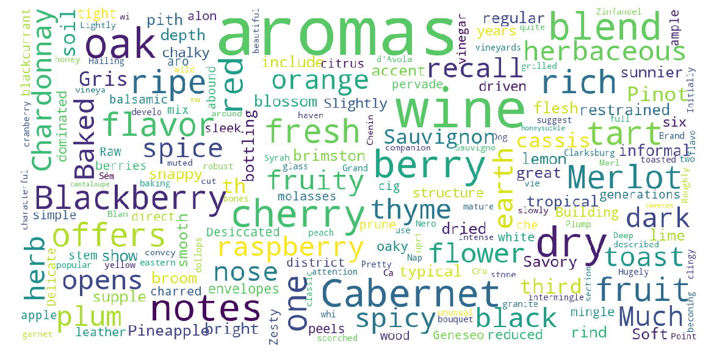
Most Important Words in the Dataset
Word Importance
This Wordcloud shows the words that are most strongly indicitve of the positivity of a review

Slide 10
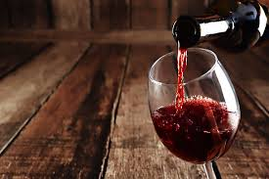
Natural Language Processing
Using the Text Reviews to Predict Whether the Bottle will acheive Positive or Negative Review… These are the top reviews with our positivity/negativity analysis
Most Positive Reviews
Most Negative Reviews
Description | Pos
A fine, clean and intense sparkling wine, with... | 0.619
88-90 Barrel sample. This is rich, with sweet ... | 0.606
The honey, orange, pineapple-jam and vanilla f... | 0.605
Fine fresh fruits, bright with good acidity an... | 0.580
Attractive perfumed wine, rich, soft, generous... | 0.574
Description | neg
This is sour, bitter and just all-around dull ... | 0.509
Disagreeable for its harsh acidity and vegetal... | 0.453
Smells baked and hot, tastes harsh and dry, a ... | 0.443
This is a yeasty wine that shows a bitter almo... | 0.372
This suffers from major problems. It has all t... | 0.371

Slide 11
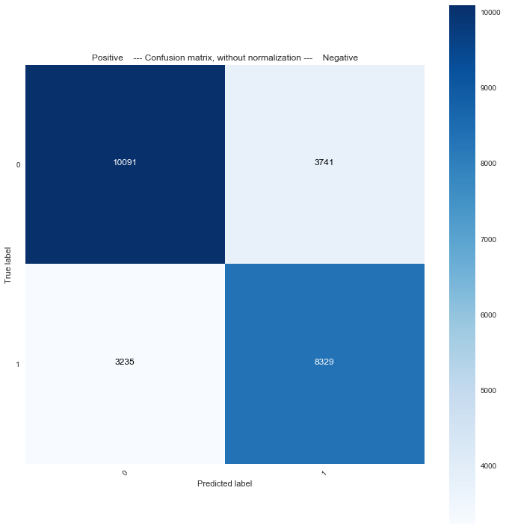
RF Confusion Matrix
Accuracy: 72.53%
Precision: 73.00%
Recall: 75.59%
F1 Score: 74.29

Slide 12
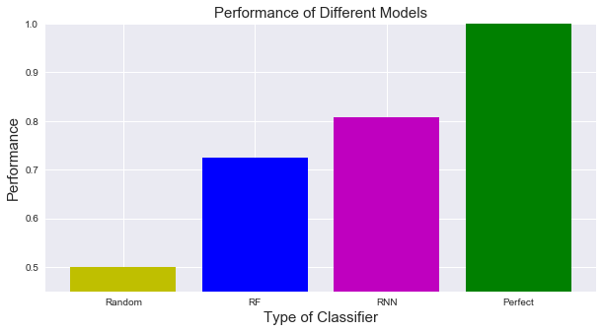
Model Performance

Slide 13
Conclusion
Interpreting the Model & Data
Wine value dependent on category
Wine value dependent on category
Review desription predicts review score best with RNN
Certain varieties of wine have a drastically higher value ratio than other,guiding consumers which varieties to look for.
Different countries have huge differences in mean price, score,and value.
RNN can be used to predict outcome of review based on text description of wine. This can be used by Wine companies to figure out what to aim for when making wine.

