Slide 1
Single-cell transcriptome shift of human traumatic brain injury
Jiaqi Ma

Slide 2
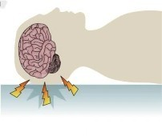
Traumatic Brain Injury (TBI)
External force
Inertia
Neuroinflammation
(Blennow et al, 2016)
Question: What are the molecular mechanisms contributing to neuroinflammation?
Figure 1: Physical mechanism of TBI (Modified from Blennow et al, 2016; figure 1c)

Slide 3
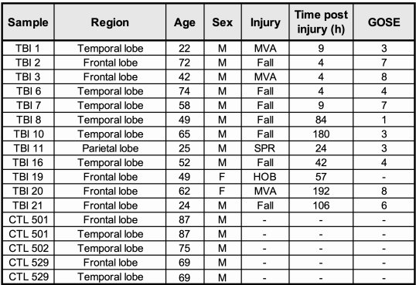
Dataset
GSE209552
Single-nucleus RNA-seq
Control: non-neuronal death postmortem brain
Treatment: Surgically removed TBI sample
(Graze et al, 2023)
Figure 2: GSE209552 metadata overview; Yellow highlight tbi group; MVA = Motor vehicle accident, SPR = sports related,
HOB = hit by object. GOSE = Glasgow Outcome Scale extended (Modified from Graze et al, 2023; supplemental table 1)

Slide 4
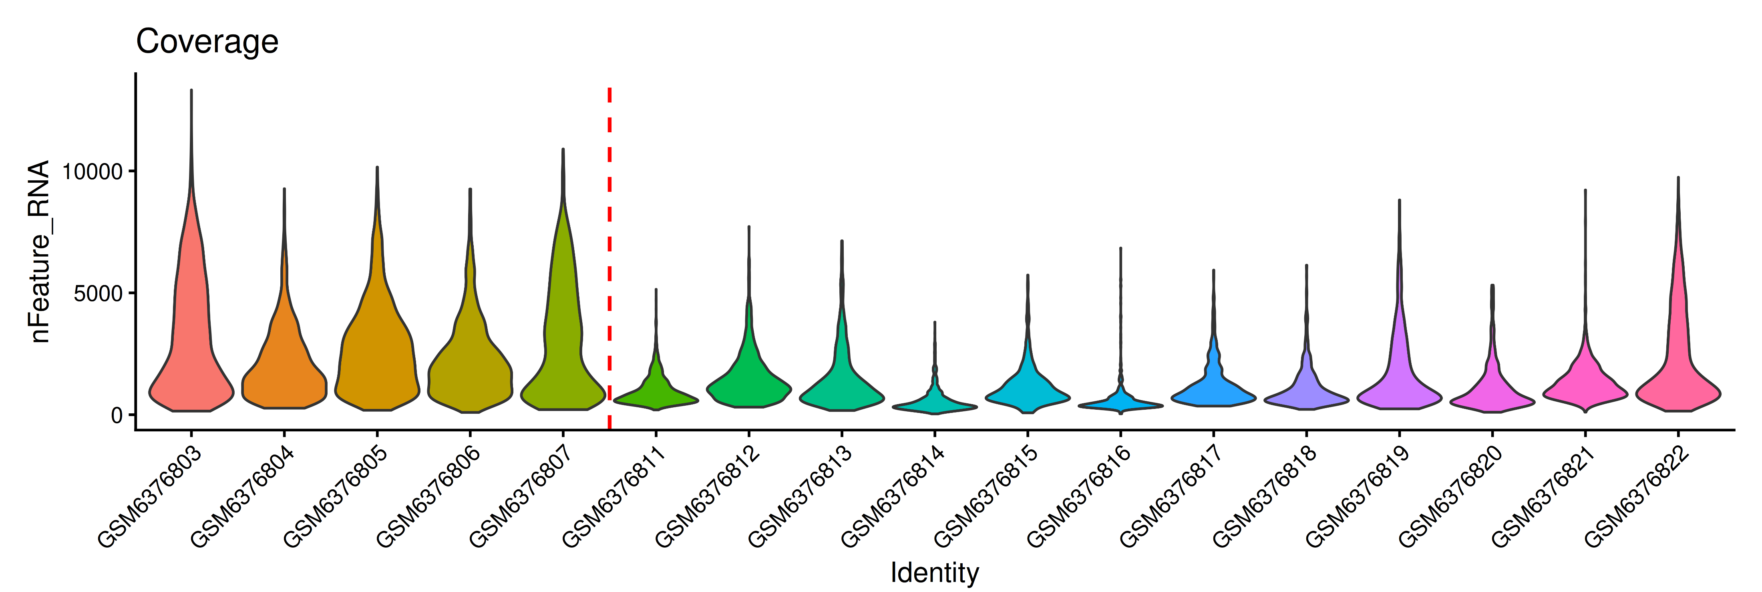
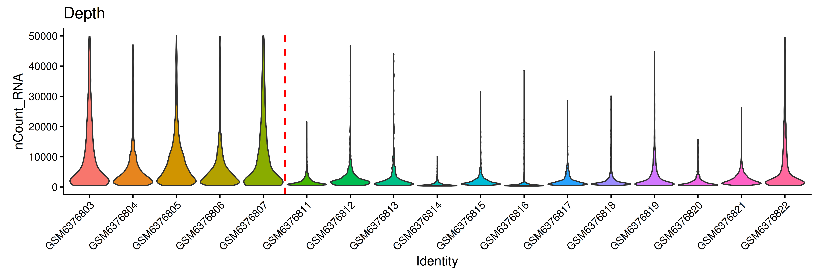
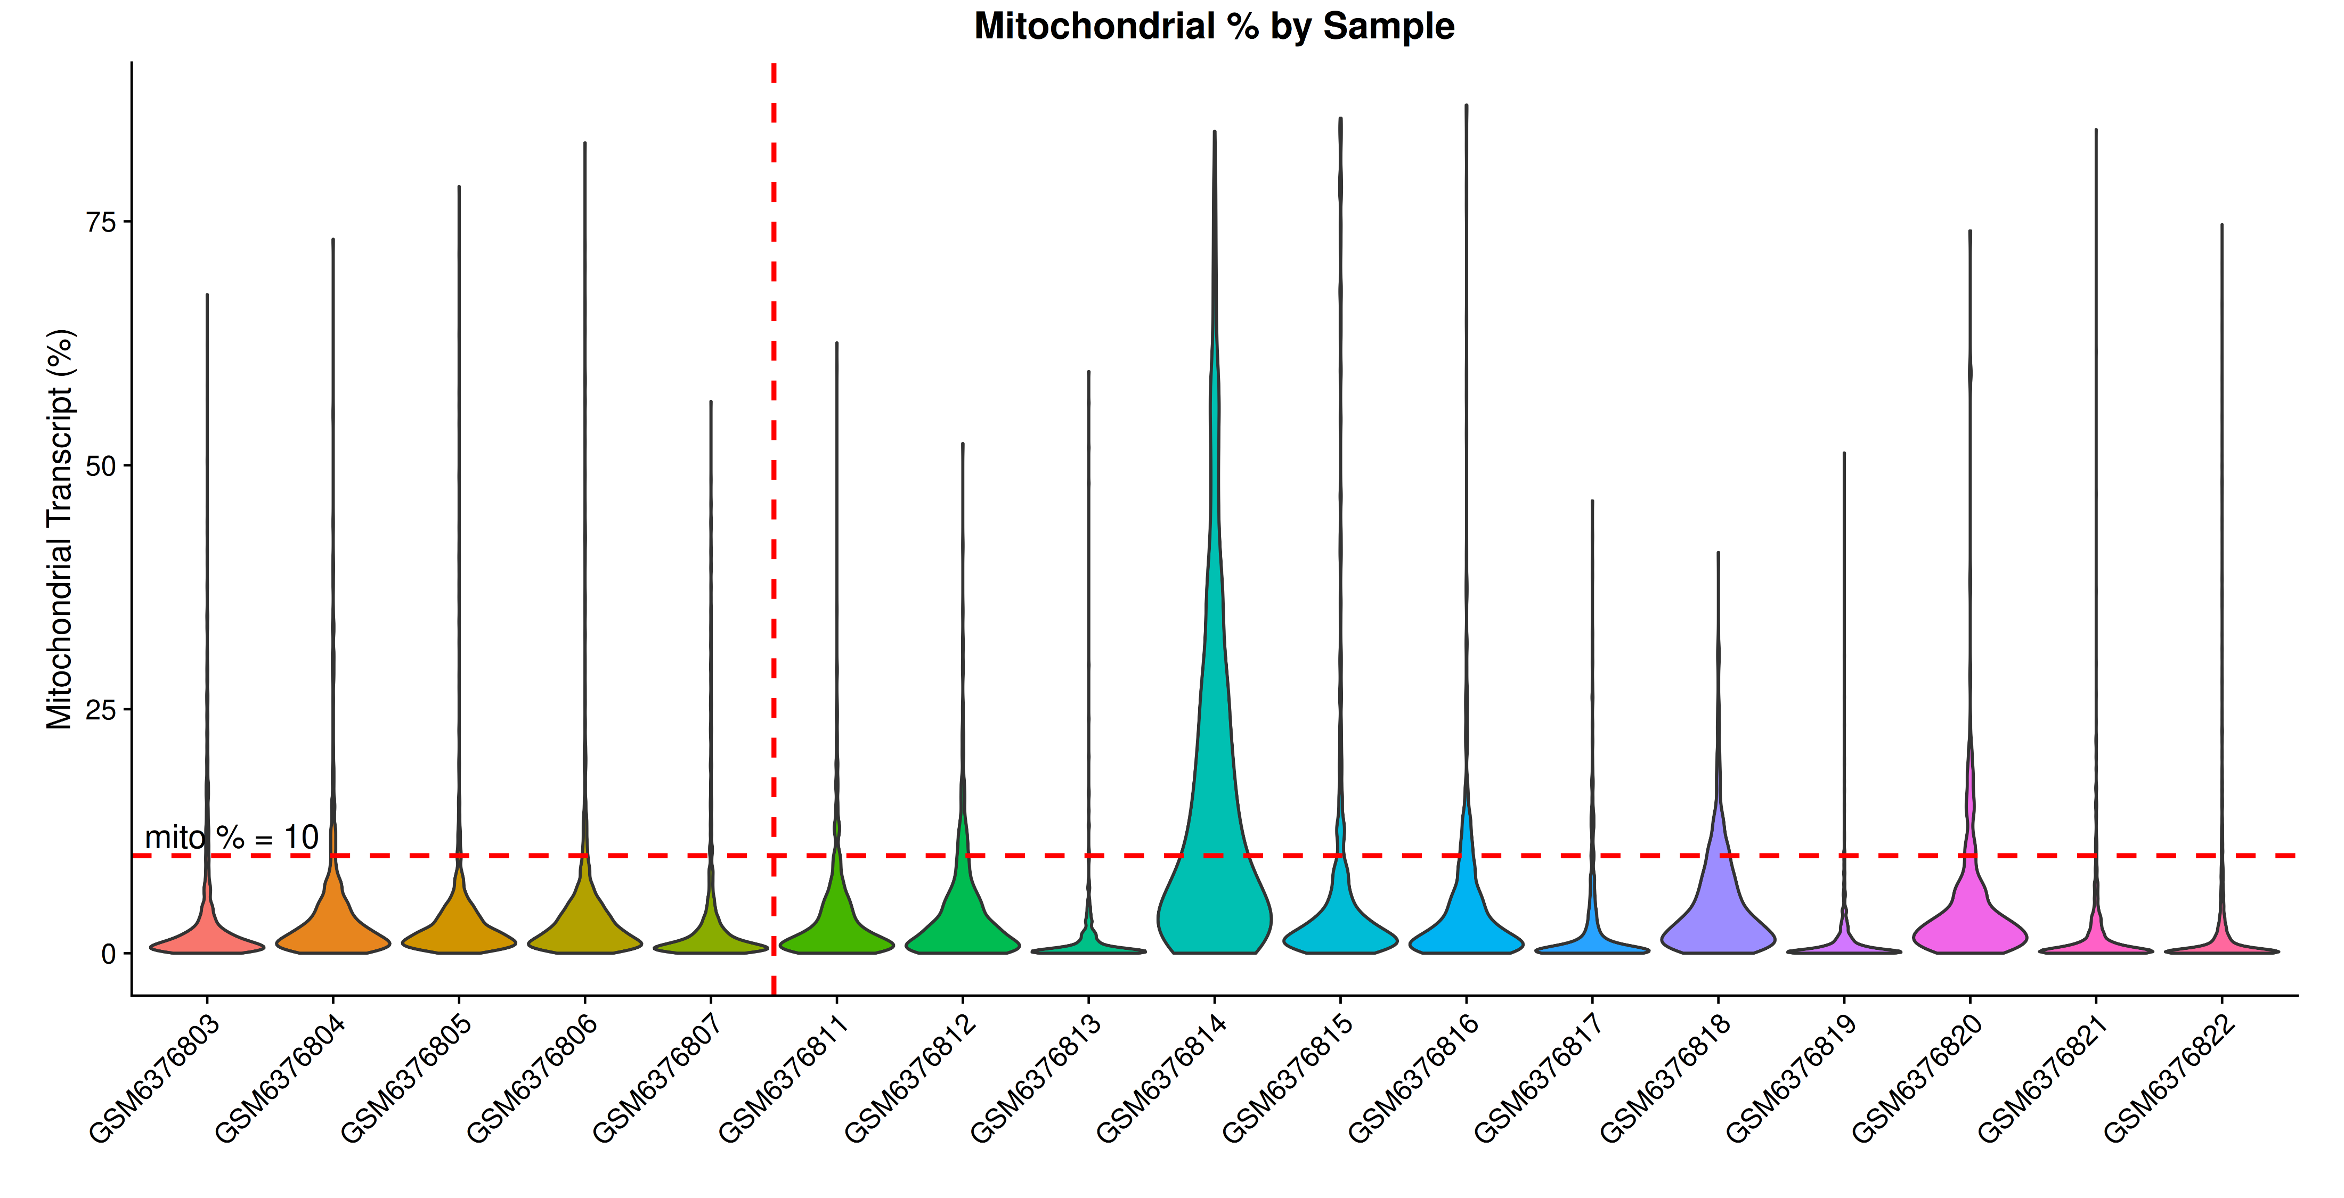
Quality Control
Lower Mito % → Better quality
Exclude GSM637381
Figure 3: Sequence coverage, depth, and mitochondrial percentage per sample; The vertical red dash line separate control (left side of red line), and tbi (right side of red line)(Created using ggplot2, v4.0.1)

Slide 5
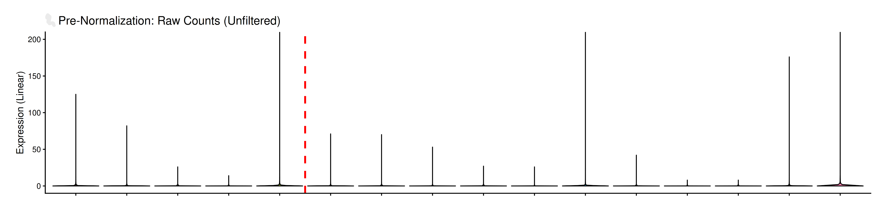
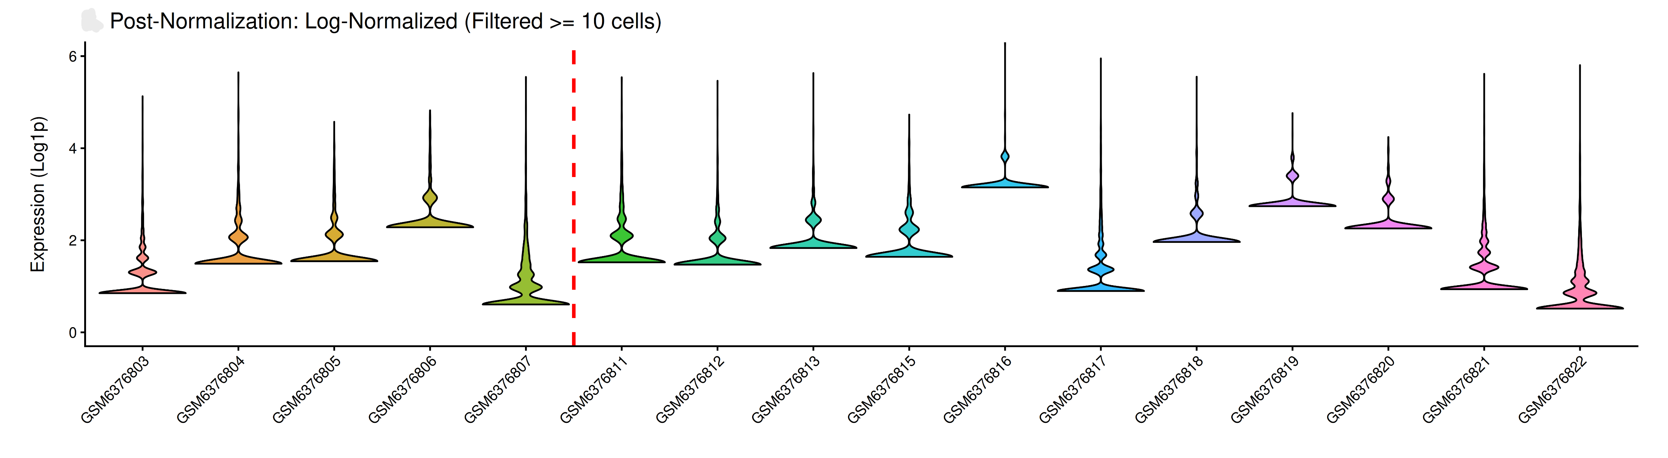
Normalization
Log-CP10k
Seurat v5.4.0
NormalizeData()
Scale.factor = 10000
Genes detected in less than 10 cells excluded
Figure 4: Pre and post normalized counts per cell (randomly sample 1 cell per GSM). The upper panel indicate the raw counts distribution; The bottom panel indicate the normalized counts after exclude all genes that expressed in less than 10 cells; X-axis indicate the GSMs that cell is sampled from; The vertical red dash line separate control and tbi )(Created using ggplot2, v4.0.1)

Slide 6
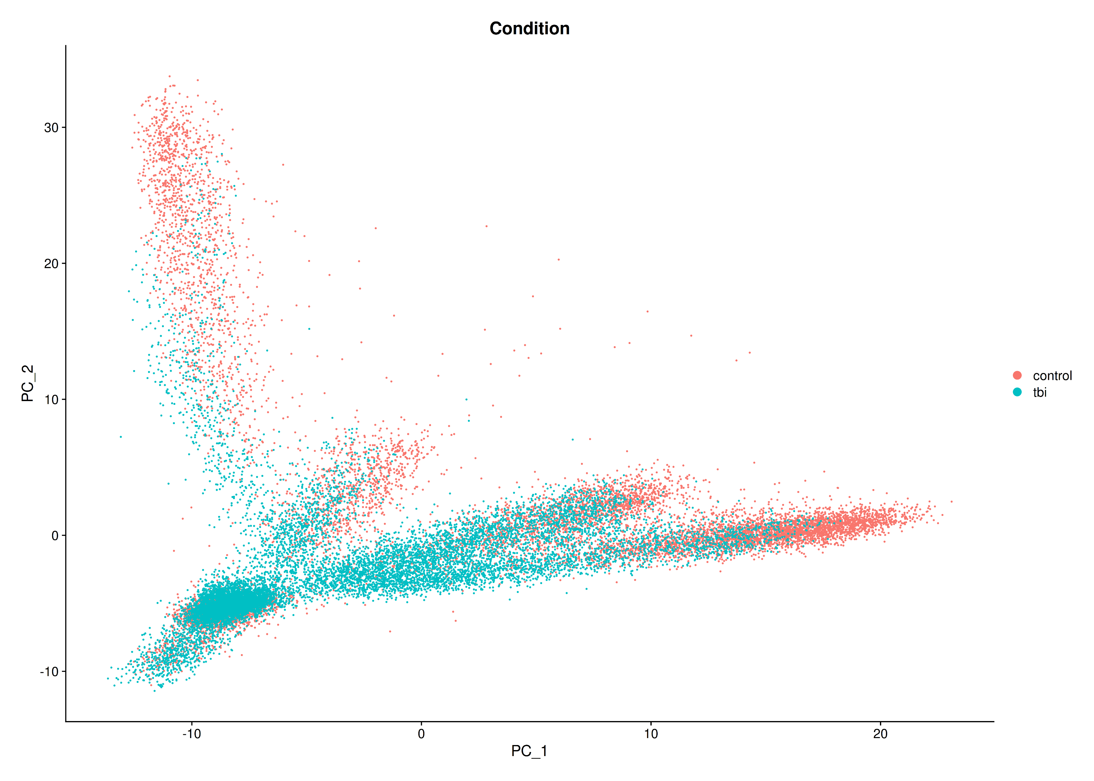
MDS Plot
Principal component analysis (PCA)
Seurat v5.4.0
FindVariableFeatures()
Selection.method = “vst”
nfeature = 2000
ScaleData()
runPCA()
npcs = 20
Figure 5: MDS plot grouped by condition. Y-axis is the second PC; X-axis is the first PC; Each dot indicate a single cell; Red denote control; Blue denote tbi (Created using Seurat, v5.4.0)

Slide 7
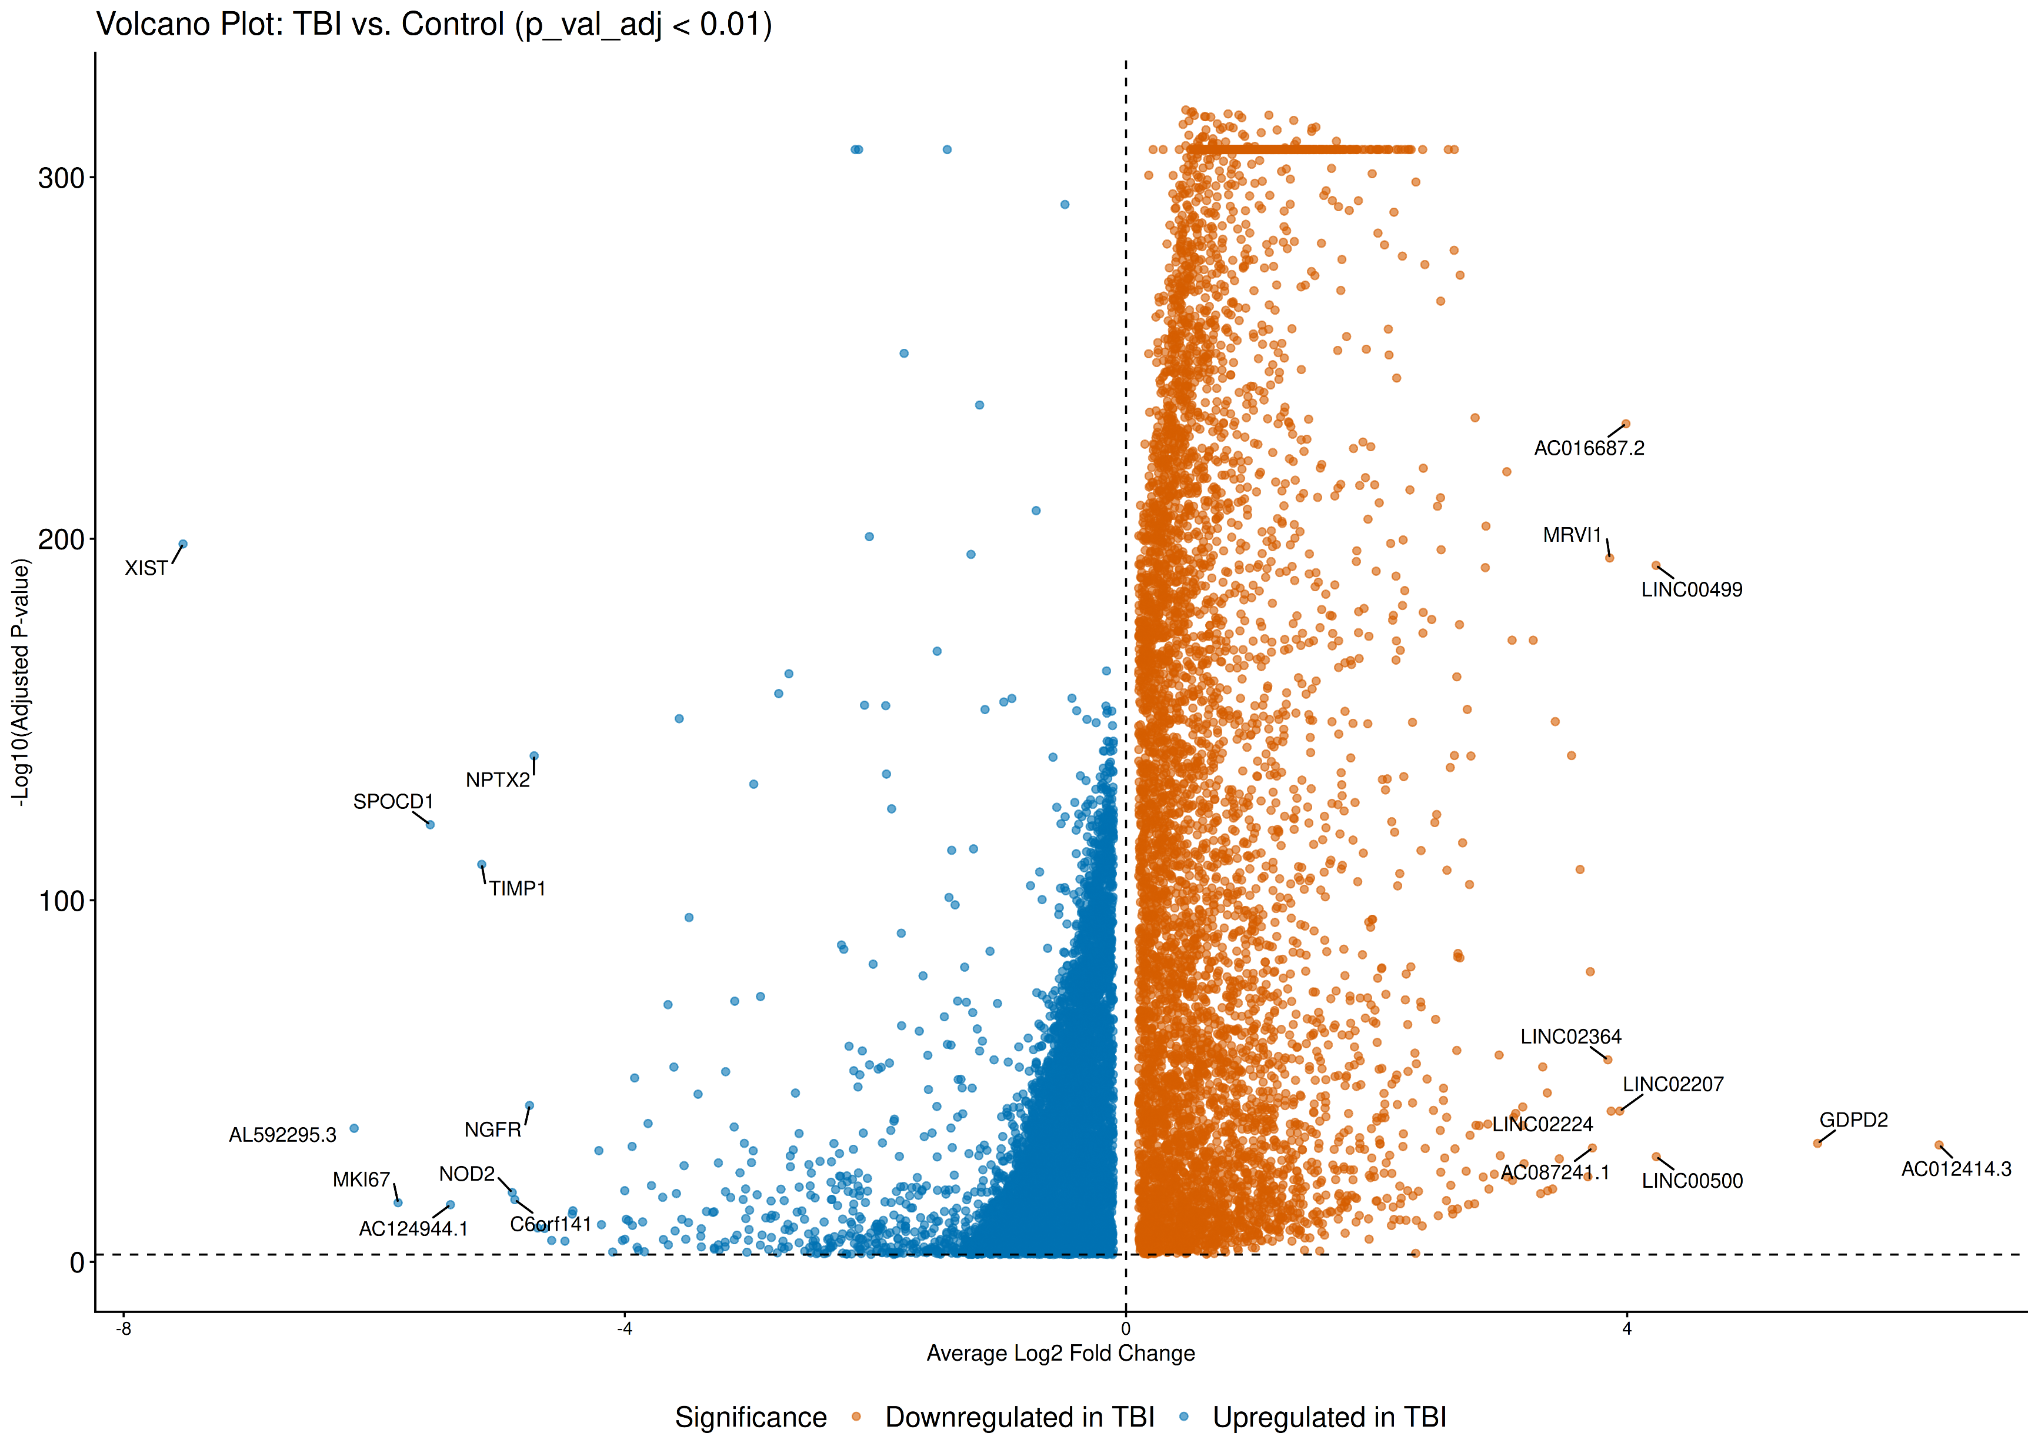
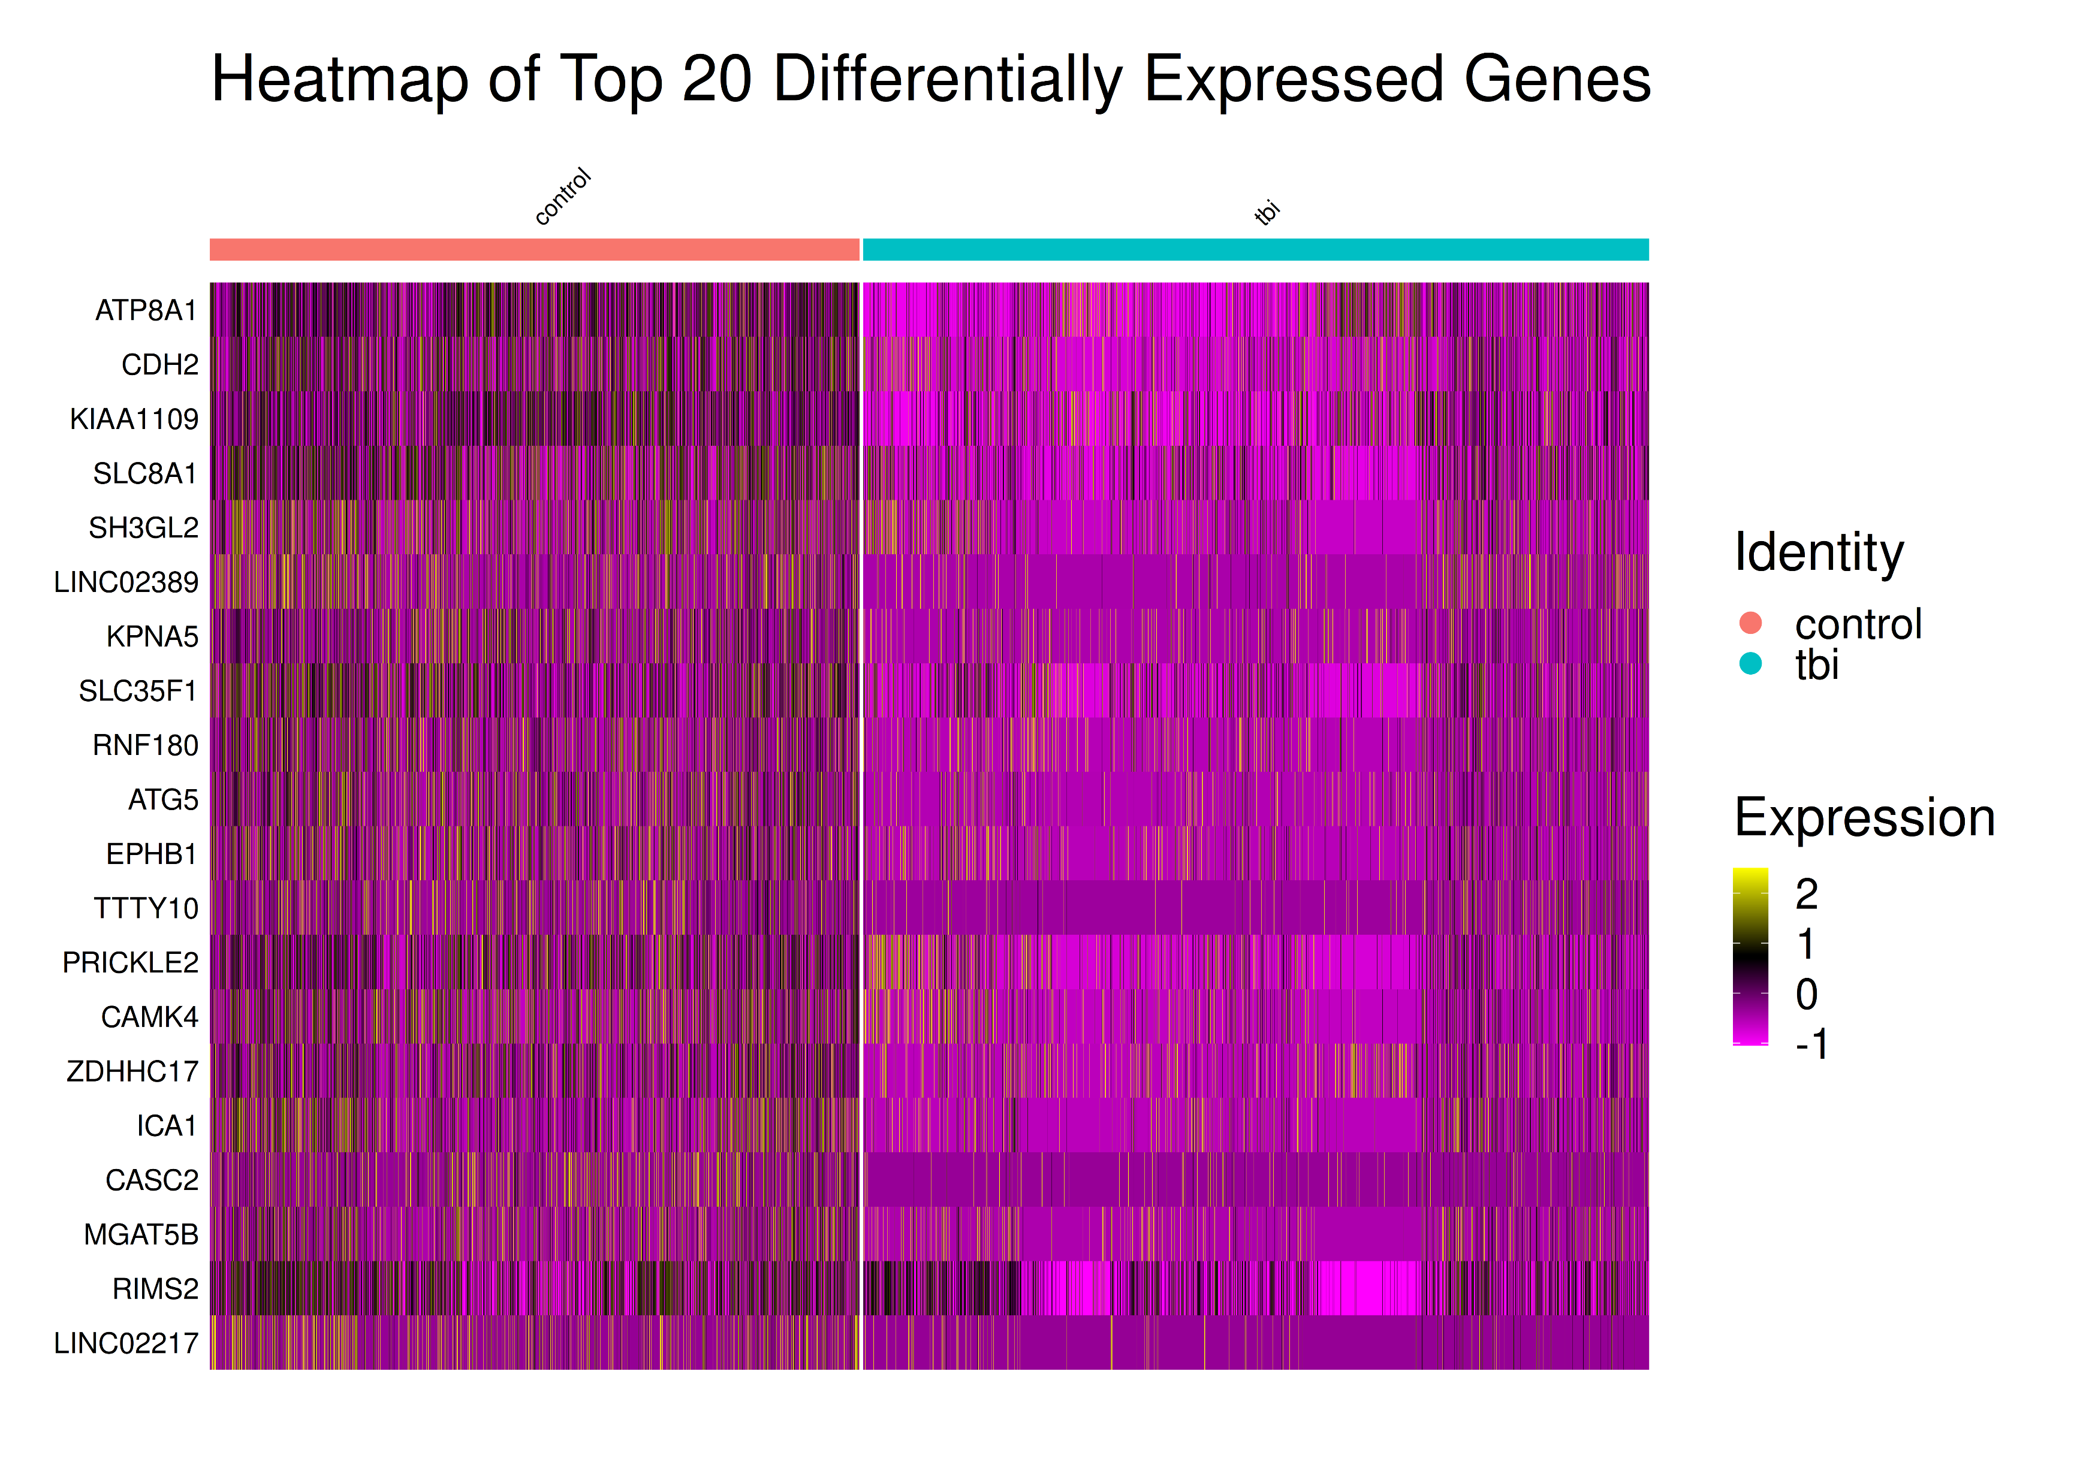
Differential Gene Expression
Wilcoxon Rank-Sum test
Bonferroni correction
Seurat v5.4.0
FindMarkers()
Figure 6: Volcano plot grouped by condition. Y-axis is negative log-transformed adjusted p value; X-axis is the average log-fold change centered at zero (Created using ggplot2, v4.0.1)
Figure 7: Heatmap of top 20 gene with lowest adjusted p value. Y-axis indicate the HOGO symbol of selected genes; Each tiny column along X-asix is a cell (Created using Seurat, v5.4.0)

Slide 8
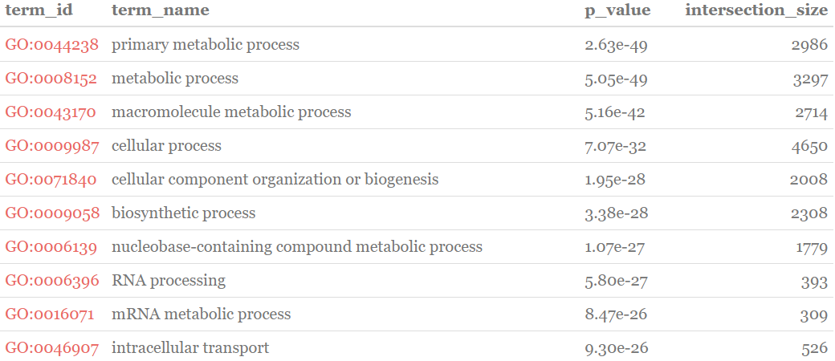
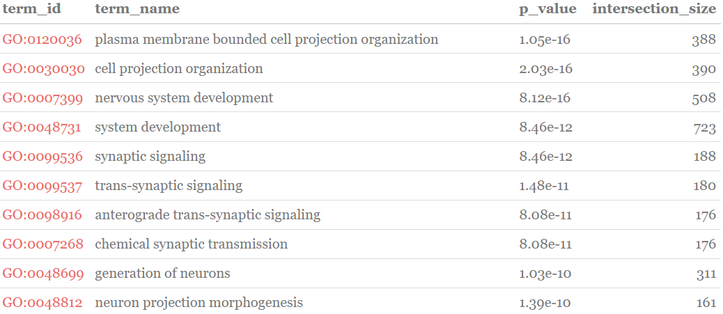
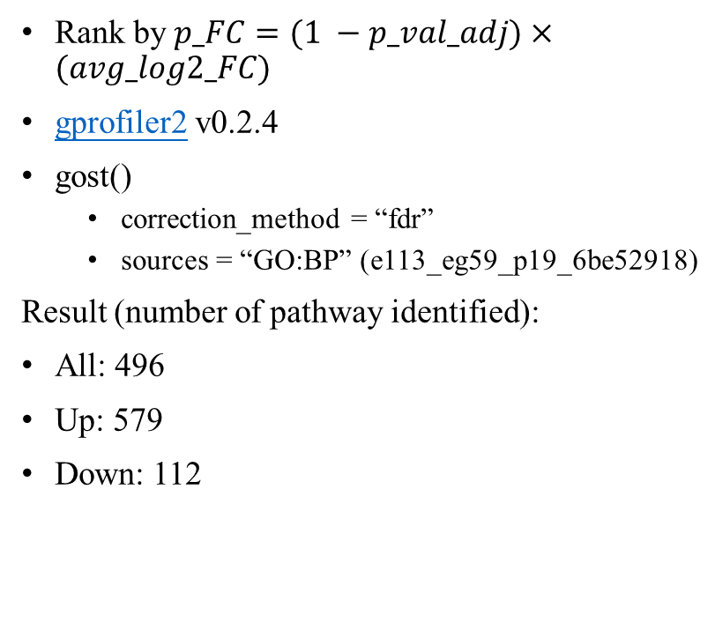
Thresholded ORA
Rank by $p_FC=(1 −p_val_adj)×(avg_log2_FC)$
gprofiler2 v0.2.4
gost()
correction_method = “fdr”
sources = “GO:BP” (e113_eg59_p19_6be52918)
Result (number of pathway identified):
All: 496
Up: 579
Down: 112
Figure 8: Top 10 significantly Up-regulated GO:BP pathway
Figure 9: Top 10 significantly Down-regulated GO:BP pathway

Slide 9
Non-thresholded GSEA
GSEA Desktop v4.4.0
Pathway data: Bader lab EM_Genesets (September_01_2025)
Number of permutations: 2000
Max size: 500 (default)
Min size: 15 (default)
Result (number of pathway identified):
Up: 4330
Down: 1243

Slide 10
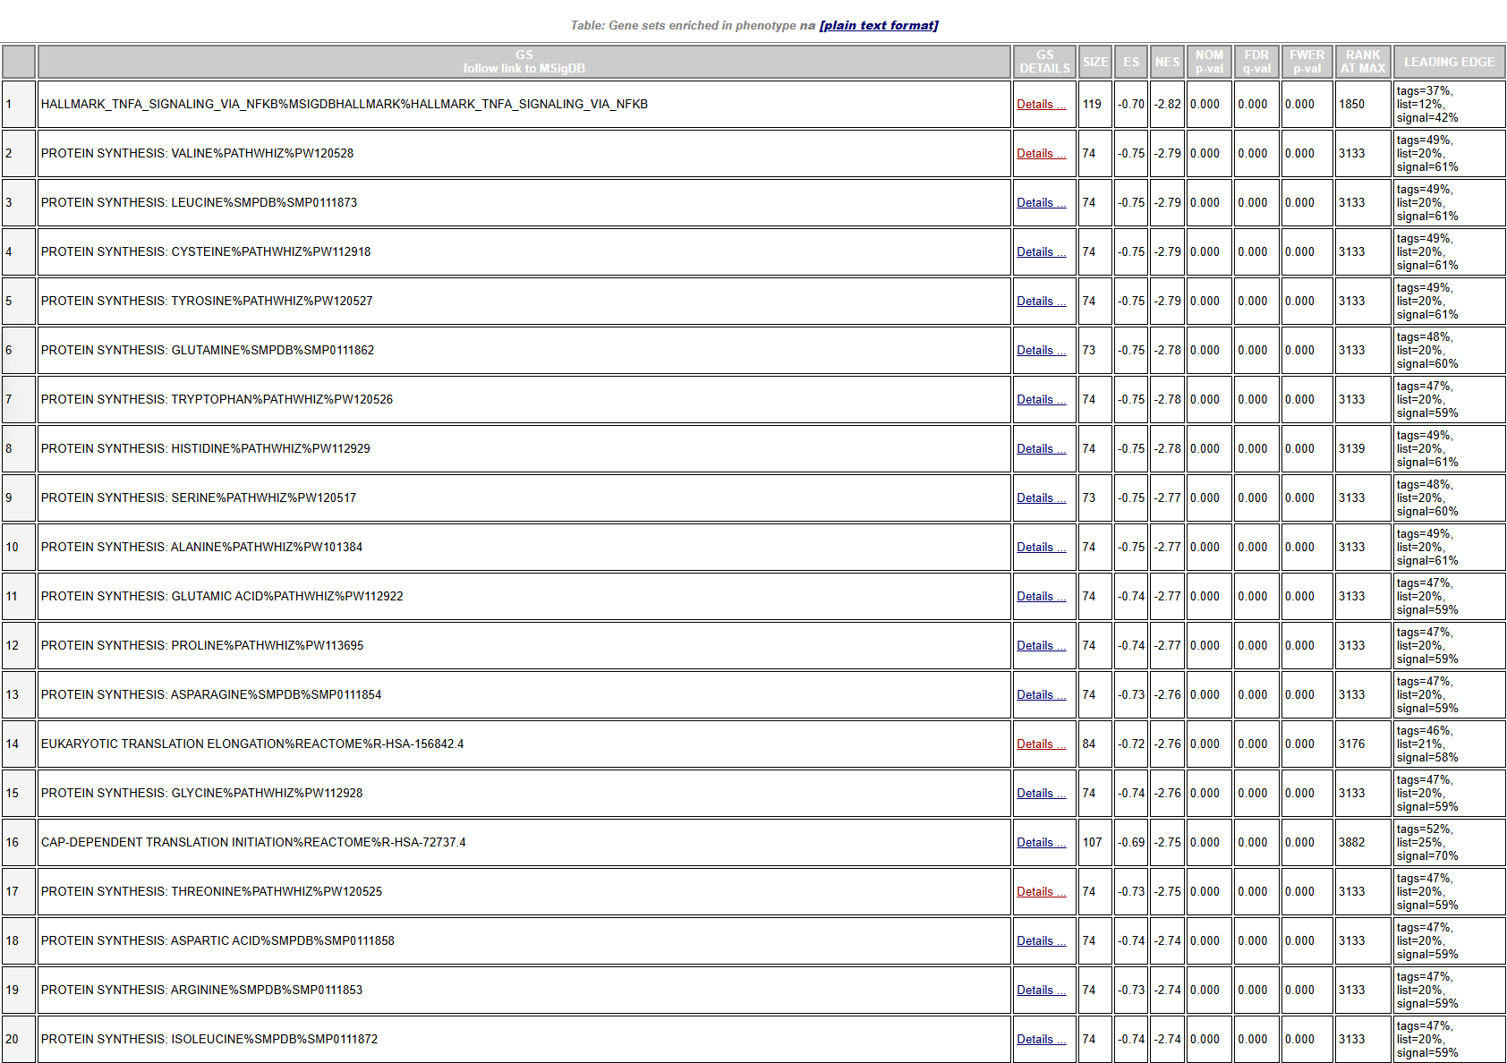
: TNF-α, NF-κB
: Protein synthesis
: Translation initiation & elongation
Figure 10: Top 20 significantly Up-regulated pathway

Slide 11
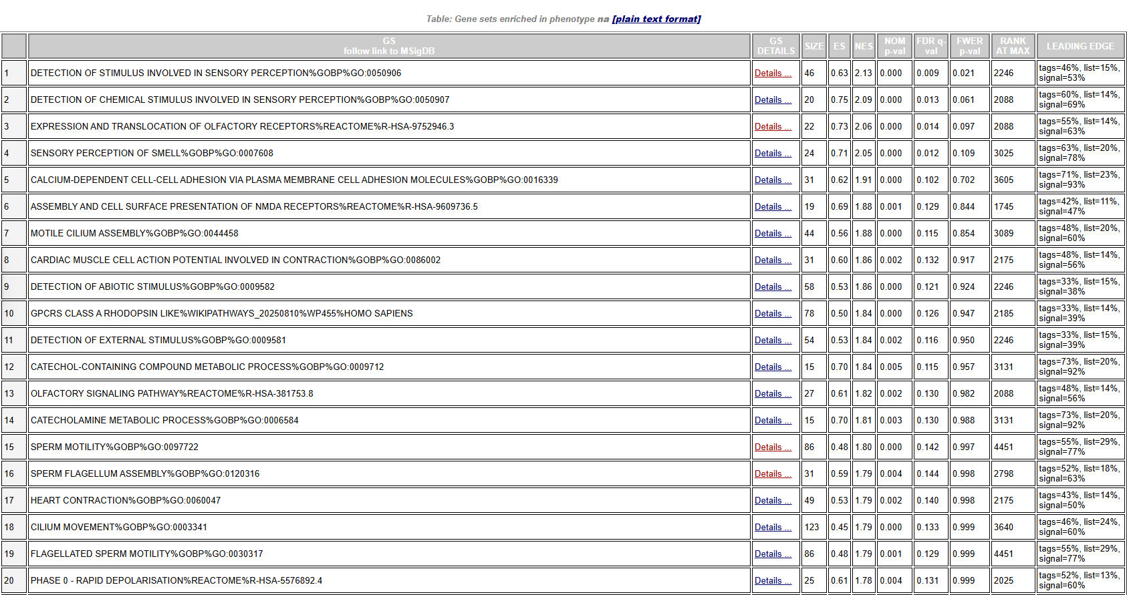
Figure 11: Top 20 significantly Down-regulated pathway
:Sensory recep.
:Olfactory recep.
:Ion func.
:Cilium, Sperm motility.

Slide 12
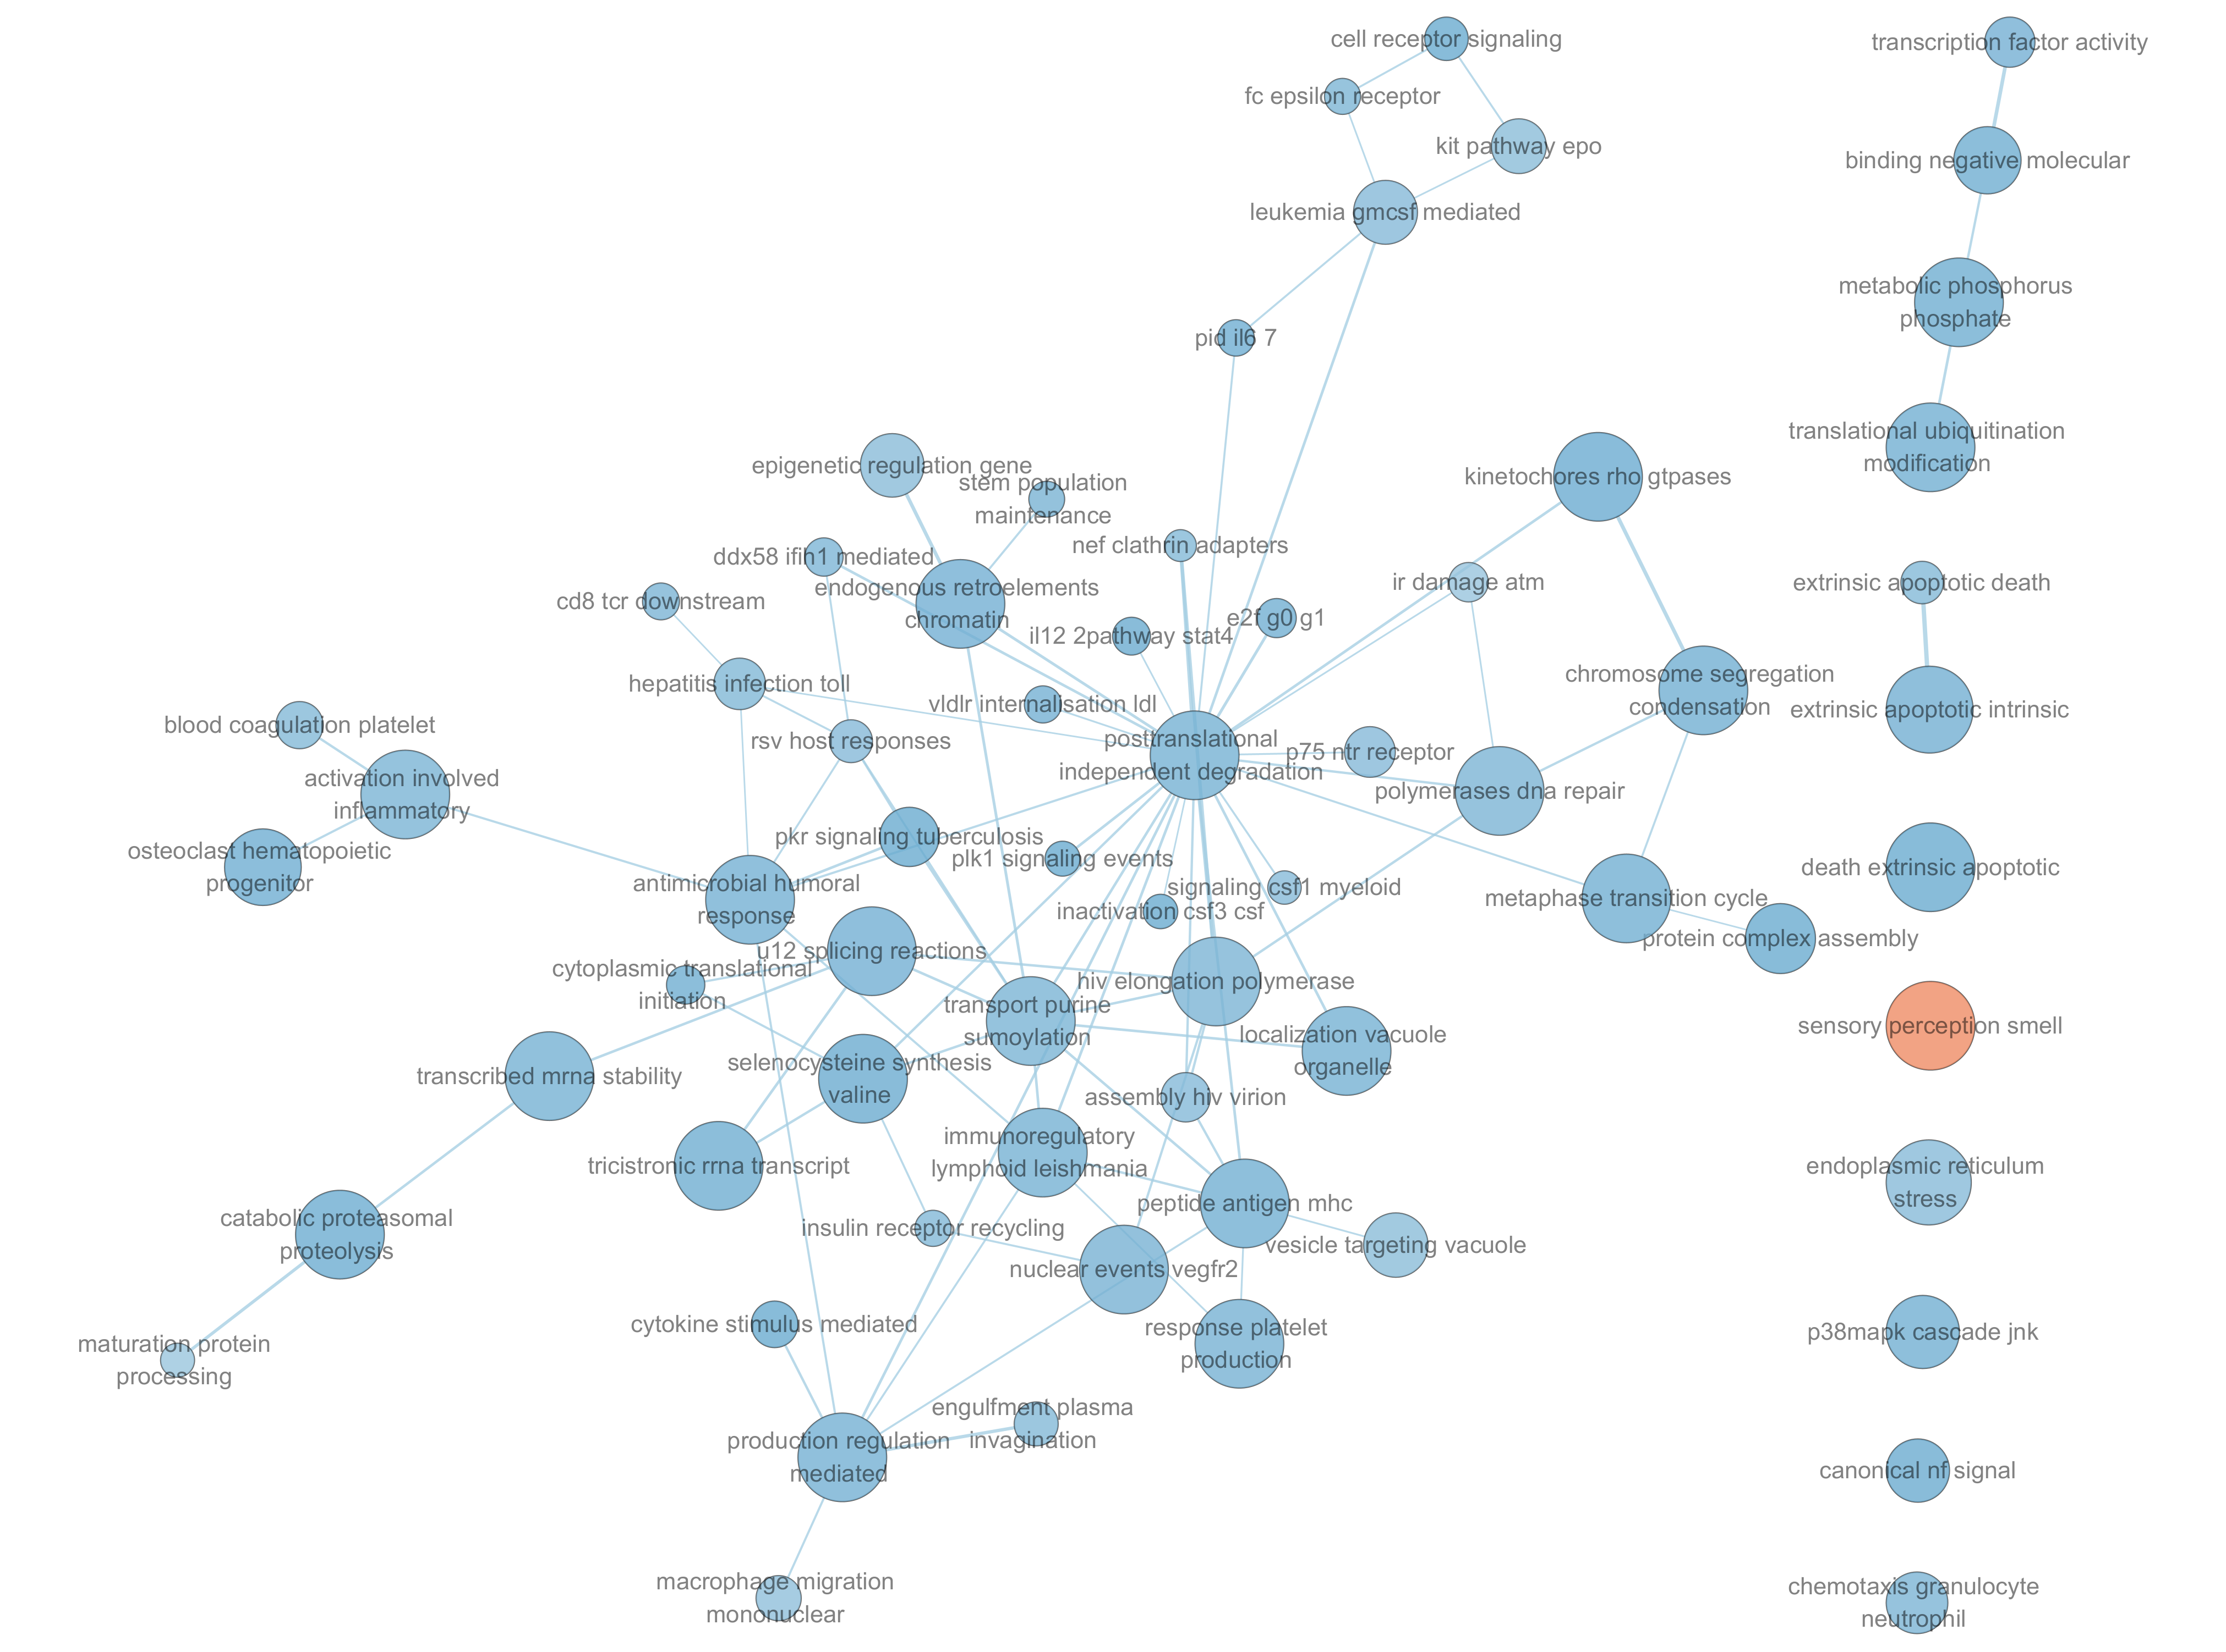
Network Visualization
:Up
:Down
Cytoscape v3.10.4 (Shannon et al, 2003)
EnrichmentMap v3.5.0 (Merico et al, 2010)
AutoAnnotate v1.5.2 (Reimand et al, 2019)
Node Cutoff (FDR q-value): 0.05
Edge Cutoff (Similarity): 0.375
Figure 12: Collapsed Theme network (Created using Cytoscape, v3.10.4)

Slide 13
Discussion
Known pathway/hallmark
TNF-α, NF-κB (Zhang et al, 2025, Longhi et al, 2013, Mettand et al, 2018)
Olfactory dysfunction (Liu et al, 2023, Luca et al, 2023, Xydakis et al, 2015)
Motile cilia impairment (Xing et al, 2022, Xiong et al, 2014, Gupta et al, 2024, Nelles & Hazrati, 2023)
Noval pathway
None
Study design
Weakly controlled variables (sex, age, time post injury)

Slide 14
Reference
Pivotal
Garza, Raquel, Yogita Sharma, Diahann A. M. Atacho, et al. 2023. “Single-Cell Transcriptomics of Human Traumatic Brain Injury Reveals Activation of Endogenous Retroviruses in Oligodendroglia.” Cell Reports 42 (11). https://doi.org/10.1016/j.celrep.2023.113395.
Hao, Yuhan, Tim Stuart, Madeline H. Kowalski, et al. 2024. “Dictionary Learning for Integrative, Multimodal and Scalable Single-Cell Analysis.” Nature Biotechnology 42 (2): 293–304. https://doi.org/10.1038/s41587-023-01767-y.
“Create Elegant Data Visualisations Using the Grammar of Graphics.” n.d. Accessed February 13, 2026. https://ggplot2.tidyverse.org/. Gprofiler2
Reimand, Jüri, Ruth Isserlin, Veronique Voisin, et al. 2019. “Pathway Enrichment Analysis and Visualization of Omics Data Using g:profiler, GSEA, Cytoscape and EnrichmentMap.” Nature Protocols 14 (2): 482–517. https://doi.org/10.1038/s41596-018-0103-9.
Shannon, Paul, Andrew Markiel, Owen Ozier, et al. 2003. “Cytoscape: A Software Environment for Integrated Models of Biomolecular Interaction Networks.” Genome Research 13 (11): 2498–504. https://doi.org/10.1101/gr.1239303.
Merico, Daniele, Ruth Isserlin, Oliver Stueker, Andrew Emili, and Gary D. Bader. 2010. “Enrichment Map: A Network-Based Method for Gene-Set Enrichment Visualization and Interpretation.” PLOS ONE 5 (11): e13984. https://doi.org/10.1371/journal.pone.0013984.
Exhaustive reference list
https://github.com/bcb420-2026/Jiaqi_Ma/blob/main/assignment_2/BCB420.bib

