Slide 1
Analysis of hILC RNA-seq data in patients of severe and mild dengue fever
Laeticia Liawas
BCB420 A3 Presentation
Mar 17 2026
Notes:
-Intro (Hi my name is …)

Slide 2
Introduction
Dengue virus remains a threat, especially tropical areas.
Infections can range in severity, from mild dengue fever (DF) to dengue haemorrhagic fever (DHF), and dengue shock syndrome which can be fatal.
Adaptive immune response has been characterized well, but studies on innate immune response are limited
This includes helper innate lymphoid cells (hILCs) which are akin to the helper T cells.

Slide 3
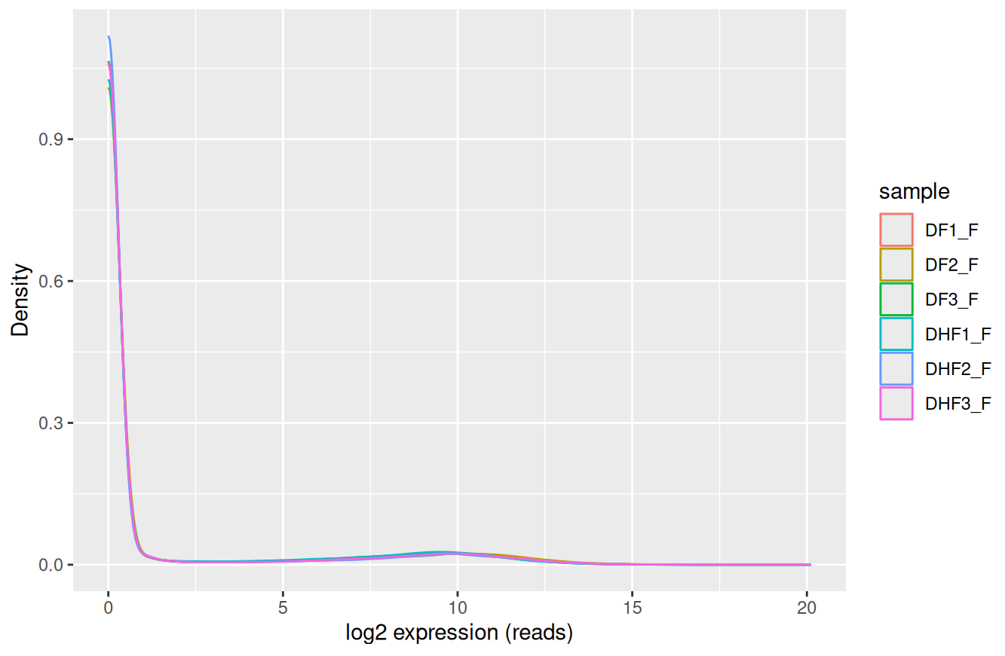
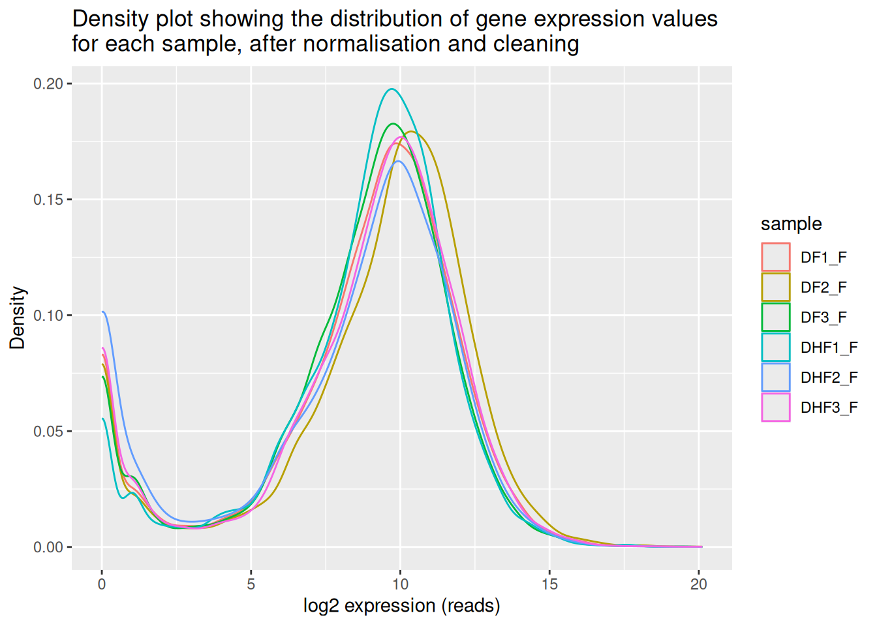
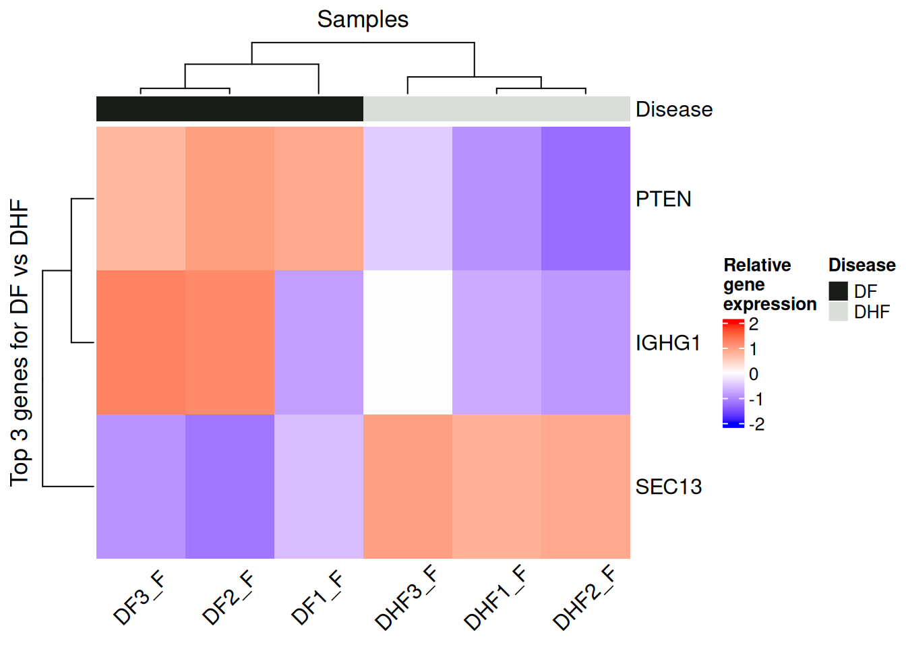
Introduction
Filtering low counts
TMM normalisation
(edgeR)
Bulk RNA-seq data of hILCs in patients in the febrile phase of the severe dengue haemorrhagic fever (DHF), or mild dengue fever (DF) (Poonpanichakul et al. (2021), GEO accession GSE155672).
Differential
expression
Analysis
(DHF vs DF)
- Scoring genes by logFC
Notes:
Clearly explains the biological question, dataset, and motivation; correct and concise
That’s why I chose to analyse a dataset of hILCs in patients at the earlier febrile or later convalescent phase, in two diff. severities of infection.

Slide 4

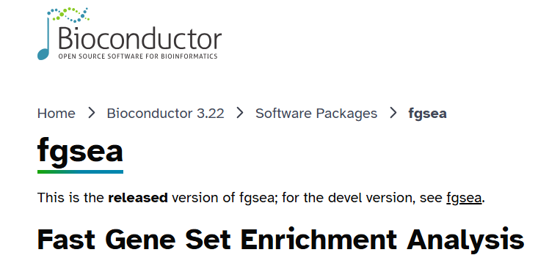


Enrichment analysis method
Gene list (ranked by logFC)
Pathway gene sets
(Bader Lab, March 02 2026 ver. )
fgsea_1.34.2
(Subramanian et al., 2005; Korotkevich et al., 2019)
Cytoscape version: 3.10.4
Enrichment Map version: v3.5.0
AutoAnnotate version: v1.5.2
(Shannon et al., 2003; Merico et al., 2010; Kucera et al., 2016)
Notes:
:Explains pipeline structure clearly Shows key code/steps reproducibly Justifies tools/packages
After differential expression analysis, I adapted the results into a gene list, ranked by logFC. Then, using the pathway gene sets provided by the Bader Lab I conducted a non-thresholded enrichment analysis using the fgsea biocond. Package. Chose because fast, and to be able to keep my working pipeline within R.
After, I used cytoscape, namely the enrichment map and auto annotate map apps, to visualise the results and easily view themes that may have been missed.

Slide 5
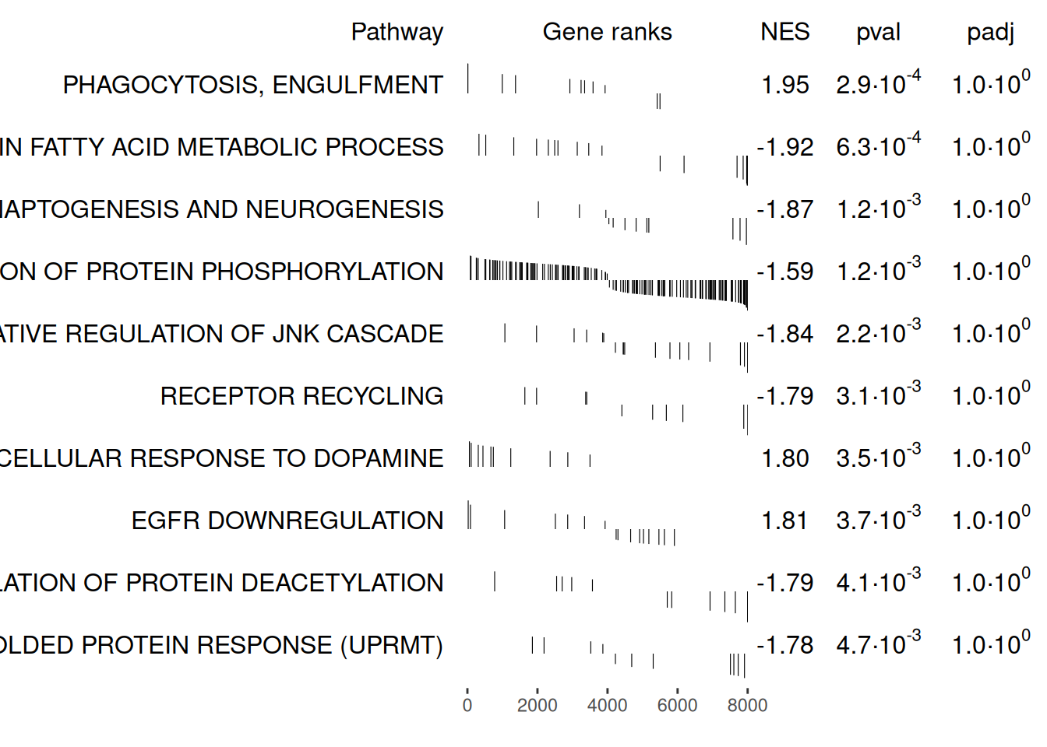
GSEA Results
Phagocytosis, engulfment and EGFR downregulation in upreg. genes
Among the top results (based on NES and p-value), most are enriched among downreg. genes
Notes:
Are conclusions supported by data?
From GSEA, found that all terms had a very high FDR
Still, based on the p-val, found that phagocytosis and egfr downregulation were enriched terms among UPREG. Genes in DHF. Corroborates with reported features of DHF, i.e. higher macrophage activity and vascularization
Many of the top terms were enriched in the downregulated genes, could be tht downregulation of certain genes and processes are correlated with the severity

Slide 6
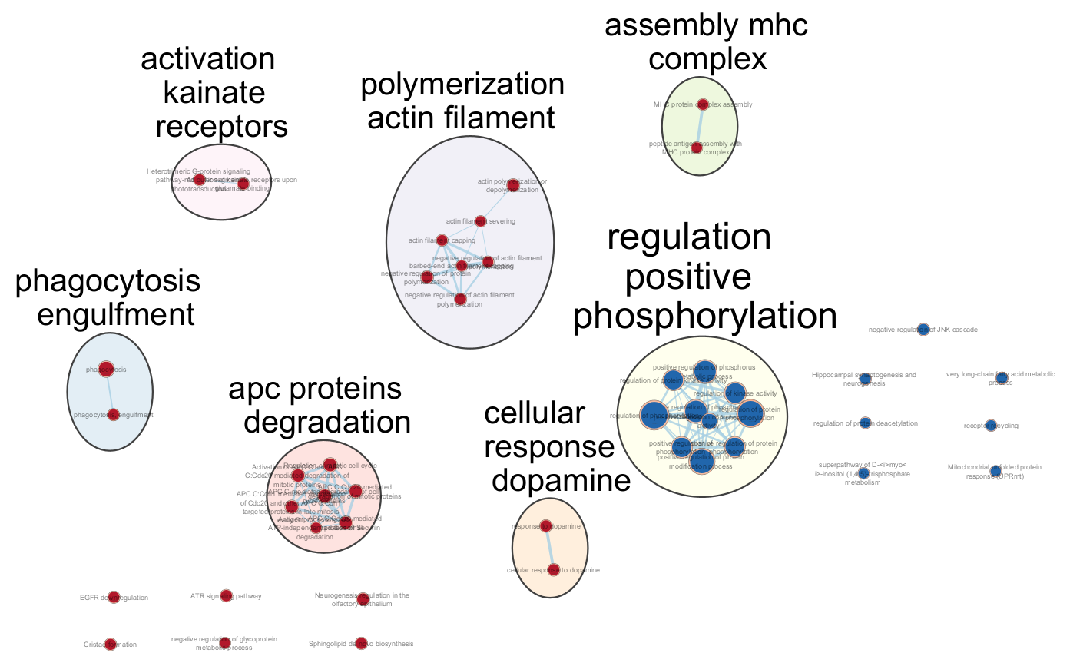

GSEA Results – Enrichment map
Less regulation in DHF hILCs than in DF
Macrophage activity
Assembly of MHC complex
Neurotransmitter-related
c
Notes:
Are conclusions supported by data?
By visualizing results in cytoscape using the enrichment map app, and grouping terms using auto annotate, found some themes in enriched terms,
Enrichment of terms related to positive phosphorylation in downreg genes: supported by the original authors findings that hILCs have looser regulation in more severe dengue infections.
Themes relating to macrophage activity and assembly of the MHC complex expected, given hILCs are involved in initiating the adaptive immune response.
Neurotransmitter-related themes were unexpected

Slide 7
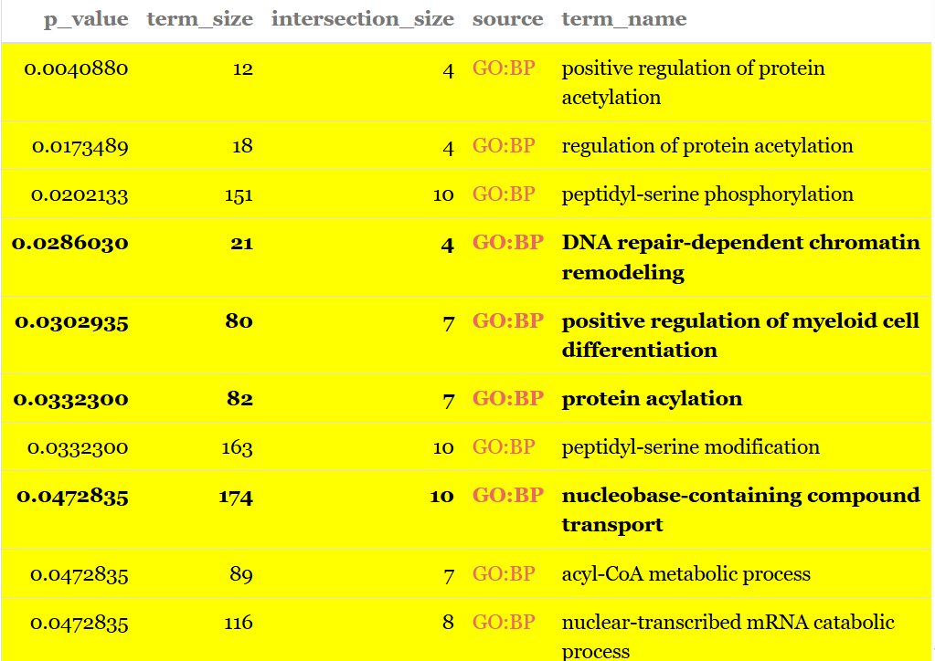
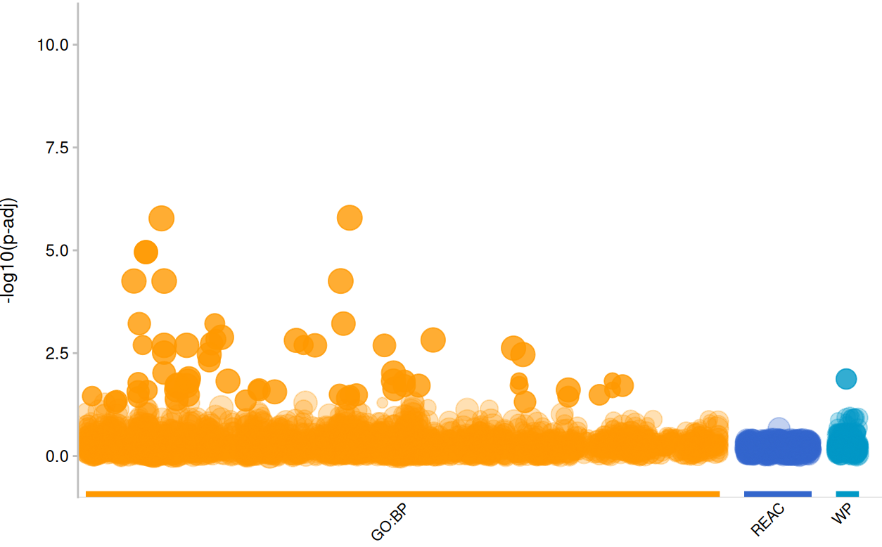
Comparison with ORA
Protein modifications
Protein transport
Regulation of differentiation
Notes:
Are conclusions supported by data?
Also conducted a thresholded gene set analysis, using g:profiler.
Most interesting results in my opinion were found when looking at only downregulated genes.
Certain themes were only significant when looking at downregulated genes, bolded here.
Found terms relating to themes like protein modification and transport, and regulation of differentiation downregulated in DHF.

Slide 8
Key insights – implications from results
Correlation between lower regulation in hILC activation and DENV infection severity.
Affirmation that hILCs play a role in different immune responses.
Synaptic transmission-related genes may also be involved.
However: high FDR – noisy data?
More samples, or could try different processing methods
Notes:
Correlation between lower regulation in hILC activation and DENV infection severity -> due to downregulation of protein modifications and transport
Affirmation that hILCs play a role in different immune responses increase in macrophage activity in DHF patients. – especially seen in enrichment of terms relating to adaptive immunity responses in upreg. Genes.
Gsea visualization results suggest involvement of synaptic transmission genes in the severity of dengue infection.

