Slide 1
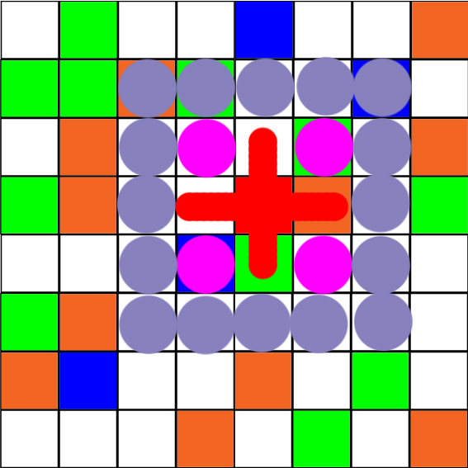
Epstein Modeling civil violence: An agent-based computational approach
Research question: How does terrorism affect the communal violence between two warring ethnic groups?
How long does it take until one group is eradicated
What happens, if we introduce deterrence to the agents and cops

Slide 2
