Slide 1
Team 1 - Quiet People
LG Security Specialist 2023

Slide 2
Agenda
Introduction
Requirement
Initial System Design
Threat modeling
Mitigations
Implementation
Documentation
Demo
Q & A

Slide 3
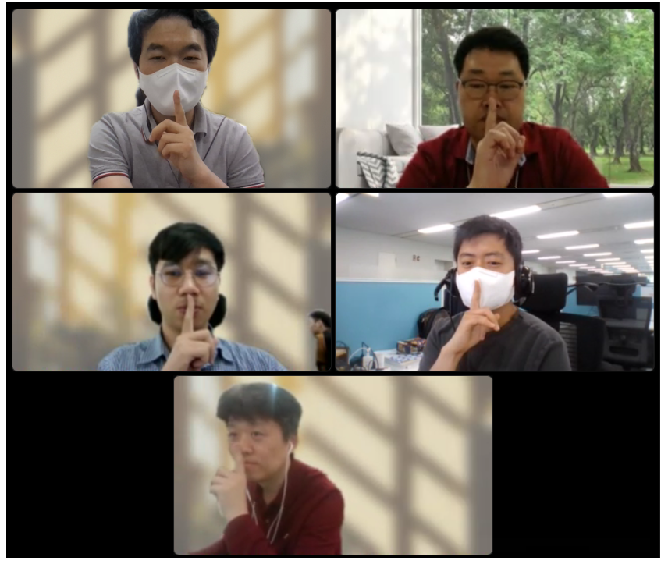
Introduction - Members
Jeeseung Jung (Photographer)
Truan Truong Phu Ho ( Learning Manager)
Byungchang Cha (Time Manager)
Kyungjun Shin (Team Leader)
Jeonghyen Lee (Launch Manager)
Client development
Crypto, Call implementation
Client development
UI,REST API I/F implementation
Server development
Web server implementation
Client development
Crypto, Call implementation
Server development
Web server implementation

Slide 4
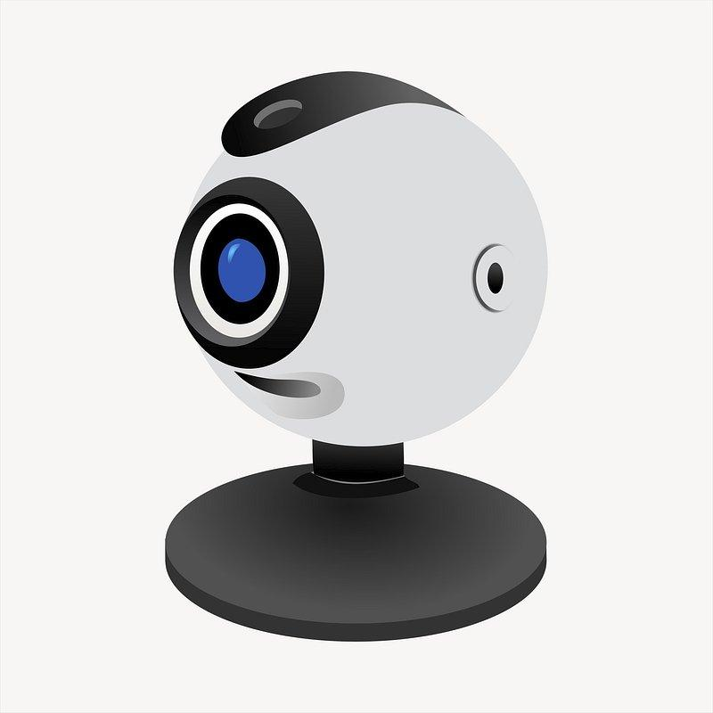





Introduction - Tartan Secure Video Call Application
Voice Communication: The App enables real-time voice communication over IP networks, allowing users to have voice conversations through their computers.
Network Compatibility: The App is compatible with IP networks, enabling communication between PCs connected to the Internet or local networks.
Call Management: The App provides basic call management functionalities, such as initiating and ending calls, accepting or declining incoming calls.

Slide 5
Requirements
Functional Requirements
User Registration:
Email address and secure password.
Two-factor authentication.
Password reset and recovery options.
Contact Management:
Unique contact identifiers for users.
Contact list with names and contact identifiers.
Call Functionality:
Initiate calls using contact identifiers or contact list.
Display call status and allow call termination.
Accept or reject incoming calls.
Missed call notification.
Call Handling:
Terminate calls at any time.
Display caller's contact identifier or name.
Foreground application during incoming calls.
Point-to-Point Communication:
Each endpoint functions as both a server and a client.

Slide 6
Requirements
Security Requirements
Performance:The system must deliver real-time video/audio for calls.
Authentication:Two-factor authentication is used for sign-on, and user credentials must be protected. Lost or compromised credentials must be handled appropriately.
Communication Privacy:Calls must remain private, preventing snooping or spying by intermediaries.
Proof of Identity (Nonrepudiation):Users should be confident in the identity of the entity they are communicating with during a call.
Reliability:The system ensures reliable calls, recovering from networking errors and dropped calls promptly while maintaining a secure and performant connection.

Slide 7

Initial System Design
Client 1
Client 2
Web Browser
Video Chat App.
4. Request Call State
5. Received Call State
Video Chat App.
Web Browser
Account Management GUI
- Create Account
- Change E-mail, Password,
- Login
- Server Start/Stop
- Connect/Disconnect
- Send/Receive Data via TCP/UDP
- Capture and display...
- Login
- Server Start/Stop
- Connect/Disconnect
- Send/Receive Data via TCP/UDP
- Capture and display...
Account Management GUI
- Create Account
- Change E-mail, Password
6. Send Video/Audio data to each other.
1.Create an account
2.Login with ID and PW
3.Get connect list
* Create an account and Login
with same method as Client 1
* Set server status to True to let other users know that Client2 can receive calls
Account Management Server
(Web Server)
Database for Login account (ID, Email , Passwords)
REST API for Video Chat App.

Slide 8
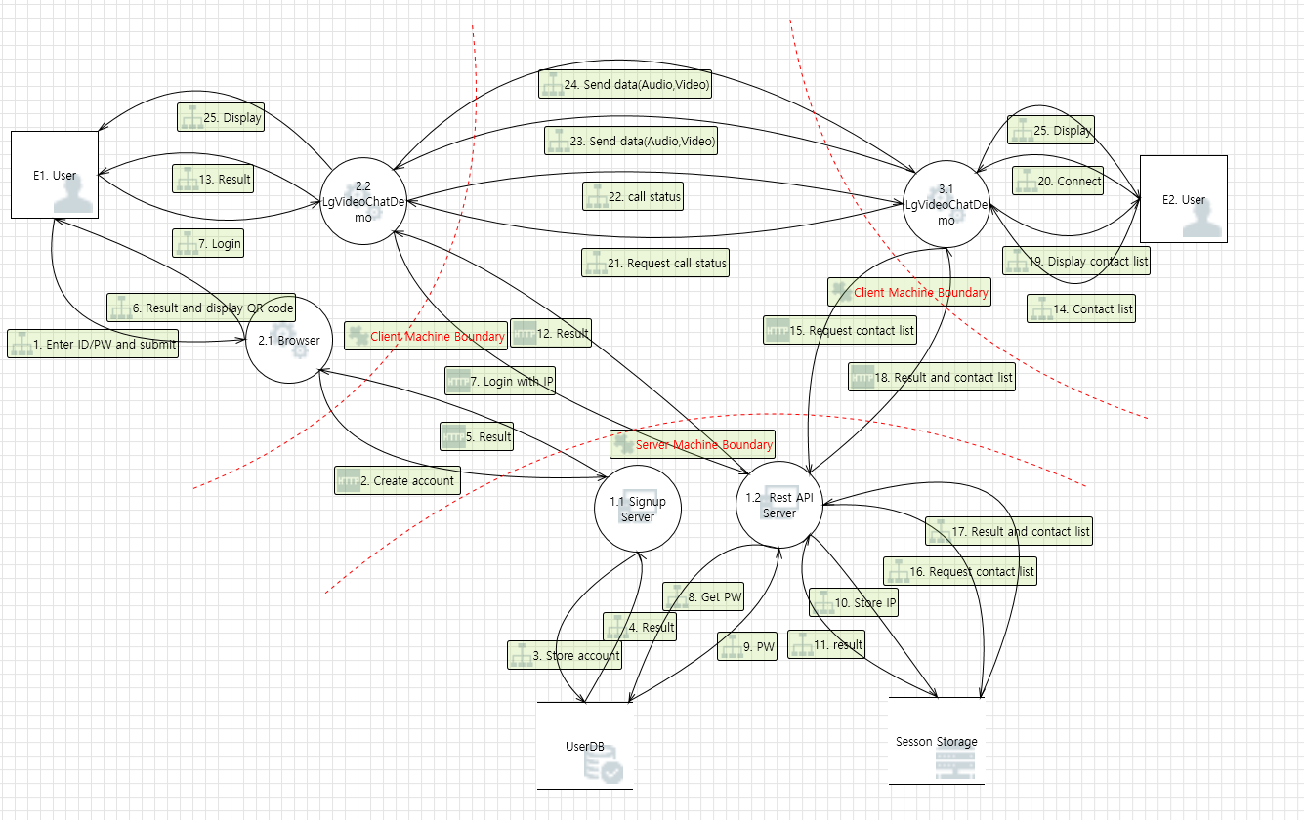
Threat Modeling

Slide 9
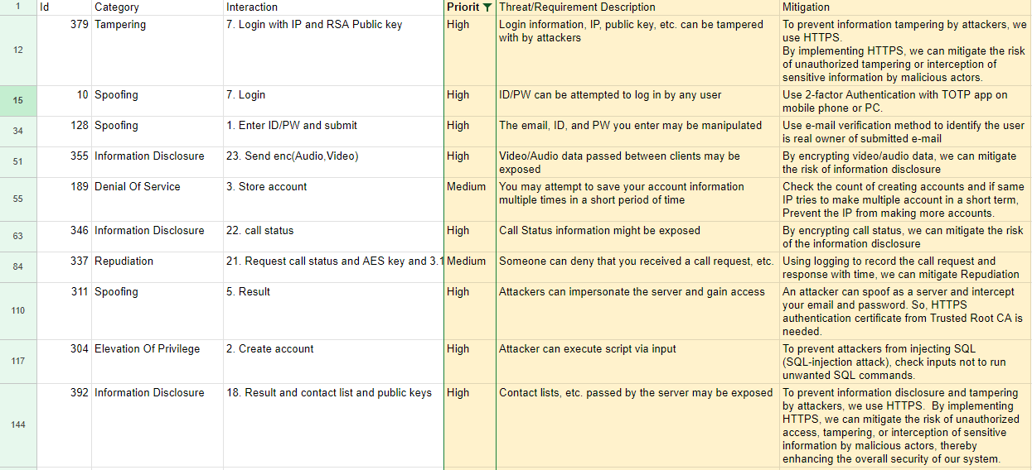
Mitigation
Select top 10 most important threats.

Slide 10
System Design after Mitigation
To ensure secure communication between the backend server and the client, HTTPS is implemented.
To secure communication between clients, RSA and AES encryption are applied.
2-factor authentication is implemented to enhance the security of the login process.
Input verification and count checking are applied to prevent SQL injection and DoS attacks.

Slide 11

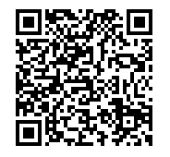
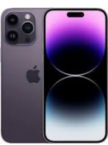
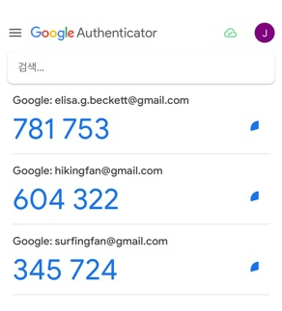
Client 1
Client 2
7. Send Client1’s hash ID encrypted by Client2’s RSA public key
9. Send Client2’s AES key encrypted by Client1’s RSA public key
10. Send video/audio data encrypted by Client2’s AES key to each other
Web Browser
Video Chat App.
Video Chat App.
Web Browser
Account Management GUI
- Create Account
- Change E-mail, Password, …
- Show QR Code
- Generate keys - RSA public key - RSA private key
- AES key
- Encrypt/Decrypt data
- Send/Receive Data via TCP/UDP
- Capture and display...
- Generate keys - RSA public key - RSA private key
- AES key
- Encrypt/Decrypt data
- Send/Receive Data via TCP/UDP
- Capture and display...
Account Management GUI
- Create Account
- Change E-mail, Password, …
- Show QR Code
Create an account with 2FA (Google OTP with client’s smartphones)
2.Login with 2FA method
3.Register Client 1’s Public Key
6. Get available contacts list (Client hash ID, IP addr., Public key, …)
5. Set server for contact list in AMS
8. Check peer with Client1’s hash ID And get Client1’s Public key
Account Management Server
(Web Server)
HTTPS enabled (Self-signed cert. while development)
Database for Login account (Passwords are encrypted)
Render QR Code for 2FA
REST API for Video Chat App.
4. Create an account and Login
with same method as Client 1

Slide 12
Client1
(VoIP Client)
Server
with SSL
Client2
(VoIP Server)
Login Information
- ID
- Password
- RSA Public Key
- IP Address
Generate RSA Keys
(Public/Private)
REST API(/api/login, Login Info.)
Generate RSA Keys
(Public/Private)
REST API(/api/login, Login Info.)
REST API(/api/set_server)
REST API(/api/contacts)
Send result
Send client list
Send ‘Call’ Protocol(Client1’s hash ID) to Client 2 (encrypted with Client 2’s public key)
Check Client 1’s Information (Hash ID) Accept the call
Check Client 1’s Information (Hash ID) In the login list
And return info and key
REST API(/api/check_peer with Client1’s hash ID)
Decrypt encrypted Client2’s AES key using Client1 private key
Send Client1’s info and public key
Encrypt Client2’s AES key with Client1’s public keyl
Send AES key (encrypted with Client 1’s public key)
Decrypt received video/audio data using Client2’s AES key
loop
Send encrypt video/audio data (TCP/UDP)
Encrypt video/audio data using Client2’s AES key
Send encrypt video/audio data (TCP/UDP)
Encrypt video/audio data using Client2’s AES key
Decrypt received video/audio data using Client2’s AES key

Slide 13
System Design - Key management
Every time a login occurs, RSA public/private keys are generated.
The RSA public key is transferred to and managed by the server.
Only clients registered on the server can obtain the public key of the other client.
For each call, an AES key is generated.
The AES key is encrypted by the receiving client using the public key received from the server, ensuring that it is the intended client registered on the server.
The RSA private key is managed exclusively within the client, and the public key is only transmitted through the server.
All keys are not stored as files.
C2 AES Key encrypted by C1 Pub key
Client1
Generate RSA Pub/Priv Key(login)
Generate AES Key(call)
Keep in memory of process
Account Management Server
(Web Server)
Client2
Generate RSA Pub/Priv Key(login)
Generate AES Key(call)
Keep in memory of process
C1 Pub key
(login)
C2 Pub key
(login)
C2 Pub key
(connect)
C1 Pub key
(check peer)

Slide 14
Implementation
Chat App.
Based on Sample program (C++)
Library - Supply chain analysis
Login, Connect/Disconnect, Start/Stop Server, Missed Call
When trying to connect
Communication between Login Server, Chat App use Cpprestsdk and OpenSSL
Communication between other Chat App, Chat App use crypto api of OpenSSL

Slide 15
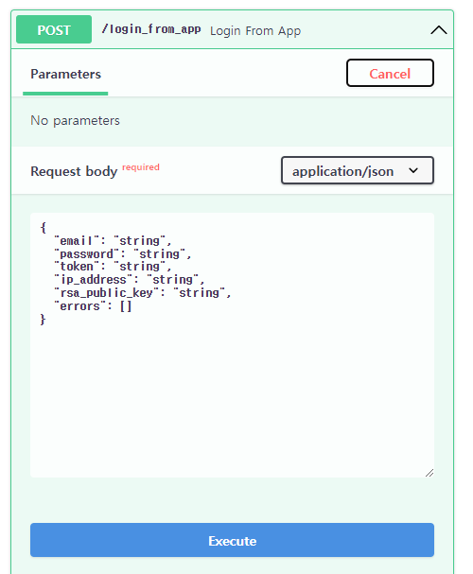
Implementation
Login Server
Based on Python with FastAPI (Reference: https://github.com/vinodiOS/two-factor-auth-FastAPI)
Sign up, Change/Reset password is web based application
Communication between Chat App. and Login server is based on REST API
Library - requirements.txt
REST API
Video Call App. call REST API for following functions
FastAPI framework provides test case GUI
login_from_app | Log in with email, password, TOTP
contacts | Get contact who are logged in
set_server | Set status information to let other users know that the user is available to receive calls
check_peer | Based on unique user id, get information of the user.

Slide 16
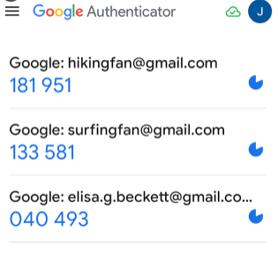
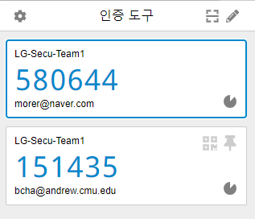
Implementation
Login Server
HTTPS enabled
Self-signed certificate is used due to budget issue.
REST API is encrypted
Password is saved as hashed value
Two Factor Authentication using TOTP (Time-based one-time password)
Google Authenticator or Chrome Authentication tool can be used.
Verification email is sent via temporary gmail account.

Slide 17
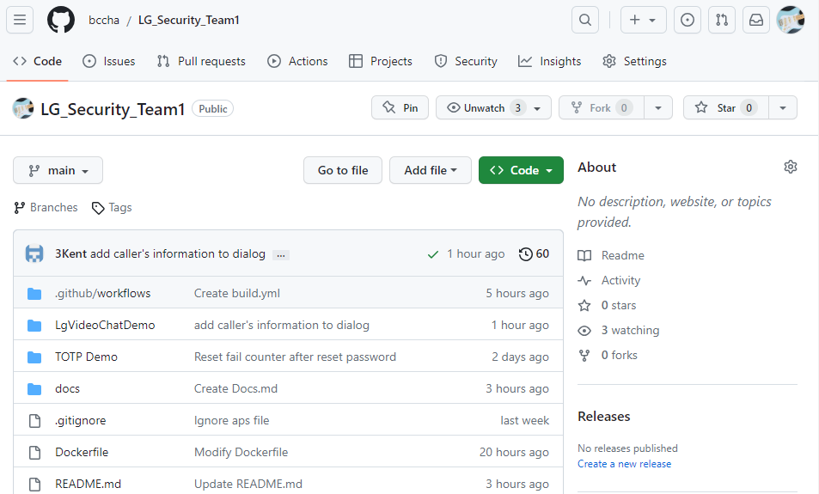
Source code management
Source code of both Chat app. and Login server is on GitHub
https://github.com/bccha/LG_Security_Team1

Slide 18
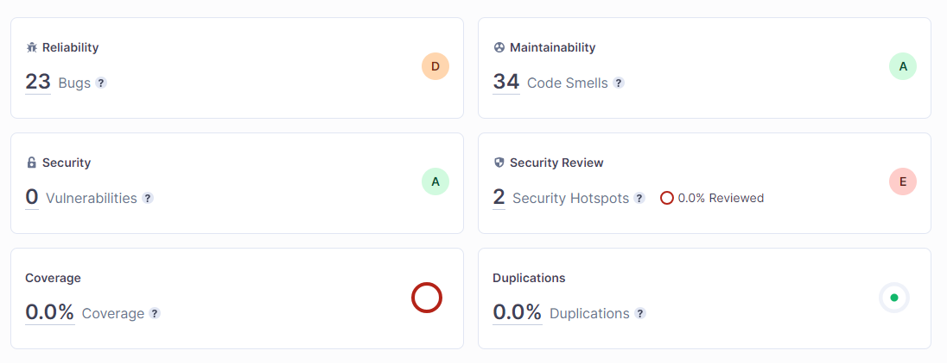
Static Analysis by SonarCloud on GitHub
Static Analysis on Python Login Server
23 bugs, 34 Code Smells, 2 Security Hotspots are found and will be fixed.

Slide 19
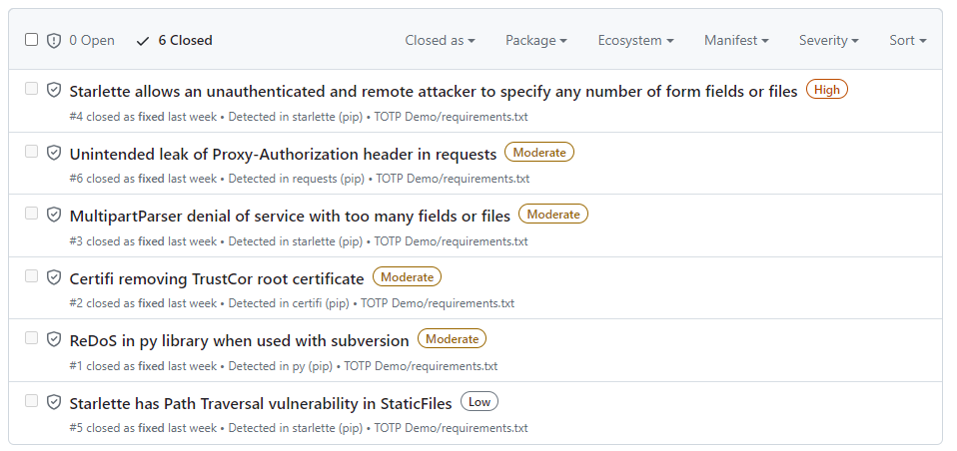
Secure DevOps on GitHub
Supply Chain Risk Analysis reported by GitHub
‘Dependabot’ checks vulnerabilities in library used.
Automatically resolves them by submit ‘Pull-request’ which upgrades the version of the libraries

Slide 20
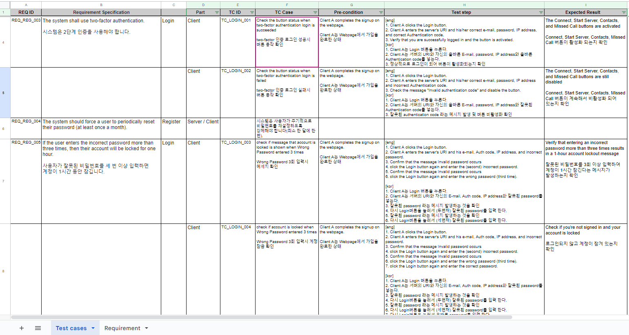
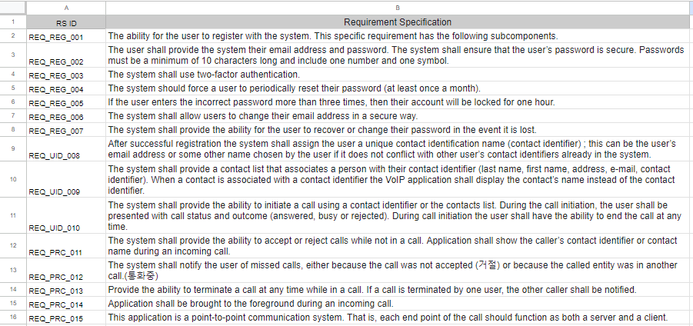
Documentation - Test Case
Indexing the requirements and using them as a foundation for creating test cases.

Slide 21
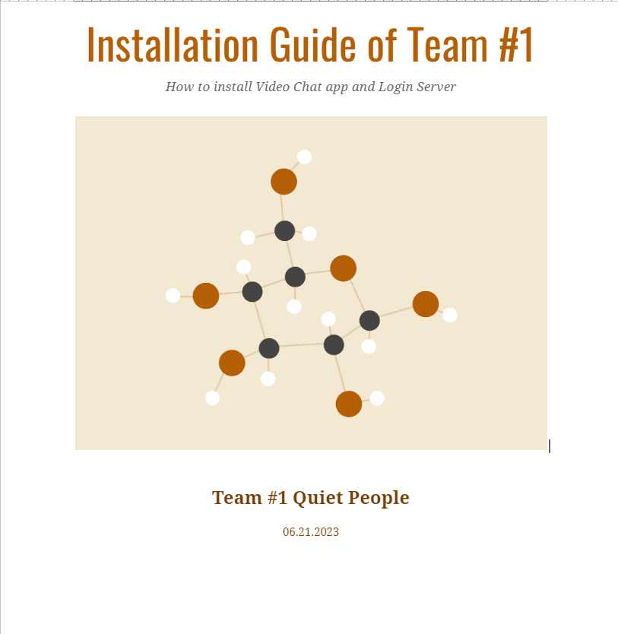
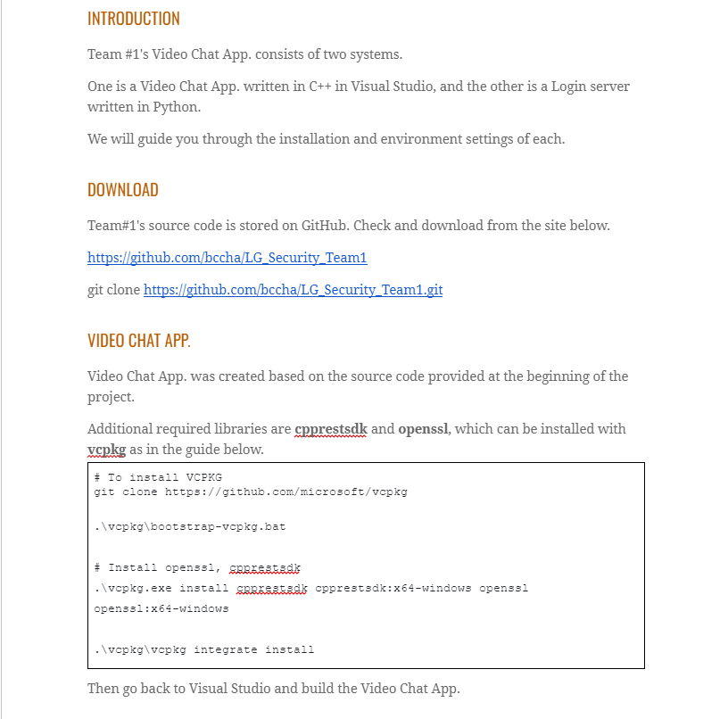
Documentation - Installation Guide
Documenting a guide on how to install and build the program

Slide 22
Demo
https://youtu.be/_a4pD-4QljE

Slide 23
Q & A

