Slide 1

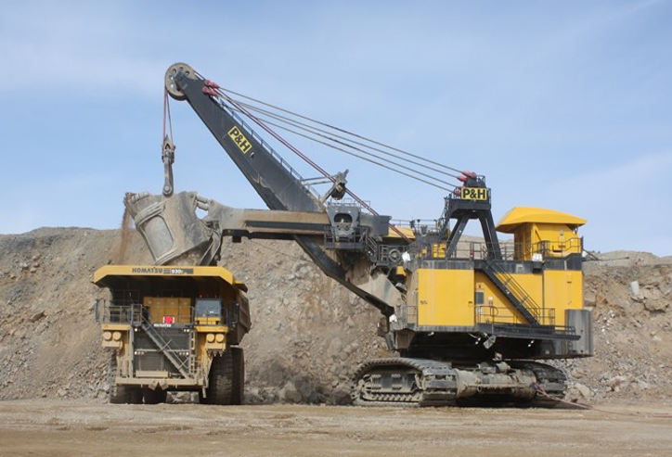
Innovation challenge:
Using data to proactively predict Equipment Failure prior to the actual failure event occurs by using equipment production, maintenance & alerts information.
Challenge Description:
Equipment downtime is the time a piece of equipment is taken out of service for planned or unplanned maintenance work. While downtime is costly in general, unplanned downtime can cost up to seven times more than planned downtime and is disruptive to the production cycle due to its unpredictability. For this reason, it is the business goal to better predict and reduce equipment unplanned downtime.
Marigold currently collects equipment usage and production information in real time via the Modular Dispatch ® system and equipment sensors, performance and alerts via the Modular Minecare® system. The Maintenance Work order history is stored in the eMaint CMMS (Computerised Maintenance Management System). There is an opportunity to derive meaningful trends and correlations from this data via these systems to predict and reduce unplanned equipment downtime.
User Story
Marigold is currently operating a fleet of 21 haul trucks (320 tons class), 2 hydraulic shovels and one electric shovel. The mine is currently experiencing higher than desired unplanned equipment downtime, which negatively impacts the ability to meet cost effective production targets. In many cases, the mine is unable to predict when, where and why a component on a piece of equipment will fail, leading to high unplanned downtime and low % unit availability. While a high amount of equipment information is gathered, the mine neither has the ability nor resource to analyze the information collected via Minecare, Dispatch and eMaint for predictive decision making.
There is an opportunity to use all the equipment information collected to predict when a piece of equipment is starting to fail. This would allow maintenance crews adequate time to react and take units out of service before failure occurs. The result of this work will create a more data-driven and controlled maintenance environment and help achieve production targets.
Relevant Data
Data will include a data dictionary and relations map
The dataset covers 12 months’ (May 2017 – Apr. 2018) worth of equipment identifiers, time profiles, production, performance, alarms and work order history. The 3 systems used are:
Dispatch: This dataset contains haul truck production summary (Equipment IDs, Tons moved, distance traveled and cycle time) and equipment time profile (operative, delays, downtime, idle time, and standby) along with downtime reasons and comments
Minecare: This data set contains haul truck sensors data, alarms and alerts history
eMaint: Maintenance Work order history which includes work order time, downtime type, work type, equipment and components and parts usage.

Slide 2
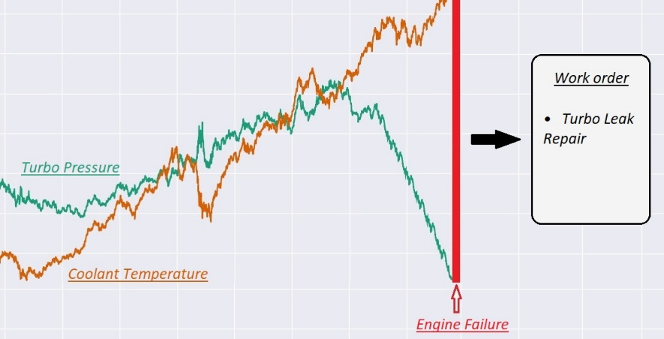
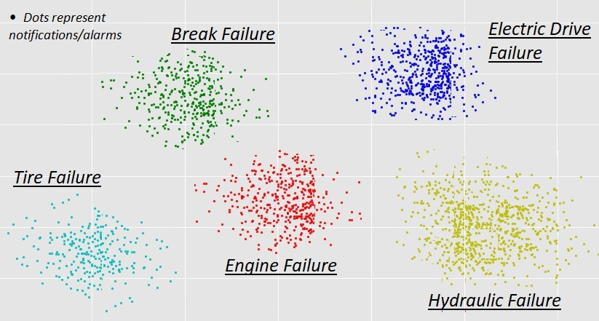
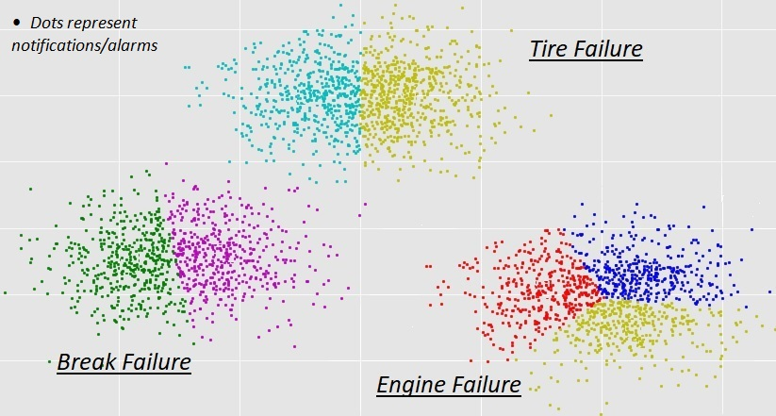
Potential Areas to consider:
Predict the failure type and the specific parts need to be repaired.
Cluster the notifications / alarms to match with the equipment failures.
Single notification / alarm causes the failure event. (One to one mapping)
Multiple notifications / alarms together cause a failure event. (Multiple to one mapping)
Predict how many hours / days before a specific part of the truck fails.

