Slide 1
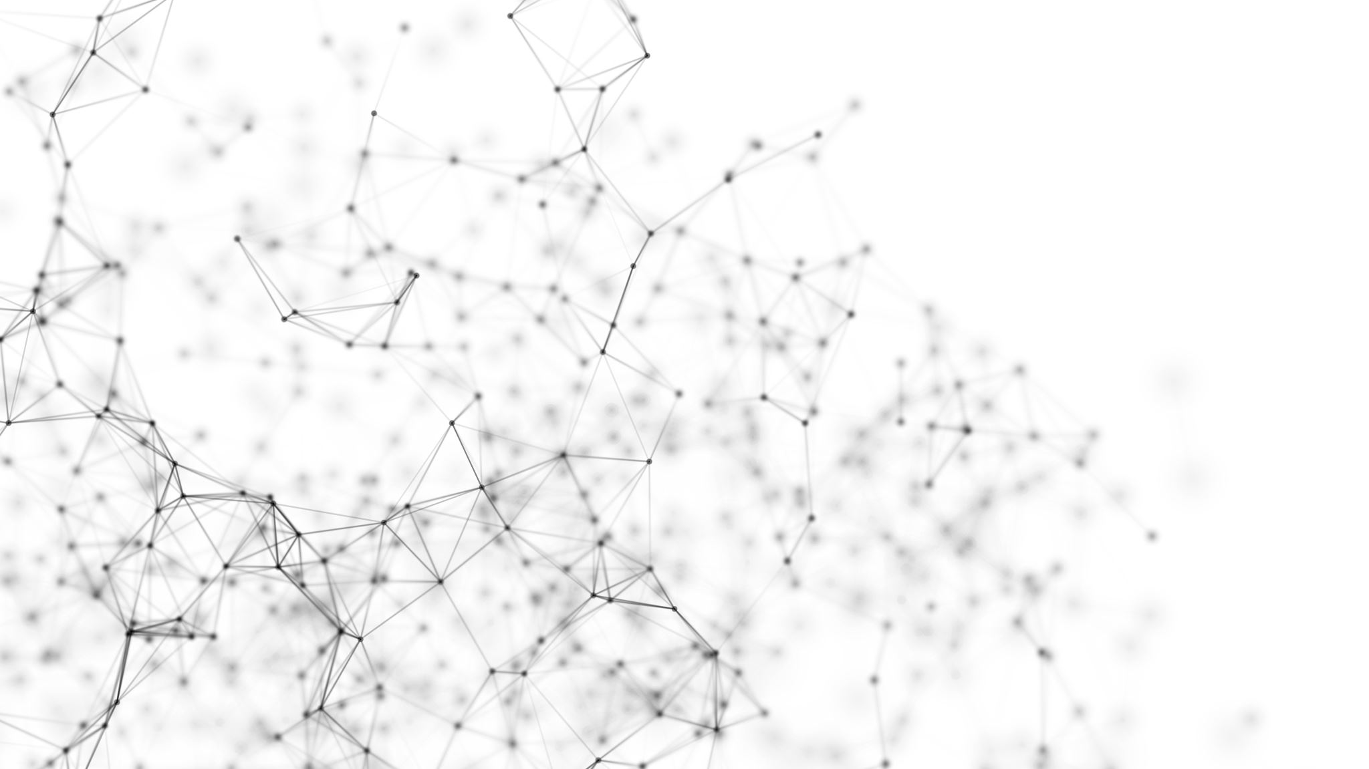
Classifying MRI Images with Alzheimer’s Disease Using Machine Learning in Apache Spark and GCP

Slide 2
What is Alzheimer’s Disease?
A progressive neuro-degenerative disorder that affects memory and thinking skills
The most common cause of dementia among older adults and the seventh leading cause of death in the world
Symptoms include memory problems, affected speech and reasoning, and confusion

Slide 3
Literature Review
Study: Alzheimer's Disease and Dementia Detection from 3D Brain MRI Data Using Deep Convolutional Neural Networks, 2018
Data: 3D MRI Images
Models: Deep CNN
Results: Accuracy of 80%

Slide 4
Literature Review
Study: Binary Classification of Alzheimer's disease using MRI images and Support Vector Machine, 2021
Data: MRI images
Models: Support Vector Machine
Results: Accuracy of 84%

Slide 5
Literature Review
Study: Alzheimer’s Disease Detection from Brain MRI Data using Deep Learning Techniques, 2021
Data: MRI images
Models: DenseNet121, MobileNet, Xception, Inception-V3
Results: Accuracy of 91% with DenseNet121

Slide 6
Project Overview
Images
Apache Spark
GCP
Use Apache Spark SVM, compare local vs. in DataProc
Use TensorFlow CNN, compare local vs. in GCP
Preprocess
Preprocess
Feature Data
Feature Data
Model
Model
Compare

Slide 7
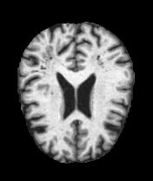
Kaggle Dataset
https://www.kaggle.com/datasets/tourist55/alzheimers-dataset-4-class-of-images
6400 images
3200 dementia-negative
3200 dementia-positive
Notes:
https://www.oasis-brains.org/#data

Slide 8
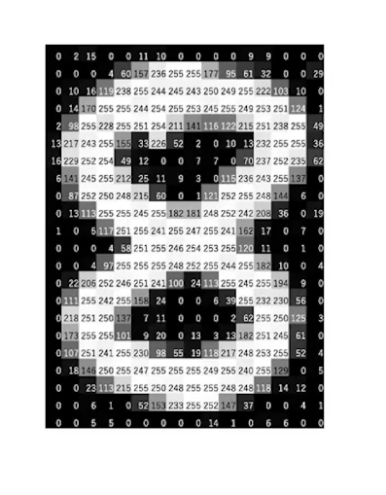
Image Processing
Image stored as bytes
Each pixel consists of 1 byte (8 bits) for a black-and-white image
8 bits represents 2⁸ = 256 tonal levels (Black 0 – White 255)
Hexadecimal -> Decimal 00 = 0 ff = 255

Slide 9
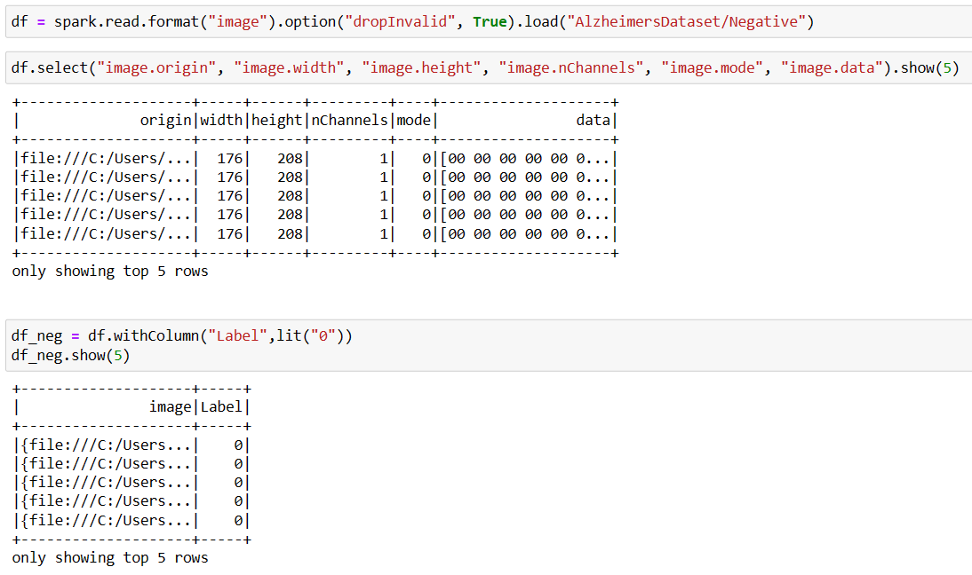
Loading Images in Apache Spark
df = spark.read.format("image")
Origin: file path
Width, Height, nChannels
Mode
Data: Image bytes
Label: 0 or 1
https://spark.apache.org/docs/latest/ml-datasource.html
Notes:
https://towardsdatascience.com/deep-learning-with-apache-spark-part-2-2a2938a36d35

Slide 10
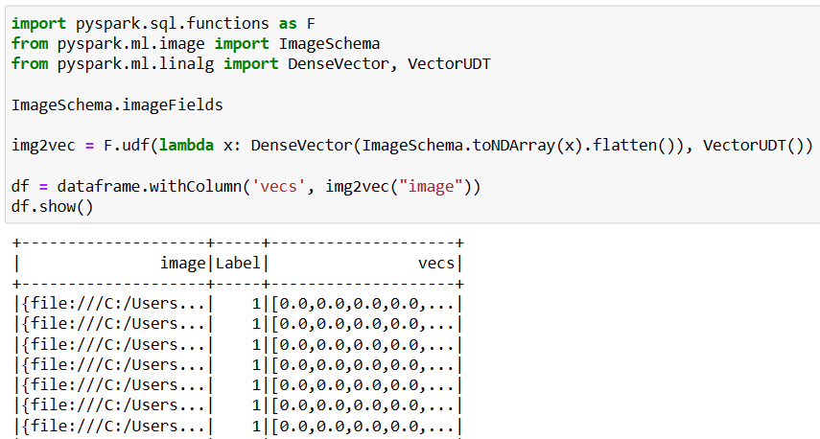
Image to vector
ImageSchema
Convert to n-dimensional array
Flatten
Vector of pixel features
Notes:
https://towardsdatascience.com/deep-learning-with-apache-spark-part-2-2a2938a36d35

Slide 11
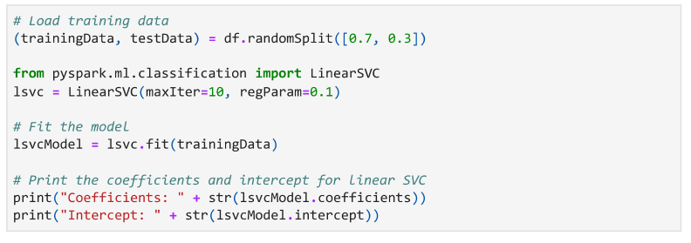
Spark MLlib SVM Model
Notes:
https://towardsdatascience.com/deep-learning-with-apache-spark-part-2-2a2938a36d35

Slide 12
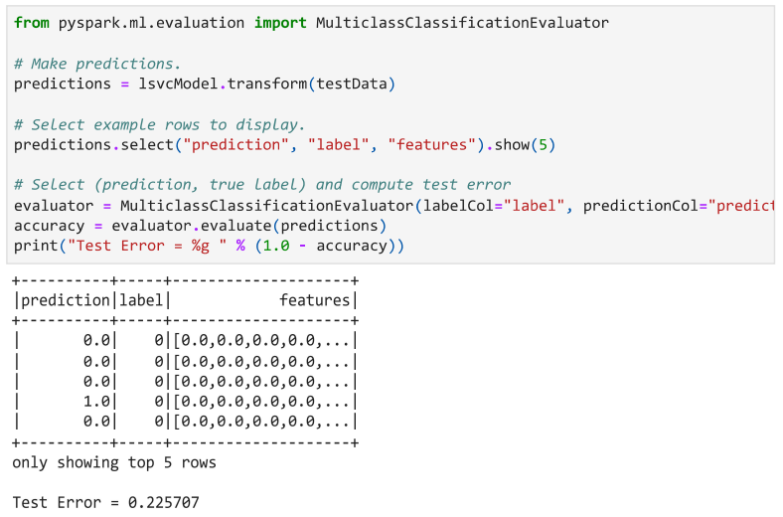
Spark MLlib SVM Model Results
Notes:
https://towardsdatascience.com/deep-learning-with-apache-spark-part-2-2a2938a36d35

Slide 13
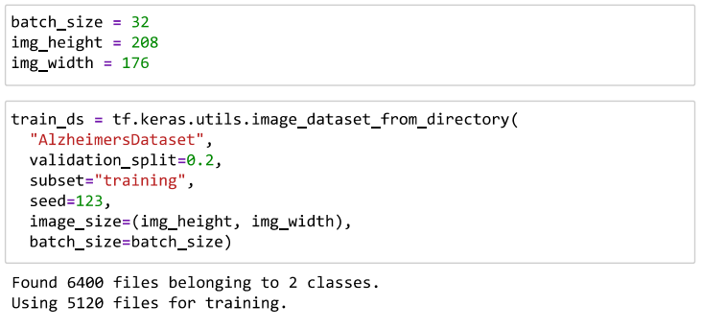
TensorFlow Image Loading
Notes:
https://towardsdatascience.com/deep-learning-with-apache-spark-part-2-2a2938a36d35

Slide 14
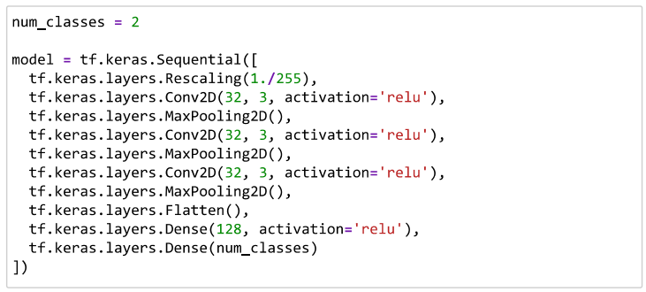
TensorFlow CNN Model
Notes:
https://towardsdatascience.com/deep-learning-with-apache-spark-part-2-2a2938a36d35

Slide 15
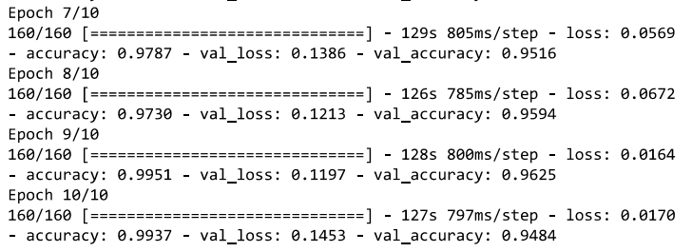
TensorFlow CNN Model Results
After 10 epochs of training: 94.84% validation accuracy
Notes:
https://towardsdatascience.com/deep-learning-with-apache-spark-part-2-2a2938a36d35

Slide 16
References
D. Chaihtra and S. Vijaya Shetty, "Alzheimer’s Disease Detection from Brain MRI Data using Deep Learning Techniques," 2021 2nd Global Conference for Advancement in Technology (GCAT), Bangalore, India, 2021, pp. 1-5, doi: 10.1109/GCAT52182.2021.9587756.
H. M. T. Ullah, Z. Onik, R. Islam and D. Nandi, "Alzheimer’s Disease and Dementia Detection from 3D Brain MRI Data Using Deep Convolutional Neural Networks," 2018 3rd International Conference for Convergence in Technology (I2CT), Pune, India, 2018, pp. 1-3, doi:10.1109/I2CT.2018.8529808.
Uma R. K, Sharvari S. S, Umesh M. G and Vinay B. C, "Binary Classification of Alzheimer’s disease using MRI images and Support Vector Machine," 2021 IEEE Mysore Sub Section International Conference (MysuruCon), Hassan, India, 2021, pp. 423-426, doi: 10.1109/MysuruCon52639.2021.9641661.

Slide 17
References
https://godatadriven.com/blog/real-distributed-image-processing-with-apache-spark/

