Slide 1
Binary Classification of MRI Images with Alzheimer’s Disease
Bailie Delpire

Slide 2
Alzheimer’s Disease
Progressive neuro-degenerative disorder
Affects memory and thinking skills
Most common cause of dementia among older adults
Seventh leading cause of death in the world
No cure
Early detection and treatment can improve quality of life
Notes:
MRI images are used to support an Alzheimer’s diagnosis and rule out other causes for the symptoms
Machine Learning has been shown effective at classifying the early stages of Alzheimer’s

Slide 3
Motivations
MRI scans are used to support an Alzheimer’s diagnosis and rule out other causes for the symptoms
Machine Learning has been shown effective at classifying the early stages of Alzheimer’s in MRI scans

Slide 4
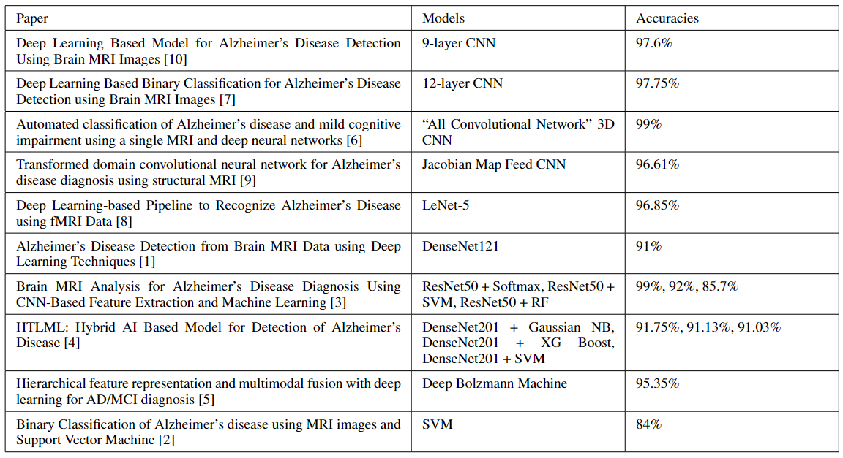
Background
Notes:
Most papers use CNN’s and state-of-the art models, which often use CNNs.
1&2: use basic CNN models that have blocks of convolutional layers and pooling layers
3: an all convolutional network CNN model uses more convolutional layers in place of pooling layers
4: processes data through a jacobian map before passing to a cnn
5: LeNet is a small CNN architecture, but it was trained on 270,000 images and tested on 90,000
6: state of the art densenet model
7 & 8: state of the art resnet or densenet for Feature extraction, other models for classification
9&10: non-cnn models

Slide 5
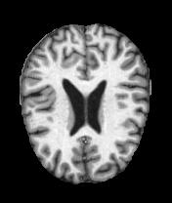
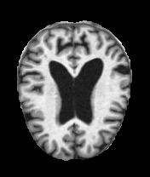
Dataset
https://www.kaggle.com/datasets/tourist55/alzheimers-dataset-4-class-of-images
6400 images
3200 Alzheimer’s Diagnosis (Very mild to moderate)
3200 Controls
Control
Positive

Slide 6
Methods
Image loading and preprocessing
CNN Model
Hybrid Models: VGG16, DenseNet121, ResNet50 as feature extractors, XGBoost, SVM as classifiers
Google Cloud’s Vertex AI
Principal Component Analysis
Apache Spark Machine Learning Library

Slide 7
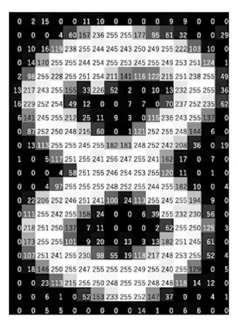
Image Preprocessing
Image stored as bytes
Each pixel consists of 1 byte (8 bits) for a black-and-white image
8 bits represents 2⁸ = 256 tonal levels (Black 0 – White 255)

Slide 8
Image Preprocessing
from tensorflow.keras.preprocessing import image
def grab_image(img_path):
img = image.load_img(img_path,
color_mode="grayscale",
target_size=(208, 176))
x = image.img_to_array(img)
x = np.expand_dims(x, axis=0)
x = preprocess_input(x)
return x
Notes:
Img_to_array: Converts a PIL Image instance to a Numpy array
Preprocess_input: scales pixel values between -1 and 1

Slide 9
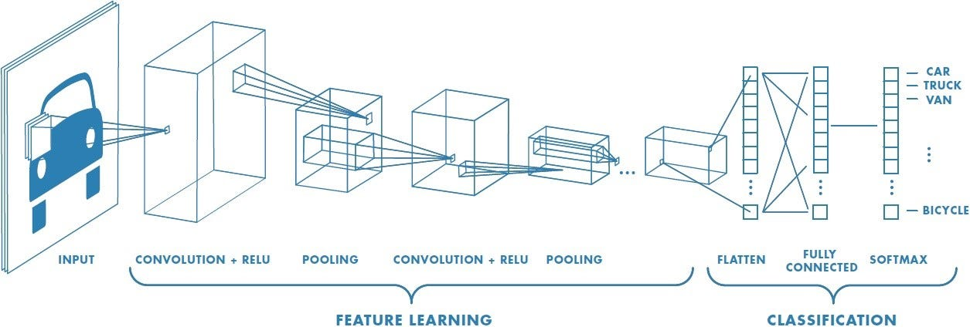
CNN
2-dimensional input data
Capture the spatial relationship between features

Slide 10
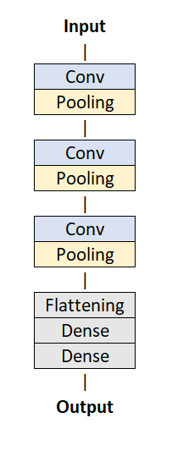
CNN Architecture
Three convolution layers
32 filters
Kernel-size of 3
Relu activation function
Intermediate pooling layers
Final flattening and dense output layer

Slide 11
CNN Training and Testing
80/20 Split
5-fold Cross Validation
10 epochs
Batch size of 32

Slide 12
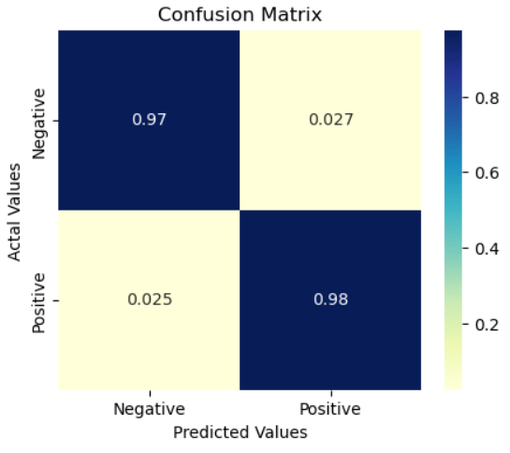
CNN Results
Accuracy | 97.44%
Precision | 97.29%
Recall | 97.51%
F1 | 97.40%

Slide 13
Hybrid Models
Feature Extraction:
VGG16
ResNet50
DenseNet121
Classification
SVM
XGBoost

Slide 14
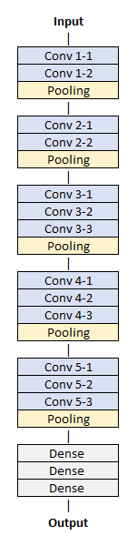
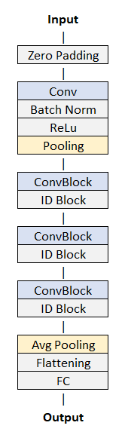
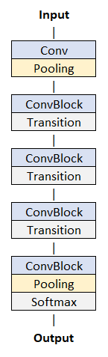
Architectures
VGG16
ResNet50
DenseNet121

Slide 15
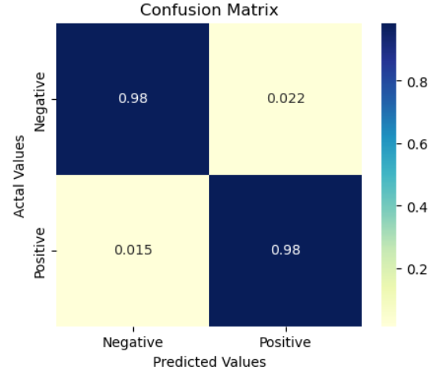
VGG16 + SVM
Polynomial kernel of degree 3
Regularization parameter C=100
Accuracy | 98.16%
Precision | 97.80%
Recall | 98.49%
F1 | 98.15%

Slide 16
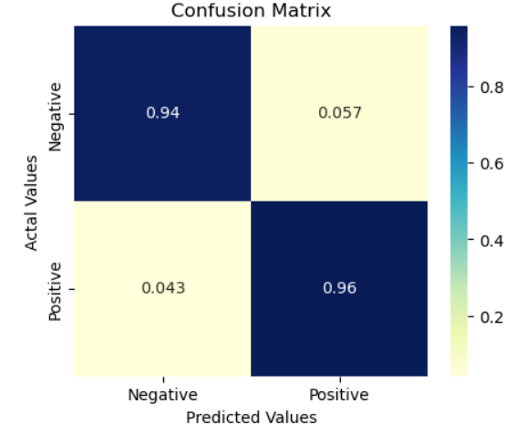
ResNet50 + XGBoost
CM
Accuracy | 95%
Precision | 94.28%
Recall | 95.71%
F1 | 94.99%

Slide 17

DenseNet121 + SVM
Polynomial kernel of degree 3
Regularization parameter C=100
Accuracy | 96.88%
Precision | 97.00%
Recall | 96.81%
F1 | 96.90%

Slide 18
Comparison
CNN
VGG16+SVM
DenseNet121+SVM
ResNet50+XGBoost

Slide 19
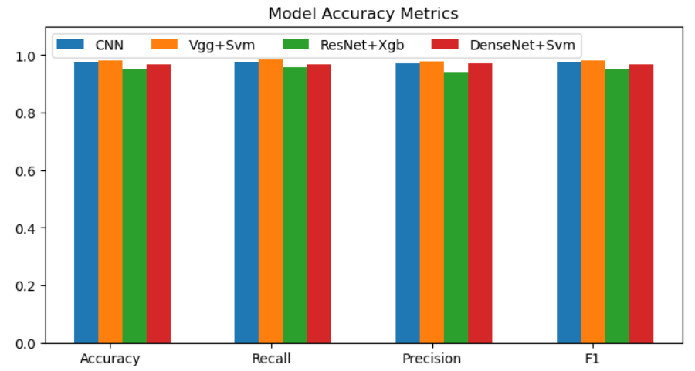
Results

Slide 20
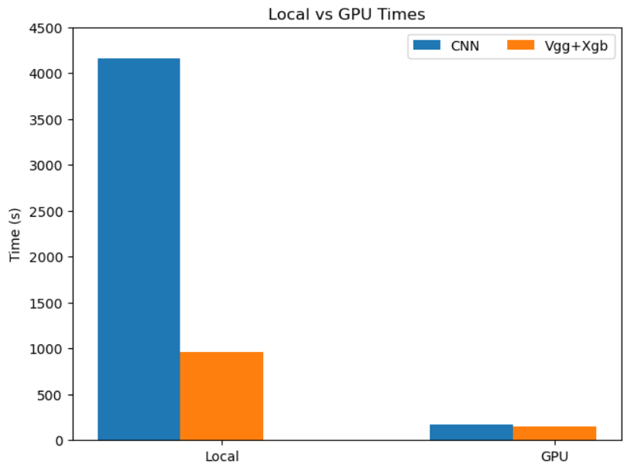
Local vs GPU

Slide 21
Vertex AI
Unified machine learning platform on Google Cloud
Managed datasets: tabular, image, text, or video
AutoML – train a machine learning model without writing code
Deploy model – easily integrate with medical resources, Google Cloud security
Pricing: $3.465 per node hour for AutoML training

Slide 22
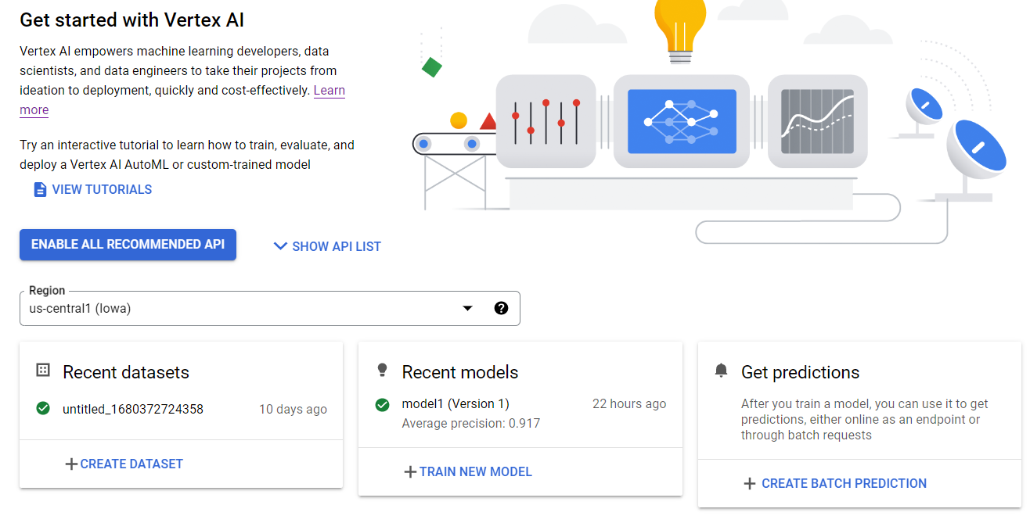
Vertex AI

Slide 23
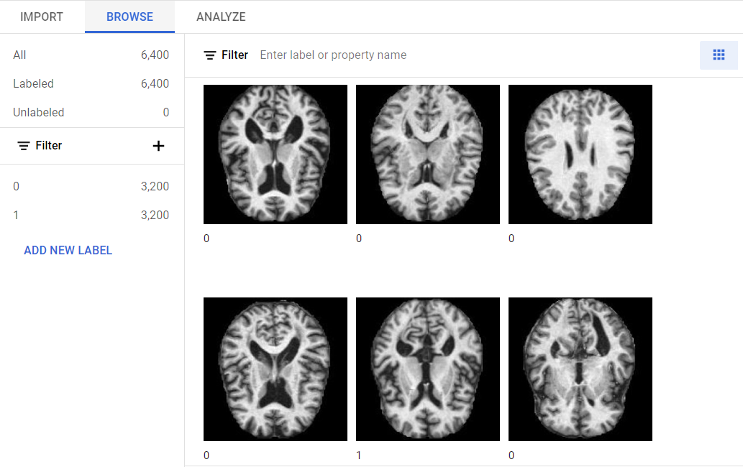
Vertex AI Dataset

Slide 24
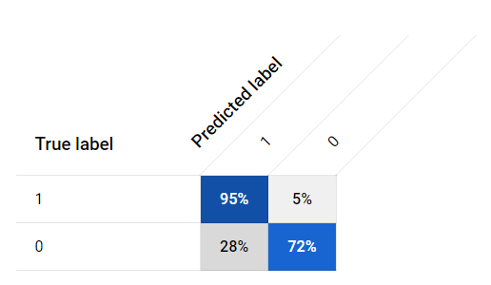
Vertex AI Results
90/10/10 Split
Average Precision: 91.7%
Precision: 83.6%
Recall: 83.6%
Billed for 8 hours, $27
After 2h 8m training
Notes:
Lots of false positives

Slide 25
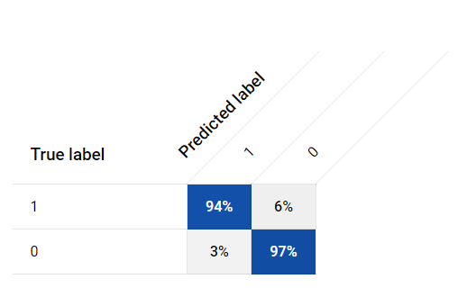
Vertex AI Results
90/10/10 Split
Average Precision: 99.5%
Precision: 95.8%
Recall: 95.8%
Billed for 8 hours, $27
After another 1h 48m training

Slide 26
Summary
2h8m
3h56m

Slide 27
Apache Spark
Unified Engine for large-scale data analytics
Clusters with implicit data parallelism and fault tolerance
Machine Learning Library
Classification Models
Logistic regression
Decision tree classifier
Random forest classifier
Gradient-boosted tree classifier
Multilayer perceptron classifier
Linear Support Vector Machine
One-vs-Rest classifier
Naive Bayes
Factorization machines classifier

Slide 28
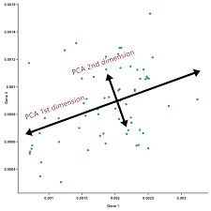
Principal Component Analysis
Reduce the dimensionality of the data by using a number of principal components less than the number of features
Can decide how much of the variance in the data you need to capture

Slide 29
PCA Results
PC | Explained Ratio | Explained Ratio Sum
0 | 0.221449 | 0.221449
1 | 0.105193 | 0.326642
2 | 0.032906 | 0.405062
… | … | …
997 | 0.000042 | 0.970224
998 | 0.000042 | 0.970266
999 | 0.000042 | 0.970308

Slide 30
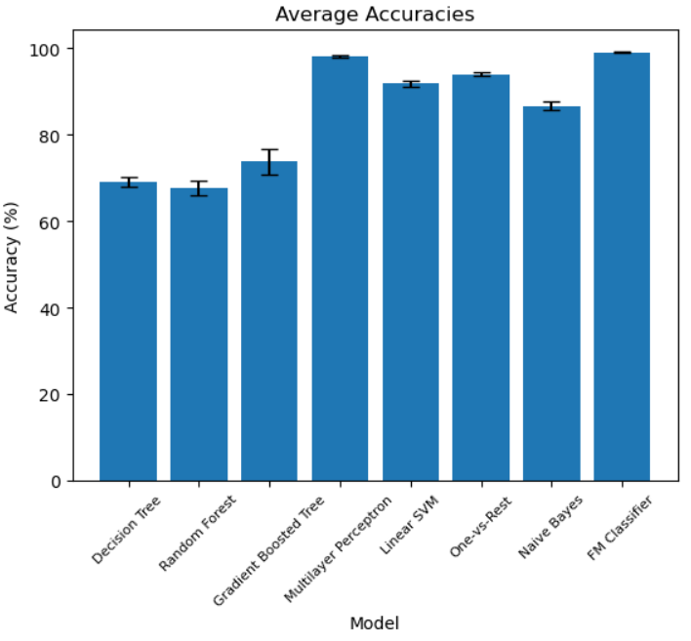
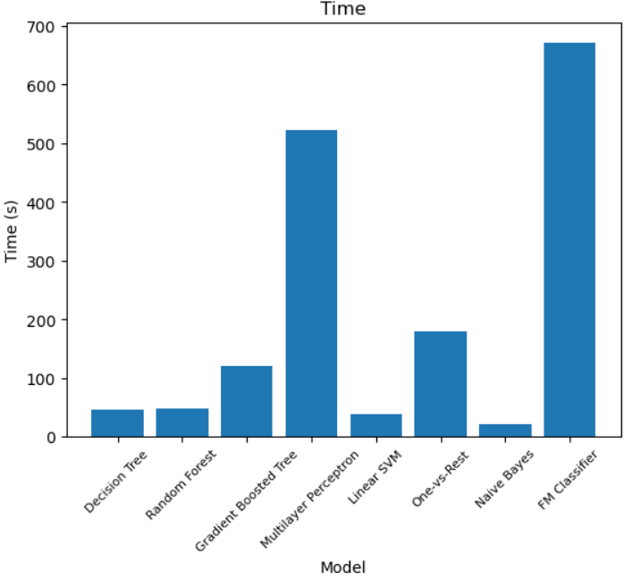
SparkML Results
Accuracy
Time

Slide 31
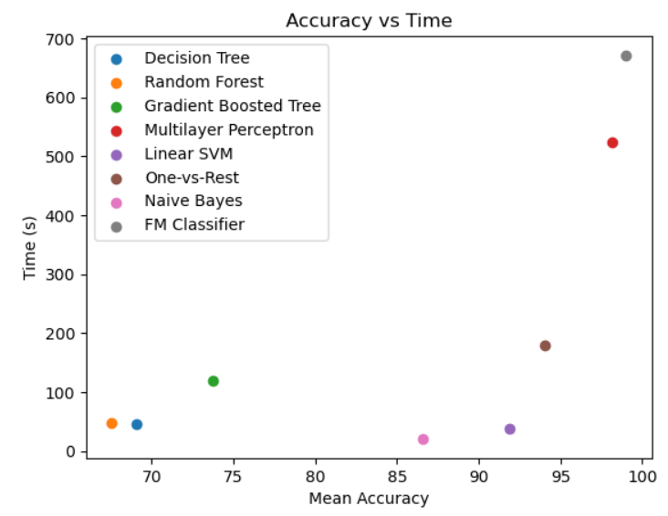
SparkML Results

Slide 32
Discussion
Top Three:
VGG+SVM: (25m) 98.16% Accuracy
PCA + Spark FM Classifier (11m): 99.02% Accuracy
VertexAI AutoML (4h): 99.5% Avg Precision
Benefits:
VertexAI: GCP security and model deployment
VGG+SVM: Fast on GPU, uses data directly
PCA+SparkML FMC: Fast with 97% data variance intact
Future Work:
Custom VertexAI Models

