Slide 1
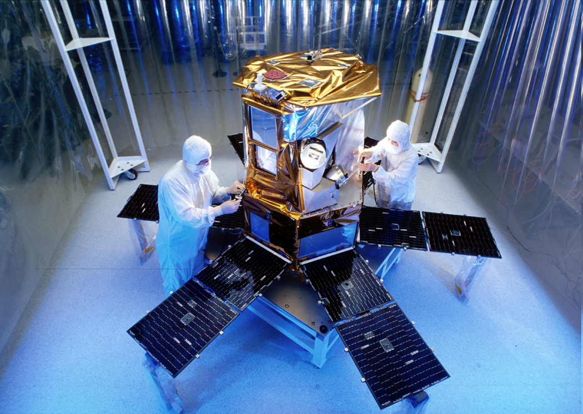
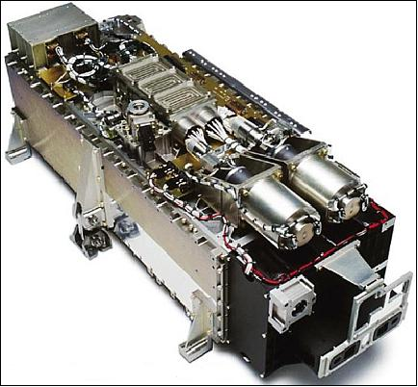
SOLAR SPECTRAL IRRADIANCE: measurements vs model BY: Bailey Donaldson – University of Colorado boulder MENTORS: LAURA SANDOVAL AND STEPHANE BELAND - lasp
SORCE (Solar radiation and climate experiment)
Photo credit: NASA
SIM (Spectral Irradiance Monitor)
Photo credit: LASP
Notes:
Purpose of SORCE and SIM

Slide 2
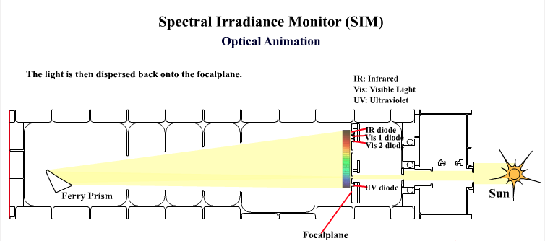
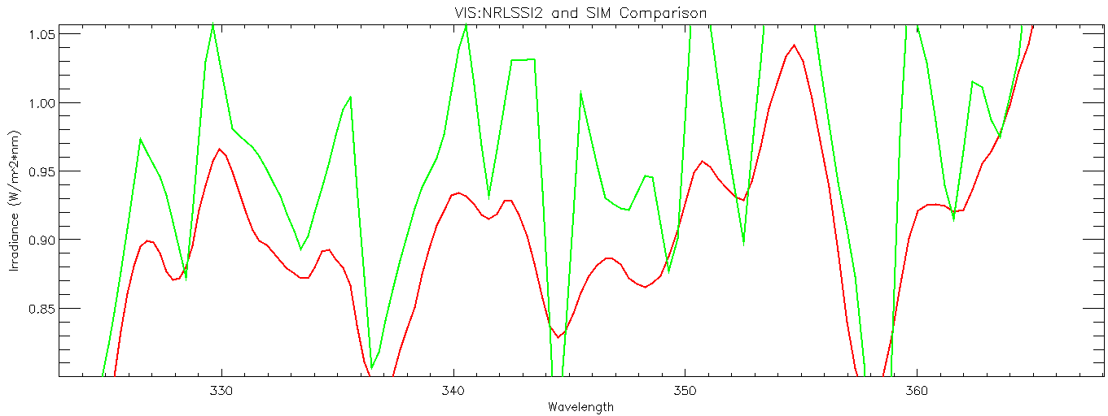
SIM & NRLSSI2
(Spectral irradiance monitor) and (Naval Research Laboratory Solar Spectral Irradiance)
HOW SIM WORKS
NRLSSI2 vs. SIM SSI at SD 453.6
SD: Sorce Day
SSI: Solar Spectral Irradiance – power density at a particular wavelength
Photo cred: LASP

Slide 3
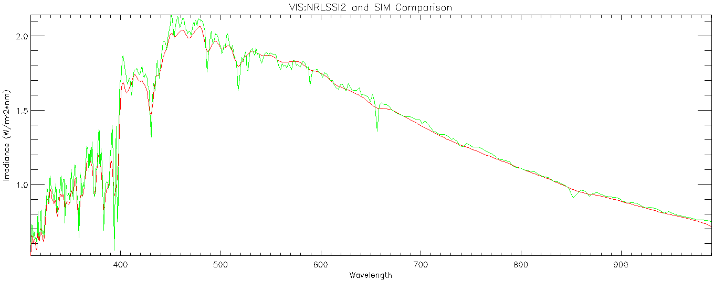

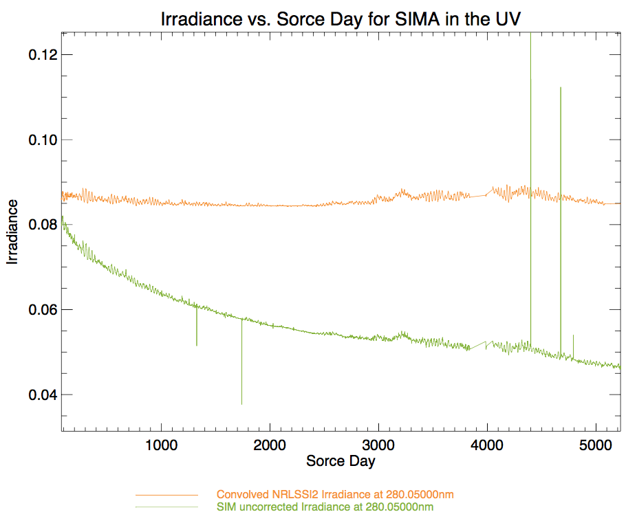
INITIAL GRAPHS
Constant SD of 453, Wavelength vs. Irradiance
Constant Wavelength of 280nm, Sorce Day vs. Irradiance
Notes:
First graph: can see the degradation of SIM, expected results is small variation in VIS
Second graph: needed to interpolate and convolve
Find trend for parameters of degradation
Bound the degradation parameters to see how they fit with the model

Slide 4
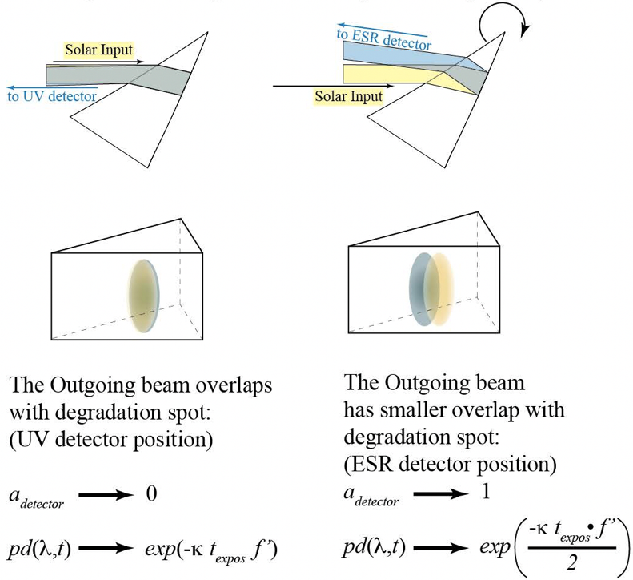
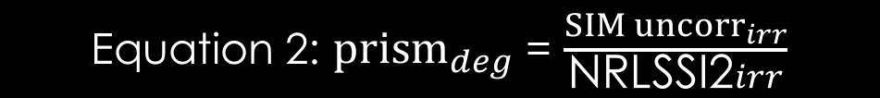
PRISM DEGRADATION
Equation 1: prism_{deg} = (1-a) * exp(-k*sol_{exp}*f’) + a*exp(-k*sol_{exp}*(f’/2))
Equation 2: ${prism}_{deg}$ = $\frac{{SIM uncorr}_{irr}}{\text{NRLSSI}\text{2}irr}$
FERRY PRISM
sol_{exp} = solar exposure of the channel
a = attenuation of light to the properties of the material through which light is traveling
k = kappa; function of wavelength; describes the properties of the prism due to the deposition of the hydrocarbons
F’ = function of time and wavelength; describes the changing properties of the prism
Notes:
Change (a) image

Slide 5
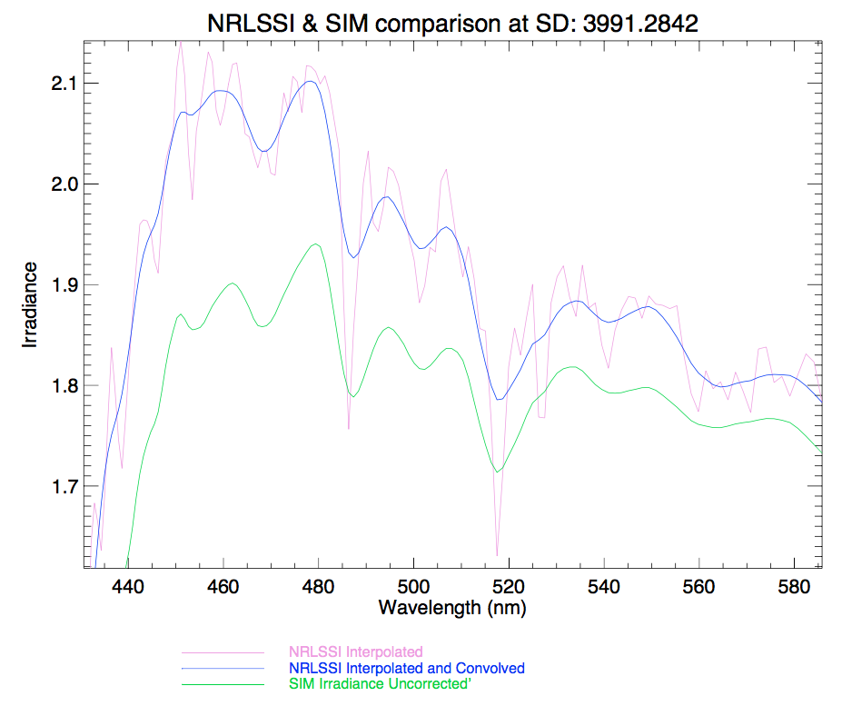
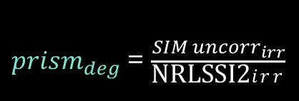

Methodology
Adjust units
Interpolate
Convolve
Method 1: Alter F function
prism_{deg} = (1-a) * exp(-k*sol_{exp}*f’) + a*exp(-k*sol_{exp}*(f’/2))
${prism}_{deg}$ = $\frac{{SIM uncorr}_{irr}}{\text{NRLSSI}\text{2}irr}$
Method 2: Alter Kappa
prism_{deg} = (1-a) * exp(-k*sol_{exp}*1) + a*exp(-k*sol_{exp}*(1/2))
${prism}_{deg}$ = $\frac{{SIM uncorr}_{irr}}{\text{NRLSSI}\text{2}irr}$
Notes:
Add graph of convolved and sim comparison

Slide 6
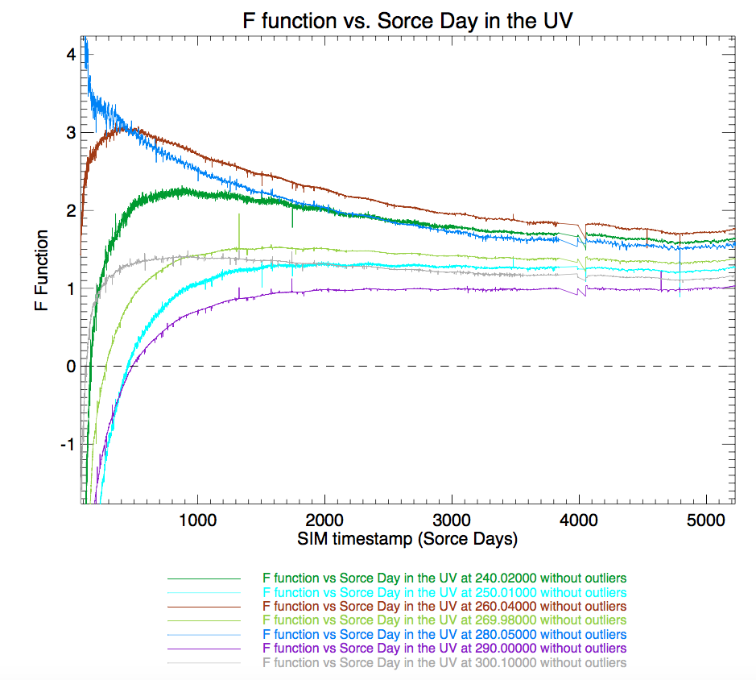
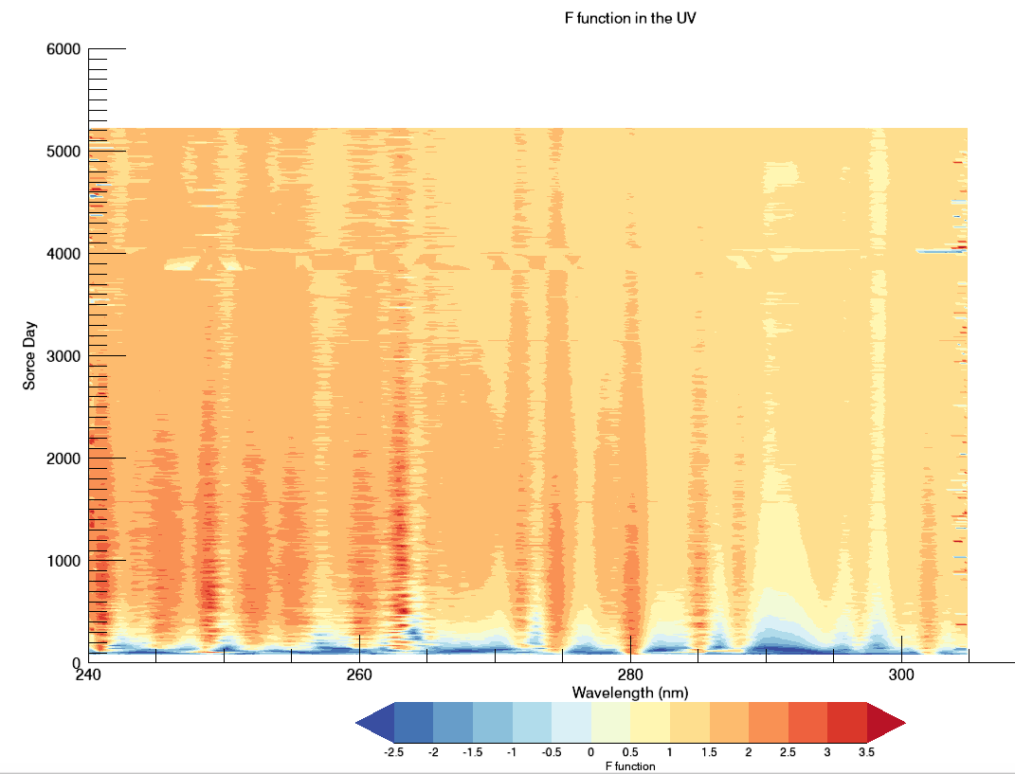
Results : alter f function
A negative f function indicates that: NRLSSI2 < SIM irradiance
A positive f function indicates that: NRLSSI2 > SIM irradiance
A f function of 0.0 indicates that: NRLSSI2 = SIM irradiance
Notes:
1st grahped 2D, didn’t see trend in wl
2nd graphed contour, differs per wl, outgassing (large gradient initially but lower later in mission, exponential change), quiet sun, overshooting,
Overshooting due to either:
SIM finding an event NRLSSI didn’t
SIM instrument incorrect

Slide 7
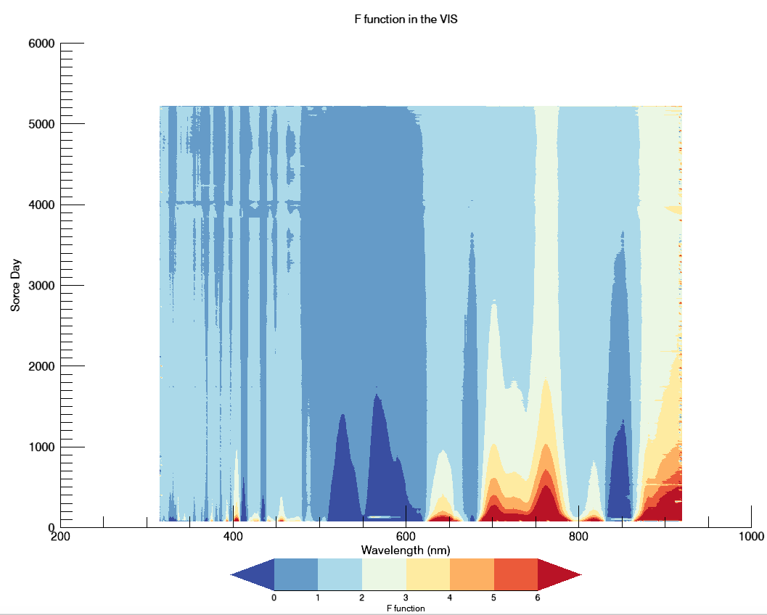
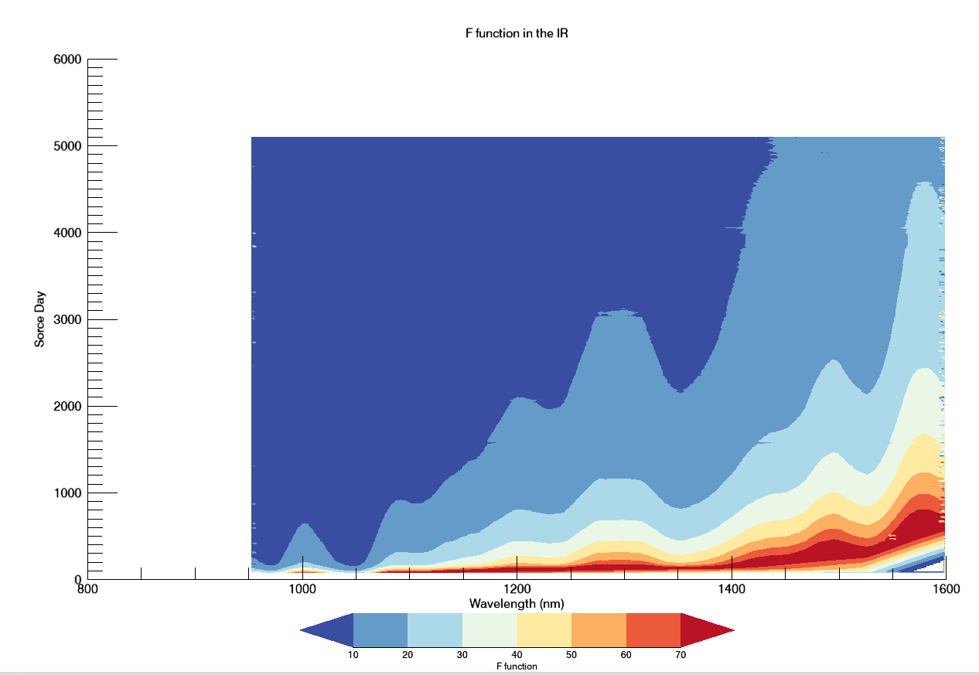
F function graphs continued
A negative f function indicates that: NRLSSI2 < SIM irradiance
A positive f function indicates that: NRLSSI2 > SIM irradiance
A f function of 0.0 indicates that: NRLSSI2 = SIM irradiance
Notes:
Range and how larger f means smaller deg. (kappa and a and sol exp also affect range)
IR more stable, deg shouldn’t affect ir as much

Slide 8
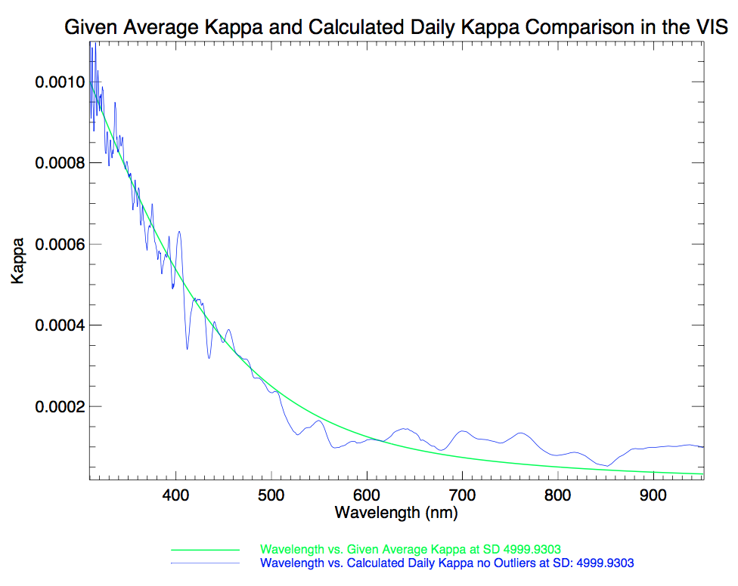
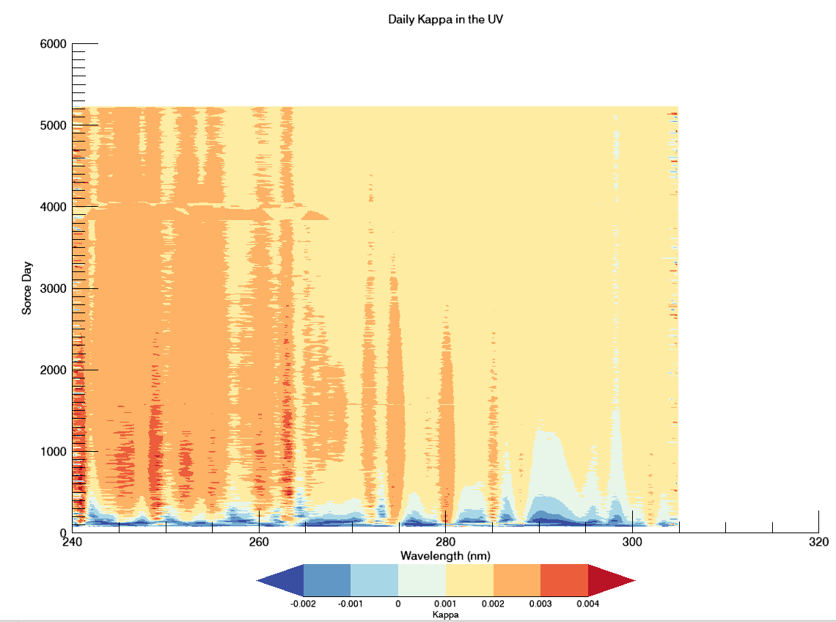
results: Alter kappa
A negative kappa indicates that: NRLSSI2 < SIM irradiance
A positive kappa indicates that: NRLSSI2 > SIM irradiance
A kappa of 0.0 indicates that: NRLSSI2 = SIM irradiance

Slide 9
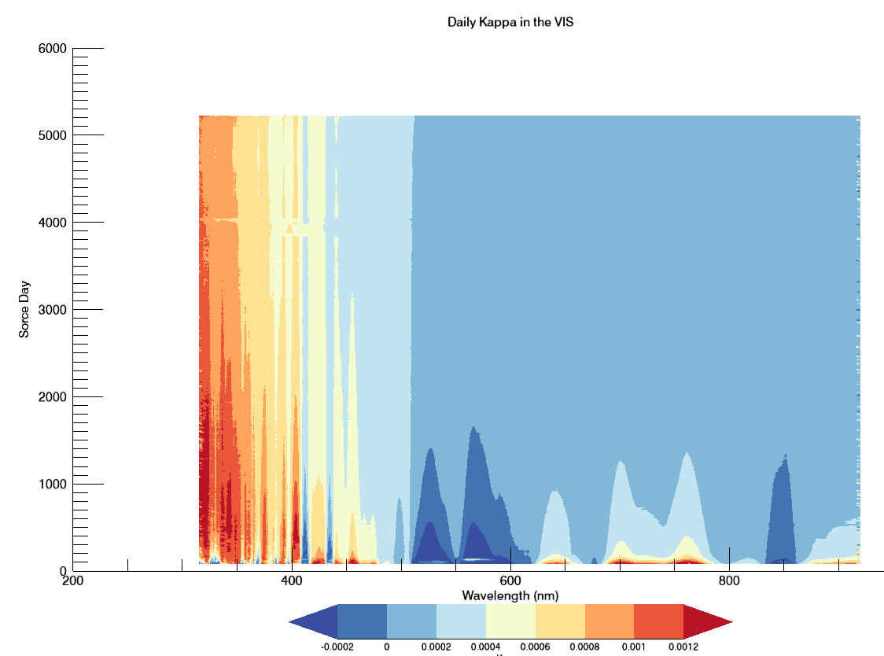
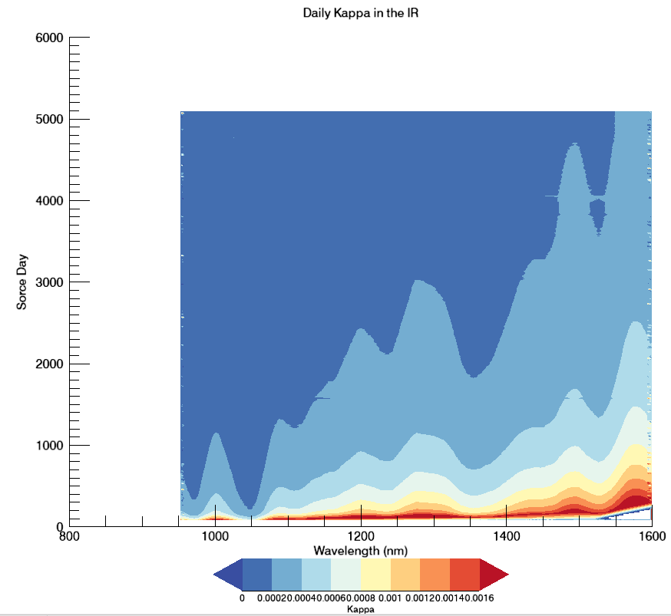
Kappa plots continued
A negative kappa indicates that: NRLSSI2 < SIM irradiance
A positive kappa indicates that: NRLSSI2 > SIM irradiance
A kappa of 0.0 indicates that: NRLSSI2 = SIM irradiance

Slide 10
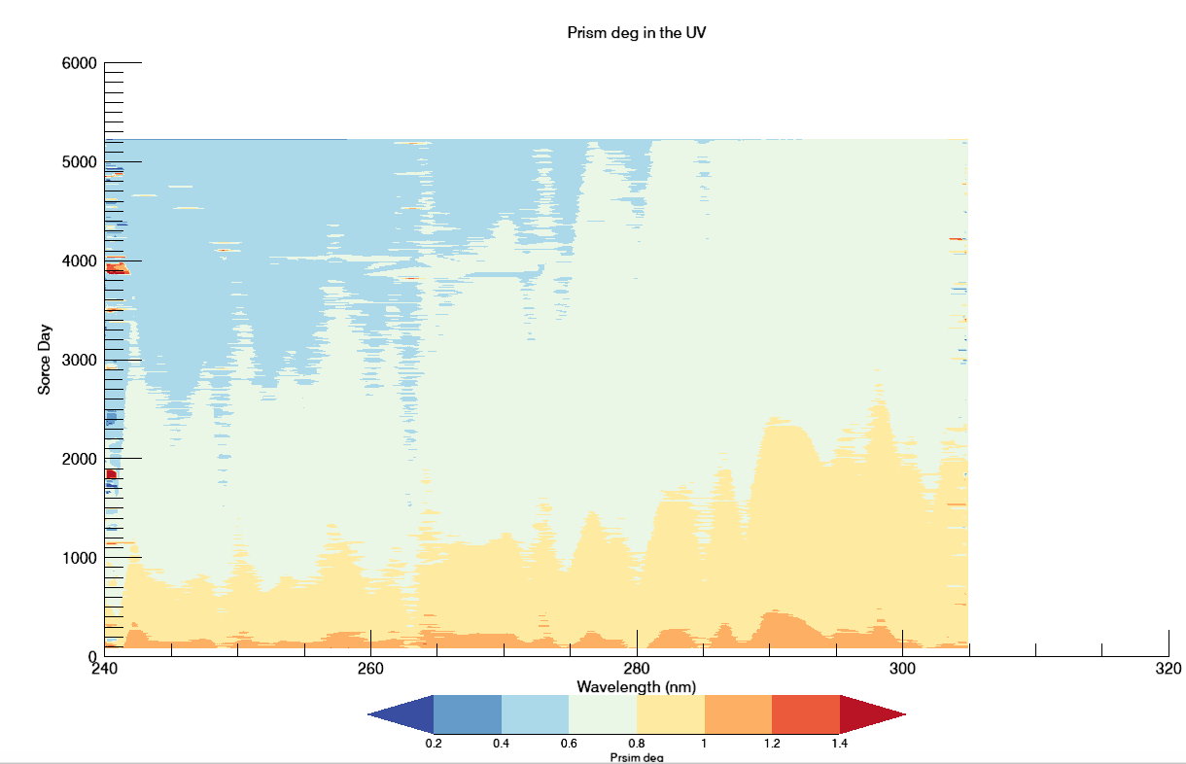
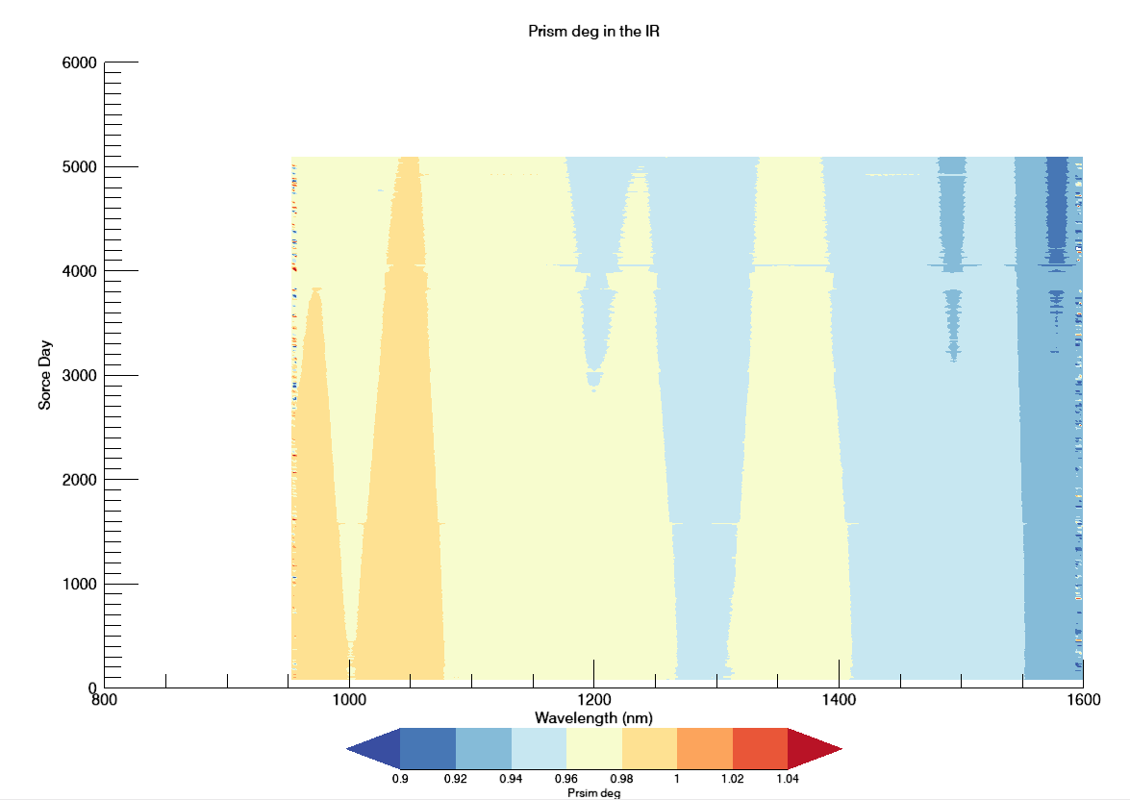

Prism degradation
When prism degradation equals 1.0: NRLSSI2 = SIM
${prism}_{deg}$ = $\frac{{SIM uncorr}_{irr}}{\text{NRLSSI}\text{2}irr}$

Slide 11
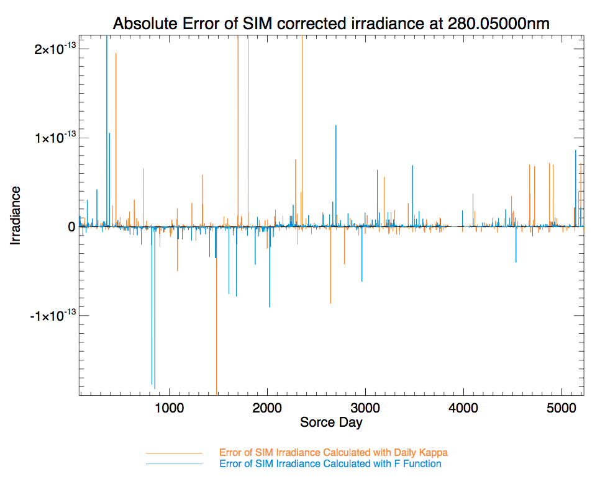
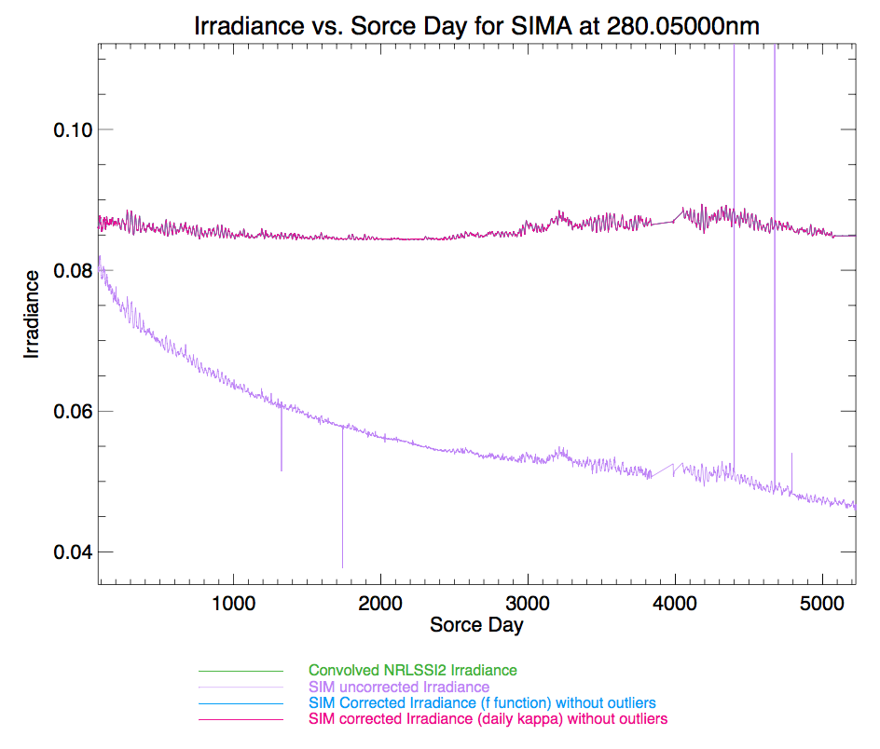
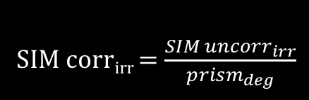
Accuracy of calculations
SIM corr_{irr} = $\frac{{SIM uncorr}_{irr}}{{prism}_{deg}}$

Slide 12
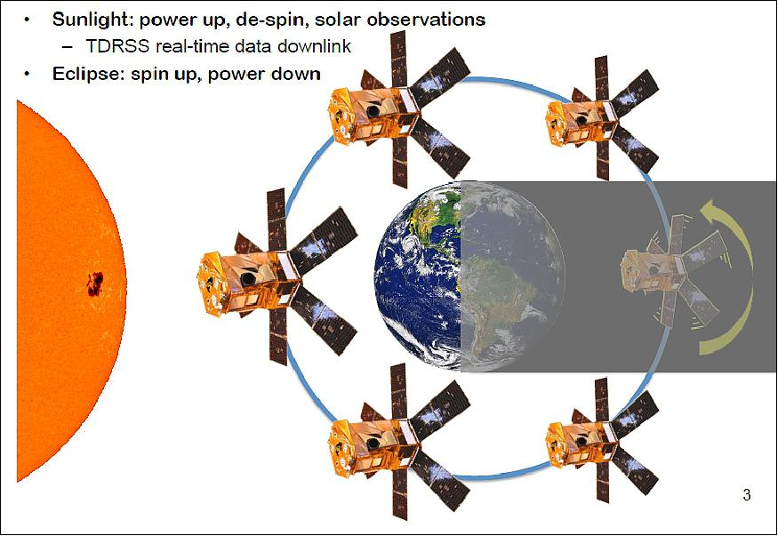
Sources of error
OBC period of shutdown
Shifting of hardware (epoxy)
~15 events
DO-OP (since 2014)
Change in temperature
Photo diode
temp changes from do-op
bombardment of high energy particles
Vacation
July 2013 to February 2014
Quiet Sun

Slide 13
References
Harder J. W., Lawrence G., Fontenla J., Rottman G., and Woods T.: 2005a, Solar Phys. 203, 141.
Harder J. W., Fontenla J., Lawrence G., Woods T., and Rottman G.: 2005b, Solar Phys. 203, 169.
Béland S., Harder J. W., Richard E., Snow M., Woods T., Sandoval L.. The SORCE Solar Irradiance
Monitor: limitations of a two-instruments model
“SORCE (Solar Radiation and Climate Experiment).” SORCE - EoPortal Directory - Satellite Missions,
EoPortal
“Multimedia.” Laboratory for Atmospheric and Space Physics, LASP,
lasp.colorado.edu/home/sorce/mission/multimedia/

