Slide 1
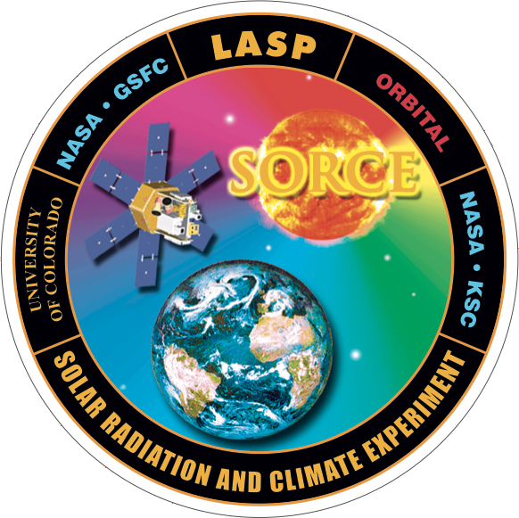
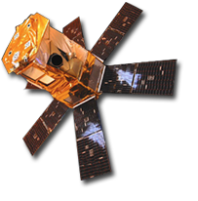
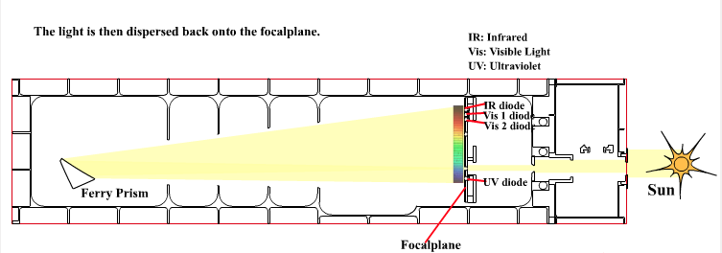
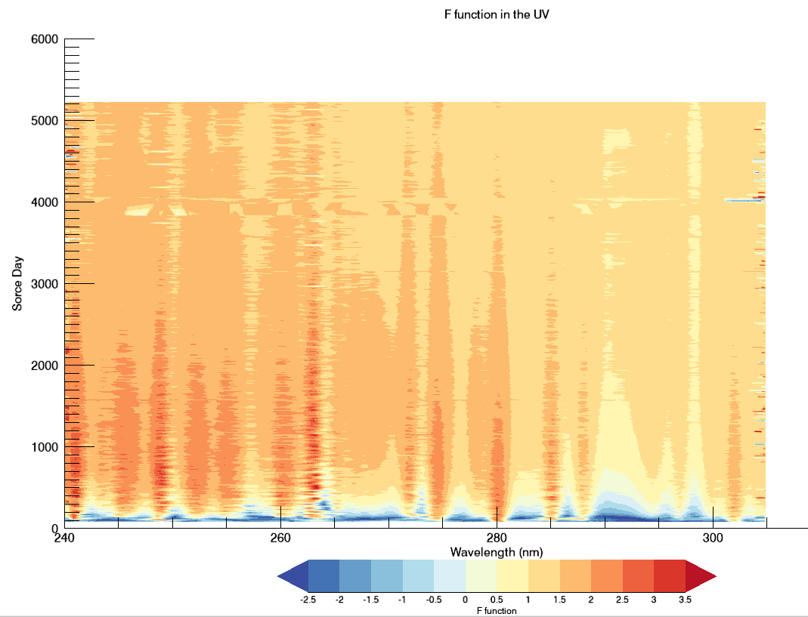
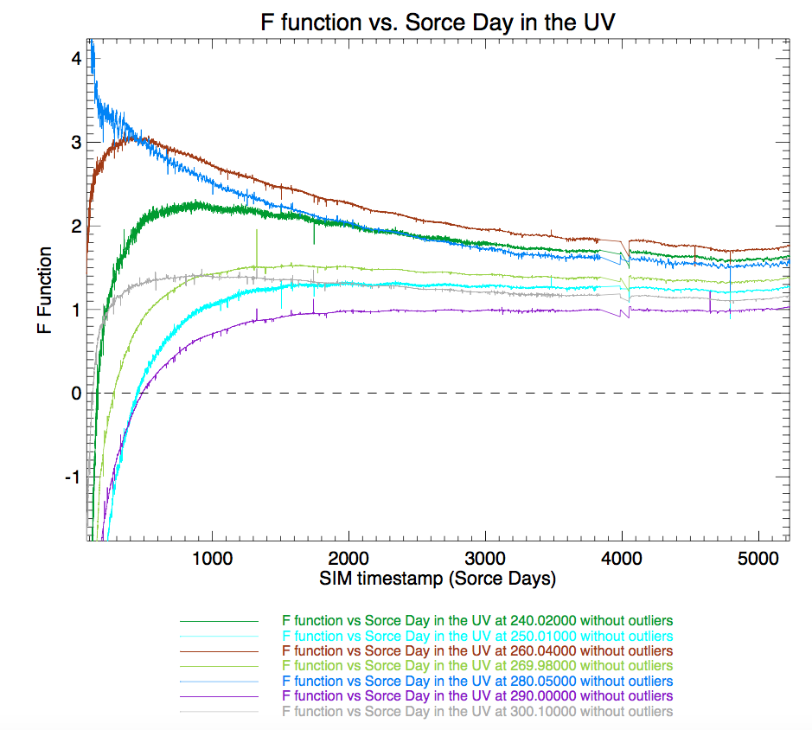
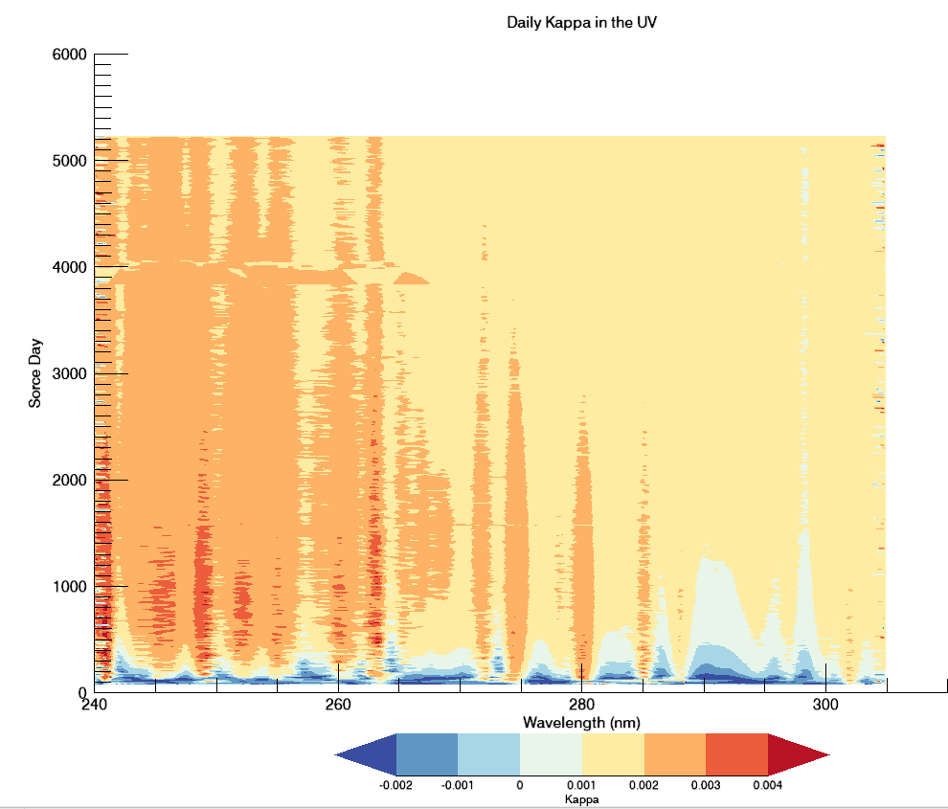
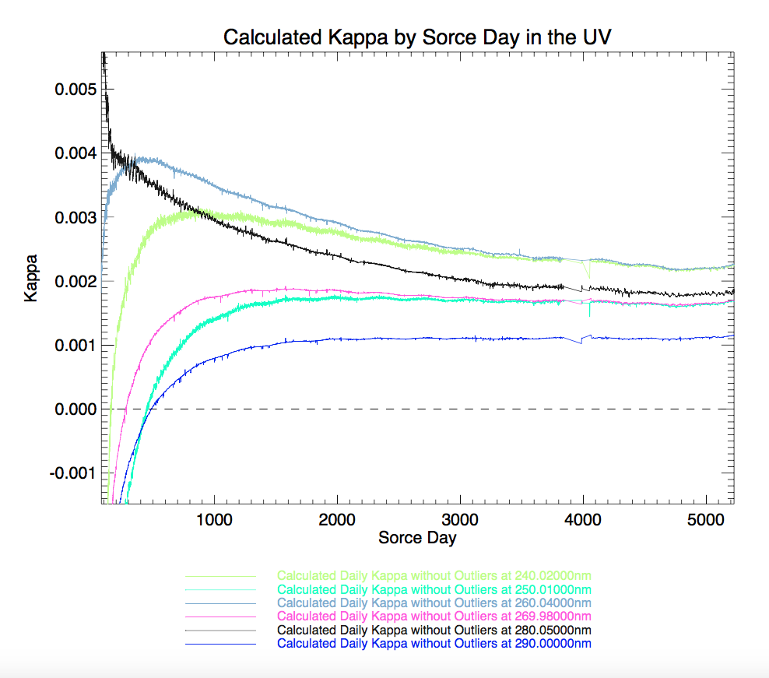
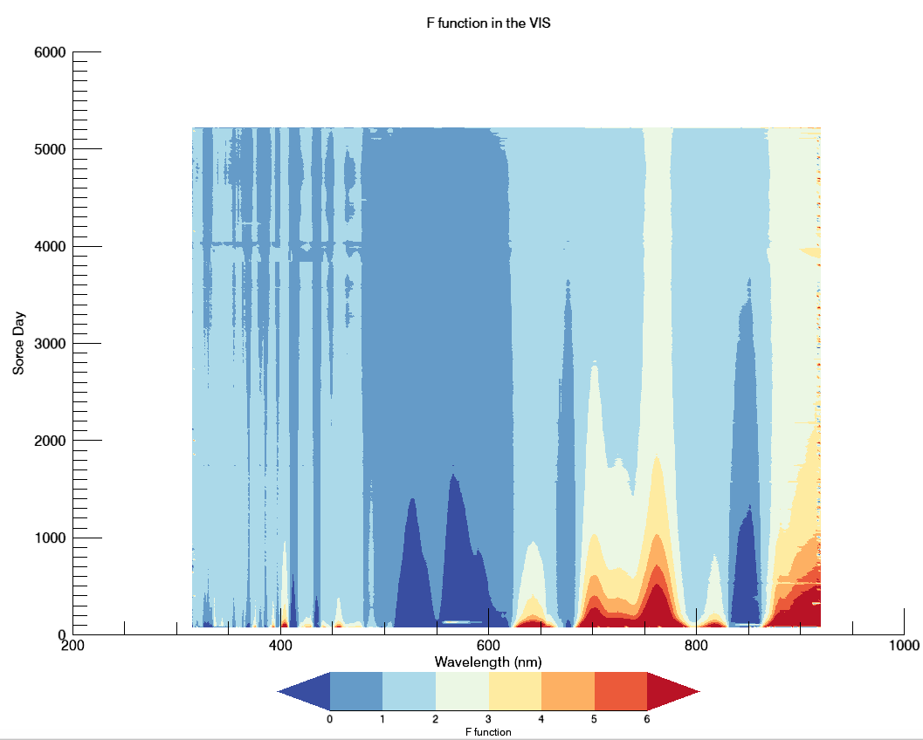
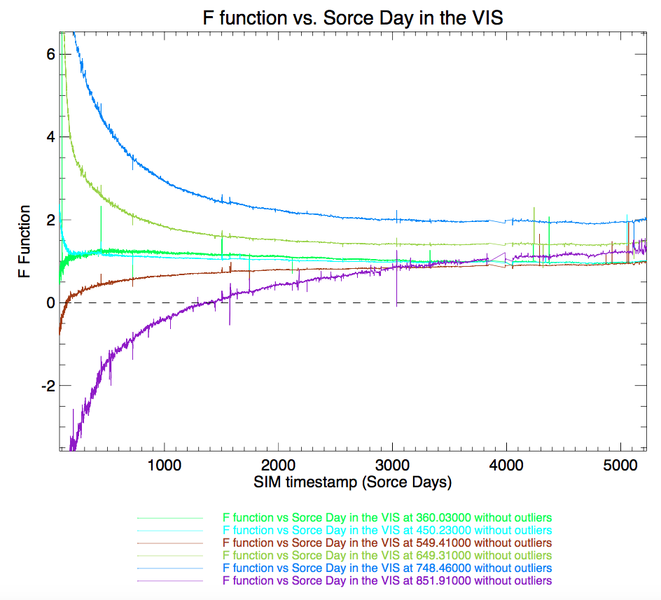
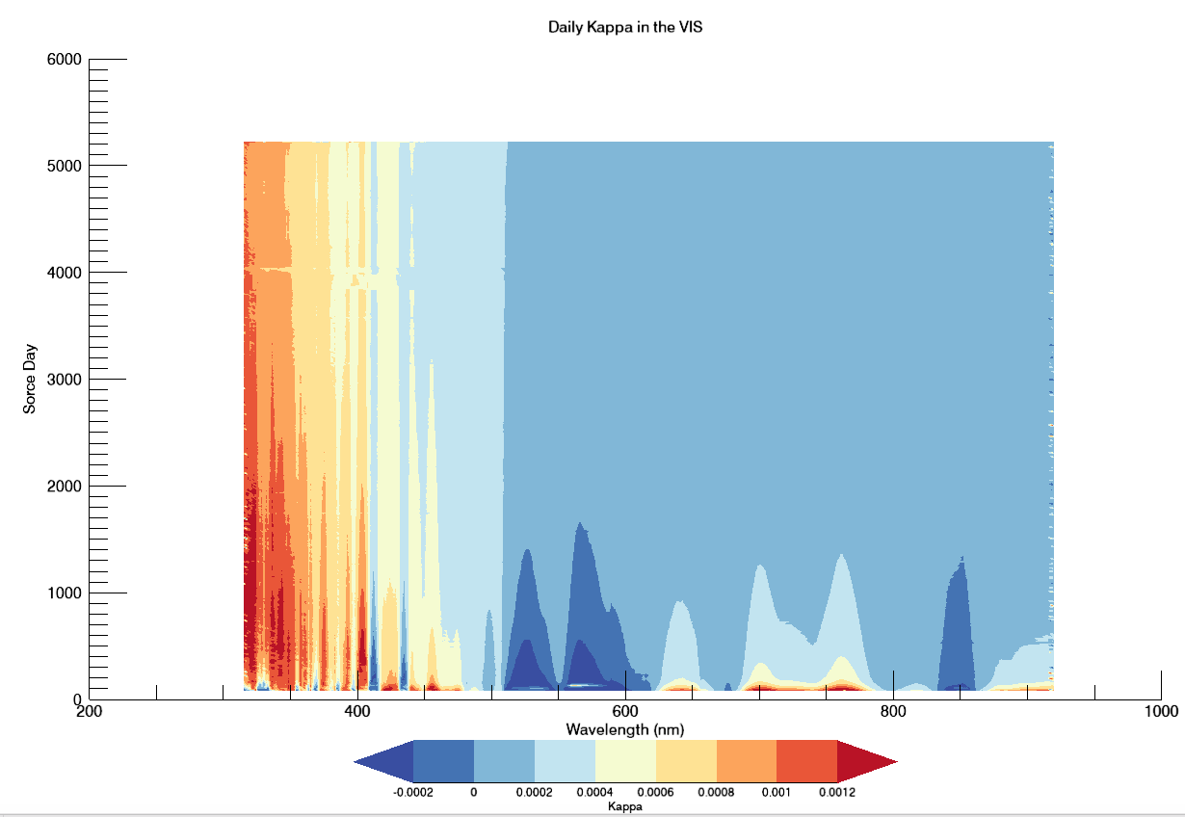
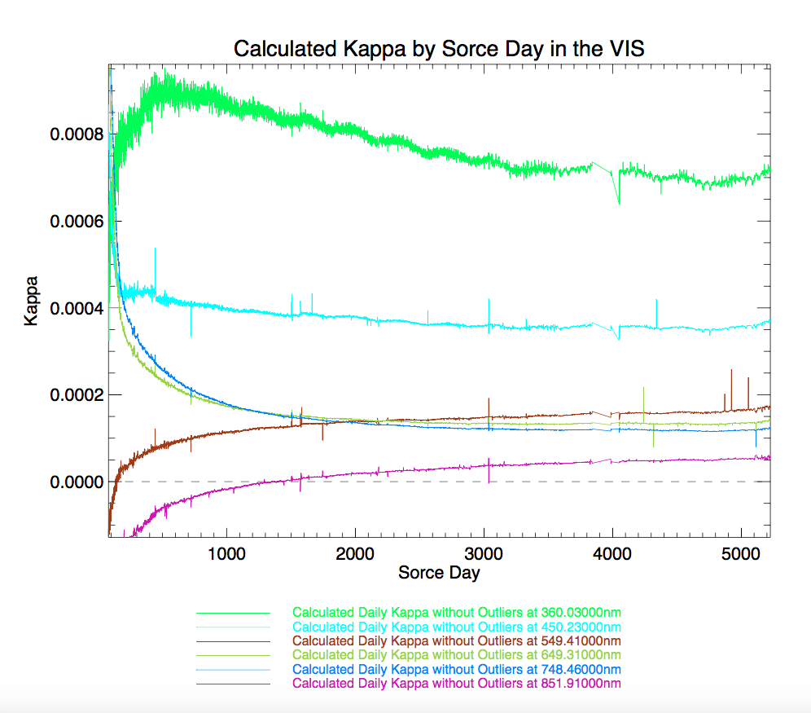
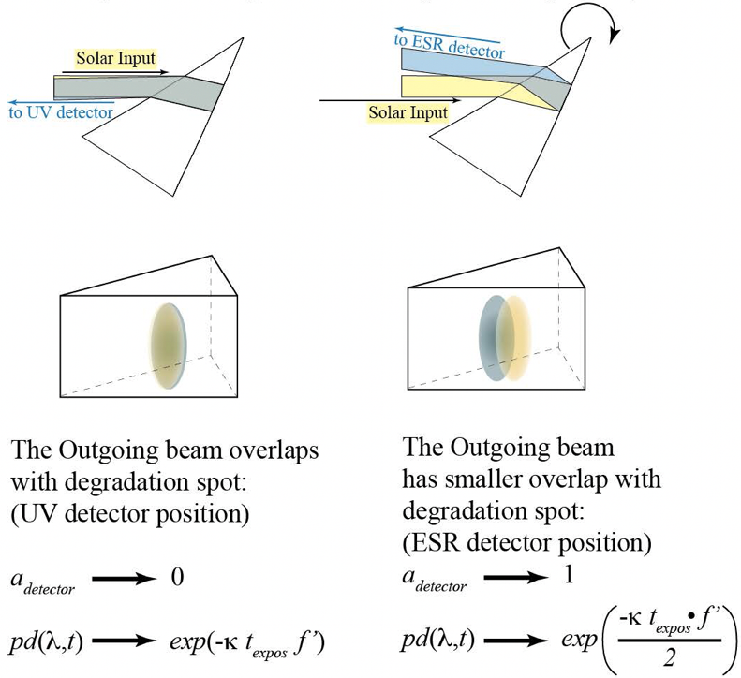
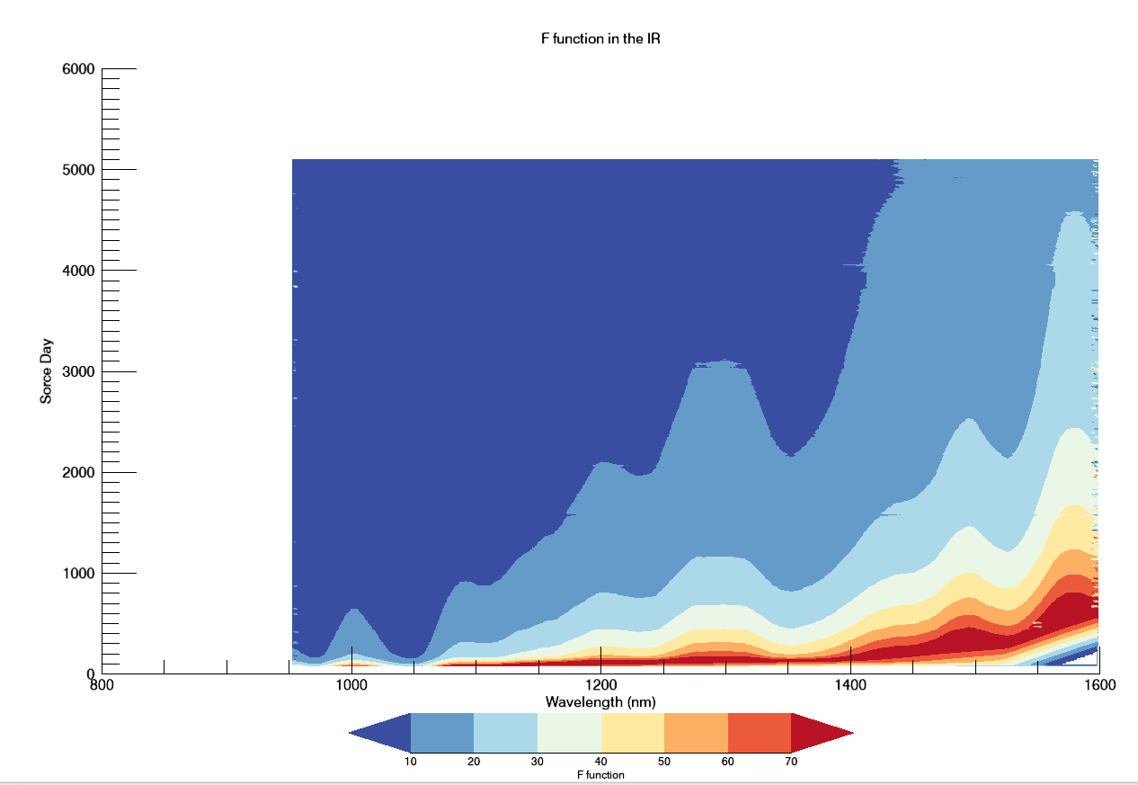
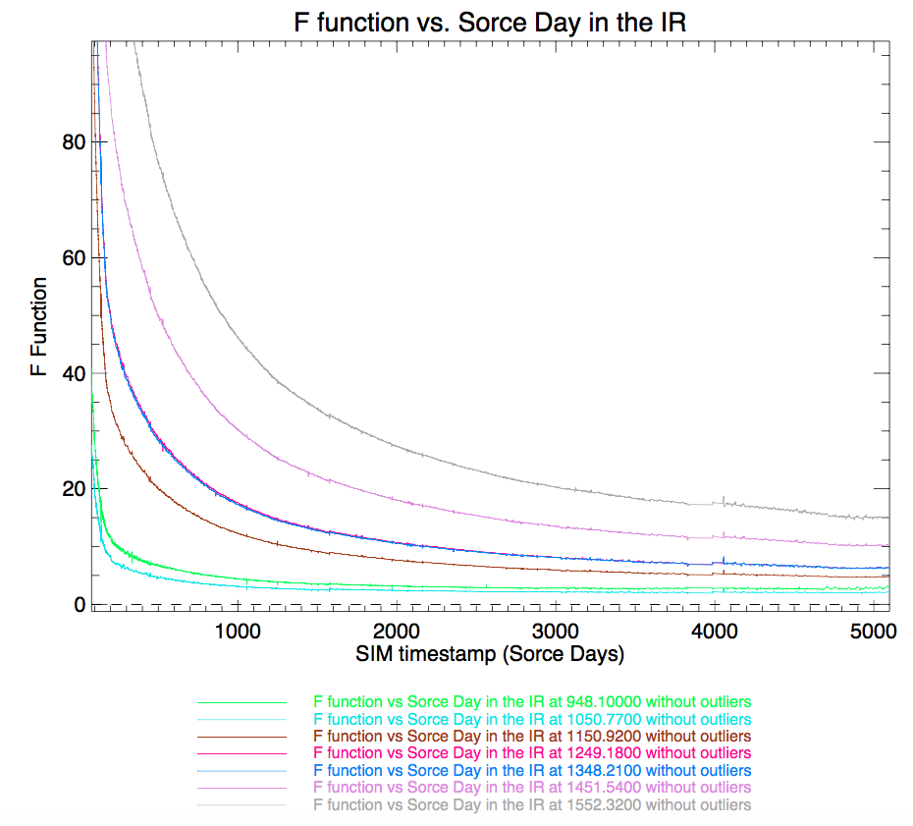
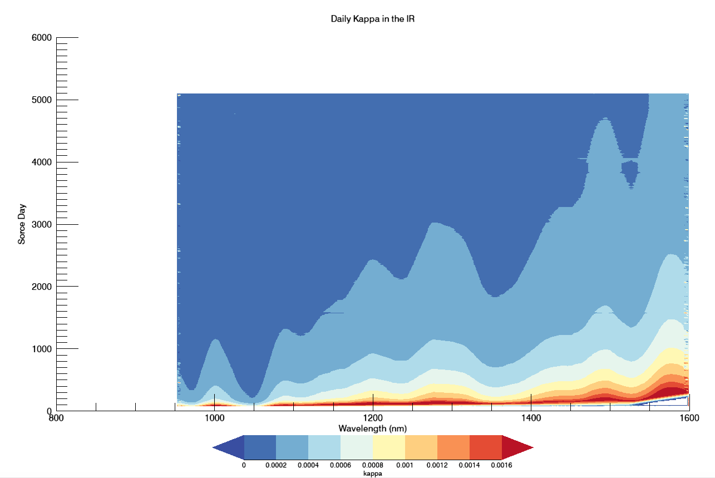
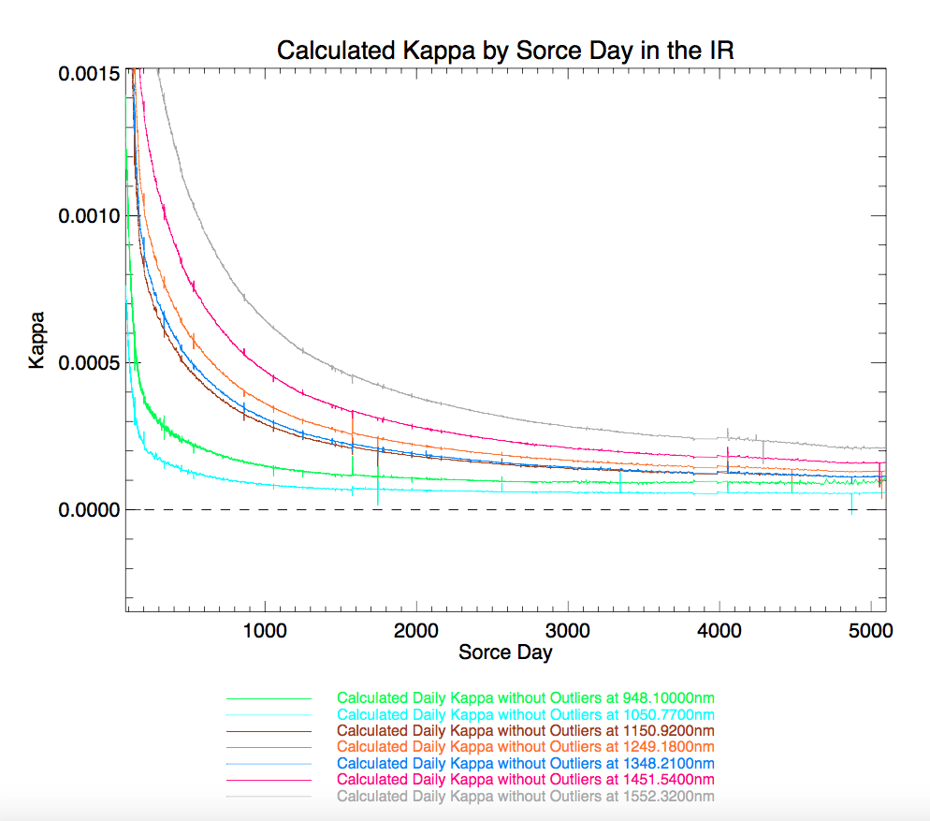
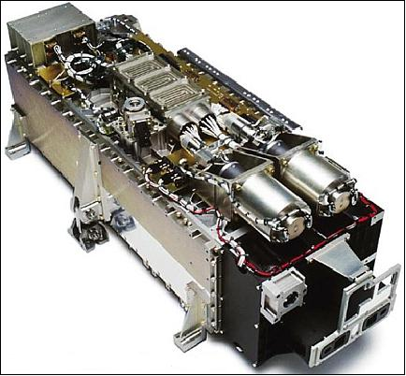
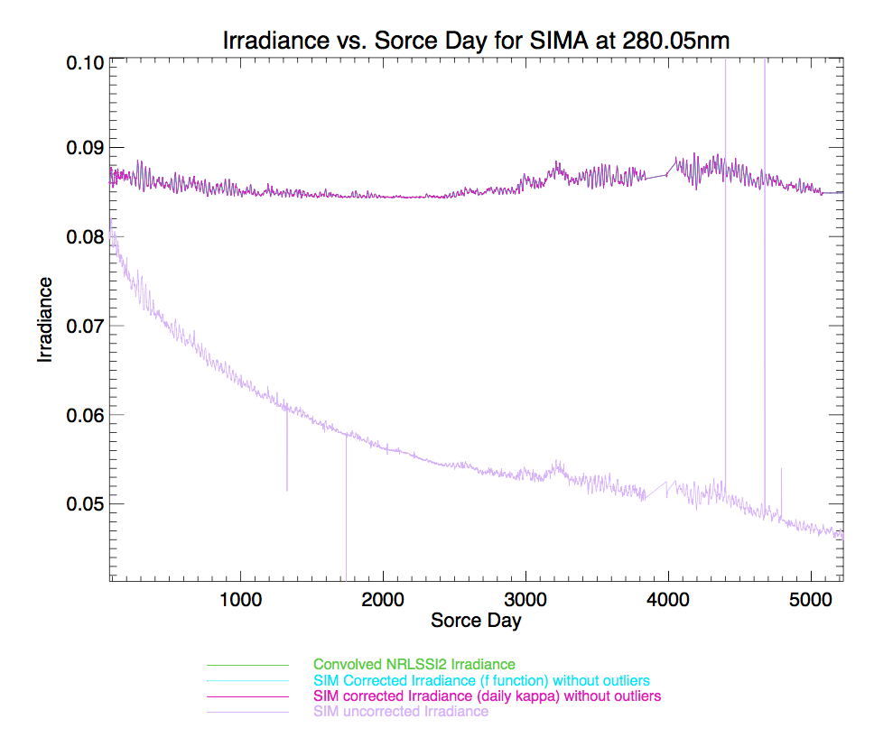
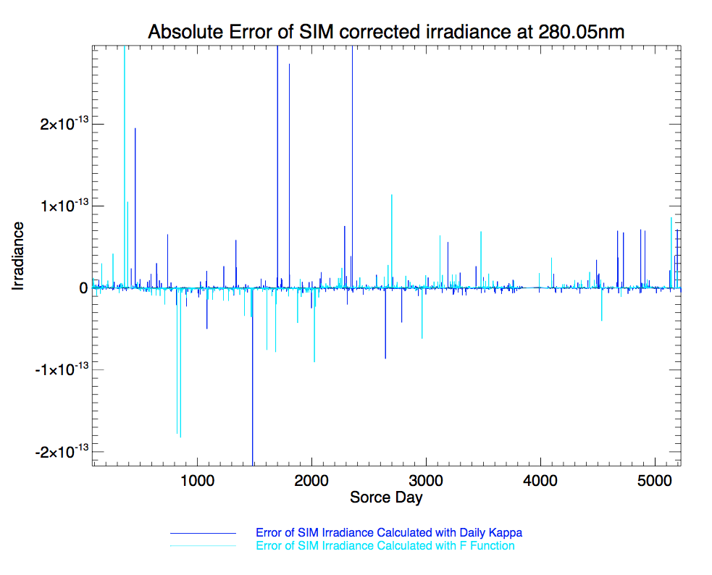

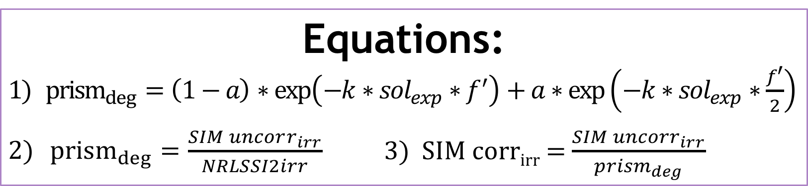
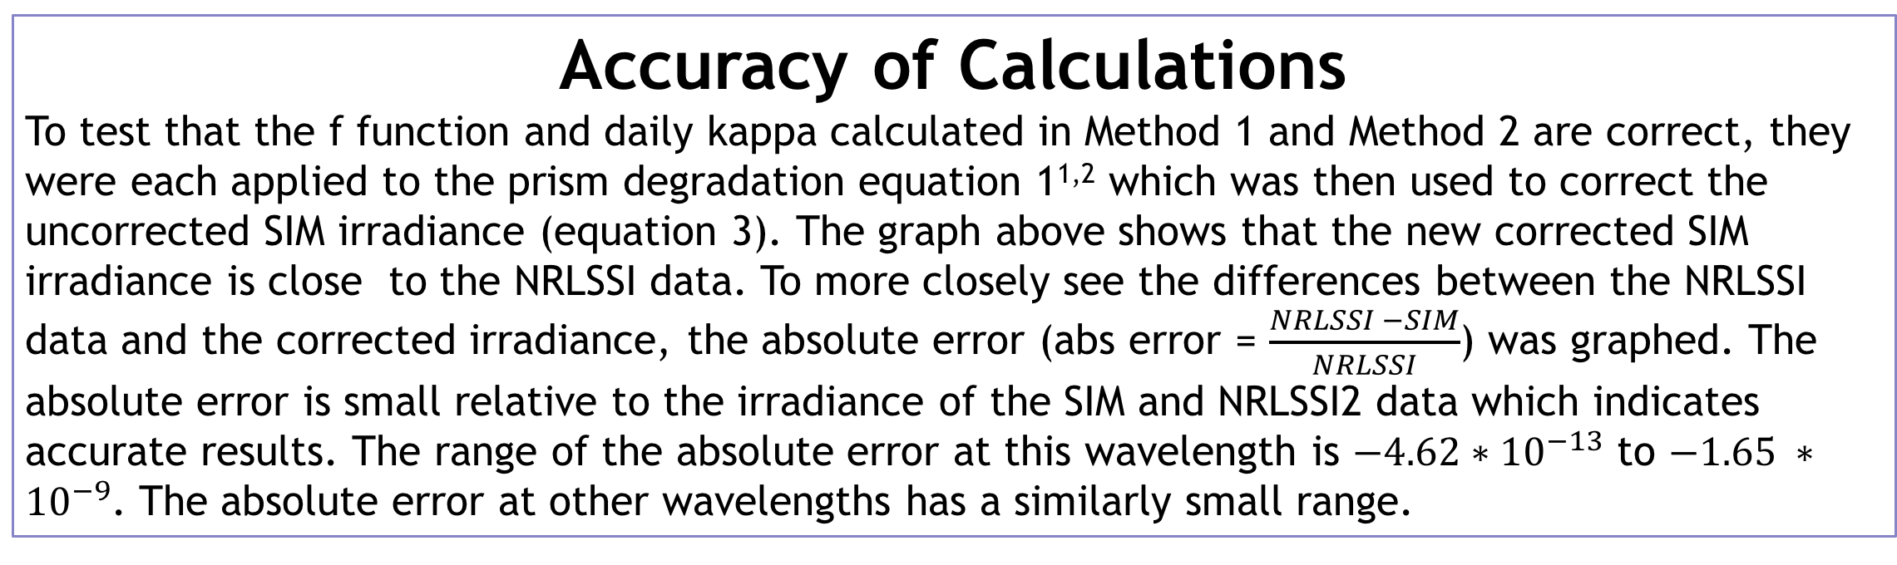
Solar Spectral Irradiance: Measurements vs Models Bailey Donaldson – University of Colorado Boulder Mentors: Laura Sandoval and Stephane Beland – LASP
Introduction
The Earth and its processes are dependent on our sun, which invariably means that any changes in the sun or its proceedings are of great interest. Correctly measuring variability in solar radiation is crucial to understanding its impacts on Earth, particularly in a time when the climate and atmosphere are rapidly changing. Since 2003, the Solar Radiation and Climate Experiment satellite (SORCE) has been collecting data on solar variability; the Spectral Irradiance Monitor (SIM) in particular measures the solar spectral irradiance (SSI) in the visible, near infrared, and slightly into the UV. The Naval Research Laboratory (NRL) has produced a model anticipating SIM’s results; however, the results of SIM and NRL do not completely concur. The SIM instrument experiences degradation throughout its lifetime; therefore, the SIM data must be calibrated. The uncorrected SIM irradiance and NRLSSI2 model were compared to enable the analysis of the parameters used in the SIM calibration. If the parameters and their bounds have palpable trends, then the accuracy of the SIM data and the NRLSSI model can be further affirmed.
Method 1: F function
Method one alters f function to find a prism degradation that satisfies equation 2 so that the uncorrected SIM irradiance and NRLSSI2 model data agree. The a, kappa, and solar exposure were the values in the recently released version 23 of SORCE SIM data. The a and kappa vary as a function of wavelength. The solar exposure varies as a function of SORCE day.
Method 2: Kappa
Method two alters kappa to find a prism degradation that satisfies equation 2 so that the uncorrected SIM irradiance and NRLSSI2 model data agree. Unlike Method one, kappa is altered as a function of SORCE day and wavelength and the kappa value from the version 23 SORCE SIM data is not used. f’ is held constant at 1.0. The a and solar exposure are the values used in the recently released version 23 of SORCE SIM data. The a varies as a function of wavelength and the solar exposure varies as a function of SORCE day.
Method 1 Results
A negative f function indicates that: NRLSSI2 < SIM irradiance
A positive f function indicates that: NRLSSI2 > SIM irradiance
A f function of 0.0 indicates that: NRLSSI2 = SIM irradiance
UV: at the beginning of the SORCE mission, at many wavelengths the SIM data is greater than the NRLSSI2 model. However, past SORCE day ~400 this becomes the opposite indicating that NRLSSI model overestimated the irradiance. Irregularity at the beginning of the mission between SIM and NRLSSI2 propagates, as represented by the vertical lines.
VIS: the trend of the f function is irregular based on wavelengths which likely results from irregularity in the SIM and NRLSSI2 at the beginning of the mission.
IR: the irradiance of SIM was less than the NRLSSI2 model throughout the mission.
Overall: there is more agreement between the NRLSSI2 model and SIM later in the mission.
Method 2 Results
A negative kappa indicates that: NRLSSI2 < SIM irradiance
A positive kappa indicates that: NRLSSI2 > SIM irradiance
A kappa of 0.0 indicates that: NRLSSI2 = SIM irradiance
UV: similar trends as with the f function
VIS: there is more disagreement between the NRLSSI2 model and SIM in the shorter wavelengths. The second half of the mission shares similar trends with the f function.
IR: similar trends as with the f function.
Overall: there is more agreement between the NRLSSI2 model and SIM later in the mission.
Figure 1: Internal diagram of SIM.
Image Credit: LASP
Prism Degradation
attenuation (a): ray-path; function of wavelength; (see Figure 2)
Kappa (k): function of wavelength and accounts for the deposition of hydrocarbons onto the prism. It is calculated by minimizing the differences in the corrected irradiance between the two channels of SIM (channels are identical except that channel A takes measurements more often then channel B resulting in different pace of degradation)
Solar Exposure: in units of seconds, length of time the prism has been exposed to sunlight
F parameter (f’): modification of the solar exposure record to account for the time and wavelength dependent affect of the prism degradation.
Figure 2: the face of the ferry prism within SIM. Due to hydrocarbon buildup, there is degradation where energetic solar protons hit the prism, inducing changes in the composition of the glass that allow for polymerization. The various ray paths are represented by a.
Image Credit: LASP
Equations:
$prism_{deg}=\left(1−a\right)∗\exp\left(−k∗sol_{exp}∗f^{′}\right)+a∗exp\left(−k∗sol_{exp}∗\frac{f^{′}}{2}\right)$
$prism_{deg}=\frac{SIM uncorr_{irr}}{NRLSSI2irr}$ 3) SIM corr_{irr} = $\frac{{SIM uncorr}_{irr}}{{prism}_{deg}}$
Accuracy of Calculations
To test that the f function and daily kappa calculated in Method 1 and Method 2 are correct, they were each applied to the prism degradation equation 1^{1,2} which was then used to correct the uncorrected SIM irradiance (equation 3). The graph above shows that the new corrected SIM irradiance is close to the NRLSSI data. To more closely see the differences between the NRLSSI data and the corrected irradiance, the absolute error (abs error = $\frac{NRLSSI −SIM}{NRLSSI}$) was graphed. The absolute error is small relative to the irradiance of the SIM and NRLSSI2 data which indicates accurate results. The range of the absolute error at this wavelength is $−4.62∗{10}^{−13}$ to $−1.65 ∗{10}^{−9}$. The absolute error at other wavelengths has a similarly small range.
Conclusions
NRLSSI2 spectrum has a different quiet sun than is measured by SIM.
Changes in prism transmission are wavelength dependent.
Overall, there is more agreement between NRLSSI2 and SIM later in the mission
The f function and calculated kappa are both zero when NRLSSI2 equals SIM irradiance.
There is more consistency between wavelengths between the SIM and the NRLSSI2 model in the IR. The UV and VIS exhibit more irregularity over wavelength.
IR is more stable
References:
1. Harder J. W., Lawrence G., Fontenla J., Rottman G., and Woods T.: 2005a, Solar Phys. 203, 141.
2. Harder J. W., Fontenla J., Lawrence G., Woods T., and Rottman G.: 2005b, Solar Phys. 203, 169
3. Béland S., Harder J. W., Richard E., Snow M., Woods T., Sandoval L.. The SORCE Solar Irradiance Monitor: limitations of a two-instruments model
4. “SORCE (Solar Radiation and Climate Experiment).” SORCE - EoPortal Directory - Satellite Missions, EoPortal
5. “Multimedia.” Laboratory for Atmospheric and Space Physics, LASP, lasp.colorado.edu/home/sorce/mission/multimedia/
Figure 3:SIM Instrument
Image credit: LASP

